Slide 1
Disease of nerves and muscles
Ashwini kamthe ( Intern)

Slide 2
Disturbances of fifth cranial nerve

Slide 3
Trigeminal neuralgia
TIC DOULOUREUX
TRIFACIAL NEURALGIA
FOTHERGILL'S NEURALGIA

Slide 4
General characteristics
AGE- 5th-6th decade of life
SEX- female> male
AFFLICTION FOR SIDE- right> left
DIVISION OF TRIGEMINAL NERVEINVOLVEMENT- V3>V2>V1

Slide 5
It is defined as sudden, usually unilateral, severe, brief, stabbing, lancinating, recurring pain in the distribution of one or more branches of the Vth cranial nerve
Trigeminal neuralgia also known as prosopalgia or fothergill's disease is aneuropathic disorder characterized by episodes of intense pain in the face, originating from trigeminal nerve

Slide 6
It is a truly agonizing condition, in which the patient may clunch the hand over the face & experience severe, lancinating pain associated with spasmodic contractions of the facial muscles during attacks- a feature that led to use of this term

Slide 7
Etiology
Usually idiopathic
Demylination of the nerve
Multiple sclerosis
Petrous ridge compression
Post-traumatic neuralgia
Intracranial tumors
Intracranial vascular abnormalities

Slide 8
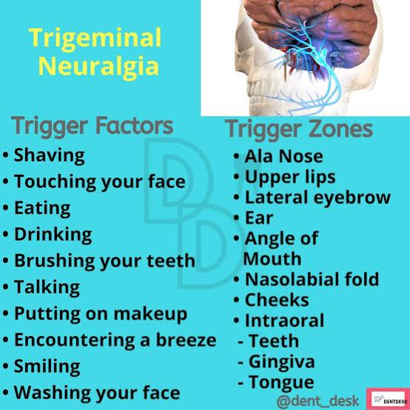

Slide 9
Clinical characteristics
Manifests as a sudden, unilateral, intermittent paroxysmal, sharp, shooting, lancinating, shock like pain, elicited by slight touching superficial 'trigger points' which radiates from that point, across the distribution of one or more branches of the trigeminal nerve
Pain is usually confined to one part of one division of trigeminal nerve
Pain rarely crosses the midline
Attacks do not occur during sleep

Slide 10
Pain is of short duration, but may recur with variable frequency.In extreme cases, the patient will have a motionless face the frozen or mask like face.
Trigger area on the face are so sensitive that touching or even air currents can trigger an episode. 10-12% of cases are bilateral, or occurring on both sides.
This mainly seen in cases with systemic involvement include multiple sclerosis or expanding cranial tumor

Slide 11
Diagnosis
From a well taken history.
CT-scan.
MRI
Diagnostic nerve block

Slide 12
Differential diagnosis
MIGRAINE- severe type of periodic headache is persistent, at least over a period of hours and it has not trigger zone.
SINUSITIS- pain is not paroxysmal, in this pain is persistent, associated nasal symptoms.
DENTAL PAIN- localized, related to biting or hot or cold foods, visible abnormalities on oral examination.
Tumors of nasopharynx in this similar type of pain is produced, manifested in the lower jaw, tongue and side of the head with associated middle ear deafness. This complex lesion is called TROTTER'S syndrome.

Slide 13
Treatment
. MEDICAL
First line of treatment is: CARBAMAZIPINE ( anticonvulsant)
Second line of treatment is: BACLOFEN, LAMOTRIGINE,OXCARBAZEPINE, PHENYTOIN,GABAPENTIN, PREGABALIN, SODIUM VALPROATE.
Low dose of Antidepressants such as AMITRYPTILINE are thought to be effective in treating neuropathic pain. Antidepressant are also used to counteract a medication side effect.

Slide 14
SURGICAL
INJECTION OF NERVE WITH ANESTHETIC AGENT
ALCOHOL INJECTION IN GASSERIAN GANGLION
PERIPHERAL GLYCEROL INJECTION
PERIPHERAL NEURECTOMY( NERVEAVULSION)
MICROVASCULAR DECOMPRESSION
-PERCUTANEOUS RHIZOTOMIES -GAMMA KNIFE RADIOSURGERY

Slide 15
AURICULOTEMPORALSYNDROME (FREY'S SYNDROME ,GUSTATORY SYNDROME)
It is an unusual phenomenon, which arises as a result of damage to the auriculotemporal nerve and subsequent reinnervation of sweat glands by parasympathetic salivary fibers.

Slide 16
Etiology
Some surgical operation i.e removal of parotidtumor or the ramus of the mandible.
After a considerable amount of time following surgery, during the damaged nerve regenerates ,the parasympathetic salivary nerve supply develops, innervating the sweat glands, which then function after salivary, gustatory or psychic stimulation.

Slide 17
Clinical features
Patient typically exhibits flushing and sweating of the involved side of the face ,chiefly in the temporal area, during eating.
Profuse sweating may often be evoked by the parenteral administration of pilocarpine or eliminated by the administration of atropine.

Slide 18
There is somewhat a similar condition known as crocodile tears in which patient exhibits profuse lacrimation when food is eaten (hot and spicy)

Slide 19
Treatment
Intracranial division of the auriculotemporal nerve
1% glycopyrollate Lotion or cream.
Injection of Atropine
TEST – STARCH IODINE TEST

Slide 20
Burning mouth syndrome
Burning of mucosa without visible mucosal lesions
Female prediction
Tongue, lips, palate affected.
CAUSES
Local – Dry mouth, geographic tongue, Lichen planus, trauma to Mucosa, GERD, sensory nerve damage.
Systemic- Vitamin B12, folate deficiency, ACE inhibitors, Sjogrens syndrome , depression, anxiety, dibetes, menopause.
Treatment – Antidepressants Or dietary supplements

Slide 21
Bell’s palsy (SEVENTH NERVE PARALYSIS,FACIAL PARALYSIS)
INTRODUCTION: Bell's palsy is a form of facial paralysis resulting from a dysfunction of the cranial nerve VII (the facial nerve) causing an inability to control facial muscles on the affected side. Several conditions can cause facial paralysis eg. Brain tumor, stroke, myasthenia gravis..
If no specific cause can be identified, the condition is known as Bell's palsy
DEFINITION: Bell's palsy is defined as an idiopathic unilateral facial nerve paralysis, usually self-limiting.

Slide 22
General characteristics
INCIDENCE- 20: 1,00,000
AGE- middle age group
SEX- female> male

Slide 23
Etiology
Cerebrovascular disease, multiple sclerosis, syphilis, HIV
Between nucleus and geniculate gangion: Fracture base of skull, post cranial fossa tumors, sacroidosis
Between geniculate ganglion and stylomastoid canal: Middle ear infection, ramsay threat sign, mastoiditis.
Branch of facial nerve (extra cranially): Local anesthesia, parotid gland surgery, TMJ arthroscopy, facial asthetic surgery, facialtrauma

Slide 24
Associated syndrome
MELKERSON ROSENTHAL SYNDROME( a triad of fissured tongue, chelities granulomatosa and cranial nerve 7th paralysis)
BILATERAL FACIAL PARALYSIS is rare may be due to acute idiopathic polyneuritis, sarcoidosis, post cranial fossa tumors.

Slide 25
SIGNS AND SYMPTOMS
Expressionless face
Forehead is unfurrowed.
Patient is unable to cross eye on that side, any attempted closure causes rolling of eye upwards(Bell's sign).
Tears tend to overflow (epiphora).
Corner of the mouth droops. Saliva dribbles and food collects in the vestibule because of paralysis of buccinator.
Altered taste sensation

Slide 26
Treatment
PHYSIOTHERAPY should be started as early as possible, consists of electrical stimuli by galvanism, gentle massage and facial exercise.
MEDICATION
Vasodilator drugs – Histamine
Flushing dose of nicotine acid
Surgical decompression

Slide 27
Disturbances of ninth cranial nerve

Slide 28
Glossopharyngeal Neuralgia
pain may be as severe and excruciating
rare condition
characterized by severe, paroxysmal episodes of pain mainly localized to the external ear canal, pharynx, and tongue, usually caused by a neurovascular conflict between postero-inferior cerebellar artery and ninth cranial nerve

Slide 29
Clinical features
No gender predilection middle-aged or older persons
sharp, shooting pain in the ear, the pharynx, the nasopharynx, the tonsil, or the posterior portion of the tongue
unilateral
The patient usually has a 'trigger zone' in the posterior oropharynx or tonsillar fossa-swallowing, talking, yawning, or coughing

Slide 30
Treatment
resection of the extracranial portion of the nerve or intracranial section
Periods of remission with subsequent recurrence are common in this disease

Slide 31
Disease of muscles

Slide 32
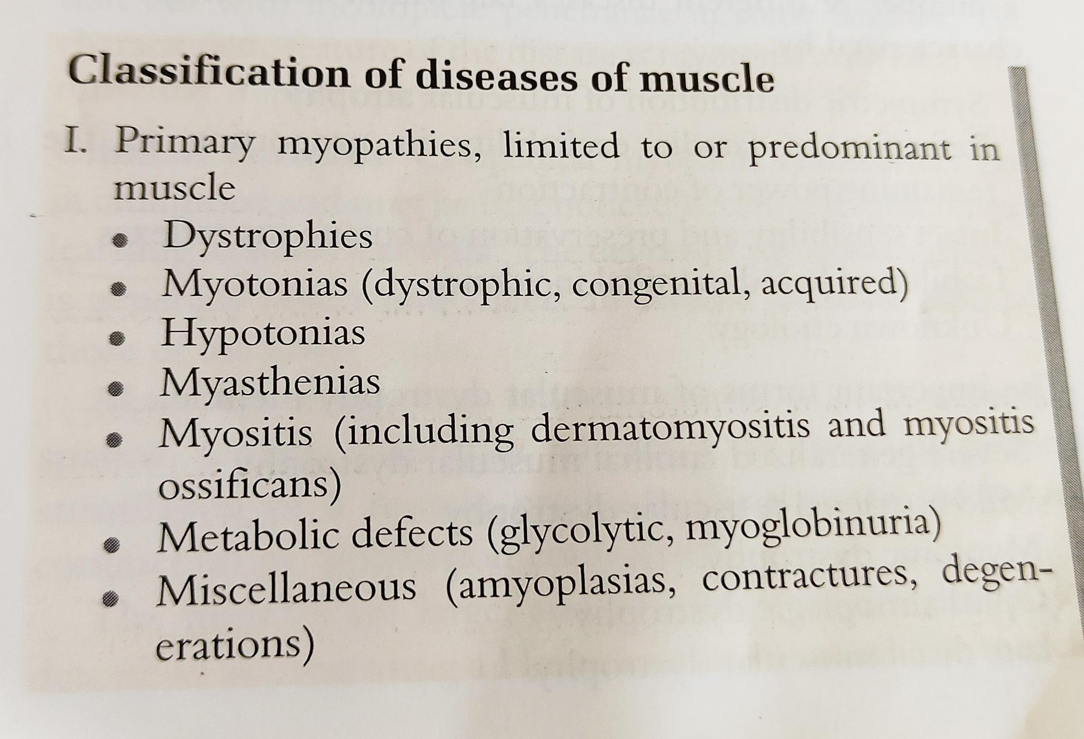
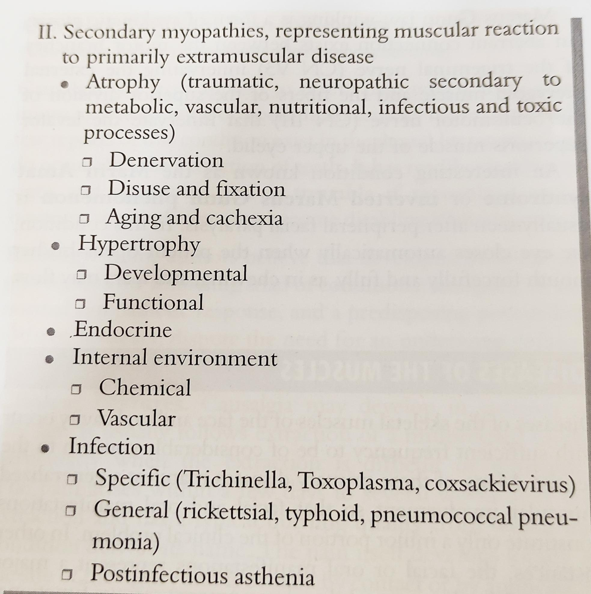

Slide 33
Dystrophies
Muscular dystrophy is a primary, progressively degenerative disease of skeletal muscle. .
The basic disorder lies within the muscle fibre itself, since the muscular nerves and nerve endings at the neuromuscular junction are normal.

Slide 34
Severe Generalized Familial MuscularDystrophy (Pseudohypertrophic Muscular Dystrophy of Duchenne)
Clinical Features
before the age of 6 years and rarely after 15 years
inability to walk or run, the children falling readily.
muscular enlargement and weakness
muscles of the extremities are generally those first affected, but even the facial muscles may be involved
ultimately proceeds to atrophy

Slide 35
limbs appear flaccid
waddling gait
muscles of mastication, facial and ocular muscles, and laryngeal and pharyngeal muscles are usually involved only late in the course of the disease
rapidly progressive muscle disease usually beginning in early childhood, presenting strong familial transmission usually through unaffected females
occurring predominantly in males with or without pseudo hypertrophy
most common form of muscular dystrophy

Slide 36
Treatment.
There is no treatment for this disease.
the disease remains incurable
die by the time they are 30 years of age, usually as a result of cardiopulmonary failure

Slide 37
Mild Restricted Muscular Dystrophy (Facioscapulohumeral Dystrophy, Landouzy-Dejerine Dystrophy)
slowly progressive proximal myopathy .
primarily involves the muscles of the shoulder and face
has a weak familial incidence
frequently presents long remissions and sometimes complete arrests

Slide 38
Clinical features
2-60 years-majority of cases is in the first two decades of life
Frequency of occurrence is higher in males
earliest signs of the condition may be inability to raise the arms above the head and inability to close the eyes even during sleep as a result of weakness of facial muscles
lips develop a characteristic looseness and protrusion which have been described as 'tapir-lips', a part of the 'myopathic facies', and the patients are unable to whistle or smile.

Slide 39
Treatment
no treatment for the disease
temporary periods of remission or even complete arrest
possibility of cardiac failure is always present

Slide 40
Myotonias
failure of muscle relaxation after cessation of voluntary contraction
Three chief forms:
1. dystrophic, 2. congenital, 3. acquired myotonia

Slide 41
Dystrophic Myotonia (Myotonic Dystrophy Dystrophia Myotonica)
steadily progressive, familial, distal myopathy with associated weakness of the muscles of the face, jaw and neck, and levators of the eyelids, a tendency for myotonic persistence of contraction in the affected parts, and testicular atrophy
autosomal dominant characteristic

Slide 42
Clinical features
Atrophy of muscles is a characteristic feature - muscles of the hands and forearms
Alterations in the facial muscles are one of the prominent features of the disease
masseteric atrophy produces a narrowing of the lower half of the face which, with the ptosis and generalized weakness of the facial musculature, gives the patient a characteristic ‘myopathic facies' and 'swan neck’
muscles of the tongue commonly show myotonia.

Slide 43
testicular atrophy, which is so common as to be considered an integral part of the syndrome;
Cataracts-even in a high percentage of young patients;
hypothyroidism with coldness of extremities, slow pulse and loss of hair
functional cardiac changes

Slide 44
Congenital Myotonia (Thomsen's Disease, Myotonia Congenita)
early in childhood.
difficulties in learning to stand and walk
generally severe affects all skeletal muscles, especially those of the lower limbs
Muscular contraction induces severe, painless muscular spasms, actually a delay in relaxation.

Slide 45
Treatment
There is no specific treatment of the disease, but the prognosis is good
some regression of the disease occurs in occasional patients

Slide 46
Acquired myotonia
spasms of muscles
more intense than those occurring in typical myotonia.
If these spasms are intermittent, the condition is called clonus (myoclonic contractions);
if constant, the term trismus is applied (myotonic contractions)

Slide 47
Myesthenia
Myasthenia is an abnormal weakness and fatigue in muscle following activity.
constitute a group of diseases in which there is a basic disorder of muscle excitability and contractility
1. myasthenia gravis
2. familial periodic paralysis
3. aldosteronism
It is an acquired autoimmune disorder.

Slide 48
Aetiology
Idiopathic in most patients
Autoimmunity
The antibodies in myasthenia gravis are directed toward the acetylcholine receptor (at the neuromuscular junction of skeletal muscles)

Slide 49
Clinical features
adults -middle age group predilection for women.
rapidly developing weakness in voluntary muscles following even minor activity
muscles of mastication and facial expression are involved before any other muscle group
difficulty in mastication and in deglutition and dropping of the jaw
Speech is often slow and slurred

Slide 50
Disturbances in taste sensation occur in some patients
Diplopia and ptosis, along with dropping of the face, Sorrowful appearance to the patient
neck muscles may be so weak that the head cannot be held up without support
Patients with this disease rapidly become exhausted, lose weight, become further weakened and may eventually become bedfast
Death frequently occurs from respiratory failure

Slide 51
Treatment
drug of choice used in treatment of myasthenia gravis & the diagnostic test for the disease- Physostigmine, an anticholinesterase, administered intramuscularly, improves the strength of the affected muscles in a matter of minutes
No 'cure' for the disease is known, even though the prognosis is good in the relapsing type.

Slide 52
Thank you

