Slide 1
Introduction to
Teaching - Learning Methods & Large Group Teaching

Slide 2
TEACHING-LEARNING PROCESS
In education,
Traditionally teachers played dominant & active role
students assigned only a passive role
Recently use of phrase "learning experience" recognizes the active and dominant role of learners in educational process.

Slide 3
Objectives:
Classify the currently used teaching methods as per the group size / type of teaching that takes place
Explore the strengths and weaknesses of the classified teaching

Slide 4
T-L Methods
Ways to allow the learner to interact with the teacher

Slide 5
T-L Methods
What are the methods, you have used while teaching or while learning as a student ?

Slide 6
T-L Methods
Teaching Large Groups - Lectures
Teaching Small Groups – Tutorial, Seminar, Group Discussion
Clinical Teaching (One-to-one) and feedback / Practicals/Demonstrations
Online/Distance Learning
Self Learning

Slide 7
Lectures
STRENGTHS
Oldest form of teaching
Economical & Efficient
LIMITATIONS
Passive
Teacher –centered
Boring!
SOLUTION :
MAKE THEM MORE STUDENT CENTRED

Slide 8
Small Group Teaching
STRENGTHS –
More student – centered ; teacher is facilitator
Allows the development of understanding
Opportunity for clarification
Development of listening, presenting, working as a team
Better chance for self –directed learning
LIMITATION –
Feasibility

Slide 9
Clinical (One-to-one) Teaching - Bedside Clinic, OPD, Operation Theatre, Ward Round
STRENGTHS –
It is the heart of training of a health professional
It tackles immediate learning needs of individual
It links prior knowledge with new clinical experiences
It enables opportunistic teaching – the teaching moment
LIMITATIONS –
Time Pressures
Unplanned, opportunistic
Clinical environment is not “teaching friendly”

Slide 10
Online/ Distance Learning
STRENGTH -
Much wider outreach, if resources present
CHALLENGES -
Difficult to design
Technology may be a challenge
Significant drop out rate
Quality assurance
Availability of tutors

Slide 11
T-L Methods
GOAL –
To maximise student learning
CHOICE OF METHOD –
Relevance
Usefulness
Practical feasibility

Slide 12
Thank you

Slide 13
Teaching large classes

Slide 14


Slide 15
Objectives:
Explore dynamics of lecture format
Demonstrate Techniques to make Lectures Interactive

Slide 16
Did you know that LECTURE
is actually an acronym???
It stands for “Lengthy Endless Continuous Torture with Unending Repetition of Explanation”

Slide 17
Method of transferring information from the notes of the lecturer to the notes of the student without passing through the heads of either

Slide 18
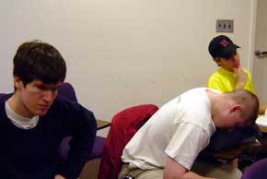
Watch on Lecturing Skills

Slide 19
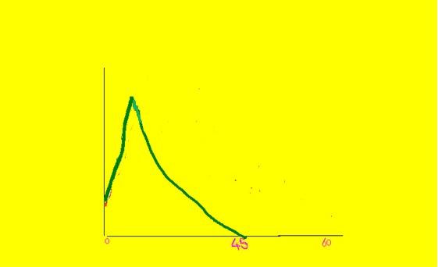
Attention and recall is best at the beginning and sometimes at the end of lecture
Curve showing attention span

Slide 20
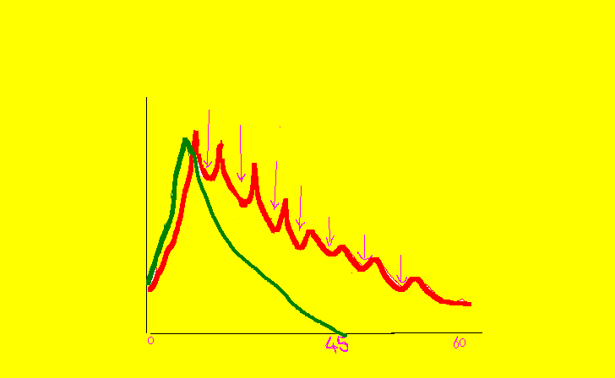
Recall can be improved by changing the
format of the lecture in between

Slide 21
HOW DO WE MAKE A LECTURE EFFECTIVE ???

Slide 22
SOLUTION??
Make them more student centered to maximize student learning
Follow 4 “P” s (Principles) of lecture organization:
PLAN
PREPARE
PRACTICE
PRESENT
Context, Objectives, time…
Resource, activities, organization, A.V.

Slide 23
To make them interesting….
Good introduction
Vary the content: use of humor, anecdotes
Vary audiovisuals
Students learn by “doing”
How to make lectures interactive???
Energy breaks – buzz groups (think - pair and share), quiet brain storming, question and answer and many more……..

Slide 24
Presentation with Interaction
What are Interactive lectures?
It is a way to capitalize on the strengths of small group learning in a large group format.

Slide 25
Word Quiz
Find out the principles of lecture organization in the given crossword puzzle

Slide 26
WORD QUIZ
X | J | M | R | V | N | B | Z | L | X | D | N
Y | Q | O | P | U | J | R | E | M | P | O | R
C | V | P | R | A | C | R | V | O | G | B | Q
T | N | R | E | X | A | W | S | T | K | J | Z
K | N | K | S | P | O | T | C | H | W | E | F
Z | A | L | E | L | R | U | O | P | R | C | K
R | L | R | N | J | D | A | N | C | D | T | I
O | P | L | T | O | D | G | C | U | J | V | G
R | B | W | R | I | T | O | L | T | Z | N | L
P | K | T | L | C | N | B | U | X | I | Y | F
B | N | R | L | T | R | N | S | H | M | C | E
I | C | T | E | A | O | F | I | O | K | M | E

Slide 27
Confusion
On a sheet of paper, write down, anything that you think you have not understood in this workshop since beginning

Slide 28
ESSENCE
Enlist as many interactive methods as you
can remember from today’s session

Slide 29

Hints for Effective Interactivity
Plan interactivity properly
Explain the method to participants
Stick to allotted time
Do not hesitate to take help of your colleagues

Slide 30
Take Home Messages
What you can cover depends on time available.
LESS IS MORE
Consider what visual images will help you convey your message.
Use proper delivery techniques

Slide 31
Take Homes
Add graphics and colour to support the message.
Be cautious while adding techniques for attention grabbing.

Slide 32
“LAST BUT NOT LEAST…”
Revise slides to shorten them.
Ask for feedback before “show time.”
Put details into handouts.

Slide 33
Thank you….

