Slide 2
Round 1
5 marks per Question
Each Team will get 2 Questions
Time limit is 30 seconds for each Question

Slide 3
Round 2
Identify the Pathology
10 marks per Question
30 seconds time

Slide 4

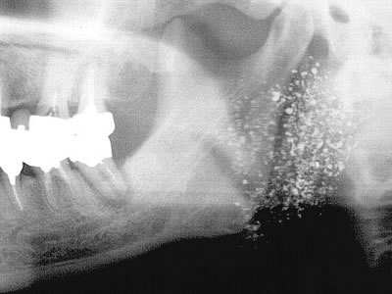

Slide 5
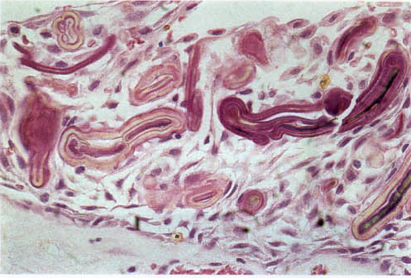

Slide 6
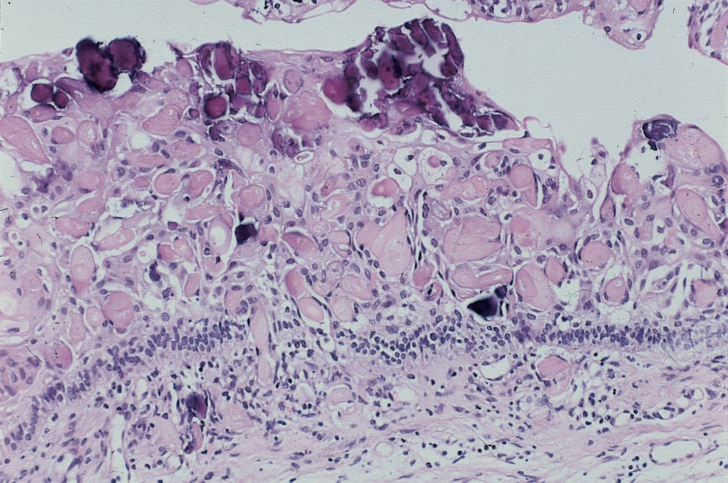

Slide 7
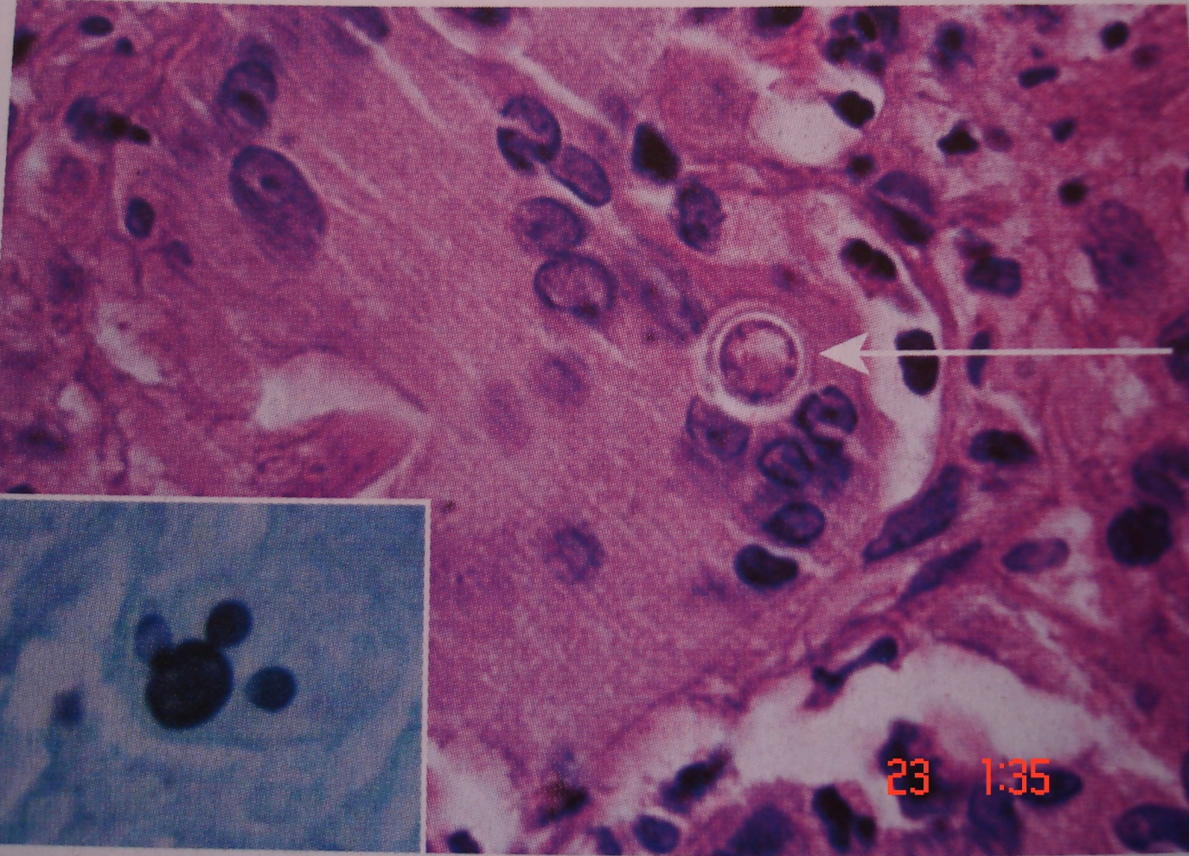
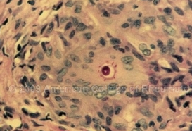
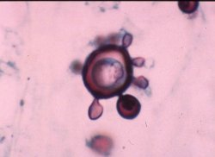
Notes:
Size varies between 10 and 60 microns, which is considerably larger.
Histopathologic— Epithelioid macrophages and multinucleated giant cells,Yeast-30μm
organisms show multiple daughter buds on parent cell— “Mickey mouse ears” or “Mariner’s wheel”
Culture—Room temperature shows septate hyphae, at 37°C Yeast cells with multiple buds are seen.

Slide 8
