Slide 1
REGRESSIVE ALTERATIONS OF THE TEETH

Slide 2
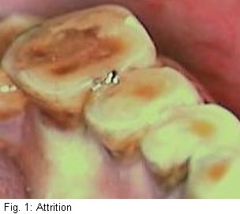
ATTRITION
DEFINATION
The physiologic wearing of a tooth as a result of tooth –to –tooth contact,as in mastication or parafunctional habits.

Slide 3
ATTRITION
Physiological not pathological process.
Present in deciduous and permanent dentition.
Present in dentinogenesis imperfecta and amelogenesis Imperfecta.
PREDISPOSING FACTORS-
Chewing tobacco
Bruxism
Exposure to abrasive dust.

Slide 4
ATTRITION
Clinical manifestation-
It is seen on occlusal, incisal and proximal surfaces of teeth.
Appearance of small polished facet on cusp tip or ridge or sligtly flattening of an incisal edge.
Shiny facets on amalgam contacts.
Fracture of cusp or restoration.
Reduction in the mesio-distal dimension of the tooth.
In severe cases enamel is completely worn away results in yellow or brown staining of exposed dentin.
Tooth worn to gingival level

Slide 5
ABRASION
DEFINITION
It is the pathologic wearing away of tooth substance through some abnormal mechanical process.
Causes-
Abrasive dentrifrices.
Tooth brush.
Other causes like- Habitual opening of bobby pins with teeth may results in notching of incisal edge of maxillary central incisor.
Habitual pipe smokers.
Improper use of dental floss,toothpicks

Slide 6
ABRASION
Clinical manifestation-
V- shaped or wedge shaped ditch on the root side of C-E junction.
More wide than deep.
Premolars and cuspids are commonly affected. It is more on left side of mouth in right handed people and vice versa.

Slide 7
EROSION
DEFINATION-
It is an irreversible loss of dental hard tissue by a chemical process that does not involve bacteria.
Pathophysiology
Dissolution of mineralized tooth structure occurs upon contact with acids that are introduced into the oral cavity by intrinsic or extrinsic sources.

Slide 8
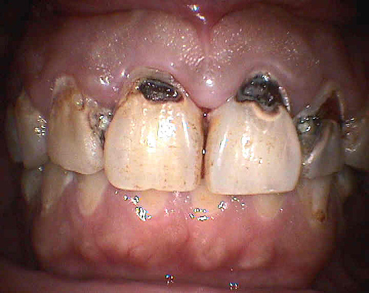

Slide 9
EROSION
Causes
Extrinsic
i)Food stuff ii)Iatrogenic
Acid beverages,
foods, medications or
environmental acids

Slide 10
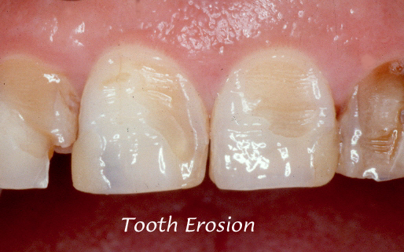

Slide 11
EROSION
Intrinsic factors
Gastric acids(pH<1)
Gastroesophageal reflux
Excessive vomiting.
Saliva as modifying agent-
-Imp factor in etiology of erosion.
- Buffering capacity .
-Flow rate .

Slide 12
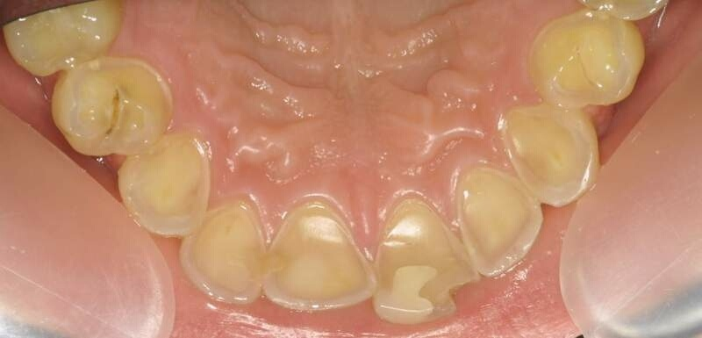

Slide 13
ABFRACTION
It is pathological loss of both enamel and dentin caused by biomechanical loading forces.
Type of tooth loss which is confined to the gingival third of the clinical crown .
Pathophysiology-
occlusal forces causes the teeth to flex though little.Constant flexing causes enamel to break from the crown(usually on buccal surface).

Slide 14
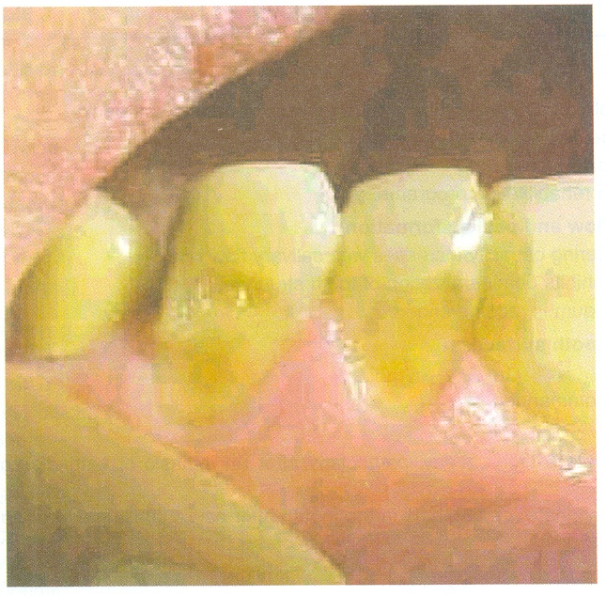
ABFRACTION
Breakdown of the structure is dependent on-
Magnitude, duration, direction , frequency, and location of the forces.

Slide 15
DENTINAL SCLEROSIS
Also c/as transparent dentin
Characterised by calcification of primary dentin that is dentinal tubules.
C/F;-Harder than normal dentin.
Causes-Injury, aging, caries, abrasion.
H/P;- In transmitted light, below carious lesion it appear transperant.
It appers transperant because of difference in the refractive index of the dentinal tubule and the normal tubules.

Slide 16
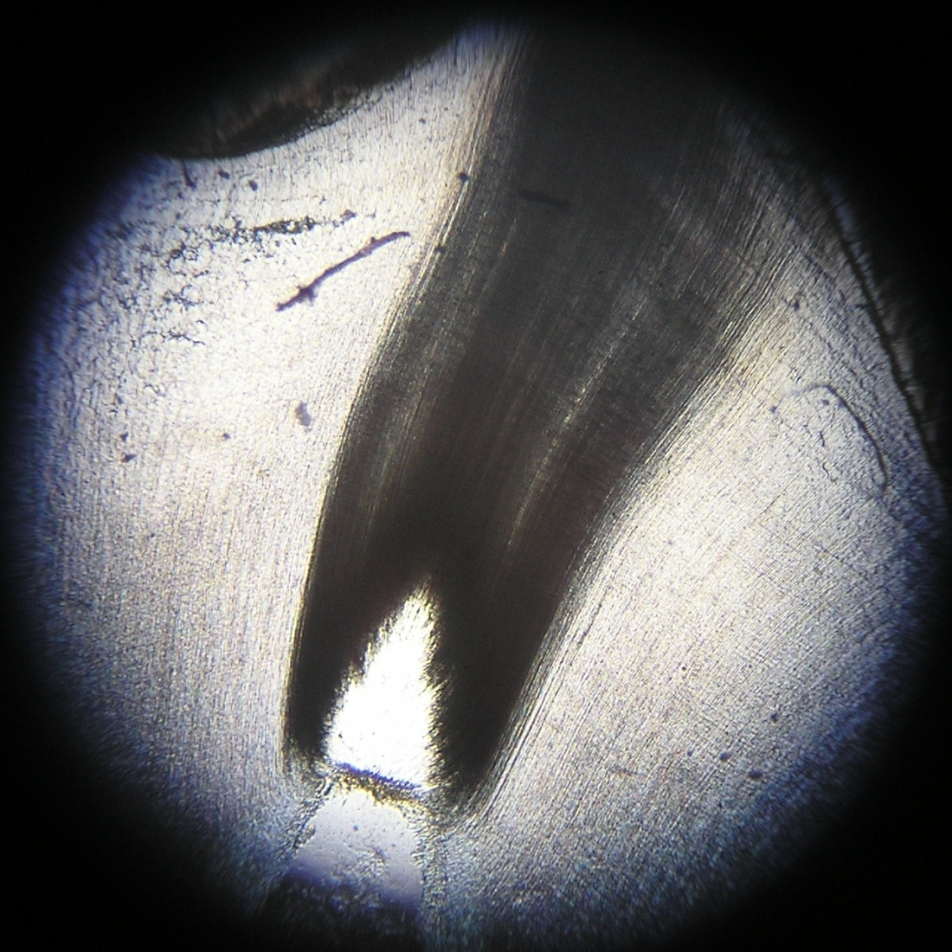

Slide 17
SECONDARY DENTIN
Physiological
Regular, uniform
Laid down through out life as a physiological factor like aging,tooth eruption
Produced slowly.
Reparative dentin
Results mainly from attrision.
It is in form of tooth wear, bruxism, produces natural protective barier

Slide 18
RETICULAR ATROPHY OF PULP
Common in elderly person.
H/P;- presence of large vacuolated spaces.
Reduction in cellular elements
Degeneration and disappearance odontoblasts.
This could be seen as fixation artifact.

Slide 19
PULP CALCIFICATION
The two chief morphologic form of pulp calcifications are
1)discrete pulp stones; and
2)diffuse calcification

Slide 20
PULP CALCIFICATION
Discrete pulp stones;
I)True pulp stones; and
II)False pulp stones.
I)True pulp stones;
Localised masses of calcified tissue that resemble dentin.
presence of dentinal tubules.

Slide 21
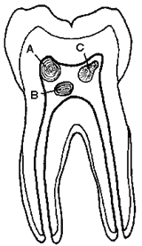

Slide 22
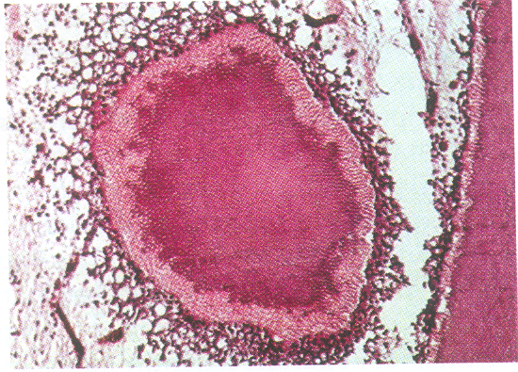
PULP STONES
Resemblance to secondary dentin.
More common in pulp chamber than in root canal.
Two types;
free & attached.

Slide 23
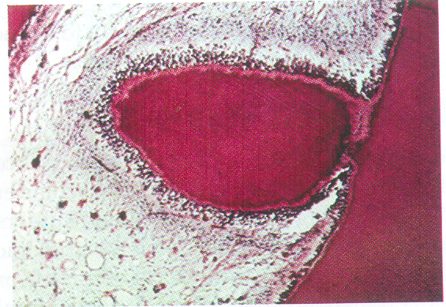
Attached pulp stone

Slide 24
PULP STONES
II) False denticles
Do not resemble dentinal tubule.
It is nodules of concentric layers, deposited around a central nidus.
False are ;free and attached
If this stone is in close approximation of dentinal wall & surrounded by secondary dentin ,c/as interstitial denticle.

Slide 25
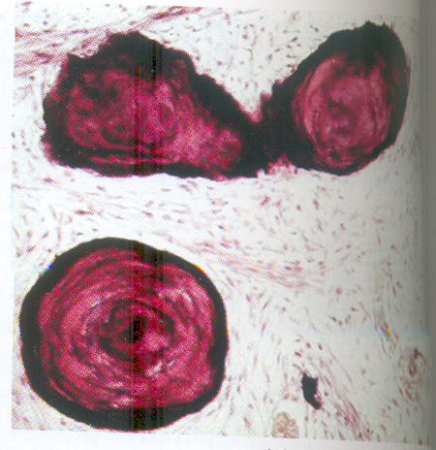
False pulp stone

Slide 26
DIFFUSE CALCIFICATION
Most commonly in root canals.
Resemble calcification seen in other part of body, calcific degeration.
Etiology-
Caries
Trauma.
Local or systemic diseases --Cholelithiasis, artherosclerosis,gout,acromegaly,osteitis deformans, hypercementosis, torus platinus.
Bacteria.
Cutting procedures and restorative materials.
Clinical features-
Pain, pulpal neuralgia ,excruciating pain resembling tic douloureux.

Slide 27
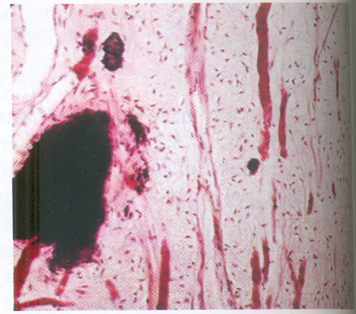
Diffuse calcification

Slide 28
RESORPTION OF TEETH
1 External resorption
a) Periapical inflammation
b) Reimplantation of teeth.
c) Tumors and cysts.
d)Excessive mechanical or occlusal forces.
e) Impaction of teeth.
f) Idiopathic.

Slide 29
Resorption
2) Internal Resorption
a) Idiopathic.

Slide 30
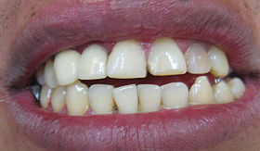
RESORPTION
INTERNAL RESORPTION
Chronic perforating hyperplasia of pulp, internal granuloma,
odontoclastoma, pink tooth of mummery.
Begins centrally within the pulp.
Inflammatory hyperplasia of the pulp.

Slide 31
RESORPTION
Clinical feature-
Appearance of a pink –hue area on the crown of the tooth.
Single tooth ,multiple tooth involvement.
Radiographic Features-
Round or ovoid radiolucent area in the central portion of the tooth.
Perforation of tooth can occur.

Slide 32
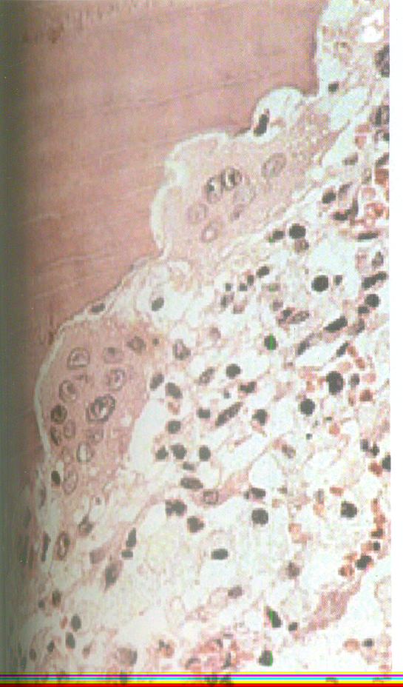
RESORPTION
Histologic Features-
Irregular lacunar variety showing osteoclast or odontoclast.
Chronic inflammatory reaction is evident.

Slide 33
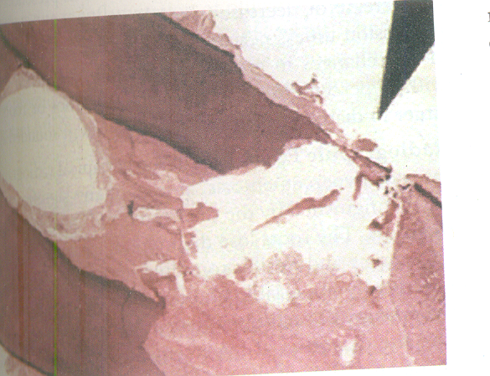

Slide 34
HYPERCEMENTOSIS
It is a non-neoplastic condition in which excessive cementum is deposited in continuation with the normal radicular cementum.
It may be Focal or all over root surface.
Etiology-
Accelerated elongation of a tooth.
Inflammation about a tooth.

Slide 35
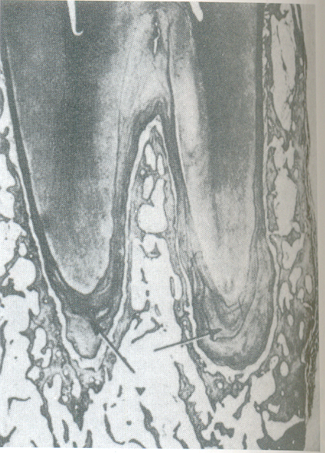

Slide 36
HYPERCEMENTOSIS
Tooth repair.
Osteitis deformans ,or paget’s disease of bone.
Spike formation.
Clinical features-
No significant signs and symptoms present.

Slide 37
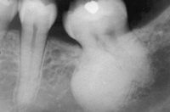
HYPERCEMENTOSIS
Radiographic features-
The roots lose their typical ‘sharpened’and ‘spiked’ appearance and exibit rounding of the apex.

Slide 38
HYPERCEMENTOSIS
Histologic features-
Excessive amount of secondary or cellular cementum is deposited diectly over the typically thin layer of primary accellular cementum.
The secondary cementum has been term osteocementum because of its cellular nature and its resemblance to bone.
Treatment- no t/t is indicated

Slide 39
CEMENTICLES
Cementicles are small foci of calcified tissue ,which lie free in the periodontal ligament of the lateral and apical root areas.
1)Develop by calcification of nest of epithelial cells as a result of degenerative changes.
2)It arise from focal calcification of connective tissue between Sharpey’s bundles with no apperent nidus.

Slide 40
CEMENTICLES
3) cemental tears or
4) fragments of bone detached from alveolar bone may resemble cementicles.
5) Also arise through calcification of thrombosed capillaries in the periodontal ligament.
If clusters of cementicles fuse ,form cementoma at the apex of root.

