Slide 1
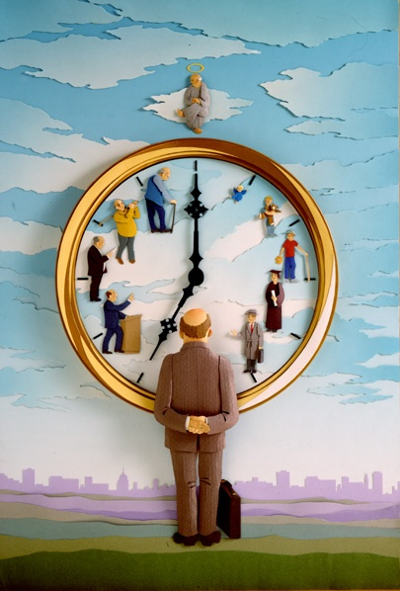
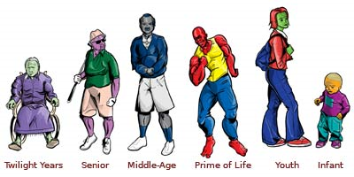
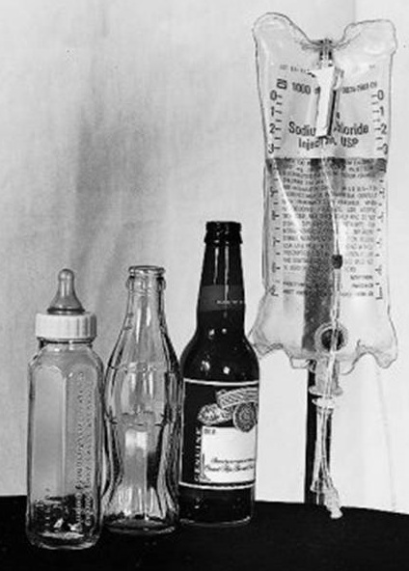
What Do We Concern Frequently in Our Life?

Slide 2
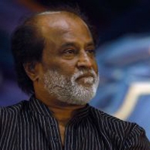
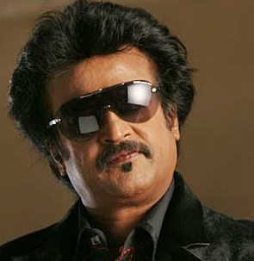
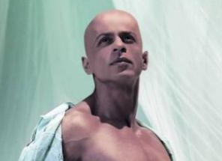


Slide 3
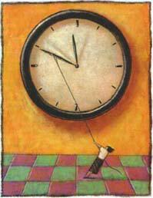
Can We Slow Down the Clock of Aging & Disease?

Slide 4
ANTIOXIDANTS –
A Fight Against Cancer & Aging
PRESENTED BY- DR. PRASAD. P. KARANDE

Slide 5
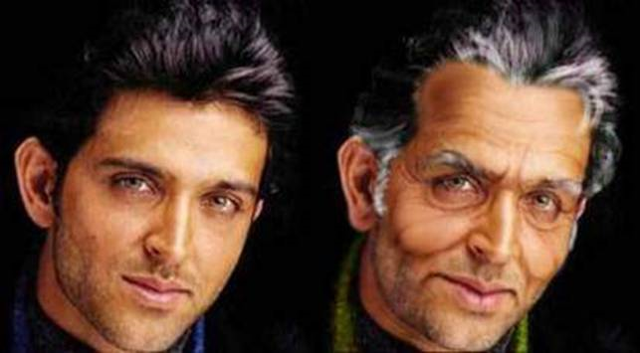
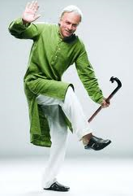
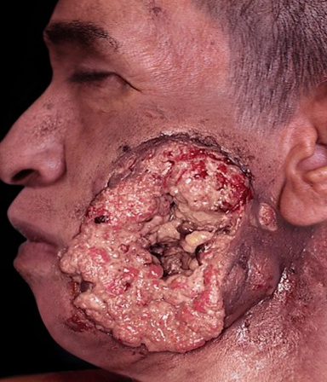
What are Antioxidant ???
An Agent that prevents or inhibits oxidation.
Antioxidants are substances that protect cells from the damaging effects of FREE RADICALS which are highly reactive chemicals that play a part in some forms of CANCER, atherosclerosis, reperfusion injuries and AGING.

Slide 6

What are FREE RADICALS ???
These are molecules containing unpaired electrons
Examples: O2 ,
OH,
Unstable and highly reactive

Slide 7
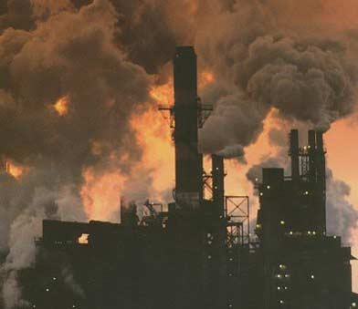
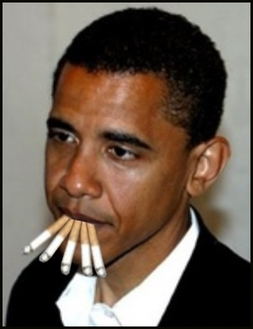
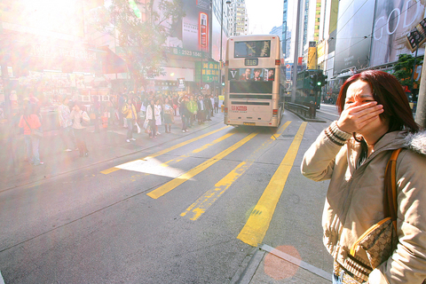
How are free radicals produced ???
Caused by air pollution, radiation, sunlight, environmental chemicals, cigarette smoke, exposure of metals, biological materials and chemical reactions that take place in our body.

Slide 8

Free Radical Formation and damage

Slide 9

Effects of DNA Oxidation Damage on Body
Long Term Consequences
Aging
Cancer
Disease

Slide 10
Effects of Reactive Oxygen Species
Gastro intestinal
Skin
Eye
Age pigment
Hepatitis
Heart
Cataract
Heart attack
Teeth
Periodontitis
Joints
Arthritis
Reactive Oxygen Species
Vessels
Atherosclerosis
Lung
Asthma
Brain
Stroke
Multiorgan failure
  Cancer

Slide 11

Counteracting free radical damage
One important line of defense against free radical damage is the presence of
Some such antioxidants, are produced during normal metabolism in the body. Other lighter antioxidants are
found in the diet.
Antioxidants.

Slide 12
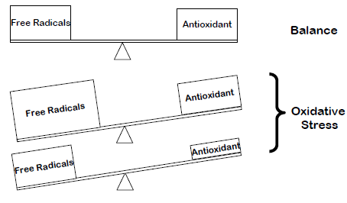
Oxidative Stress

Slide 13
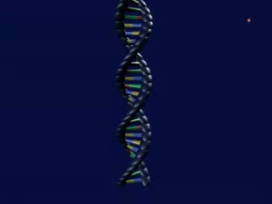
Mechanism of action of antioxidants

Slide 14
Antioxidants

Slide 15
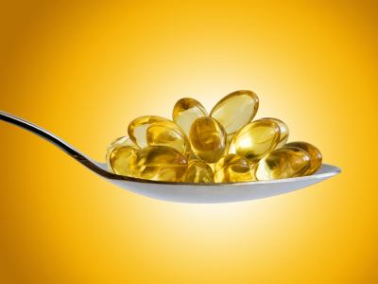
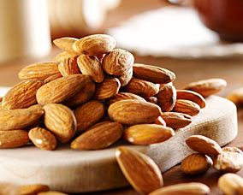
Vitamin E
Primary defender against effects of free radicals in the body
Protects components of the cell and their membrane from destruction
RDA :
Men = 15mg/day
Women = 15mg/day

Slide 16
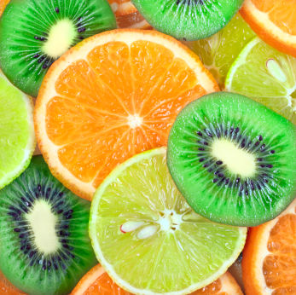
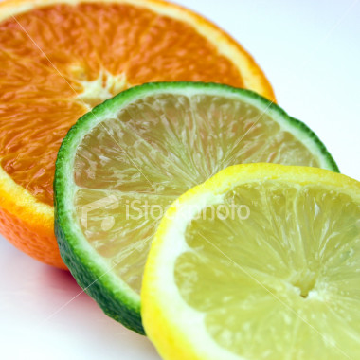
Vitamin C
(ascorbic acid)
Gives up electrons very easily when they are needed.
Unique that they can then receive them again to become reactive.
RDA:
Men = 90 mg/day
Women = 75 mg/day

Slide 17
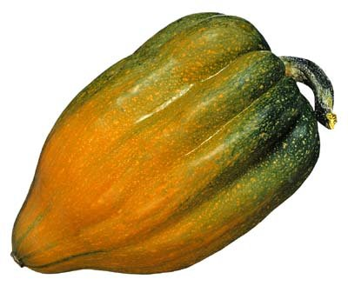
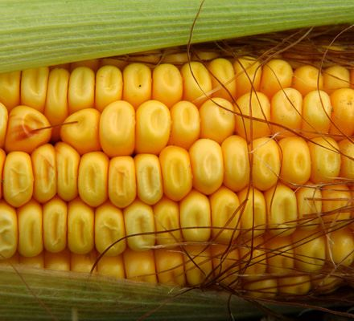
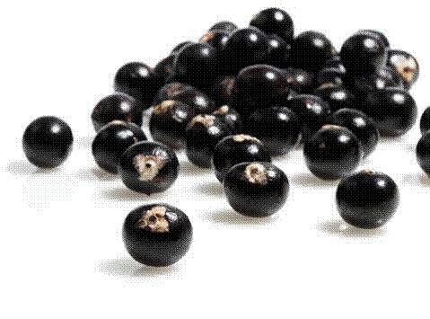
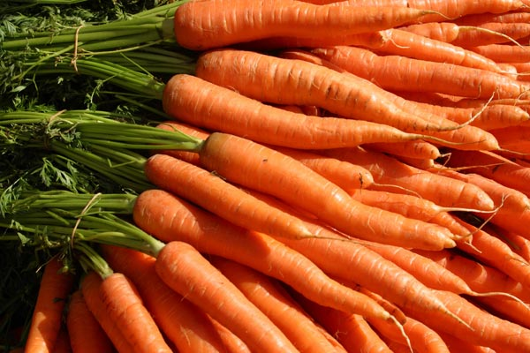
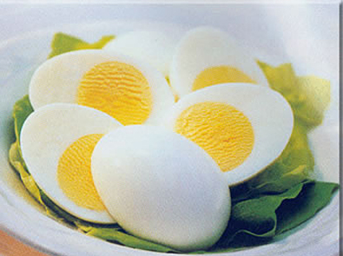
β - Carotene
Beta Carotene is a water soluble precursor to Vitamin A, and is a antioxidant in itself; where Vitamin A has no antioxidant activity.

Slide 18






Phytochemicals
Contribute to food taste, aromas, colors and other characteristics.
Act as antioxidants and suppress the development of diseases.

Slide 19
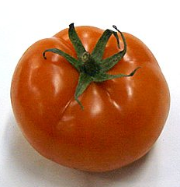
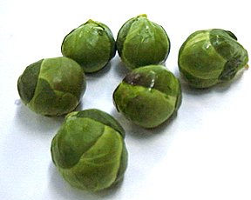
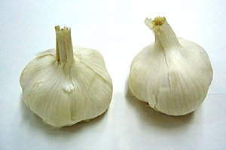
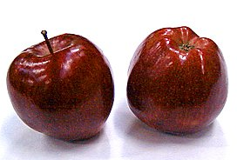
Sulforaphane
Lycopene
Flavonoids
Allicin

Slide 20
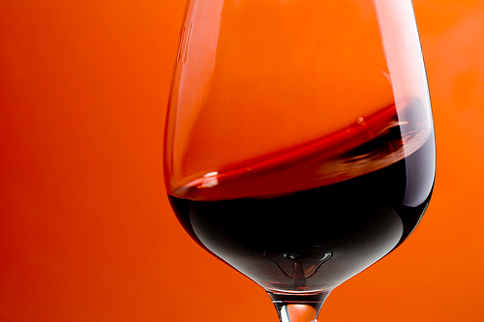
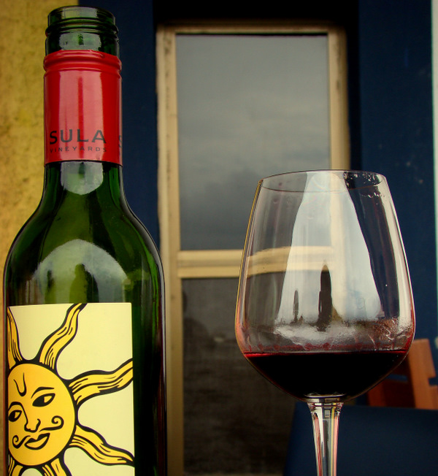
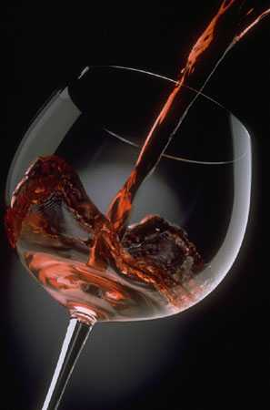
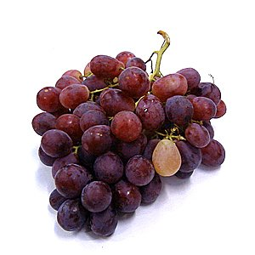
The phytochemical resveratrol found in grapes protects against cancer by inhibiting cell growth and against heart disease by limiting clot formation.

Slide 21
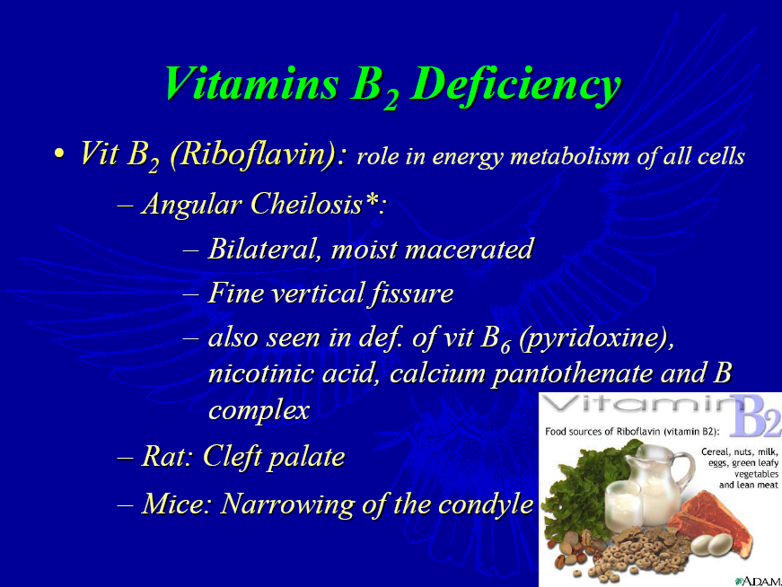
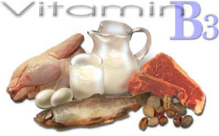
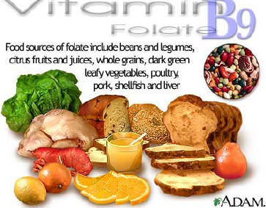
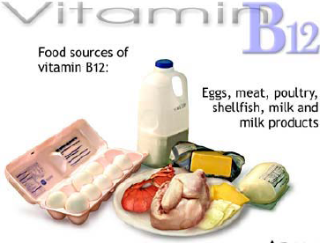
Vitamin B- Complex though not an antioxidant but prevents aging by increasing the life cycle period of a cell or by increasing the cell life.

Slide 22
American Cancer Society (ACS)
Recommendation
Suggest ≥ 5 servings of fruits & vegetables
each day to prevent cancer and heart diseases
Byers et al. CA Cancer J Clin. 2002; 52: 92-119

Slide 23
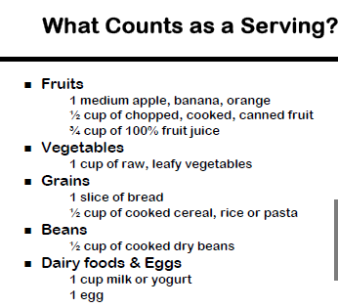

Slide 24
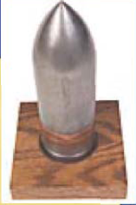
War model of cancer treatment
Treatment = Heroic measures
of aggressive surgery, radiation
and toxic chemotherapy drugs.
Research Focus= Find “MAGIC BULLET” =CURE
How then could foods influence cancer cells???

Slide 25
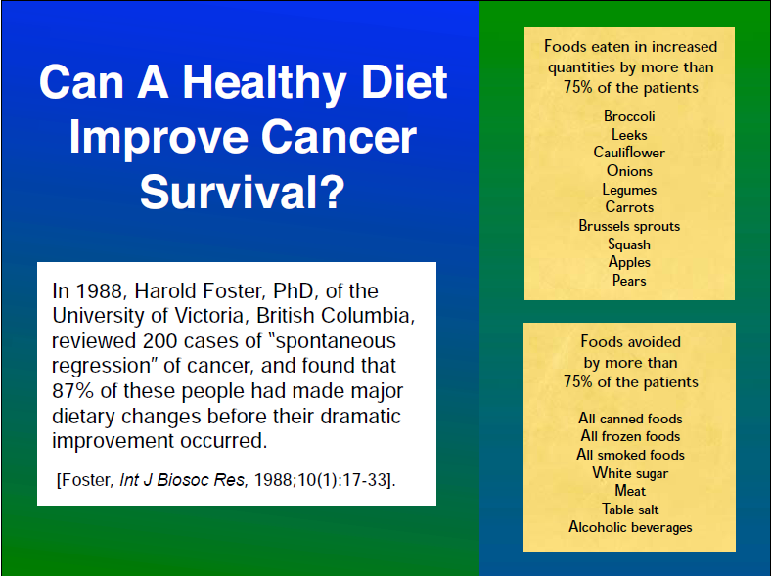
Can a healthy diet improve cancer survival ???
Harold Foster of University of Victoria Reviewed 200 cases of Spontaneous regression of cancer and found that 87% patients had made major dietary changes before their dramatic improvement.
Foster, Int J Biosoc Res, 1988; 10(1): 17, 33

Slide 26
Are You Ready to the Reactive Oxygen Species Attack?
Fight
O₂•⁻, ¹O₂, HO•, H₂O₂,
RO•, ROO•
Antioxidants
ROS Jail
R•, RO•, ROO•,
¹O₂, O⁻2,
.OH, H2O2,

Slide 27
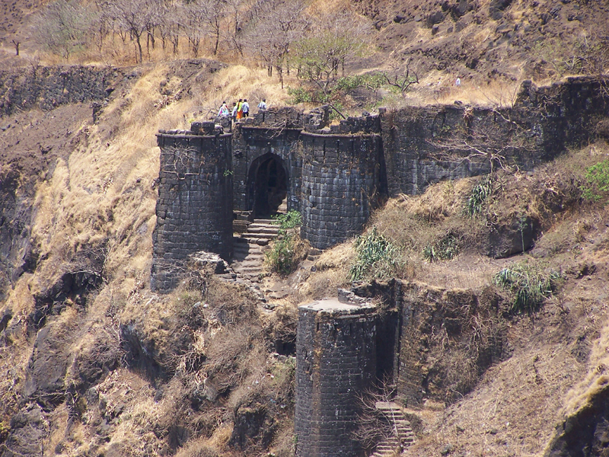
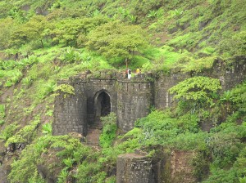
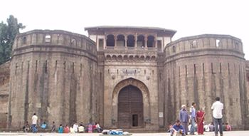
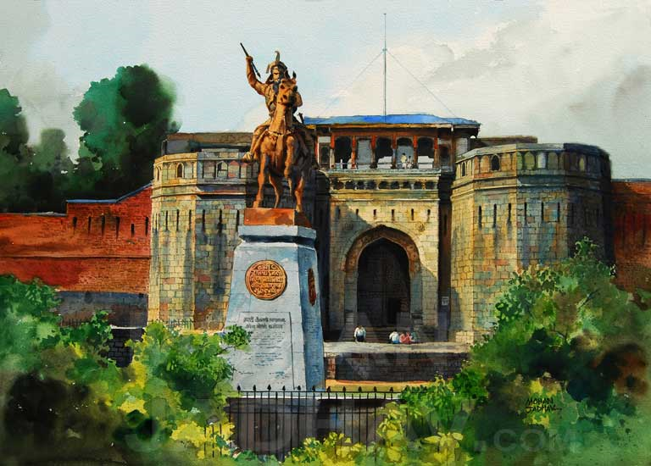
Thank you!

