Slide 1
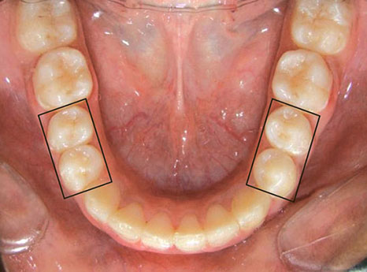
PERMANENT MANDIBULAR PREMOLARS

Slide 2
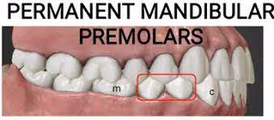
Introduction :
These are 4 in number ; 2 in each side.
They’re present DISTAL to lower canine and
MESIAL to the lower molars.

Slide 3
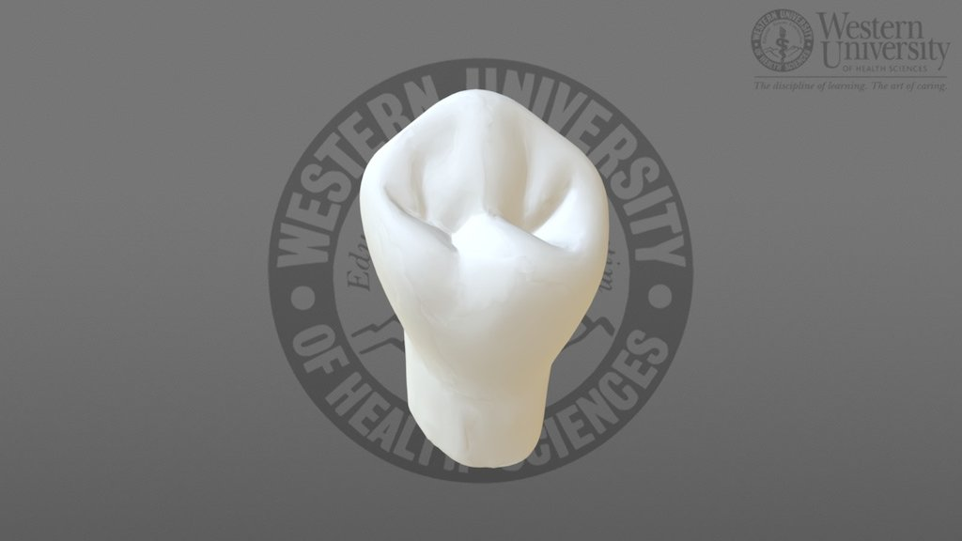
MANDIBULAR FIRST PREMOLARS
Tooth Number
Dimensions
Chronology
Relation
Surface Anatomy
Buccal Aspect
Lingual Aspect
Mesial Aspect
Distal Aspect
Occlusal Aspect

Slide 4
Mandibular 1st Premolar
TOOTH NUMBER :-
 | Mand 1st premolar RIGHT | Mand 1st premolar LEFT
Universal System | 28 | 21
FDI System | 44 | 34

Slide 5
MANDIBULAR 1ST PREMOLAR
DIMENSIONS {in mm}:
->Length of crown = 8.5
-> Length of Root = 14.0
-> Mesiodistal diameter of crown = 7.0
-> Mesiodistal diameter of crown = 5.0
at cervix

Slide 6
MANDIBULAR 1ST PREMOLAR
CHRONOLOGY :-
-> 1st evidence of calcification = 1 3/4 – 2 years
-> Enamel completion = 5-6 years
-> Age of Eruption = 10- 12 years
-> Root Completion = 12-13 years

Slide 7
MANDIBULAR 1ST PREMOLAR
RELATIONS :
The lower 1st premolar makes contact mesially with the distal surface of the lower canine and distally with the mesial surface of the 2nd premolar.

Slide 8
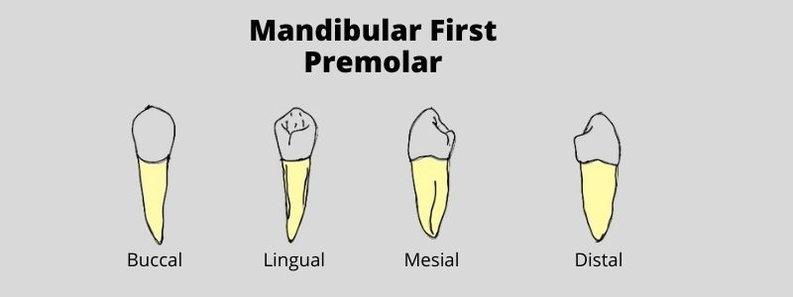
MANDIBULAR 1ST PREMOLAR
SURFACE ANATOMY :

Slide 9
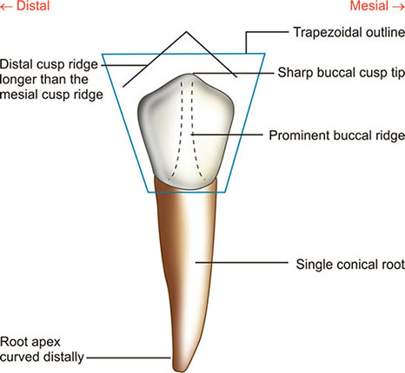
MANDIBULAR 1ST PREMOLAR
BUCCAL ASPECT :
Trapezoid in shape :short side –cervically
long side – occlusally
Mesial outline is slightly concave till the mesial
Contact area.
The distal outline is slightly concave till the
Distal contact area.
The mesial slope is shorter than the distal
Slope.
The buccal cuspal tip is slightly mesial to the
Midline.

Slide 10
Presence of Buccal ridge .
Presence of Cervical ridge .
Two developmental grooves mesial and distal to the buccal ridge.
THE ROOT :
The root is cone shaped with distal inclination of the apical 3rd.
The root is shorter than that of Canines.

Slide 11
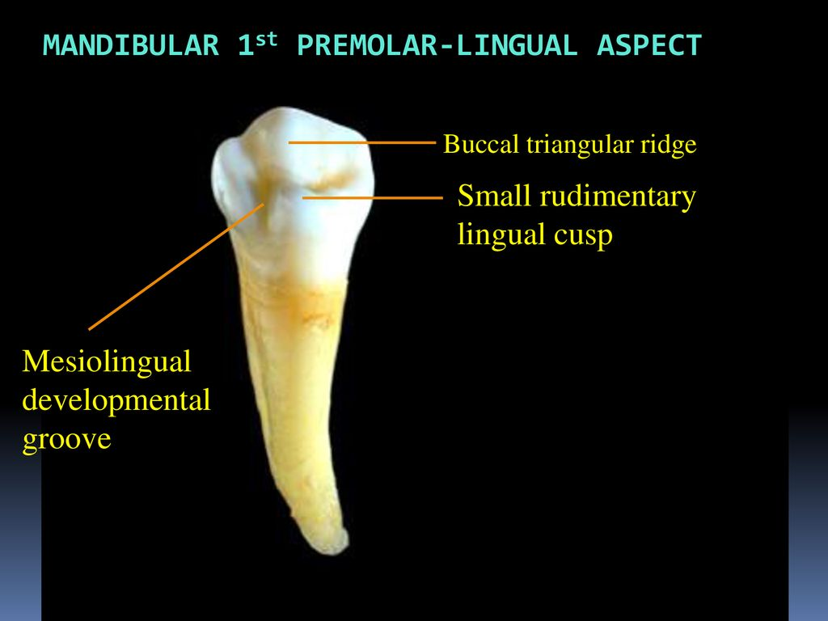
MANDIBULAR 1ST PREMOLAR
LINGUAL ASPECT:

Slide 12
Lingual cusp is 2/3rd of the buccal cusp.
The short lingual slope can be called well developed cingulum.
The mesial and distal triangular fossae can be seen
Cervical line is slightly convex or even straight.

Slide 13
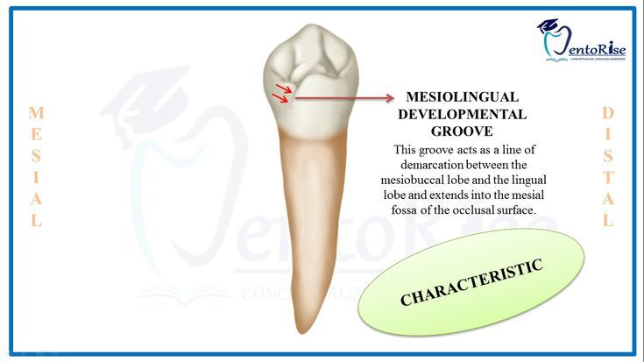
A characteristic feature of the
Lingual surface is the
Mesiolingual developmental
groove

Slide 14
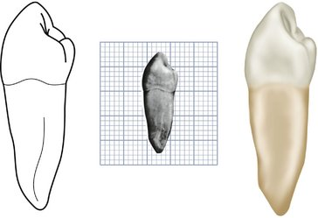
MANDIBULAR 1ST PREMOLAR
MESIAL ASPECT:
It is Rhomboid in shape due to
lingual inclination.
The buccal outline is convex from
Cervical line to the cusp tip.
The lingual outline is convex.
The lingual cusp is 2/3rd of buccal cusp.
The mesial marginal ridge is sloping lingually.
The contact area is in line with the buccal cusp
Tip.
THE ROOT :
It tapers to pointed apex and has
Deep developmental groove.

Slide 15
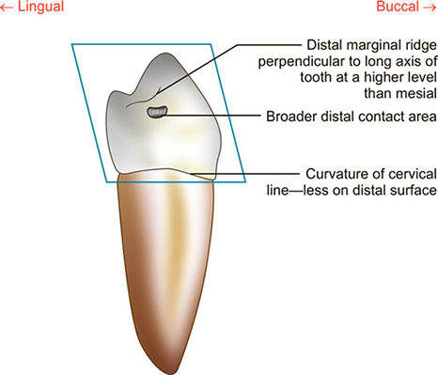
MANDIBULAR 1ST PREMOLAR
DISTAL ASPECT:
Similar to mesial aspect but differs in:
The distal marginal ridge is straight and
(i)Perpendicular to long axis of the tooth
(ii)No developmental groove
(iii)The contact area is more cervical
And broader
(iv) The distal cervical line is more curved.

Slide 16
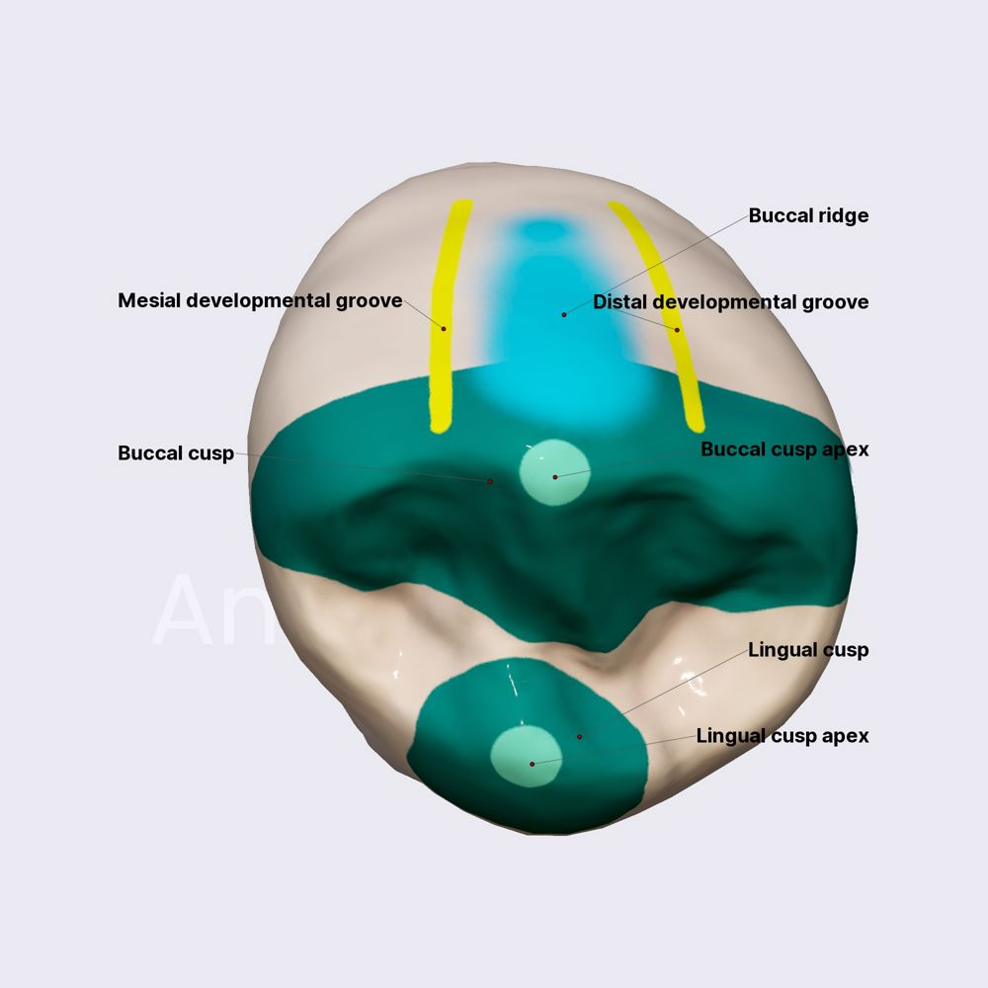
MANDIBULAR 1ST PREMOLAR
OCCLUSAL ASPECT:
It is diamond or round shaped.
The occlusal surface tapers linguallgy.
The buccal cusp has large triangular fossa.
The small lingual cusp has small triangular ridge.
The buccal and lingual traingular ridges are
Connected by transverse ridge.
Mesial and Distal triangular fossae.
Central developmental groove may cross the
Transverse ridge.

Slide 17
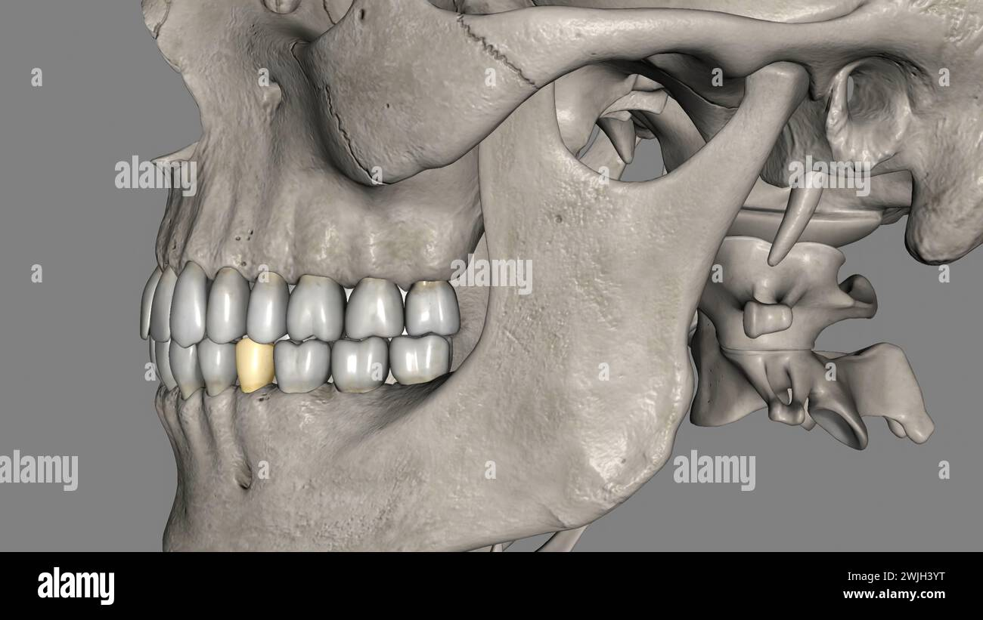
MANDIBULAR 2ND PREMOLAR

Slide 18
MANDIBULAR 2ND PREMOLAR
TOOTH NUMBER :
 | Mandibular 2nd premolar RIGHT | Mandibular 2nd premolar LEFT
Universal System | 29 | 20
FDI system | 35 | 45

Slide 19
MANDIBULAR 2ND PREMOLAR
Dimensions {in mm} :
-> Length of crown = 8.0
->Length of root = 14.5
->mesiodistal diameter of crown = 7.0
->mesiodistal diameter of crown = 5.0
At cervix

Slide 20
MANDIBULAR 2ND MOLAR
Chronology :
-> 1st evidence of calcification = 2 ¼ - 2 ½
->Enamel completion = 6-7 years
->Age of eruption = 11-12 years
->Root completion =13-14 years

Slide 21
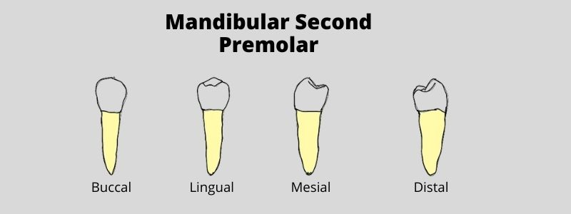
MANDIBULAR 2ND PREMOLAR
SURFACE ANATOMY :

Slide 22
Presence of cervical ridge.
Presence of buccal ridge.
Two developmental grooves mesial and distal to the buccal ridge.
THE ROOT:
The root is cone shaped with rare distal inclination of the apical 3rd.

Slide 23
SURFACE ANATOMY :
Presence of cervical ridge.
Presence of buccal ridge.
Two developmental grooves mesial and distal to the buccal ridge
THE ROOT:
The root is cone shaped with rare distal inclination of the apical 3rd.

Slide 24
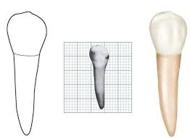
MANDIBULAR 2ND PREMOLAR
BUCCAL ASPECT :
Comparison with mandibular 1 st premolar:-
The buccal cusp is shorter & less pointed.
The contact areas are broad & appear to
be higher because of the short buccal cusp.
The root is broader mesiodistally & longer than that of the first premolar
The mesial slope is shorter than the distal slope.

Slide 25
MANDIBULAR 2ND PREMOLAR
Lingual aspect:
Comparison with mandibular 1 st premolar:
the lingual cusp or cusps longer.
Less of the occlusal surface may be seen from this aspect.
A/ in the three -cusp type, there are a mesiolingual & a distolingual cusps.
Mesiolingual cusp is the larger & the longer one in most cases
B/ in the two-cusp type, there is single lingual cusp of equal height with the three-cusp type.
has no groove, but it shows a developmental depression distolingually.

Slide 26
MANDIBULAR 2ND PREMOLAR
MESIAL ASPECT :
Comparison with mandibular 1 st premolar:
• The crown & root are wider buccolingually.
• The buccal cusp is shorter & it is not so nearly centered over the root trunk.
• The marginal ridge is higher & it is at right angle to the long axis of the tooth.
• Less of the occlusal surface may be seen.
• There is no mesiolingual developmental groove.
• The root is longer & slightly convex on the mesial surface.
• The apex of the root is usually more blunt.

Slide 27
MANDIBULAR 2ND PREMOLAR
Distal aspect:
Comparison with mandibular 1 st premolar :
• All of the three cusps may be seen from this aspect.
• More of the occlusal surface may be seen, since the distal marginal ridge is at a lower level than the mesial marginal ridge.

Slide 28
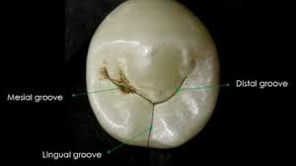
MANDIBULAR 2ND PREMOLAR
OCCLUSAL ASPECT:
1] THREE CUSPAL TYPE:
The geometrical outline is
Square.
It has one buccal cusp and two
Lingual cusps.
Every cusp has triangular ridge.
Y shaped developmental groove separating the cusps.
There is central fossa & central pit.
Mesial & distal triangular fossae.

Slide 29
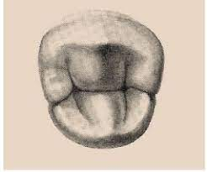
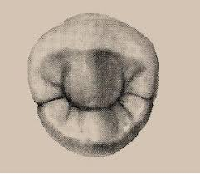
2] TWO CUSPAL TYPE:
The geometrical outline is round.
There is lingual convergence.
There is one buccal & one lingual
Cusp.
The central developmental groove may be
H or U shaped.
The mesial and distal fossae are round.

Slide 30


