Slide 1
Introduction To Dental Anatomy

Slide 2
Introduction
Midline: imaginary vertical line which divides each arch as well as body into approx equal halves
Right Maxillary teeth: teeth arranged in upper arch
Manduibular teeth: teeth arranged in lower arch

Slide 3
Quadrants: two approximately equal portions of each arch divided by midline
Four in entire mouth and termed as
1. maxillary (upper) right
2. maxillary (upper) left
3. mandibular (lower) right
4. mandibular (lower) left

Slide 4
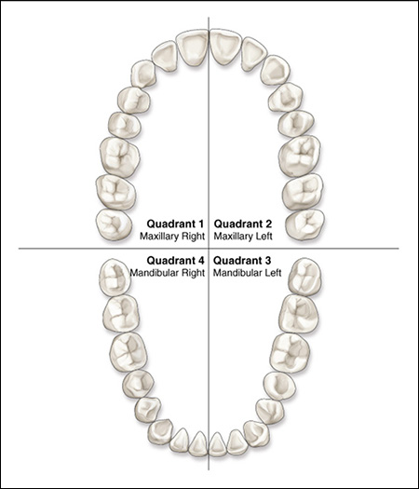

Slide 5
Dentition
Two types of dentition are present in humans
Deciduous
Primary

Slide 6
Deciduous teeth
So named because they are shed like the leaves of tree in autumn
20 total deciduous teeth are present
Erupts from 6 months to 2 years other non scientific names for deciduous teeth include "milk” teeth “temporary" teeth

Slide 7
Permanent Dentition
Teeth of the secondary, or adult dentition
There are 32 permanent teeth
Erupt from 6-21 years of age

Slide 8
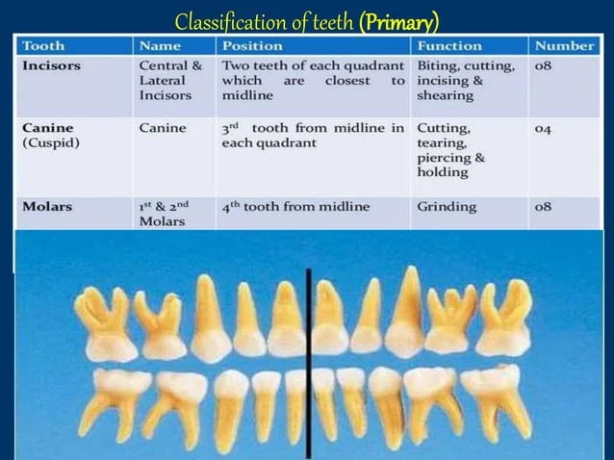
Classification of deciduous teeth

Slide 9
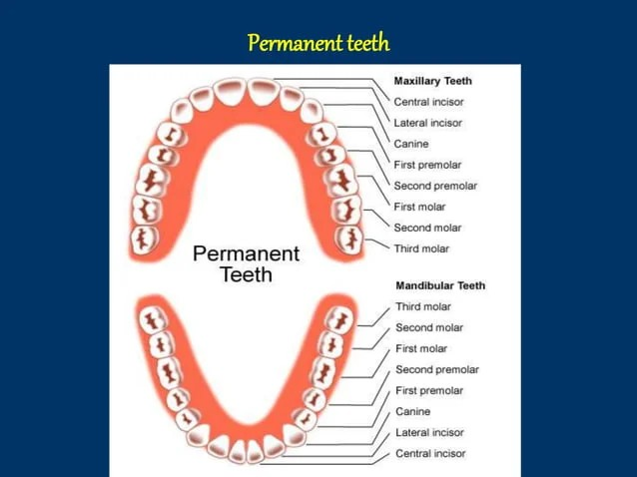
Permanent teeth

Slide 10
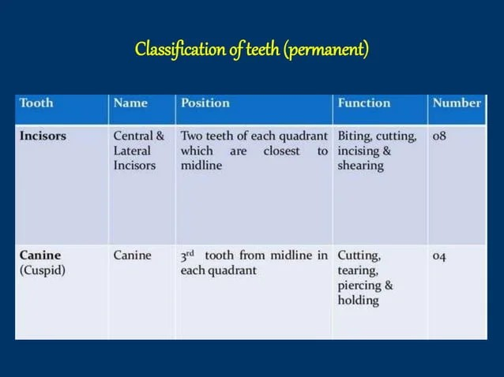

Slide 11
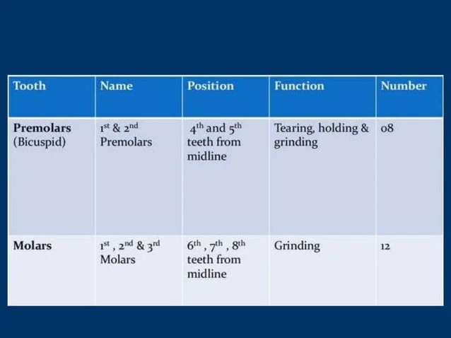

Slide 12
Succedaneous teeth
It Simply means "succeeding" deciduous teeth
Twenty deciduous teeth are replaced by twenty succedaneous teeth
Incisors and canines – replace their deciduous counterpart
Premolars - which replaces deciduous molars
Molars are not considered as succedaneous teeth

Slide 13
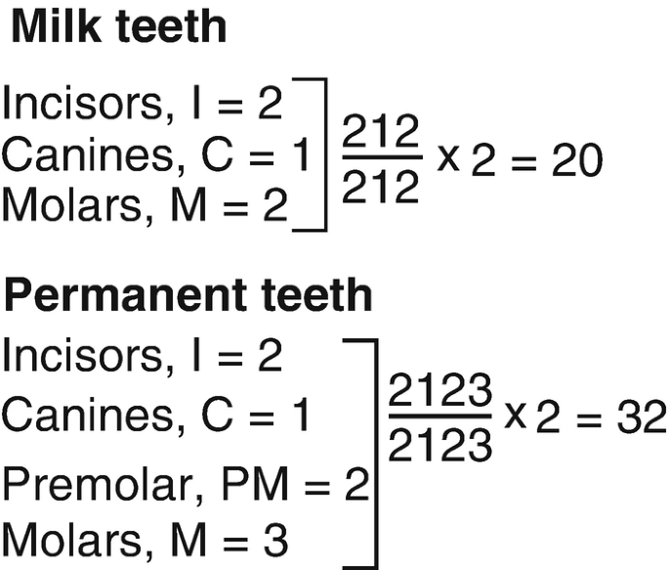
Dental formula

Slide 14
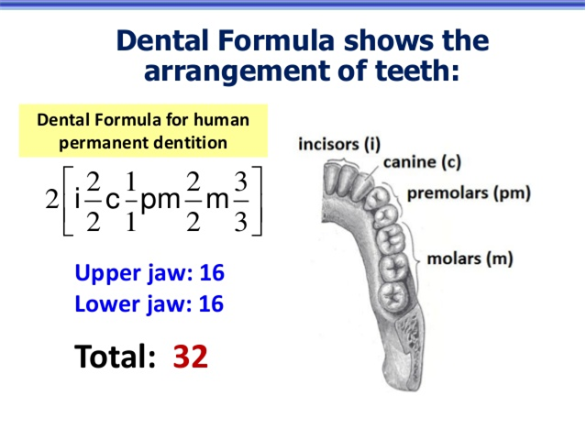

Slide 15
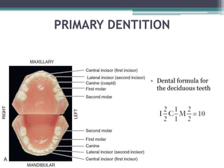

Slide 16
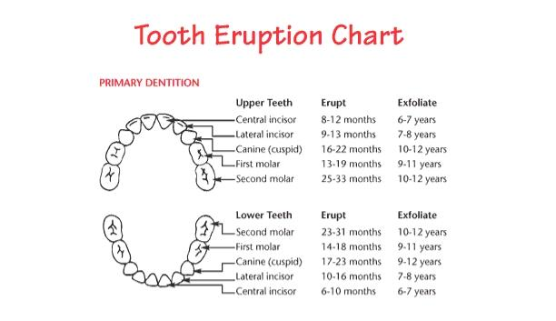
Erruption Patterns
Deciduous Dentition

Slide 17
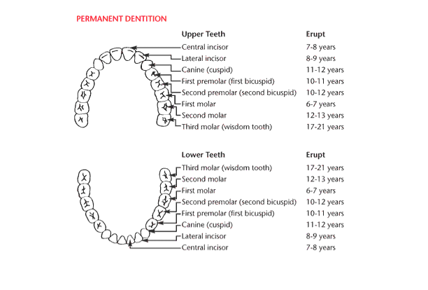

Slide 18
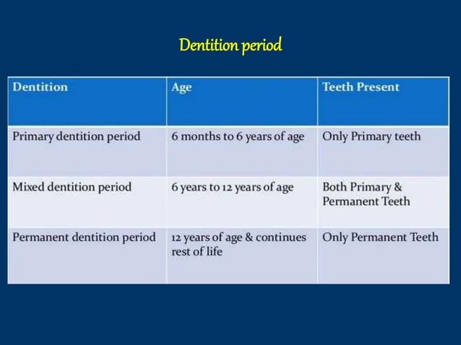

Slide 19
Tooth numbering system
Tooth numbering or "short hand" system of tooth notation.
Necessary in clinical practice for
-Recording data
Communication

Slide 20
The various tooth notation systems:
1. Zsigmondy palmer notation system
2. Universal notation system
3. FDI system

Slide 21
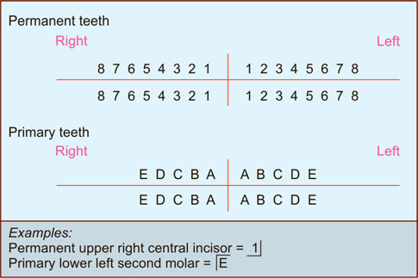
Zsigmondy palmer notation system

Slide 22
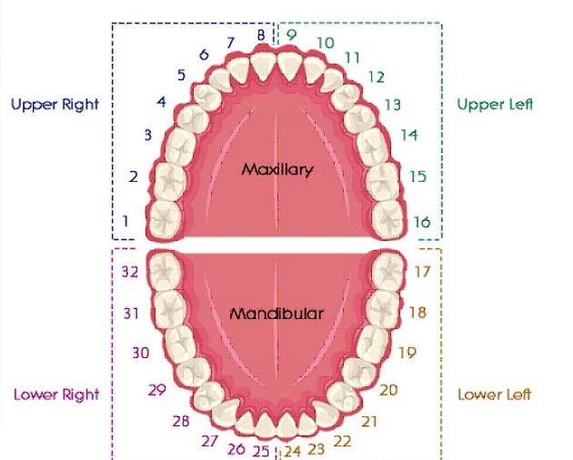
Universal Notation System

Slide 23
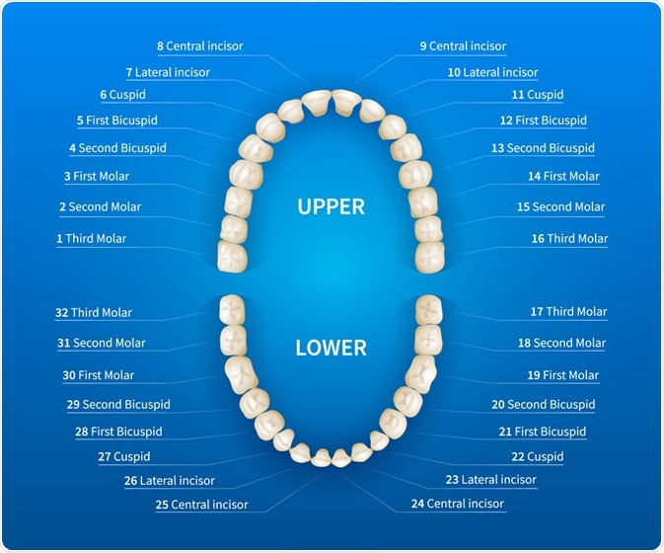

Slide 24
FDI system (federation dentaire internationale)
Two digit system
First digit indicates the quadrant and second digit indicates the tooth within the quadrant
1 to 4 and 5 to 8 as the first digit indicates permanent and primary dentition respectively
• 1 to 8 and 1 to 5 as the second digit indicates permanent teeth respectively.

Slide 25
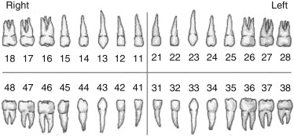

Slide 26
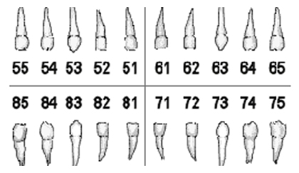
FDI notation for primary teeth

Slide 27
General and oral anatomy
Anatomical crown: portion of tooth which is covered by enamel
Clinical crown:
1.portion of tooth which is visible in mouth
2.Clinical crown may, or may not correspond to
anatomical crown, depending on level of soft tissue and
may also include a portion of anatomical root.

Slide 28
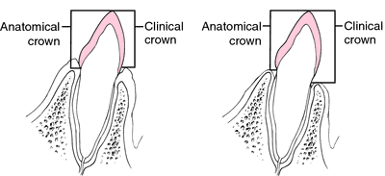

Slide 29
Anatomical root: portion of tooth which is covered with cementum
Clinical root:
1. portion of tooth which is not visible in mouth
2.Clinical root is an ever changing entity and may, or may not correspond to anatomical root

Slide 30
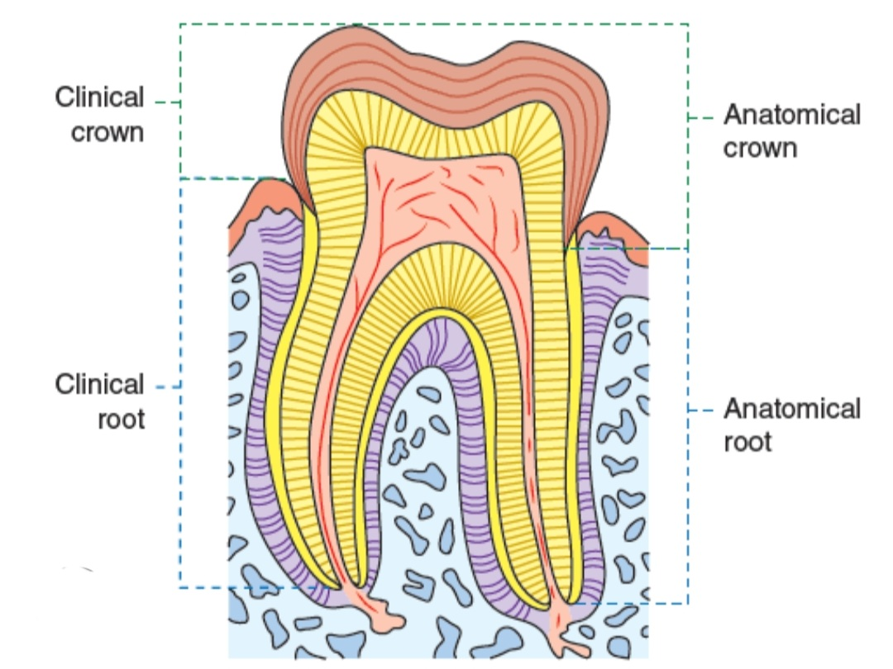

Slide 31
Enamel: hard, mineralized tissue which covers dentin of anatomical crown of a tooth and hardest living body tissue
Dentin: hard tissue which forms main body of tooth and surrounds pulp cavity and is covered by enamel in anatomical crown and by cementum in anatomical root.
Cementum: a layer of hard, bone like tissue which covers dentin of anatomical root of tooth

Slide 32
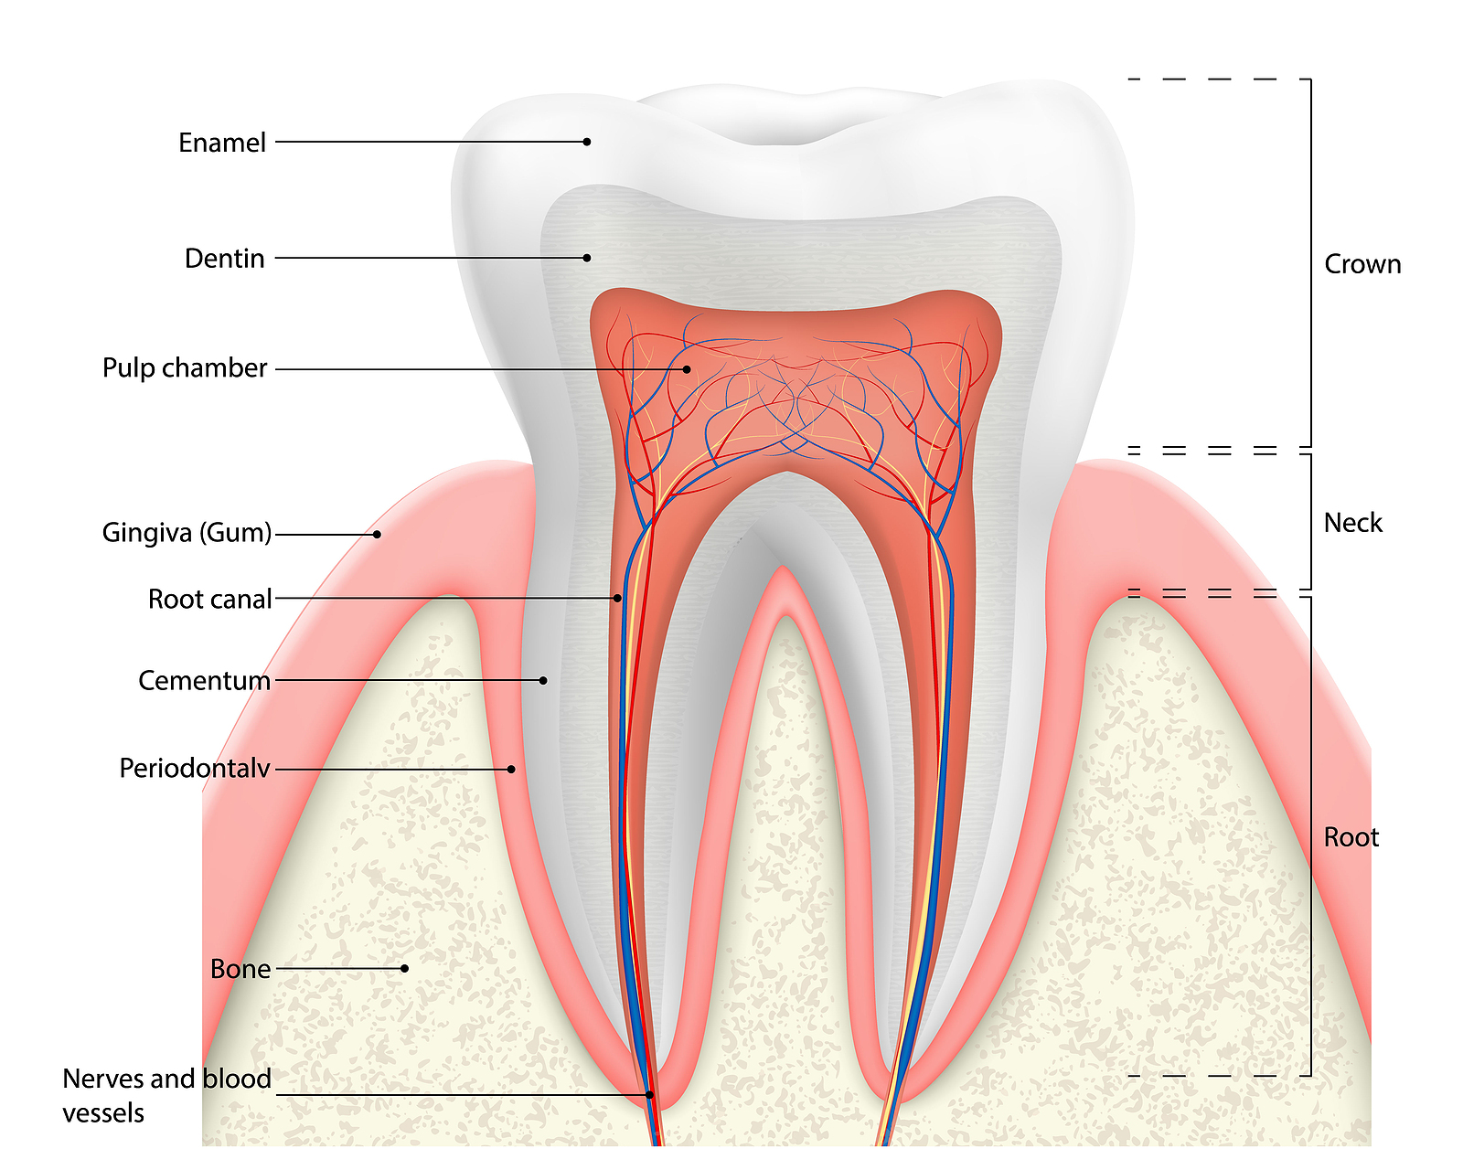

Slide 33
Dentino-enamel junction or DEJ: internal line meeting of dentin and enamel in anatomical crown of a tooth
Pulp: living soft tissue which occupies pulp cavity of a vital tooth and contains tooth's blood vessels and nerve supply.

Slide 34
Pulp cavity: entire internal cavity of tooth which contains the pulp and consists of the following entities
Pulp canal: portion of pulp cavity which is located in root of the tooth (also called as root canal)
Pulp chamber: enlarged portion of pulp cavity which is found mostly in anatomical crown
Pulp horn: usually pointed incisal or occlusal elongations of pulp chamber which often correspond to cusps, or lobes of teeth.

Slide 35
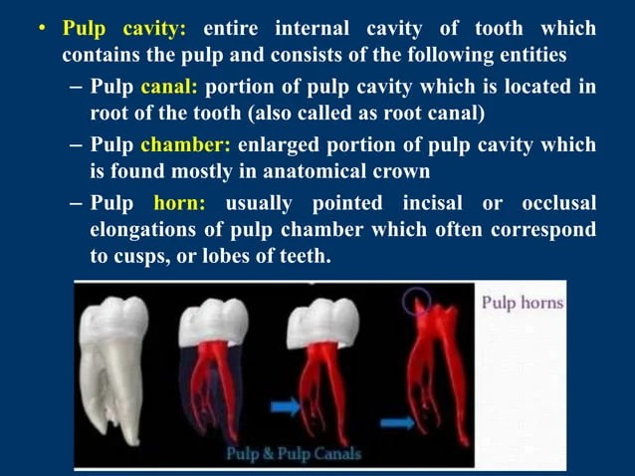

Slide 36
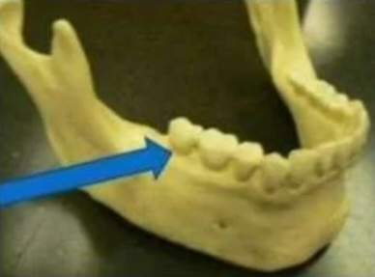
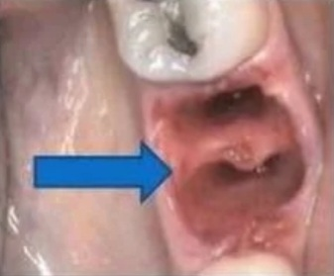
Alveolar process: entire bony entity which surrounds and supports all teeth in each jaw member
• Alveolus: bony socket, or portion of alveolar process, into which an individual tooth is set

Slide 37
Periodontal ligament: fibrous attachment of tooth cementum to the alveolar bone
Gingiva: "gum" or "gums”, or fibrous tissue enclosed by mucous membrane that covers alveolar process and surrounds neck of teeth

Slide 38
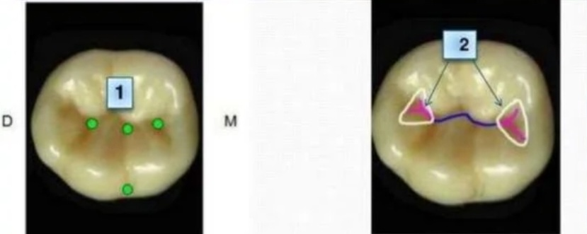
Depression on the tooth surface
1. Pit: A small pinpoint depression on the surface of enamel
2. Fossa: An irregular depression or concavity on surface of tooth

Slide 39
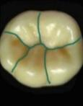
3. Sulcus: A long depression on the surface of a tooth
4. Groove: is a shallow linear depression on the surface of a tooth
A developmental groove is a shallow groove or line between the primary parts of the crown or root
A supplemental groove is less distinct and does not mark the junction of primary parts

Slide 40
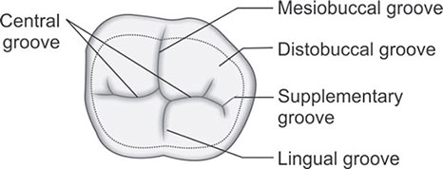

Slide 41
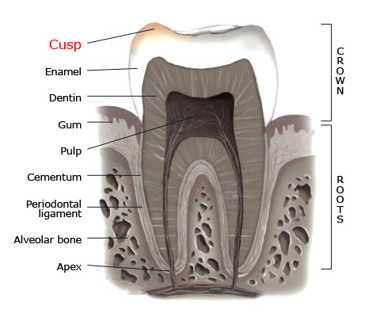
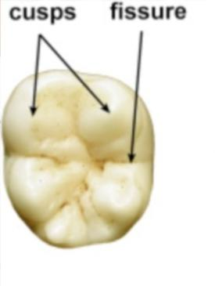
Elevations on tooth surface
1: Cusp: an elevation or mound on the crown of a tooth

Slide 42
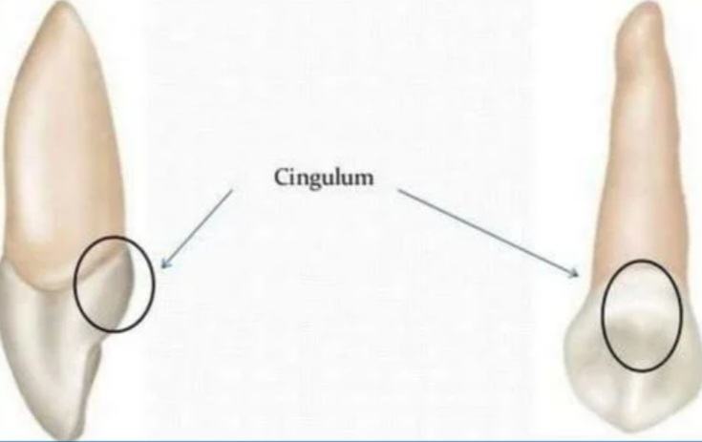
2: Cingulum: is the lingual lobe of an anterior tooth and makes up the bulk of the cervical third of the lingual surfaces
3. Lobe: is one of the primary section of forma in development of crown
Cusps and mamelons are representative of lobes

Slide 43
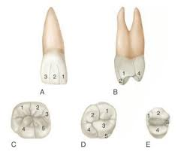
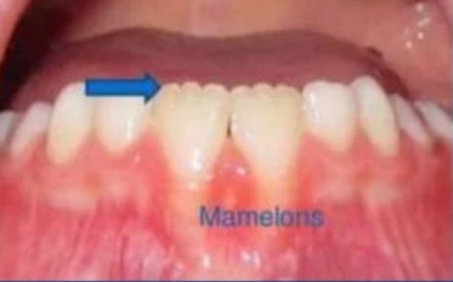
4. Mamelons: are three rounded protuberances found on incisal ridges of newly erupted incisor teeth

Slide 44
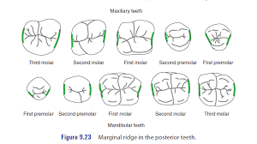
5. Ridge: A linear elevation on the surface tooth
- Marginal ridges: are rounded borders of enamel that form mesial and distal margins of occlusal surfaces of posterior teeth and mesial and distal margin of lingual surface of anterior teeth

Slide 45
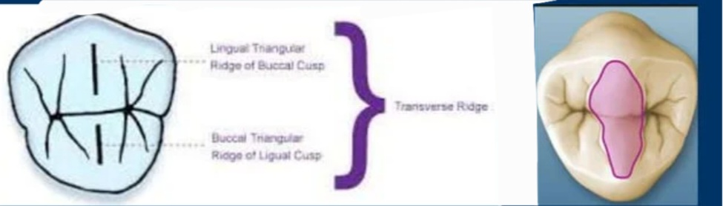
Triangular ridge: is a ridge that descends from the tips of the cusps of molars and premolars towards the center part of the occlusal surfac
Transverse ridge: is formed by the union of buccal and lingual ridges

Slide 46
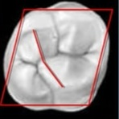
Oblique ridge: is a ridge obliquely crossing occlusal surface of maxillary molars

Slide 47
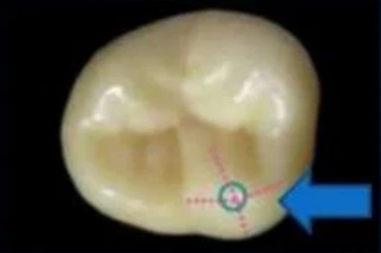
Cusp ridge:
Each cusp has four cusp ridges extending in different directions (mesial, distal, facial, lingual) from its tip
• Normally the cusp ridge which extends towards central portion of occlusal surface is also a triangular ridge
• Named by the direction they extend from the cusp tip

Slide 48
Surfaces of teeth
Crowns of all teeth have 5 surfaces
Facial surface: facial surface can be labial surface or buccal surface
Labial surface: the surface of incisors and canines that are towards lip
Buccal surface: the surfaces of premolars and molars that are towards the cheek

Slide 49
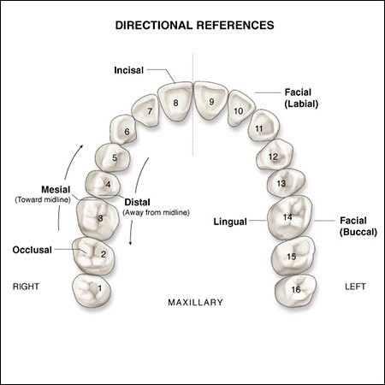

Slide 50
Lingual surface (palatal surface)
Surface facing towards tongue
Proximal surfaces-
Mesial: surfaces towards midline
Distal: surfaces away from midline.

Slide 51
Incisal or occlusal surface:
- Incisal surface: the surface of incisors canines that come in contact with those in the opposite jaws during the act of closure are called incisal surfaces- . Occlusial surface -the surface of premolars and molars that come in contact with those in opposite jaws during act of closure are called occlusal surfaces.

