Slide 1

GOOD MORNING !!!

Slide 2
Premolars

Slide 3
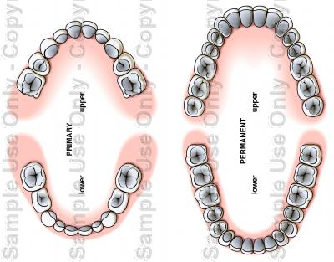
Premolars
There are four maxillary and four mandibular premolars:
Upper 1st premolar: upper 4
Lower 1stpremolar: Lower 4
Upper 2nd premolar: upper 5
Lower 2nd premolar: Lower 5

Slide 4
Similarities To Anterior Teeth
1) Developmental lobes
  Facial surface develops from
  three lobes
  Buccal ridge more prominent in
  maxillary arch
  One developmental lingual lobe
  (cingulum or cusp)
  Exception: Mandibular 2nd
  premolar (can have 2 lingual
  lobes)

Slide 5
Similarities To Anterior Teeth
2) Taper from the facial, crowns are narrower in the cervical third than occlusally

Slide 6
Similarities To Anterior Teeth
3) Cervical lines
  Proximal CEJ is concave
  Facial and lingual CEJ is convex apically

Slide 7
Similarities To Anterior Teeth
4) Root shape
  Lingual and facial
  surfaces are convex
  Lingual side of the root and crown are
  narrower than the facial side

Slide 8
Chronology
Maxillary first premolar
First evidence of calcification:1.5-1.75yr
Enamel completed:5-6yr
Eruption:10-11yr
Root completed:12-13yr
Maxillary second premolar
First evidence of calcification:
2-1.25yr
Enamel completed:6-7yr
Eruption:10-12yr
Root completed:12-14yr

Slide 9
Function Of Premolars
1st premolars function with canine
  1) In shearing or cutting food
  2) Support the corners of the
  mouth
2nd premolars function with molars
  1) To masticate
  2) To maintain vertical dimension

Slide 10
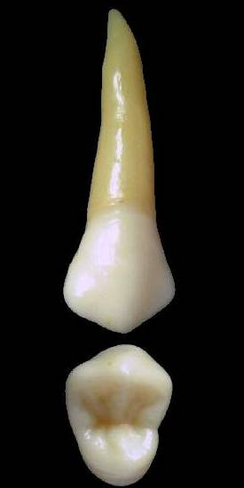
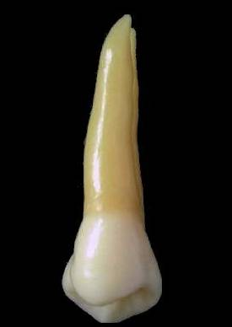
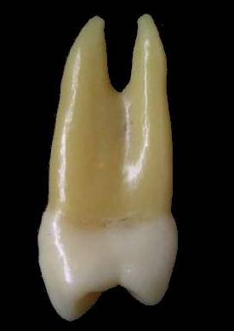
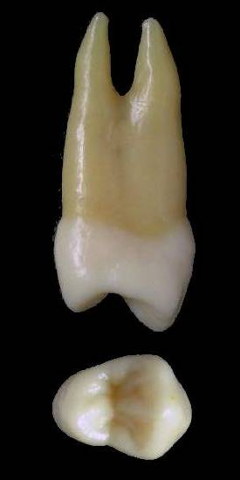

Maxillary first premolar
It has 5 surfaces:
Buccal
Lingual
Mesial
Distal
occlusal

Slide 11
Geometric outline of the crown
Buccal and lingual surfaces have trapezoid outline .The smallest uneven side cervically.

Slide 12
BUCCAL ASPECTS

Slide 13
Buccal Outlines
Mesial outline is nearly concave.
Distal outline is nearly straight.
Mesial cusp slope is nearly straight while the distal cusp slope is slightly convex.
Contact areas:
Mesially is at the middle third while Distally it is occlusally positioned which is an exception from other permanent posterior teeth.
Cervical line: is convex root wise.
D
M
B cusp pointed and long

Slide 14
Outline and surface anatomy of the root
The M and D outline of the root tapers to a pointed apex that is slightly curved distally.
.
If it has two roots, the lingual root is hidden behind the buccal root as it’s shorter and narrower than the buccal root.
The surface of the root is convex and smooth

Slide 15
Surface anatomy of the crown
Elevations:
The buccal surface is convex with the maximum convexity at the cervical 1/3 .
The middle lobe is prominent buccally forming the BUCCAL ridge.
Depressions:
Shallow depressions are present mesial and distal to the B ridge (M&D developmental grooves)

Slide 16
LINGUAL ASPECT

Slide 17
Lingual outline and surface anatomy of the crown
M and D outlines are convex.
The lingual cusp is shorter by 1 mm but sharper than the buccal cusp
The D slope of the lingual cusp is longer than the M slope
M
D
Cervical line: is convex root wise.
The lingual surface is convex with the maximum convexity at the middle 1/3

Slide 18
Outline and surface anatomy of the root
The M and D outlines of the root taper to a pointed apex that is curved distally.
If two roots, the lingual root appears shorter and narrower than the buccal root.
The surface of the root is convex and smooth

Slide 19
MESIAL ASPECT

Slide 20
Geometric outline of the mesial aspect
Trapezoid in shape
Smallest of the uneven sides
is occlusaly

Slide 21
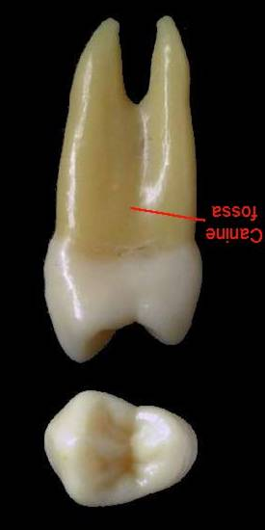
Buccal outline is convex with the maximum convexity at the
cervical 1/3.
Lingual outline is evenly convex.
Cervical line is regular in outline and curvature is less occlusaly ie 1mm.

Slide 22
B cusp is longer than L cusp by 1mm.
Wide occlusal table.
B cusp tip is below the center of B root.
L cusp tip is in one line with the lingual
outline of the L root

Slide 23
Contact area:
At the middle third and slightly buccal to the midline (BL dimension)
Mesial developmental groove is crossing MMR and located lingual to the contact area.
Mesial Developmental depression in the crown and continues with that between the roots (canine fossa).

Slide 24
In case of two roots (80%).
Root trunk is about half the root length.
Surface is smooth and convex except deep developmental depression below bifurcation.

Slide 25
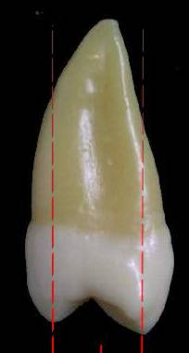
In case of one root.
The B and L outlines tapers to a blunt apex on the center of the crown.
The surface is smooth and convex except for a shallow depression in the center that is deeper mesially than distally.

Slide 26
DISTAL ASPECT

Slide 27
Curvature of cervical line is less as compare to mesial surface it is almost flat.
Developmental grooves are less evident.
Root trunk is flattened with no outstanding developmental signs.

Slide 28
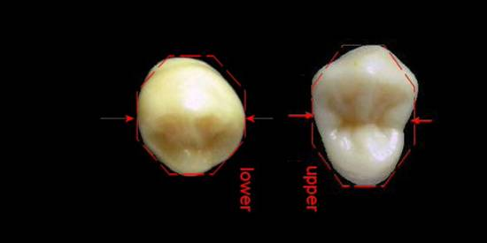
Geometric outline of the occlusal aspect
It is hexagonal in shape
2 equal buccal sides (MB, DB)
M side shorter than D side.
ML side shorter than DL side.
Thickness is greater than width
The crown is wider buccally than lingually.
D
M

Slide 29
Surface anatomy of occlusal aspect:
Elevations:
B triangular ridge.
L triangular ridge.
M & D marginal ridges
Depressions:
Central developmental groove
M and D triangular fossae.
M marginal developmental groove.

Slide 30
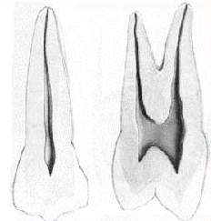
Pulp cavity
MD section
BL section
Root canals:
2 root canals (B&L)
L canal is larger &more accessible
Narrow
Wider
Pulp chamber:

Slide 31


Slide 32
MAXILLARY SECOND PREMOLARS

Slide 33
Maxillary 2nd Premolars
The maxillary 2nd premolar has two cusps (facial & lingual) of nearly equal size and height
Shorter mesial cuspal ridges
This tooth typically has one root with 2 pulp canals.
The facial ridge is not as prominent as that of the maxillary 1st premolar.
When compared to the maxillary 1st premolar, this tooth will usually present with more supplemental occlusal anatomy.

Slide 34
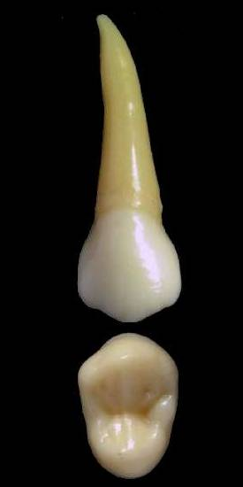
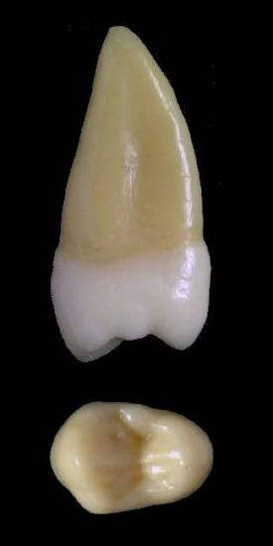
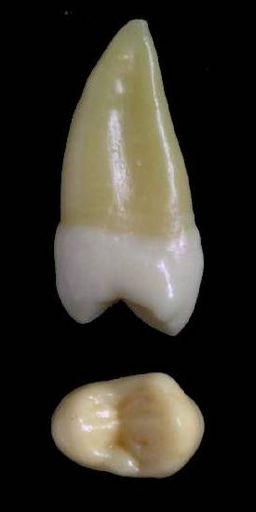
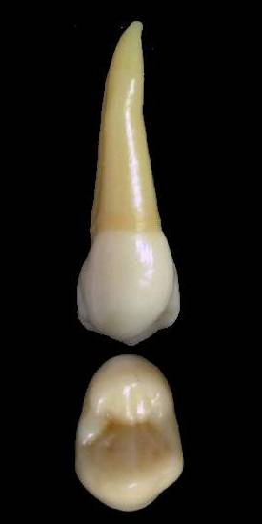
Maxillary second premolar
It has 5 surfaces:
Buccal
Mesial
Lingual
Distal
occlusal

Slide 35
Geometric outline of the crown
Buccal and lingual surfaces have trapezoid outline.
The smallest of the uneven sides is cervically.

Slide 36
Facial Outlines and surface anatomy of the crown
4
5
D
M
D
M
B cusp is long and pointed
B cusp is short and less pointed
M slope is longer than D
M slope is shorter than D
Mesial contact A is in the M1/3 while distally more occlusal.
Mesial contact A is in O1/3 while distally more cervically.
Cervical line curved root wise.
Cervical line less curved.

Slide 37
4
5
D
M
D
M
Prominent B ridge
Less prominent B ridge
Narrow cervical portion.
Wider cervical portion.
Short root.
Longer root.

Slide 38
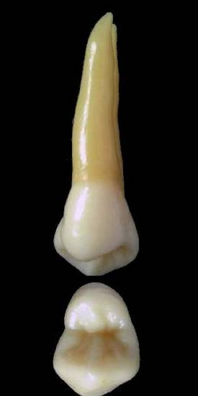
Lingual outline and surface anatomy of the crown
4
5
The L cusp is shorter by 1 mm than the B cusp.
The L and B cusps are nearly of same height.
80% has 2 roots with L root is shorter than B root and its apex is pointed.
Rare to has 2 roots
In case of two roots the L root is shorter and its apex is more blunt.

Slide 39
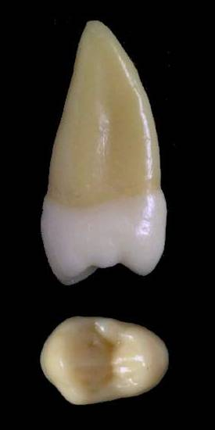
Mesial aspect
4
5
B cusp is longer than L cusp by 1mm
The cusps are nearly at the same level.
The occlusal table is narrow.
The occlusal table is wide.
The crown surface is smooth and convex while the root has shallow developmental depression.
Mesial DG and canine fossa.

Slide 40
4
5
MMR at the junction of M1/3 &O1/3
MMR positioned more occlusal.
Contact area:
At the occlusal third (OC dimension) and slightly buccal to the midline (BL dimension)
At the middle third (OC dimension) and slightly
buccal to the midline (BL dimension)

Slide 41
Distal aspect
4
5
DMR more occlusal than MMR
DMR more cervical than MMR
CA occlusally positioned and more buccally than MCA.
CA cervically positioned and more buccally than MCA.
Smooth and convex surface except for a small flat area cervical to contact area.
Smooth and convex surface.

Slide 42
4
5
Root trunk is long as the bifurcation is near apical 1/3
One root and if 2 the bifurcation will be more apically.
Surface is smooth and convex except shallower DD on the root trunk than mesially.
Surface is smooth and convex except deeper DD in the middle of the root than mesially.

Slide 43
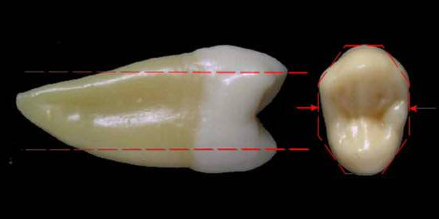
Occlusal aspect
4
5
D
M
D
M
It’s hexagonal
It’s oval
B & L triangular ridges.
B & L triangular ridges.
M & D marginal ridges
Thicker M & D MRs

Slide 44
4
5
Long Central DG
Shorter Central DG.
M developmental groove
Not present.
M and D triangular fossae.
M and D triangular fossae.

Slide 45
TRAIT CATEGORIES
Set traits
Arch traits
Class traits
Type traits

Slide 46
SET TRAITS
These traits distinguish teeth of Primary from Permanent Dentition.
-Premolars are only present in Permanent Dentition

Slide 47
ARCH TRAITS
These traits Distinguish Maxillary from mandibular teeth
  1st & 2nd premolars are much more a like while
  they are different in mandibular
  Wider BL than MD
  while in mandibular BL = MD

Slide 48
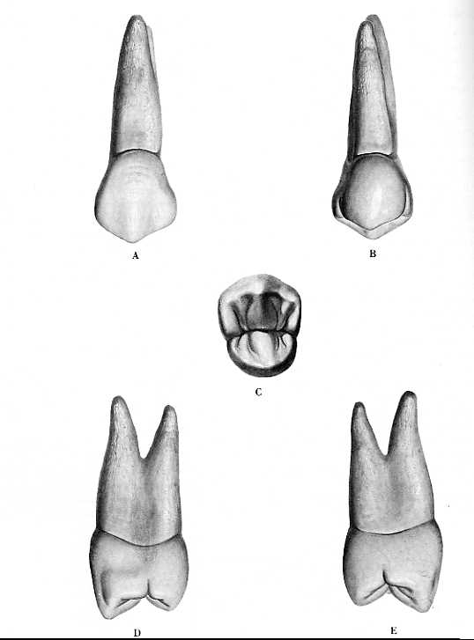
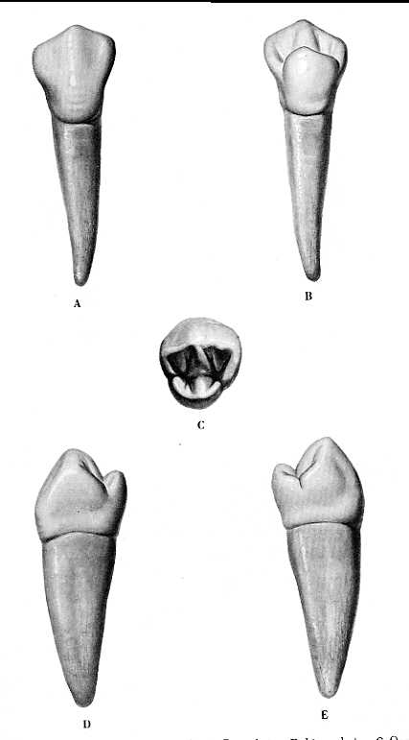
  Slight lingual inclination of the crown while mandibular have strongly lingually inclined crowns

Slide 49
CLASS TRAITS
Four classes: Incisors, Canines, Premolars and molars.
Incisors- Crown compressed Labio-lingually: efficient for cutting
Canines- Single pointed Cusp: For piercing food
Premolars- 2cusps: for shearing and grinding
Molars- 3-5 cusps: for grinding

Slide 50
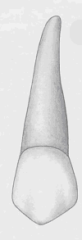
TYPE TRAITS
They differentiate teeth within a class: 1st and 2nd Premolar

Slide 51
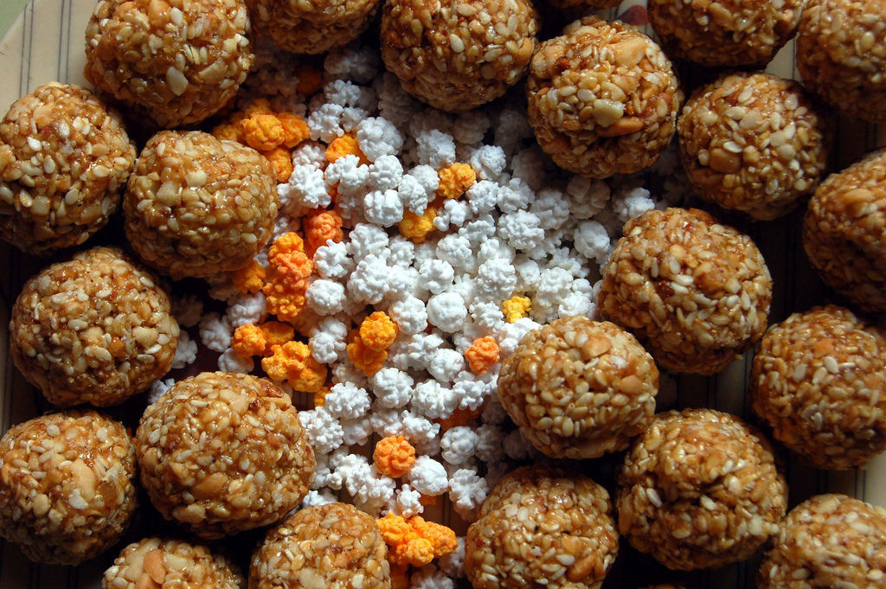
THANK YOU !!!!

