Slide 1
Maxillary Premolars
Dr. Syed Sadatullah
Ibnsina National College
Jeddah

Slide 2
Introduction
Premolars are so named because they are placed between the anterior teeth and the molars
Premolars assist the canines and the molars in tearing and chewing food
Maxillary premolars have two cusps and sometimes one or two roots
Maxillary 1st premolar erupts between 10-11 years and maxillary 2nd premolar erupts between 10-12 years of age

Slide 3
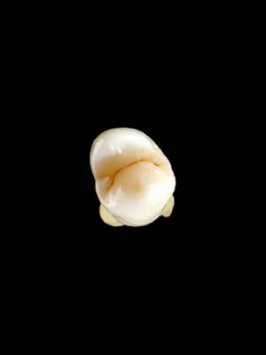
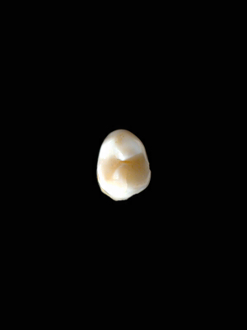
Maxillary 1st Premolar
Maxillary 2nd Premolar

Slide 4
Maxillary 1st Premolar
Buccal aspect
This tooth has two cusps, buccal and lingual cusps. The buccal cusp is long with a pointed tip resembling the cusp of a canine
The mesial slope of the buccal cusp is longer than the distal slope, which is the opposite of canine
The buccal surface is convex, showing strong a strong buccal ridge
The crown exhibits little cervical line curvature

Slide 5

Buccal aspect

Slide 6
Lingual aspect
The crown tapers towards the lingual aspect
The lingual cusp is shorter than the buccal cusp
The lingual cusp is smooth from the cervical portion to the area near the cusp tip
The cusp tip is pointed with mesial and distal slopes meeting at an angle of about 90 degrees
Small portion of the buccal cusp can be seen from this aspect

Slide 7

Lingual aspect

Slide 8
Mesial aspect
From the mesial and distal aspect both the buccal and lingual cusps are visible
A well developed mesial marginal ridge and a mesial marginal developmental groove is present
In the middle of the mesial surface is the mesial developmental depression which continues beyond the cervical line
The contact area is near the halfway point (JOM₃)

Slide 9

Mesial aspect

Slide 10

Distal aspect
There is no developmental depression or groove on this aspect, instead it is convex at almost all points
The curvature of the cervical is less on this aspect
The contact area is near the junction of occlusal and middle third
Distal aspect

Slide 11
Occlusal aspect
The occlusal aspect is roughly hexagonal in shape
The buccolingual dimension of the crown is much greater than the mesiodistal dimension
The occlusal surface is circumscribed by the cusp ridges and marginal ridges

Slide 12
Within the cusp ridges and marginal ridges the following are present
Central developmental groove
Mesiobuccal and distobuccal developmental groove
Mesial marginal developmental groove
Mesial and distal developmental pit
Mesial and distal triangular fossa
Buccal and lingual triangular ridge

Slide 13

Occlusal aspect

Slide 14
Root
Most Maxillary first premolars have 2 roots, but one and three roots can also be seen. Two roots; buccal and lingual
The buccal portion of the root resembles canine
The root when viewed from the proximal side shows a big trunk and bifurcation area from where the buccal and lingual root separate
A developmental depression is seen on the mesial aspect of the trunk.

Slide 15
Average Dimensions in millimeters
Crown Length
Root
Length
Mesiodistal
Diameter at
Contact Area
Mesiodistal
Diameter at
Cervical Line
Labiolingual
Diameter at
Crest of Curvature
Labiolingual
Diameter at
Cervical Line
Curvature of Cervical Line
M D
8.5
14.0
7.0
5.0
9.0
8.0
1.0 0

Slide 16
Maxillary 2nd Premolar
Buccal aspect
The maxillary second premolar resembles the maxillary first premolar in form and function
The buccal cusp is not as long as that of maxillary 1st premolar
It is less pointed.
The mesial slope of the buccal cusp ridge is shorter than the distal cusp ridge

Slide 17
Lingual aspect
The lingual cusp is more or less the same size as the buccal cusp
Mesial and Distal aspects
There is greater distance between the cusps
No developmental depression is present nor any developmental groove crossing the marginal ridge on the mesial aspect
On the distal aspect there is a developmental depression which is deeper than the depression on the mesial surface of maxillary 1st premolar

Slide 18
Occlusal aspect
The occlusal aspect is more rounded
The central developmental groove is shorter
There are multiple supplementary grooves radiating from the central groove
Root
Maxillary 2nd premolar has one root, which is usually as long or a millimeter longer than the root of maxillary 1st premolar

Slide 19



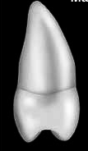

Buccal aspect
Lingual aspect
Occlusal aspect
Mesial aspect
Distal aspect

