Slide 1
Anatomy of Maxillary Premolars
PRASAD KARANDE

Slide 2
Learning Objectives
General features of premolars
Class traits of premolars
Anatomy of maxillary premolars

Slide 3
General features of Premolars

Slide 4
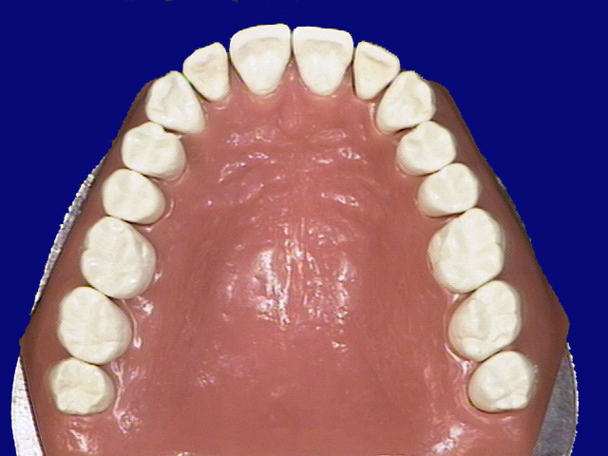
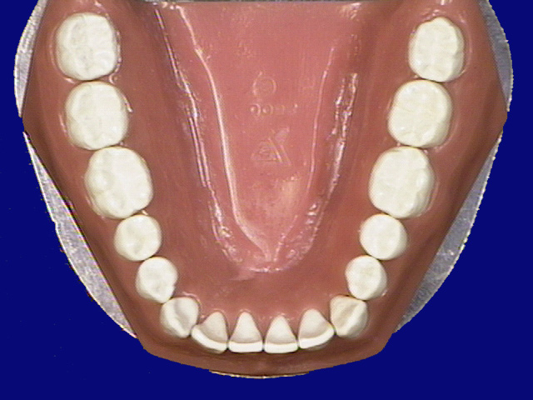
General Description
Of Premolars
  There are eight premolars in the human dentition
  Numbers 4,5,12,13,20,
  21,28,29
5
12
4
13
29
20
28
21

Slide 5
Function Of Premolars
1st premolars function with canine
  1) In shearing or cutting food
  2) Support the corners of the
  mouth
2nd premolars function with molars
  1) To masticate
  2) To maintain vertical dimension

Slide 6
Similarities To Anterior Teeth
1) Developmental lobes
  Facial surface develops from
  three lobes
  Buccal ridge more prominent in
  maxillary arch
  One developmental lingual lobe
  (cingulum or cusp)
  Exception: Mandibular 2nd
  premolar (can have 2 lingual
  lobes)

Slide 7
Similarities To Anterior Teeth
2) Taper from the facial, crowns are narrower in the cervical third than occlusally

Slide 8
Similarities To Anterior Teeth
3) Cervical lines
  Proximal CEJ is concave
  Facial and lingual CEJ is convex apically

Slide 9
Similarities To Anterior Teeth
4) Root shape
  Lingual and facial
  surfaces are convex
  Lingual side of the root and crown are
  narrower than the facial side

Slide 10
Differences To Anterior Teeth
1) Terminology
  Facial surface now correctly called the buccal
  surface (not labial)
  Possess occlusal surfaces not incisal edges

Slide 11
Differences To Anterior Teeth
2) Occlusal surface versus incisal edges
  No incisal edge or cingulum
  Possess one facial cusp and one or two lingual cusps

Slide 12
Differences To Anterior Teeth
3) Marginal ridges
  Oriented in a horizontal plane (not vertical
  like anterior teeth)

Slide 13
Differences To Anterior Teeth
4) Crown length
  Maxillary premolars are shorter than maxillary
  anterior teeth
  Premolar root are about the same length as
  maxillary central incisor

Slide 14
Differences To Anterior Teeth
5) Crest of curvature (height of contour)
  From a mesial and distal aspect,
  crest of curvature on buccal and
  lingual are more occlusal than
  anterior teeth
  Exception: Mandibular first
  premolar - located as far
  cervically as anterior teeth

Slide 15
Differences To Anterior Teeth
6) Contact areas
  Proximal contact areas are
  more cervically located
  than anterior teeth

Slide 16
Class Traits of Premolars

Slide 17
Buccal Class Traits Of Premolars
1) Crown shape (outline)
  Crown is broadest at level of
  contact areas and
  narrow at the cervix
  Has pentagonal shape
  Mesial and distal sides straight from contact to cervix

Slide 18
Buccal Class Traits Of Premolars
2) Cusp slope size
  Buccal cusp tip often slightly
  mesial to long axis (like canine)
  Mesial cusp slope shorter than the distal
  Exception: Maxillary first premolar - cusp tip
  slightly to the distal

Slide 19
Buccal Class Traits Of Premolars
3) Convex contact areas
  Both mesial and distal are
  convex around the contact areas
  Distal contact normally slightly
  more cervical than the mesial
  Exception: Mandibular first
  premolars - mesial contact slightly
  more cervical

Slide 20
Buccal Class Traits Of Premolars
4) Crown morphology
  Buccal surface is convex
  Buccal ridge runs occluso-cervically in the
  middle of the crown

Slide 21
Buccal Class Traits Of Premolars
5) Root
  Buccal surface is convex with an apical
  taper
  The apical third may possess a distal bend

Slide 22
Lingual Class Traits Of Premolars
1) Crown shape (outline)
  Crown is narrower on the lingual
  than the buccal
  Exception: Mandibular 2nd premolars with three cusps
  Lingual surface is convex

Slide 23
Lingual Class Traits Of Premolars
2) Root
  Lingual surface is convex and narrower
  mesiodistally than the facial aspect

Slide 24
Proximal Class Traits Of Premolars
1) Triangular ridges
  Buccal and lingual triangualr ridges meet in
  the central groove forming the transverse
  ridge
  Exception: Mandibular 2nd premolar (three
  cusp form)

Slide 25
Proximal Class Traits Of Premolars
2) Crest of curvature (height of contour)
  On buccal at or near junction of middle and
  Cervical thirds
  On lingual at middle third
  Exception: Mandibular first premolars
  buccal height of contour at cervical third (lingual same as other premolars)

Slide 26
Proximal Class Traits Of Premolars
3) Marginal ridges
  Mesial marginal ridge more occlusal than the distal
  Exception: Mandibular first premolars

Slide 27
Occlusal Class Traits Of Premolars
1) Tooth proportions
  Considerably wider faciolingually than
  mesiodistally

Slide 28
Occlusal Class Traits Of Premolars
2) Occlusal table
  Both buccal and lingual cusps have mesial and
  distal cusp ridges or slopes which travel
  cervically to join the marginal ridges
  These structures form the occlusal table (or outline)

Slide 29
Occlusal Class Traits Of Premolars
3) Triangular ridges
  Extend from the cusp to to the central groove
  (together form a transverse ridge)
  Exception: Three-cusped mandibular 2nd premolar

Slide 30
Occlusal Class Traits Of Premolars
4) Grooves and fossae
  Central developmental groove runs mesiodistally
  Exceptions: Mandibluar 1st premolar and
  three-cusped 2nd premolar
  Fossae possess supplemental grooves to the
  buccal and lingual

Slide 31
Occlusal Class Traits Of Premolars
5) Proximal contacts
  From this view are either on or slighlty buccal to the mid-root axis

Slide 32
Maxillary Premolars

Slide 33
Buccal Aspect - Relative Size And Shape Of The Crown
Maxillary first premolars are
the widest of the eight
The crown is longer than
the second premolar crown
Consequently the second
premolar crowns appear squat
Notes:
On picture, should be tooth #12, not 5.

Slide 34
Buccal Aspect - Relative Size And Shape Of The Crown
The mesial and distal sides converge more noticeably on maxillary first premolars
Cusp ridges are more broad and angular on maxillary first premolars

Slide 35
Buccal Aspect - Contacts
Mesial contact is in the middle third, near the junction of the middle and occlusal thirds
Distal contact is slightly more cervical (still in
middle third)

Slide 36
Buccal Aspect - Buccal Cusp
Tip Location
Exception: Maxillary first
premolar has a cusp tip slightly
to the distal of the mid-tooth line
This creates a mesial cusp ridge
longer than the distal cusp ridge
The opposite is true for maxillary
second premolars

Slide 37
Buccal Aspect - Buccal Cusp Shape
Buccal cusp is relatively long and sharp
on the maxillary first premolar
Mesial and distal slopes meet at nearly
right angles (100-110º)
Cusp tip on second premolar not
as pointed with ridges that are
more obtuse (125-130º)

Slide 38
Buccal Aspect - Contour Of
The Crown
Prominent buccal ridge on the
maxillary first premolar
Can find a mesial depression
next to buccal ridge
Rarely find a distal depression
Buccal ridge less prominent on
maxillary second premolars

Slide 39
Buccal Aspect - Root
Maxillary first premolar
usually has two divided
roots branching from
a common trunk
Can occasionally see the lingual root tip from
buccal on first premolars

Slide 40
Buccal Aspect - Root Length
The second premolar root
is longer on average
than the first
premolar root
The crown to root ratio is highest for any
maxillary tooth

Slide 41
Buccal Aspect - Distal Bend In Root
The apical portion of the
root of both premolars
frequently bends to the
distal
Can bend mesially or be
straight (not as common)

Slide 42
Lingual Aspect - Crown Shape
Narrower on the
lingual side than
the buccal side

Slide 43
Lingual Aspect - Relative Cusp Size
The lingual cusp is
shorter than the
buccal cusp
(noticeably on first)

Slide 44
Lingual Aspect - Cusp Ridges (Slopes)
Mesial and distal cusp
ridges meet at a rounded
cusp tip (sharper than
molars)

Slide 45
Lingual Aspect - Lingual Cusp Position
The cusp tip always bends
towards the mesial on unworn
lingual cusps
This makes it easy to tell
right from left

Slide 46
Lingual Aspect - Root
Lingual root of two-rooted
first premolars are shorter
than the buccal
Both first and second
premolar roots taper
lingually

Slide 47
Proximal Aspect - Crown Morphology
Maxillary first premolars have a prominent concavity cervical to the contact area

Slide 48
Proximal Aspect - Relative Cusp Height
From this view buccal cusp tip is noticeably longer
than the lingual cusp tip on maxillary first premolars
Nearly equal length on second premolars

Slide 49
Proximal Aspect - Marginal Ridge
Distal marginal ridge is more cervical than mesial marginal ridge
Can see more of the occlusal surface from the
distal

Slide 50
Proximal Aspect - Marginal Ridge Groove
Mesial marginal ridge of maxillary first premolar crossed by groove
Less frequently see distal marginal ridge groove
See mesial and distal groove on second premolars
much less frequently

Slide 51
Proximal Aspect - Cervical Line
Mesial aspect curve more occlusally than distal
Lingual CEJ more occlusal than buccal

Slide 52
Proximal Aspect - Height Of Contour
Lingual located in the middle third of the crown
Buccal located more cervical at the junction of the middle and cervical thirds

Slide 53
Proximal Aspect - Root
Frequently see two roots on first premolar
The bifurcation is in the apical third to half of the root

Slide 54
Proximal Aspect - Root Depressions
Maxillary first premolar has prominent root depressions
On second premolars there is a mesial and distal root depression, usually more prominent on the distal

Slide 55
Occlusal Aspect - Relative Size
Generally the first premolar is smaller than the second from this aspect

Slide 56
Occlusal Aspect - Grooves And Fossae
Possess a central developmental groove

Slide 57
Occlusal Aspect - Grooves And Fossae
Mesial and distal pits are closer to the marginal ridges on first premolars
Fewer supplemental grooves on first premolars

Slide 58
Occlusal Aspect - Grooves And Fossae
First premolars possess a mesial marginal ridge groove

Slide 59
Occlusal Aspect - Taper To The Lingual
On first premolars have narrower lingual surface than buccal
On second premolars only slight lingual taper
Crown greater buccolingually than mesiodistally

Slide 60
Occlusal Aspect - Occusal Outline
The second is typically more symmetrical and less angular

