Slide 1

+
GOOD MORNING

Slide 2
TEMPEROMANDIBULAR JOINT

Slide 3
Contents
  Introduction to joint
  Classification of joints
  Introduction to TMJ
  Development
  Anatomy
  Biomechanics of the TMJ
  Temperomandibular disorders
  Conclusion
  References

Slide 4
INTRODUCTION TO JOINT
Joint is a junction between two or more bones or cartilages.
It permits movements, however immovable joints are meant primarily for growth, and may permit moulding during childbirth.
Joints are more in child than adult because as the growth proceeds some of the bones fuse together e.g.-ilium ischium and pubis to form pelvic bone…

Slide 5
CLASSIFICATION OF JOINTS
Based on structural characteristics
    fibrous joint
        Sutures
        Syndesmosis
        Gomphosis
    Cartilagenous joint
        Synchondrosis
        symphysis

Slide 6
    Synovial joint
        Ball & socket
        Saddle
        Condylar
        Ellipsoid
        Hinge
        Pivot
        plane

Slide 7
Based on functional characterstics
    Synarthrosis: immovable , like fibrous joint
    Amphiarthroses: slightly movable, Cartilagenous joints
    Diarthrosis: freely movable, synovial joints
Based on regional characteristics
    Skull type : immovable
    Vertebral type : slightly movable
    Limb type : freely movable

Slide 8
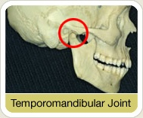
INTRODUCTION TO TMJ
Synovial
Diarthroidal
Ginglymoid
Compound joint
Also called as
‘Craniomandibular Articulation ‘

Slide 9
The mammalian craniomandibular articulation is a comparatively modern evolutionary feature; being as recent as 70×10 ⁶ years old.
Prior to this, vertebrates had various types of jaw articulations , simplest with Meckel’s cartilage articulating indirectly with the otic capsule, which are now in the middle ear.

Slide 10
DEVELOPMENT
TMJ begins to develop by 10th week of gestation period from two separate blastemas (mesenchymal condensation)-
i) for the Temporal bone component.
ii) for the Condyle.
The Temporal & Condylar mesenchymal cells differentiate into Osteoblasts, which lay down the membrane Bone.
Soft x-ray analysis of TMJ region from 12 to 32 weeks of gestation period reveals high degree of calcification in condylar head.

Slide 11
Superior to condylar blastema, a band of mesenchymal cells develops that differentiate into the Disc.
In the center of the condyle a Cartilage develops the Secondary Cartilage which remains in the condyle upto 27 year of age.
Secondary cartilage contributes to Subendochondral bone growth, which causes enlargement of the condyle in adulthood as a part of adaptive changes in response to overloading.

Slide 12
The developing disc continues anteriorly with the developing Lateral Pterygoid muscle & posteriorly by a ligament with the superior end of the Meckel’s cartilage.

Slide 13
ANATOMY
Technically, it is compound joint which by definition requires the presence of at least 3 bones.
Although composed of only two bones the mandible and the temporal, this requirement can be satisfied by considering the articular disc as a non-ossified 3rd bone.

Slide 14
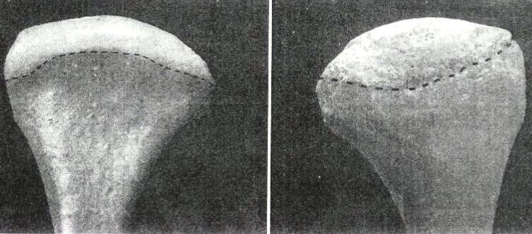
Condyle
The portion of the mandible that articulates with the cranium around which movements occurs.
Anterior view: It has medial and lateral projection called poles.
Medial pole is generally more prominent then the lateral.

Slide 15
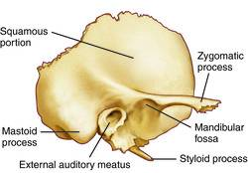
Temporal bone
The squamous portion of the temporal bone is made-up of the concave mandibular fossa also called articular / glenoid fossa.
Immediately anterior to the fossa is a convex bony prominence called articular eminence.

Slide 16
The steepness or degree of convexity of articular eminence dictates the pathway of the condyle when the mandible is positioned anteriorly.
The posterior roof of the mandibular fossa is quite thin (therefore doesn’t sustain heavy forces).
The articular eminence consist of thick dense bone and can more likely tolerate such forces.

Slide 17
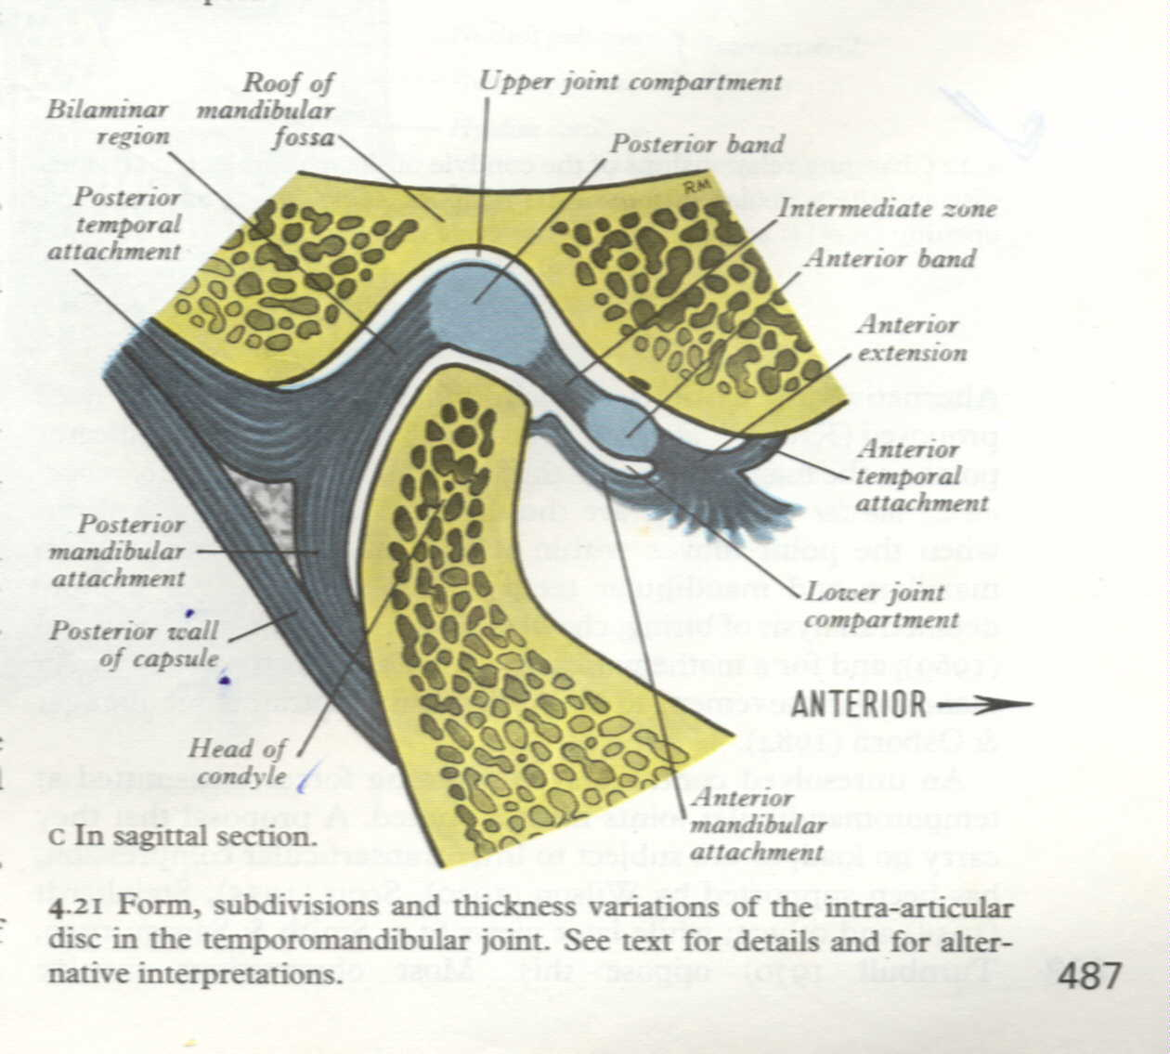
Articular disc
Composed of dense fibrous connective tissue devoid of any blood vessels, nerve fibers.
Divided into three regions according to thickness. The central area is thinnest (intermediate zone), Posterior border is generally slightly thicker than anterior border.

Slide 18
In the normal joint the articular surface of the condyle located in intermediate zone.
From anterior view disc is generally thicker medially than laterally.
During movement, the disc is flexible and can adapt to the functional demands of the articular surfaces.
The disc maintains its morphology unless destructive forces are transferred.

Slide 19
If these changes occur the morphology of the disc can be irreversibly altered and a pathologic condition ensues.
The contour of the disc with the thick bands helps in preventing displacement of the disc from the condyle during translation.
Function : divides the joint cavity into two distinct cavities each with a different function; the articular disc creates a double joint one above the other.

Slide 20
Lower joint
Upper joint

Slide 21
During functional movement of the mandible, stability within the TMJ is achieved by maintaining the thin intermediate zone of the disc between the condyle and the eminence.
The disc also serves as a shock absorber to counter act the many forces acting on the joint during both functional and parafunctional activity (i.e. when the teeth are clenched).

Slide 22
Synovial membrane
Surrounding the TMJ, there is a thin fibrous connective tissue capsule that defines the anatomic and functional boundaries of the TMJ.
The capsule is attached superiorly to the temporal bone and inferiorly to the neck of the condyle.
A synovial membrane that secretes synovial fluid into the joint cavities lines the inner surface of the capsule.

Slide 23
It does not cover the articular surfaces of the joint or the disc except for its posterior bilaminar region
On its lateral wall, the capsule is reinforced by the temporomandibular ligament

Slide 24
Functions of synovial fluid
Lubrication
metabolic requirements
Lubrication
metabolic requirements

Slide 25
TMJ ligaments
Made up of collagenous connective tissue.
Act as passive restraining devices to limit and restrict joint movements.
These are….
Functional ligaments
  Collateral (discal) ligament
  Temporomandibular ligament

Slide 26
  Capsular ligament
Accessory ligaments
  Sphenomandibular ligaments
  Stylomandibular ligaments

Slide 27
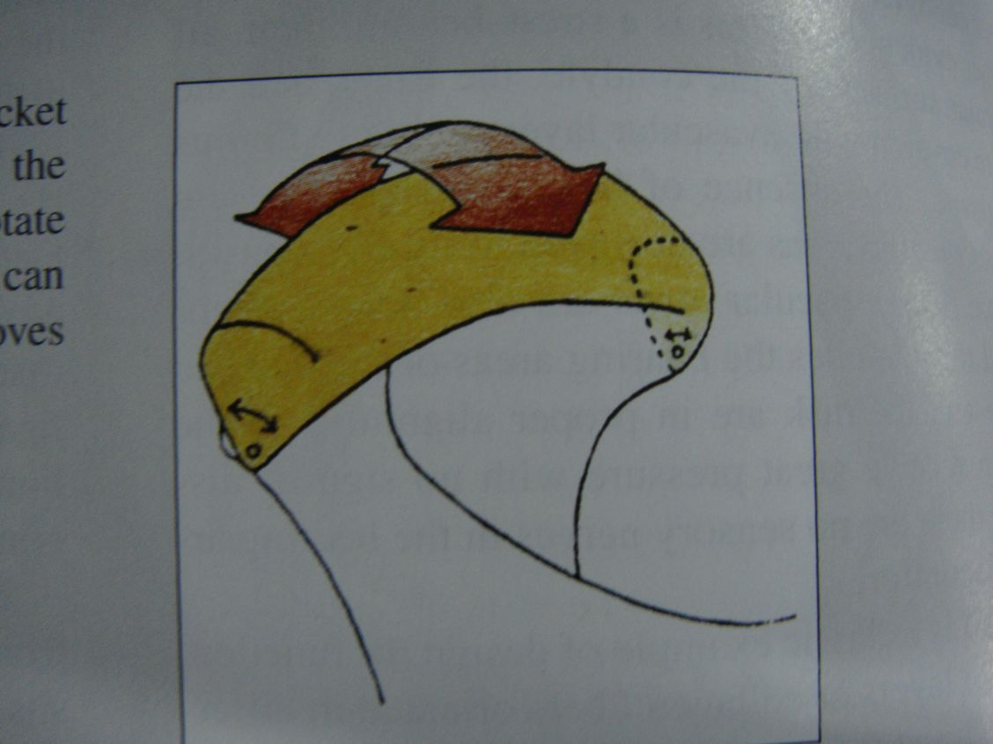
Collateral (discal) ligament
Attach the medial and lateral borders of the articular disc to the poles of the condyle, divides the joint mediolaterally into the superior and inferior compartments.

Slide 28
Functions
Restrict the movement in the lower joint to hinge or rotary action when viewed in a sagittal plane.
Discal ligaments cause the disc to move passively with the condyle in an anterior and posterior direction during condylar translation.
They have a vascular supply and are innervated which provides information regarding joint position and movements.

Slide 29
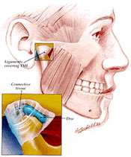
Capsular ligaments
Surrounds the entire TMJ.
Fibers attached superiorly to the temporal bone along the borders of the articular surfaces i.e. mandibular fossa, articular eminence and inferiorly attaches to the neck of the condyle.

Slide 30
Function
Resist any medial, lateral or inferior forces that tend to
separate or dislocate the articular surfaces.
Retain the synovial fluid by encompassing the entire joint.
Well innervated and provides proprioceptive feed back
regarding joint position and movements.

Slide 31
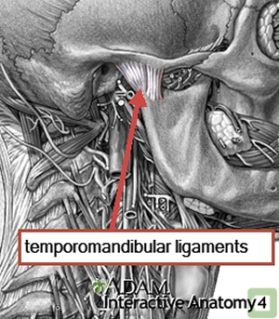
Temporomandibular ligament
Composed of 2 parts, an outer oblique portion and an inner horizontal portions
The outer portion extends from the outer surface of the articular tubercle and zygomatic process posteroinferiorly to the outer surface of the condylar neck.

Slide 32
The inner horizontal portion extends from the outer surface of the articular tubercle and zygomatic process posteriorly and horizontally to the lateral pole of the condyle and posterior part of the articular disc.
Functions
Outer oblique portion – resists excessive dropping of the condyle and therefore acts to limit the extent of mouth opening.
It limits rotational opening movement of the mandible.

Slide 33
The inner portion limits posterior movement of the condyle and disc.
Also protects the lateral pterygoid muscle from over lengthening or extrusion.

Slide 34
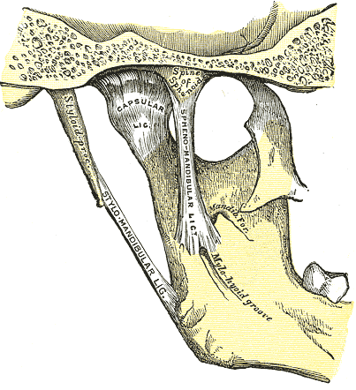
They become tight when the mandible is protruded and thus limits the excessive protrusive movements of the mandible.
Accessory ligament

Slide 35
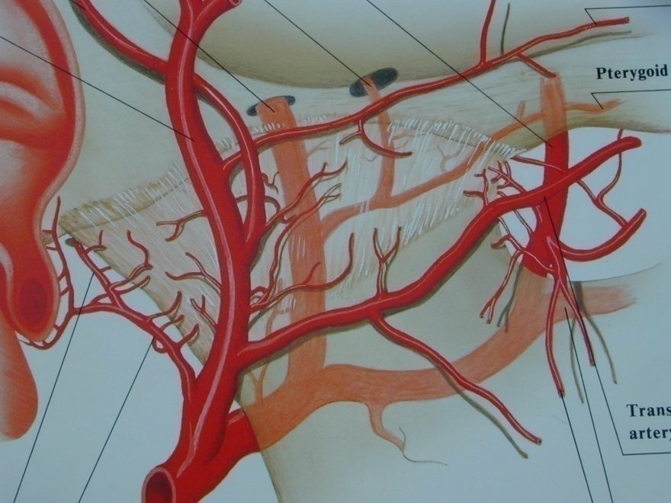
Vascular supply
Superficial temporal artery from the posterior.
Middle meningeal artery from the anterior.
Internal maxillary artery from the inferior.
Other arteries are deep auricular, Anterior tympanic, Ascending pharyngeal.

Slide 36
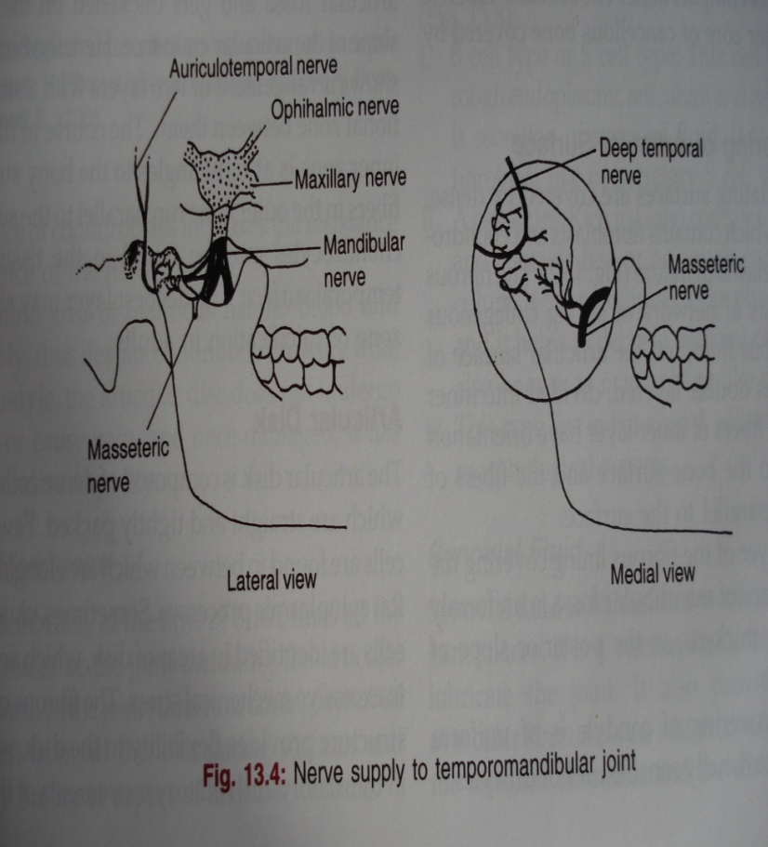
Nerve supply
Most of the innervation is by the auriculotemporal nerve as it leaves the mandibular nerve behind the joint and ascends laterally and superior to wrap around the posterior region of the joint.
deep temporal and masseteric nerve

Slide 37
Lymphatic Drainage
Anterior surface drains into PAROTID lymph nodes.
Posterior and medial surface drain into SUBMANDIBULAR lymph nodes.
Lateral surface drains into PREAURICULAR and PAROTID lymph nodes.

Slide 38
Biomechanics of the TMJ
Within the TMJ 2 types of movements can be isolated
Rotational or hinge movement between the disc and condyle in the lower compartment.
Sliding movement or translation in the upper compartment between the superior surface of the disc and the articular eminence.

Slide 39
What are TMDs?
TMD is a collective term describing problems that affect masticatory muscles and TMJ and associating structures or both...term was coined by Bell.
Conditions producing abnormal, incomplete or impaired function of the TMJ.(GPT-8)
Other terms
costen syndrome, temporomandibular joint dysfunction, functional temporomandibular joint disturbance, occlusomandibular disturbance

Slide 40
CLASSIFICATION
Temporomandibular joint disorders
    Deviation in form
        Articular surface defects
        Disc thinning and perforations
    Disc displacement with or without reduction
    Displacement of disc condyle complex
        subluxation
        Dislocation
    Inflammatory conditions
        Capsulitis and synovitis
        Retrodiscitis

Slide 41
    Degenerative diseases
        Osteoarthritis
        Polyarthritis
        Ankylosis – fibrous and bony
Masticatory muscle disorders
      Acute
          Myositis
          Reflex muscle splinting
          Muscle spasm
      Chronic
          Myofascial pain
          Muscle contracture
          Hypertrophy
          Myalgia secondary, to systemic disease

Slide 42
Congenital and developmental disorders
          Condylar hyperplasia/ hypoplasia
          Aplasia
          Condylolysis
          Neoplasms
          Fracture

Slide 43

Thank you

