Slide 1
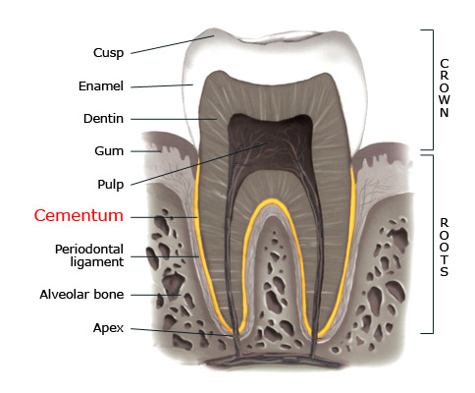
CEMENTUM & BONE
Presented by: Mrinal S.
Part 1 PG

Slide 2
Contents:
Cementum – properties & composition
Cementogenesis
Types of cementum
CDJ & CEJ
Functions
Clinical considerations

Slide 3
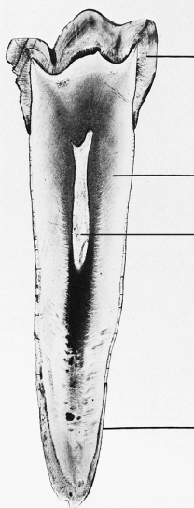
Cementum:
Cementum is the mineralized dental tissue covering the anatomic roots of human teeth.
1st demonstrated microscopically in 1835 by two pupils of Purkinje.
Begins at cervical portion of tooth at CEJ and continues to the apex.
Specialized connective tissue.
Avascular & Non innervated
cementum

Slide 4
Physical properties
Hardness of fully mineralized cementum is less than that of dentin.
Light yellow in color. Can be distinguished from enamel by its lack of luster and darker hue.
Lighter in color than dentin.
Thinnest at CEJ ( 20-50µm) and thickest towards apex(150-200 µm)

Slide 5
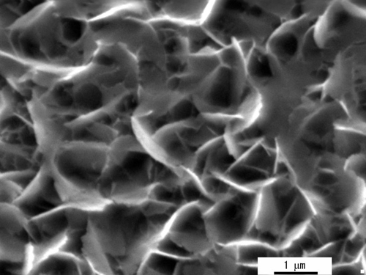
Chemical composition:
45-50 % inorganic substances
50-55 % organic material & water
Inorganic content:
Calcium & phosphate in form of hydroxyapatite
Crystals are 55 nm wide and 8nm thick similar to bone.
Trace elements Mg, S, Cu, Zn.
Cementum has highest fluoride content amongst dental tissues.
Highest fluoride than any other calcified tissue

Slide 6
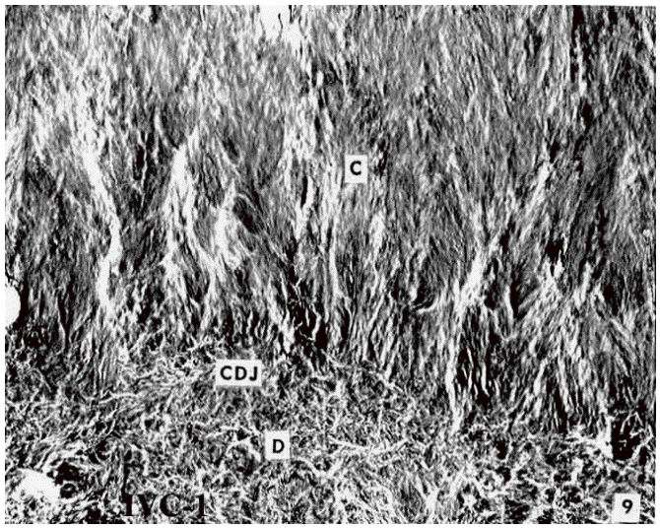
Organic contents
Type I collagen mainly
Other collagens – type III, V, VI, XII
Proteoglycans – Chondroitin sulfate, Heparan sulfate, Hyaluronate

Slide 7
MOLECULE | ROLE IN CEMENTOGENESIS
1. GROWTH FACTORS: A) TGF-β superfamily including BMPs B) PDGF & IGF C) FGF | Promote cell differentiation-cementogenesis Alter cell cycle activities Promote cell proliferation, migration & vasculogenesis
2. ADHESION MOLECULES: BSP- Bone Sialoprotein Osteopontin | Promotes adhesion of selected cells to newly forming root & also mineralization Regulates extent of crystal growth- inhibitor
3. EPITHELIAL / ENAMEL PROTEINS: | Involved in promoting follicle cells along cementoblast pathway
4. Gla PROTEINS: ( γ- carboxyglutamic acid) Matrix Gla proteins Bone Gla proteins | Prevent abnormal ectopic calcification Strong affinity for calcium- mineralization & regulation of crystal growth

Slide 8
MOLECULE | ROLE IN CEMENTOGENSIS
5.TRANSCRIPTION FACTORS (Osterix) | Cementoblast differentiation
6. SIGNALING MOLECULES A) OPG- Osteoprotegerin B) RANK & RANKL | Mediate bone & root resorption by cementoclasts

Slide 9
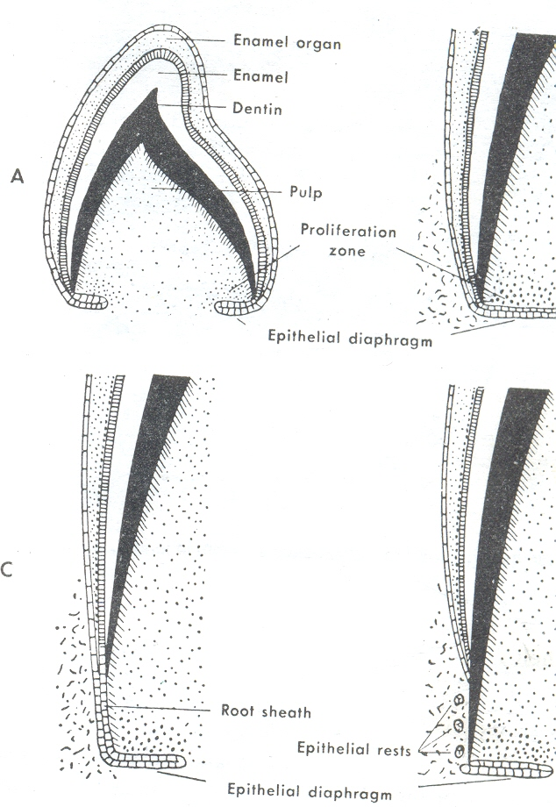
CEMENTOGENESIS
Cementum formation in developing tooth is preceded by deposition of dentin along the inner aspect of HERS.
Once dentin formation is under way, breaks occur in epithelial root sheath.

Slide 10
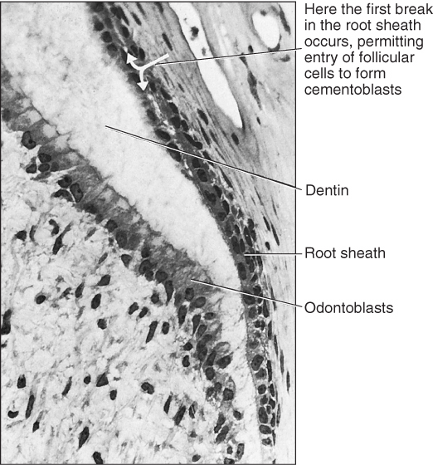
The epithelium is moved away from the surface of the dentin so that connective tissue cells come into contact with the outer surface of the dentin and differentiate into
Cementoblasts that deposit a layer of cementum onto the surface of the dentin.

Slide 11
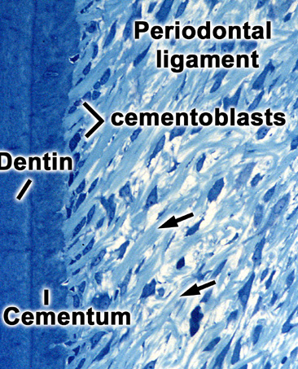
CEMENTOBLASTS
Synthesize collagen and protein polysaccharides, which form the organic matrix of cementum.
Cells have- numerous mitochondria, a well-formed Golgi apparatus & large amounts of granular ER.
Cementoblasts are identified by 3H Thymidine labeling.

Slide 12
Cementoblasts derived from
Inner cells of Dental follicle HERS
Similar phenotype as Osteoblasts different phenotype
Forms- Cellular Intrinsic Fiber Acellular Extrinsic
Cementum(CIFC) Fiber Cementum
(AEFC)
(E11 Antibody strongly reacts.
& Express receptors for PTH.)

Slide 13
Development of cellular cementum: (2 stages)
Early stage- in which extrinic Sharpey’s fibers are few & intrinsic fibers are randomly arranged.
A later stage- in which Sharpey’s fibers are thicker and intrinsic fibers are arranged to encircle them.
Multipolar mode of matrix secretion & faster rate of formation cementoblast entrapment in its own matrix( cementocytes) cellular cementum
Notes:
Multipolar mode--- matrix secretion from different parts of cementoblasts

Slide 14
Formation of Acellular cementum:
Associated with secretion of enamel matrix proteins (EMP) by HERS .
HERS is also shown to secrete cementum related proteins like BSP, Osteopontin & fibrillar collagen.
Notes:
Role of hers is disputed. As amelogenin antibodies did not react wid cemental proteins.

Slide 15
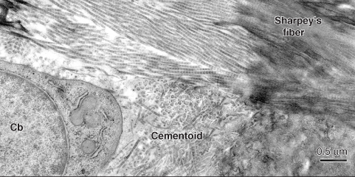
CEMENTOID TISSUE
After some matrix has been laid down, its mineralization begins.
The uncalcified matrix is called – Cementoid.
Growth of cementum- rhythmic process.
New layer of cementoid formed, old one calcifies.
Thin layer of cementoid usually found on cemental surface.

Slide 16
Cementoid tissue is lined by cementoblasts.
Connective tissue fibres from periodontal ligament pass between cementoblasts into cementum.
Fibres are embedded into cementum and serve to attach the tooth to surrounding bone.
Embedded portions are known as Sharpey’s fibers.
Cementoid tissue not observed in AEFC

Slide 17
Incremental lines of Salter:
Cementogenesis proceeds continuously with cyclic activity outward in to PDL, resulting in successive layers of cementum.
Cyclic activity----- Incremental lines of Salter
Appear as narrow lines following contour of the root.
Thus, the fine lines represent periods between intervals of cementogenic activity.
Notes:
Provenza---- Add pic

Slide 18
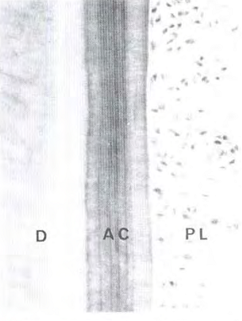
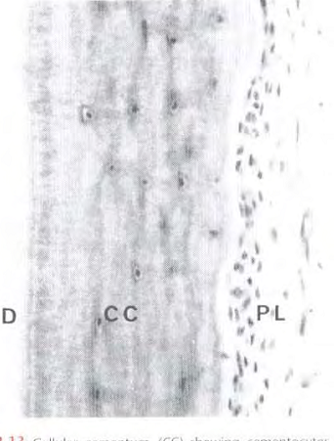
CLASSIFICATION
Based on the presence or absence of cementocytes : (Gottlieb B,1942)
Acellular (primary) cementum
  Cellular (secondary) cementum.

Slide 19
Can also be classified on the basis of:
Types of fibers- intrinsic/ extrinsic fibres
Presence / absence- afibrillar cementum
Intrinsic fibres Extrinsic fibres
produced by cementoblasts PDL fibroblasts
(1-2 microns dia) (5-7 microns dia)
Oriented parallel to surface perpendicular

Slide 20
Different types of cementum
Acellular Extrinsic Fibre Cementum ( AEFC)
Cellular Intrinsic Fibre Cementum (CIFC)
Acellular Afibrillar Cementum (AAC)
Acellular Intrinsic Fibre Cementum (AIFC)
Cellular & Acellular Mixed Fibre Cementum
Cellular Mixed Stratified Cementum

Slide 21
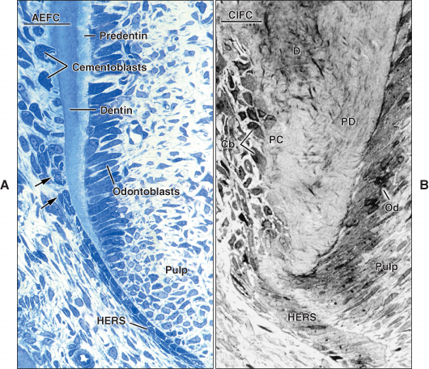
Acellular extrinsic fiber cementum:
AEFC extends from cervical margin to apical 1/3rd.
Only type of cementum in single rooted teeth.
Extrinsic fibers are seen perpendicular to surface of cementum.
Known as Sharpey’s fibers- mineralized except their inner core.
This type of cementum forms slowly & regularly so incremental lines are placed parallel to surface & closer together.
Main function---- Anchorage

Slide 22
Cellular cementum:
Secondary cementum
2 types:
Cellular mixed fiber cementum: apical interradicular regions
CIFC: middle & apical 3rd.
Function: Adaptation & repair of cementum.
Cells incorporated in matrix- Cementocytes.

Slide 23
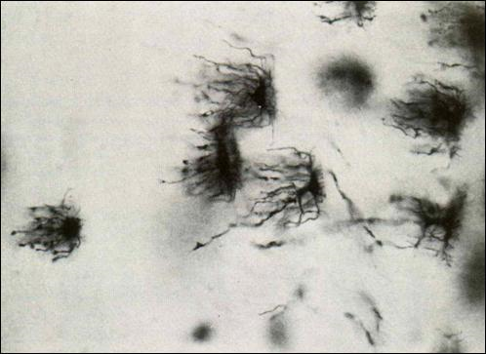
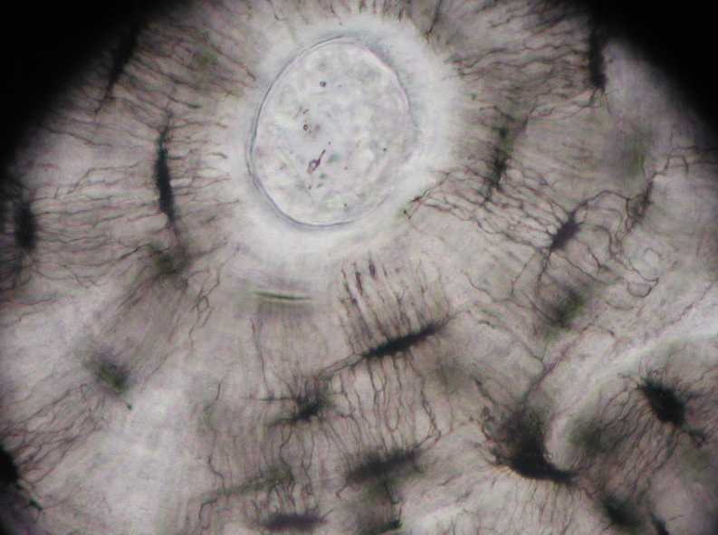
Differences between cementocytes & osteocytes:
Lacunae of cementocytes varies from being ovoid to tubular but, Osteocytic lacunae are oval.
The canaliculi less complicated & facing PDL but, Osteocytes have radiating canaliculi arranged in complex network.
Immunocytochemical studies --- cementocytes immuno+ve for- Fibromodulin & Lumican
but, not osteocytes.

Slide 24

AEFC CIFC

Slide 25
ACELLULAR EXTRINSIC FIBRE CEMENTUM | CELLULAR INTRINSIC FIBRE CEMENTUM
1. Located from cervical to apical third | Apical third and furcations
2. Formed earlier- Primary cementum | Formed later & during repair - Secondary cementum
3. Noncollagenous proteins- Tenascin, Fibronectin, Osteocalcin absent | Non collagenous proteins are present.
4. Growth factors TGFβ & IGF not seen | Growth factors are seen.
5. Proteoglycans, Versican, Decorin, Lumican not identified in matrix | These proteoglycans are seen in matrix.
6. Cementoid is usually absent. | Cementoid seen on the surface
7. Contains extrinsic fibers produced by PDL fibroblasts | Contains intrinsic fibers produced by cementoblasts
8. Probably the only type of cementum seen in single rooted teeth | May be absent in single rooted teeth

Slide 26
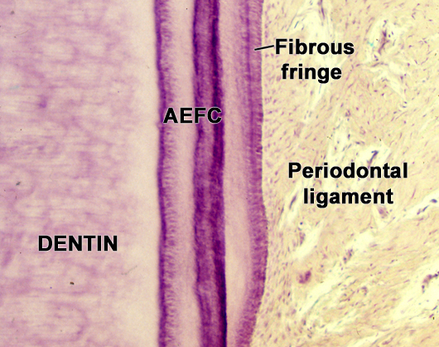
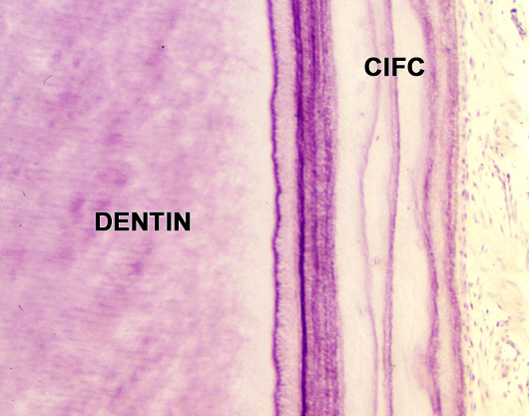
ACELLULAR EXTRINSIC FIBRE CEMENTUM | CELLULAR INTRINSIC FIBRE CEMENTUM
9. Main function is anchorage. | Main function is adaptation and repair.
10. Slow formation | Rapid formation
11. Incremental lines therefore are closer together. | Incremental lines further apart
12. Cementocytes not seen | Cementocytes are seen
13. Cementoblasts derived from HERS | Cementoblasts derived from cells of dental follicle
14. Cementoblasts do not express PTH receptor. | Cementoblasts express PTH receptor

Slide 27
Cellular mixed stratified cementum:
Towards the root apex and in the furcation areas of multi-rooted teeth.
The acellular extrinsic fibre cementum & cellular intrinsic fibre cementum commonly may be present in alternating layers known as ------ cellular mixed stratified cementum.
Notes:
ADD PIC

Slide 28
Mixed fibre cementum:
Collagen fibres are derived from both- extrinsic fibres (PDL) & intrinsic fibres (cementoblasts).
Intrinsic & extrinsic fibres can be distinguished :
Intrinsic fibres run between extrinsic fibers in different orientation.
Fiber bundles are of different sizes:
- extrinsic fibre bundles: ovoid-round , 5-7 µm dia.
- intrinsic fibre bundles: 1-2 µm in dia.
Can be acellular / cellular mixed fibre cementum
Notes:
Add pic

Slide 29
Afibrillar cementum:
Contains no collagen fibres
Sparsely distributed & contains well mineralized ground substance
Thin, acellular, which covers the cervical enamel or intervenes between fibrillar cementum & dentin
Afibrillar cementum is thought to be formed at this site following the loss of reduced enamel epithelium.
Notes:
Add pic

Slide 30
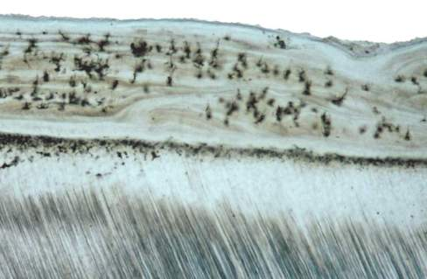
CEMENTO-DENTINAL JUNCTION
Relatively smooth in permanent teeth, scalloped in deciduous teeth
Attachment is quite firm.
CDJ consists of wide zone containing large quantities of collagen associated with Glycosaminoglycans like Chondroitin sulfate- stiffness
Notes:
Stiffness--- TO redistribute occlusal forces to alv bone

Slide 31
Cemental fibers intermingle with dentinal fibers at CD junction. This aids in attachment of cementum to dentin.
But, the presence of proteoglycans is the major factor in this attachment.
Intermediate cementum layer/ Hyaline layer:
Apical thirds of roots of molars & premolars
Represents the areas where cells of HERS become trapped in rapidly deposited dentin or cementum matrix
Considered to be of dentinal origin

Slide 32
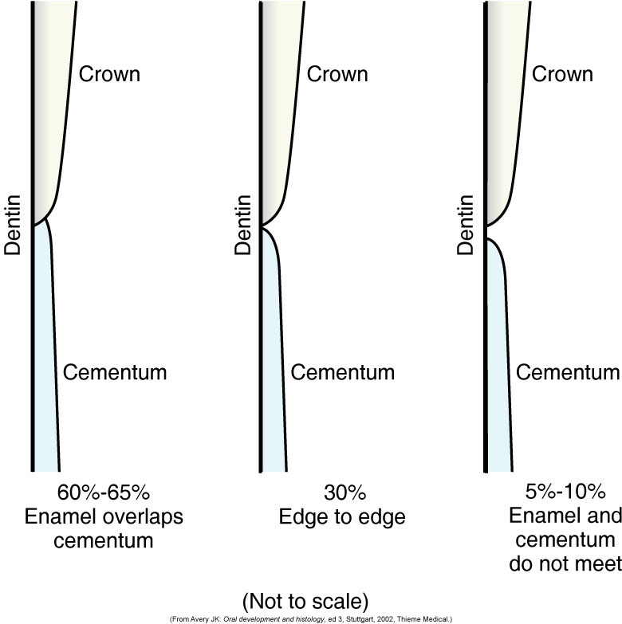
CEMENTO- ENAMEL JUNCTION
Overlap junction
Butt joint
Gap junction
Notes:
Wen enamel epi degenerates at cervical termination , permits ct. to cum in contact wid enamel surface. Afibrillar cementum formed
3. Delayed separation of enamel epi frm cervical portion of root from dentin. Covered wid ree

Slide 33
FUNCTIONS
Anchorage- furnish a medium for attachment of collagen fibres that bind tooth to alveolar bone.
Adaptation- deposition of cementum in apical area can compensate for tooth substance due to occlusal wear.
Repair – damage to roots such as fractures & resorption can be repaired by deposition of new cementum.

Slide 34
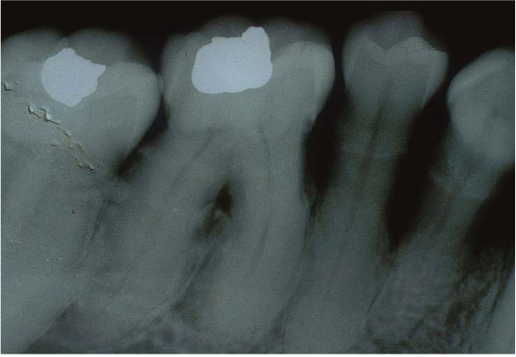

CLINICAL CONSIDERATIONS
HYPERCEMENTOSIS
Abnormal thickening of cementum
Non-neoplastic condition in which excessive cementum is deposited in continuation with normal radicular cementum.
Secondary cementum deposition in entire root/apex.

Slide 35
Localised hypertrophy:
Hyperplastic:
Seen in areas where enamel drops have developed over dentin
Hyperplastic cementum covering the enamel drops are irregular & sometimes contain round bodies that may be calcified epithelial rests.
These calcified bodies found on localised areas of hyperplastic cementum--- Excementoses
A spur or prong like extension of cementum is formed.
Seen in teeth that are exposed to great stress.
The prong-like extension of cementum provides larger surface area for attaching fibers ---- firmer anchorage assured.

Slide 36
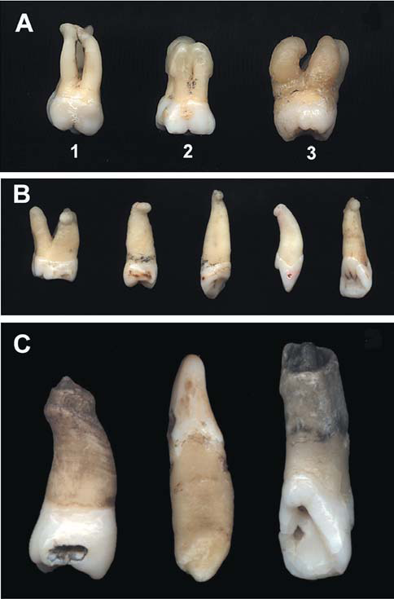

Slide 37
Etiology:
Accelerated root elongation
Inflammation about the root
Tooth repair / Trauma from occlusion (TFO)
Paget’s disease
Histopathology:
Cellular cementum over a thin layer of acellular cementum
Secondary cementum termed as- Osteocementum: cellular nature – resemblance to bone
Notes:
1. Antagonist absent 2. pulpal infection stimulares cementum formn also periapical inflammatn- increase in eruption of tooth– so to maintain width of PDL cementum formed 3. trauma- root resorption – to repair 4. pd- lamina dura not seen, generalised

Slide 38
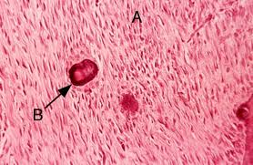
CEMENTICLES
Foci of calcified tissue, not necessarily cementum , which lie free in PDL of lateral & apical root areas.
Dystrophic calcification – regressive change
Formation:
1. Calcification of epithelial rests in PDL
2. Focal calcification of C.T between Sharpey’s bundles
3. Cemental tears- if detached
4. Calcification of thrombosed capillaries in PDL

Slide 39
ANATOMIC & FUNCTIONAL REPAIR:
Trauma/ Excessive forces: cementum resorption
Severe cases ---- up to dentin
Damage repaired either by formation of acellular or cellular cementum or by alternate formation of both.
In most cases there is tendency to re-establish the former outline of the root surface.
This is called Anatomic repair.

Slide 40
However, if only a thin layer is deposited on the surface of deep resorption, the root outline is not reconstructed and a baylike recess remains…..
In such areas sometimes PDL space is restored to its normal width by a bony projection so that proper functional relationship will result.
The outline of the alv. bone in these cases follows that of the root surface.
This change is called Functional repair.
Notes:
Find article for diabetes n cementum thickness

Slide 41
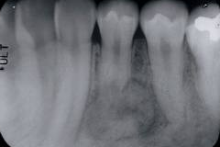
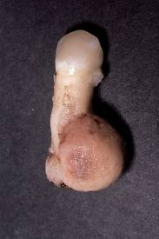
CEMENTOBLASTOMA
Benign cementoblastoma is a true neoplasm of functional cementoblasts which form a large mass of cementum or cementum like tissue on the root.
Mandi. 1st molar
H/p: sheets of cementum like tissue
Reversal lines scattered throughout
Cemental trabeculae lined by cementoblasts
Notes:
Tooth vital

Slide 42
HYPOPHOSPHATASIA
Rare inherited metabolic disease of decreased tissue nonspecific alkaline phosphatase &
Defective bone mineralization
Loosening and premature loss of teeth
Failure of cementogenesis ---- No sound functional attachment of tooth to bone by PDL.

Slide 43
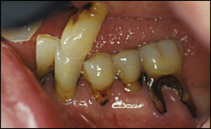
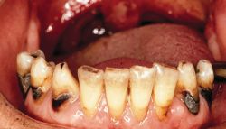
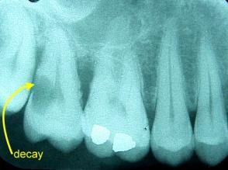
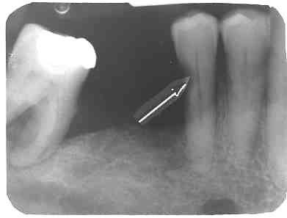
CEMENTAL CARIES
“Soft ,progressive lesion that is found anywhere on root surface that has lost the connective tissue attachment & is exposed to the oral environment”
Root caries is usually saucer shaped. Root caries does not occur in areas covered by a well attached gingiva.
Microorganisms invade cementum along Sharpey’s fibres or between bundles of fibres.
Notes:
As concentric layers--- lateral spread of caries

Slide 44
AGE CHANGES IN CEMENTUM:
Permeability of cementum decreases with age.
Cellular proliferative activity of cementum decreases with age.
Cementum surface becomes irregular with age i.e., an irregular surface into which the sharpey’s fibers are inserted.
Cementum is deposited through out the life of an individual.

Slide 45
REFERENCES
A TEXT BOOK OF ORAL HISTOLOGY-ORBANS
SHAFER’S TEXTBOOK OF ORAL PATHOLOGY
TENCATE’S TEXTBOOK OF ORAL HISTOLOGY
ORAL ANATOMY, HISTOLOGY & EMBRYOLOGY- BERKOVITZ
ORAL HISTOLOGY- PROVENZA
A SCANNING ELECTRON MICROSCOPIC STUDY OF HYPERCEMENTOSIS -J Appl Oral Sci. 2008;16(6):380-4
INTERNET
THANK YOU
Notes:
Ask how to distinguish calcification, cementum n bone under microscope??????

Slide 46
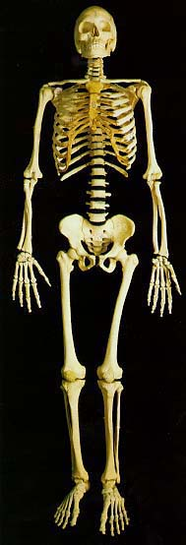
HISTOLOGY OF BONE
Bone is a special dense connective tissue wherein the cells and fibres are embedded in a calcified matrix.

Slide 47
FUNCTIONS OF BONE:
Give shape and support to the body.
Provide surface for the attachment of muscles, tendons, ligaments.
The skull, vertebral column & thoracic cage protect brain, spinal cord and thoracic viscera, respectively.
It manufactures blood cells.
It stores 97% of the body calcium and a very large part of body phosphorous.
Helps in immunity.
Notes:
Bone marrow contains reticulo-endothelial cells which are phagocytic in nature and take part in the immune response of the body.
Explanation for point 6

Slide 48
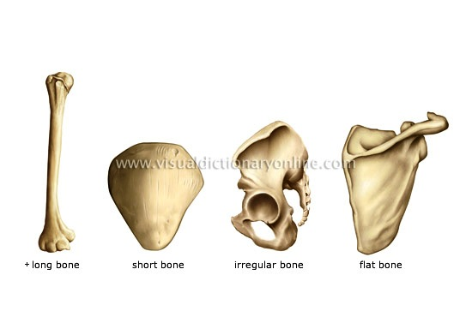
CLASSIFICATION
Based on location
Axial skeleton - skull, vertebral column
Appendicular skeleton - etrimities
Based on shape
Long bones- humerous
Short bones- carpals
Flat - skull
Irregular - Face
Sesamoid - patella

Slide 49
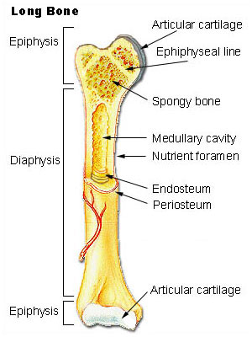
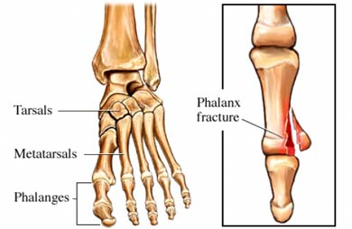
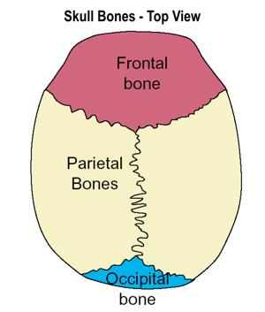

Slide 50
Based on microscopic structure:
Lamellar bone/ mature bone: compact/ cancellous
Woven bone
Based on Maturity
Immature bone
Mature bone
Based on developmental origin
Intramembraneous– facial flat bones, mandible, clavicle
Intracartilagenous – bones of trunk and extremities

Slide 51
COMPOSITION OF BONE
67% inorganic 33% organic
hydroxyapatite 28% 5%
collagen noncollagen protein
type I
osteocalcin
sialoprotein
phosphoprotein
osteonectin
bone specific protein
BMPs

Slide 52
Inorganic Mineral:
Consist of calcium phosphate salt in form of hydroxyapatite
Shape – rhombic prism
Hydroxyapatite crystallite – 100 x 200 x 50 x 50 Å
Ions like Mg, F, Al, Na are also present.
Organic contents:
Collagen Type I & also Type III, V, XII
Ground substance

Slide 53
Non collagenous proteins
1. Osteocalcin-
15% of non collagenous proteins
Bone gla protein- γ carboxy glutamic acid
Carboxy terminal segment of osteocalcin acts as chemoattractant for osteoclasts. Role in bone resorption
Also, it has role in bone calcification- as it is a calcium binding protein

Slide 54
2. Bone Sialoprotein (BSP)
Initiation of mineral crystal formation
3.Osteopontin:
Inhibitor of hydroxyappetite crystal growth
Enriched at cell matrix interface where it mediates attachment of cells including osteoclasts
4. Osteonectin:
It is bound to hydroxyappetite crystals
It is a secreted calcium binding glycoprotein.
Role- regulation of cell adhesion & proliferation

Slide 55
5. Proteoglycans:
Chondroitin sulfate, Biglycan, Decorin
Bind to TGF-β & extracellular macromolecules including collagen regulate fibrillogenesis
6. Lysyl oxidase:
Critical enzyme for collagen cross linking
7. Matrix gla proteins:
Prevent mineralization in vascular tissues & cartilage

Slide 56
Cytokines :
Bone morphogenetic proteins (BMP)
Platelet derived growth factors (PDGF)
Insulin like growth factors (IGF)
Fibroblast growth factors (FGF)
Transforming growth factor (TGF)
THE CYTOKINES INCREASE RAPIDITY OF BONE FORMATION & REPAIR

Slide 57
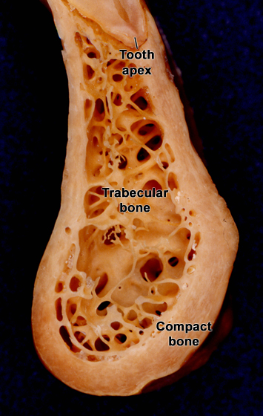
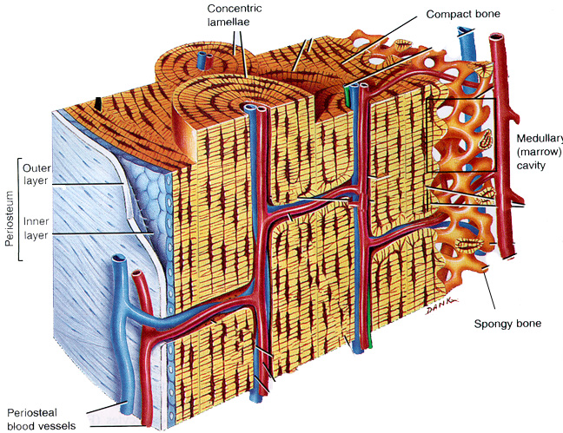
BONE HISTOLOGY

Slide 58
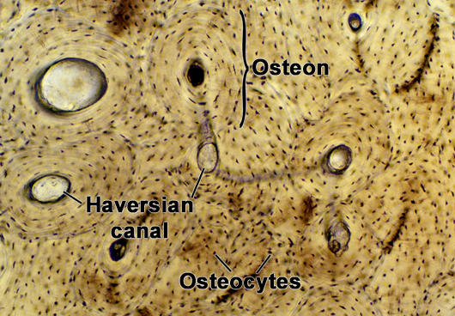
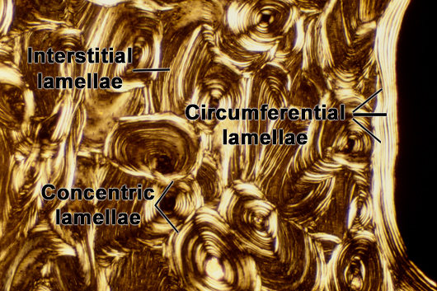
HISTOLOGY OF BONE

Slide 59
SPONGY BONE
Trabecular/ Cancellous bone
Same cells and intercellular matrix as compact bone but, differ in arrangement of components
Large slender spicules – trabeculae
Oriented along lines of stress to withstand the forces applied to bone
Marrow spaces are large
Trabeculae derive nutrition from marrow

Slide 60
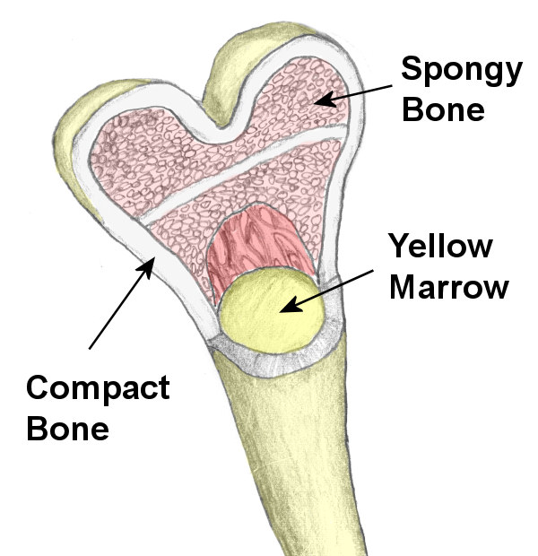
Hemopoietic tissue in bones:
Red marrow- young bones
Yellow marrow- old bones
Red marrow seen in- the cavities of spongy bone
In newborn infants- medullary cavities & spongy bone contains red marrow.
Red marrow – mesenchymal cells/ blood cell lineage
Yellow marrow- loss of hemopoietic potential.

Slide 61
BONE CELLS:
Two cell lineages are present in bone:
Osteogenic cells, which form and maintain bone, and
Osteoclasts, which resorb bone.
Osteogenic cells include osteoprogenitors, preosteoblasts, osteoblasts, osteocytes, and bone-lining cells.
Notes:
Periosteum during childhood growth, after skeletal fractures or with bone forming tumors.
Osteoprogenitor cells, are small, pale-staining, spindle shaped cells that are present on all nonresorbing surfaces of living bone
When circumstances cause osteogenic cells of the periosteum or endosteum to proliferate, these cells give rise to osteoblasts in regions that is well vascularized and to chondroblasts in regions that are avascular.

Slide 62
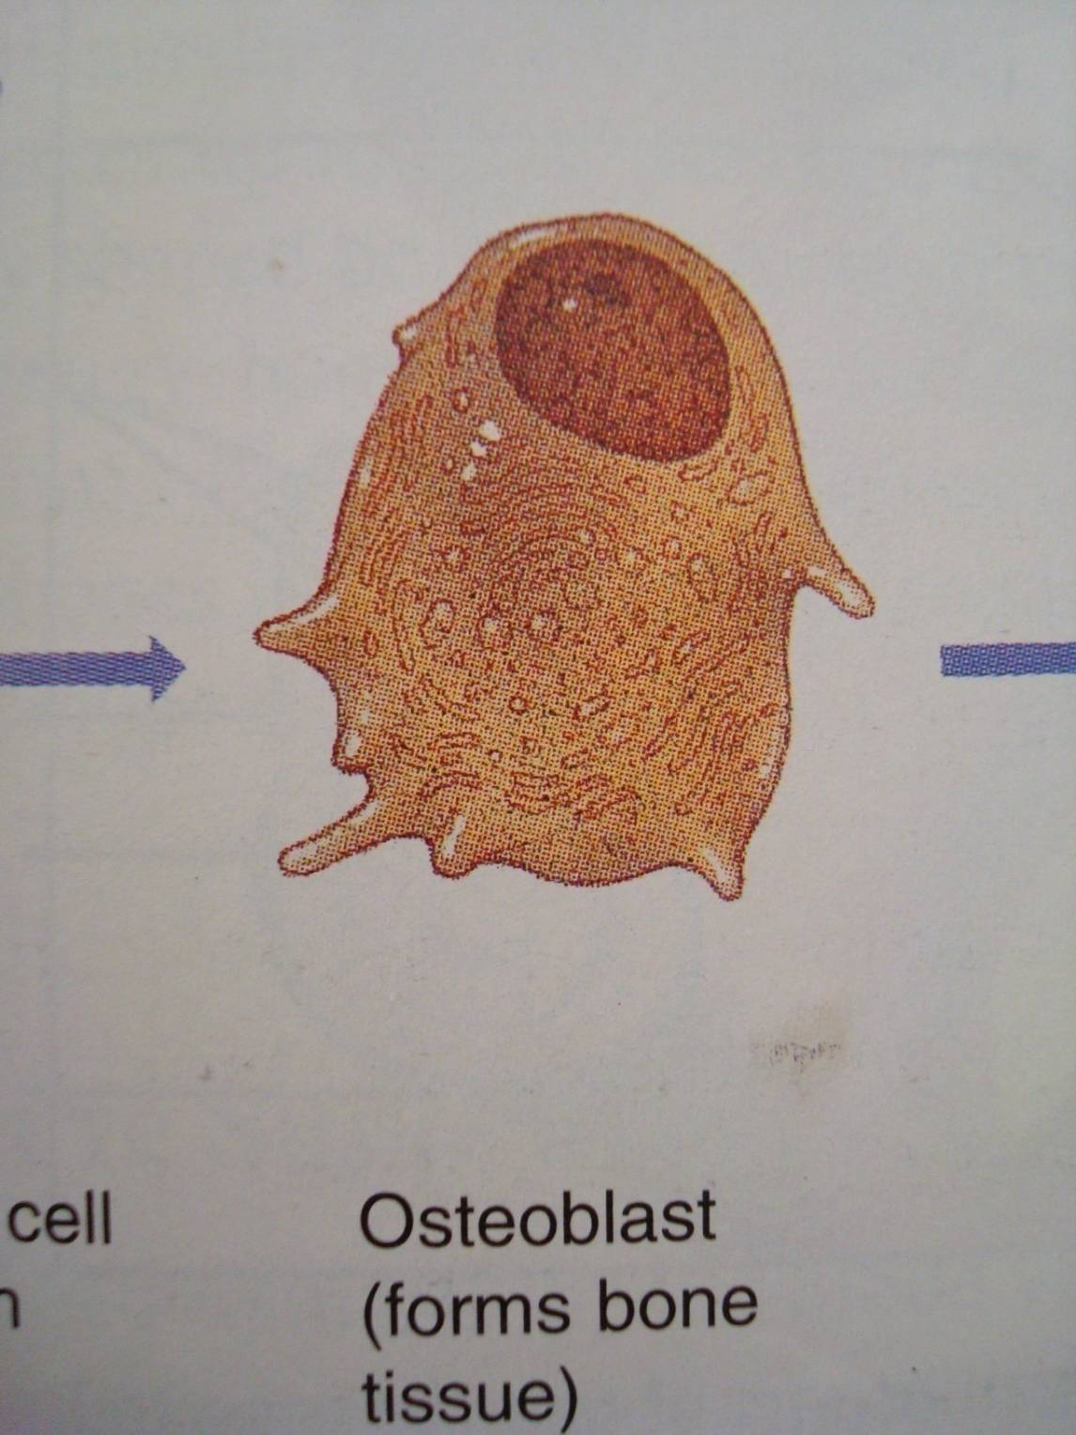
OSTEOBLASTS
Mononucleated cells responsible for the synthesis & secretion of macromolecular organic constituents of bone matrix.
Derived from: osteoprogenitor cells of mesenchymal origin in bone marrow & other C.T
PERIOSTEUM also imp reservior- during childhood growth, after skeletal fractures

Slide 63
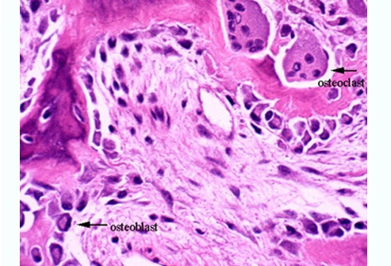
Morphology:
Basophilic, plump cuboidal or slightly elongated cells
Exhibit abundant & well developed protein synthetic organelles.
Intense cytoplasmic basophilia- abundance of RER
RER- Procollagen & organic bone matrix transfer vesicles Golgi complex secretory granules
Granules release their contents along the cell surface opposed to forming bone which, assemble as fibrils to form osteoid.

Slide 64
Formation of osteoblasts
Undifferentiated pluripotent stem cells
Inducible osteo-progenitor cells (IOPC)
BMP’s, Growth factors
Determined osteo-progenitor cells(DOPC)
Bone derived growth factors
osteoblasts

Slide 65
Functions:
Formation of new bone via synthesis of proteins & polysaccharides
Regulation of bone remodeling & mineral metabolism
Mineralization of the osteoid
Osteoblasts secret RANKL, Cbfa-1 (osteoblast specific transcription factor)
RANKL: membrane bound TNF- Osteoclast differentiation
Cbfa-1 : regulates expession of OPG – potent inhibitor of osteoclast formation

Slide 66
Regulation of osteoblast activity:
Role of PTH: Hypocalcemia release of calcium from bone PTH receptors on osteoblasts bone resorption
Vitamin D3: Bone resorption
Also essential for bone growth & Ca absorption from intestine
Growth hormone: attaining normal bone mass
Insulin: IGF-1 matrix formation & mineralization
BMPs: differentiation of mesenchymal cells to osteogenic cells
FGF, PDGF: osteogenic differentiation & osteogenesis

Slide 67
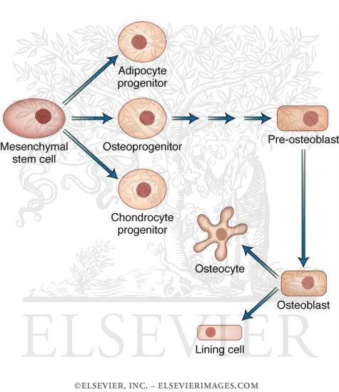

Slide 68
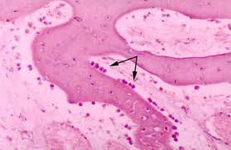
Bone lining cells:
Once osteoblasts have completed their function, they are either entrapped in bone matrix and become osteocytes or remain on the surface as lining cells.
Osteoblasts flatten & extend along the bone surface
Very few organelles but retain gap junctions with osteocytes
Apoptosis: TNF Antiapoptotic- TGF-β & IL-6

Slide 69
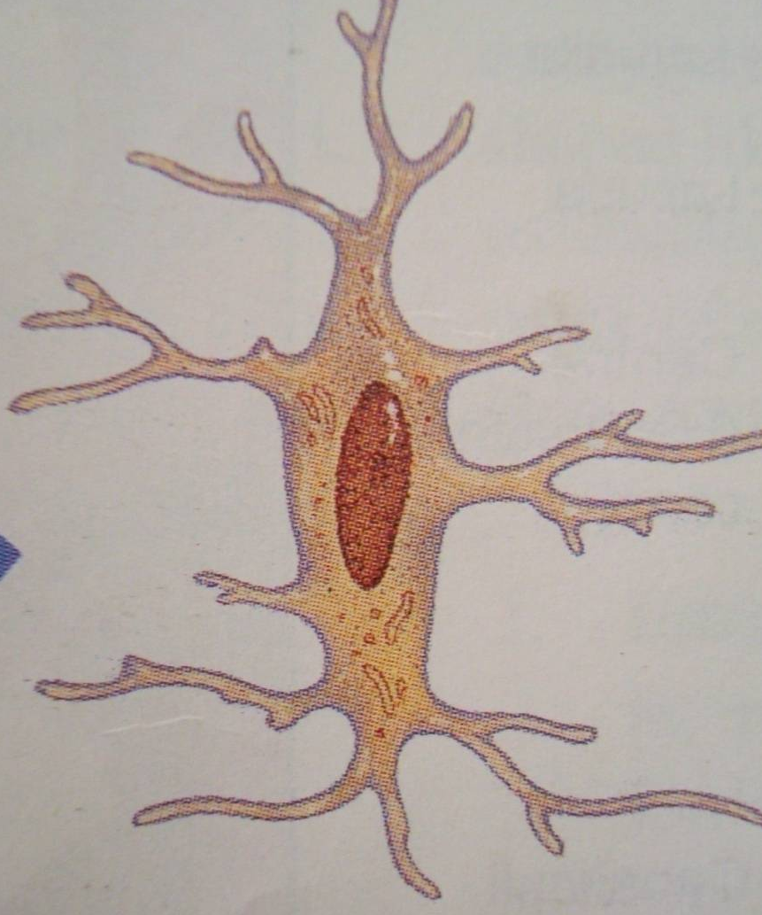
OSTEOCYTES:
Osteoblasts entrapped within the matrix
No. of osteocytes depends on the rapidity of bone formation. Embryonic woven bone has more osteocytes than lamellar bone
Osteocytic lacuna
Narrow extensions of these lacunae form channels – Canaliculi
Canaliculi contain osteocytic processes
Canaliculi penetrate the bone matrix & permit diffusion of nutrients, gases & waste products between osteocytes & blood vessels.

Slide 70
Functions:
Maintain bone matrix and
Release calcium ions from bone matrix when calcium demands increase.
Also sense the changes in environment & sends signals that affect response of other cells in remodelling

Slide 71
OSTEOCLASTS:
Osteoclast- Greek word : “bone & broken”
Type of bone cell that removes the bone tissue by removing the mineralized matrix of bone.
40-100 µm in diameter with 15 to 20 closely packed nuclei.
Cytoplasm shows acid phosphatase containing vesicles and vacuoles- distinguishes osteoclast from other multinucleated giant cells
Lie in resorption bays called as HOWSHIP’s LACUNAE.

Slide 72
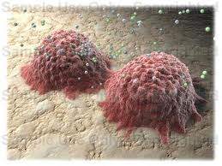
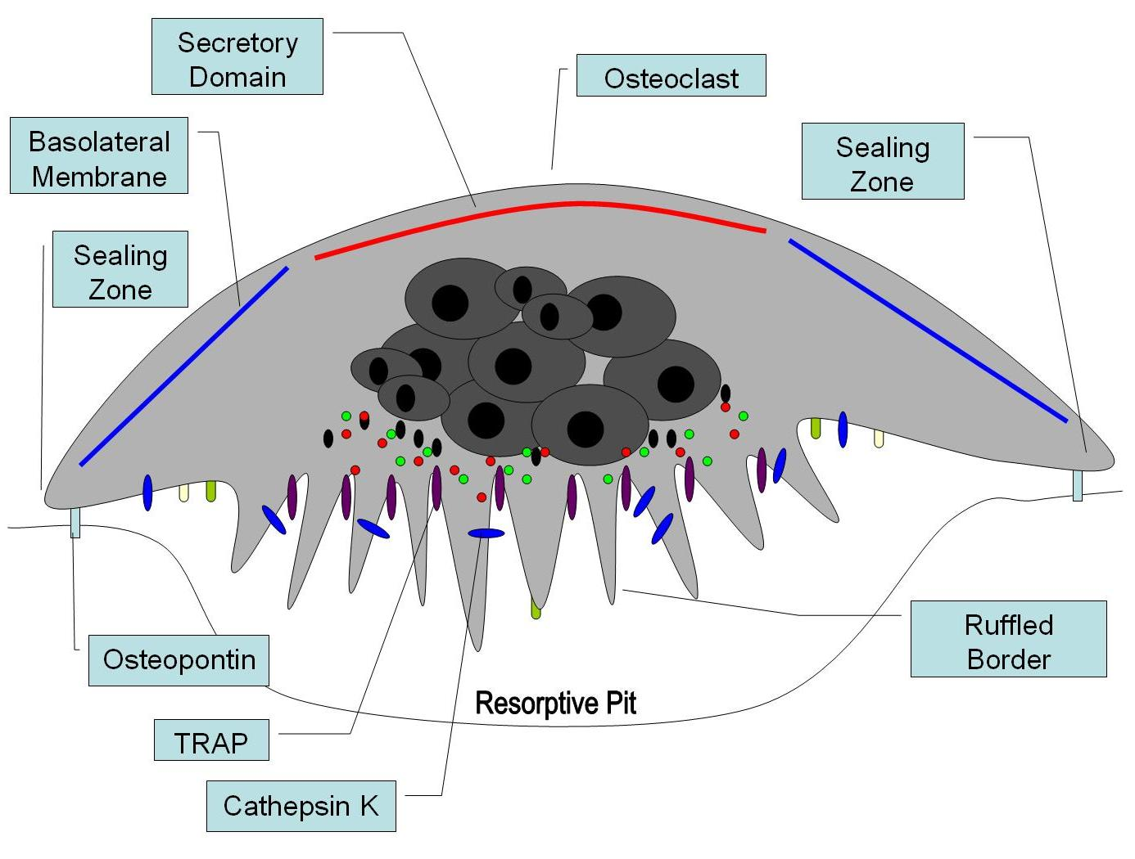
Morphology of Osteoclasts:
Extensive mitochondria – except below ruffled border
Golgi complex- extensive
Cathepsin containing vesicles- close to ruffled border indicating resorptive activity of cells

Slide 73
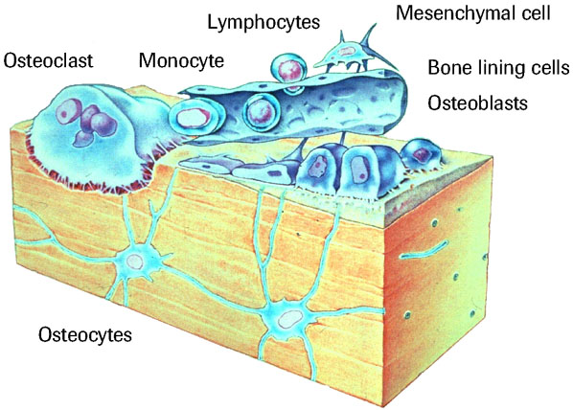
Formation:
Hemopoietic stem cells of
monocyte-macrophage lineage
cell cell interaction RANKL, M-CSF
osteoclast

Slide 74
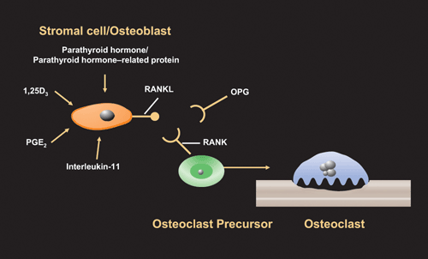

Slide 75
Regulation of Osteoclast activity:
OPG( Osteoprotegerin): member of TNF receptor family natural RANKL antagonist
Estrogen: supresses production of bone resorbing cytokines- IL-1 & IL-6
es TGF-β APOPTOSIS of osteoclast
Vit D3 & PTH: Stimulate bone resorption through osteoclasts
Calcitonin: Inhibitor of osteoclast activity

Slide 76
BONE FORMATION
Intramembranous ossification
Endochondral bone formation

Slide 77
Intramembranous ossification:
Direct formation of bone within highly vascular sheets of condensed primitive mesenchyme.
Occurs in the flat bones of the skull and clavicles.
Begins towards the end of second month of gestation.
Process involves the following steps:
Formation of bone matrix within the fibrous membrane.
Formation of woven bone.
Appositional growth.
Formation of osteon.

Slide 78
Formation of bone matrix within the fibrous membrane.
Loose mesenchyme at bone development site.
centre of osteogenesis develops
Proliferation & condensation of mesenchyme to form compact nodules.
Center cells differentiate to OSTEOBLASTS.
Forms organic bone matrix which later calcifies to irregular bony spicules.

Slide 79
Formation of woven bone
Bony spicules gradually lengthen into longer and anastomosing structures called trabeculae.
Trabeculae grow in radial pattern to enclose blood vessels
This early membrane bone- Woven bone.
External to the woven bone, there is condensation of vascular mesenchyme to form Periosteum.
Notes:
osteoblasts that deposit new layers of bone matrix on preexisting bone surfaces. This is appositional growth, which results in buildup of bone tissue one layer at a time

Slide 80
Appositional growth & formation of compact bone
Osteoblasts & osteogenic cells cover the spicules & trabaculae of bone.
These osteogenic cells proliferate in richly vasclarised environment & give rise to osteoblasts that
deposit new layer of bone matrix on preexisting bone surfaces.
This is appositional growth – build up of bone tissue one layer at a time.
Cbfa1 and BMP’s are required for the process to take place

Slide 81
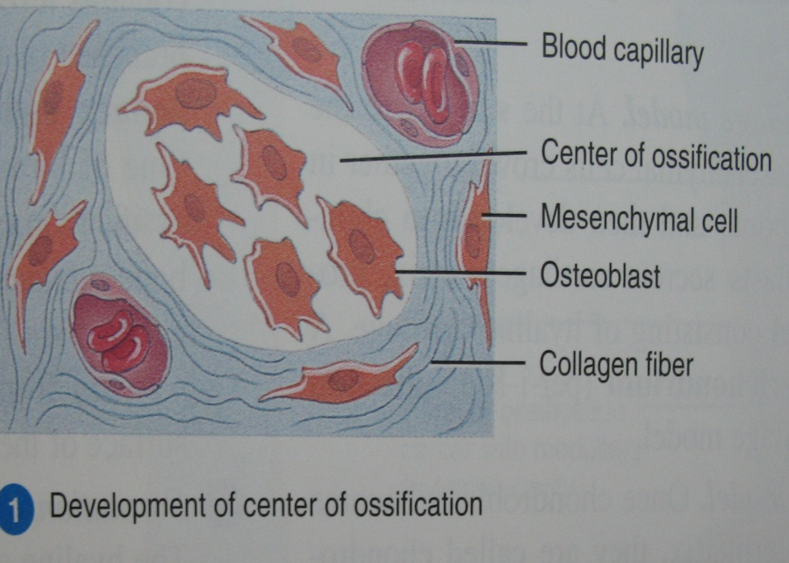
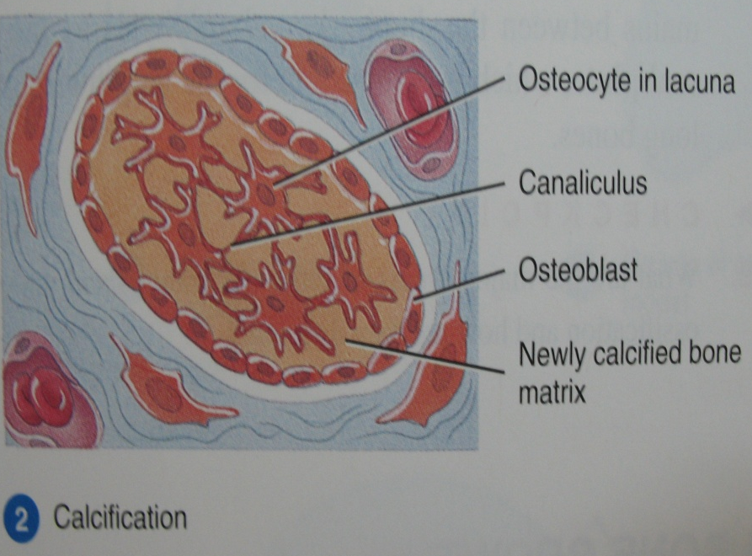
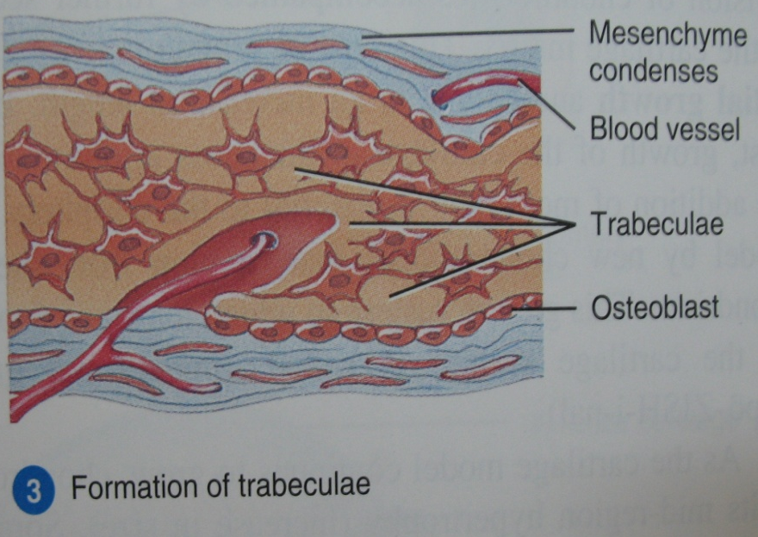
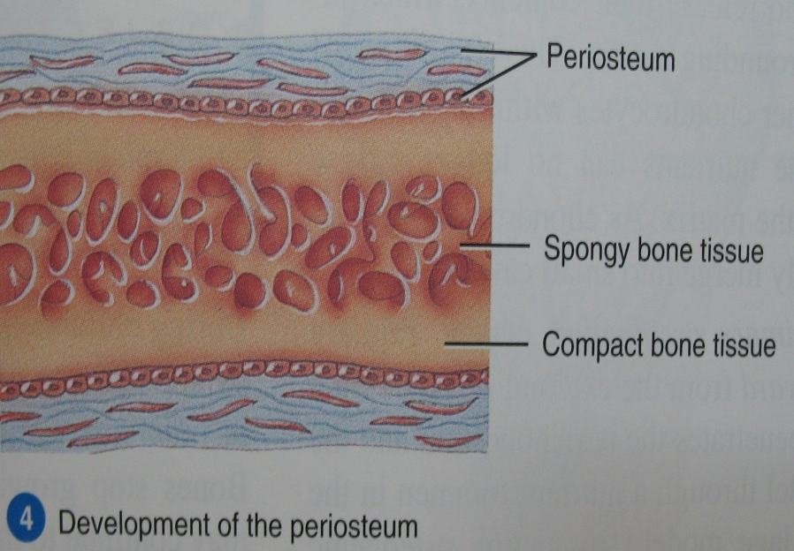
INTRAMEMBRANOUS OSSIFICATION

Slide 82
Difference between mature & woven bone
Features | Mature bone | Woven bone
Orientation of collagen fibres | Collagen fibres in one lamella lies at right angles to other lamella | Collagen fibres oriented in different directions
Interfibrillar space Mineral density | Space less more | Space is more less
Deposition and mineralization | Slow than woven bone, osteocytes lesser in number | Faster, more number of osteocytes are present
Resorption | Portion of lamellar matrix is resorbed at one time | Woven bone can be entirely removed
H & E staining | Eosinophilic | Basophilic (higher proteoglycan content)

Slide 83
Endochondral ossification:
Replacement of a cartilaginous model by bone.
Occurs at the extremities of all long bones, vertebrae, ribs, articular extremity of the mandible and base of the skull.
The process involves the following steps:
Formation of a cartilaginous model.
Formation of bone collar.
Formation of periosteal bud.
Formation of medullary cavity.
Formation of secondary ossification center.
Mechanism of calcification.

Slide 84
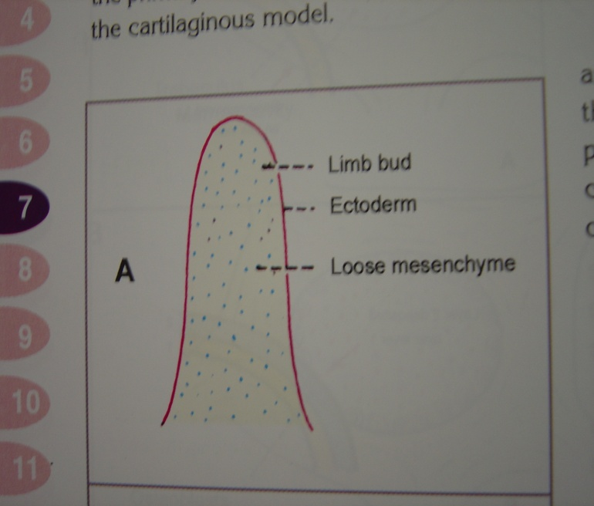


FORMATION OF CARTILAGENOUS MODEL:
Notes:
At the site where a limb will later emerge, the embryo shows outgrowth of mesoderm covered by ectoderm. The mesenchymal cells in this site condense, differentiate into chondroblasts and resulting in the development of a hyaline cartilage model. The model is surrounded by a perichondrium made up of an inner chondrogenic layer and outer fibrous layer. No osteoblasts are produced by the cells in the chondrogenic layer, because differentiation is taking place in an avascular environment.
The growth of the cartilage model is by interstitial and appositional growth. Increase in the length is by interstitial growth . Widening of the model is due to appositional growth. As the differentiation of cartilage cells moves towards the metaphysis, the cells organize into longitudinal columns which are subdivided into three zones
Zone of proliferation: The cells are small and flat, and constitute a source of new cells.
Zone of hypertrophy and maturation: This is the broadest zone. The chondrocytes hypertrophy, and in the early stages secrete Type II collagen. As hypertrophy proceeds, proteoglycans are secreted. The increased cell size and increased cell secretion, lead to an increase in the size of the cartilaginous model.
Zone of provisional mineralization: Matrix mineralization begins in the zone of mineralization by formation of matrix vesicles

Slide 85

Formation of a cartilaginous model.
Zone of proliferation- small, flat cells.
Zone of hypertrophy and maturation- secret collagen & non-collagenous proteins
Zone of provisional mineralization- begins mineralization

Slide 86


Slide 87

Role of Matrix vesicles
PLAY A ROLE IN NUCLEATION
Notes:
Evaginations of the cortical cytoplasm are formed from the basal segment of the principal segment. Round or oval or club shaped, get consticted at the bases and become detached by fusion of plasmalemma. Once freed the protoplasmic bud undergoes changes. As nascent buds cytoplasm is moderately free of organelles, later more granular cytoplasm, by late bud stage crystals appear

Slide 88



Matrix vesicles accumulate Ca++ via a Ca++ pump( ATP driven)
Pi ions are introduced into vesicular membrane by ALKALINE PHOSPHATASE
Initial ACP precipitated
Single crystals of HA appear
Crystals grow rapidly and rupture from the confines of the vesicles, spread as clusters of crystallites
ALK. PHOSPHATASE
P i
Ca++ ion pump
Ca++
Ca++
Ca++
Notes:
At step 2 free mineral ions in the vesicles increase causing precipitation of amorphous ACP. Further growth by action of alkaline phosphatase

Slide 89
Alkaline phosphatase which is associated with the vesicle represents 2 distinct enzymatic activities:
1. Active against pyro-phosphatase which is an
inhibitor of HA formation
2. Helps in growth of the crystal
Vesicles show a high level of alkaline phosphatase
The mechanisms of mineralization and role of alkaline phosphatase in health and disease, Hideo Orimo, J of Nippon Med Sch, 2010

Slide 90
Theories of mineralization
First theory -Nucleation-formation of crystals upon substrates acting as models or templates (eg.in collagenous tissue where crystallites are deposited along collagen fibrils)-epitaxis
Second theory-mineral is initially deposited as an amorphous calcium phosphate. Subsequently becomes hydrolyzed to crystalline hydroxyapatite
Third theory-neither a nucleation site nor an amorphous precursor is necessary and that tissues are supersaturated with respect to calcium and phosphorus & will precipitate crystals spontaneously.
Oral Histology- Inheritance and Development, Provenza, 2nd ed.

Slide 91
BONE RESORPTION:
Removal of mineral and organic components of the ECM
SEQUENCE OF EVENTS
Ist PHASE: formation of osteoclast progenitors in the blood, followed by vascular dissemination & formation of osteoclasts.
IInd PHASE: activation of osteoclasts and retraction of osteoblasts to expose minerals to osteoclasts.
IIIrd PHASE: activated osteoclasts resorbing bone.

Slide 92
ALTERATION IN OSTEOCLASTS:
Formation of ruffled borders: extensive surface area
Clear (sealing) zone: attachment- through integrins
Isolated microenvironment
Notes:
Clear zone creates an isolated microenvironment in which resorption can take place with out diffusion of hydrolytic enzymes produced by the cell into adjacent tissue.

Slide 93
REMOVAL OF HYDROXYAPATITE:
Dissolution by HCL creating a pH of 2.5-3.
The protons for HCL arise from activity of Carbonic Anhydrase II synthesized by osteoclasts.
DEGRADATION OF ORGANIC MATRIX:
Brought about by proteolytic enzymes CATHEPSIN-K, MMP-9

Slide 94
REMOVAL OF DEGRADATION PRODUCTS:
Endocytosis and removal from FUNCTIONAL SECRETORY DOMAIN -FSDs (exocytosis).
Following resorption osteoclasts undergo APOPTOSIS. (TGF-β & Estrogen promote apoptosis)
Recently TRAP (tartrate resistant acid phosphatase) role is emphasized in regulation of bone resorption.

Slide 95
BONE REMODELING:
Bone- highly dynamic connective tissue
Process by which the overall size and shape of bone is established (COUPLING of bone resorption & formation)
Turnover rates- 30%- 100% per year in rapidly growing children. Adults- slow
Function of remodeling:
  Prevent accumulation of damaged & fatigued bone by regenerating new bone
  Allow bone to respond to changes to mechanical forces
  To facilitate mineral homeostasis

Slide 96
SEQUENCE OF EVENTS:
Osteoclasts tunnel into surface of bone- 3 wks.
Osteoclasts travel along the vessel and resorb haversian lamellae & part of circumferential lamellae & form a “cutting cone”.
After sometime resorption ceases and osteoclasts are replaced by osteoblasts.
Osteoblasts lay down a new set of haversian lamellae. Entire area of active osteon formation-“filling cone”

Slide 97
ALVEOLAR BONE
Defined as that part of maxilla and mandible that forms and supports the sockets of the teeth.
FUNCTIONS:
Houses the roots of teeth.
Anchors the roots of teeth to the alveoli- Sharpy’s fibers in to bone
Helps to move the teeth for better occlusion.
Helps to absorb and distribute Occlusal forces.
Supplies vessels to PDL.
Organizes eruption of primary & permanent teeth.

Slide 98
STRUCTURE OF ALVEOLAR BONE:
ALVEOLAR BONE PROPER: thin lamella of bone that surrounds the root of tooth & gives attachment to the PDL
a. Lamellated bone
b. Bundle bone-
Bundle bone:
Principle fibers of PDL are anchored.
“bundle bone”- bundles of principle fibers
Scarcity of fibrils
Radiographically: lamina dura
Radiopacity- thick bone without trabeculations
Notes:
Lamellated bone: some lamellae are arranged parallel to surface of adjacent marrow spaces.

Slide 99
Cribriform plate:
Inner wall of the socket perforated by many openings that carry branches of interalveolar nerves & blood vessels in to PDL.
Interdental septum:
Bone between 2 teeth & composed entirely of cribriform plate
The interdental & interradicular septa contain the perforating canals of Zuckerkandl & Hirshfield (nutrient canal) --- house the artries, veins, lymph vessels, nerves

Slide 100
SUPPORTING ALVEOLAR BONE:
a. Cortical plates
Compact bone. Forms inner & outer plates of alveolar processes.
b. Spongy bone
Fills the area between the corticle plates & alv. bone proper
Type I- interdental & inter radicular trabeculae are regular & horizontal in ladderlike arrangement (MANDIBLE)
Type II- shows irregularly arranged, numerous, delicate trabeculae. (MAXILLA)

Slide 101
CLINICAL CONSIDERATIONS

Slide 102


Osteogenesis Imperfecta
Brittle bones , Lobstein disease
Abnormality in type-1 collagen ---- Mutation of COL1A1 (chromosome 17) or COL1A2 (7).
Autosomal dominant
4 types: I, II, III, IV
C/F: bone fragility, fractures, blue sclera,
a/w DI, short stature etc
H/P: Thin, spongy bone, reduced osteoblast activity,
Both- qualitative & quantitative defect of collagen

Slide 103



Oseopetrosis
Marble Bone Disease / Albers-Schonberg disease
Failure of osteoclasts to resorb bone leads to increases bone mass.
Bone has poor mechanical properties.
Fragility--- fractures

Slide 104


Osteoporosis
In osteoporosis, the bone mineral density (BMD) is reduced, bone micro architecture is disrupted, and the amount and variety of non-collagenous proteins in bone is altered.
Osteoporosis is most common in women after the menopause, when it is called postmenopausal osteoporosis

Slide 105

Rickets & Osteomalacia
“Wricken” = to bend
Vitamin D deficiency calcium absorption weak bones
RICKETS: Decreased mineralization at the level of growth plate growth retardation
Pigeon chest, lumbar lardoisis,
rachetic rosary, bowed legs,
craniotabes etc.
OSTEOMALACIA: Adults

Slide 106


Hyperparathyroidism
Primary, secondary, tertiary,
C/F: bone pain, tenderness, spontaneous fractures,
weakness, generalized osteoporosis, abortive attempts at bone repair.
R/F: generalized radiolucency as compared to normal,
later sharply defined radiolucencies in mandible,
“ground-glass” appearance,
lamina dura lost,
osteoclastomas

Slide 107



Achondroplasia
Mutation in gene for fibroblast growth factor receptor-3 (FGFR-3)
Short stature, short arms & legs, long trunk
Midfacial hypoplasia, Frontal bossing
Mandibular prognathism, malocclusion
h/p: failure of endochondral ossification

Slide 108
FIBROUS DYSPLASIA
Developmental condition of replacement of normal bone by an excessive proliferation of cellular fibrous connective tissue intermixed with irregular bone trabeculae.
Mutation of GNAS 1 gene (guanine nucleotide-binding protein, α-stimulating activity peptide)
G protein ---- cAMP---- endocrine hyperfunction
proli of melanocytes
differentiation of osteoblasts
4 patterns:
I) Monostotic II) Polyostotic III) Craniofacial IV) Cherubism

Slide 109

Monostotic accounts for 80-85% of cases; jaws are common location; maxilla > mandible; maxillary lesions sometimes part of wider craniofacial fibrous dysplasia.
Radiographic poorly demarcated “ground-glass” appearance of affected bone causing expansion; in long bones often radiolucent, multilocular & expansile.
PDL may be narrow and lamina dura indistinct; inferior alveolar nerve canal displaced superiorly.
Polyostotic (PFD) involves two or more bones.
Jaffe-Lichtenstein syndrome consists of PFD with café au lait pigmentation.
McCune-Albright syndrome consists of PFD, café au lait pigmentation and multiple endocrinopathies such precausious puberty , pituitary adenoma or hyperthyroidism.

Slide 110


Classical histopathologic characteristics of fibrous dysplasia-cellular, active fibrous connective tissue containing irregular, partially calcified bone trabeculae.
The characteristic features are: · Proliferating stellate fibroblasts in a whorled stroma of interlacing collagen fibres · Metaplastic woven bone trabeculae in different patterns like "C" shape or in the form of "Chinese letters.

Slide 111



CHERUBISM
C/F: Bilateral symmetric painless jaw expansion
Lymphadenopathy
“Eyes turned unto heaven” appearance
a/w Noonan’s syndrome & Ramon’s syndrome
Given by Jones in 1933
Autosomal dominant, benign FOL involving more than 1 quadrant
Stabilizes after growth period
Facial deformity & malocclusion
Premature exfoliation of deciduous teeth & delayed eruption of permanent teeth

Slide 112


ETIOLOGIES:
Hereditary
Mutation of non sex linked gene- 4p16.3- responsible for jaw dev.
R/F: Multilocular- honey comb/ soap bubble app
Bilat. cystic expansion of jaws
Floating tooth syndrome
Ground glass app of bone
H/P: multinucleated giant cells with strong positivity for TRAP – Characteristic of osteoclasts
Collagenous stroma – spindle fibroblasts, water-logged granular nature
Perivascular eosinophilic cuffing

Slide 113
PAGET’S DISEASE
Excessive & abnormal remodeling of bone
Seen in middle aged & elderly
Extensively vascular, weak, enlarged & deformed bones of entire skeleton.
Suggested etiologies:
Autosomal dominant inheritence – genetic mutation
Viral infections
Chronic inflammation
Auto-immunity
Connective tissue & vascular disorders
Notes:
Also called-----Osteitis deformans

Slide 114



R/F: Osteoporosis circumscripta
Gen. radiopacities of jaw=“ cotton wool” app.
Hypercementosis, loss of lamina dura
H/P: mosaic pattern/ jigsaw
C/F: leontiasis ossea
Painful enlargement of maxilla & mandible
Widened alv. ridges, flat palate
Exfoliation & spacing in teeth
Inability to wear dentures

Slide 115

OSTEOMA
Benign neoplasm characterized by proliferation of either compact or cancellous bone, usually in an endosteal or periosteal location.
Periosteal: well circumscribed swelling, asymmetry, slow growing
Endoseal: slower
Seldom any pain associated with this tumor.
Multiple osteomas- Gardner’s syndrome
H/P: extremely dense compact bone/ coarse cancellous bone

Slide 116

OSTEOID OSTEOMA
Benign tumor of bone , True nature unknown.
C/F: Young children, males
Frequently- femur or tibia, in jaw- mandible
Unrelenting, sharp pain. Classically relieved by Aspirin.
R/F: round radiolucent area surrounded by sclerotic border.
H/P: Central nidus of compact osteoid tissue, interspersed by vascular C.T, outlined by active osteoblasts.
Neural staining: many axons throughout---- pain

Slide 117
OSTEOBLASTOMA (Giant osteoid osteoma)
Osteoblastic nature--- histologic resemblance to osteoid osteoma.
But, has high growth potential, lacks characterisic pain & halo of sclerotic bone
H/P: Hallmark of osteoblastoma:
Vascularity of lesion, Moderate no. of multinucleated giant cells, actively proliferating osteoblasts.

Slide 118

OSTEOCLASTOMA (Giant cell tumor of bone)
Distinctive neoplasm of undifferentiated cells
Multinucleated giant cells- fusion of mononuclear cells
H/P: the basic proliferating cell has round to oval or spindle nucleus that is diagnostic of true giant cell tumor.
Giant cells scattered throughout the lesion
contain 40-60 nuclei
Areas of infarct-like necrosis
Small collection of foam cells common

Slide 119
ANEURYSMAL BONE CYST
ABC is an intraosseous accumulation of variable sized blood filled spaces surrounded by cellular fibrous connective tissue that is admixed with trabeculae of reactive woven bone.
C/F: young , male=female
  h/o trauma
  Lesion is tender or painful, swelling over the region
  Blood welling up from the tissue
  Tissue is described as --- blood soaked sponge with large pores that are cavernous spaces

Slide 120

Pathogenesis:
Persistent alteration in the hemodynamic increased venous pressure dev. of dilated/ engorged vascular bed in bone
Exuberant attempt at repair of hematoma of bone & hematoma maintains circulatory connection with damaged vessel.
Secondary reactive lesion of bone.
H/P: fibrous connective tissue with many
cavernous/ sinusoidal blood filled spaces.
- hemosiderin

Slide 121

FLORID OSSEOUS DYSPLASIA (Gigantiform Cementoma)
Widespread form of cemental dysplasia.
Normal cancellous bone is replaced by dense acellular cementoosseous tissue in a background of fibrous C.T
Asymptomatic painless expansion of Alv. Process of mandible.
R/F: cotton wool appearance to large areas of calcification
Periphery is well defined – has sclerotic border

Slide 122


Orthodontic treatment & bone:
Bone- though one of the hardest tissues, is biologically highly plastic
Resorption : pressure
Formation : tension
On pressure side: cAMP
Bone resorption
On tension side: osteoblasts activated
Notes:
CYCLIN ADENOSINE MONOPHOSPHATE

Slide 123
THERAPEUTIC CONSIDERATIONS:
Bone Grafts: Autografts, Allografts, Xenografts
Synthetic bone graft materials:
hydroxyapatite, calcium carbonate etc.
Bone grafts
Osteogenic Osteoinductive Osteoconductive

Slide 124
REFERENCES
A TEXT BOOK OF ORAL HISTOLOGY-ORBANS
SHAFER’S TEXTBOOK OF ORAL PATHOLOGY
TENCATE’S TEXTBOOK OF ORAL HISTOLOGY
ORAL ANATOMY, HISTOLOGY & EMBRYOLOGY- BERKOVITZ
ORAL HISTOLOGY- PROVENZA
Regulatory mechanism of osteoblast & osteoclast differentiation – ( J Oral Diseases-2002 8, 147-159)
Physiology & Pathophysiology of bone remodelling- (Clinical Chemistry- 1999 45; 8)

Slide 125
Thank You
Mrinal S part 1 pg

