Slide 1


Slide 2
ENAMEL

Slide 3
Definition
Composition
Properties
Formation of enamel & Life cycle of Ameloblasts
Histology
Age changes
Clinical Aspects

Slide 4
Enamel is defined as hardest calcified structure covering the anatomic crown of a tooth.

Slide 5
PHYSICAL PROPERTIES
Hardness
The hardest substance of the human body.
Knoop hardness No. 343.
Forms a resistant covering of the teeth, rendering it suitable for mastication.

Slide 6
Enamel is very brittle structure with a high elastic modulus and low tensile strength which indicate a rigid structure.
Enamel require a base of dentin to withstand masticatory forces.
Enamel rods that fail to posses a dentin base because of dental caries or improper preparation design are easily fractured away from neighbouring rod.
For maximum strength in tooth preparation all enamel rod should be supported by dentin.

Slide 7
THICKNESS:
Enamel forms a protective covering of variable thickness over the entire surface of the crown.
On cusp of molar and premolars enamel attain a maximum thickness of about 2 to 2.5 mm thinning down almost a knife edged at the neck of the tooth.
Thicker on lingual surfaces of maxillary molars and buccal surfaces of mandibular molars.--- supporting cusps--- adaptation to functional demands.

Slide 8
PERMEABILITY-Semipermeable
Although enamel is hard and dense it is permeable to certain ions and molecule permitting both partial and complete penetration.
Color- Enamel is translucent.
Yellowish white to grayish white.
Specific Gravity-2.8

Slide 9
CHEMICAL COMPOSITION
Enamel is highly mineralized tissue with 96% inorganic and 4% organic material and water.
Inorganic content – Crystaline CaPO4, Hydroxy Apatite.
Entire volume of the enamel is occupied by hydroxy apatite crystal and a fine lacy network of organic material appear between the crystal.
Various ions Strontium, Mg, Lead, Fluoride.
Core of crystals richer in Mg and carbonate--- greater solubility in acids than peripheral proteins.

Slide 10
Enamel proteins
90 percent of enamel proteins are Amelogenins.
10 percent are Nonamelogenins
(Enamelin, Ameloblastin, Tuftelin)

Slide 11
Enamel proteins
Amelogenins:
90%
Low molecular weight proteins
Hydrobhobic
Rich in proline, histidine, glutamine, leucine
Non-amelogenins:
10%
High molecular weight proteins
( Enamelin, Ameloblastin, Tuftelin)
Rich in glycine, aspartic acid, serine

Slide 12
AMELOGENESIS
3 STAGES---
Pre- Secretory
Secretory
Post- Secretory

Slide 13
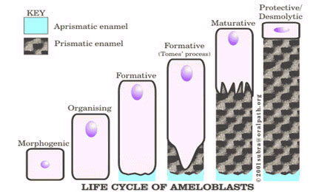
Life cycle of the Ameloblasts

Slide 14
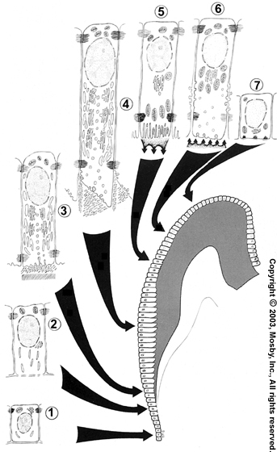
Morphogenic stage
Organizing/Differentiation stage
Secretory/Formative stage
Maturation stage
Protective stage
Desmolytic stage
Attachment stage

Slide 15
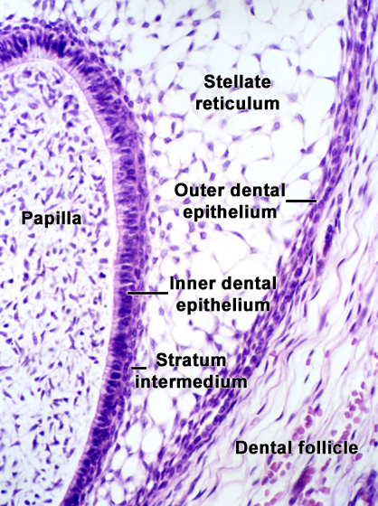
Morphogenic stage
Pre Secretory Stage
Cells of dental organ along with dental papilla react by differential growth to produce the shape of the crown- during Bell Stage.
Peripheral to the short low columnar cells of IEE; lie the stratum intermedium, stellate reticulum & OEE.

Slide 16
Cells of enamel epithelium are
separated from dental papilla by
a basement membrane.
Cell free zone b/w IEE &
dental papilla is present.
These cells have large centrally
located nuclei.
Poorly developed Golgi elements in
the proximal portion of the cells
(facing stratum intermedium)
Mitochondria are scattered throughout the cell.

Slide 17
ORGANIZING STAGE
IEE cells interact with the cells of dental papilla; which differentiate into odontoblasts.
IEE cells are now called as Ameloblasts.
IEE cells become tall & columnar & the nuclei become aligned at the proximal ends of the cells adjacent to stratum intermedium.
During last phase; formation of dentin by odontoblasts begin.

Slide 18
Cell free zone b/w IEE & dental papilla
disappears because of the elongation of
epithelial cells towards the papilla.
Fine acidophilic granules(mitochondria)
are centered in the proximal part of cell.
Golgi Complex increases in volume &
migrates distally from its proximal
position to occupy a major portion of
the supra nuclear cytoplasm
Amount of r ER also increases significantly.
“Reversal of functional polarity”

Slide 19
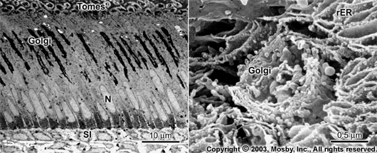
A 2nd junctional complex develops at the distal extremity of the cell, compartmentalizing the ameloblast into a body & a distal extension called Tomes process against which enamel forms.
Thus, ameloblast becomes a polarized cell with the majority of its organelles situated in the cell body distal to the nucleus.

Slide 20
During the terminal phase of organizing stage the formation dentin by odontoblasts begins.
“Reversal of nutritional source”

Slide 21
Secretory/Formative stage
After 1st layer of dentin has been formed, ameloblasts enter their formative stage
Presence of dentin is necessary for the beginning of enamel matrix formation.
Ameloblasts retain almost the same length & arrangement during formation of enamel matrix

Slide 22
Fine structure of secretory ameloblasts
reflects their intense synthetic &
secretory activity.
Extensive Golgi complex form cylindrical
organelle surrounded by numerous
cisternae of r ER- occupying large part of
supranuclear compartment.

Slide 23
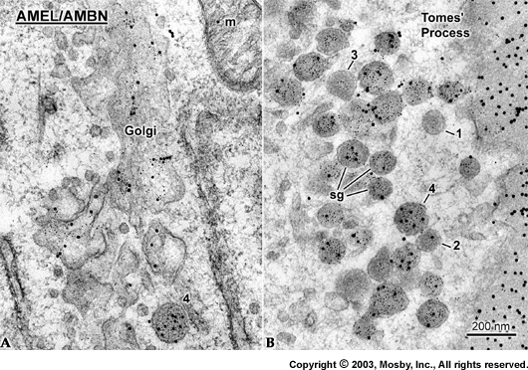
Messenger RNA for enamel proteins is translated by ribosomes on the membrane of r ER.
Synthetic proteins are translocated into its cisternae.
Post translational modifications occur in Golgi complex.
These granules migrate to the Tomes’ process.

Slide 24
When enamel formation begins, Tomes process comprises only a proximal portion.
The content of secretory granules is released against the newly formed mantle dentin along the surface of the tomes process to form an initial layer of enamel that does not contain enamel rods.
The first hydroxyapatite crystals formed interdigitate with the crystals of dentin.

Slide 25
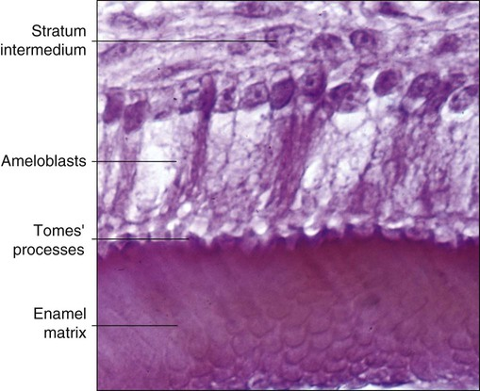

Slide 26
As initial enamel is formed, ameloblasts migrate away from the dentin surface &
develop the distal portion of Tomes’ process as an outgrowth of the proximal portion.
When the distal portion of Tomes process is established, secretion of enamel proteins becomes staggered and is confined to two sites.

Slide 27
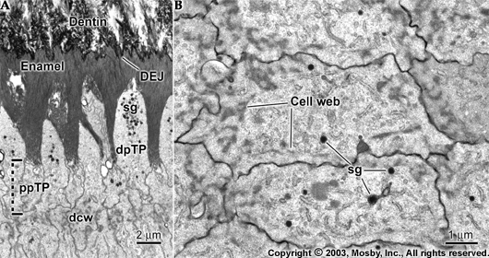

Slide 28
Secretion from the first site (on the proximal part of the process around the periphery of the cell) results in the formation of enamel partitions that delimit a pit in which resides the distal portion of the Tomes process.
These partitions are not distinct units and in effect form a continuum throughout the enamel layer called interrod enamel.

Slide 29
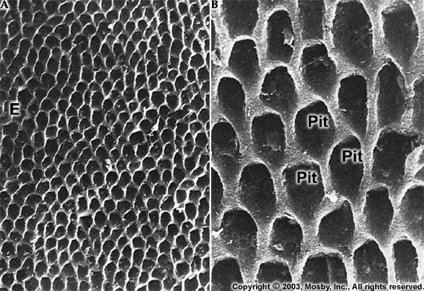

Slide 30
Secretion from the second site (along one face of the distal portion of the Tomes process) later fills this pit with matrix that regulates formation of the rod enamel.
Formation of interrod enamel is always a step ahead because the interrod enamel must delimit the cavity into which rod enamel is formed.
Rod and Interrod enamel differ only in the orientation of their crystallites.

Slide 31
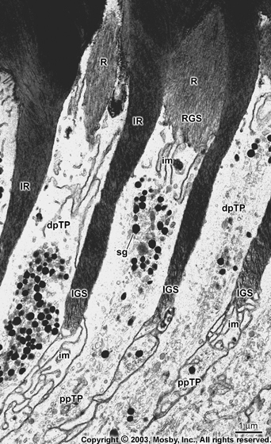

Slide 32
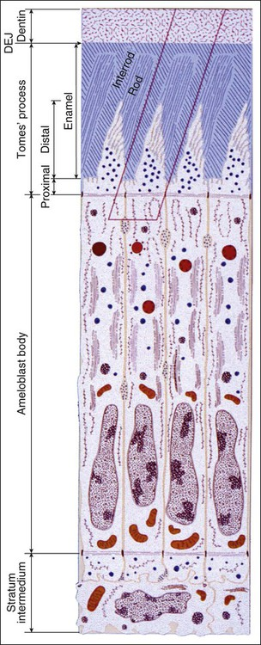
Organization of secretory stage of Ameloblast:

Slide 33
The distal Tomes process eventually is squeezed out of existence, creating a narrow space along most of the circumference between rod and interrod enamel that fills with organic material forming the rod sheath.
When the outer portion of the enamel layer is being formed, the shape of the distal portion of Tomes process is altered and its orientation to the cell body changes.
As a result rods in the outer third of the enamel have a slightly different profile.

Slide 34
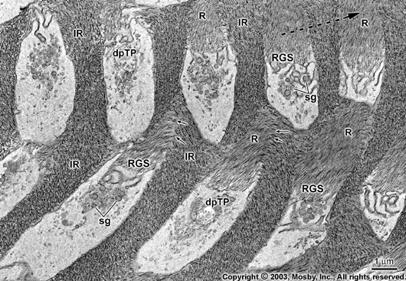

Slide 35
Eventually the ameloblast becomes shorter and loses its distal portion of Tomes process.
Because rods form in relation to the distal portion of Tomes process, the final few enamel increments just as the first few do not contain any rods.

Slide 36
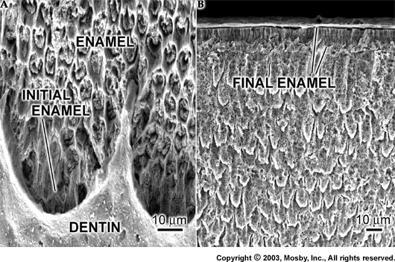

Slide 37
Maturation Stage
After most of the thickness of enamel has been formed in occlusal or incisal area, enamel maturation occurs.
Ameloblasts are reduced in size & cells of stratum intermedium loose their cuboidal shape & assume a spindle shape.
Recognizing individual cell layers (SR, SI ) is no longer possible.
About 2/3rd of formation time of enamel is occupied by the maturation stage.

Slide 38
Crystal growth during maturation
stage occurs at the expense of matrix
proteins & enamel fluid that are
largely absent from mature enamel.
Although ameloblasts are now referred
to as postsecretory cells, they still
synthesize & secrete proteins as they still
exhibit a prominent Golgi complex, a
structural feature consistent with such activity.

Slide 39
Transitional phase: It involves reduction in height of the ameloblasts & a decrease in their volume & organelle content
During maturation stage, ameloblasts undergo programmed cell death ( Apoptosis)
The initial ameloblast population is thus reduced by roughly half during amelogenesis.

Slide 40
Modulation- The cyclic creation , loss & re creation of a highly invaginated ruffle ended apical surface or a smooth end is called modulation.
The significance of modulation is uncertain but they seem to be related to Ca transport & alteration in permeability of the enamel organ.

Slide 41
Modulated Cells
Ruffle ended
Proximal junctions are leaky.
Distal junctions are tight
Show considerable endocytotic activity
Contain numerous lysosomes, Ca binding proteins & Ca ATPase
Allow incorporation of inorganic material
Smooth ended
Proximal junctions are tight.
Distal junctions are leaky
Show little endocytotic activity
Almost no membrane Ca- ATPase activity
Permit free passage of protein fragments & water

Slide 42
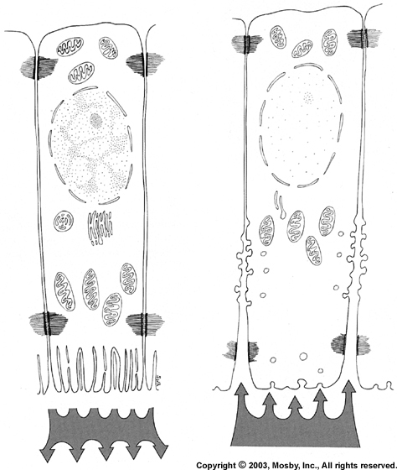
Ruffle ended Ameloblast
Smooth ended Ameloblast
Proximal leaky junctions
Proximal tight junctions
distal tight junctions
distal leaky junctions

Slide 43
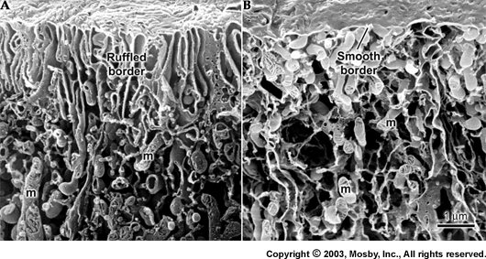

Slide 44
It has been shown that for every unit cell, of hydroxyapatite crystals that are formed, 8 H+ protons are released in the extracellular environment, lowering the pH.
This increased acidic conditions if allowed to continue, could result in crystal dissolution.
During the secretory phase of amelogenesis, the enamel matrix proteins could provide the buffering effect.
1

Slide 45
However, during maturation the protein content of the matrix decreases significantly and another buffering system must take over.
The generation of bicarbonate anions by carbonic anhydrase has been proposed as a buffering mechanism during enamel maturation.
Carbonic anhydrase is abundant in apical cytoplasm of ruffle ended ameloblasts.
Later this buffer system fails to keep pace with crystal growth.
2

Slide 46
Although the exact mechanism triggering a change from ruffle-ended to smooth-ended is not known, it has been suggested to be related to the drop of pH occuring beneath ruffle ended ameloblasts during active crystal growth.
Following the transition from ruffle-ended to smooth-ended ameloblasts, there is an abrupt rise in pH.
The leaky apical junctions of smooth-ended ameloblasts allow for rapid influx of fluids and buffering components (serum bicarbonate) into the enamel.
3

Slide 47
Re-establishment of a pH balance may be a part of the triggering mechanism that signals the modulation from smooth-ended to ruffle-ended ameloblasts.
Areas of enamel covered by ruffle-ended ameloblasts are mildly acidic (-pH 6.1-6.8), whereas areas covered by smooth-ended ameloblasts appear nearly physiologic (-pH 7.2-7.4)

Slide 48
Mineral pathway and mineralization
It takes place in two stages:-
First, an immediate partial mineralization occurs in the matrix segments and the interprismatic substance as they are laid down.
Initial influx is 25-30% of the total mineral content
The second stage or maturation is characterised by gradual completion of mineralization.
Each rod matures from the depth to the surface, and sequence of maturing rods is from cusps or incisal edge toward the cervical
Notes:
Diagram?

Slide 49
In the initial phase, acquisition of the matrix by the apatite crystal and its lengthwise growth produces long ribbonlike crystals about 1.5nm thick and 30nm wide.
During the maturation phase, the mineral content is increased by growth of existing crystals in thickness and width not by the addition of more crystals.
In mature enamel, the crystals are of somewhat hexagonal cross section, measuring about 25nm thick and 65nm wide.

Slide 50
3 theories of crystal formation
First theory -Nucleation- formation of crystals upon substrates acting as models or templates (eg.in collagenous tissue where crystallites are deposited along collagen fibrils)
Second theory-mineral is initially deposited as an amorphous calcium phosphate (ACP). Subsequently it becomes hydrolysed to crystalline hydroxyapatite
Third theory-neither a nucleation site nor an amorphous precursor is necessary and that tissues are supersaturated with respect to calcium and phosphorus & will precipitate crystals spontaneously.

Slide 51
Mineralization of enamel
No matrix vesicles are associated with mineralization of enamel.
Immediate formation of crystallites occur in newly secreted enamel protein.
Crystals grow by fusion of nucleation sites.
Tuftelin helps in the initial mineralization of enamel.

Slide 52
Enamel proteins
90 percent of enamel proteins are Amelogenins.
10 percent are Nonamelogenins
(1. Enamelin, 2. Ameloblastin, 3. Tuftelin)

Slide 53
Amelogenin
Major component of enamel matrix proteins.
It undergoes extracellular degradation by proteolytic enzymes into smaller low molecular weight fragments like tyrosine rich and leucine rich amelogenin polypeptide which are suggested to have specific functions as in regulating crystal growth.
Unique protein-hydrophobic and has a tendency to aggregate or clump.

Slide 54
They form thixotropic gels in that they can be easily squeezed out by the pressure from the growing crystals.
Amelogenins have been shown to form minute nanospheres between which enamel crystals form.
Thus, it is suggested to have a functional role in maintaining spaces between the crystals.
Experimentally, absence of amelogenin, resulted in the formation of hypoplastic teeth.

Slide 55
Non-Amelogenins
Enamelin and Ameloblastin are reported to help in nucleation and growth of crystals.
Interacts strongly with apatite.
Play important role in mineralization.
Tuftelin is localized to DE junction and is involved in cell signaling.
Recently, amelotin a new protein was reported to be secreted by maturative ameloblast.
This protein is suggested to help in enamel formation.

Slide 56
Enzymes
2 classes of proteinases are involved in the extracellular processing and degradation of enamel proteins.
MMP-20(Enamelysin) short term processing of newly secreted matrix proteins.
Serine proteinase family(1) functions as bulk digestive enzymes.

Slide 57
Protective Stage
When enamel has completely developed & fully mineralized, the ameloblasts cease to be arranged in a well defined layer.
They can not be differentiated from the cells of SI & OEE.
These cell layers then form a stratified epithelial covering of the enamel, the so called reduced enamel epithelium.

Slide 58
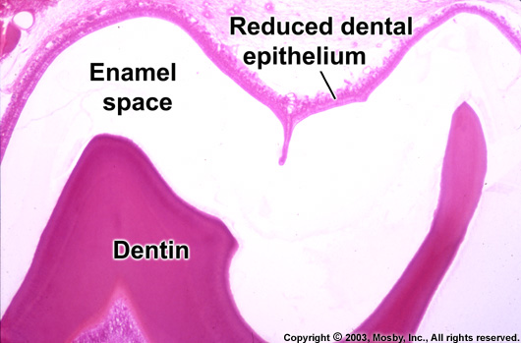
It functions as a protective covering over mature enamel by separating it from the connective tissue until the tooth erupts.
Due to breach in REE, if Connective Tissue contacts enamel, anomalies like cementum over the enamel may develop or enamel may be resorbed.

Slide 59
Desmolytic Stage
The REE proliferates and seems to induce atrophy of the connective tissue separating it from the oral epithelium, so that fusion of the two epithelia can occur.
Epithelial cells elaborate enzymes that are able to destroy connective tissue fibres by desmolysis.
Premature degeneration of REE may prevent the eruption of a tooth.

Slide 60
Attachment Stage
Junctional or attachment epithelium (REE + Oral epi)
Epithelial attacment (REE+enamel surface)
Attached epithelium (REE forms a cuff/band around the tooth).

Slide 61
3 BASIC STAGES OF AMELOGENESIS
Morphogenic stage
Organizing/Differentiation stage
Secretory/Formative stage
Maturation stage
Protective stage
Desmolytic stage
Attachment stage
Pre- Secretory stage
Secretory stage
Post- Secretory stage

Slide 62
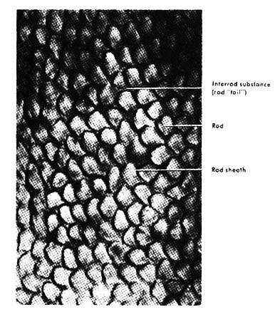
STRUCTURE OF ENAMEL
Enamel rods
It is the basic structural unit of enamel owes its existence to highly organized pattern of crystal orientation.
The shape of the rod is cylindrical and is made up of crystal with their long axis running parallel to longitudinal axis of the rod.

Slide 63
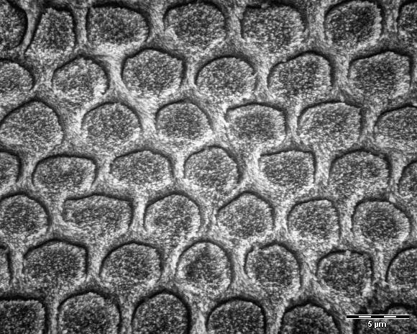
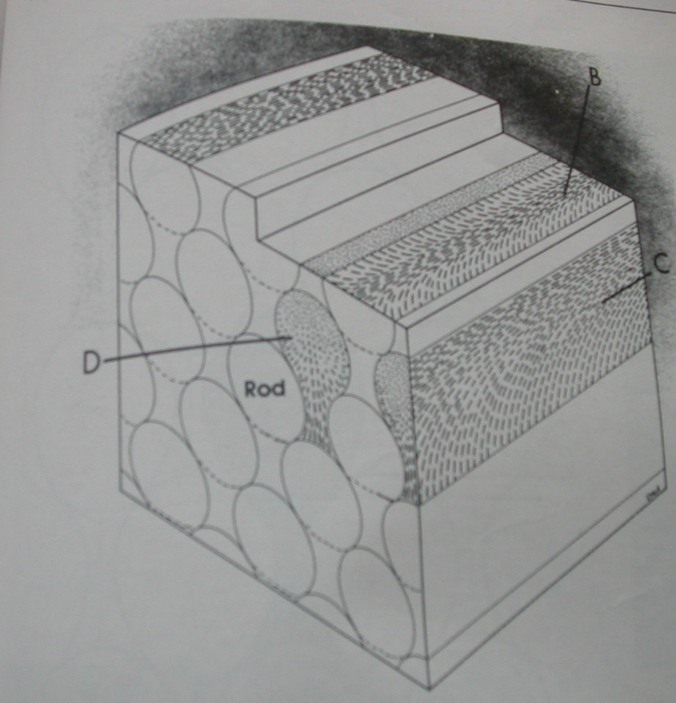
keyhole pattern

Slide 64
The number of rod has been estimated as ranging from 5 million in the lower lateral to 12 million in upper 1st molar.
From Dentino-enamel junction the rods run some what tortuous coarse outward to the surface of the tooth.
The rod located in the cusps the thickest part of enamel are longer than those at the cervical area of the teeth.

Slide 65
The diameter of the rod averages 4μ.
Diameter of the rod increases from the dentino enamel junction towards the surface of enamel at a ratio of about 1:2.
Surrounding each enamel rod is the rod sheath which contain more organic substance than the rod therefore is not susceptible to demineralization by acid.
Enamel rod and rod sheath are held together by an interprismatic substance.
In the interrod region, crystals are oriented in a different direction from those making up the rod.

Slide 66
Submicroscopic structures
They are arranged in a keyhole pattern/ paddle shaped where tail of one rod is fitted into heads of 2 rods.
Rods measure 9 um in length and 5 um in breadth.
Body or Head of rod is near occlusal & incisal surface, where as tail points cervically.
Notes:
1 rod is formed by 4 meloblasts, 1 ameloblast contributes to 4 rods

Slide 67
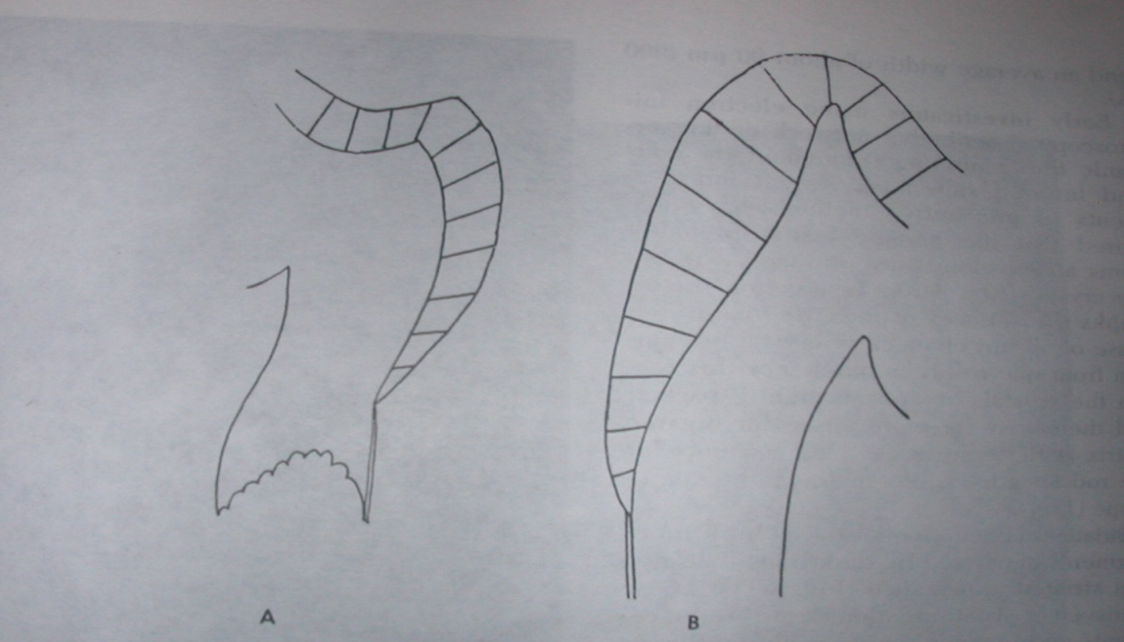
Direction of Enamel Rods
Rods are oriented at right angles to dentin surface.
These follow same pattern in primary and permanent teeth except in cervical region, where rods are almost horizontal in primary teeth, whereas in permanent teeth, they are inclined apically.

Slide 68
Transverse Striations
Each enamel rod is built up of segments separated by dark lines that give it a striated appearance.
The rods are segmented because the enamel matrix is formed in a rhythmic manner.
In humans these segments seem to be a uniform length of about of 4 um. Reflects a diurnal rhythmicity in rod formation.

Slide 69
Gnarled enamel
Over the cusps of teeth, rods appear twisted around each other in a seemingly complex arrangement.
The bundles of rods seem to interwine more irregularly.
This optical appearance of enamel is called Gnarled enamel.

Slide 70
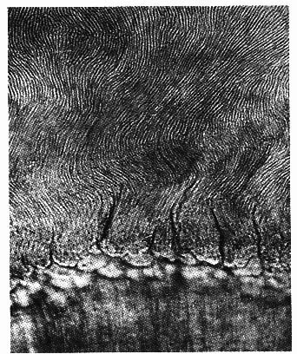

Slide 71
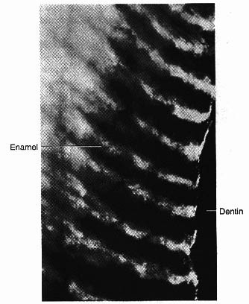
Hunter-Schreger bands
The change in direction of enamel rods as a functional adaptation to minimize cleavage in the axial direction under influence of masticatory forces produce an optical appearance called Hunter-Schreger bands.

Slide 72
Bands in which rods are sectioned more transversely are called diazones (light bands) those in which the rods are sectioned more longitudinally are termed parazones. (dark bands)
They are most clearly seen in longitudinal ground section viewed by reflected light.
Seen on the inner 2/3rd of enamel.

Slide 73
Incremental lines of Retzius
These are incremental growth lines appearing as brownish bands in ground sections of enamel reflecting successive apposition layers of enamel.
In transverse sections, these appear as concentric circles.
In longitudinal sections, lines transverse the cuspal and incisal areas in a symmetrical arc pattern.
These lines reflect variations in structure & mineralization, which occurs during growth of enamel

Slide 74
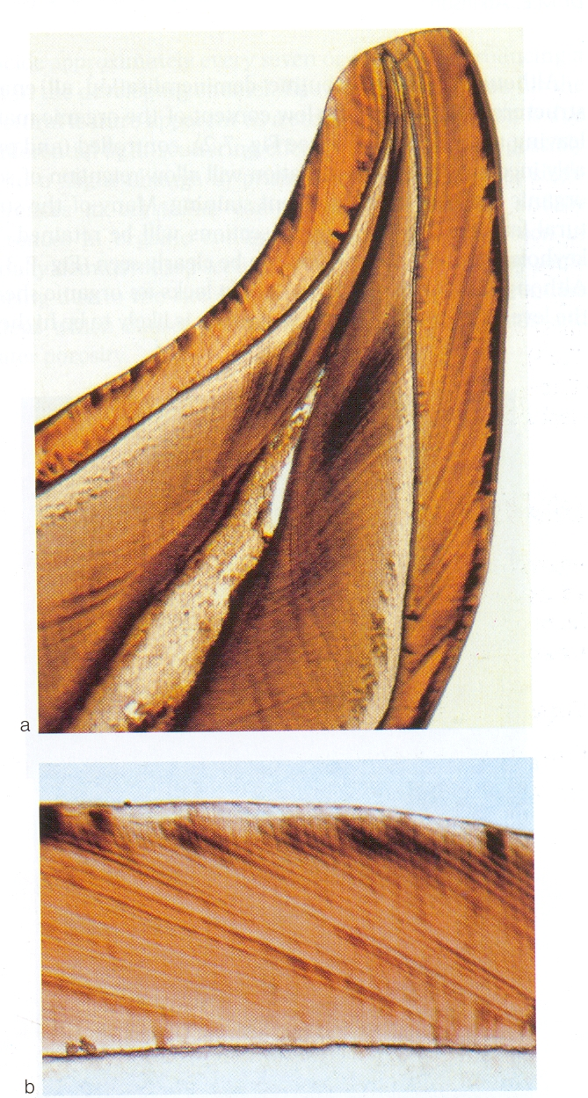
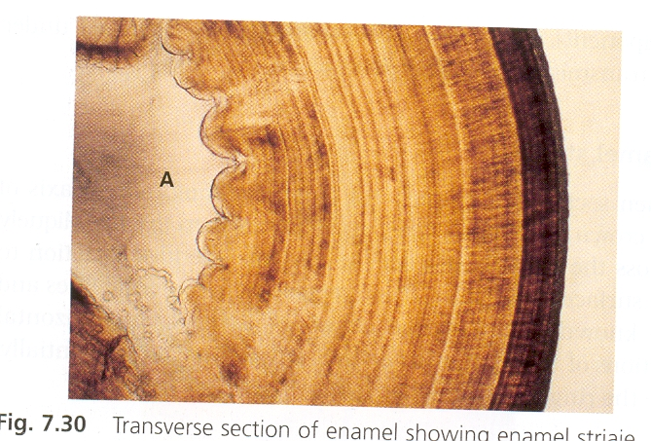

Slide 75
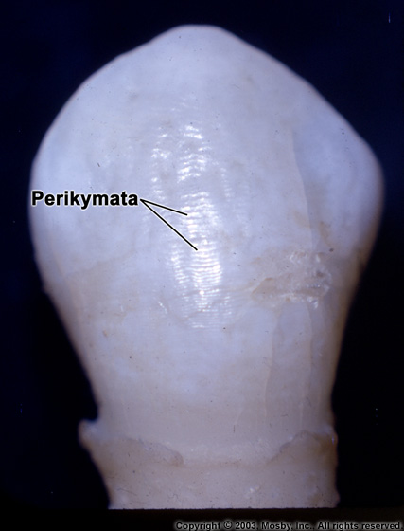
Perikymata
The striae of Retzius often extend from the DEJ to the outer surface of enamel where they end in shallow
furrows k/a Perikymata.
When the circle formed by Striae of Retzius is incomplete at the enamel surface, a series of alternating grooves called Imbrication lines of Pickerill, are formed.
The elevations between the grooves is called Perikymata

Slide 76
Neonatal line
The enamel of the deciduous teeth develops partly before and partly after birth.
The boundary between the two portions of enamel in the deciduous teeth is marked by an accentuated incremental line of Retzius, the neonatal line or neonatal ring.
It appears to be the result of the abrupt change in the environment and nutrition of the newborn infant.

Slide 77
Enamel Cuticle
Nasmyth’s membrane/ Primary enamel cuticle
A delicate membrane which covers the entire crown of newly erupted tooth but is soon removed by mastication.
Secreted by ameloblasts after completion of enamel formation.
The membrane is replaced by an organic deposit called pellicle which is the precipitate of salivary proteins. Micro-organisms may invade the pellicle and form plaque, a potential precursor to dental disease.

Slide 78
Enamel lamellae
Enamel lamellae extend for varying depth from surface of enamel towards DEJ.
They are leaf like structures, which may even penetrate into dentin.
They consist of organic material, with little mineral content.
May be a site of weakness in a tooth and may form a road of entry for bacteria that initiate caries.

Slide 79
Lamellae may develop in planes of tension. When rods cross such a plane, short segment of rod may not calcify.
If disturbance is more severe a crack may develop which may be filled by surrounding cells, (if tooth is unerupted) or by organic material from oral cavity (if tooth is erupted). So, 3 types of lamellae can be differentiated.
Type A: - Lamellae composed of poorly calcified rod segments (in enamel)
Type B: - Lamellae filled with degenerated cells (May reach into dentin)
Type C: - Lamellae filled with organic matter from saliva

Slide 80
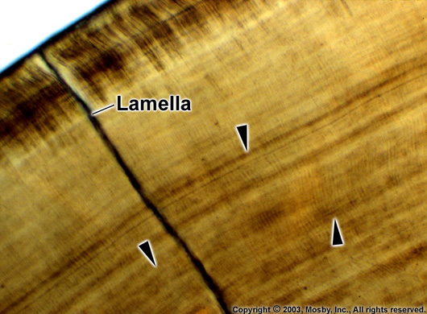

Slide 81
Enamel Cracks
These are narrow fissure like structures seen on enamel surfaces.
These are the outer edges of enamel lamellae, which extend for varying distances and are perpendicular to DEJ.
Enamel cracks disappear when sections of enamel are decalcified but enamel lamellae persist. So we can differentiate between the two.

Slide 82
Enamel Tufts
These are the geologic faults best seen in transverse sections of enamel.
Enamel tufts project from DEJ for a short distance into the enamel about one fifth to one third of its thickness.
These are hypomineralized & contain greater concentration of enamel proteins than the rest of enamel.
They are believed to occur developmentally because of abrupt changes in the direction of group of rods that arise from different regions of the scalloped DEJ.

Slide 83
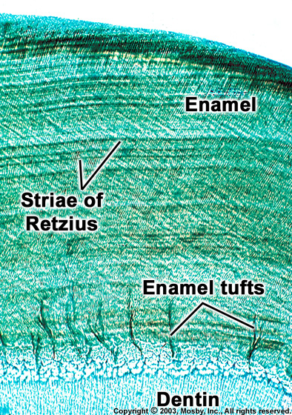
Enamel Tufts

Slide 84
Dentinoenamel junction
The junction between enamel and dentin is established as these two hard tissues begin to form and is seen as a scalloped profile in cross section.
The shape and nature of the junction increases the surface area probably increasing the adherance between dentin and enamel.
Thus prevents the shearing of enamel during function.

Slide 85
Enamel Spindles
Sometimes the odontoblastic processes pass across the DEJ into enamel.
When their ends are thickened, they are called as enamel spindles.
In ground sections of dried teeth, organic content of spindles disintegrates & replaced by air. So, it appears dark in transmitted light.
These spindles may serve as pain receptors, thereby explaining enamel sensitivity by some patients during tooth preparation.

Slide 86
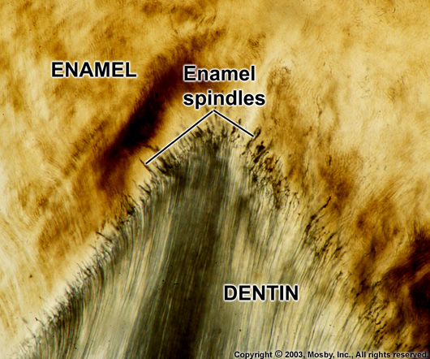

Slide 87
Aprismatic enamel
Many teeth exhibit a superficial layer of enamel that is devoid of typical rod architecture.
Found in most deciduous and occurs near the cervical region of many permanent teeth.
It is believed to be caused by the cessation of secretory activity by the ameloblast and the retraction of Tomes process.

Slide 88
The extension of the Tomes process is thought to influence crystal orientation, it follows that in the absence of the process the characteristic shift in crystal orientation found in the interrod areas will be lacking.
It is this shift in orientation that is primarily responsible for rod or prism morphology.
It may also be observed at the DEJ.
It is presumed that aprismatic enamel at the DEJ is secreted by the preameloblasts prior to the formation of Tomes process.

Slide 89
Enamel pits, caps and broches
Surface of enamel is not even. Shows pits and elevations.
Pits– 1-1.5 µ--- represent ends of ameloblst lost after enamel formation.
Elevations – as a result of deposition of enamel and debris of enamel organ.
Smaller elevations: 10-15 µ : enamel caps
Larger elevations: 30-50 µ : enamel brochs

Slide 90
Age changes
Enamel wears away slowly with age.
Regressive alterations Attrition
Abrasion
Erosion
Abfraction
Darkens in color
Reduced permeability
Surface composition alters

Slide 91
Notes:
In cej--- max tensile strength is located

Slide 92
CLINICAL ASPECTS

Slide 93
ENAMEL HYPOPLASIA
Hypoplasia defined as incomplete or defective formation of enamel matrix
Two types of enamel hypoplasia:
1.Hereditary- Amelogenesis Imperfecta
2.Environmental enamel hypoplasia

Slide 94
Amelogenesis Imperfecta
A complex inheritance pattern gives rise to amelogenesis imperfecta, a structural defect of the tooth enamel.
It may be differentiated into 3 main groups:
Hypoplastic
Hypocalcified
Hypomature

Slide 95
Aetiology of Amelogenesis Imperfecta is related to the alteration of genes involved in the formation and maturation of enamel.
The AI phenotypes vary widely depending on the specific gene involved, the location and type of mutation, and the corresponding putative change at the protein level.
Different inheritance patterns such as X-linked, autosomal dominant and autosomal recessive types have been reported and 14 subtypes of AI are recognized.

Slide 96
Hypoplastic type -There is a disturbance in the differentiation or viability of ameloblasts and this is reflected in defects in matrix formation upto and including total absence of matrix.
Hypocalcification type -reflected in defects of matrix structure and of mineral deposition.
Hypomaturation type -alteration in enamel rod and rodsheath structures.

Slide 98
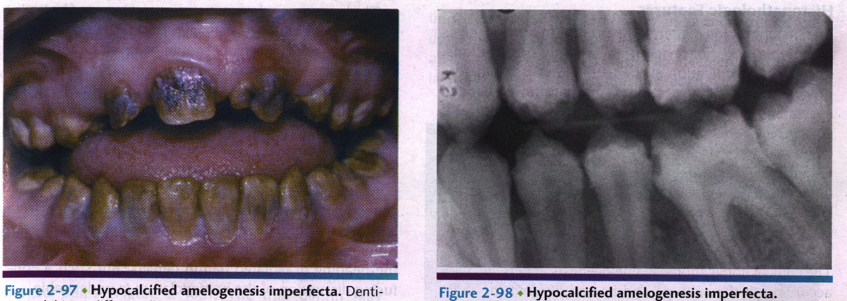

Slide 99
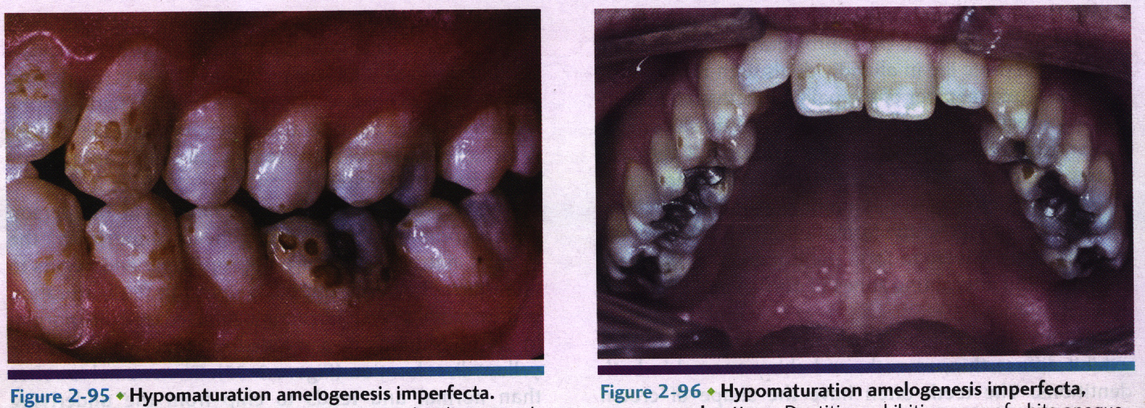

Slide 100
ENVIRONMENTAL ENAMEL HYPOPLASIA

Slide 101
Factor capable of producing injury to
ameloblast are:
Nutritional deficiency
Exanthematous disease
Congenital syphilis
Hypocalcemia
Birth Injury
Local infection
Injestion of chemicals
Idiopathic causes

Slide 102
Hypoplasia due to nutritional deficiency and exanthematous diseases
It is due to deficiency of Vit.A, C and D.
Exanthematous diseases like measles, chickenpox and scarlet fever are etiologic factors.
The type of hypoplasia occurring from these deficiencies or diseases, is usually of pitting type.
Hypoplasia involves the teeth that form within the first year after birth.
The teeth commonly involved are central, lateral incisor, cuspids and first molar.

Slide 103
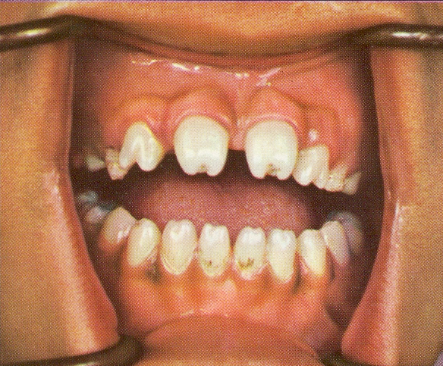
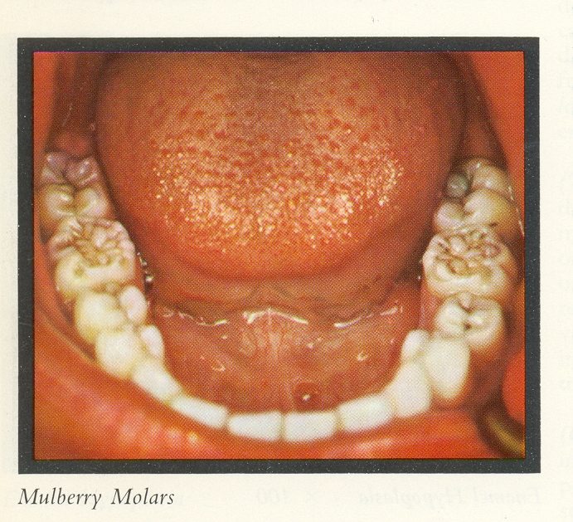
2) Due to congenital syphilis
The hypoplasia due to congenital syphilis is not of pitting variety but presents a pathognomonic appearance.
The teeth affected are maxillary and mandibular permanent incisor (Hutchinson teeth) and first molar (Mulberry molars).

Slide 104
Due to hypocalcemia
In tetany the serum calcium level may fall as low as 6 to 8 mg/100 ml and at this level hypoplasia is frequently produced in teeth developing concomitantly.
This type is usually of pitting variety.

Slide 105
4) Due to local infection
This type of hypoplasia occasionally seen in single tooth, most commonly affected teeth are permanent maxillary incisor or maxillary premolars.
Degree of hypoplasia may range from mild brownish discolouration of enamel to even pitting and irregularity of tooth crown.
The affected teeth are referred as Turner’s teeth and condition is called Turner’s hypoplasia.

Slide 106
5 Hypoplasia due to birth injuries
In traumatic births the formation of enamel may even cease at that time.
Common in prematurely born children.
The neonatal ring may be thought as a type of hypoplasia because there is a disturbance produced in the enamel, which is indicative of trauma or change of environment at the time of birth.

Slide 107
6) Due to Flouride (Mottled enamel)
Mottled enamel is a type of enamel hypoplasia due to excessive fluoride content (5ppm) in the drinking water at the time of tooth formation.
Severity increase with increase in amount of fluoride.
Pathogenesis
This type of hypoplasia is due to disturbance of ameloblast during formative stage of tooth development.
Higher level of fluoride interfere with calcification process of matrix.

Slide 108
Clinical features
Depending upon the level of fluoride in water supply there is a wide range of severity
1) Questionable changes characterized by occasional white fleck or spotting of enamel.
2) Mild changes manifested by white opaque area involving more of tooth surface.
3) Moderate and severe changes show pitting and brownish staining of the surface.
Teeth which are moderately or severely effected may show a tendency for wear or fracture of enamel.

Slide 109
Treatment
Stained mottled enamel can be treated by Bleaching
Aesthetically / functionally defective tooth can be restored by Composite/ Labial Veneer / Full crown.

Slide 110
Tetracycline induced defect
When antimicrobial tetracycline are incorporated into mineralization tissue of enamel it will result in a band of brown pigmentation or total pigmentation of enamel.
The degree of damage is determined by the magnitude and duration of tetracycline therapy.

Slide 111
Developmental alterations:
Enamel pearl
The cells of epithelial root sheath remain adherent to the dentin surface, they may differentiate into functioning ameloblasts and form small round islands of enamel called enamel pearls.

Slide 112
ENAMEL ADHESION
Enamel has a low surface energy, surface is relatively inert also contaminated, requires modification to bond.
In 1955 Bunocore pioneered a method called Acid-etch technique.
The effect:
1) It removes old & faulty reacted enamel.
2)It removes residual pellicle ,exposes the inorganic crystallite component.
3)It enhances the enamel porosity.
4)It increases the surface area and surface energy.

Slide 113
Acid etching of enamel surfaces is done for obtaining improved bonding of resins to enamel.
Retention depends maily on a mechanical interlocking. Accordingly, Enamel etching is classified into three different morphologic patterns.
Type I- characterized by preferential removal of rods.
Type-II- Interrod enamel is removed but rods are left intact.
Type-III- Irregular and indiscriminate.

Slide 114
Ameloblasts alone possess the capacity for enamel formation.
If they are destroyed they cannot be replaced.
Thus enamel can neither be repaired biologically nor replaced.
Accordingly fractured, diseased, or otherwise damaged enamel can be repaired only by restorative dental procedures.
Hence, a thorough knowledge of composition, formation and structure of enamel is essential.

