Slide 1
MASTICATION
- ROSHNI RANKAWAT (INTERN)

Slide 2
INTRODUCTION
MASTICATION is the act of chewing food.
It commences with Ingestion and ends with Swallowing.
Structures involved-
Teeth
Lips
Cheeks
Tongue
Palate
Gingiva
Periodontium
The TMJ
Lubricating and enzymatic action of saliva

Slide 3
Food crushed by GRINDING action
Breakdown of food INCREASES SURFACE AREA of food particles
Hence this increases ENZYMATIC ACTION
In this process TONGUE plays an important role since it controls the movement of food and formation of bolus.
For food to be broken down it has to be positioned by the tongue in conjunction with the buccinator muscles of the cheek between the occlusal surfaces of the teeth.

Slide 4
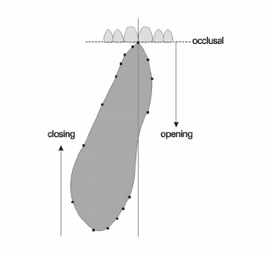
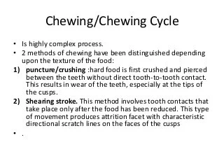

Slide 5
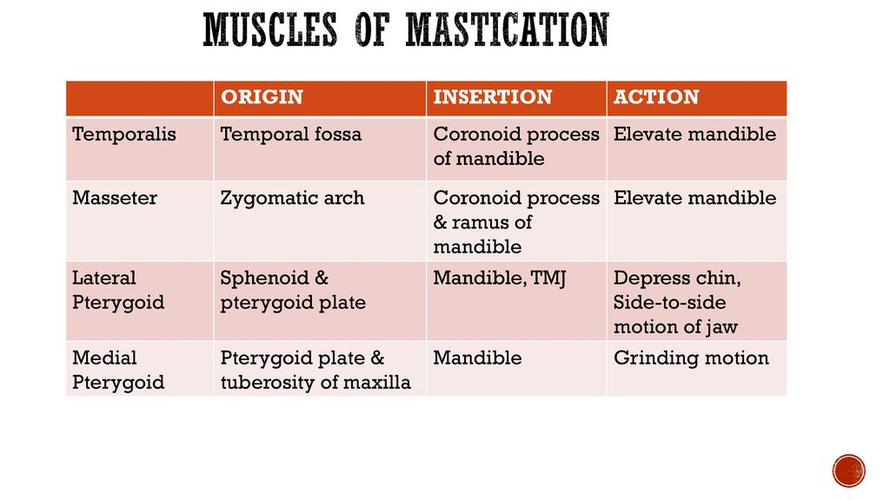

Slide 6
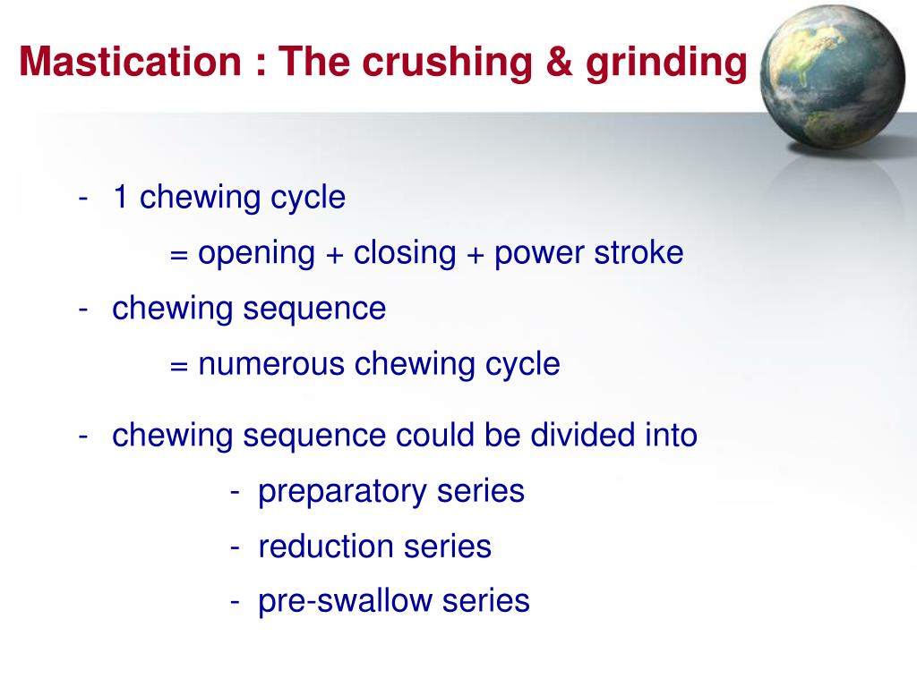

Slide 7
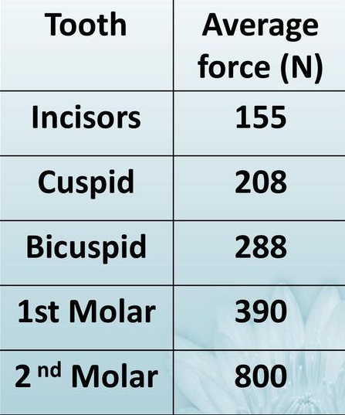
MUSCLE ACTIVITY
ELECTROMYOGRAPHY (EMG) is used to record the muscle movements of jaws and GNATHODYNAMOMETER is used to measure bite forces.
Masticatory muscles exhibit an asynchronous pattern of activity.
There is variation in time of onset, peak activity and rate of decline.
Variation depends on many factors such as species, type of food and rate of breakdown.
Masticatory force on anterior teeth is 10-15 kg and on molars is 50kg

Slide 8
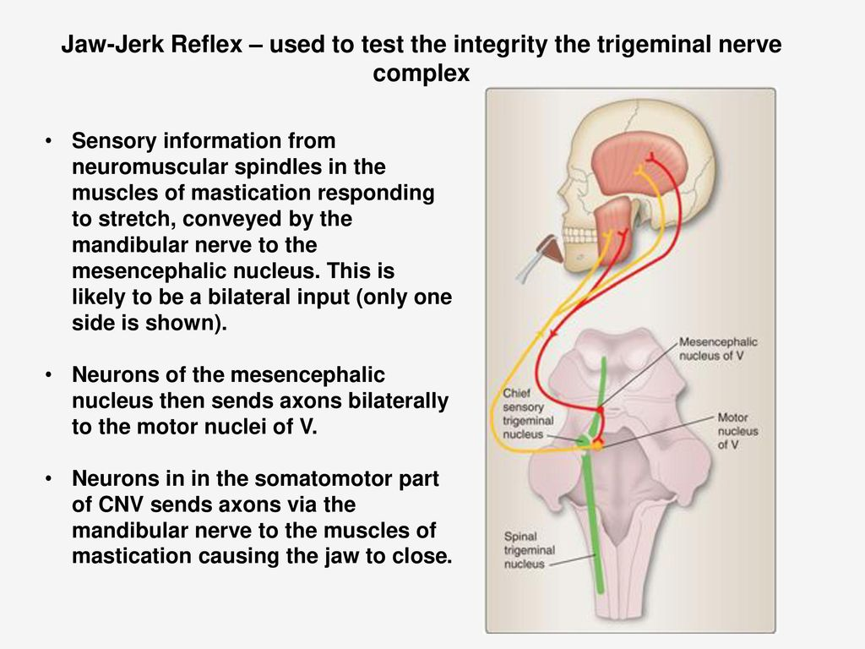

Slide 9
JAW- OPENING REFLEX
Initiated by mechanical stimulation of the PDL and mucosal mechanoreceptors
The result of excitation of jaw opening muscles and inhibition of jaw closing muscles.
This is not a monosynaptic reflex and at least one interneuron is involved in the reflex pathway.
It is initiated by the stimulation of numerous other areas innervated by trigeminal and other cranial nerves.

Slide 10
UNLOADING REFLEX
This helps to protect the teeth during a heavy occlusal load.
It stops the mandibular closure by decreasing masseter and digastric muscle activity.
This sudden reduction is the result of inactivation of muscle spindles

Slide 11
CONTROL OF MASTICATION
It is majorly controlled by- Trigeminal , Hypoglossal , Facial , and possibly other motor nuclei in the brainstem.
Motor and sensory nuclei contained in the brainstem play important role in mastication.
The basic oscillatory pattern of masticatory movements originates in a neural pattern generator located in brainstem.
Interconnected neural circuits form a neural oscillatory network that is capable of generating the pattern of masticatory movements.

Slide 12


