Slide 1


Slide 2
Oral Mucous Membrane
Mucous Membrane:
Moist lining of the gastrointestinal tract, nasal passages and other body cavities that communicate with the exterior
In the oral cavity the lining is called as oral mucous membrane or oral mucosa

Slide 3
Functions of the Oral Mucosa
1.Protection: Barrier for mechanical trauma and microbiological insults
2.Sensation: Temperature (heat and cold), touch, pain, taste buds, thirst;reflexes such as swallowing, etching, gagging and salivating
3. Secretion: Salivary secretion
4. Thermal regulation: Important in dogs not in humans

Slide 4
Organization of the Oral Mucosa

Slide 5
1.Masticatory Mucosa
25% of total mucosa. Gingiva (free, attachedand interdental) and hard palate. Primary mucosa to be in contact with food during mastication.
MASTOCATORY MUCOSA IS USUALLY KERATINIZED.

Slide 6
2.Lining Mucosa:
60% of total mucosa.
Covers the floor of mouth, ventral (underside) tongue, alveolar mucosa, cheeks, lips and soft palate.
Does not function in mastication and therefore has minimal attrition.
Non-keratinized; soft and pliable.

Slide 7
3.Specialized Mucosa:
15% of total mucosa.
Covers dorsal tongue and composed of cornified epithelial papillae.

Slide 8
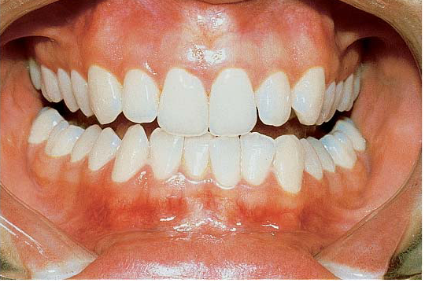
Masticatory Mucosa

Slide 9
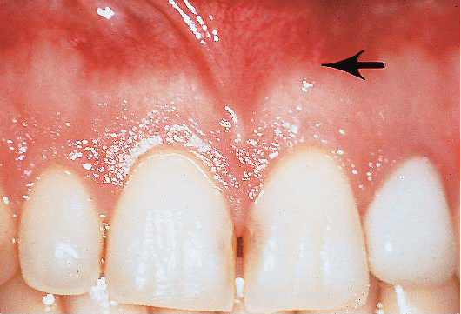

Slide 10
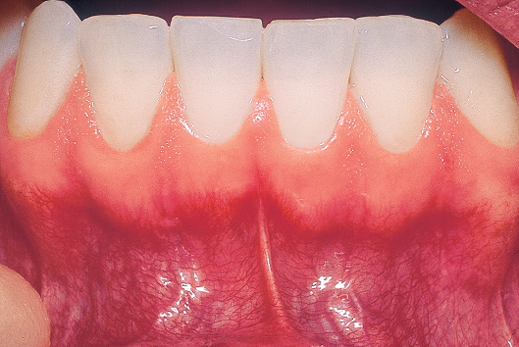

Slide 11
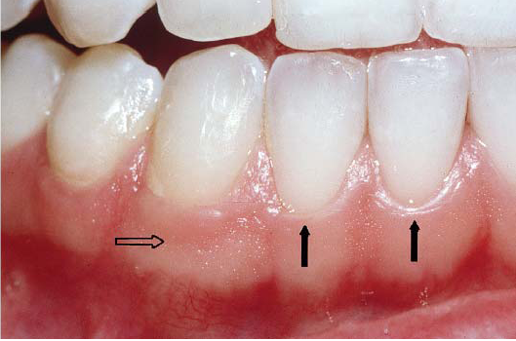

Slide 12
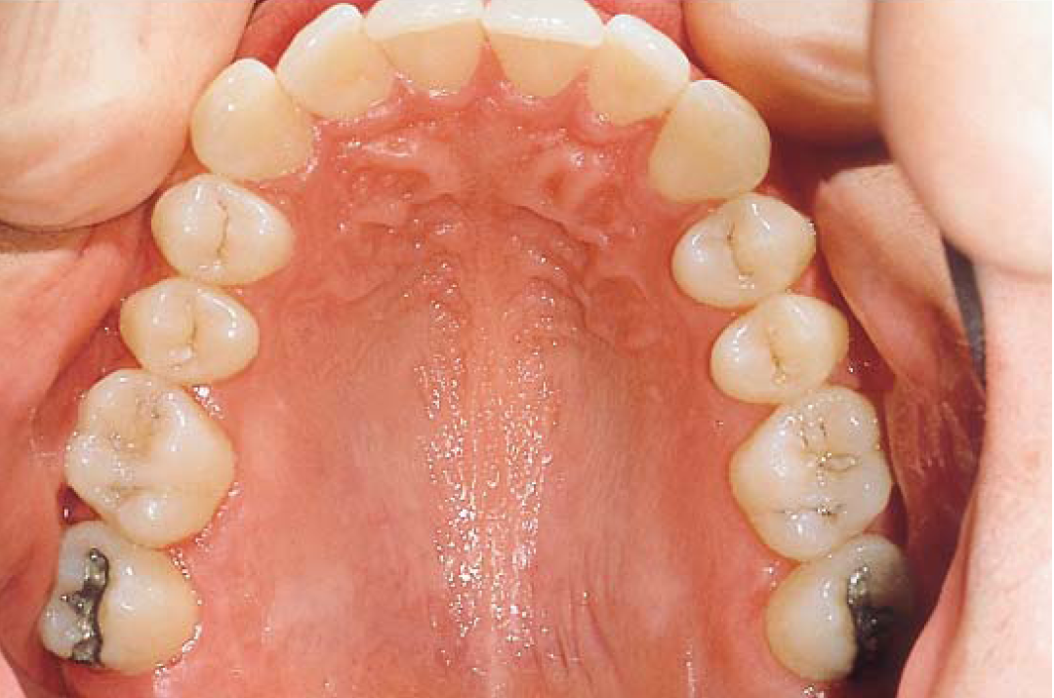
Masticatory Mucosa

Slide 13
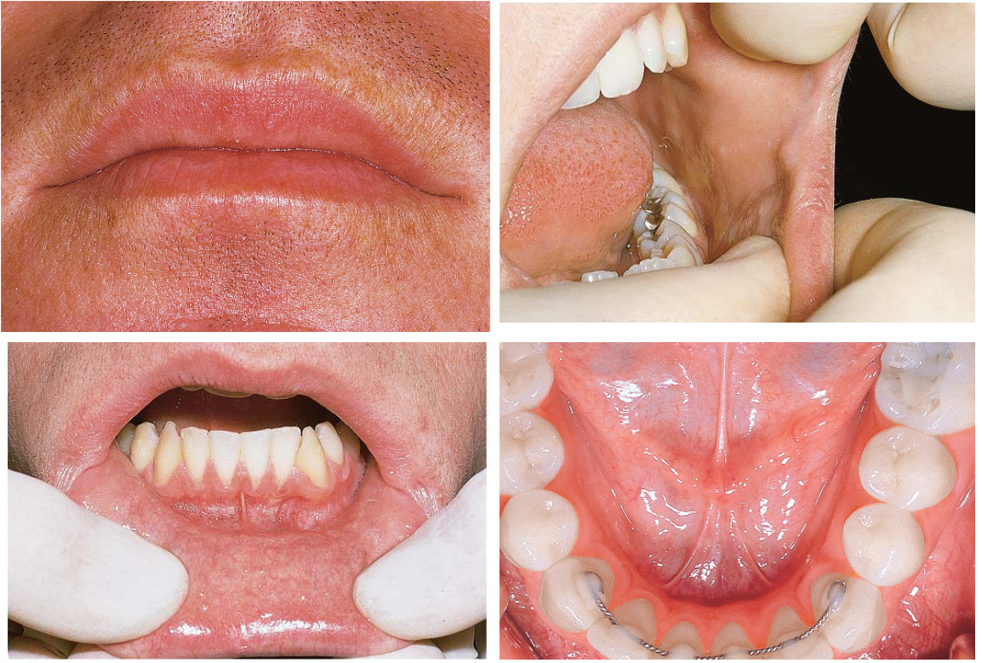
Lining Mucosa

Slide 14
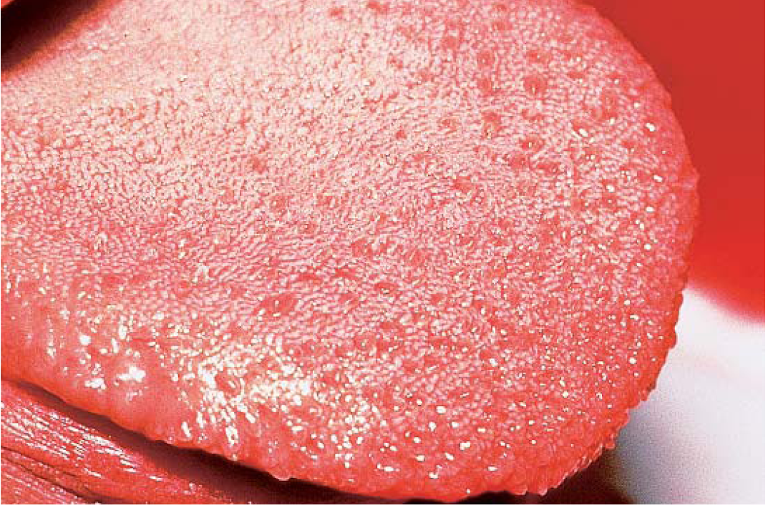
Specialized Mucosa

Slide 15
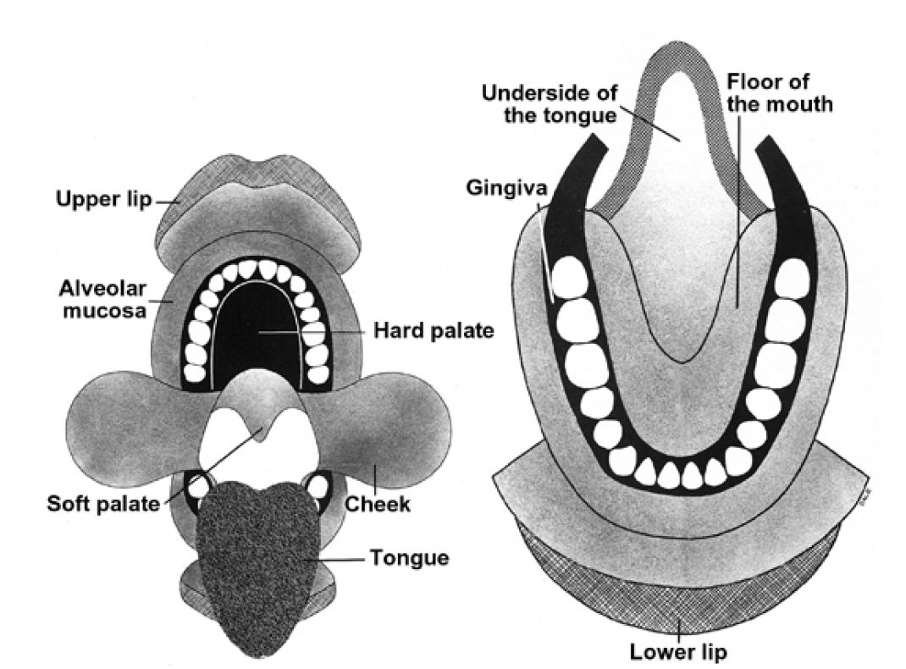

Slide 16
General Features of Oral Mucosa
1.Separated from the skin by vermillion zone of the lips which is more deeply colored than rest of the oral mucosa
2.Factors affecting color of the oral mucosa:
Concentration and state of dilation of the blood vessels in underlying connective tissue
Thickness of the epithelium.
Degree of keratinization.
Amount of melanin pigmentation

Slide 17
Clinically, color of oral mucosa is very important. For example, inflamed oral tissues appear red rather than the normal pale pink

Slide 18
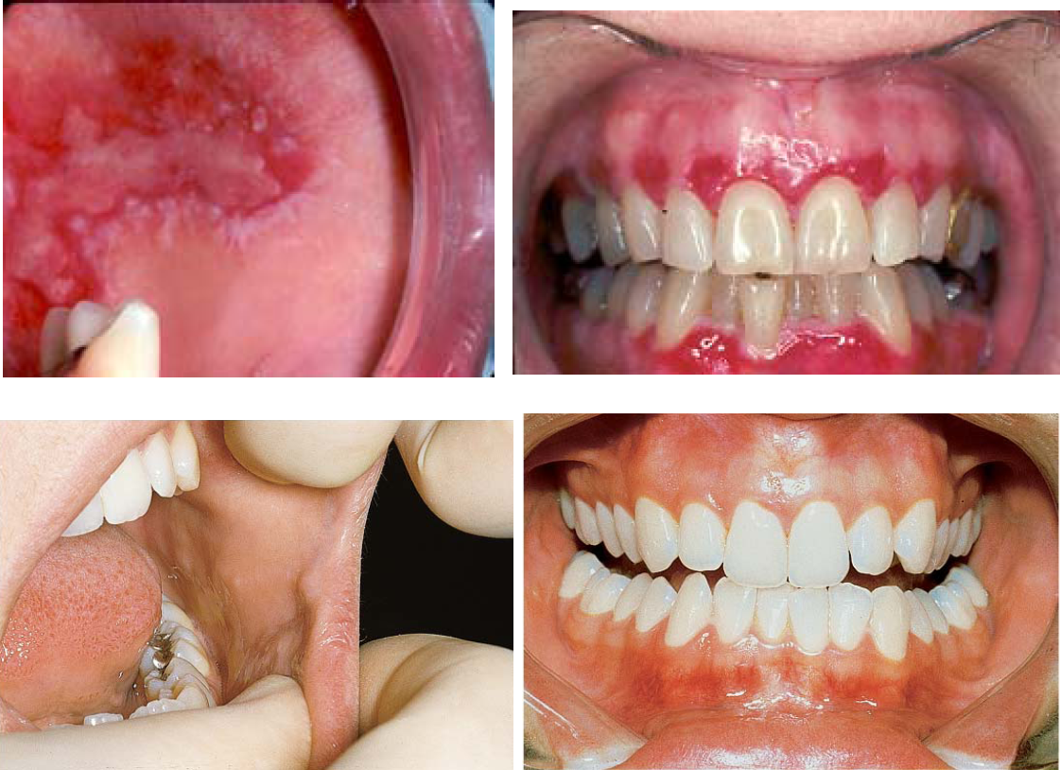

Slide 19
How is the oral mucosa different from skin?

Slide 20
1.Color
2.Moist surface
3.Absence of adnexal skin structures such as hair follicles, sweat glands and sebaceous glands (exception in Fordyce’s disease)
4.Fordyce’s disease: Sebaceous glands in oral cavity predominantly in upper lip, buccal mucosa and alveolar mucosa
5.Presence of minor salivary glands in oral mucosa
6.Texture of surface: Oral mucosa is smoother than the skin (few exceptions like dorsal tongue –due to papillae; hard palate –rugae; gingiva –stippling)

Slide 21
7.Firmness: Oral mucosa varies in its firmness. For example buccal mucosa and lips are loose and pliable whereas the gingiva and hard palate are firm so critical clinically while giving injections

Slide 22
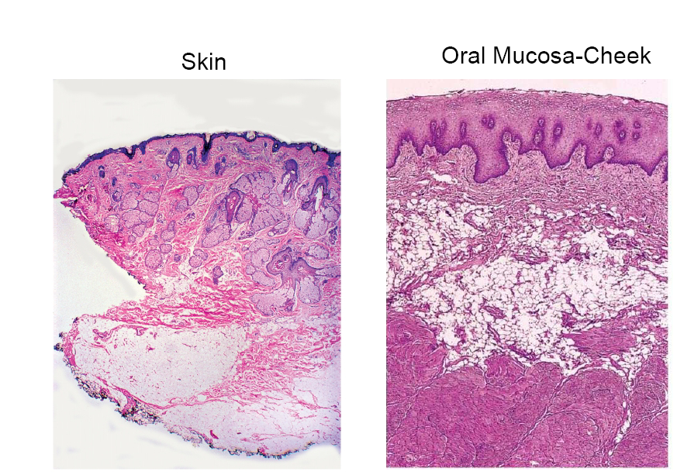

Slide 23
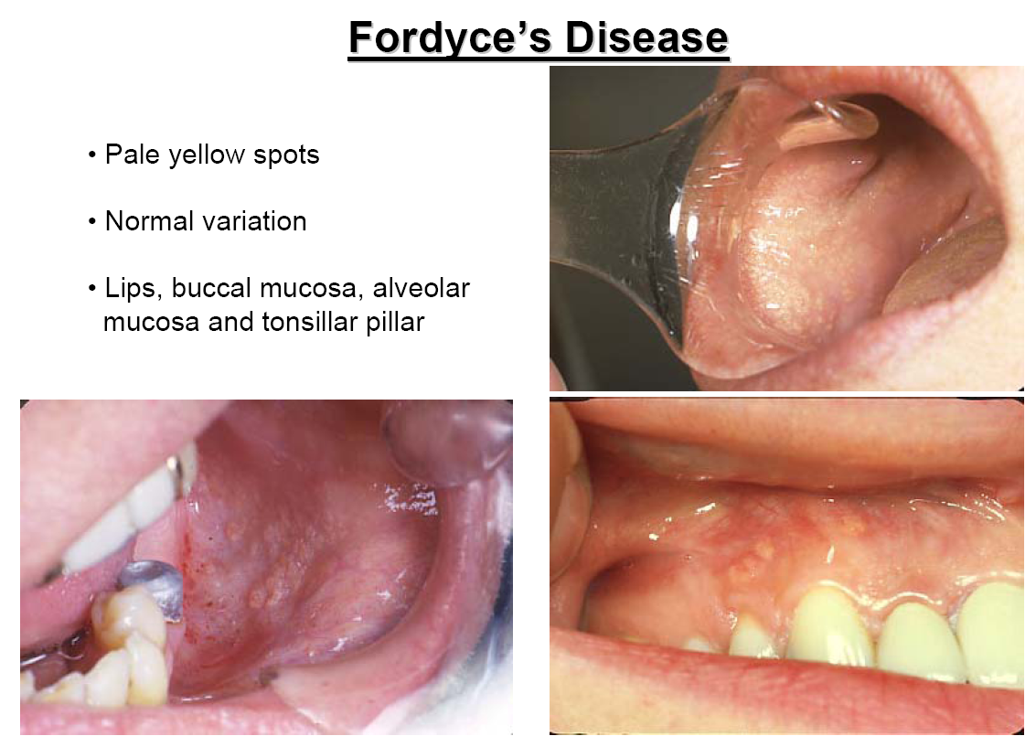

Slide 24
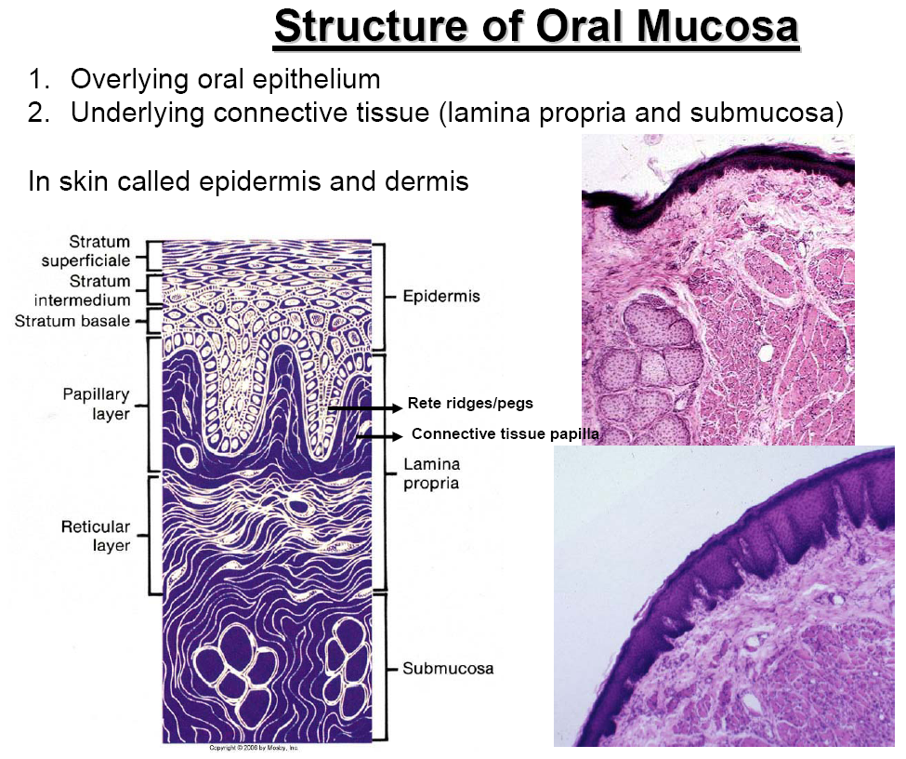

Slide 25
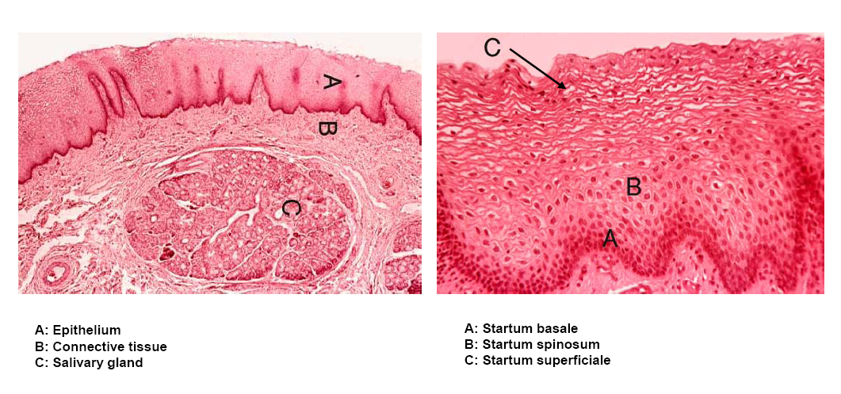

Slide 26
The oral epithelium is keratinized or non-keratinized stratified squamous epithelium
The interface between epithelium and connective tissue is comprised of a structureless layer called basement membrane
This interface is irregular and is composed of downward projections of epithelium called reteridges or retepegs, and upward projection of connective tissue termed as connective tissue papillae

Slide 27
Junction between oral epithelium and lamina propria is more obvious than that between lamina propria and submucosa
No muscularis mucosae layer seen in oral mucosa
Loose fat and glandular tissue with blood vessels and nerves seen underneath oral mucosa from underneath bone or muscle layer -this layer is termed SUBMUCOSA –provides flexibility

Slide 28
In gingiva and hard palate, no submucosa is seen and the lamina propria is directly attached to the periosteum of the underlying bone which provides firm, inelastic attachment –this is called ORAL MUCOPERIOSTEUM

Slide 29
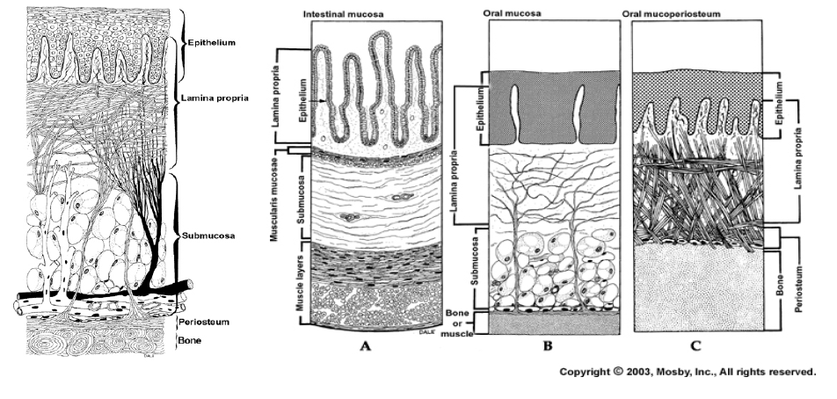

Slide 30
Connective tissue in oral cavity is comprised of salivary glands, sebaceous glands(Fordyce’s disease) and lymphoid tissue (tonsillartissue)

Slide 31
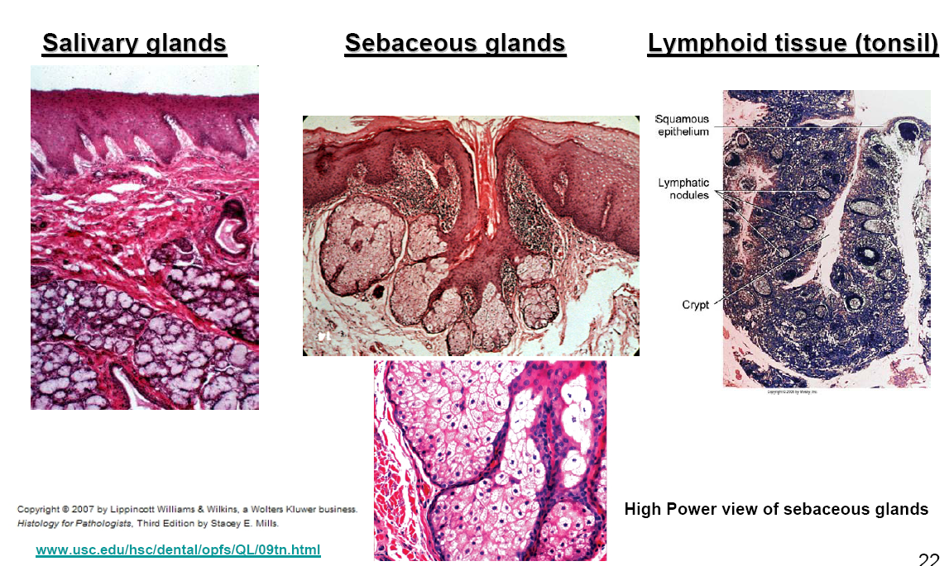

Slide 32
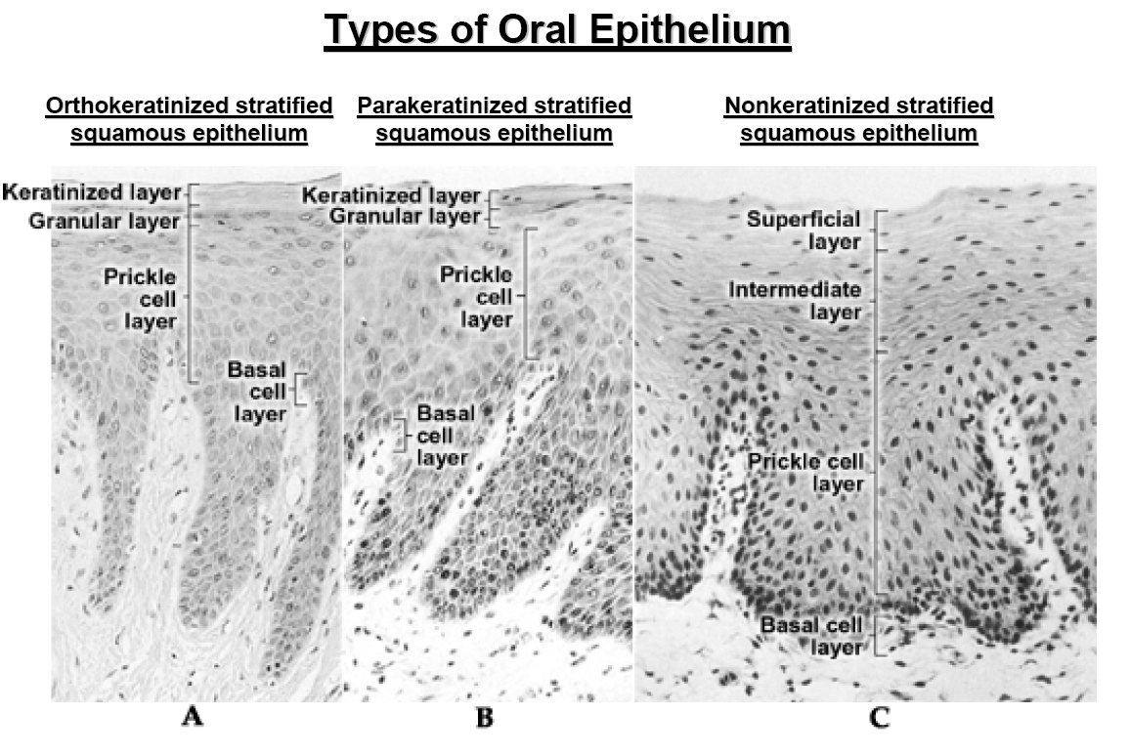

Slide 33
Components of Oral Epithelium
Lining Mucosa: Stratum Basale: Basal cell layer comprised of cuboidal cells. Progenitor cells that divide and provide new cells by mitotic division that migrate to thesurface to replace cells that are shed.
Starum Spinosum(or intermedium):Cells are oval and represent bulkof the epithelium.
Startum Superficiale: Cells are flat and contain small oval nuclei that are continuously shed.

Slide 34
Histology of Lip Histology
Skin:keratinized stratified squamousepithelium with adnexal skin structures
Oral Mucosa:Moist-surface, covered by nonkeratinized stratified squamous epithelium associated with small round seromucous glands of the lamina propria. In thesubmucosa fibers of orbicularis oris muscle is noted.
Vermillion zone: Very thin keratinized epithelium that contains no adnexal skinstructures (can contain sebaceous glands)

Slide 35
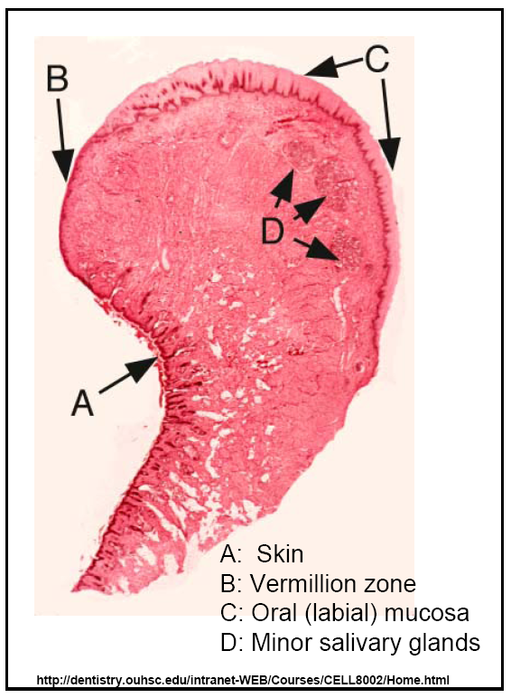

Slide 36
What gives the vermillion zone the red color?
1.Epithelium is thin
2.Epithelium contains eleidin, which is transparent
3.Blood vessels are present near the surface
Eleidinis a semi-fluid clear substance present in the stratum lucidum of the skin epithelium

Slide 37
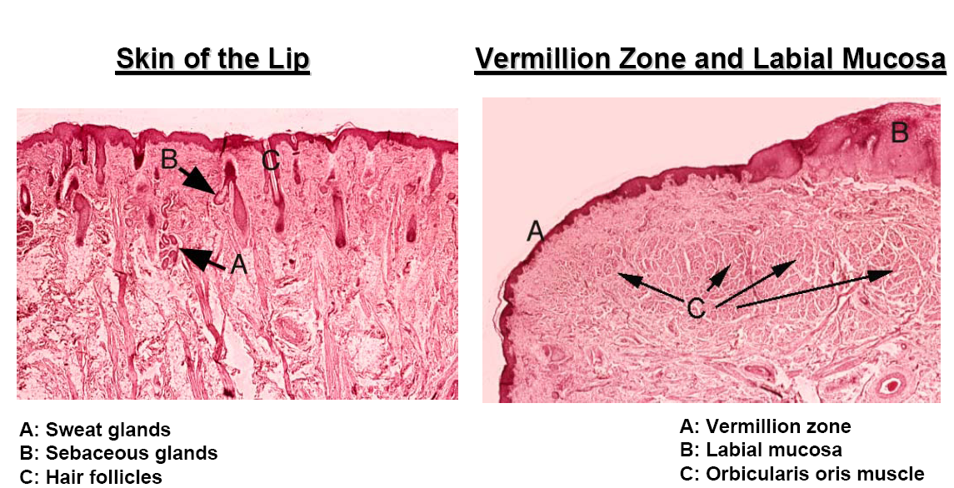

Slide 38
Soft palate

Slide 39
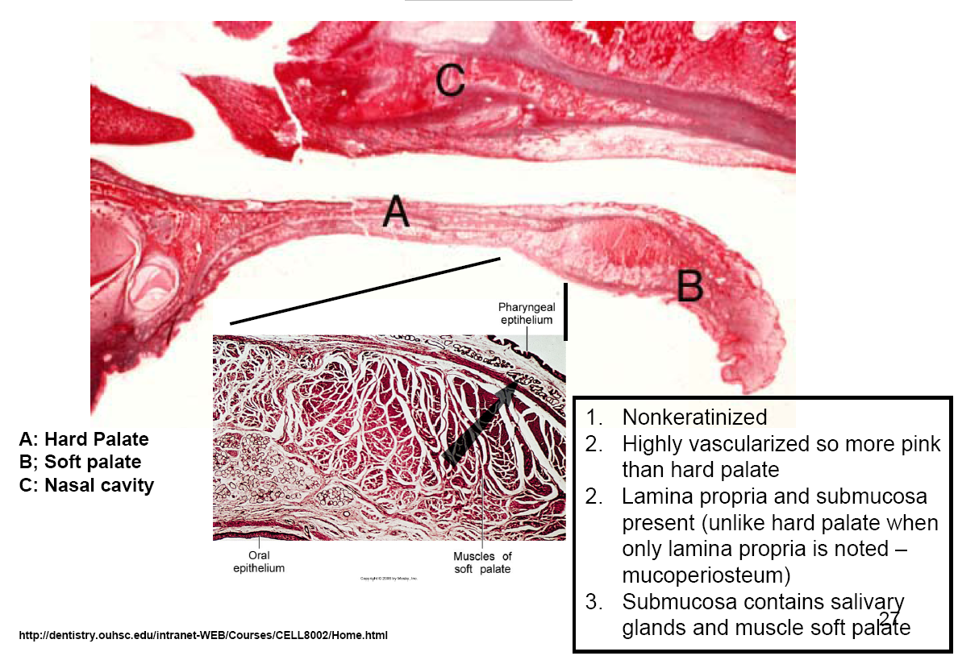

Slide 40


Slide 41
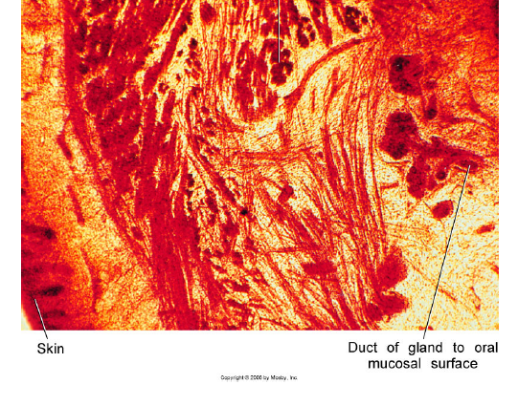
Cheeks (Buccal Mucosa)

Slide 42
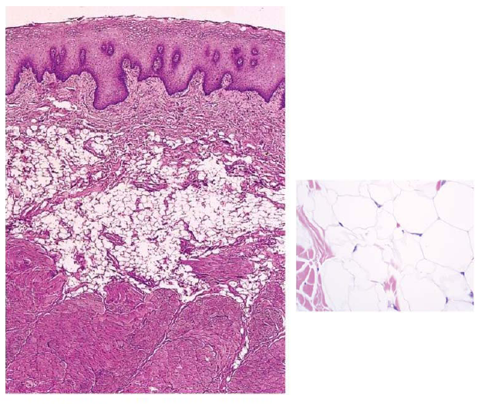

Slide 43
Cheeks (Buccal Mucosa)
Similar to lips and soft palate
Nonkeratinized stratified squamous epithelium, lamina propria and submucosa
Submucosa of cheeks contain fat cells along with lobules of minor salivaryglands and muscle fibers

Slide 44
Ventral surface of tongue
Nonkeratinized stratified squamous epithelium, lamina propria and submucosa
Extremely dense muscle fibers
interlacing connective tissue fibers in submucosa

Slide 45
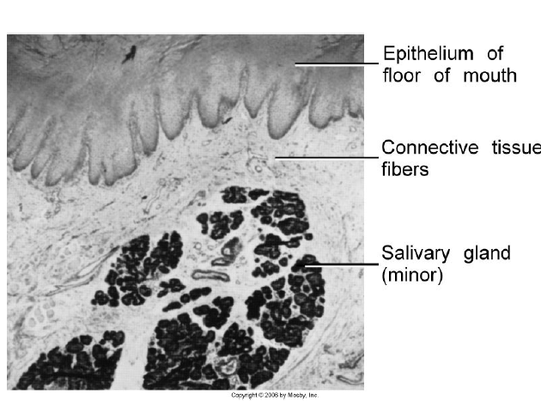
Floor of mouth

Slide 46
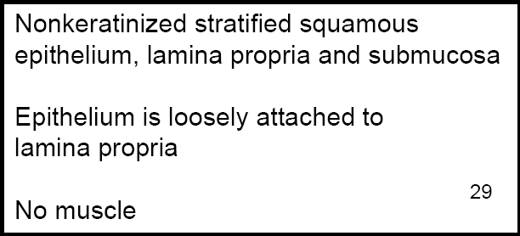

Slide 47
Masticatory Mucosa
Epithelium that covers gingiva and hard palate
Mucosa is thicker than nonkeratinized because of the keratin layer
Stratum basale-Same as nonkeratinized epithelium
Startumspinosum-Same as nonkeratinized epithelium
Stratum granulosum: Cells contain keratohyaline granules
Stratum corneum :Contains thin, flat and non nucleated cells which are filled with keratin. In contrast to the hard keratin seen in nails and hair, keratin overlying normal masticatory oral mucosa is soft. Keratin is tough, nonliving material tha tis resistant to friction and impervious to bacterial invasion. Same as nonkeratinized epithelium

Slide 48
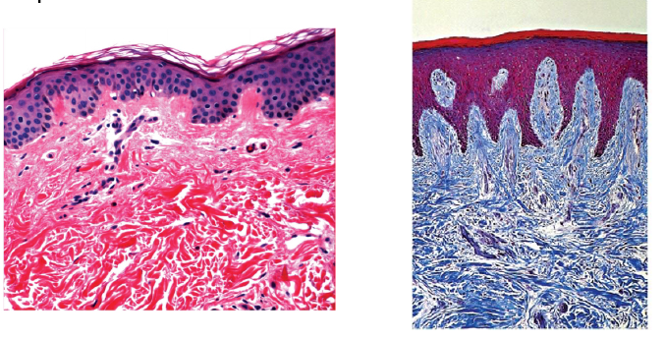

Slide 49
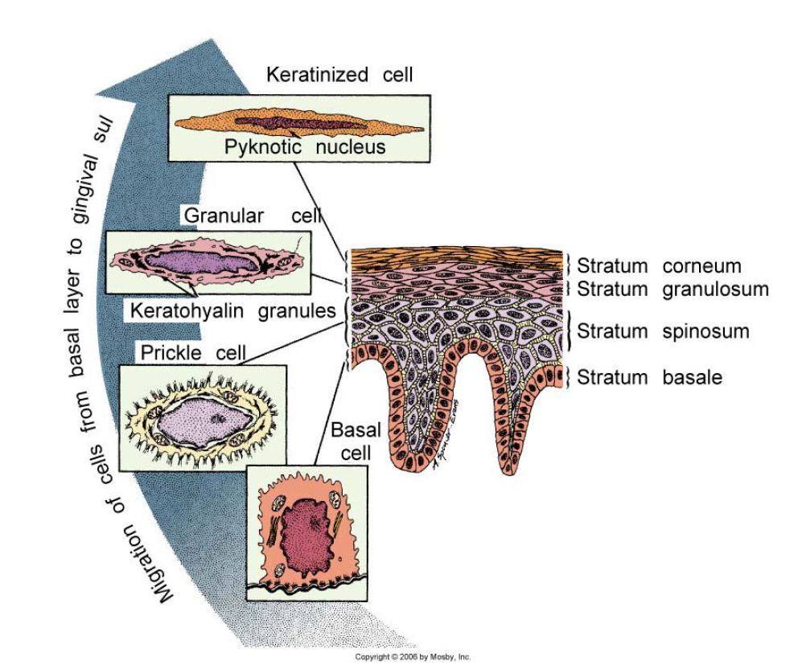

Slide 50
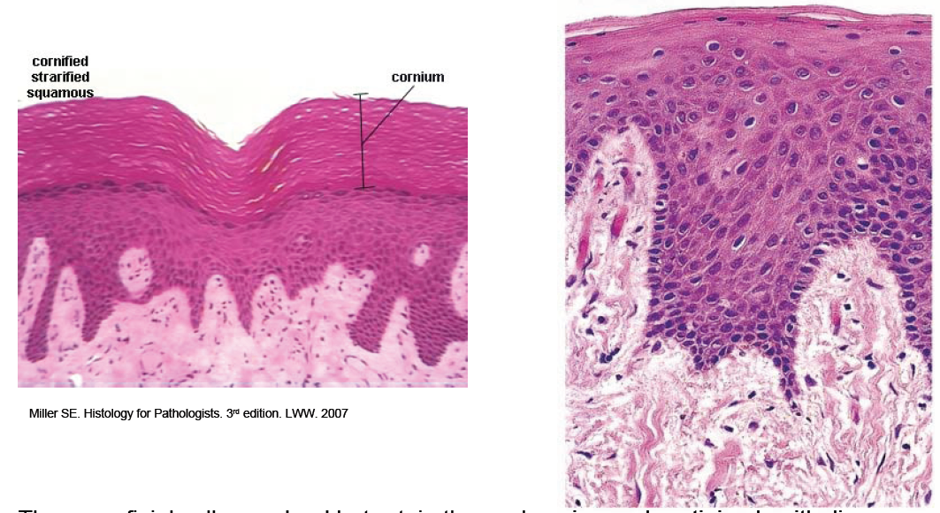
Types of Keratinized Epithelium

Slide 51
EpitheliumThe superficial cells are dead but retain the nucleus in parakeratinized epitheliumbut the nuclei are lost in orthokeratinized epithelium
The retepegs are long and slender in keratinized epithelium
Mucoperiosteum

Slide 52
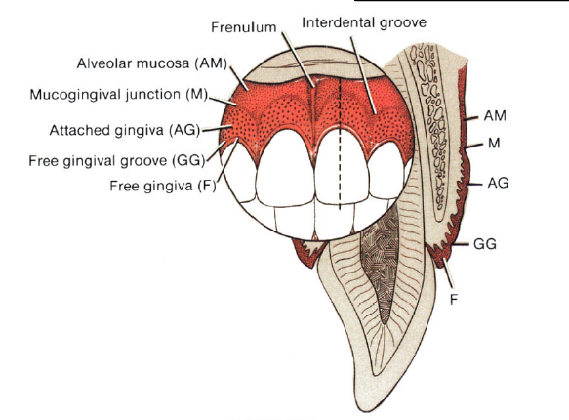
Gingiva and Epithelial Attachment

Slide 53
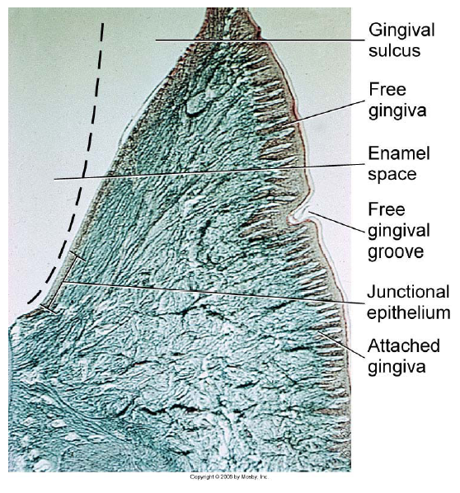

Slide 54
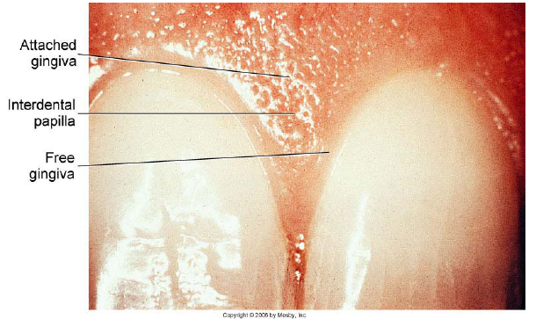
Free or marginal gingiva
Attached gingiva attaches with the neck of the tooth by means of junctional epithelium

Slide 55
Histology of Gingiva
Thick (250 µm), either orthokeratinized or parakeratinized stratified squamous epithelium with a stippled surface
In healthy attached gingiva “stippling”is seen which appears as small pits in the epithelium and are due to deep retepegs.
The lamina propria is composed of long narrow papillae which are not highly vascular.
No distinct submucosa is noted as the overlying mucosa is directly attached to the underlying periosteum and cementum by collagen fibers

Slide 56
Free Gingiva:
Keratinized; NOT STIPPLED; bound on inner margin by thegingival sulcus, which separates it from the tooth; bound on its outer margin bythe oral cavity; and apicallyby the free gingival groove.
Attached Gingiva:
Keratinized; STIPPLED; separated from the alveolar mucosaby the mucogingivaljunction (groove). Attached to the tooth by junctional epithelium.

Slide 57
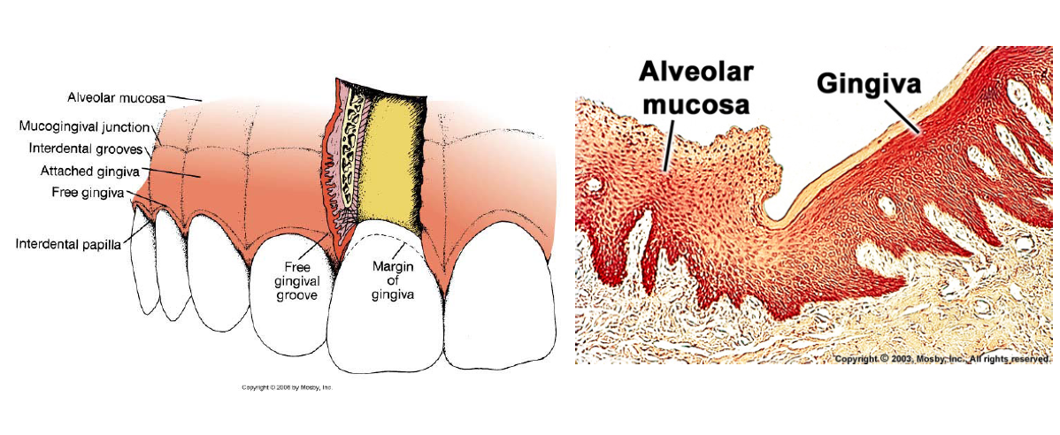

Slide 58
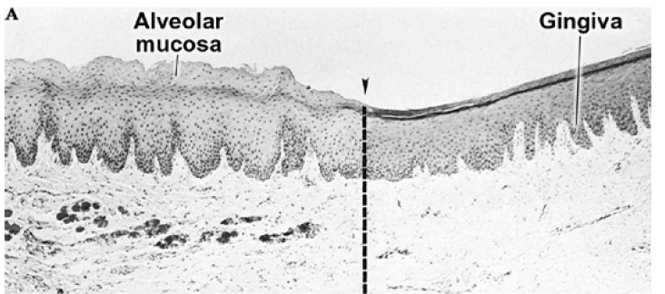
note the difference in keratinization, thickness of epithelium and ridge pattern.

Slide 59
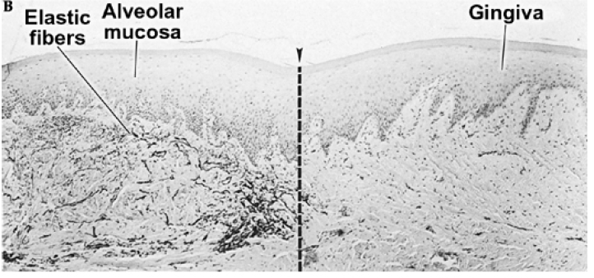
stained with an elastic stain, note the presence o felastic fibers in lamina propriain alveolar mucosa. Not much difference in the epithelium is seen between the two types of mucosa.

Slide 60
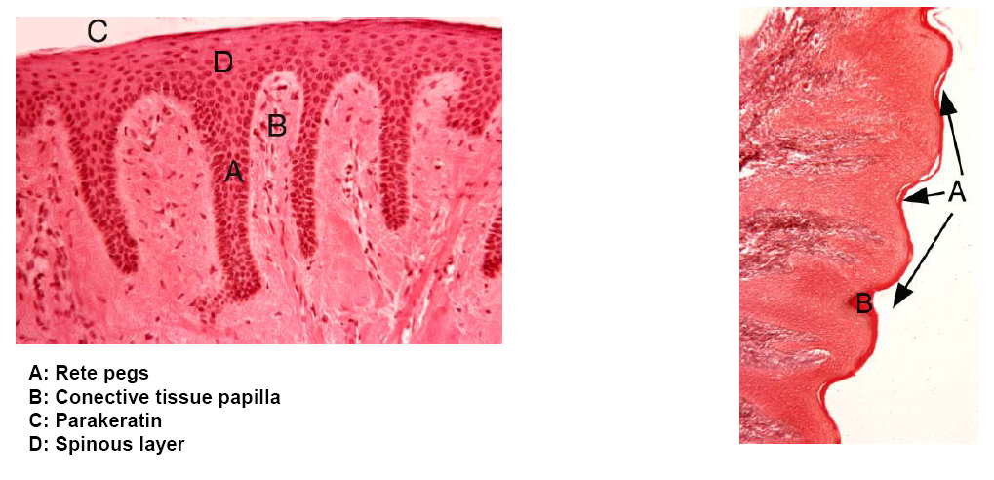

Slide 61
In healthy attached gingiva “stippling”is seen which appears as small pits in the epithelium and are due to deep retepegs.
The lamina propria is composed of long narrow papillae which are not highly vascular.
No distinct submucosa is noted as the overlying mucosa is directly attached to the underlying periosteum and cementum by collagen fibers

Slide 62
Dentogingival Junction and Junctional Epithelium
Dentogingival junction is the region where the oral mucosa meets the surface of the tooth
Very important because it is a weak area in the oral mucosa which is otherwise continuous
Bacteria on the surface of the tooth produce toxins that can incite inflammation and damage if it enters into the mucosal tissues
Gingival sulcus in healthy individuals is ~ 0.5 to 3 mm (mild inflammation is present-1.8 mm average)

Slide 63
Depth greater that 3mm is considered pathologic; and the sulcus represents periodontal pocket
Floor of the sulcus and the epithelium cervical to it is called junctional epithelium which is in contact with the tooth surface (enamel and some times cementum)
Wall of the gingival sulcus is lined by nonkeratinizing stratified squamous epithelium that is derived from and continuous with the rest of the oral mucosa –oral sulcular epithelium

Slide 64
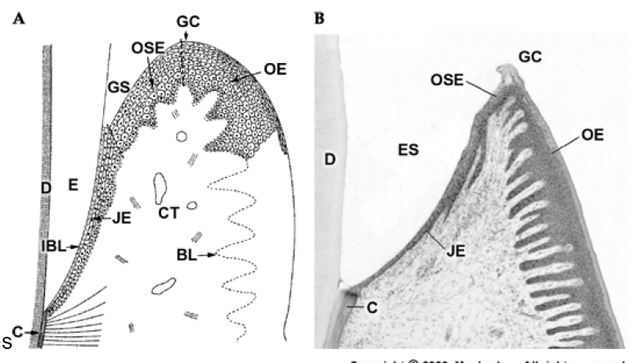

Slide 65
Junctional Epithelium
The epithelium that is attached to the tooth (enamel or sometimes cementum) surfacecontinuous with sulcularepithelium
Derived from reduced enamel epithelium of the tooth germ
Junctionalepithelium consists of flat cells aligned parallel to the toothsurfaceincreasing in thickness from the apex to the crown
Attached to enamel by internal basal lamina and to the connective tissue by externalbasal lamina. Hemidesmosomesare present in both basal laminas.

Slide 66
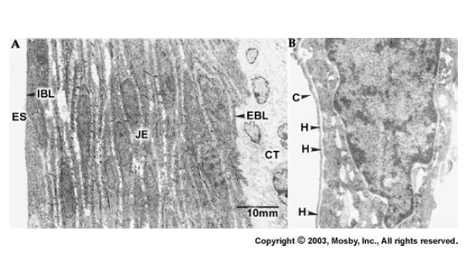
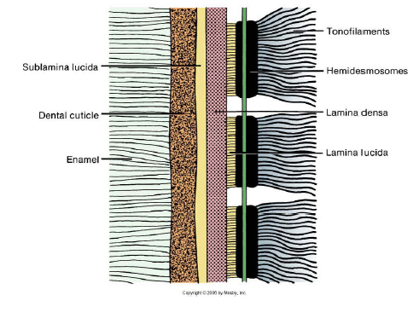

Slide 67
Epithelial cell turnover in gingiva
Similar to all other epithelia, the deepercells adjacent to the connective tissueundergo cell division to replenish thoselost at the surface
High rate of cell division
Migrate about 2 to 3 cell layers from thetooth surface and then join a main migratoryroute in a coronal direction, parallel to toothsurface, to be desquamated into thegingival sulcus.
Key point: Junctionalepithelium readilyregenerates from the sulcularepitheliumor oral epithelium if it is damaged or surgicallyexcised
Connective tissue normally contains plenty of neutrophilswhich is differentthan the normal oral mucosa

Slide 68
Col
Col (or depression): This is how the gingiva looks in the interdental area. Similar to an outline of a depression or col with buccal and lingual peaks. Col epithelium is identical to junctional epithelium and has the same origin (from dental epithelium)and is also replaced continually by cell division.
Not sure if there is any significance that the col is more vulnerable to inflammation, but the incidence of gingivitis is greater interdentally.

Slide 69
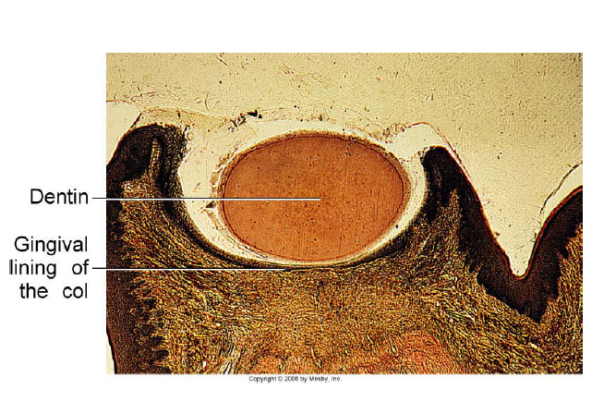

Slide 70
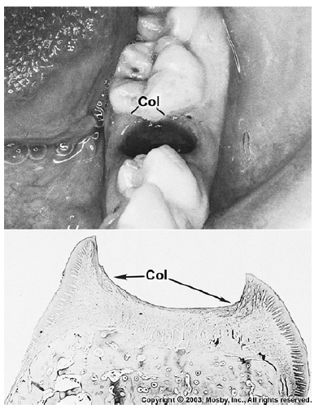

Slide 71
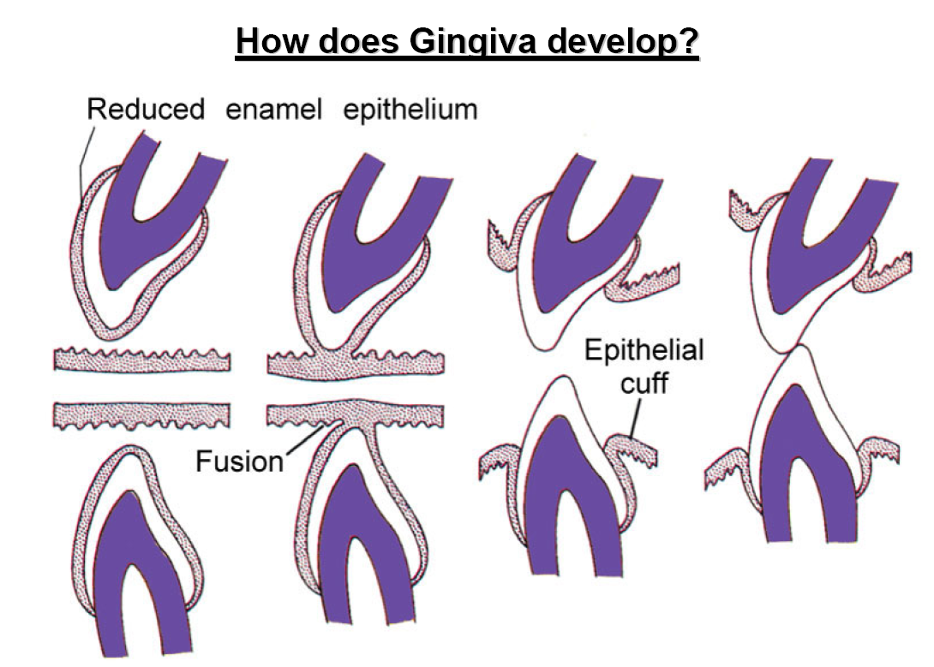

Slide 72
A quick note on…..
Blood supply to the gingiva: Derived from periosteal vessels in the periosteum of the alveolar process
Blood supply to the dentogingival junction: Continuation of interalveolar arteries
Nerve supply to the gingiva: terminal branches of periodontal nerve fibers and by branches of the infraorbital and palatine, or lingual, mental, and buccal nerves

Slide 73
Histology of Hard Palate
Thick orthokeratinized (or parakeratinized in areas) epithelium showing ridges (rugae)
Lamina propria shows long papillae with thick dense connective tissue
Submucosa is mucoperiosteum with dense collagenous connective tissue attaching directly to periosteum. Contains fat and salivary glands

Slide 74
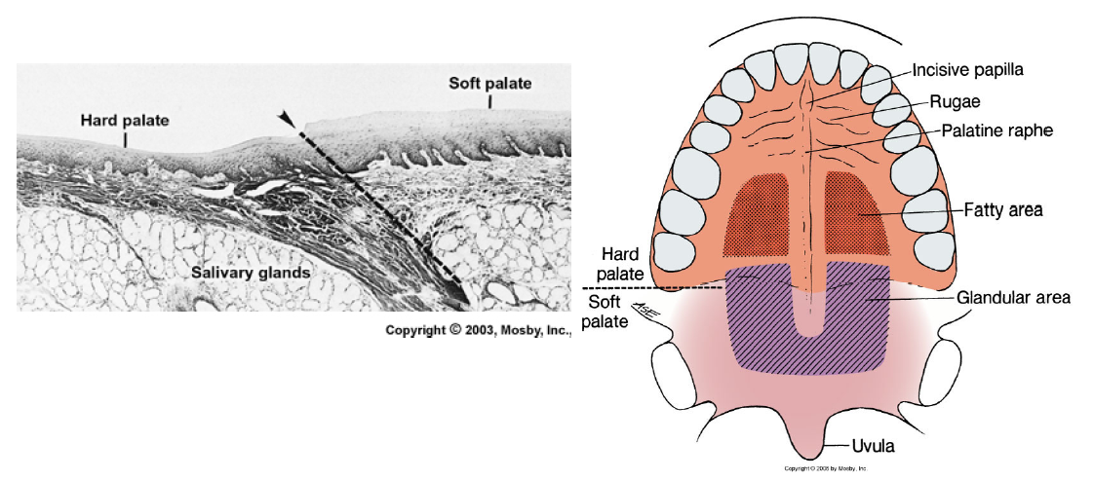

Slide 75
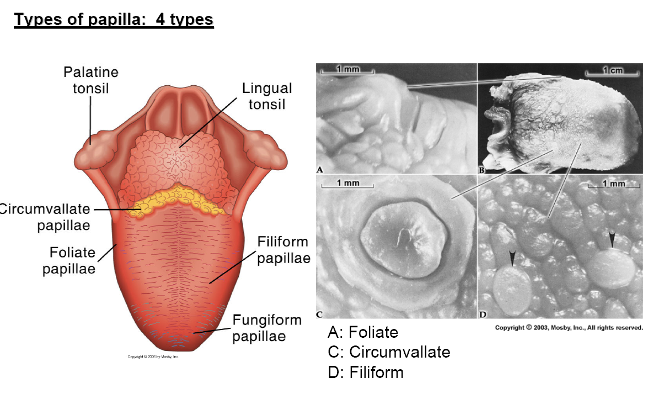
Specialized Mucosa -Dorsal Tongue

Slide 76
Filiform papilla:
Makes up majority of the papillae and covers the anterior part of the tongue.
They appear as slender, threadlike keratinized projections(~ 2 to 3 mm) of the surface epithelial cells.
These papillae facilitate mastication(by compressing and breaking food when tongue is apposed to the hard palate) and movement of the food on the surface of the tongue.
The papillae is directed towards the throat and assist in movement of food towards that direction.
NO TASTE BUDS.

Slide 77
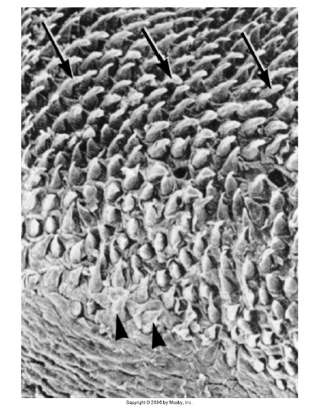
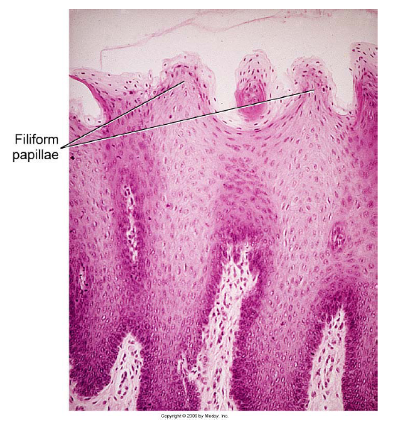

Slide 78
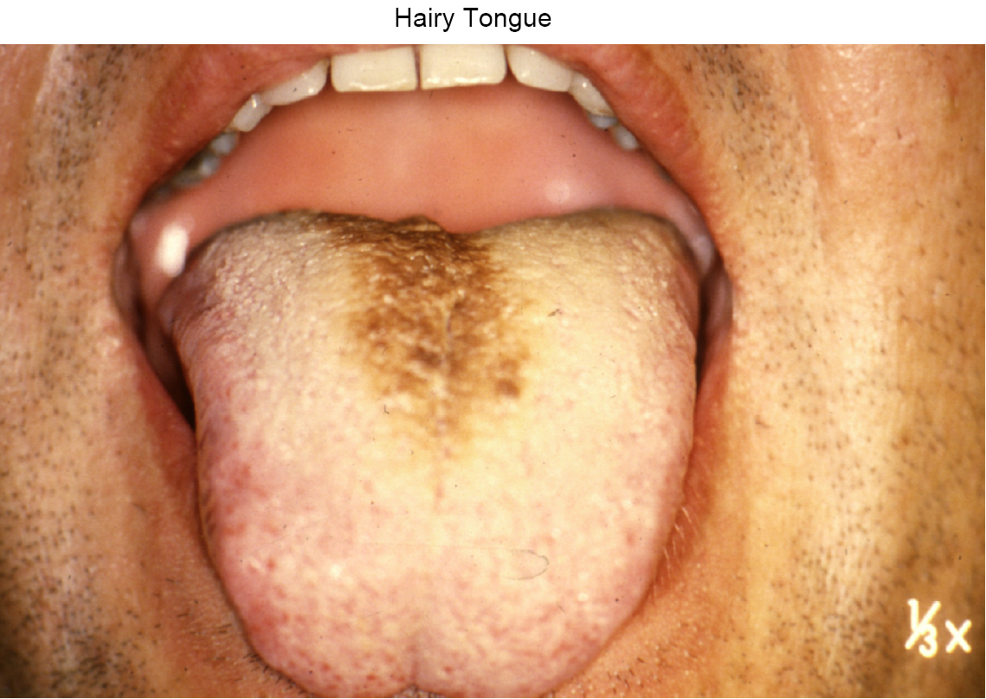

Slide 79
Fungiform papilla
(Fungus-like) These are interspersed between the filiformpapilla.
More numerous near the tip of the tongue.
Smooth, round structures that appearred because of their highly vascular connective tissue core
seen through a thin,nonkeratinized stratified squamous epithelium.
Taste buds are usually seen within the epithelium.

Slide 80
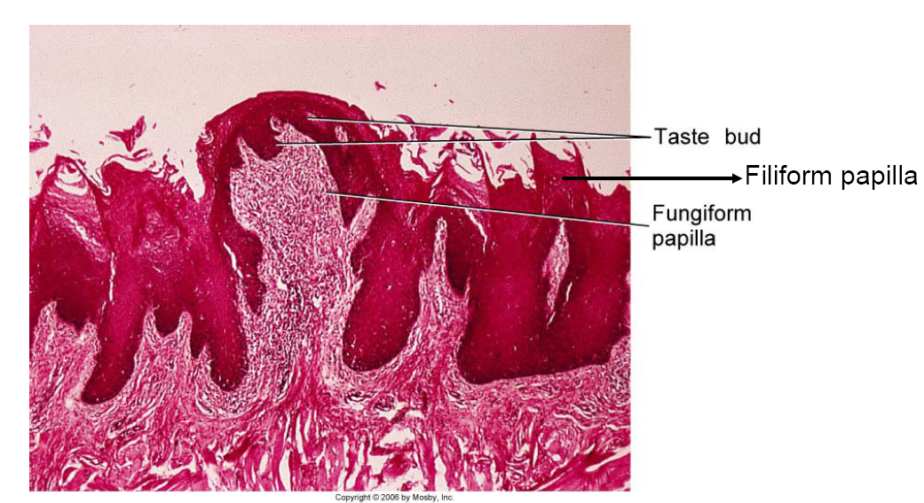

Slide 81
Foliate Papilla
(Leaf-like). Present on the lateral margins of the posterior tongue.
Consist of 4 to 11 parallel ridges that alternate with deep grooves in the mucosa,
and a few taste buds are present in the epithelium.
They contain serous glands underlying the taste buds which cleanse the grooves.

Slide 82
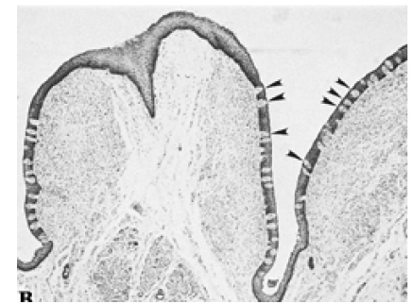

Slide 83
Circumvallate papilla
(Walled papilla). 10 to 14 in number these are seen along the V-shaped sulcus between the base and the body of the tongue.
Large, ~ 3 mmin diameter with a deep surrounding groove.
Ducts of von Ebner glands (serous salivary glands) open into the grooves.
Taste buds are seen lining the walls ofthe papillae.

Slide 84
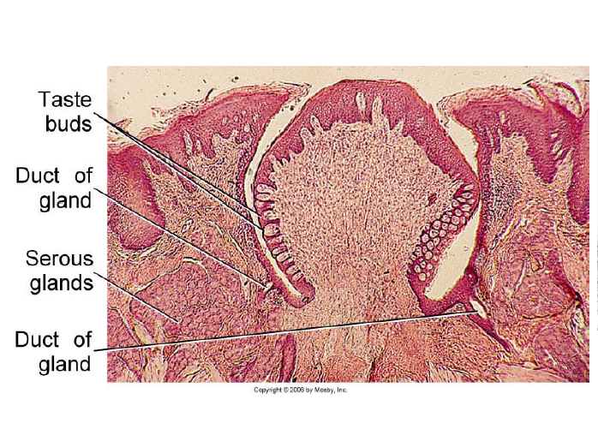

Slide 85
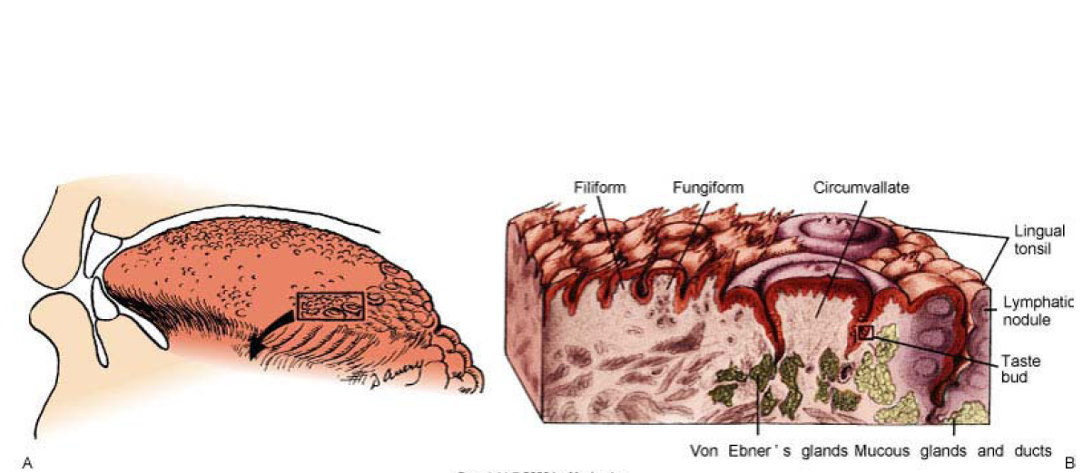

Slide 86
Structure of Mucosa in different regions
Region | Covering epithelium | Lamina propria | submucosa
Lining mucosa
Labial & buccal mucosa | Very thick-nonkeratinized | Long slender papillae; dense fibrous CT, rich vascular supply | Muscle forming firm attachment .Fat, minor salivary glands, sometimes sebaceous glands
Floor of mouth | Very thin-nonkeratinized | Short papillae, extensive vascularity | Loose CT, containg fat and minor salivary glands
Soft palate | Thin-nonkeratinized Taste buds | Thick with numerous short papillae, elastin fibers, highly vascular | Diffuse tissue containing numerous minor salivary glands

Slide 87
Structure of Mucosa in different regions
Region | Covering epithelium | Lamina propria | submucosa
Lining mucosa
Lips vermilion zone | Thin orthokeratinized | Numreous narrow papillae | Mucosa firmly attached to muscle, some sabecous glands, minor salivary glands and fat
Ventral surface of the tongue | Thin nonkeratinized | Thin with numerous short papillae, few minor salivary glands | Thin and irregular, may contain fat and small vessels ;tongue musculature

Slide 88
Structure of Mucosa in different regions
Region | Covering epithelium | Lamina propria | submucosa
Masticatory mucosa
Gngiva | Thick parakeratinized/ orthokeratinized | Long nrarrow papillae(fork like) not highly vascular | No distinct layer-mucoperiosteum
Hard palate | Othokeratinized | Longe thick papaillae, dense collagenous tissue | Mucoperiosteum, antlatelaral –fat, Posterolateral-minor salivary glands

Slide 89
Non-keratinocytes
Oral epithelium in many areas contain cells that differ in appearance from other epithelial cells.
Lack desmosomal attachment to adjacent cells
Hence during histological processessing cytoplasm shrinks around the nucleus to produced Clear cell
None of these cells contain the large numbers of tonofilaments and Desmosomes seen in epithelial keratinocytes and none participates in the process of maturation seen in epithelial hence called the Non-keratinocytes

Slide 90
Non-keratinocytes
The various non-keratinocytes are
Melanocytes
Merkel Cell
Langerhan’s cells
Inflammatory cells

Slide 91
Melanocytes
Origin: Neural crest cytoderm
Function: Produce Melanin — Pigment.
Description:
  They are present predominantly at Basal layer of epithelium
  lack desmosomes and tonofilaments
  Long dendritic processes that extend between keratinocytes
  Melanin — synthesized within the Melanocytes as small structures called — Melanosomes
  Injected into cytoplasm of adjacent keratinocytes by the dendritic processes of Melanocytes

Slide 92
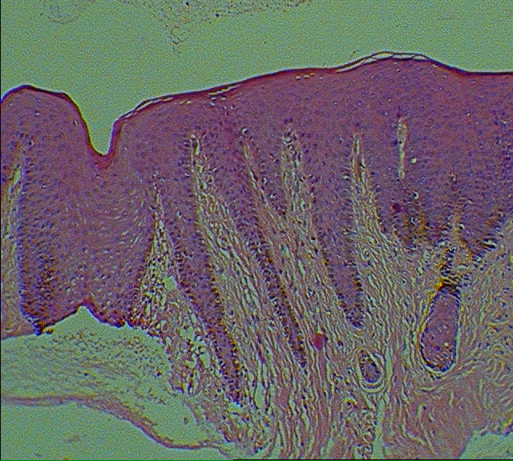

Slide 93
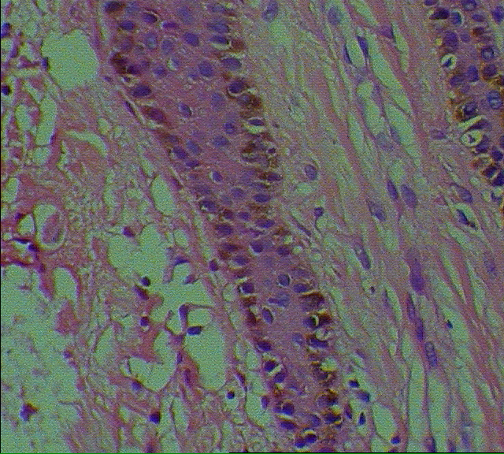

Slide 94
Merkel Cell:
Location: Basal layer.
Function: Tactile sensory cell.
Description: Unlike Melanocytes and Langerhan’s cells it is not dendric.
It does not contain tonofilaments and presence of occasional desmosomes linking to adjacent cells— hence not always clear cell.

Slide 95


Slide 96


Slide 97
Langerhan’s cells:
Location: Supra basal.
Function: Antigen trapping and processing
Description: Dendritic cell
  Lack desmosomal attachments
  Characterized ultra structurally by a small rod or flask shaped granules sometimes called — Birbeckgranules
  They may be capable of limited division with in the epithelium
  Professional antigen presenting cells (APCs)

Slide 98



Slide 99
Inflammatory cells:
Location: Variable.
Function: Associated with inflammatory *** in Oral Mucosa.
Description: Sections of normal Oral inflammatory cells often in the nucleated cell layers.
  These cell — transient
  do not reproduce themselves in the epithelium
  The cell most frequently seen is
  Lymphocyte occasionally PMM and most cells can also be seen
  ~ Lymphocytes — often associated with Langerlan’s cells

Slide 100
Don’t look in past with anger or future with fear look around you with Awareness

