Slide 1


Slide 2
Oral Mucous Membrane
Mucous Membrane:
Moist lining of the gastrointestinal tract, nasal passages and other body cavities that communicate with the exterior
In the oral cavity the lining is called as oral mucous membrane or oral mucosa

Slide 3
Functions of the Oral Mucosa
1.Defence: Barrier for entry of micro-organisms. Impermeable to bacterial toxins
2.Sensory: Temperature (heat and cold), touch, pain, taste buds, thirst;reflexes such as swallowing, etching, gagging and salivating
3. Secretion: Salivary secretion
4. Thermal regulation: Important in dogs not in humans
5. Protection: Protects deeper tissues from mechanical forces

Slide 4
Classification of the Oral Mucosa
According to FUNCTION
1.Masticatory Mucosa:
2.Lining Mucosa:
3.Specialized Mucosa:

Slide 5
Classification of the Oral Mucosa
according to HISTOLOGY
1.Keratinised
2. Non- Keratinised

Slide 6
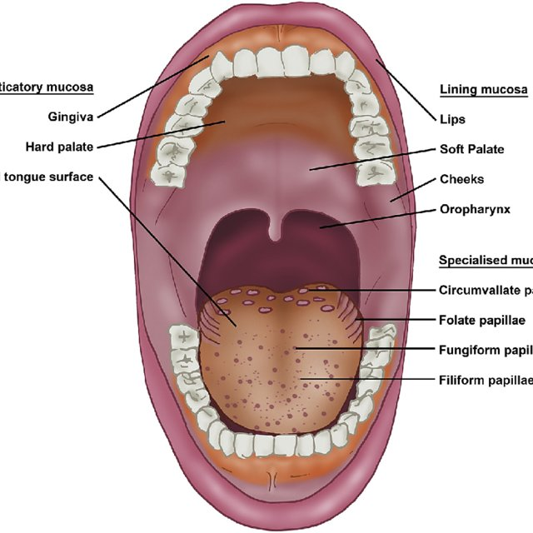

Slide 7
1.Masticatory Mucosa
25% of total mucosa.
Gingiva (free, attached and interdental)
Hard palate.
Primary mucosa to be in contact with food during mastication.
MASTOCATORY MUCOSA IS USUALLY KERATINIZED.

Slide 8
2.Lining Mucosa:
60% of total mucosa.
Covers the floor of mouth, ventral (underside) tongue, alveolar mucosa, cheeks, lips and soft palate.
Does not function in mastication and therefore has minimal attrition.
Non-keratinized; soft and pliable.

Slide 9
3.Specialized Mucosa:
15% of total mucosa.
Covers Dorsal surface of tongue and composed of cornified epithelial papillae and Taste buds.

Slide 10
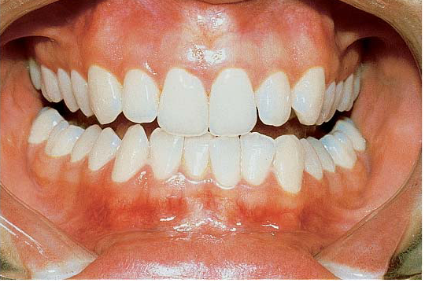
Masticatory Mucosa

Slide 11
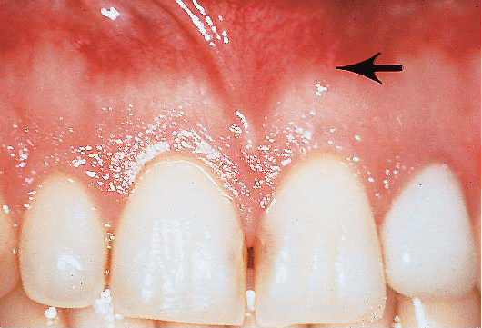

Slide 12
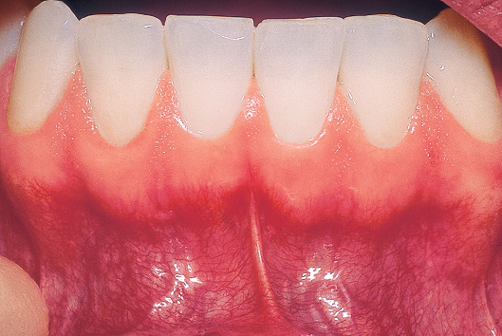

Slide 13
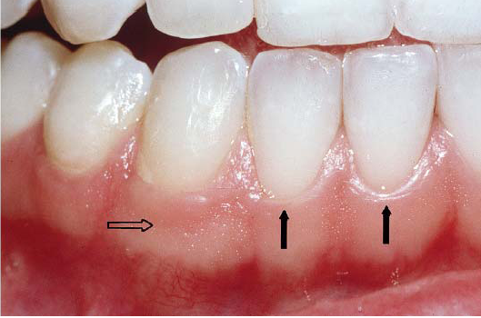

Slide 14
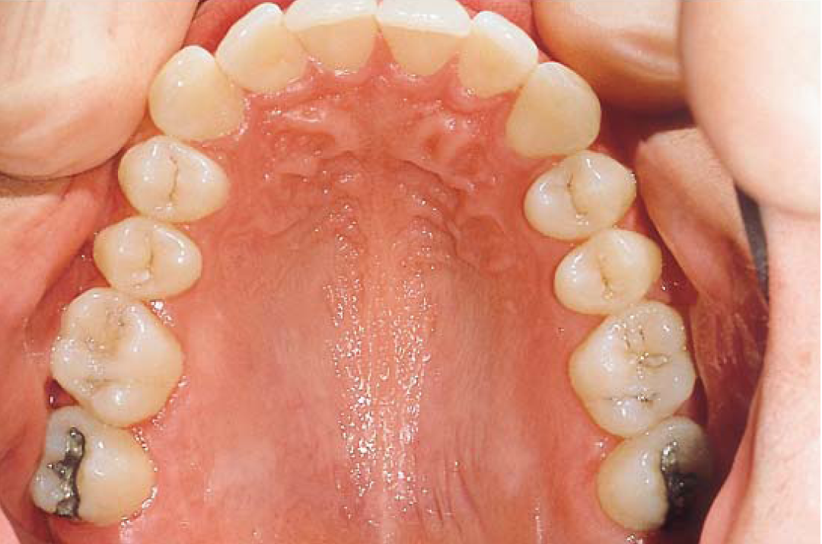
Masticatory Mucosa

Slide 15
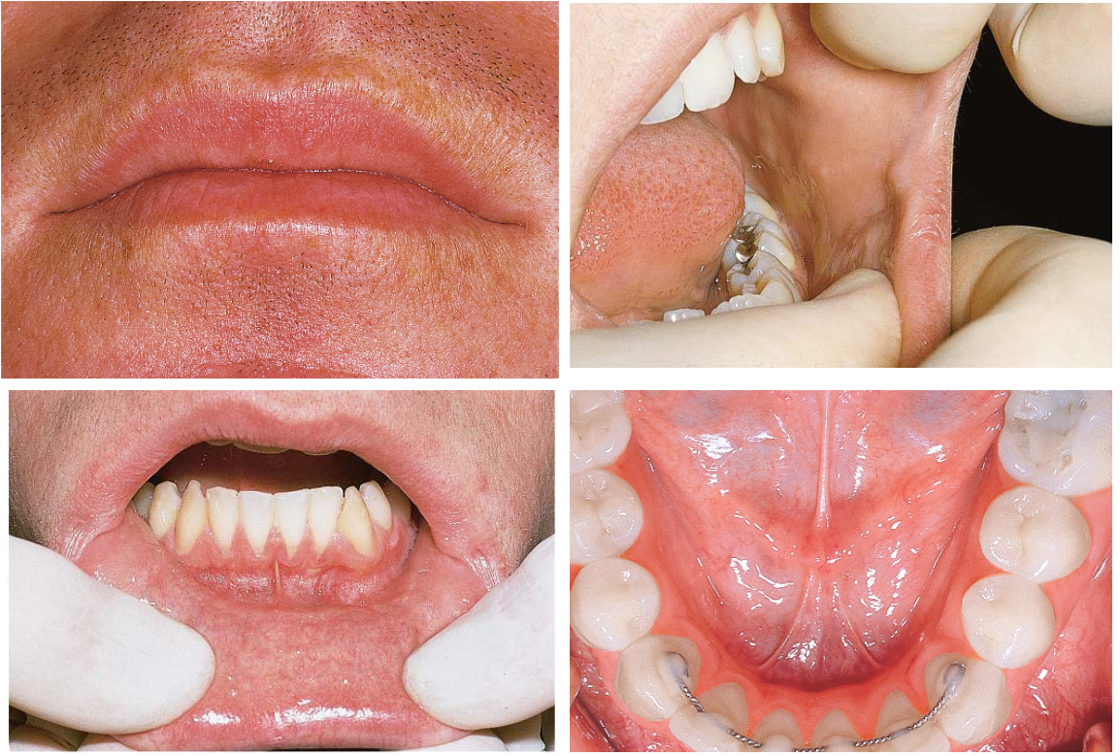
Lining Mucosa

Slide 16
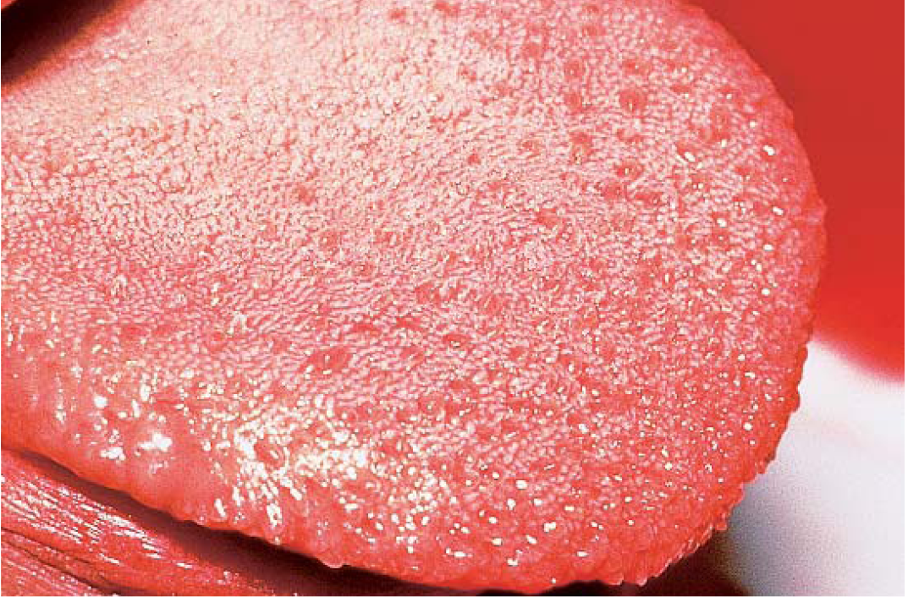
Specialized Mucosa

Slide 17
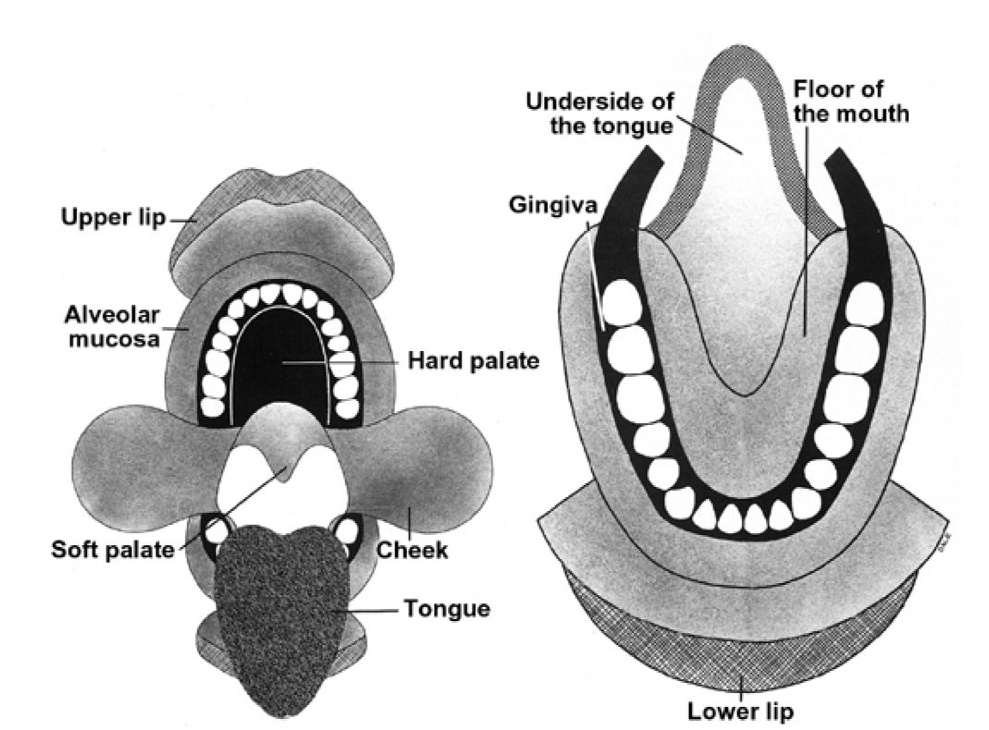

Slide 18
General Features of Oral Mucosa
1.Separated from the skin by vermillion zone of the lips which is more deeply colored than rest of the oral mucosa
2.Factors affecting color of the oral mucosa:
Concentration and state of dilation of the blood vessels in underlying connective tissue
Thickness of the epithelium.
Degree of keratinization.
Amount of melanin pigmentation

Slide 19
Clinically, color of oral mucosa is very important.
For example, inflamed oral tissues appear red rather than the normal pale pink

Slide 20
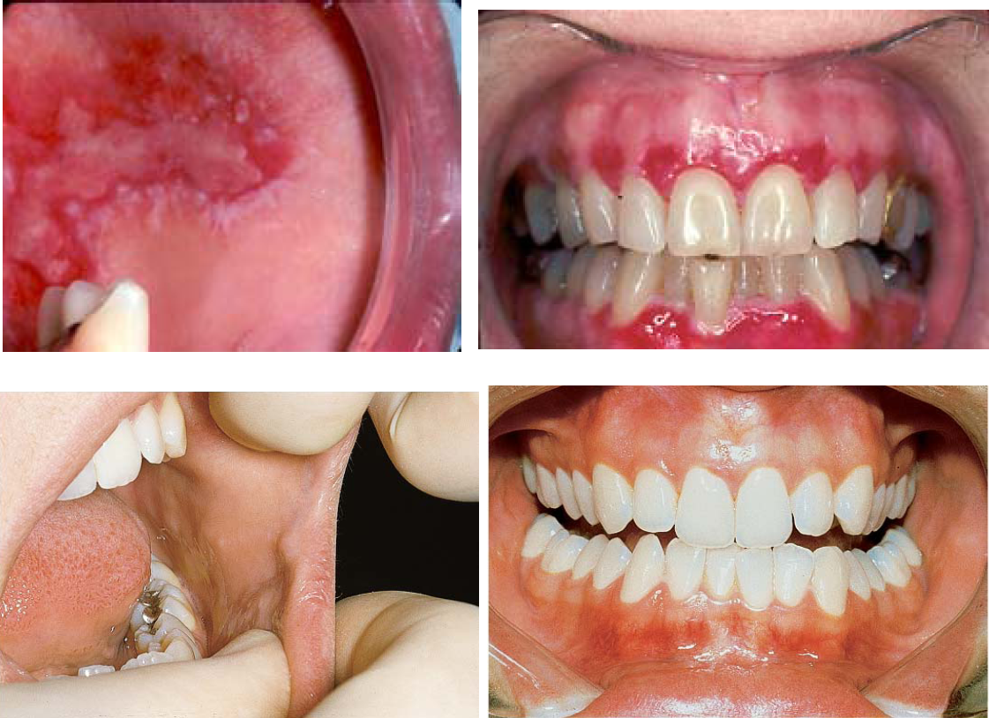

Slide 21
How is the oral mucosa different from skin?

Slide 22
1.Color
2. Moist surface
3.Absence of adnexal skin structures such as hair follicles, sweat glands and sebaceous glands (exception in Fordyce’s disease)
4.Fordyce’s disease: Sebaceous glands in oral cavity predominantly in upper lip, buccal mucosa and alveolar mucosa
5.Presence of minor salivary glands in oral mucosa
6.Texture of surface: Oral mucosa is smoother than the skin (few exceptions like dorsal tongue –due to papillae; hard palate –rugae; gingiva –stippling)

Slide 23
7.Firmness: Oral mucosa varies in its firmness.
For example buccal mucosa and lips are loose and pliable whereas the gingiva and hard palate are firm so critical clinically while giving injections

Slide 24
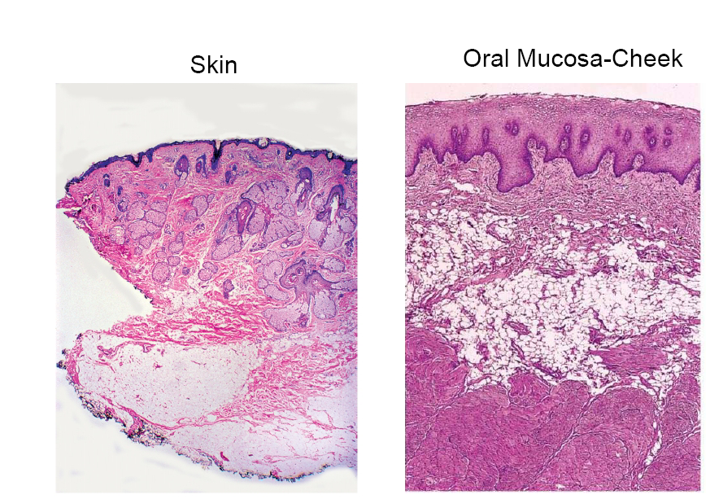

Slide 25
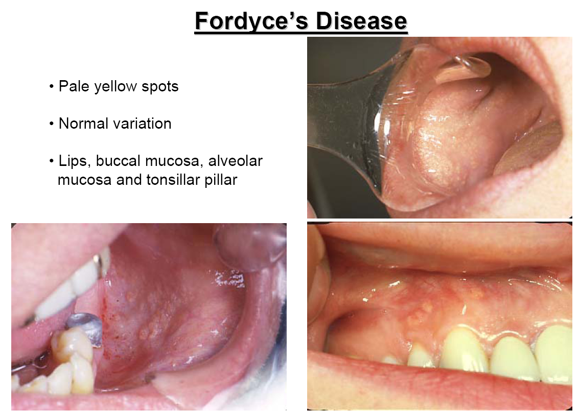

Slide 26
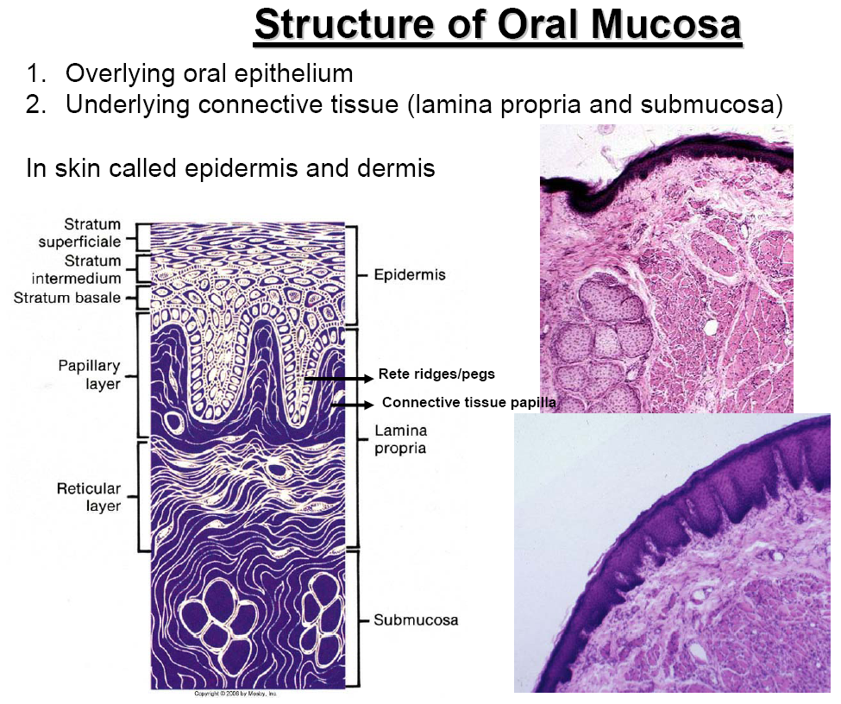

Slide 27
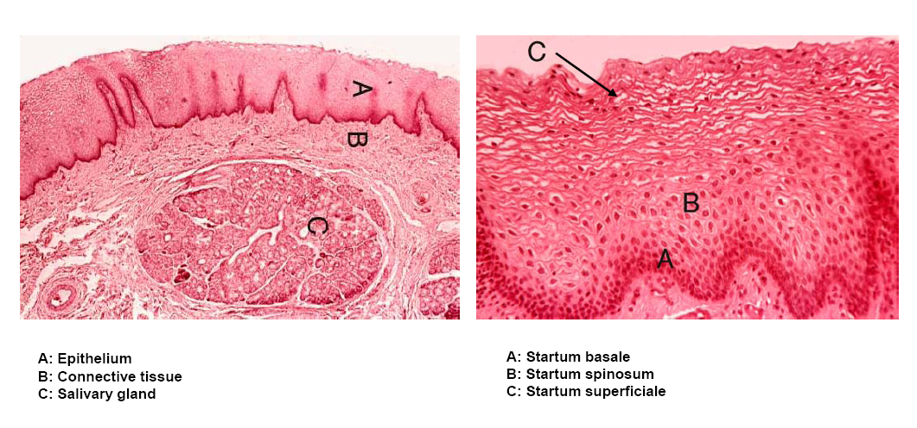

Slide 28
The oral epithelium is Keratinized Or Non-keratinized Stratified Squamous Epithelium
The interface between epithelium and connective tissue is comprised of a structureless layer called basement membrane
This interface is irregular and is composed of downward projections of epithelium called reteridges or retepegs, and upward projection of connective tissue termed as connective tissue papillae

Slide 29
Junction between oral epithelium and lamina propria is more obvious than that between lamina propria and submucosa
No muscularis mucosae layer seen in oral mucosa
Loose fat and glandular tissue with blood vessels and nerves seen underneath oral mucosa from underneath bone or muscle layer -this layer is termed SUBMUCOSA –provides flexibility

Slide 30
In gingiva and hard palate, no submucosa is seen and the lamina propria is directly attached to the periosteum of the underlying bone which provides firm, inelastic attachment –this is called ORAL MUCOPERIOSTEUM

Slide 31
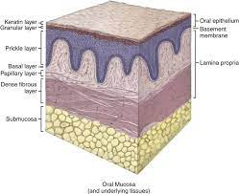

Slide 32
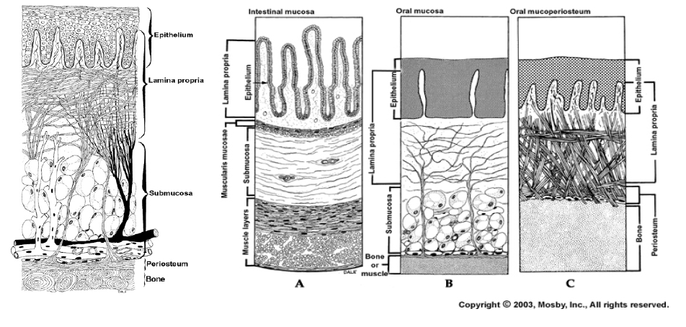

Slide 33
Connective tissue in oral cavity is comprised of salivary glands, sebaceous glands(Fordyce’s disease) and lymphoid tissue (tonsillar tissue)

Slide 34
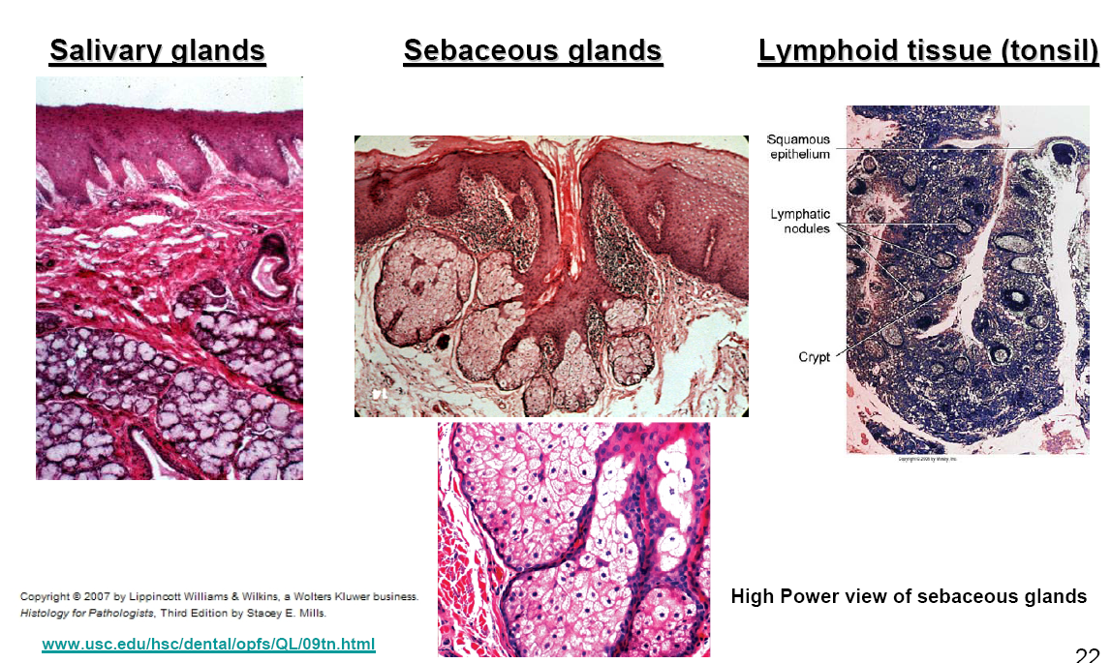

Slide 35
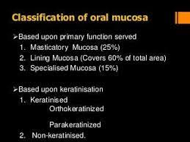

Slide 36
Masticatory Mucosa/ Keratinized Epithelium
Mucosa is thicker than nonkeratinized because of the keratin layer
Stratum basale-Same as nonkeratinized epithelium
Startumspinosum-Same as nonkeratinized epithelium
Stratum granulosum: Cells contain keratohyaline granules
Stratum corneum :Contains thin, flat and non nucleated cells which are filled with keratin. In contrast to the hard keratin seen in nails and hair, keratin overlying normal masticatory oral mucosa is soft. Keratin is tough, nonliving material that is resistant to friction and impervious to bacterial invasion. Same as nonkeratinized epithelium

Slide 37
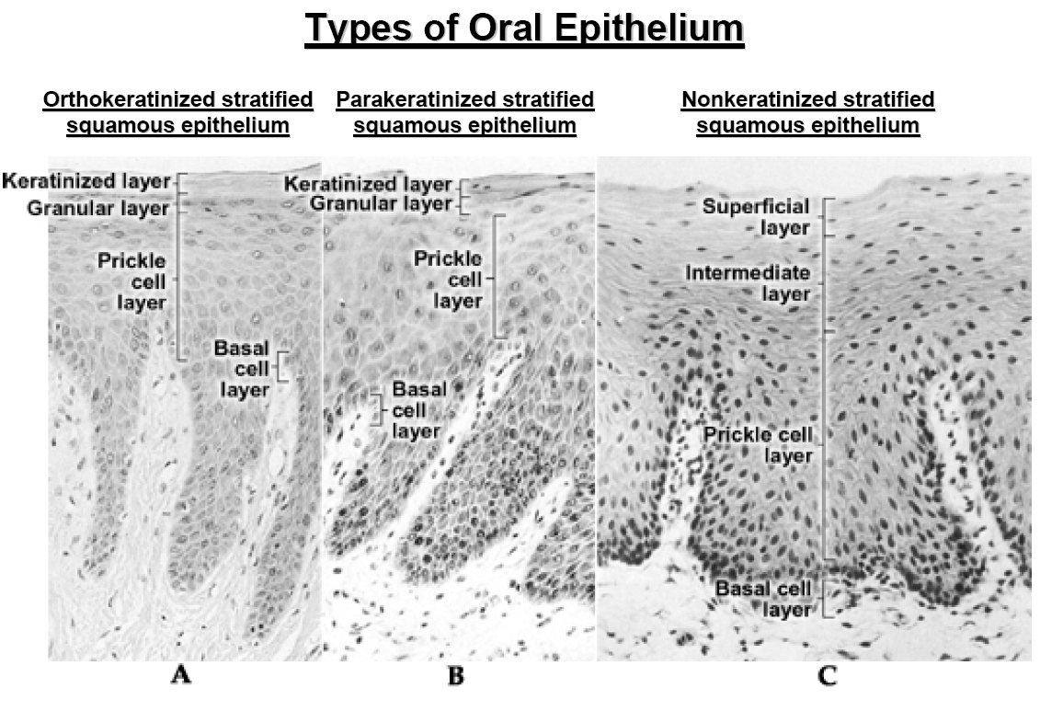

Slide 39
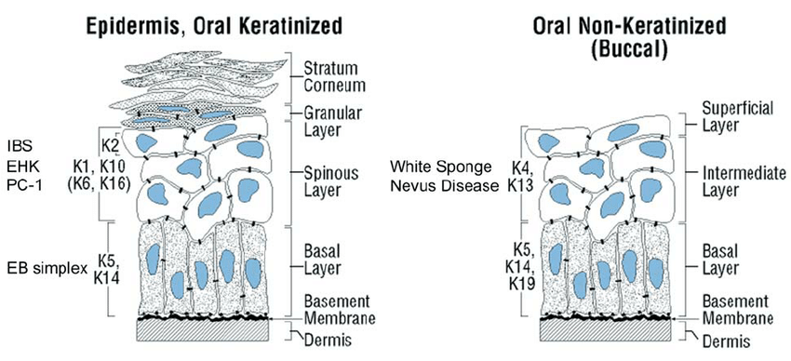

Slide 40
Components of Oral Epithelium
Lining Mucosa:
Stratum Basale: Basal cell layer comprised of cuboidal cells. Progenitor cells that divide and provide new cells by mitotic division that migrate to thesurface to replace cells that are shed.
Starum Spinosum (or intermedium):Cells are oval and represent bulk of the epithelium.
Startum Superficiale: Cells are flat and contain small oval nuclei that are continuously shed.

Slide 42
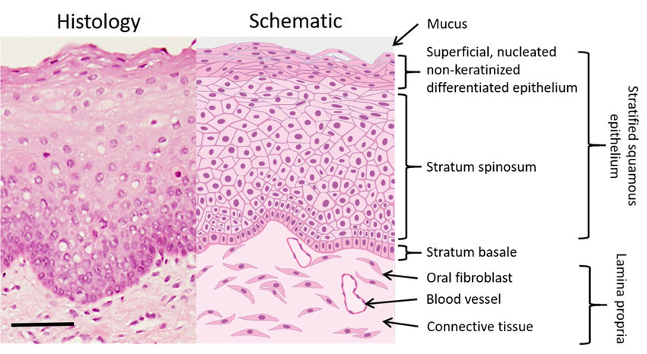

Slide 43
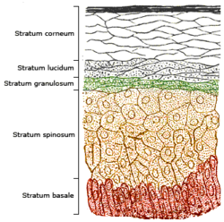

Slide 44
Cytokratins
Cytokeratins form the Cytoskeleton of all epithelial cells, along with microfilaments and microfibrils.
Serve to provide mechanical linkages and distribute the forces over wide area.
Function as stress bearing structures within epithelium and are important in maintaining cell shape.

Slide 45
Structural elements of cell
Cell
Cytoskeleton
Microfilaments Intermediate Microtubules
(4-6nm) filaments (keratin) (25nm)
actin (7-11nm) tubulin
six types
Type I- Basic keratin
Type II- Acidic keratin

Slide 46
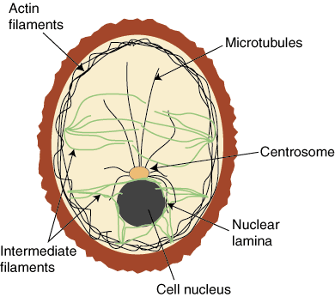
Cytoskeleton

Slide 47
Type I Cytokeratins
Type II Cytokeratins
Basic group
Cytokeratins: 1-8
Mol wt: 52-67 KDa
LARGER cytokeratins
Acidic group
Cytokeratins: 9-20
Mol wt: 40-56.5 KDa
SMALLER cytokeratins

Slide 48
TYPE II
TYPE I
10
1,2
12
3
13
4
14, 15
5
16,17
6, 7
18
8
19
Only unpaired cytokeratin

Slide 50
Masticatory Mucosa--- CK1, CK10
Lining Mucosa--- CK4, CK13
Ventral surface of Tongue- CK5,6,14
Soft Palate- CK7,8,18

Slide 51
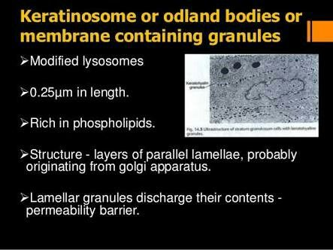

Slide 52
ODLAND BODIES/ KERATINOSOMES
Lamellar granules secrete their contents in to the intercellular spaces forming a intercellular lamellar structure.
This contributes to the permiability barrier.
This barrier forms at the junction of granular and cornium layer.

Slide 53
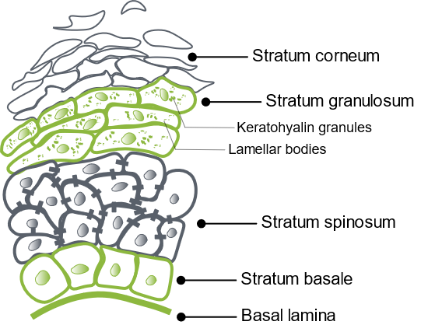
Odland bodies

Slide 54
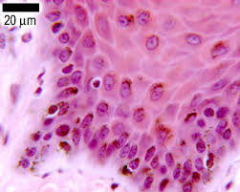
Non- keratinocytes.
Oral epithelium in many areas contain cells that differ in appearance from other epithelial cells.
Lack desmosomal attachment to adjacent cells Hence During histologic processing, Cytoplasm shrinks around the nucleus To produce--------- Clear cell
None of these cells contain the large numbers of tonofilaments and Desmosomes seen in epithelial keratinocytes and none participates in the process of maturation seen in epithelial.
They are called as --- Non keratinocytes

Slide 55
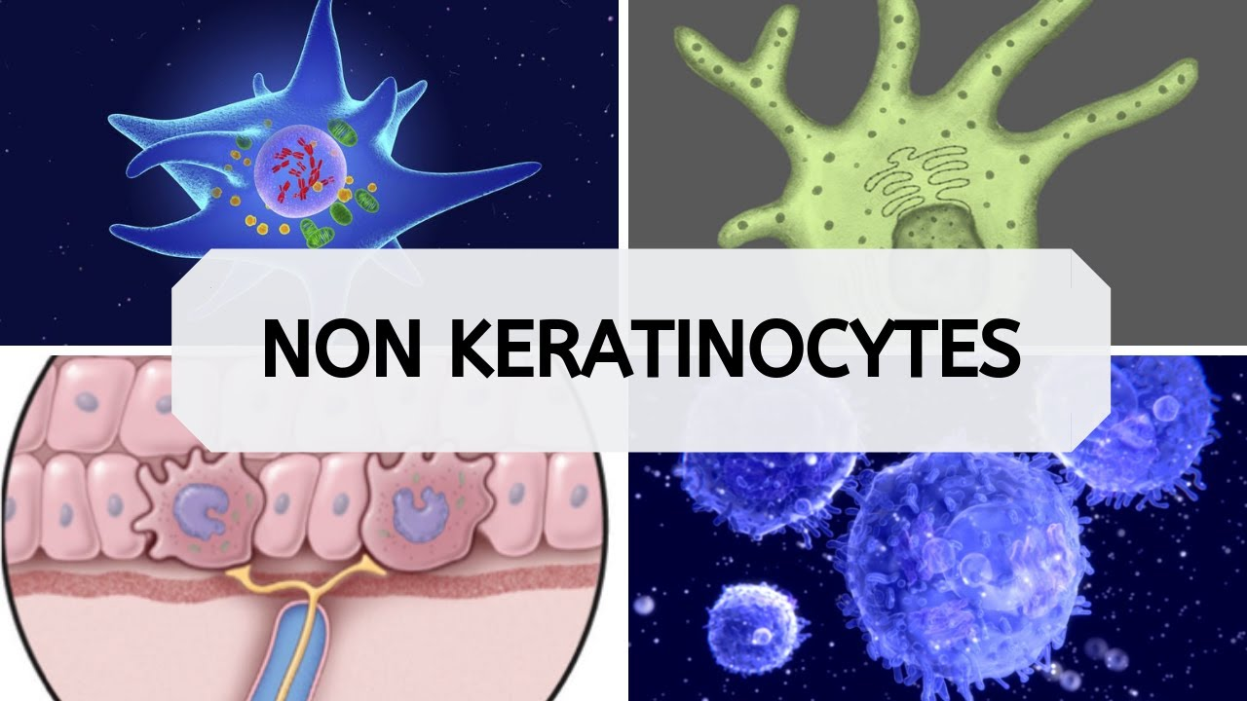

Slide 57
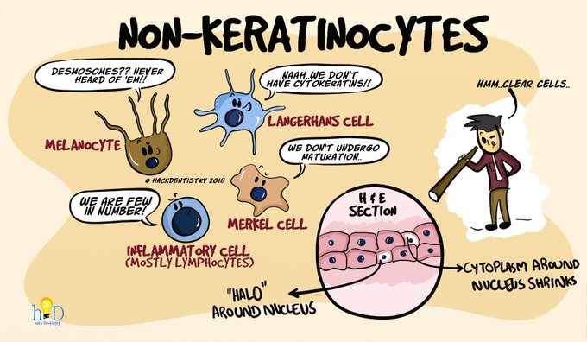

Slide 58
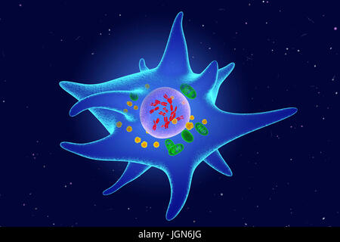
Langerhan’s cells:
Location: Supra basal.
Function: Antigen trapping and processing
Description: Dendritic cell
~ Lack desmosomal attachments
~ Characterized ultra structurally by a small rod or flask shaped granules sometimes called — Birbeck granules.
They may be capable of limited division with in the epithelium.

Slide 59
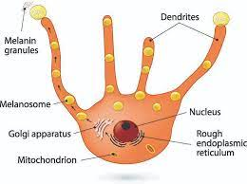
Melanocytes:
Origin: Neural crest cytoderm.
Function: Produce Melanin — Pigment.
Description: They are present predominantly at Basal layer of epithelium.
~ They lack desmosomes and tonofilaments but have Long dendritic processes that extend between keratinocytes.
~ Melanin — synthesized with in the Melanocytes as small structures called — Melanosomes. Injected Into cytoplasm of adjacent keratinocytes by the dendritic processes of Melanocytes.

Slide 60
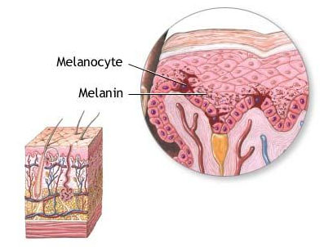

Slide 61
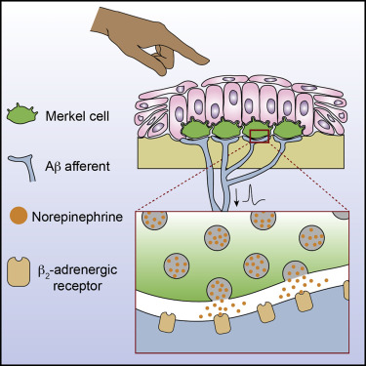
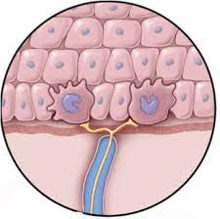
Merkel Cell:
Location: Basal layer.
Function: Tactile sensory cell.
Description: Unlike Melanocytes and Langerhan’s cells it is not dendric.
It does not contain tonofilaments and presence of occasional desmosomes linking to adjacent cells— hence not always clear cell.

Slide 62
It has nerve tissue immediately adjacent.
It is presumed to be “Specialised neural pressure-sensitive receptor cell”
Responds to touch sensation.

Slide 63
Characteristic features:
Small membrane bound vesicles in the cytoplasm
Sometimes situated adjacent to nerve fiber associated with the cell
These granules many liberate Transmitter substance
Across synapse like function between Merkel cell and Nerve fiber--- trigger an impulse
These cells may arise from division of an epithelial cell (Keratinocyte).

Slide 65
Inflammatory cells:
Function: Associated with inflammatory process in Oral Mucosa.
Description: Sections of normal Oral inflammatory cells often in the nucleated cell layers.
~ These cell — transient & do not reproduce themselves in the Epithelium
~ The cell most frequently seen is
~ Lymphocyte occasionally PNM and mast cells can also be seen
~ Lymphocytes — often associated with Langerlan’s cells

Slide 66
Histology of Lip
Skin: keratinized stratified squamous epithelium with adnexal skin structures
Oral Mucosa: Moist-surface, covered by nonkeratinized stratified squamous epithelium associated with small round seromucous glands of the lamina propria. In thesubmucosa fibers of orbicularis oris muscle is noted.
Vermillion zone: Very thin keratinized epithelium that contains no adnexal skinstructures (can contain sebaceous glands)

Slide 67
The Transitional zone between the Skin of the Lip and the Mucous Membrane of Lip is the RED ZONE/ VERMILLION ZONE.
The line that separates the skin from the Vermillion zone- VERMILLION BORDER

Slide 68
The skin on outer surface of Lip- moderately Thick keratinized epithelium with thick str. Corneum.
CT Papillae few and short.
Transitional Zone- midly keratinized epi with long CT papillae.
Deep in to epi---- large capillary loops

Slide 69
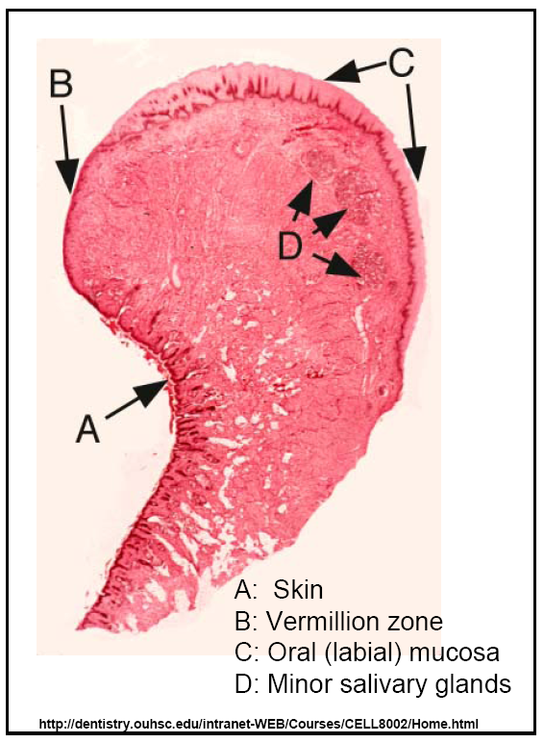

Slide 70
What gives the vermillion zone the red color?
1.Epithelium is thin
2.Epithelium contains eleidin, which is transparent
3.Blood vessels are present near the surface

Slide 71
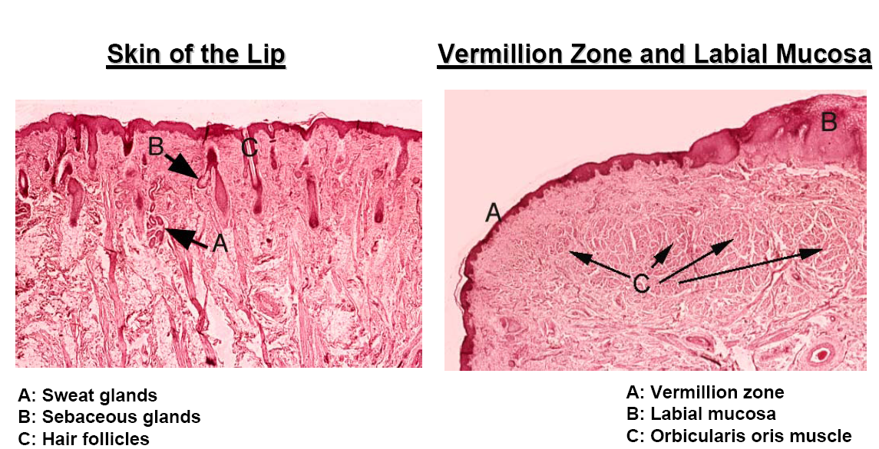

Slide 72
Soft palate

Slide 73
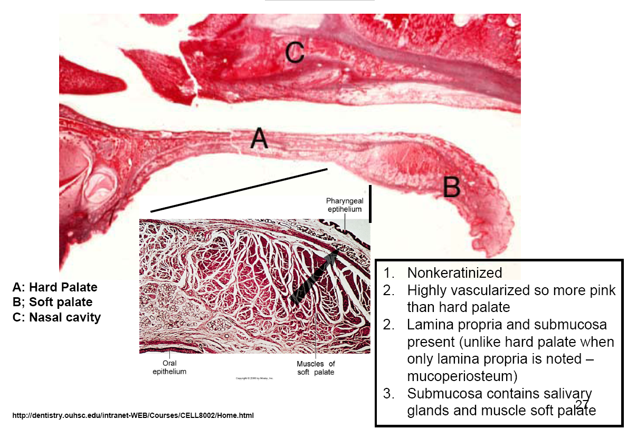

Slide 74
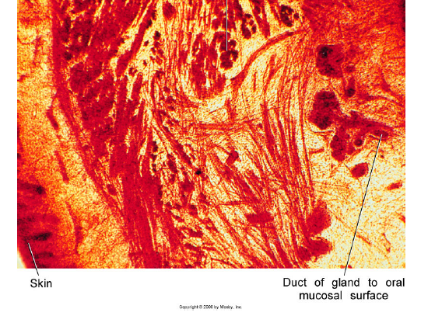
Cheeks (Buccal Mucosa)

Slide 75
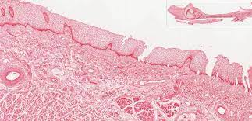

Slide 76
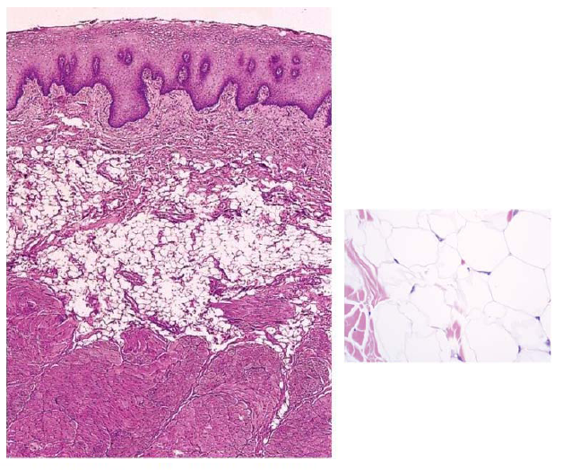

Slide 77
Cheeks (Buccal Mucosa)
Similar to lips and soft palate
Non-keratinized stratified squamous epithelium, lamina propria and submucosa
Submucosa of cheeks contain fat cells along with lobules of minor salivary glands and muscle fibers

Slide 78
The strands of dense connective tissue limit the mobility mucous membrane, holding it to the musculature and preventing the elevation between folds.
This prevents mucous membrane of lips and cheeks from lodging between biting surfaces of teeth.

Slide 79
Ventral surface of tongue
Nonkeratinized stratified squamous epithelium, lamina propria and submucosa
Thin epi loosely attached to underlying structures– free mobility of tongue
Extremely dense muscle fibers
interlacing connective tissue fibers in submucosa

Slide 80
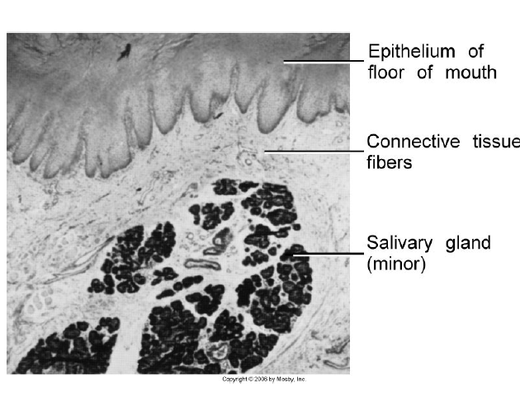
Floor of mouth

Slide 81
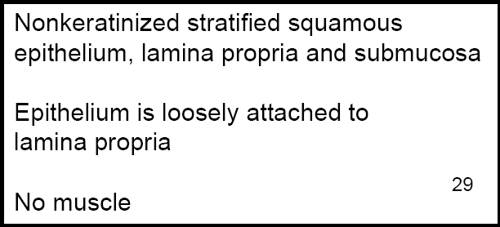

Slide 82
Masticatory Mucosa
Epithelium that covers gingiva and hard palate
Mucosa is thicker than nonkeratinized because of the keratin layer
Stratum basale-Same as nonkeratinized epithelium
Startumspinosum-Same as nonkeratinized epithelium
Stratum granulosum: Cells contain keratohyaline granules
Stratum corneum :Contains thin, flat and non nucleated cells which are filled with keratin. In contrast to the hard keratin seen in nails and hair, keratin overlying normal masticatory oral mucosa is soft. Keratin is tough, nonliving material tha tis resistant to friction and impervious to bacterial invasion. Same as nonkeratinized epithelium

Slide 83
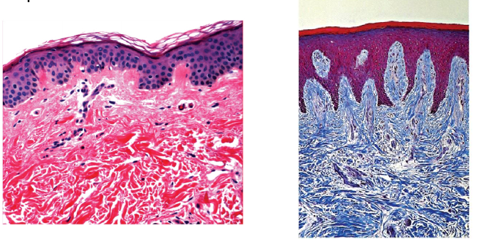

Slide 84
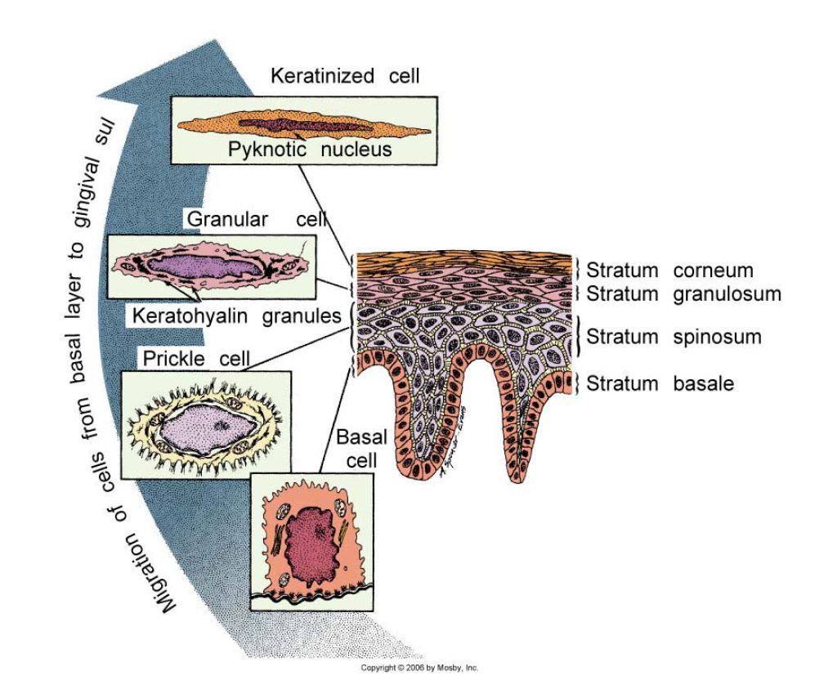

Slide 85
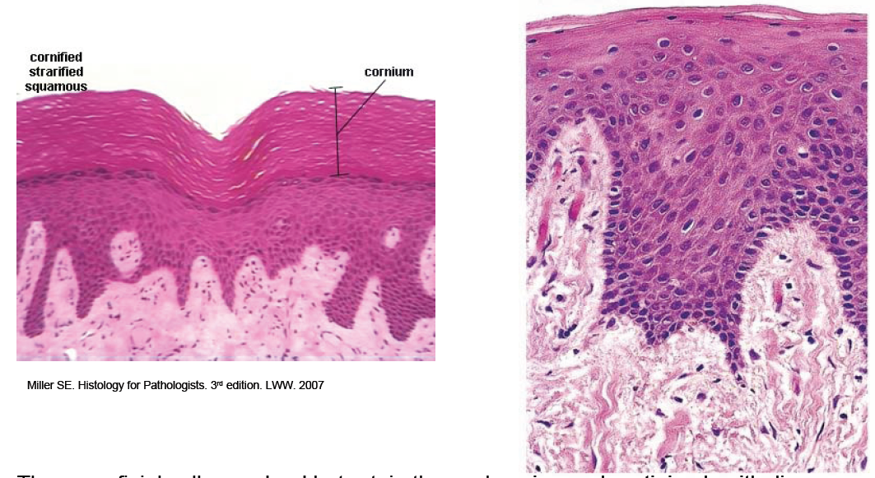
Types of Keratinized Epithelium

Slide 86
Epithelium-- The superficial cells are dead but retain the nucleus in parakeratinized epithelium but the nuclei are lost in orthokeratinized epithelium
The rete pegs are long and slender in keratinized epithelium
Mucoperiosteum

Slide 87
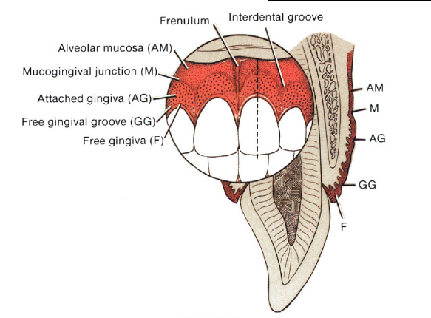
Gingiva and Epithelial Attachment

Slide 88
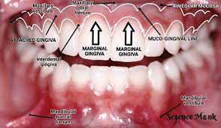

Slide 89
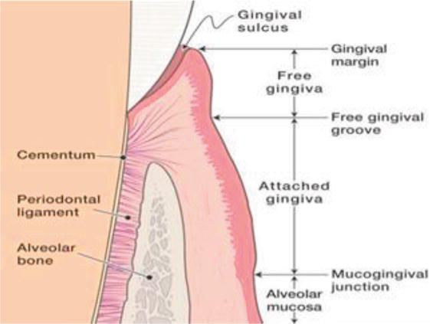
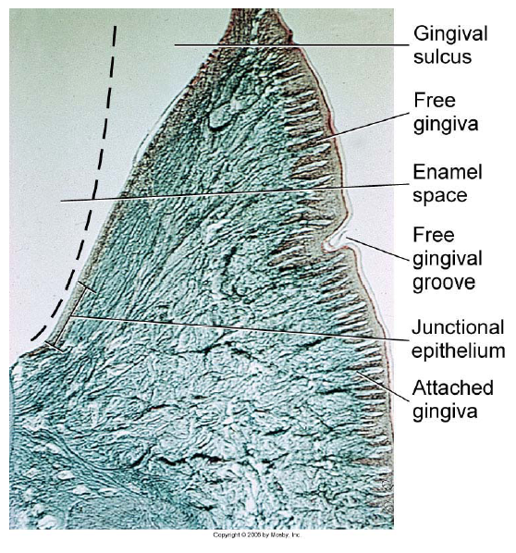

Slide 90
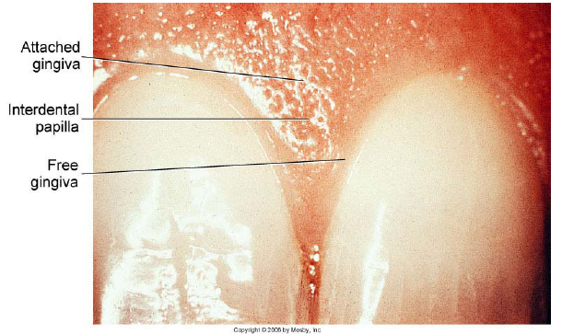
Free or marginal gingiva
Attached gingiva attaches with the neck of the tooth by means of junctional epithelium

Slide 91
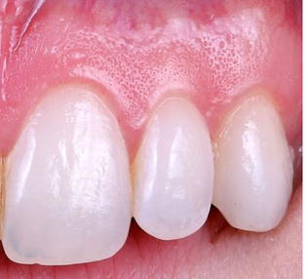
STIPPLING
Functional adaptation to mechanical forces
Healthy gingiva

Slide 92
Histology of Gingiva
Thick (250 µm), either orthokeratinized or parakeratinized stratified squamous epithelium with a stippled surface
In healthy attached gingiva “stippling”is seen which appears as small pits in the epithelium and are due to deep retepegs.
The lamina propria is composed of long narrow papillae which are not highly vascular.
No distinct submucosa is noted as the overlying mucosa is directly attached to the underlying periosteum and cementum by collagen fibers

Slide 93
Free Gingiva:
Keratinized; NOT STIPPLED; bound on inner margin by the gingival sulcus, which separates it from the tooth; bound on its outer margin by the oral cavity; and apically by the free gingival groove.
Attached Gingiva:
Keratinized; STIPPLED; separated from the alveolar mucosa by the mucogingival junction (groove). Attached to the tooth by junctional epithelium.

Slide 94


Slide 95

note the difference in keratinization, thickness of epithelium and ridge pattern.

Slide 96

stained with an elastic stain, note the presence o f elastic fibers in lamina propria in alveolar mucosa. Not much difference in the epithelium is seen between the two types of mucosa.

Slide 97


Slide 98
In healthy attached gingiva “stippling”is seen which appears as small pits in the epithelium and are due to deep retepegs.
The lamina propria is composed of long narrow papillae which are not highly vascular.
No distinct submucosa is noted as the overlying mucosa is directly attached to the underlying periosteum and cementum by collagen fibers

Slide 99
Dentogingival Junction and Junctional Epithelium
Dentogingival junction is the region where the oral mucosa meets the surface of the tooth
Very important because it is a weak area in the oral mucosa which is otherwise continuous
Bacteria on the surface of the tooth produce toxins that can incite inflammation and damage if it enters into the mucosal tissues
Gingival sulcus in healthy individuals is ~ 0.5 to 3 mm (mild inflammation is present-1.8 mm average)

Slide 100
Depth greater that 3mm is considered pathologic; and the sulcus represents periodontal pocket
Floor of the sulcus and the epithelium cervical to it is called junctional epithelium which is in contact with the tooth surface (enamel and some times cementum)
Wall of the gingival sulcus is lined by NON-KERATINIZED stratified squamous epithelium that is derived from and continuous with the rest of the oral mucosa –oral sulcular epithelium

Slide 101


Slide 102
Junctional Epithelium
The epithelium that is attached to the tooth (enamel or sometimes cementum) surface continuous with sulcular epithelium
Derived from reduced enamel epithelium of the tooth germ
Junctional epithelium consists of flat cells aligned parallel to the tooth surface increasing in thickness from the apex to the crown
Attached to enamel by internal basal lamina and to the connective tissue by external basal lamina.
Hemidesmosomesare present in both basal laminas.

Slide 103



Slide 104
Epithelial cell turnover in gingiva
Similar to all other epithelia, the deeper cells adjacent to the connective tissue undergo cell division to replenish those lost at the surface
High rate of cell division
Migrate about 2 to 3 cell layers from the tooth surface and then join a main migratory route in a coronal direction, parallel to tooth surface, to be desquamated into the gingival sulcus.
Key point: Junctional epithelium readily regenerates from the sulcular epithelium or oral epithelium if it is damaged or surgically excised
Connective tissue normally contains plenty of neutrophils which is different than the normal oral mucosa

Slide 105
Col
Col (or depression): This is how the gingiva looks in the interdental area. Similar to an outline of a depression or col with buccal and lingual peaks. Col epithelium is identical to junctional epithelium and has the same origin (from dental epithelium)and is also replaced continually by cell division.
Not sure if there is any significance that the col is more vulnerable to inflammation, but the incidence of gingivitis is greater interdentally.

Slide 106


Slide 107


Slide 108


Slide 109
A quick note on…..
Blood supply to the gingiva: Derived from periosteal vessels in the periosteum of the alveolar process
Blood supply to the dentogingival junction: Continuation of inter alveolar arteries
Nerve supply to the gingiva: terminal branches of periodontal nerve fibers and by branches of the infraorbital and palatine, or lingual, mental, and buccal nerves

Slide 110
Histology of Hard Palate
Thick orthokeratinized (or parakeratinized in areas) epithelium showing ridges (rugae)
Lamina propria shows long papillae with thick dense connective tissue
Submucosa is mucoperiosteum with dense collagenous connective tissue attaching directly to periosteum. Contains fat and salivary glands

Slide 111


Slide 112

Specialized Mucosa -Dorsal Tongue

Slide 113
NERVE SUPPLY OF TONGUE
ANTERIOR 2/3^{RD---} TREGEMINAL NERVE
POST 1/3RD--- GLOSSOPHARYANGEAL NERVE
MUSCLES OF NERVE--- HYPOGLOSSAL NERVE EXCEPT,
PALATOGLOSSUS MUSCLE--- VAGUS NERVE

Slide 114
Filiform papilla:
Makes up majority of the papillae and covers the anterior part of the tongue.
VELVET Appearane to tongue
They appear as slender, threadlike keratinized projections(~ 2 to 3 mm) of the surface epithelial cells.
These papillae facilitate mastication(by compressing and breaking food when tongue is apposed to the hard palate) and movement of the food on the surface of the tongue.
The papillae is directed towards the throat and assist in movement of food towards that direction.
NO TASTE BUDS.

Slide 115


Slide 116



Slide 117


Slide 118
Fungiform papilla
These are interspersed between the filiform papilla.
More numerous near the tip of the tongue.
Smooth, round structures that appearred because of their highly vascular connective tissue core
seen through a thin,nonkeratinized stratified squamous epithelium.
Taste buds are usually seen within the epithelium.

Slide 119


Slide 120
Foliate Papilla
(Leaf-like). Present on the lateral margins of the posterior tongue.
Consist of 4 to 11 parallel ridges that alternate with deep grooves in the mucosa,
A few taste buds are present in the epithelium.
They contain serous glands underlying the taste buds which cleanse the grooves.

Slide 121


Slide 122
Circumvallate papilla
(Walled papilla). 10 to 14 in number these are seen along the V-shaped sulcus between the base and the body of the tongue.
Large, ~ 3 mmin diameter with a deep surrounding groove.
Ducts of Von Ebner glands (serous salivary glands) open into the grooves.
Taste buds are seen lining the walls of the papillae.

Slide 123


Slide 124


Slide 125


Slide 126
TASTE BUDS
Small ovoid or Barrel shaped intra- epithelial organ
80um high and 40um thick
Extend from basal lamina till surface
Seen in:
A. Circumvallate papillae
B. Folds of foliate papillae
C. Post part of epiglottis
D. Fungiform papillae

Slide 127


Slide 128


Slide 129

SWEET- TIP
SALTY- LATERAL BORDER
BITTER- POSTERIOR MIDLINE
SOUR- POSTERIOR LATERAL

Slide 130
Structure of Mucosa in different regions
Region | Covering epithelium | Lamina propria | submucosa
Lining mucosa
Labial & buccal mucosa | Very thick-nonkeratinized | Long slender papillae; dense fibrous CT, rich vascular supply | Muscle forming firm attachment .Fat, minor salivary glands, sometimes sebaceous glands
Floor of mouth | Very thin-nonkeratinized | Short papillae, extensive vascularity | Loose CT, containg fat and minor salivary glands
Soft palate | Thin-nonkeratinized Taste buds | Thick with numerous short papillae, elastin fibers, highly vascular | Diffuse tissue containing numerous minor salivary glands

Slide 131
Structure of Mucosa in different regions
Region | Covering epithelium | Lamina propria | submucosa
Lining mucosa
Lips vermilion zone | Thin orthokeratinized | Numreous narrow papillae | Mucosa firmly attached to muscle, some sabecous glands, minor salivary glands and fat
Ventral surface of the tongue | Thin nonkeratinized | Thin with numerous short papillae, few minor salivary glands | Thin and irregular, may contain fat and small vessels ;tongue musculature

Slide 132
Structure of Mucosa in different regions
Region | Covering epithelium | Lamina propria | submucosa
Masticatory mucosa
Gngiva | Thick parakeratinized/ orthokeratinized | Long nrarrow papillae(fork like) not highly vascular | No distinct layer-mucoperiosteum
Hard palate | Othokeratinized | Longe thick papaillae, dense collagenous tissue | Mucoperiosteum, antlatelaral –fat, Posterolateral-minor salivary glands

