Slide 1
Salivary glands

Slide 2
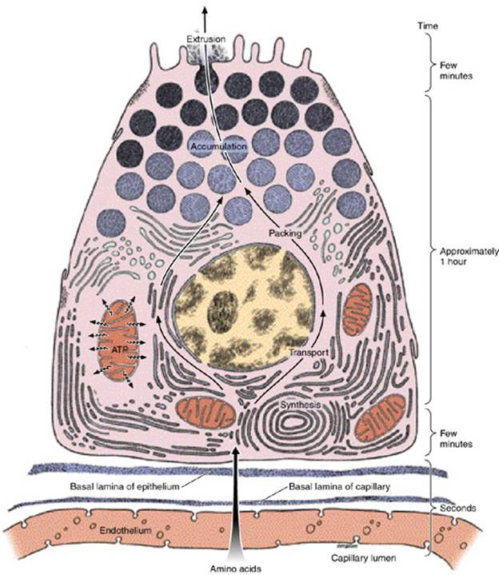

Slide 3
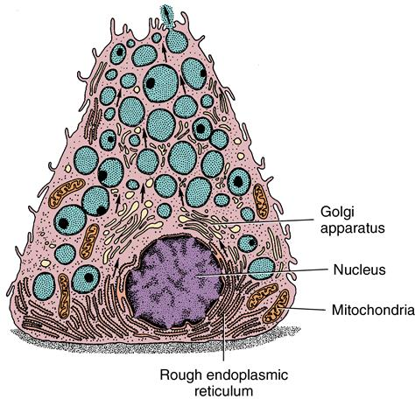

Slide 4
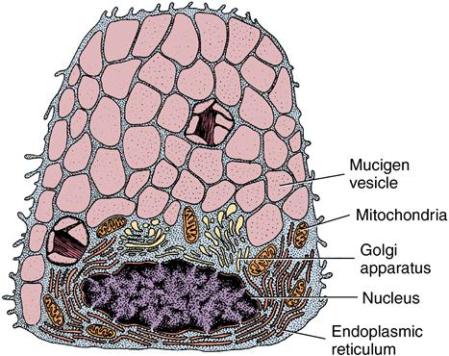

Slide 5
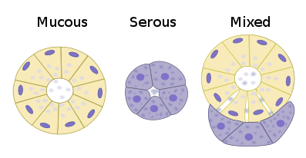

Slide 6
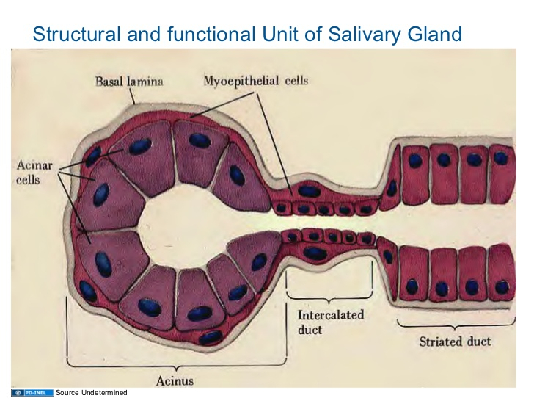

Slide 7
DEFINITONS
GLAND: A GLAND IS A COLLECTION OF SPECIALISED CELLS INVOLVED IN THE PRODUCTION & DISCHARGE OF SECRETIONS REQUIRED FOR A PARTICULAR FUNCTION.
SALIVARY GLANDS: THEY ARE MULTICELLULAR, MEROCRINE, EXOCRINE GLANDS WHOSE SECRETIONS FLOW INTO THE ORAL CAVITY.

Slide 8
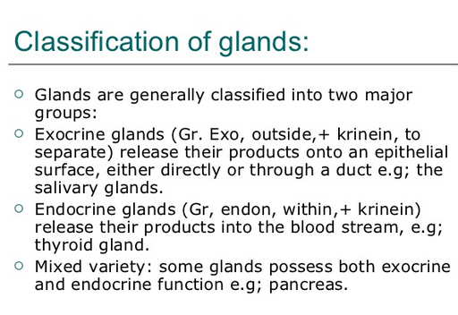

Slide 9
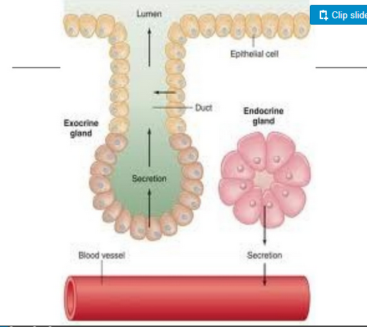

Slide 10
SALIVARY GLANDS ARE EXOCRINE GLANDS, WHOSE SECRETION FLOW INTO THE ORAL CAVITY.
3 PAIRS OF LARGE GLANDS- EXTRA ORALLY CALLED AS MAJOR SALIVARY GLANDS
NUMEROUS SMALL GLANDS– MUCOSA & SUBMUCOSA OF ORAL CAVITY– MINOR SALIVARY GLANDS

Slide 11
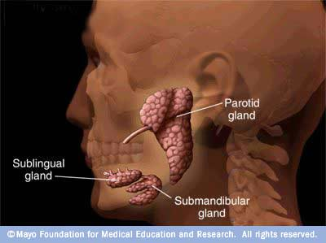
MAJOR SALIVARY GLANDS

Slide 12
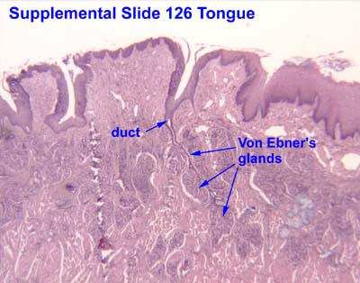

Slide 13
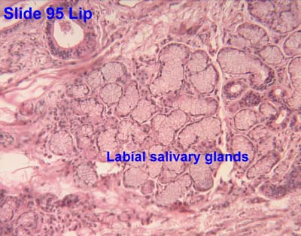

Slide 14
FUNCTIONS OF SALIVA
I . PROTECTION
A. Lubrication
B. Lavage
C. Pellicle formation
D. Water proofing

Slide 15
FUNCTIONS OF SALIVA
II. DIGESTION
Bolus formation
Digestion of starch
Neutralization of esophageal contents

Slide 16
FUNCTIONS OF SALIVA
III. BUFFERING
Maintenance of P^{H}
Neutralization of acids

Slide 17
FUNCTIONS OF SALIVA
IV. TASTE
Solution of molecules
Taste bud growth and maturation

Slide 18
FUNCTIONS OF SALIVA
V. ANTIMICROBIAL
Antibodies
Hostile environment

Slide 19
FUNCTIONS OF SALIVA
VI. TOOTH INTEGRITY
Enamel maturation
Remineralization
Decreased susceptibility

Slide 20
FUNCTIONS OF SALIVA
VII. SOFT TISSUE REPAIR
Reduction in bleeding tissue
Increase in rate of wound contraction
Rate of wound healing enhances
Formation of blood clot

Slide 21
CLASSIFICATIONS
ACCORDING TO SIZE:
a) MAJOR- PAROTID, SUBMANDIBULAR & SUBLINGUAL.
b) MINOR- LABIAL & BUCCAL GLANDS, GLOSSOPALATINE GLANDS, PALATINE GLANDS, LINGUAL GLANDS.

Slide 22
CLASSIFICATIONS
ACCORDING TO THE LOCATION:
GLANDS WHOSE DUCTS OPEN IN THE VESTIBULE:
A) LIP- i) SUPERIOR LABIAL. ii) INFERIOR LABIAL
B) CHEEK– i) PAROTID ii) BUCCAL

Slide 23
CLASSIFICATIONS
II) GLANDS WHOSE DUCTS OPEN IN THE ORAL CAVITY PROPER:
FLOOR OF THE MOUTH i)SUBMANDIBULAR ii) SUBLINGUAL iii)GLOSSOPALATINE
TONGUE a) BODY: ANTERIOR LINGUAL b) POSTERIOR LINGUAL (VON EBNER)
PALATE

Slide 24
CLASSIFICATIONS
ACCORDING TO SECRETION:
A) SEROUS: i) PAROTID ii) VON EBNER
B) MUCOUS : i) PALATINE ii) GLOSSOPALATINE
C) MIXED: i)SUBMANDIBULAR ii) SUBLINGUAL iii) BUCCAL iv) LINGUAL

Slide 25
INTRODUCTION
BOTH MAJOR & MINOR SALIVARY GLANDS ARE COMPOSED OF PARENCHYMAL ELEMENTS INVESTED IN & SUPPORTED BY CONNECTIVE TISSUE.

Slide 26
INTRODUCTION
PARENCHYMAL ELEMENTS ARE DERIVED FROM ORAL EPITHELIUM
TERMINAL SECRETORY DUCTS
DUCTS
OPEN INTO ORAL CAVITY

Slide 27
INTRODUCTION
CONNECTIVE TISSUE FORMS A CAPSULE AROUND THE GLAND & EXTENDS INTO IT, DIVIDING GROUPS OF SECRETORY UNITS & DUCTS INTO LOBES & LOBULES.
BLOOD & LYMPH VESSELS & NERVES ARE PRESENT IN THE CONNECTIVE TISSUE.

Slide 28
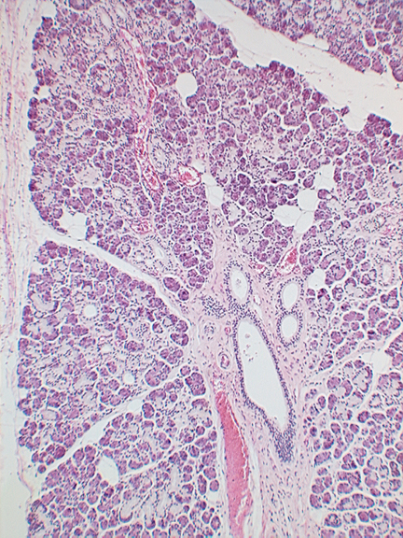

Slide 29
INTRODUCTION
MAIN FUNCTION OF SALIVARY GLANDS IS TO PRODUCE SALIVA
SALIVA CONTAINS ORGANIC & INORGANIC SUBSTANCES PROVIDES NATURAL PROTECTION FOR THE TEETH & SOFT TISSUES OF THE ORAL CAVITY & ASSISTS IN MASTICATION, DEGLUTITION & DIGESTION OF FOOD.

Slide 30
MICROSCOPIC STRUCTURE
ACINAR REGION : COMPRISES OF SERIES OF SECRETORY UNITS (ACINAR CELLS)
DUCTS
MYOEPITHELIAL CELLS

Slide 31
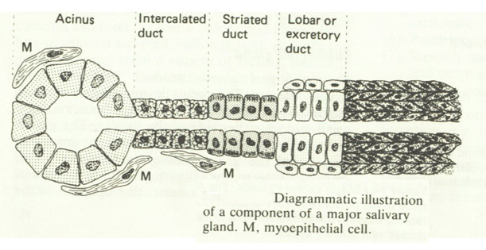

Slide 32
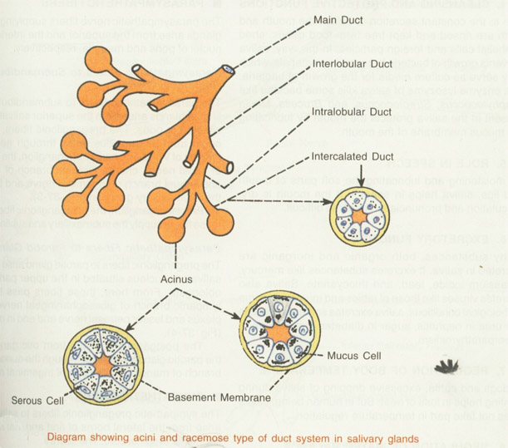

Slide 33
ACINAR CELLS
CLUSTERED AROUND A CENTRAL LUMEN. ACINI COMPRISE THE TERMINAL OR SECRETORY END PIECE OF THE GLAND , SITUATED FARTHEST FROM ORAL CAVITY.
POLYGONAL CELLS ON BASEMENT MEMBRANE CENTERED AROUND A CENTRAL DUCTAL LUMEN.

Slide 34
CONT..
ACINAR CELLS OF SUBMANDIBULAR &SUBLINGUAL CONTAINS MUCOUS CELLS . THEY CONTAIN LARGE SECRETORY VACUOLES AND AREAS OF SMOOTH PARALLEL CISTERNAE. OTERWISE SIMILAR TO SEROUS CELLS.

Slide 35
CONT..
SEROUS CELLS COMPRISE THE MAJORITY OF THE ACINAR CELLS OF THE PAROTID & GLANDS OF VON EBNER. ALSO SEEN IN ANTERIOR LINGUAL, SUBMANDIBULAR GLANDS.

Slide 36
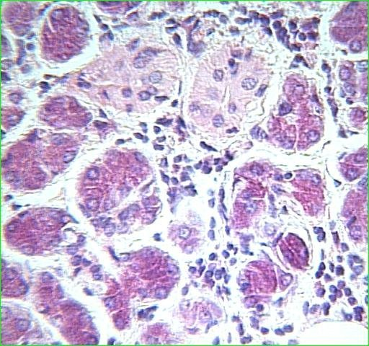
SEROUS CELLS
SPECIALIZED FOR SYNTHESIS, STORAGE & SECRETION OF PROTEINS.
PYRAMIDAL IN SHAPE
BROAD BASE RESTING ON A THIN LAMINA WITH ITS NARROW APEX BODERING LUMEN.

Slide 37
SEROUS CELLS
SPHERICAL NUCLEUS, LOCATED IN THE BASAL REGION OF THE CELL, USUALLY BINUCLEATED.
ACCUMULATION OF SECRETORY GRANULES IN THE APICAL CYTOPLASM PROMINENT FEATURE

Slide 38
SEROUS CELLS
GRANULES CLOSELY APPOSED TO ONE ANOTHER, THE PLASMA MEMBRANE, OR OTHER ORGANELLES
BASAL PORTION OF THE CYTOPLASM FILLED WITH RIBOSOME- STUDDED (ROUGH) ER, A CLOSED SYSTEM OF MEMBRANEOUS SACS OR CISTERNAE.

Slide 39
SEROUS CELLS
RIBOSOMES, CONSISTING OF RNA & PROTEINS, ARE THE BASIC UNITS OF PROTEIN SYNTHESIS.

Slide 40
EXOCYTOSIS
THE COMPLETED SECRETORY PROTEINS ARE STORED IN THE SECRETORY GRANULES IN THE CELL APEX.
SECRETION & DISCHARGE OF THE GRANULE CONTENT OCCURS BY A PROCESS CALLED EXOCYTOSIS.

Slide 41
EXOCYTOSIS
EXOCYTOSIS INVOLVES FUSION OF GRANULE MEMBRANE WITH THE PLASMA MEMBRANE AT THE LUMEN OR INTRACELLULAR CANALICULUS,FOLLOWED BY THE OPENING OF THE FUSED PORTION.
THE GRANULE MEMBRANE BECOMES CONTINOUS WITH THE PLASMA MEMBRANE & THE GRANULE CONTENT IS EXTERIORIZED WITHOUT LOSS OF CYTOPLASM.

Slide 42
SEROUS CELLS
FREE OR UNATTACHED RIBOSOMES---- SYNTHESIS OF NON SECRETORY CELLULAR PROTEINS.
MITOCHONDRIA---CONTAIN THE ENZYMES OF CITRIC ACID CYCLE, ELECTRON TRANSPORT & OXIDATIVE PHOSPHORYLATION--- SOURCE OF HIGH ENERGY COMPOUNDS NECESSARY FOR NUMEROUS SYNTHETIC & TRANSPORT PROCESS THAT OCCUR IN THE CELL.

Slide 43
SEROUS CELLS
LYSOSOMES----POTENT HYDROLYTIC ENZYMES---- TO DESTROY FOREIGN MATERIALS TAKEN UP BY THE CELLS, AS WELL AS CELLS THEMSELVES, SUCH AS WORN OUT MITOCHONDRIA OR OTHER ORGANELLS.

Slide 45
WHERE SEROUS CELLS PREDOMINATE IN AN ACINUS, THEY ARE LARGE, POLYGONAL IN SHAPE.
WHEN THE GLAND IS PREDOMINANTLY MUCOUS, THE SEROUS CELLS HAVE A CRESCENT ( DEMILUNE ) OR FLATTENED SHAPE. THEY HAVE A NUCLEUS TOWARDS BASEMENT MEMBRANE. ALSO CONTAIN ENDOPLASMIC RETICULUM . NUMEROUS GRANULES & VACUOLES IN THE LUMINAL REGION.

Slide 46
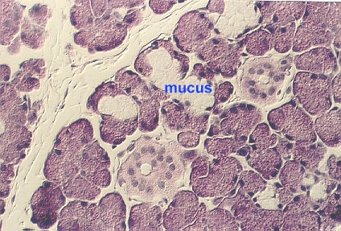
MUCOUS CELLS

Slide 47
DUCTS
THE SECRETION PASS FROM THE ACINUS TO A SHORT INTERCALATED DUCT, LINED BY CUBOIDAL CELLS HAVING LARGE NUCLEUS & MANY MITOCHONDRIA BUT VERY FEW ENDOPLASMIC RETICULUM. THE CELLS HAVE SMALL CYTOPLASMIC VILLI EXTENDING IN LUMEN.

Slide 48
CONT..
INTERCALATED DUCTS THEN PASS ABRUPTLY INTO ANOTHER SHORT, BUT WIDE, STRIATED DUCT. THEY ARE LINED BY COLUMNAR CELLS WITH MARKED CELLULAR MEMBRANE INTERDIGITATIONS PROJECTING TOWARDS THE LUMEN.

Slide 49
CONT..
CYTOPLASM CONTAINS NUMEROUS LINEARLY ARRANGED MITOCHONDRIA PROVIDING THE STRIATED APPEARANCE.
STRIATED DUCTS THEN PASS ABRUPTLY INTO TWO EPITHELIAL CELL LAYERED EXCRETORY DUCTS & FINALLY TO A STRATIFIED SQUAMOUS EPITHELIAL CELL LINED TERMINAL DUCT.

Slide 50
MYOEPITHELIAL CELLS
THESE CELLS CONSTRICT THE ACINI & DUCTS TO FACILITATE SALIVARY SECRETORY FLOW.
THESE STELLATE CELLS HAVE LONG THIN CYTOPLASMIC PROCESSES THAT INTERDIGITATE AROUND ACINI & DUCTS .
THEY RESEMBLE SMOOTH MUSCLE CELLS

Slide 51
MECHANISM OF SALIVARY SECRETION
ACINAR FLUID FORMATION: ACINAR FLUID COSISTS OF WATER, IONS, SMALL MOLECULES & SECRETORY PRODUCTS SYNTHESIZED BY THE CELLS. THE FLUID IS DERIVED FROM THE INTERSTITIAL FLUID, WHICH IN TURN IS DERIVED FROM THE BLOOD IN THE ADJACENT CAPPILLARIES.

Slide 52
CONT..
AS SECRETION IS STIMULATED , THE BLOOD FLOW TO THE ACINAR REGION IS INCREASED, WITH THE PRESSURE GRADIENT TOWARDS THE ACINUS FACILITATING PRIMARY ACINAR FLUID FORMATION.

Slide 53
ROLE OF THE DUCTS
ON PASSING THROUGH THE DUCTS , THE ACINAR FLUID IS TRANSFORMED FROM AN ISOTONIC FLUID WITH ANALOGOUS IONIC CONC TO PLASMA , TO A HYPOTONIC FLUID WITH LOW CHLORIDE & SODIUM ION CONC. THIS IS RESTICTED TO STRIATED DUCT, FACILITATED BY MARKED INTERDIGITATIONS OF LUMINAR CELLULAR WALLS.

Slide 54
CONT..
THERE IS ACTIVE TRANSPORT OF SODIUM OUT OF THE FLUID WITH ACTIVE POTASSIUM TRANSPORT IN THE OPPOSITE DIRECTION, PASSIVE CHLORIDE DIFFUSION MAINTAINING AN ELECTROCHEMICAL BALANCE. BICARBONATE IS ALSO ACTIVELY SECRETED IN THE FLUID.

Slide 55
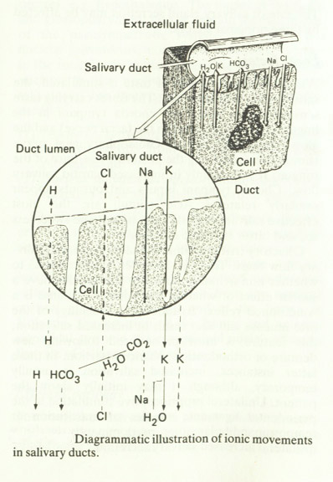

Slide 56
NERVE SUPPLY
SALIVARY GLANDS ARE UNDER THE CONTROL OF AUTONOMIC NERVOUS SYSTEM & RECEIVE EFFERENT NERVE FIBERS FROM BOTH PARASYMPATHETIC & SYMPATHETIC DIVISIONS OF AUTONOMIC NERVOUS SYSTEM.

Slide 57
PARASYMPATHETIC FIBERS
ARISE FROM SUPERIOR & INFERIOR SALIVATORY NUCLEI OF PONS & MEDULLA.

Slide 58
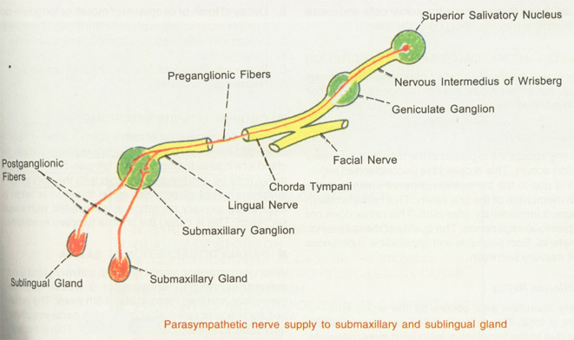
PARASYMPATHETIC NURVE SUPPLY TO SUBMANDIBULAR & SUBLINGUAL GLANDS

Slide 59
SYMPATHETIC FIBRES
SYMPATHETIC FIBRES TO SALIVARY GLANDS ARISE FROM THE LATERAL HORNS OF FIRST & SECOND THORACIC SEGMENTS OF SPINAL CORD. THE FIBERS LEAVE THE CORD THROUGH THE ANTERIOR NERVE ROOT & END IN SUPERIOR CERVICAL SYMPATHETIC GANGLION.

Slide 60
FUNCTION OF NERVE FIBRE
PARASYMPATHETIC : ACTIVATE THE ACINAR CELLS & DILATE THE BLOOD VESSELS OF SALIVARY GLANDS. WHEN PARASYMPATHETIC FIBERS ARE STIMULATED , PROFUSE & WATERY SALIVA IS SECRETED . THE ORGANIC COMPONENTS ARE LESS. NEUROTRANSMITTER IS ACETYLCHOLINE

Slide 61
REFLEX MECHANISM
TWO TYPES : 1) UNCONDITIONAL REFLEX 2)CONDITIONAL REFLEX

Slide 62
UNCONDITIONAL REFLEX
WHEN ANY SUBSTANCE IS PLACED IN THE MOUTH , THE SALIVARY SECRETION OCCURS. THIS IS DUE TO THE STIMULATION OF NERVE ENDINGS IN THE MUCUS MEMBRANE OF THE ORAL CAVITY. THS REFLEX IS INBORN & OCCURS IMMEDIATELY AFTER BIRTH.

Slide 63
CONDITIONAL REFLEX
SALIVARY SECRETION ALSO OCCURS BY THE SIGHT, SMELL, OR THOUGHT OF FOOD.THIS IS DUE TO IMPULSES ARISING FROM EYES, NOSE ETC. THIS IS NOT INBORN REFLEX BUT IT IS AN ACQUIRED REFLEX.

Slide 64
SALIVA
THE SALIVA CIRCULATING IN THE MOUTH AT ANY GIVEN TIME IS TERMED WHOLE SALIVA.
IT COMPRISES A MIXTURE OF SECRETIONS FROM THE MAJOR & MINOR SALIVARY GLANDS.

Slide 65
CONT…
SOME SALIVARY COMPONENTS IMMEDIATELY ATTACH TO TOOTH SURFACES, WHEREAS OTHERS INTERACT WITH ORAL SOFT TISSUES, BACTERIA & FOOD.

Slide 66
PROPERTIES OF SALIVA
VOLUME: 1000 TO 1500 ml OF SALIVA IS SECRETED PER DAY & APPX ABOUT 1ml PER MIN.
REACTION: MIXED SALIVA FROM ALL THE GLANDS IS SLIGHTLY ACIDIC WITH ph 6.35 TO 6.85
SPECIFIC GRAVITY: 1.002 TO 1.012
OSMOLALITY: SALIVA IS HYPOTONIC TO PLASMA

Slide 67
COMPOSITION OF SALIVA
99% - WATER
1% - LARGE ORGANIC MOLECULES LIKE PROTEINS, GLYCOPROTEINS & LIPIDS
SMALL ORGANIC MOLECULES LIKE GLUCOSE, UREA.
ELECTROLYTES LIKE Na, Ca, Cl2, PHOSPHATES.

Slide 68
PROTEINS
MAJOR & PRIMARY CONTRIBUTION : ACINI.
MINOR CONTRIBUTION : DUCTS & PLASMA CELLS.
PAROTID : Avg 2.3 +/- 1.7 gm/lt
SUBMANDIBULAR: 1.2 +/- 0.8 gm/lt
SUBLINGULAL : 2.6 +/- 0.7 gm/lt

Slide 69
PROTEINS OF ACINAR ORIGIN
AMYLASE
LIPASE
MUCIN
PROLINE- RICH PROTEINS
TYROSINE- RICH PROTEINS
HISTIDINE- RICH PROTEINS
CYSTEINE- RICH PROTEINS

Slide 70
CONT…
PEROXIDASE
LACTOFERRIN
SECRETORY COMPONENTS
GUSTIN
PAROTID AGGREGINS
EPIDERMAL GROWTH FACTOR

Slide 71
PROTEINS OF DUCTAL ORIGIN
LYSOZYME
SECRETORY IgA
KALLIKREIN
FIBRONECTIN
VITAMIN- BINDING PROTEIN
NERVE GROWTH FACTOR
RIBONUCLEASES

Slide 72
CONT…
CARBOHYDRASES
ESTERASES
PHOSPHATASE

Slide 73
PROTEINS ANALOGOUS TO THOSE FOUND IN BLOOD
FACTOR VII ( PROACTIVATOR )
FACTOR IX ( CHIRSTMAS FACTOR )
FACTOR VIII ( ANTI HEMOPHILIC FACTOR)
PLATELET FACTOR

Slide 74
SERUM PROTEINS
α - β GLOBULIN
ALBUMIN
Ig G, Ig m , Ig A

Slide 75
ELECTROLYTES
SODIUM
POTASSIUM
CALCIUM
PHOSPHOROUS
CHLORIDE
THIOCYNATE
FLUORIDE
BICARBONATES

Slide 76
SECRETORY IgA
PREVENTS BACTERIA COLONIZATION BY AGGLUTINATION.
BINDS TO SPECIFIC BACTERIAL ANTIGENS INVOLVED IN ADHERENCE.
AFFECTS SPECIFIC ENZYMES ESSENTIAL FOR BACTERIAL METABOLISM

Slide 77
AMYLASE
30% OF THE PROTEIN FOUND IN SALIVA IS α-AMYLASE (PTYALINE) IS CALCIUM DEPENDENT & IS ACTIVATED BY CHLORIDE IONS. THIS ENZYME HYDROLYSES COOKED STRACH TO MALTOSE.

Slide 78
LYSOZYME
PRESENT IN ALL MAJOR BODY FLUIDS BUT OCCURS AT HIGH CONC IN SALIVA, IN ADDITION TO LACRIMAL FLUID & NASAL & BRONCHIAL SECRETION.
LYSOZYME ACTS ON THE B(1-4) BOND BETWEEN N- ACETYL- MURAMIC ACID & N-ACETYL-GLUCOSAMINE IN THE GRAM- POSITIVE BACTERIAL CELL WALL COMPONENT PEPTIDOGLYCAN LEADING TO ITS SUBSEQUENT DISRUPTION &MICROBIAL DEATH.

Slide 79
ACID PHOSPHATASE,CHOLINESTERASE, RIBONUCLEASE.
THESE ENZYMES ARE PRESENT IN SIMILAR CONC IN PAROTID & SUBMANDIBULAR SALIVA , WITH PHOSPHATASE HAVING AN OPTIMUM Ph of 4.0

Slide 80
LIPASE
A SPECIFIC LIPASE OCCURS IN PAROTID SALIVA.

Slide 81
PEROXIDASE
IT IS AN ANTIBACTERIAL , OCCURS IN PAROTID SALIVA . IT INHIBITS GROWTH & ACID PRODUCTION OF A VARIETY OF MICRO-ORGANISMS, INCLUDING STREPTOCOCCI, LACTOBACILLI, FUNGI & ENTERIC BACTERIA.

Slide 82
KALLIKREIN
IT SPLITS SERUM β GLOBULIN IN BRADYKININ, WHICH THEN PASSES BACK INTO THE GLAND & INTO THE BLOOD VESSELS. KALLIKREIN MAY THEREFORE CAUSE FUNCTIONAL VASODILATION TO SUPPLY AN ACTIVELY SECRETING GLAND.

Slide 83
MISCELLANEOUS ENZYMES
PROTEASES
AMINO-PEPTIDASES
CARBOXYPEPTIDASES
LIPASES
UREASE
GLUCURONIDASE
HYALURONIDASE
NEURAMINIDASE
ESTERASES
PHOSPHATASES
SULPHATASE

Slide 84
MISCELLANEOUS ENZYMES CONTD…
ACID & ALKALINE RIBONUCLEASES
GLYCOLYTIC PATHWAY ENZYMES:
SUCCINIC DEHYDROGENASE
MALATE DEHYDROGENASE
LACTATE DEHYDROGENASE
GLUTAMATE DEHYDROGENASE
β-HYDROXYBUTYRATE DEHYDROGENASE

Slide 85
MUCOPROTEINS AND GLYCOPROTEINS
THE MAJORITY OF SALIVARY PROTEINS CONTAIN A LARGE PROPORTION OF CARBOHYDRATE IN THEIR MOLECULES,INCLUDING GALACTOSE, MANNOSE, HEXOSAMINE AND FUCOSE. PROLINE,GLYCINE AND GLUTAMIC ACID COMPRISE THE MAJOR AMINO ACID COMPONENTS.

Slide 86
CONTD…
THESE NEGATIVELY CHARGED PROTEINS PROBABLY INTERACT WITH THE POSITIVELY CHARGED CALCIUM ON HYDROXYAPATITE SURFACES. THEY ALSO PROBABLY CONTRIBUTE TO THE ENAMEL PELLICLE, ENAMEL REMINERALIZATION AND PREVENTING TOOTH SURFACE BACTERIAL COLONIZATION.

Slide 87
BLOOD GROUP SUBSTANCES
A,B,AB,OR THE GLYCOPROTEIN H SUBSTANCE , OTHER BLOOD GROUP ANTIGENS EX. THE LEWIS ANTIGEN FAMILY HAVE BEEN DESCRIBED IN SALIVA.

Slide 88
HORMONES
TWO HORMONE LIKE SUBSTANCES ARE PRESENT : PAROTIN, WHICH FACILITATES CALCIFICATION AND HELPS TO MAINTAIN SERUM CALCIUM LEVELS, AND A NERVE GROWTH FACTOR THAT AFFECTS GROWTH AND DEVELOPMENT OF SYMPATHETIC NERVE FIBRES.

Slide 89
CARBOHYDRATES
IN ADDITION TO CARBOHYDRATES BOUND TO PROTEINS, PAROTID SALIVA ALSO CONTAINS GLUCOSE AT A SIMILAR CONCENTRATION TO BLOOD. IN ADDITION TO GLUCOSE, SUBMANDIBULAR SALIVA ALSO CONTAINS HEXOSE AND FUCOSE WITH SMALL AMOUNTS OF HEXOSEAMINE AND SIALIC ACID.

Slide 90
LIPIDS
DIGLYCERIDES, TRIGLYCERIDES, CHOLESTROL , CHOLESTROL ESTERS, PHOSPHOLIPIDS , IN ADIITION TO CORTICOSTEROIDS (MAINLY CORTESONE).THESE LIPIDS MAY PLAY A ROLE IN SALIVARY PROTEIN BINDING, BACTERIAL ADSORPTION TO APETITE AND PLAQUE MICROBIAL AGGREGATION

Slide 91
LACTOFERRIN
LACTOFERRIN FUNCTIONS WITH OTHER ANTIMICROBIAL AGENTS, EXAMPLE, LYSOZYME AND LACTOPEROXIDASE TO MONITOR THE ORAL MICROBIAL FLORA.

Slide 92
INORGANIC SUBSTANCES
SODIUM, POTASSIUM, CHLORIDE, BICARBONATE , HYDROGEN ION, IODINE FLOURIDE, THIOCYNATE, CALCIUM , PHOSPHATE.

Slide 93
FACTORS AFFECTING SALIVARY FLOWRATE
DIURINAL VARIATION…
PROTEIN CONCENTRATIONS HIGH IN THE AFTERNOON
SODIUM AND CHLORIDE CONC. ARE HIGH IN THE EARLY MORNING.
POTASSIUM HIGH IN THE EARLY AFTERNOON.
CALCIUM CONC. INCREASES AT NIGHT

Slide 94
CONTD…
DURATION OF STIMULUS:
IF SALIVARY GLANDS ARE STIMULATED LONGER THAN 3 MINUTES CONC. OF MANY COMPONENTS REDUCES . AFTER SHORT PERIOD BICARBONATE, CALCIUM AND PROTEIN CONC. BEGIN TO RISE AGAIN. MAGNESIUM PHOSPHATE AND POTASSIUM CONC. REMAINS STABLE AFTER INITIAL FALL.CHLORIDE CONC. FALLS . SODIUM AND IODIDE CONC. ARE UNAFFECTED BY THE DURATION OF THE STIMULATION AFTER THE FIRST FEW MINUTES.

Slide 95
CONTD…
NATURE OF STIMULUS
DIETERY FACTORS
PLASMA CONC.
HORMONAL INFLUENCES – ALDOSTERONE RESULTS IN INCREASED SODIUM REABSORPTION IN THE STRIATED DUCTS.
ANTIDIURETIC HORMONE- IT FACILITATES WATER REABSORPTION BY STRIATED DUCT CELLS.

Slide 96
THANK YOU

