Slide 1
DEVELOPMENT OF TOOTH

Slide 2
INTRODUCTION
The primitive oral cavity called stomodeum – lined by stratified squamous epithelium - oral ectoderm.
The oral ectoderm contact the endoderm of the foregut to form the buccopharyngeal membrane.
At about 27th day of IUL buccopharyngeal membrane ruptures and the primitive oral cavity establishes a connection with the foregut.

Slide 3
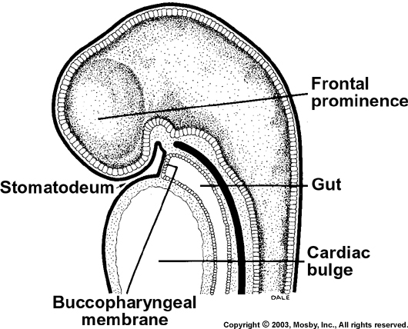
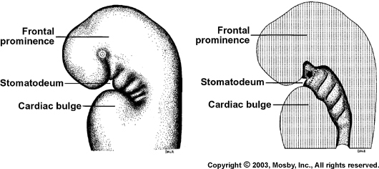

Slide 4
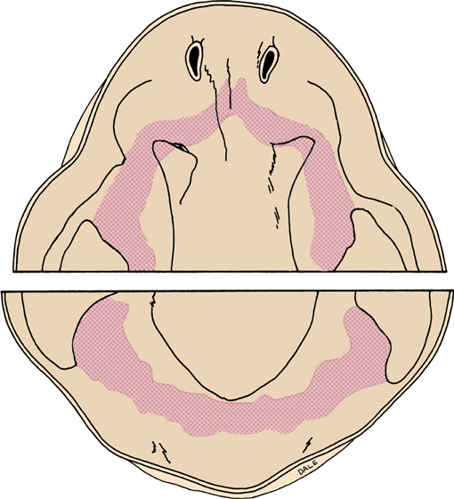
PRIMARY EPITHELIAL BAND
When the embryo is about 6 wks old-
Bands are roughly horse shoe shaped and correspond to the positions of the future dental arches.

Slide 5
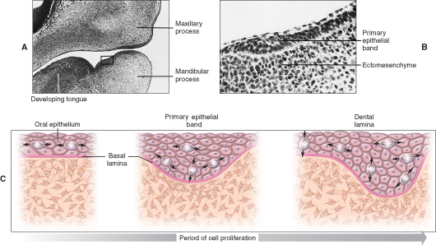
Thickening of epithelial band occurs due to - change in orientation of mitotic spindles & cleavage plane of dividing cells.

Slide 6
Primary epithelial band
Vestibular lamina (labially)
Dental lamina (lingually)
Deciduous teeth
Its Lingual extension
(successional)
Distally gives rise to permanent molars
All permanents except molars

Slide 7
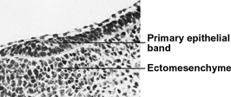
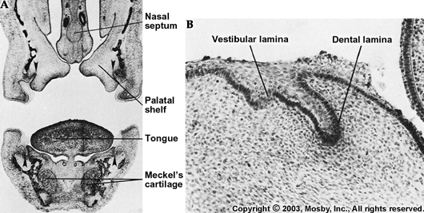

Slide 8
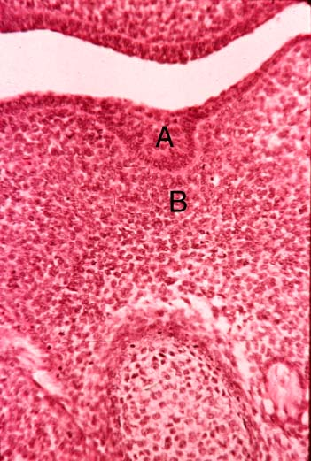
DENTAL LAMINA
Dental lamina is band of epithelium that has invaded the underlying ectomesenchyme along each of the horse shoe-shaped future dental arches.
It serves as the primordium for the ectodermal portion of the deciduous teeth.
Later, during the development of the jaws, the permanent molars arise directly from a distal extension of the dental lamina.

Slide 9
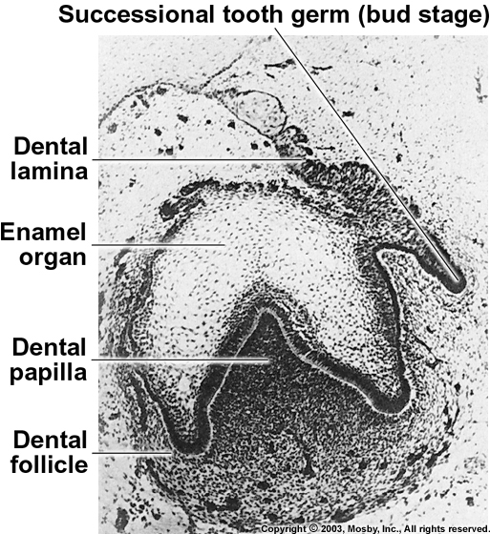
The successors of the deciduous teeth develop from lingual extension of the free end of the dental lamina opposite to the enamel organ of each deciduous tooth .
The lingual extension of the dental lamina is named successional lamina and develops from the fifth month in utero to the tenth month of age.
Notes:
Abortive lamina---- chances of tumors in molar region

Slide 10
FATE OF DENTAL LAMINA
The total activity of the dental lamina extends over a period of at least 5 years.
Any particular portion of the dental lamina functions for a much briefer period since only a short time elapses after initiation of tooth development before the dental lamina begins to degenerate at that particular location.

Slide 11
The dental lamina may still be active in the third molar region after it has disappeared elsewhere, except for occasional epithelial remnants.
Remnants of the dental lamina persist as epithelial pearls or islands within the jaw as well as in the gingiva – called cell rests of Serres.

Slide 12
VESTIBULAR LAMINA
Labial and buccal to the dental lamina in each dental arch, another epithelial thickening develops independently and somewhat later. It is the vestibular lamina, also termed the lip furrow band.
It subsequently hollows and forms the oral vestibule between the alveolar portion of the jaws and the lips and cheeks.

Slide 13
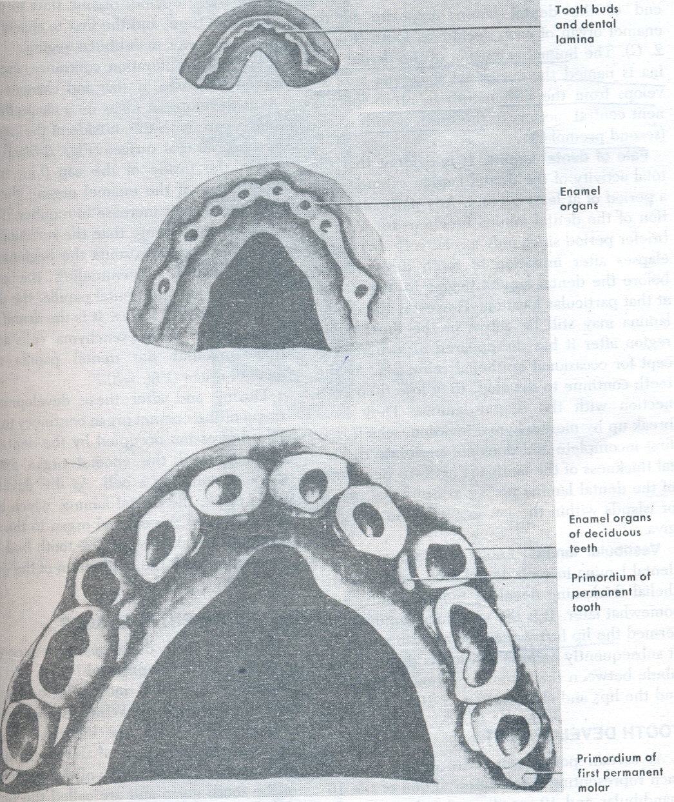
TOOTH DEVELOPMENT
10 small swellings develop in the region of future primary teeth.
They form enamel organ and give rise to the enamel of the teeth.

Slide 14
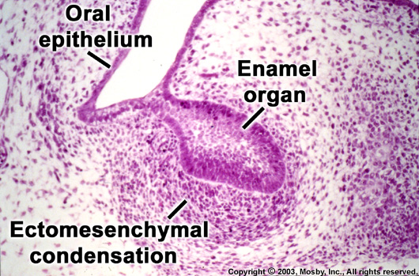
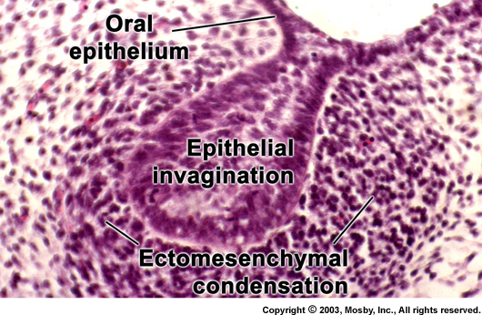

Slide 15
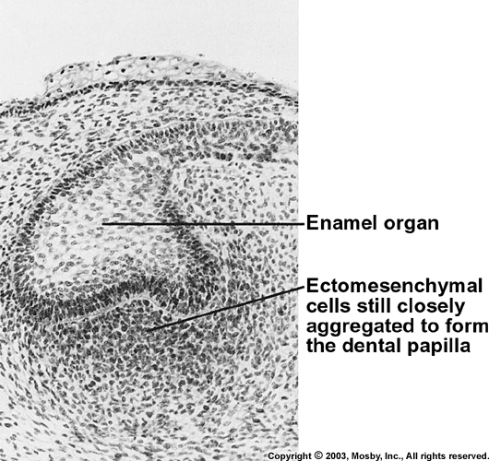
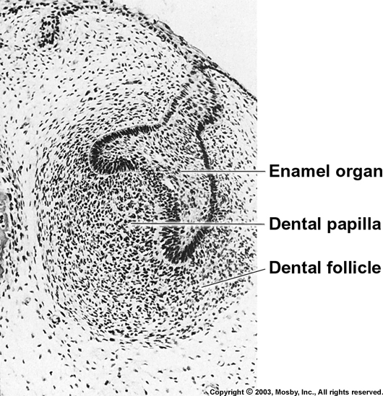
DENTAL PAPILLA AND SAC
Peripheral condensation of ectomesenchymal cells around enamel organ forms dental papilla
Surrounding dental papilla and enamel organ is dental follicle or sac

Slide 16
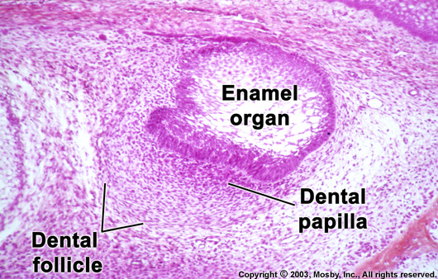

Slide 17
Tooth germ is formed by
  Enamel organ enamel
  +
  Dental papilla pulp and dentin
  +
  Dental sac cementum and PDL

Slide 18
STAGES OF TOOTH DEVELOPMENT
3 morphological stages in tooth development are seen------
BUD STAGE
CAP STAGE
early
BELL STAGE
advanced

Slide 19
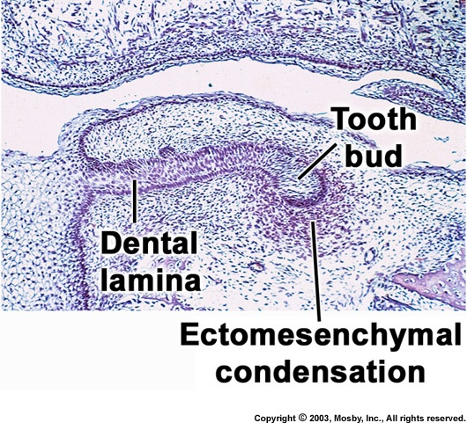
BUD STAGE
The epithelium of the dental lamina is separated from the underlying ectomesnchyme by a basement membrane.
The cells of the epithelium proliferate faster than the adjacent cells.
The enamel organ consists in this stage peripherally located low columnar cells & centrally located polygonal cells.

Slide 20
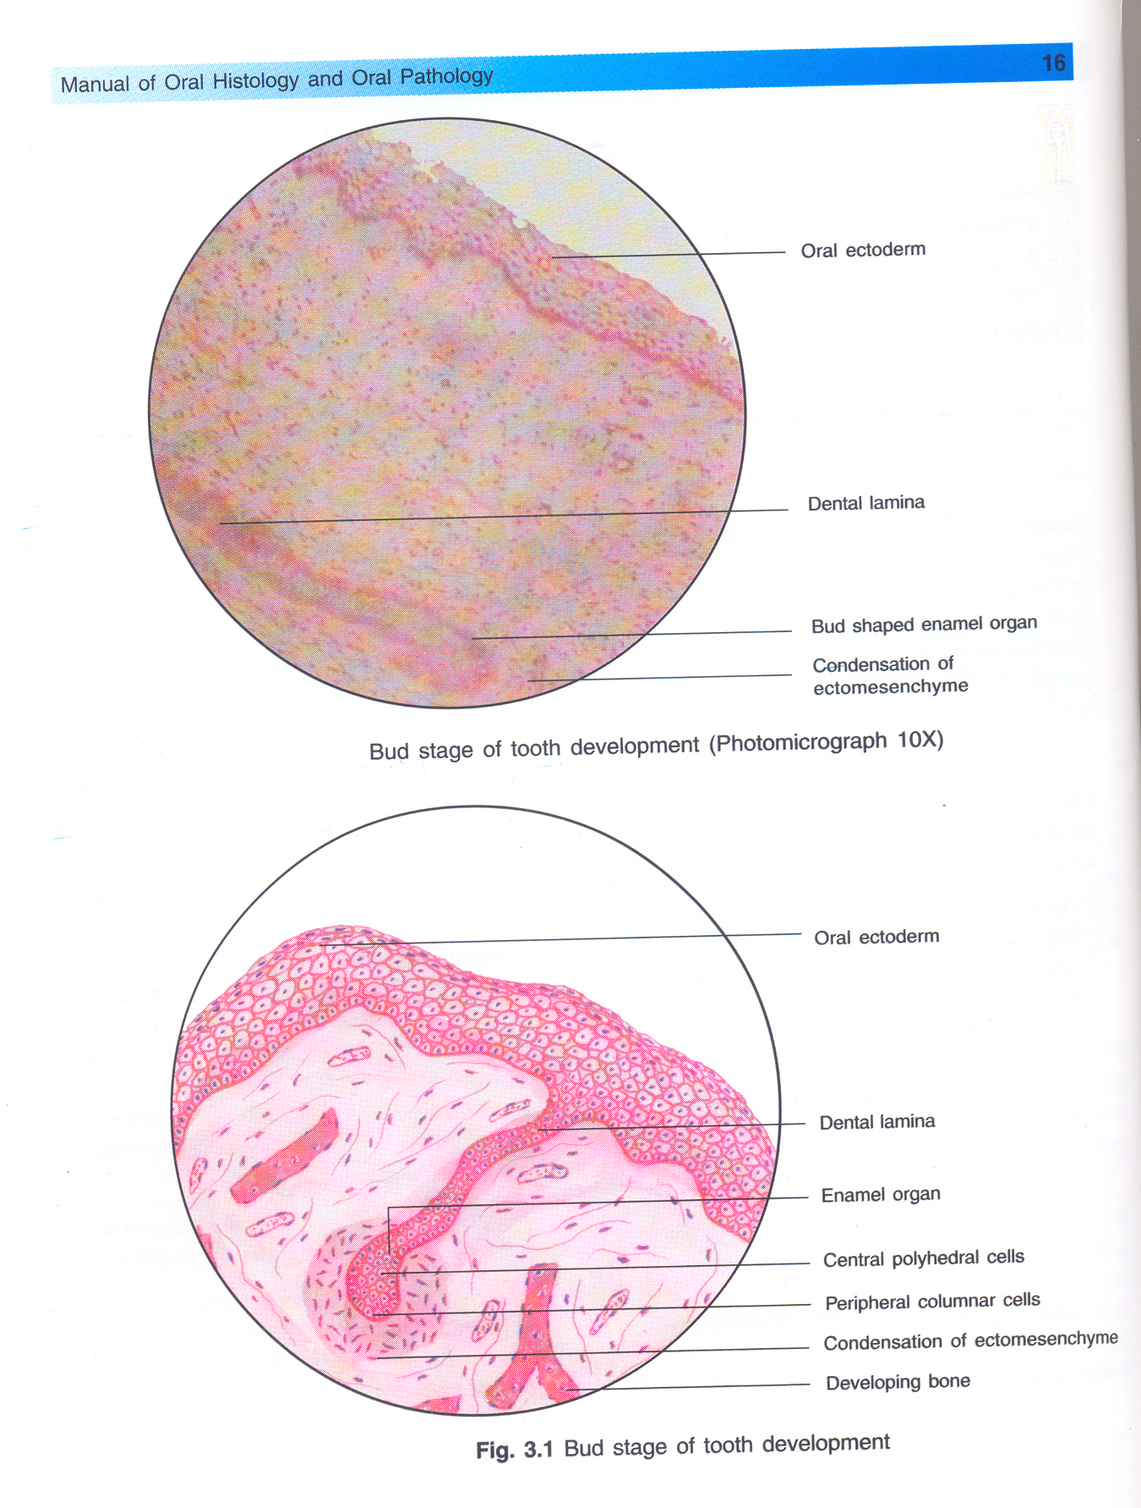


Slide 21
The next step is mitosis of cells of both epithelium & C.T.
As a result of mitosis & migration of neural crest cells into the area, the ectomesenchymal cells surrounding the tooth bud condense.
The area of ectomesenchymal condensation immediately adjacent to enamel organ is called dental papilla.
The cells of dental papilla will form pulp & dentin.

Slide 22
Dental papilla & enamel organ are surrounded by dental sac.
This consists of ectomesenchymal cells and fibers.
The cells of dental sac will form cementum & periodontal ligament.

Slide 23
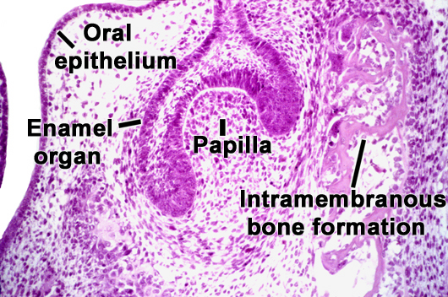
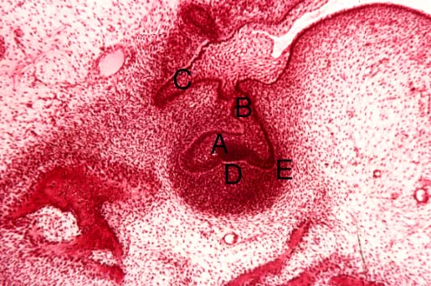
CAP STAGE
Outer and inner enamel epithelium
Stellate Reticulum
Dental papilla
Dental sac

Slide 24
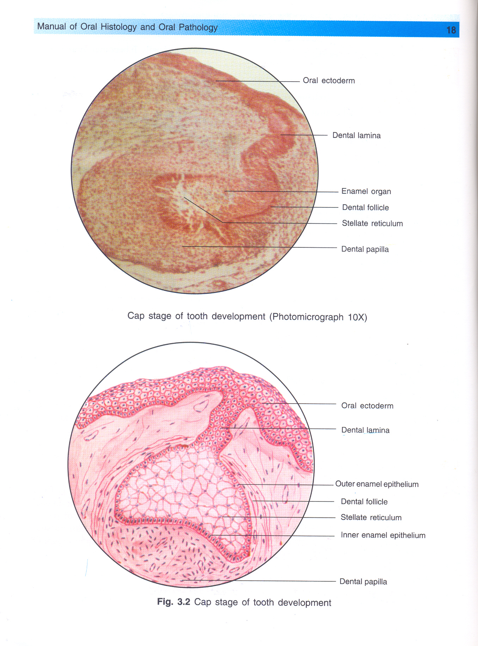
Outer and inner enamel epithelium
OUTER ENAMEL EPITHELIUM
Convexity cuboidal in shape
INNER ENAMEL EPITHELIUM
Concavity tall columnar cells

Slide 25
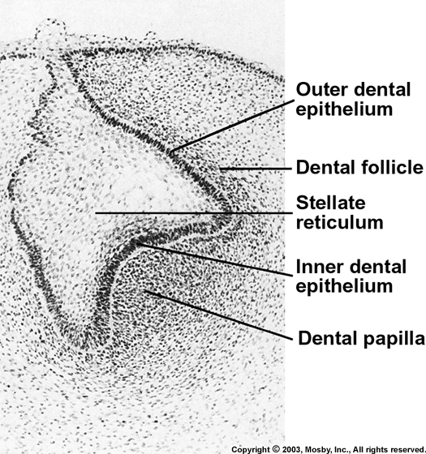
Basal lamina separates inner/outer epithelial cells from dental papilla and dental sac respectively

Slide 26
STELLATE RETICULUM
Polygonal cells located in the center between the outer and inner enamel epithelia.
Cells begin to separate
Polygonal cells star shaped
Form cellular network = stellate reticulum
Cushion like consistency shock absorber supports and protects delicate enamel forming cells

Slide 28
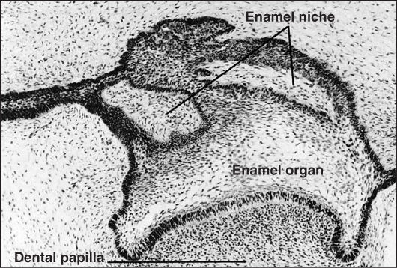
Enamel niche
An appearant structure in histologic sections.
Dental lamina is a sheet rather than a strand of cells & concavity filled with C.T.
section through this arrangement

Slide 29
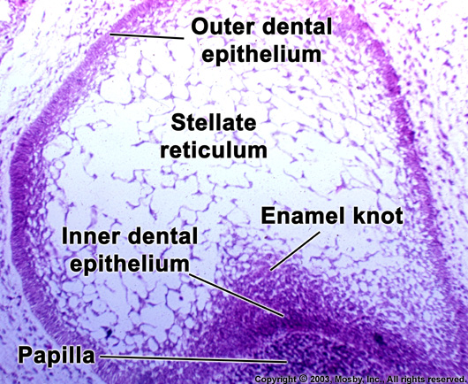
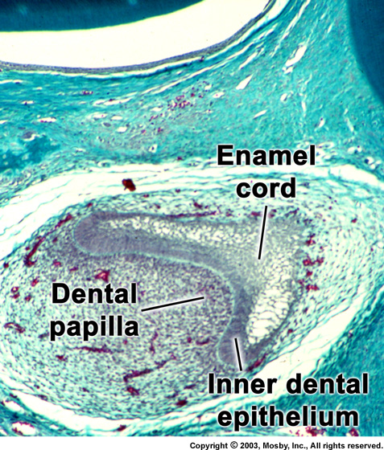
TRANSIENT STRUCTURES
Enamel knot(Ahren’s knot):
Clusters of non-dividing epithelial cells
At deepest portion of invagination of enamel organ
Enamel cord:
Linear condensation of cells from inner to outer enamel epithelium
Enamel septum & navel

Slide 30
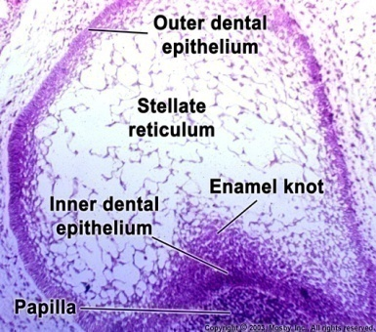
Functions of enamel knot
Reservoir of cells Signaling center (tooth shape/form)
Expresses genes for many signaling molecules- Bmp2&4, Fgf-4&9, Slit-1, Shh
Secondary enamel knot appears at futre cusp tips in molars.
Represent an organizational centre that orchestrates cuspal morphogenesis

Slide 31
Dental papilla
Under the organizing influence of proliferative epithelium of enamel organ
Papillary cells proliferate
Budding of capillaries and mitotic figures
Later differentiate – odontoblasts - dentin

Slide 32
Dental sac
marginal condensation in the ectomesenchyme
surrounding the enamel organ and dental papilla.
in this zone a denser and more fibrous layer
Develops
primitive dental sac
formation of cementum and the periodontal ligament

Slide 33
BELL STAGE
Morpho and histodifferentiation occurs
Crown shape is determined
2 stages
Early Advanced

Slide 34
Inner enamel epithelium
Consists of a single layer of cells
differentiate prior to amelogenesis into
tall columnar cells (4-5 µm dia & 40µm height)
Ameloblasts

Slide 35
The cells of the inner enamel epithelium exert an organizing influence on
mesenchymal cells in the dental papilla
later differentiate into odontoblasts.

Slide 36
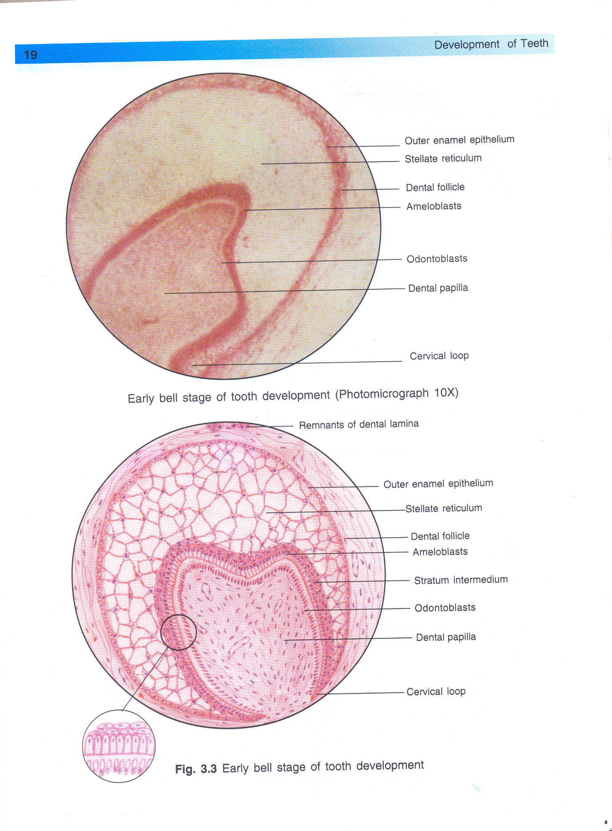

Slide 37
Stratum intermedium
Formed by a few layers of squamous cells between the inner enamel epithelium and the stellate reticulum.
The well-developed cytoplasmic organelles, acid mucopolysaccharides, and glycogen deposits indicate a high degree of metabolic activity.
This layer seems to be essential to enamel formation- high activity of enz. Alkaline Phosphatase

Slide 38
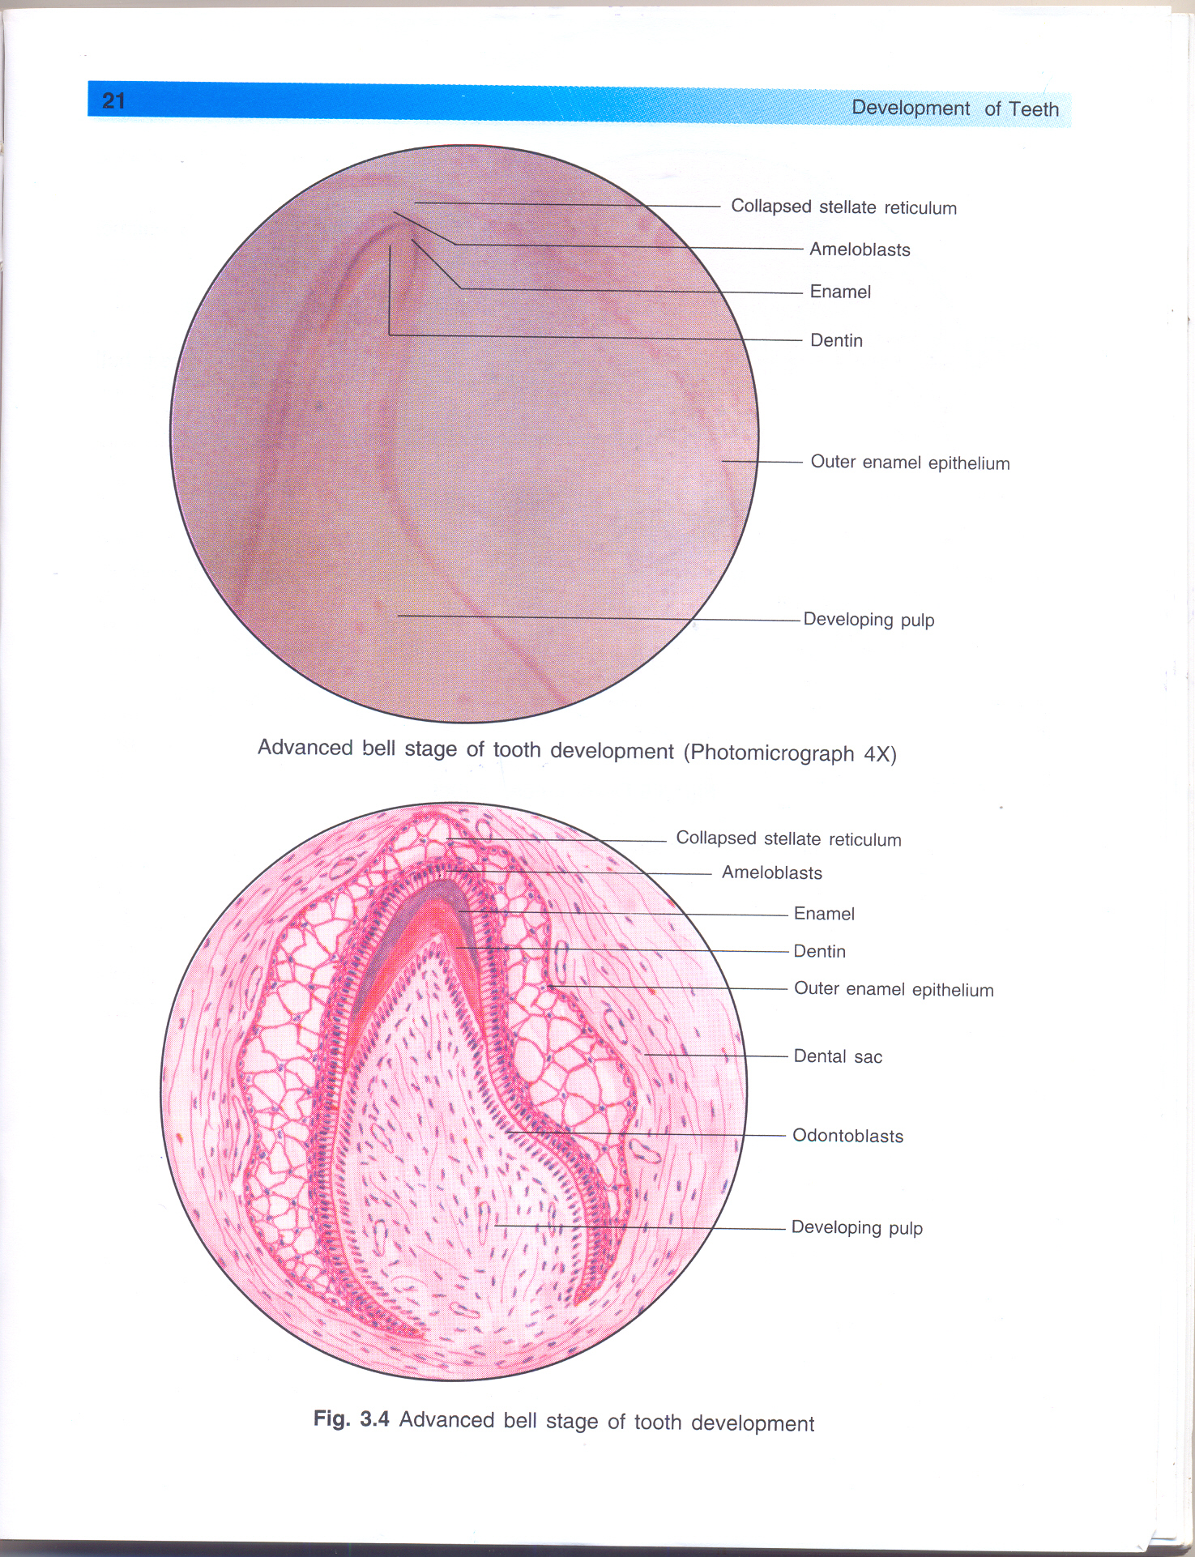
Stellate reticulum
The stellate reticulum expands further mainly by an increase in the amount of intercellular fluid.
The cells are star shaped, with long processes that anastomose with those of adjacent cells.
Collapses

Slide 39
Outer enamel epithelium
These cell flatten to a low cuboidal form.
At the end of the bell stage, the formerly smooth surface of the outer enamel epithelium is laid in folds.
Between the folds the adjacent mesenchyme of the dental sac forms papillae that contain capillary loops and thus provide a rich nutritional supply for the intense metabolic activity of the avascular enamel organ.

Slide 40
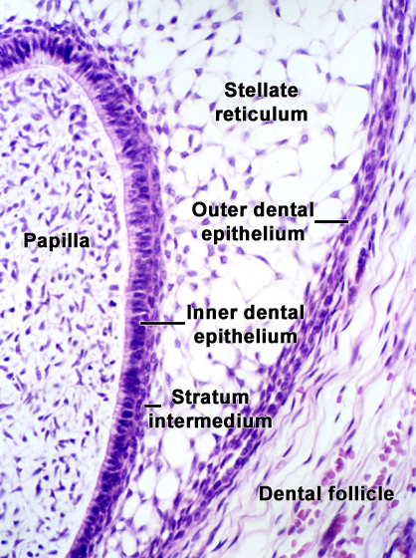

Slide 41
Dental papilla
The dental papilla is enclosed in the invaginated portion of the enamel organ.
Odontoblast differentiation
First, they assume a cuboidal form; later they assume a columnar form and acquire the specific potential to produce dentin

Slide 42
The basement membrane
separates the
enamel organ and the dental papilla
just prior to dentin formation
MEMBRANA PREFORMATIVA

Slide 43
Dental sac
Circular arrangement of its fibers and resembles a capsular structure.
With the development of the root, the fibers of the dental sac differentiate into the periodontal fibers that become embedded in the developing cementum and alveolar bone.

Slide 44
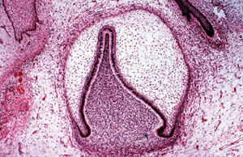
Cervical loop
This point is where the cells continue to divide until the tooth crown attains its full size.
ZONE OF REFLEXION

Slide 45
Advanced bell stage
Commencement of mineralization
Crown pattern determination
Break up of the dental lamina
Root formation
During the advanced bell stage, the boundary between inner enamel epithelium and odontoblasts outlines the future dentinoenamel junction.
In addition cervical portion of the enamel organ gives rise to the epithelial root sheath of Hertwig.

Slide 47
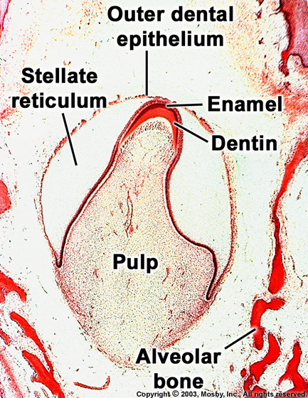
1.AMELOGENESIS & DENTINOGENESIS
After odontoblasts form due to organizing influence of epithelial cells, they instruct ameloblasts in turn to secrete enamel matrix
(reciprocal induction)

Slide 48
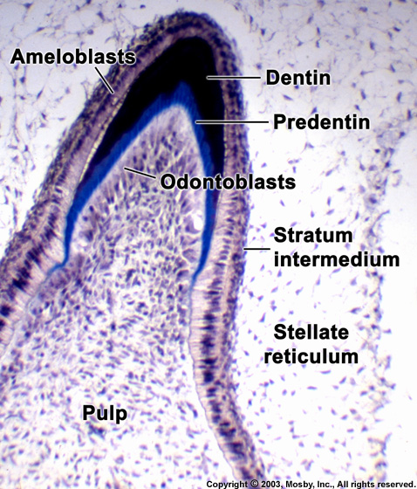

Slide 49
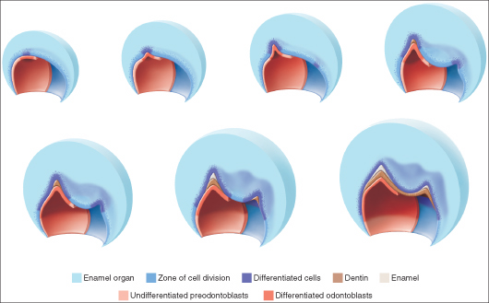
2. CROWN PATTERN DETERMINATION:

Slide 50
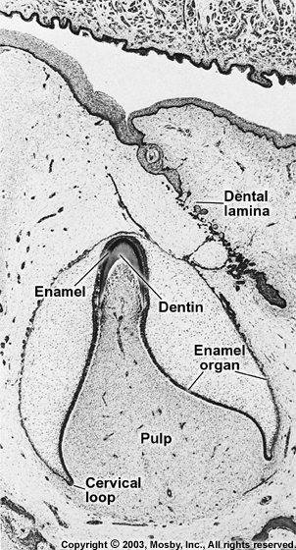
3. BREAK UP OF DENTAL LAMINA
D.L breaks up into discrete islands of epithelial cells oral epithelium separated from tooth germ these cells usually disintegrate but if persist they are called epithelial pearls

Slide 51
4. ROOT DEVELOPMENT
Occurs in later part of bell stage when enamel and dentin formation reaches future CEJ
Hertwig’s epithelial root sheath(HERS) formed from outer/inner enamel epithelia
Blue print of root development

Slide 52
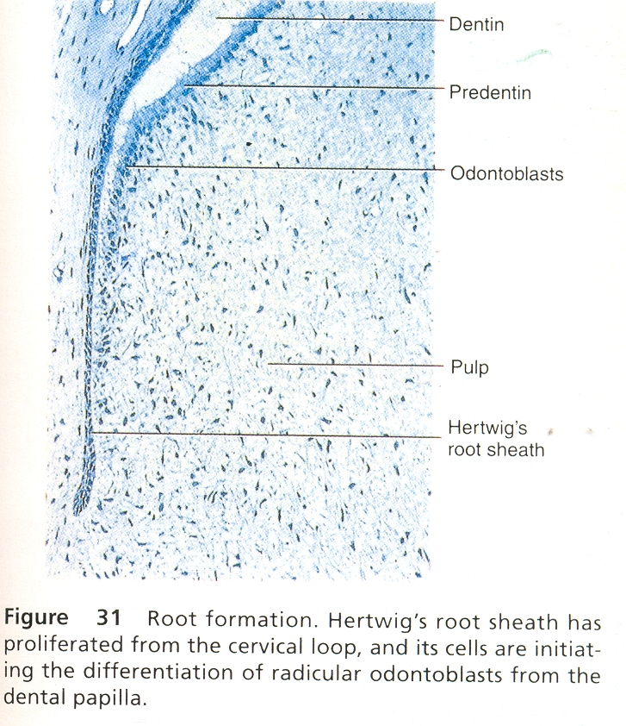
HERS formed from inner/outer enamel epithelia

Slide 53
The first layer of dentin has been laid down
the epithelial root sheath loses its structural continuity & its close relation to the surface of the root.
Its remnants persists as an epithelial network of strands or tubules near the external surface of the root.
These epithelial remnants are found in the periodontal ligament of erupted teeth
called rests of malassez.

Slide 54
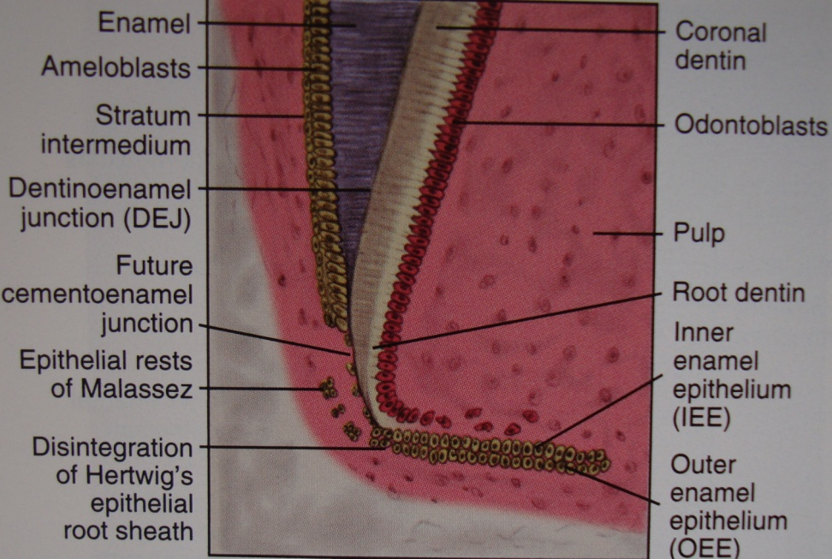

Slide 55
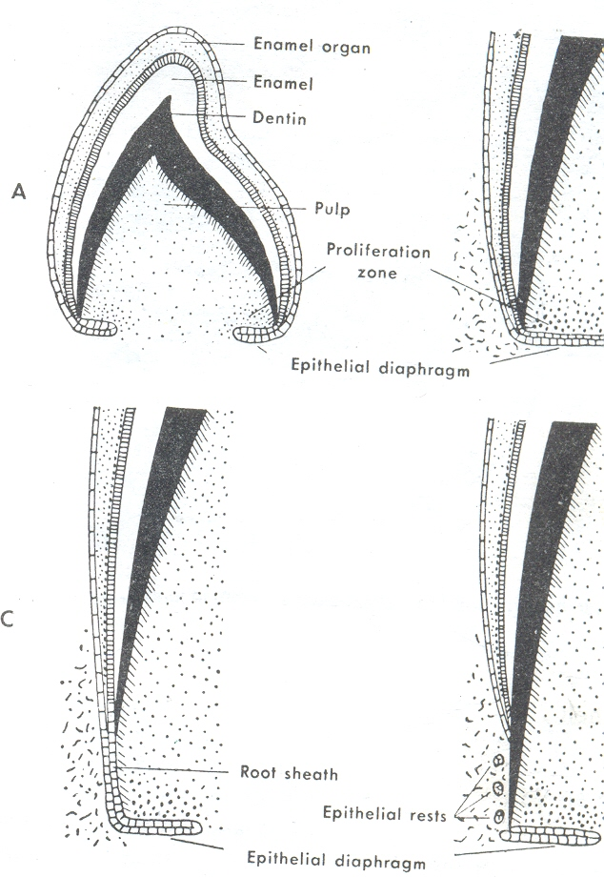
Epithelial diaphragm formation:

Slide 56
The differentiation of odontoblasts and the formation of dentin follow the lengthening of the root sheath.
At the same time the connective tissue of the dental sac surrounding the root sheath proliferates and invades the continuous double epithelial layer dividing it into a network of epithelial strands.

Slide 57
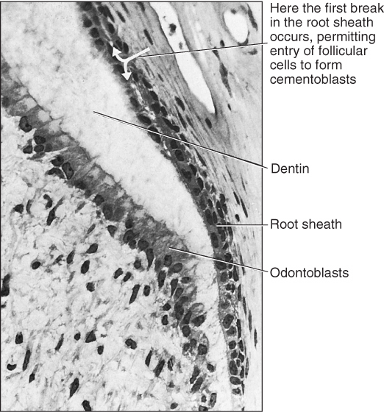
The epithelium is moved away from the surface of the dentin so that connective tissue cells come into contact with the outer surface of the dentin and differentiate into
cementoblasts that deposit a layer of cementum onto the surface of the dentin.

Slide 58
In the last stages of root development , the proliferation of the epithelium in the diaphragm lags behind that of the pulpal connective tissue.
The wide apical foramen is reduced:
1.first to the width of the diaphragmatic opening itself and later is further narrowed by
2.apposition of dentin and cementum to the apex of the root.

Slide 59
Development of root in multi-rooted teeth
Epithelial diaphragm expands eccentrically
Horizontal tongue like extensions
Unite and proliferate
Single apical opening is divided into 2-3 openings

Slide 60
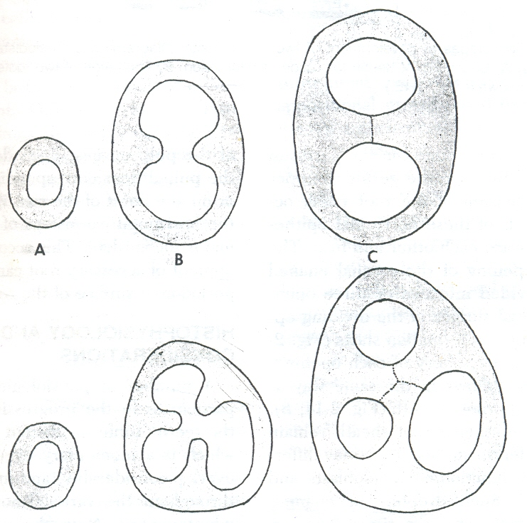
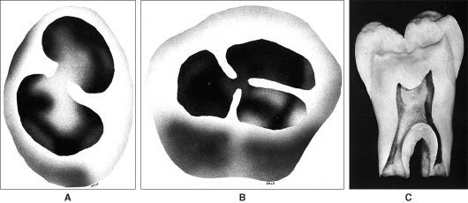
DEVELOPMENT OF TEETH WITH TWO AND THREE ROOTS

Slide 61
HISTOPHYSIOLOGY
Initiation
Proliferation
Histodifferentiation
Morphodifferentiation
Apposition

Slide 62
Initiation
The epithelial ectomesenchymal interaction is essential for initiation induction.
If there is a lack of initiation ,it results in the absence of either a single tooth or many teeth.
Abnormal initiation may result in the development of supernumerary teeth.
Proliferation
It is characterized by regular changes in the size and shape of the developing tooth germ. In this stage the tooth germ has a strong affinity to differentiate into various structures.

Slide 63
Histodifferentiation
Histodifferentiation shows maximum development in the early bell stage of tooth development .
It is during this stage that the formative cells of the tooth germ undergo definite morphologic as well as functional changes and acquire their functional roles.
The cells differentiate and give up their capacity to multiply.

Slide 64
Morphodifferentiation
Proliferation is essential for morphodifferentiation.
The basic anatomic form of tooth is established in the late bell stage after active histodifferentiation .
In this stage the dentinoenamel and the cementoenamel junctions are developed by the continuous deposition of enamel, dentin and cementum from ameloblasts, odontoblasts and cementoblasts respectively
resulting in the establishment of a complete morphologic pattern, size and shape of a tooth.

Slide 65
Apposition
After the morphologic pattern of a tooth is established, an additive growth of the hard dental tissues occurs.
Apposition is characterized by the rhythemic, layer-like deposition of an extracellular matrix of enamel and dentin.

Slide 66
STAGES IN TOOTH GROWTH
Morphologic changes Physiologic processes
Dental lamina initiation
Bud stage proliferation
Cap stage
Early bell stage histodifferentiation
Advanced bell morphodifferentiation
Enamel/dentin
formation apposition

Slide 67
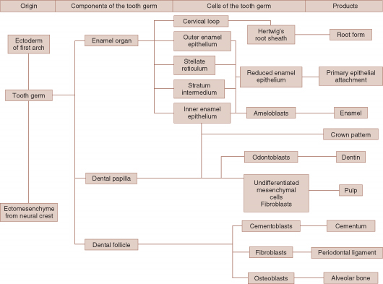

Slide 68
MOLECULAR INSIGHTS IN TOOTH MORPHOGENESIS

Slide 69
What initiates tooth development ?
Tooth formation can only be initiated
by oral epithelium.
Mesenchyme must be neural crest in origin,
but need not be from cranial region.

Slide 70
Epithelial Mesenchymal Interaction describes the reciprocal signaling between epithelial and mesenchymal tissue layers during embryogenesis.
Epithelial–mesenchymal interactions are essential for the formation of tooth.

Slide 72
HOWEVER, after the twelfth day of development, the first arch epithelium looses this odontogenic potential.
Which is then assumed by ectomesenchyme so that ectomesenchyme can elicit tooth formation from a variety of epithelium.

Slide 73
Eg: late 1st arch ectomesenchyme + epithelium from foot planter fascia
Enamel organ formation
Eg: late 1st arch dental epithelium + skin mesenchyme
epidermis

Slide 74
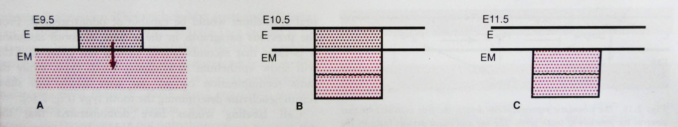
Tooth initiation harbors within epithelium or dental mesenchyme?
EM depends on epithelium for signals
EM responds to FGF8 and BMP 4, as spatial domains in EM are created. But EM cannot respond to any other signal from outside
EM no longer dependent on epithelium for signals

Slide 75
Genes expressed during odontogenesis
Oral epithelium of first arch
Produces signalling molecules
Expression of Lhx-6/7(lim-homeobox)
genes in the mesenchyme (earliest mesenchymal markers)
Initiation of tooth development
Fgf-8: is the candidate for induction of Lhx genes.

Slide 76
What determines tooth type?
Determination of specific tooth types
at their correct positions in jaws
Patterning of dentition
2 hypothetical models
field model clone theory

Slide 77
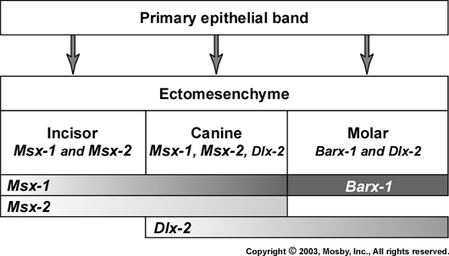
FIELD MODEL
Factors responsible for tooth shape reside in the ectomesenchyme in distinct but graded fields for each tooth family
Premolar—Msx-1,Dlx-1,Dlx-2

Slide 78
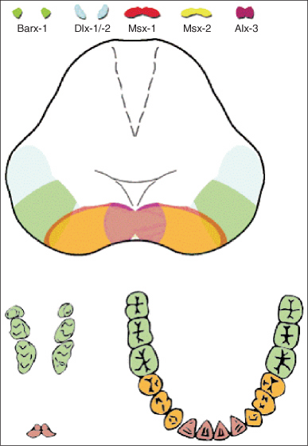
Field model

Slide 79
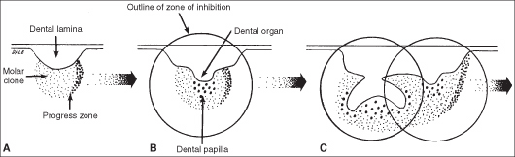
Clone theory:
Each tooth class is derived from a clone of ectomesenchymal cells programmed by the epithelium to produce teeth of a given pattern

Slide 81
What determines tooth position ?
Pax-9 Gene : Earliest mesenchymal gene that defines location of tooth germ
Co-localizes with the exact sites where tooth germs appear
Induced by Fgf-8
Pax 9 is produced where Fgf-8 is and not where BMP is.

Slide 82
Other genes involved
Shh: localised at E11. Good signaling candidate for tooth initiation.
Lef-1: 1st expressed in dental epithelial thickening & shifts to mesenchyme. In Lef-1 knockout mutants all tooth development arrested at bud stage.
Activin βA-helps in development of tooth during E10.5-11.5

Slide 83
BUD to CAP TRANSITION
Marks onset of morphologic differences between tooth germs – gives rise to different types of teeth
Msx-1 expressed with Bmp-4 in mesenchymal cells that condense around tooth buds
Msx-1 -/- (mutants)
1. development arrested at bud stage 2. loss of Bmp-4 expression

Slide 84
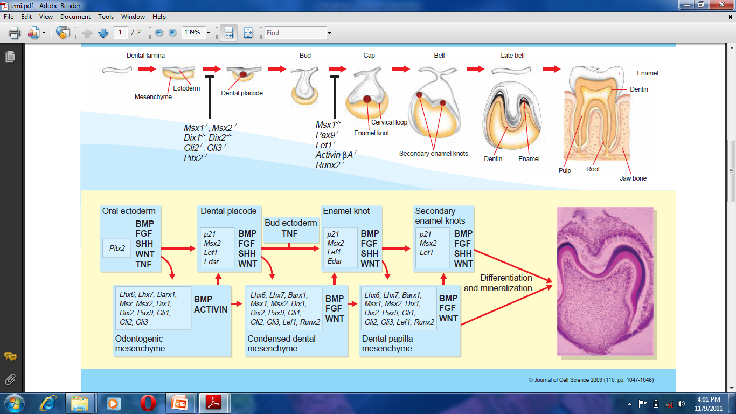
Epithelial-mesenchymal signalling regulating tooth morphogenesis
(Irma Thesleff) Journal of Cell Science 116, 1647-1648 2003

Slide 85
CLINICAL CONSIDERATIONS

Slide 86
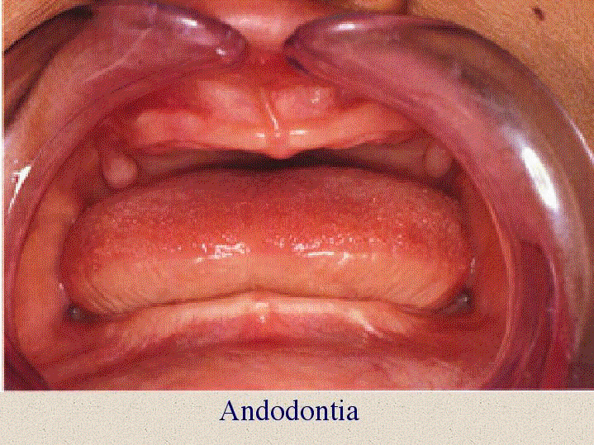
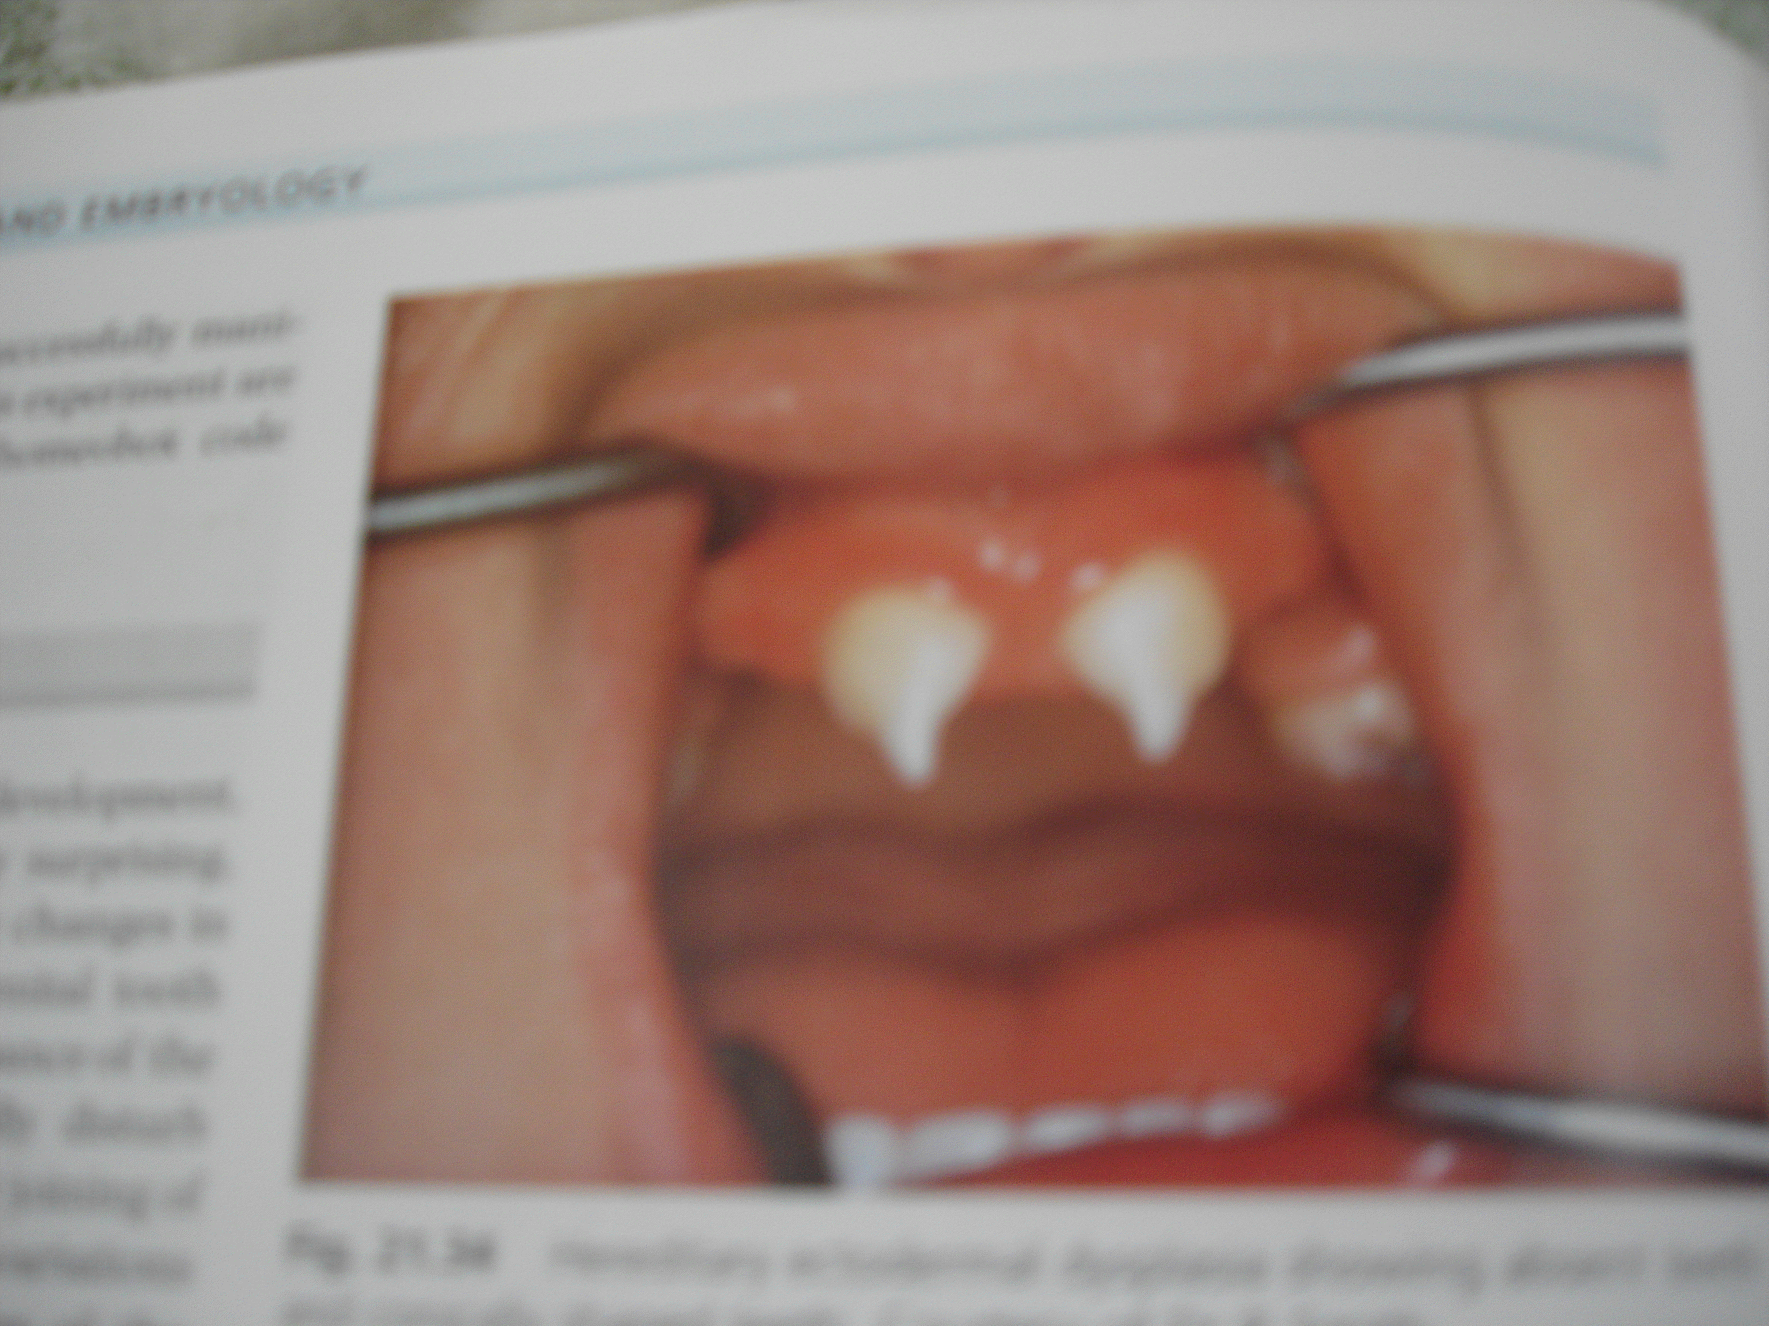
Missing teeth
Anodontia
Oligodontia
LACK OF INITIATION

Slide 87
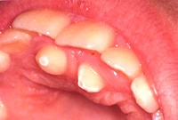
Supernumerary teeth
ABNORMAL INITIATION

Slide 88
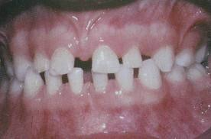
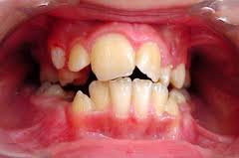
Microdontia & Macrodontia
Teeth smaller than normal
Teeth larger than normal

Slide 89
MORPHODIFFERENTIATION
Size and form of teeth affected without impairing function of ameloblasts/odontoblasts e.g :
- Twinning
- Fusion
- Concrescence
- Dilaceration
- Talon cusp
- Dens In Dente
- Taurodontism

Slide 90
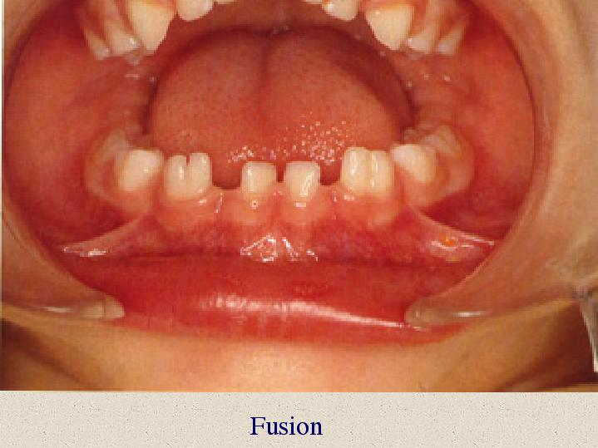
Fusion
If it occurs before calcification begins 2 teeth may be completely united to form a single large tooth
If a portion of the tooth crown has completed its formation – union of roots occur
Fusion of two normally separated tooth germs

Slide 91



Gemination
Division of single tooth germ by an invagination.
Tooth with two completely or incompletely separated crowns having single root & root canal

Slide 92

Concrescence
Form of fusion occurs after root formation has been completed.
Teeth are united by cementum only.

Slide 93
Dilaceration
An angulation , or a sharp bend, in the root portion of formed teeth.
Cause: trauma

Slide 94

Talons cusp
Associated syndrome
Rubinstein – Taybi syndrome
Lingual projection from cingulum areas of incisors

Slide 95


Dens in dente
Type I II III
Enamel organ invaginates in to dental papilla
Radicular variety with a radicular invagination results from infolding of hertwig’s sheath

Slide 96


Taurodontism
Enlarged crown at the expense of the roots
  Could be due to failure of Hertwig’s epithelial sheath to invaginate at the proper horizontal level.

Slide 97
Enamel pearls
Cells of epi root sheath remain adherent to dentin surface & differentiate in to ameloblast and form enamel

Slide 98
Apposition & Maturation
Enamal hypoplasia
Amelogenesis Imperfecta
Dentinogenesis Imperfecta
Dentin dysplasia
Regional Odontodysplasia

Slide 99


ENAMEL HYPOPLASIA
Genetic & environmental factors may disturb normal secretion & synthesis of organic matrix
Genetic- amelogenesis imperfecta
Aquired- trauma, flourosis, syphillis, hypoparathyroidism

Slide 100


Amelogenesis imperfecta
Autosomal dominant
Hypoplastic-
matrix formation
Hypocalcified-
initial mineralization
Hypomaturation-
maturation

Slide 101


Dentin Dysplasia (Rootless Teeth)
Rare disturbance of dentin formation characterised by normal enamel but atypical dentin formation & abnormal pulpal morphology.
Autosomal dominant.
Can be: Radicular
        Coronal

Slide 102


Dentinogenesis imperfecta
Autosomal dominant
a/w osteogenesis imperfecta
Not a/w osteogenesis imperfecta
Brandy wine type

Slide 103
CONCLUSION :
Knowledge of development of teeth is indispensable for a dentist, helping him not only to diagnose a developmental disorder but also to exactly pinpoint the event where development was anomalous.

Slide 104
REFERENCES
Tencate’s Oral histology 7th Edn Antonio Nanci
Orban’s Oral histology and embryology 12th Edn
Essentials of oral histology and embryology-A Clinical approach James K Avery
Provenza
Shafer’s – Textbook of oral pathology

Slide 105
Review article: Genetic control of early odontogenesis ( British Journal of Orthodontics vol 26 1999 pg: 21-28)
Epithelial-mesenchymal signalling regulating tooth morphogenesis (Irma Thesleff)
Journal of Cell Science 116, 1647-1648 2003
The genetic control of early tooth development (Mass & Bei): Crit Rev Oral Bid Med 1997 8(1)

Slide 106

He who sees things grow from the beginning.......
will have the finest view of them !!

Slide 107
Thank you
Mrinal shete
Part 1 PG

