Slide 1
Frey’s Syndrome

Slide 2
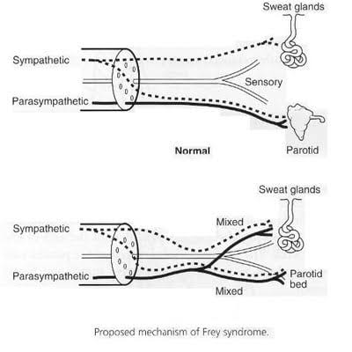
Frey syndrome was first described by Lucie Frey in 1923 and was termed Auriculotemporal syndrome. It described sweating and flushing in the pre auricular area in response to mastication or a salivary stimulus.

Slide 3
Introduction
Commonly occur after salivary gland surgery, occurring in 62% of post parotidectomy patients 6 to 18 months after surgery
. The previous sympathetic responses of sweating and flushing are now controlled by post ganglion parasympathetic fiber’s.. Mastication, which releases acetylcholine from the parasympathetic nerve ndings , now induces sweating and flushing, which was a sympathetic cholinergic response before synkinesis of parasympathetic nerve fibers

Slide 4
Symptoms
The symptoms of Frey syndrome can include
flushing,
sweating,
burning,
neuralgia, and
itching.
Generally, the symptoms are mild but can result in discomfort as well as social anxiety and avoidance

Slide 5
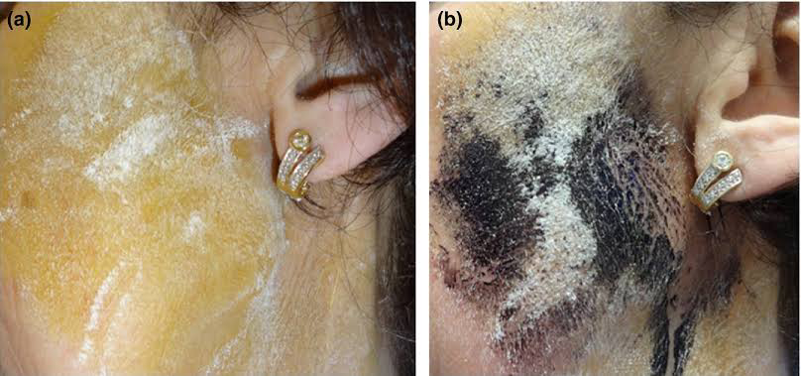
Diagnosis
Minor Starch testing
Diagnosis of Frey syndrome is based on clinical history, but confirmatory testing can be done with a Minor starch-iodine test.
The starch-iodine test consists of painting the patient’s postsurgical affected region with iodine.
Once dry, dry starch is then applied to the painted area, and a salivary stimulus is given.
The starch turns blue/brown in the presence of iodine and sweat

Slide 6
Treatment
Intracranial division of auriculotemporal nerve.
Subcutaneous injection of botulinum toxin A into affected areas can be used to treat the postoperative symptoms of Frey syndrome.

