Slide 1
HIV/AIDS + HbsAg

Slide 2
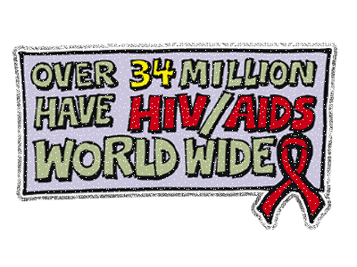
Prevalence
India -3rd highest number of estimated people living with HIV.
According to the HIV Estimations 2012, the estimated number of people living with HIV/AIDS in India was 20.89 lakh, with an estimated adult (15-49 age group) HIV prevalence of 0.27% in 2011

Slide 3
People Living with HIV
The total number of people living with HIV (PLHIV) in India is estimated at 2.4 million with uncertainty bounds of 1.93 to 3.04 million in 2009.
Children under 15 years of age account for 4.4% of all infections, whilst people aged 15 to 49 years account for 82.4% of all infections.
Thirty-nine percent of all HIV infections are estimated to be among women. This amounts to 0.93 million women with HIV in India.

Slide 4
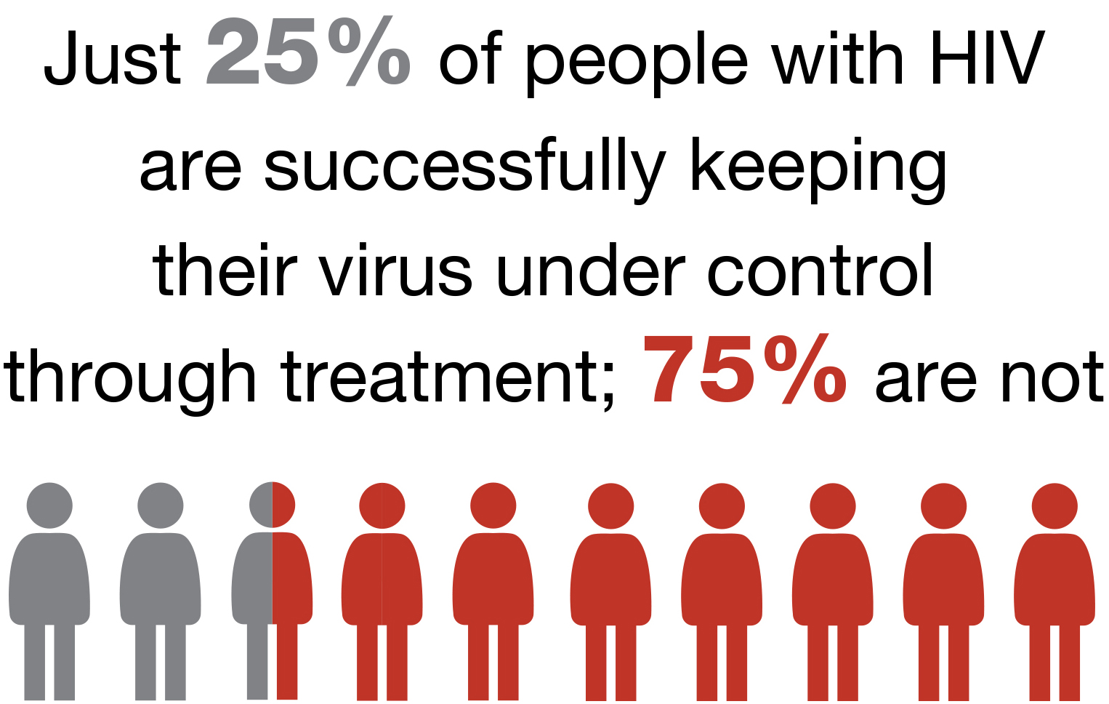
AIDS related deaths
2008/2009 HIV estimates highlight the declining trend of annual AIDS deaths post 2004.
Approximately 172,000 people died of AIDS related causes in 2009 in India.

Slide 5
Maharashtra accounts for 420,000 cases,

Slide 6
What's the role of dental professionals?

Slide 7
Life expectancy of PLWHA is increased- due to ART
Thus dental practitioners are more likely to face such patients frequently in their clinics

Slide 8
More than 40 oral manifestations of HIV infection recorded
Between 70% and 90% of persons with HIV infection will have at least one oral manifestation at some time during the course of their disease.
Oral health-care workers (OHCWs) are therefore, key players in the prevention and management of HIV-infection

Slide 9

We may be the first to identify such patients especially HbsAg.
But are we utilizing such opportunity??

Slide 10
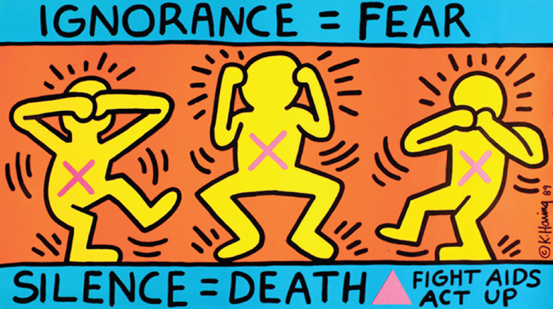
Problems in current Dental Practice + Education
Lack of awareness
Lack of communication
No standard/ uniform protocols for dental treatment in India dental colleges or institutes
Fear, Stigma, Discrimination….

Slide 11
What next?

Slide 12
1. Lack of awareness
Developing training program for dental students at early stages- BDS IIIrd year
Monitoring the changes

Slide 13
The stigma associated in Dental health care workers
Many dentists even refuse to treat infected patients.
  at least 32 % dentists in India refuse treatment to HIV-infected patients as they fear the risk of multiple cross-infection.

Slide 14
A recent national survey of dentists in India published in the Science Journal of Public Health revealed a startling fact: with the spread of HIV infection dental care workers like dentists, dental hygienists and dental assistants fear contact with people infected with the viruses.

Slide 15
Refusal to treat patients with HIV was primarily associated with lack of ethical responsibility and fear related to cross-infection.
This fear is mostly because of lack of proper knowledge to deal with such patients," the survey report said.

Slide 16
A maximum 68.4 per cent were willing to treat HIV-positive patients while 31.6 per cent were still not willing to treat these patients.
Out of 33.1 per cent, slightly more than 18.4 per cent dentists from private practice were reluctant to treat HIV patients in their private clinical setups, while dentists practicing in institutions, significantly, showed a willingness to treat patients with HIV

Slide 17
Indian Dental Association
A dentist has a general obligation to provide care to those in need. It is unethical to deny treatment to anyone infected with HIV, HBV, HBA virus. "Treatment should not differ for infected and non-infected patients. Current guidelines are that dentists must not refuse to treat a patient solely on the grounds of HIV infection," the report said.

Slide 18

But are we able to perform this???
We need continuing educational program and probably make them mandatory

Slide 19

Confidentiality, non disclosure, stigmatisation , unawareness…….? Real estimates

Slide 20
Developing training programme for dental students
At early stages- BDS IIIrd year
Team buildup- multispeciality
  Oral surgery + Endodontics + Periodontics + Oral Medicine + Oral Pathology

Slide 21
Developing training programme for dental students
Content build up
  Basic pathology
  Overcoming the myths
  Treatment protocols by each specialty
  HIV/HbsAg Testing guidelines
  Pre and post exposure prophylaxis
  Medico legal aspects
  Ethical aspect such as
    Informed consent
    Confidentiality

Slide 22
Developing training program for dental students
Evaluating the program
  comparison between pre & post test questionnaire.
  Using OSCE/ OSPE
Sustaining the program for long term
  probably by making part of routine curriculum

Slide 23

2. Lack of communication
Team building with national organizations like NACO + NARI
Developing reporting systems
Developing SOPs in managing such patients in Dental clinics and institutes

Slide 24
NACO
NACP-IV: launched- 2012-2017 with main objectives of are to reduce new infections and provide comprehensive care and support to all PLHIV and treatment services to all those who require it.
Where are we?

Slide 25
Recent report
In 2011-12 at least 2.7 per cent of the total HIV infected population caught HIV through unknown and unspecified routes, leading them to believe it could be Dental Surgery.
Taking stock of the situation, National AIDS Control Organisation (NACO) is thinking about highlighting the infection spread through dental surgery. "This is an important but unseen problem. We will soon include it in our strategy and programmes," said Lov Verma, director-general of NACO and secretary, department of AIDS control.

Slide 26
Team building
NACO/NARI + Dental Institutes
Patients from NARI
Dental Institutes
Developing ART Centers in Dental Institutes

Slide 27
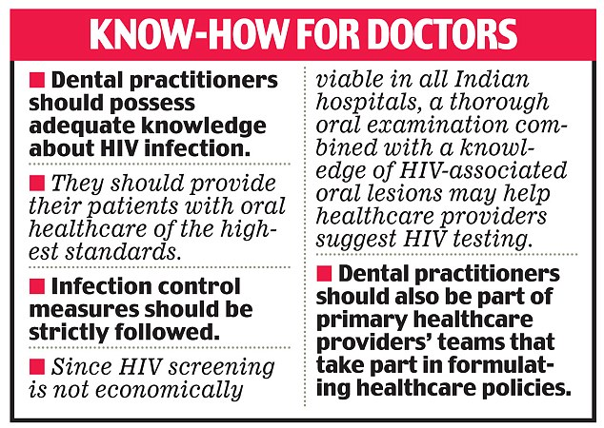
What next?

Slide 28


Foreigner dancing on bollywood song
without understanding its meaning
Indian dancing on bollywood song
with understanding its meaning

Slide 29
That’s what happening in current dental education students passing without understanding.
Dental education has to be more outcome orientated rather than exam oriented

Slide 30
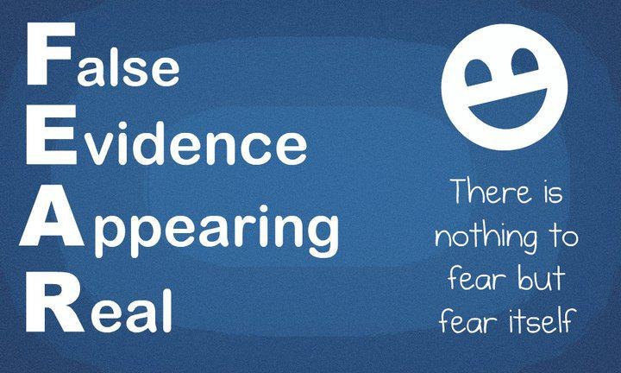

Slide 31
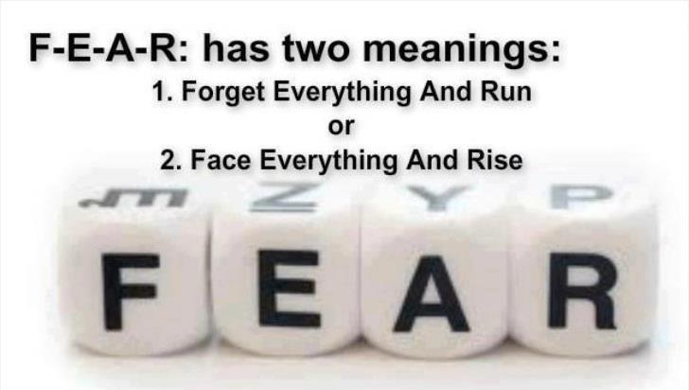

Slide 32
Challenges India faces to overcome this epidemic are enormous, defeating AIDS will require a significant intensification in our efforts.
Peter Riot –
executive director of UNAIDS.

