Slide 1
CALCIUM & PHOSPHORUS METABOLISM

Slide 2
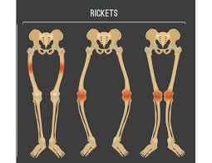
Carpopedal spasm

Slide 3


Slide 4
Introduction
The mineral (inorganic) elements constitute only a small proportion of the body weight.
There is a wide variation in their body content. For instance, calcium constitutes about 2%.
Minerals perform several vital functions which are absolutely essential for the very existence of the organism. These include
calcification of bone, blood coagulation, neuromuscular irritability, acid-base equilibrium, fluid balance
and osmotic regulation.

Slide 5
Classification
The minerals are classified as principal elements and trace elements.
The seven principal elements (macrominerals) constitute 60-80% of the body’s inorganic material.
These are calcium,phosphorus, magnesium, sodium, potassium,
chloride and sulfur.
The principal elements are required in amounts greater than 100 mg/day.
microminerals are required in amounts less than 100 mg/day. They are subdivided- 1. Essential trace elements : Iron, copper,
iodine, manganese, zinc, molybdenum, cobalt,
fluorine, selenium and chromium.

Slide 6
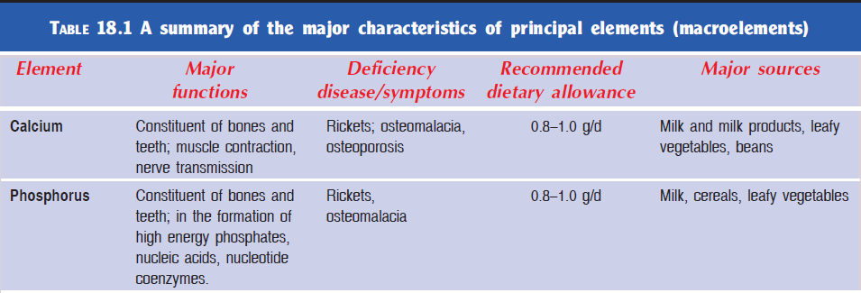

Slide 7
CALCIUM
Calcium is the most abundant among the
minerals in the body.
The total content of calcium in an adult man is about 1 to 1.5 kg.
As much as 99% of it is present in the bones and teeth.
A small fraction (1%) of the calcium, found outside the skeletal tissue, performs a wide variety of functions.
About 99% the
body’s calcium is present in bone together with phosphate
as the mineral hydroxyapatite [Ca10 (PO4)6 (OH)2], with
small amounts in soft tissue and extracellular fluid.

Slide 8
Functions
1. Formation of bone and teeth: 99% of the body’s calcium is located in bone in the form of hydroxyapatite crystal [3Ca3 (PO4)2 Ca (OH)2]. The hardness and rigidity of bone and teeth are due to hydroxyapatite.
2. Blood coagulations: Calcium present in platelets
involved in blood coagulation, the conversion of an
inactive protein prothrombin into an active thrombin requires calcium ions.
3. Muscle contraction: Muscle contraction is initiated
by the binding of calcium to troponine.

Slide 9
4. Release of hormones: The release of certain hormones like parathyroid hormone, calcitonin, etc. requires calcium ions.
5. Release of neurotransmitter: Influx of Ca2+ from extracellular space into neurons causes release of neurotransmitter.
6. Regulation of enzyme activity: Activation of number of enzymes requires Ca2+ as a specific cofactor. For example:
– Activation of enzyme glycogen phosphorylase kinase which then triggers glycogenolysis.
Activation of salivary and pancreatic α-amylase.
7. Second messenger: Calcium acts as a second messenger for hormone action. For example, it acts as a second messenger for epinephrine or glucagon.
Ca also functions as a third messenger for some hormones such as antidiuretic hormone (ADH).

Slide 10
8. Membrane excitability: Calcium ions activate the sodium channels. Deficiency of calcium ions lead to decreased activity of Na-channels, which ultimately leads to decrease in membrane potential so that the
nerve fiber becomes highly excitable causing muscle tetany.
9. Cardiac activity: Cardiac muscle depends on extracellular Ca2+ for contraction. Myocardial
contractility increases with increased Ca2+ concentration and decreases with decreased calcium
concentration.
10. Membrane integrity and permeability: Calcium is required for maintenance of integrity and permeability of the membrane.
11. Hydrolysis of casein of milk: Calcium is required for
the formation of Ca-paracaseinate (insoluble curd).
The significance of this reaction is to convert milk into a more solid form to increase its retention in the stomach for a longer period of time and facilitate its gastric digestion in infants.

Slide 11
Recommended dietary allowance (RDA) per day
1 to 3 years = 500 mg
4 to 8 years = 800 mg
9 to 18 years = 1,300 mg
19 to 50 years = 1,000 mg
51 years and above = 1,200 mg
Pregnant ladies and
lactating mothers = 1,300 mg

Slide 12
SOURCE OF CALCIUM
1. Dietary Source
Calcium is available in several foodstuffs. Percentage of
calcium in different food substance is:
Whole milk = 10%
Low fat milk = 18%
Cheese = 27%
Other dairy products = 17%
Vegetables = 7%
Other substances such as meat, egg, grains, sugar, coffee, tea, chocolate, etc. = 21%
2. From Bones Besides dietary calcium, blood also gets calcium from
bone by resorption.

Slide 13
TYPES OF CALCIUM
Calcium in Plasma
Calcium is present in three forms in plasma:
i. Ionized or diffusible calcium: Found freely in plasma and forms about 50% of plasma calcium.
It is essential for vital functions such as neuronal activity, muscle contraction, cardiac activity,
secretions in the glands, blood coagulation, etc.
ii. Non-ionized or non-diffusible calcium: Present in non-ionic form such as calcium bicarbonate.
It is about 8% to 10% of plasma calcium
iii. Calcium bound to albumin: Forms about 40% to 42% of plasma calcium.
Calcium in Bones
Calcium is constantly removed from bone and deposited
in bone. Bone calcium is present in two forms:
i. Rapidly exchangeable calcium or exchangeable calcium: Available in small quantity in bone and
helps to maintain the plasma calcium level
ii. Slowly exchangeable calcium or stable calcium: Available in large quantity in bones and helps in
bone remodeling.

Slide 14
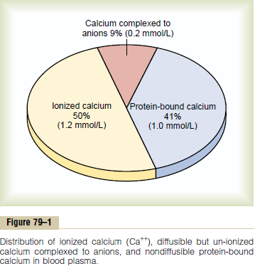

Slide 15
ABSORPTION AND EXCRETION
Factors affecting absorption: The absorption of calcium from the intestine depends on several factors. Some of these are discussed below:
Factors that stimulate calcium absorption
1. Vitamin D stimulates absorption of calcium from intestine by inducing the synthesis of calcium
binding protein, necessary for the absorption of calcium from intestine.
2. Parathyroid hormone (PTH) stimulates calcium absorption indirectly via activating vitamin D.
3. Acidic pH: Since, calcium salts are more soluble in acidic pH, the acidic foods and organic acids (citric acid, lactic acid, pyruvic acid, etc.) favor theabsorption of calcium from intestine.

Slide 16
4. High protein diet favors the absorption of calcium.
Basic amino acids, lysine and arginine derived from hydrolysis of the dietary proteins increase calcium absorption.
5. Lactose is known to increase the absorption of calcium, by forming soluble complexes with the calcium ion.

Slide 17
Factors that inhibit calcium absorption
1. Phytates and Oxalates bind dietary calcium forming insoluble salts which cannot be absorbed from the
intestine. Phytates present in many cereals and oxalates present in green leafy vegetables.
2. High fat diet decreases the absorption of calcium.
High amounts of fatty acids derived from hydrolysis of dietary fats react with calcium to form insoluble
calcium soaps which cannot be absorbed.
3. High phosphate content in diet causes precipitation of calcium as calcium phosphate and thereby lower the
ratio of Ca: P in the intestine. The Ca: P ratio should be 1:2–2:1 for optimum absorption of calcium. Absorption
of calcium is maximum when food contains almost equal amounts of calcium and phosphorus.
4. High fiber diet decreases the absorption of calcium
from intestine.

Slide 18
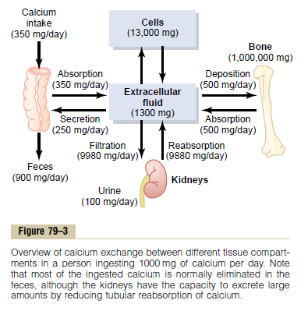

Slide 19
Schematic diagram showing calcium metabolism. Values belong to adults

Slide 20
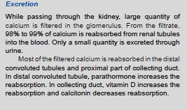
About 1,000 mg of calcium is excreted daily. Out
of this, 900 mg is excreted through feces and 100 mg
through urine.

Slide 21
PLASMA CALCIUM
The plasma calcium concentration in normal individual
is 9–11 mg%.

Slide 22
Regulation of Plasma Calcium Level (Figure 17.1)
Homeostasis of plasma calcium is dependent on the:
• Function of three main organs:
1. Bone
2. Kidney
3. Intestine.
• Function of three main hormones:
1. Parathyroid hormone (PTH)
2. Vitamin D or cholecalciferol (d3/provitamin) or calcitriol (active)
3. Calcitonin.

Slide 23
1. Parathormone
Parathormone is a protein hormone secreted by parathyroid gland and its main function is to increase
the blood calcium level by mobilizing calcium from bone
(resorption)
2. 1,25-dihydroxycholecalciferol – Calcitriol
Calcitriol is a steroid hormone synthesized in kidney. It is the activated form of vitamin D. Its main action is
to increase the blood calcium level by increasing the calcium absorption from the small intestine
3. Calcitonin
Calcitonin secreted by parafollicular cells of thyroid gland. Thyroid gland is a calcium-lowering hormone. reduces the blood calcium level mainly by decreasing bone resorption

Slide 24
The four major processes are
1. Absorption of calcium from the intestine, mainly
through the action of vitamin D.
2. Reabsorption of calcium from the kidney, mainly
through the action of parathyroid hormone and
vitamin D.
3. Demineralization of bone mainly through action
of parathyroid hormone, but facilitated by
vitamin D.
4. Mineralization (calcification) of bone through the
action of calcitonin

Slide 27
Role of parathyroid hormone (PTH): It is secreted by the parathyroid in response to drop in the blood calcium
level. It acts on two main target organs, bone and kidney and indirectly via the activation of vitamin D on the
intestine to increase the plasma calcium concentration.
Action on bone: PTH stimulates mobilization of calcium and phosphate from bones by stimulating osteoclast
activity. Osteoclast activity results in demineralization of the bone.
• Uptake of calcium and phosphate by bone is also decreased by PTH resulting in an increase in blood calcium and phosphate level.
Action on kidney: In kidney PTH increases the tubular reabsorption of calcium and decreases renal excretion of calcium. PTH increases excretion of phosphate by inhibiting its renal reabsorption.
Action on intestine: Action of PTH on intestine is indirect
via the formation of calcitriol, active form of vitamin D.

Slide 28
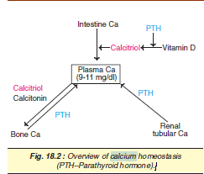

Slide 29
Role of vitamin D (calcitriol): It is the active form of vitamin D, which causes the increase in plasma calcium and phosphate concentration by stimulating the following
processes:
• Absorption of calcium and phosphorus from intestine by inducing synthesis of calcium binding protein necessary for the absorption of calcium from intestine.
• Reabsorption of calcium and phosphorus from the kidney.
• Mobilization of calcium and phosphorus from the
bone.
• Thus, overall effects of PTH and calcitriol elevate
plasma calcium and phosphate level.

Slide 30
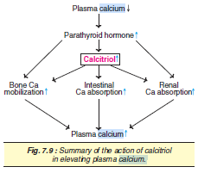

Slide 31
Role of Calcitonin: The secretion of calcitonin is
stimulated by increase in blood calcium level.
• Action of calcitonin on the bones is opposite to that
of the PTH. It inhibits calcium mobilization from bone
and increases bone calcification (mineralization) by
increasing the osteoblasts activity.
• In the kidney it stimulates the excretion of calcium
and phosphorus, thereby decreasing the blood
calcium level.

Slide 32
1. Growth hormone
Growth hormone increases the blood calcium level by
increasing the intestinal calcium absorption. It is also
suggested that it increases the urinary excretion of
calcium. However, this action is only transient.
2. Glucocorticoids
Glucocorticoids (cortisol) decrease blood calcium by
inhibiting intestinal absorption and increasing the renal
excretion of calcium.

Slide 33
DISEASE STATES
The blood Ca level is maintained within a narrow range by the homeostatic control, most predominantly by PTH. Hence abnormalities in
Ca metabolism are mainly associated with alterations in PTH.

Slide 34
Hypercalcemia
Elevation in serum Ca level (normal 9–11 mg/dl) is hypercalcemia.
The symptoms of hypercalcemia include
lethargy, muscle weakness, loss of appetite,
constipation, nausea, increased myocardial
Contractility and susceptibility to fractures.
The commonest causes of hypercalcemia
are:
• Hyperparathyroidism
• Malignant disease.
Clinical features of hypercalcemia • Neurological symptoms such as depression, confusion, inability to concentrate. • Muscle weakness • Gastrointestinal problems such as anorexia, abdominal pain, nausea and vomiting and constipation. • Renal features such as polyuria and polydypsia. • Cardiac arrhythmias.

Slide 35
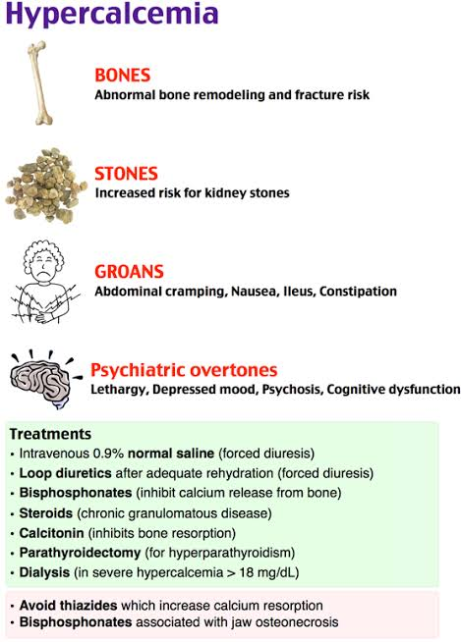

Slide 36
Hypocalcemia
Hypocalcemia is a more serious and life threatening condition. It is characterized by a fall in the serum Ca to below 7 mg/dl, causing tetany.
The causes of hypocalcemia include:
• Hypoparathyroidism: The commonest cause of hypoparathyroidism is neck surgery, or due to magnesium deficiency (See functions of magnesium).
• Vitamin D deficiency: This may be due to dietary deficiency, malabsorption or little exposure to sunlight. It may lead to bone disorders, osteomalacia
in adults and rickets in children.
• Renal disease: The diseased kidneys fail to synthesize calcitriol due to impaired hydroxylation.

Slide 37
Clinical features of hypocalcemia
The clinical features of hypocalcemia include:
• Neuromuscular irritability
• Neurologic features such as tingling, tetany,
numbness (fingers and toes).
• Muscle cramps
• Cardiovascular signs such as an abnormal ECG.
• Cataracts.

Slide 38
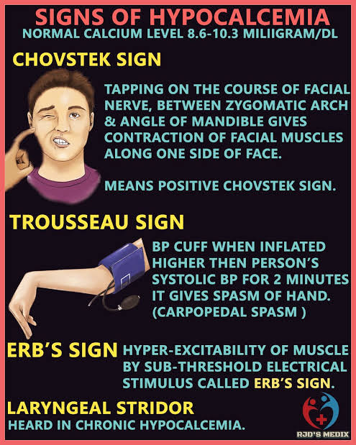
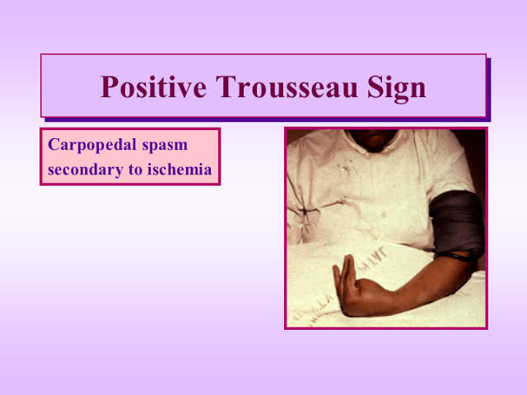

Slide 39
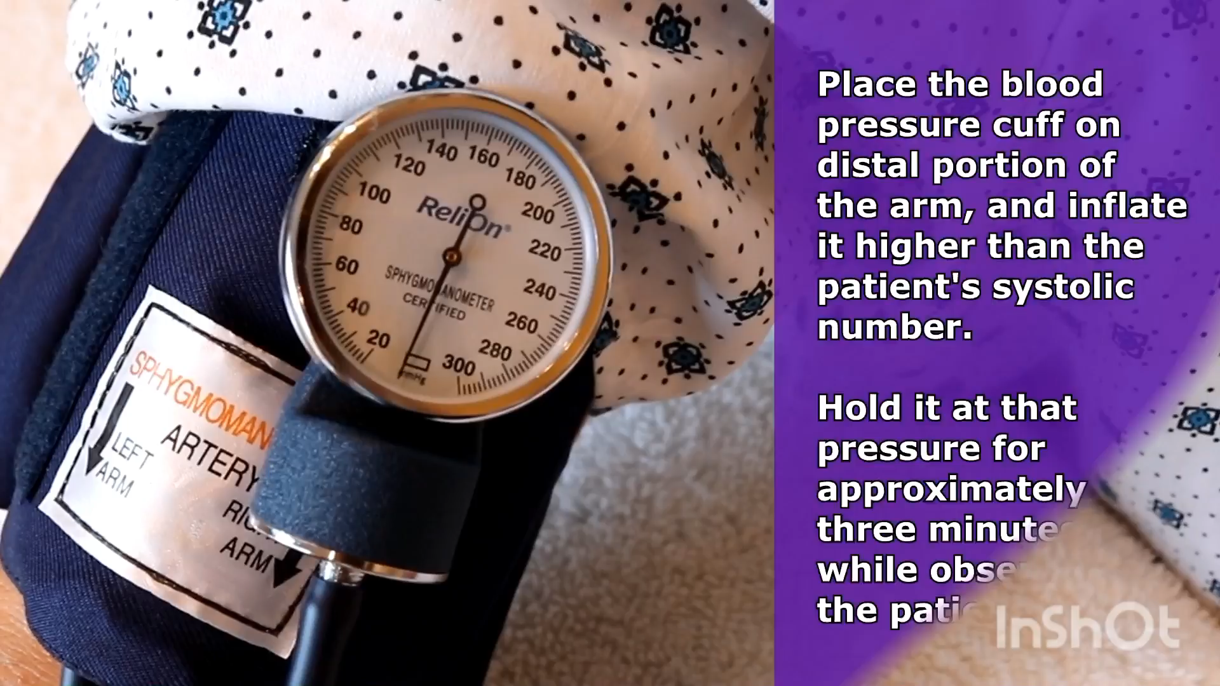

Slide 40


Slide 41
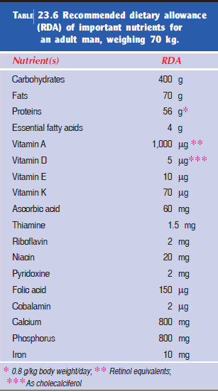

Slide 42
PHOSPHATE METABOLISM
Phosphorus (P) is an essential mineral that is required
by every cell in the body for normal function. Phosphorus
is present in many food substances, such as peas,
dried beans, nuts, milk, cheese and butter.
Inorganic phosphorus (Pi) is in the form of the phosphate (PO4).
The majority of the phosphorus in the body is found as
phosphate. Phosphorus is also the body’s source of
phosphate. In body, phosphate is the most abundant
intracellular anion.

Slide 43
NORMAL VALUE
Total amount of phosphate in the body is 500 to 800 g.
Though it is present in every cell of the body, 85% to
90% of body’s phosphate is found in the bones and
teeth.
Normal plasma level of phosphate is 4 mg/dL.

Slide 44
IMPORTANCE OF PHOSPHATE
Functions
• Constituent of bone and teeth: Inorganic phosphate
is a major constituent of hydroxyapatite in bone,
thereby playing an important role in structural
support of the body.
• Acid-base regulation: Mixture of HPO4 – – and
H2PO4
– constitutes the phosphate buffer which plays
a role in maintaining the pH of body fluid.

Slide 45
• Energy storage and transfer reactions: High energy
compounds, e.g. ATP, ADP, creatin phosphate, etc.
which play a role of storage and transport of energy,
contain phosphorus.
• Essential constituent: Phosphate is an essential
element in phospholipid of cell membrane, nucleic
acids (RNA and DNA), nucleotides (NAD, NADP,
c-AMP, c-GMP, etc.)
• Regulation of enzyme activity: Phosphorylation and
dephosphorylation of enzymes modify the activity
of many enzymes.

Slide 46
Dietary sources
The foods rich in calcium are also rich in phosphorus,
i.e. milk, cheese, beans, eggs, cereals, fish and meat.
Recommended dietary allowance per day
• The recommended dietary allowance for both men
and women is 800 mg/day.
• The amount during pregnancy and lactation is
1200 mg/day.

Slide 47
Absorption
• Like calcium, phosphorus is absorbed from small intestine and the degree of absorption is similarly affected by different factors as that of calcium.
• Vitamin D stimulates the absorption of phosphate along with calcium.
• Acidic pH favors the absorption of phosphorus.
• Phytate and oxalates decrease absorption of phosphate from intestine.
• Optimum absorption of calcium and phosphate
occurs when dietary Ca: P ratio is 1:2 – 2:1.
Excretion
Phosphates are mainly excreted by the kidneys as
NaH2PO4 through urine (unlike calcium). PTH decreases the reabsorption of phosphorus from the tubules and cause increased excretion of phosphorus in urine.

Slide 48
REGULATION OF PHOSPHATE LEVEL
Phosphorus is taken through dietary sources. It is
absorbed from GI tract into blood. It is also resorbed
from bone. From blood it is distributed to various parts
of the body. While passing through the kidney, large
quantity of phosphate is excreted through urine.
Blood phosphate level is regulated mainly by three
hormones:
1. Parathormone
2. Calcitonin
3. 1,25-dihydroxycholecalciferol (calcitriol).

Slide 50
1. Parathormone
Parathormone stimulates resorption of phosphate from bone and increases its urinary excretion. It also increases the absorption of phosphate from gastrointestinal tract
through calcitriol. The overall action of parathormone
decreases the plasma level of phosphate.
2. Calcitonin
Calcitonin also decreases the plasma level of phosphate by inhibiting bone resorption and stimulating the urinary
excretion.
3. 1,25-Dihydroxycholecalciferol – Calcitriol
Calcitriol hormone increases absorption of phosphate from small intestine

Slide 51
Effects of Other Hormones
In addition to the above mentioned three hormones,
phosphate level.
1. Growth hormone
Growth hormone increases the blood phosphate level
by increasing the intestinal phosphate absorption.
2. Glucocorticoids
Glucocorticoids (cortisol) decreases blood phosphate
by inhibiting intestinal absorption and increasing the
renal excretion of phosphate.

Slide 52
Clinical Conditions Related to Plasma
Phosphorus Concentration Alterations
Hypophosphatemia
In hypophosphatemia serum inorganic phosphate
concentration is less than 2.5 mg/dL.

Slide 53
Causes of hypophosphatemia
• Hyperparathyroidism: High PTH increases phosphate excretion by the kidneys and this leads to low
serum concentration of phosphate.
• Congenital defects of tubular phosphate reabsorption,
e.g. Fanconi’s syndrome, in which phosphate is lost
from body.
Clinical symptoms of hypophosphatemia
• As phosphate is an important component of ATP,
cellular function is impaired with hypophosphataemia
and leads to muscle pain and weakness
and decreased myocardial output.
• If hypophosphatemia is chronic; rickets in children
or osteomalacia in adults may develop.
Premature loss of the mandibular anterior dentition

Slide 54
Hyperphosphatemia
(High serum phosphate concentration)
Causes of hyperphosphatemia
• Renal failure: This is the commonest cause in which
phosphate excretion is impaired.
• Hypoparathyroidism: Low PTH decreases phosphate
excretion by the kidney and leads to high
serum concentration.
Clinical symptoms of hyperphosphatemia
Elevated serum phosphate may cause a decrease in
serum calcium concentration; therefore tetany and
seizures may be the presenting symptoms.

Slide 55
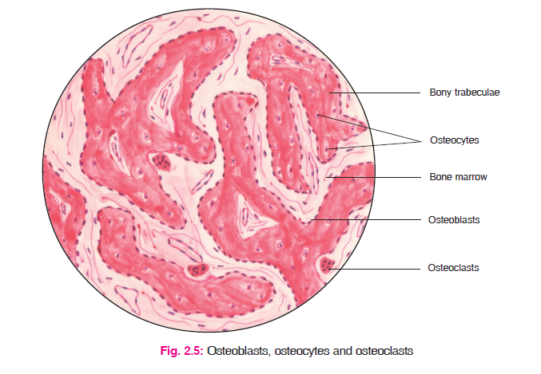
APPLIED PHYSIOLOGY –
DISEASES OF BONE
1-Osteoporosis
2. Rickets
3. Osteomalacia
Rickets in adults is called osteomalacia or adult rickets

Slide 56
Osteoporosis
Osteoporosis is the bone disease characterized by the
loss of bone matrix and minerals. Osteoporosis means
‘porous bones’.
Causes of osteoporosis
Osteoporosis occurs due to excessive bone resorption
and decreased bone formation. Osteoporosis is common
in women after 60 years.

Slide 57
Manifestations of osteoporosis
Loss of bone matrix and minerals leads to loss of bone
strength, associated with architectural deterioration of
bone tissue. Ultimately, the bones become fragile with
high risk of fracture. Commonly affected bones are
vertebrae and hip.

Slide 58
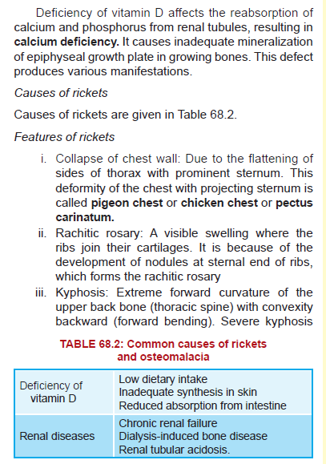

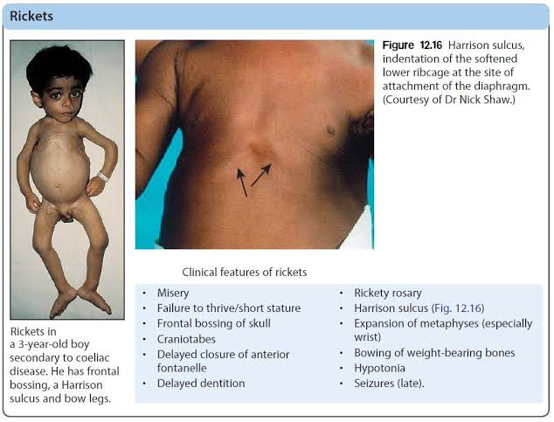

Slide 59
Causes formation of a hump (protuberance)
which is called humpback, hunchback or Pott
curvature
Lordosis: Extreme forward curvature of back bone in lumbar region: also called hollow back
or saddle back
. Scoliosis: Lateral curvature of spine
. Harrison sulcus: A groove in rib cage due to pulling of diaphragm inwards
i. Bowing of hands and legs
. Enlargement of liver and spleen
. Tetany: In advanced stages, the patient may
die because of tetany, involving the respiratory
muscles.

Slide 60
Rickets
Enamel hypoplasia in a patient affected by rickets. In this case the child had been exclusively breast-fed and had little exposure to sunlight. (Courtesy Dr. Pamela McDonald.)
Rickets
Radiograph of the same patient in Fig. 17.13 identifying enamel hypoplasia of the central incisors. The enamel of these teeth is formed early in childhood and therefore was most affected by the dietary vitamin D deficiency

Slide 61
Vitamin D–resistant rickets (VDRR), also known as familial hypophosphatemic rickets, represents a group of heritable conditions that are characterized by loss of phosphate in the urine (leading to reduced serum phosphate levels), low to normal vitamin D levels, and elevated levels of FGF23 (fibroblast growth factor 23). Patients develop many of the signs of rickets, including bowing of the lower limbs in childhood, reduced height, and bone pain. oral findings are significant because the dentition exhibits a variety of abnormalities, including thin enamel and defects in the dentin that may extend to the dentinoenamel junction. An ill-defined lamina dura is often seen radiographically, as well as abbreviated roots. The teeth have enlarged pulp chambers, and the lengthened pulp horns reach into the cusps of the teeth. This results in susceptibility of the teeth to pulpal exposure and necrosis, either spontaneous or caused by attrition and abrasion. The nonvital teeth develop periapical inflammation that results in abscess formation and multiple sinus tracts. m

Slide 62
Vitamin D–Resistant Rickets
The widened, elongated pulp chambers often extend far into the coronal portion of the dentin, increasing the risk of pulpal exposure related to minor trauma. (Courtesy Dr. Pamela McDonald.)

Slide 63
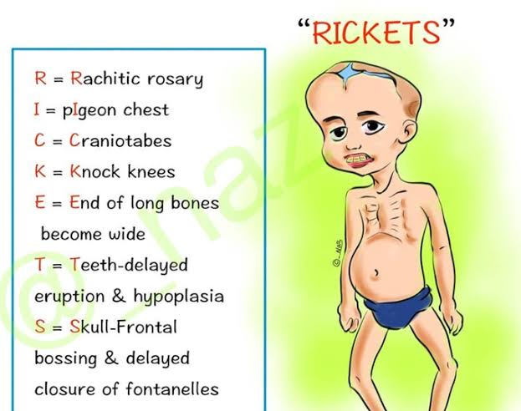

Slide 64
3. Osteomalacia
Rickets in adults is called osteomalacia or adult rickets.
Causes of osteomalacia
Deficiency vit d . It also occurs due to prolonged damage of kidney
(renal rickets).
Features of osteomalacia
i. Vague pain
ii. Tenderness in bones and muscles
iii. Myopathy leading to waddling gait (gait means
the manner of walking). In waddling gait, the feet
are wide apart and walk resembles that of a duck
iv. Occasional hypoglycemic tetany.

Slide 65
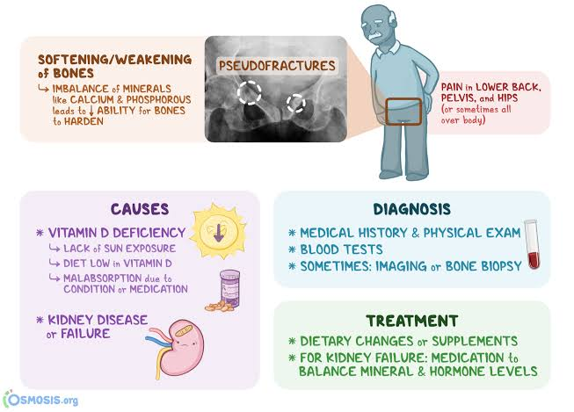

Slide 66
Osteopetrosis
(marble bone disease)
Osteopetrosis is characterized by increased
bone density. This is primarily due to inability to
resorb bone. This disorder is mostly observed in
association with renal tubular acidosis (due to a
defect in the enzyme carbonic anhydrase) and
cerebral calcification.

Slide 67
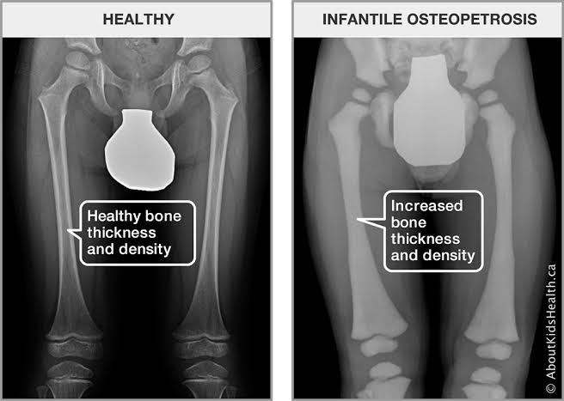

Slide 68
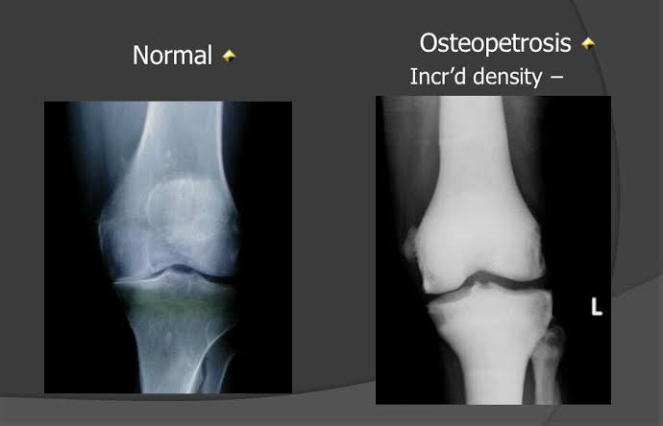

Slide 69
Key points about phosphate
Disease states
1. Serum phosphate level is increased in
hypoparathyroidism and decreased in hyperparathyroidism.
2. In severe renal diseases, serum phosphate
content is elevated causing acidosis.
3. Vitamin D deficient rickets is characterized
by decreased serum phosphate (1–2 mg/dl).
4. Renal rickets is associated with low serum
phosphate levels and increased alkaline
phosphatase activity.
5. In diabetes mellitus, serum content of
organic phosphate is lower while that of
inorganic phosphate is higher.

Slide 70
Flouride metabolism

Slide 71
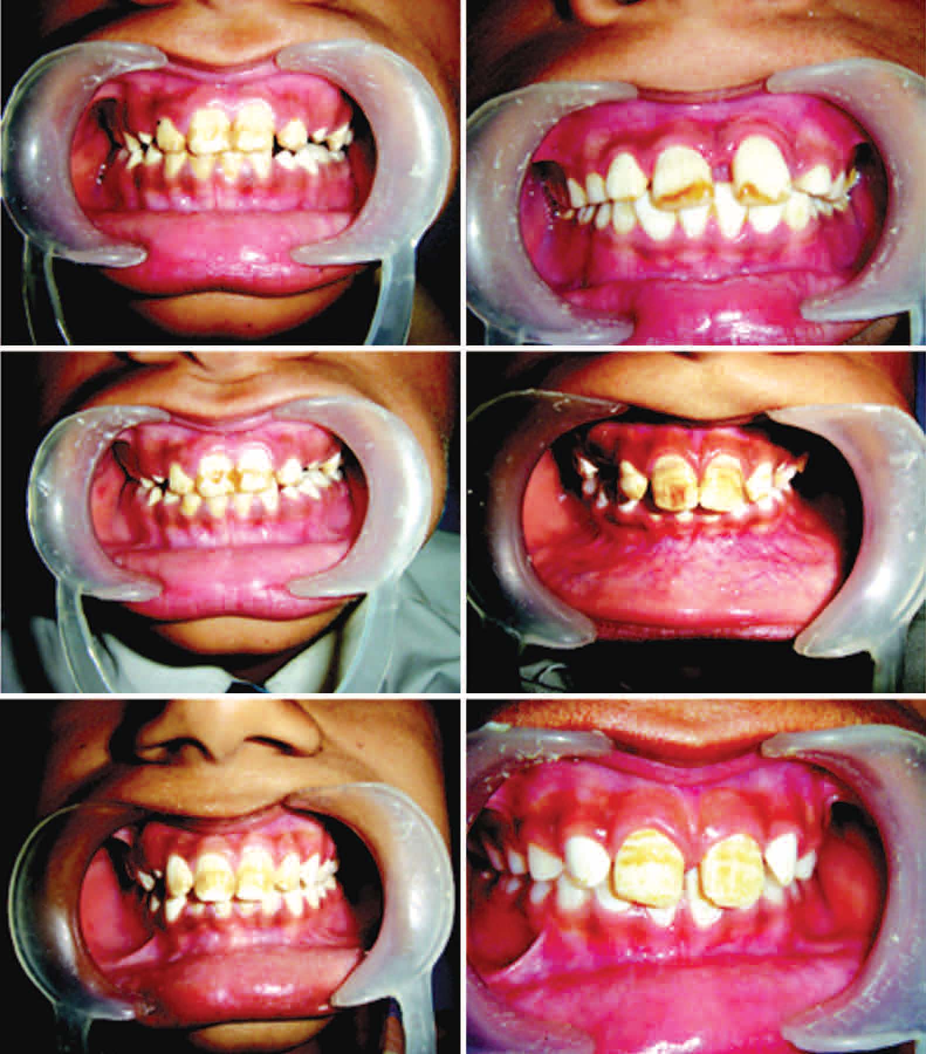

Slide 72
Exposure to fluoride has been shown to be an effective agent for reduction in dental caries, but it also can be associated with enamel defects known as dental fluorosis. Healthcare advocates strive to determine the most appropriate level of fluoride exposure that will result in maximal caries reduction and minimal dental fluorosis.
Teeth with clinically evident fluorosis are caries resistant and demonstrate areas of white opaque enamel that may exhibit intermixed areas of yellow or brown discoloration. In severe fluorosis, irregular brownish depressed areas of defective surface enamel may be seen, which has been termed mottled enamel. Surface microabrasion of zones of yellow or brown discoloration often results in a permanent improvement of the enamel coloration. Elimination of the white lusterless enamel usually requires labial veneers or full crowns.

Slide 73
FLUORINE
Fluoride is one of those remarkable
elements, which have not only notable chemical qualities, but
also physiological properties of great interest and importance
for human health. Fluoride has been described as an essential nutrient in the Federal Register of United States Food and
Drug Administration (1973) and World Health Organization
(WHO) expert committee on trace elements and human
health. They have also included fluoride in the list of 14
elements recognized to be physiologically essential for the normal development and growth of human beings.
Its atomic weight is 19 and atomic number is 9.
Fluoride is never encountered in nature in the elemental form, as it is the most electronegative and reactive of all elements and thus it is found in salt form.

Slide 74
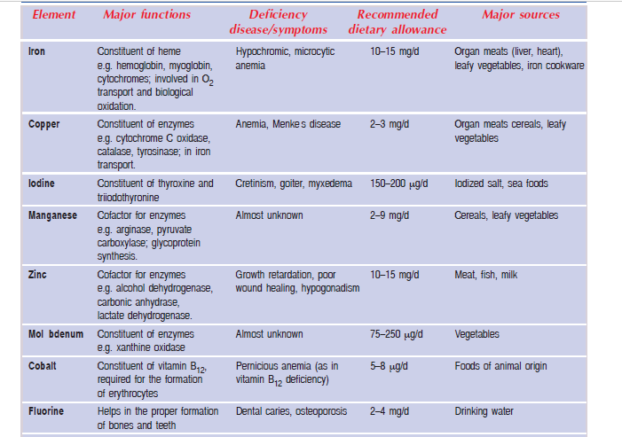

Slide 75
Biochemical functions
1. Fluoride prevents the development of
dental caries. It forms a protective layer of acid
resistant fluoroapatite with hydroxyapatite of the
enamel and prevents the tooth decay by bacterial
acids. Further, fluoride inhibits the bacterial
enzymes and reduces the production of acids.
2. Fluoride is necessary for the proper
development of bones.
3. It inhibits the activities of certain enzymes.
Sodium fluoride inhibits enolase (of glycolysis)
while fluoroacetate inhibits aconitase (of citric
acid cycle).
Dietary requirements and sources An intake of less than 2 ppm of fluoride will meet the daily requirements. Drinking water is the main source.

Slide 76
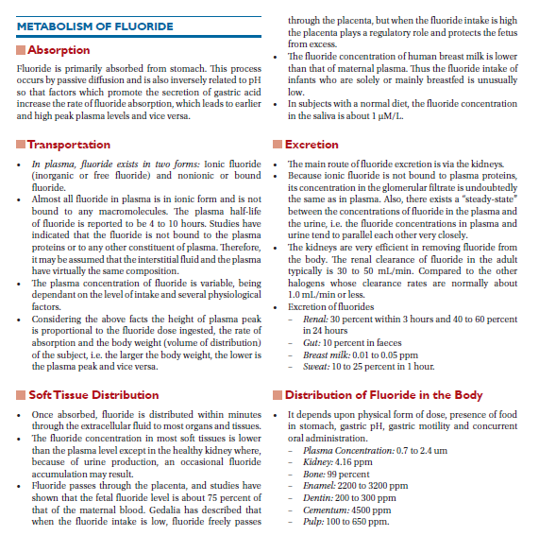

Slide 78
Disease states
1. Dental caries : It is clearly established that
drinking water containing less than 0.5 ppm of
fluoride is associated with the development of
dental caries in children
Xerostomia-Related Caries
Severe, generalized caries in a patient with xerostomia caused by radiation therapy to the head and neck.

Slide 79
Fluorosis : Excessive intake of fluoride is
harmful to the body. An intake above 2 ppm(particularly > 5 ppm) in children causes mottling of enamel and discoloration of teeth.
The teeth are weak and become rough with characteristic brown or yellow patches on their surface. These manifestations are collectively referred to as dental fluorosis.
An intake of fluoride above 20 ppm is toxic and causes pathological changes in the bones.
Hypercalcification, increasing the density of the bones of limbs, pelvis and spine, is a
characteristic feature and collagen of bones get calcified. Neurological disturbances are also commonly observed. The manifestations described here constitute skeletal fluorosis. In the advanced stages, the individuals are crippled and cannot perform their daily routine work due to stiff joints. This condition of advanced fluorosis is referred to as genu valgum.

Slide 80
Probably toxic dose (PTD): Defined as the threshold dose that could
cause serious or life threatening systemic signs and symptoms.
Safely tolerated dose: 8 mg – 16 mg/kg body weight
Toxic dose: 16 mg – 32 mg/kg body weight
Lethal dose: 32 mg – 64 mg/kg body weight

Slide 81
The fluoride content of water in some parts of
Andhra Pradesh, Punjab and Karnataka is quite
high. Fluorosis is prevalent in these regions,
causing concern to government and health
officials.
3. Fluoridation of water and use of fluoride
tooth-pastes : In order to prevent the dental
caries in children, some advanced countries like
USA have started fluoridation of water. Further,
the consumer markets till recently were flooded
with fluoride toothpastes. There is some
rethinking on these aspects due to the toxic
effects of excess fluoride.

