Slide 1
Oral aspects of defect in lipid metabolism
By Mukta Shinde

Slide 2
Introduction
Lipids are heterogenous group of organic compds, insolube in water but soluble in organic solvents like alcohol, choloroform etc.
Lipid metabolism is concerned with assimilation, utilisation, replacement and synthesis of fatty acids.

Slide 3
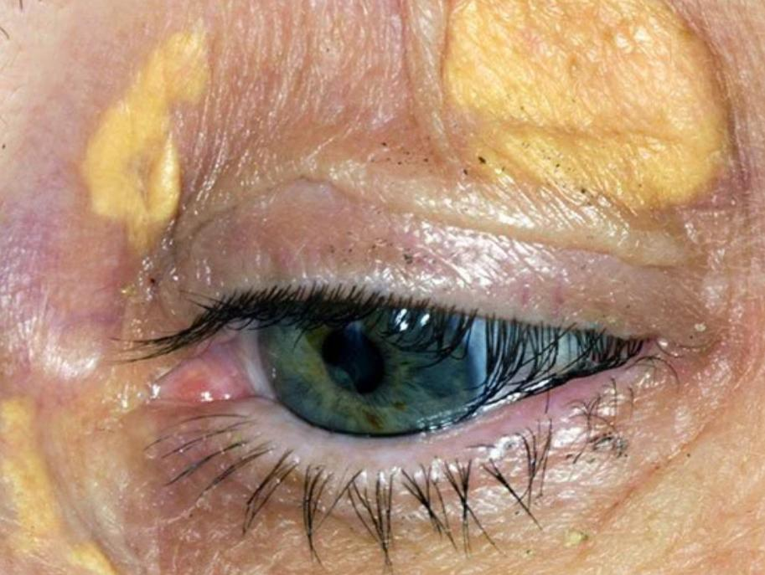
Disturbances
Disturbances in lipid metabolism are
rare, but they do occur
Classified as “lipoid storage diseases”
Xanthomatoses
Lipid granulomas

Slide 4
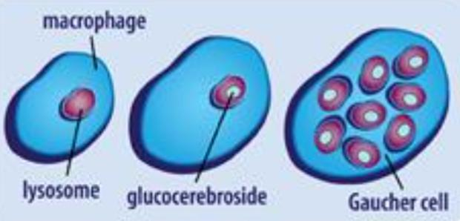
GAUCHER DISEASE
Common lysosomal storage disease
Characterised by deposition of gluco-cerebroside in cells of monocyte- macrophage system
Caused dues to Deficiency of lysosomal hydrolase, glucocerebrosidase
Types:
Type1 – chronic non-neuropathic form
Type 2 – infantile or Acute neuropathic form
Type 3 – juvenile or Norrbottnian form

Slide 5
Type 1 : Chronic non-neuropathic form
Often presence in childhood
Hepatosplenomegaly, pancytopenia and skeletal diseases
Common occurrence in Ashkenazi Jewish descents
Radiographic evidence- Erlenmeyer Flask Deformity of distal femur

Slide 6
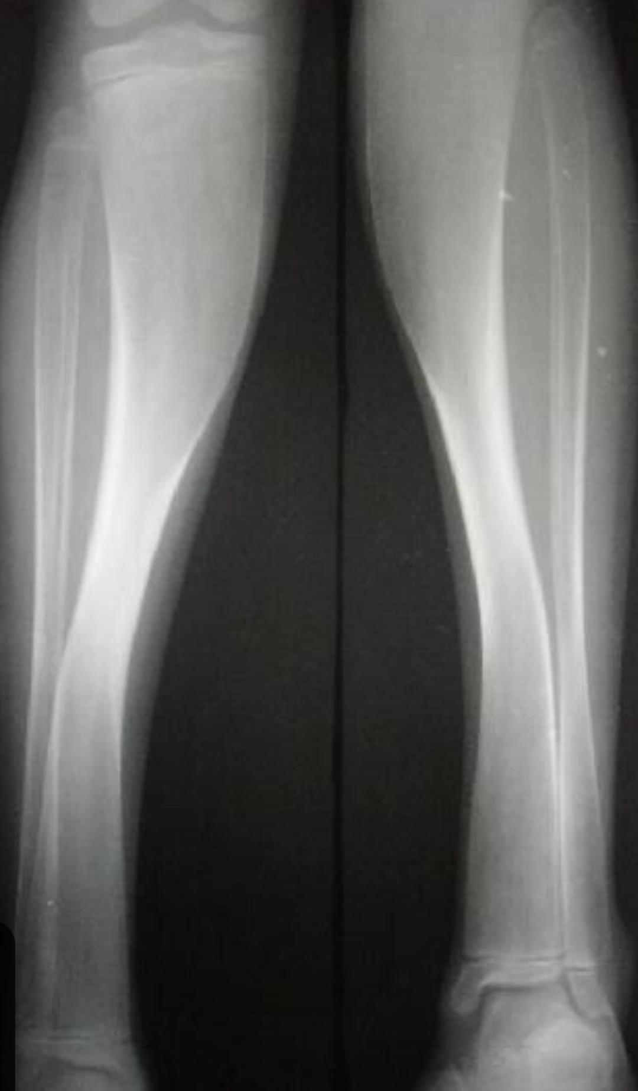
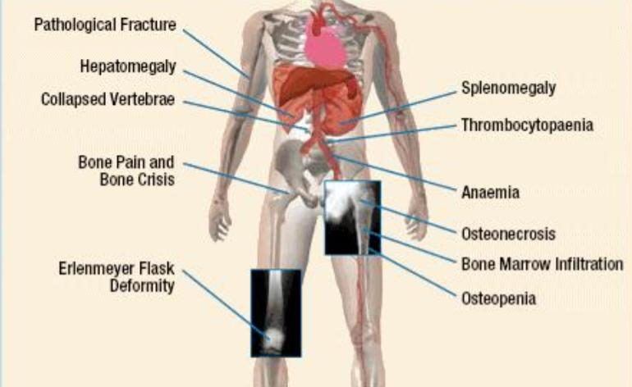

Slide 7
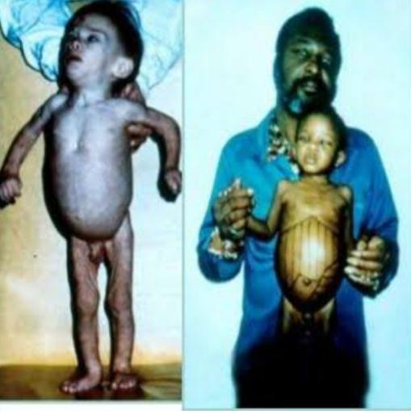
Type 2 : infantile or acute neuropathic form
Causes rapidly progressive neurovisceral involvements
Death of the infant

Slide 8
Type 3: juvenile or Norrbottnian form
Juveniles with systemic involvments
CNS involvments begins in teens or twenties

Slide 9
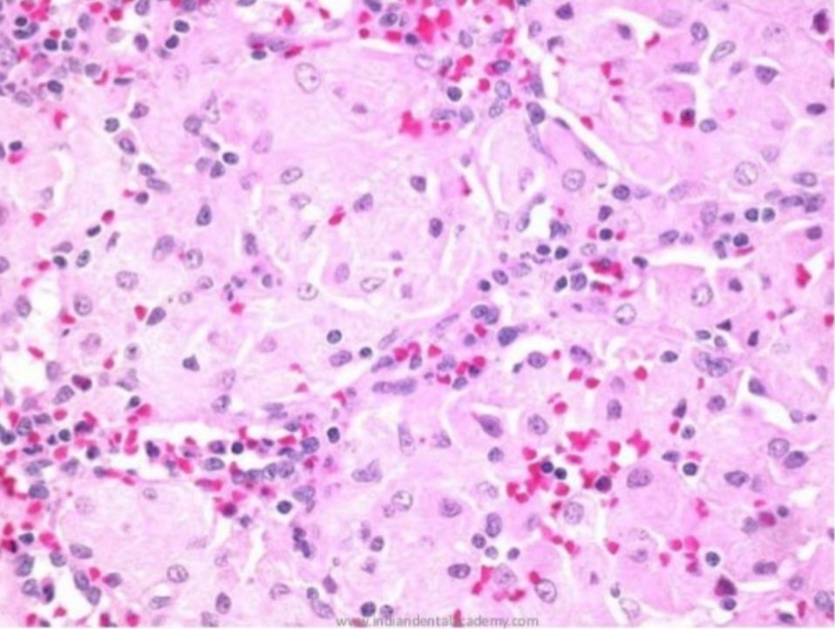
Histology
Biopsy of spleen or liver
Gauchers cell- Round pale cell, 20-80 Microns in diameter , small eccentric nucleus, Wrinkled or crumpled silk cytoplasm.

Slide 10
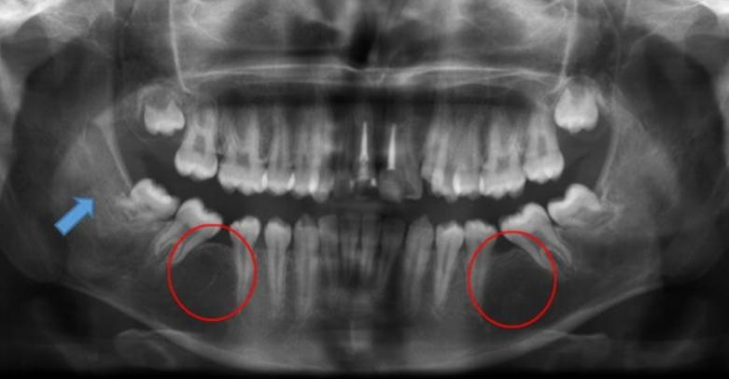
Common features
GAUCHER cell infiltration is common in long bones.
Mandible is a long bone hence becomes a target
Pseudocystic or honeycomb radiolucent lesions in molar and premolar region due to accumulation of GAUCHER cell
Osteopenia and osteoporosis
Enlargement of bone marrow spaces
Displacement of mandibular canal
Apical root resorption

Slide 11
Oral findings
Yellow pigmentation and petechiae
Delayed eruption of permanent teeth

Slide 12
Prognosis and treatment
Prognosis is very poor
Leads to death in 1 yr
Less virulent forms may persist until sixth decade , patients usually die of intercurrent infection
Enzyme replacement therapy is available but expensive.

Slide 13
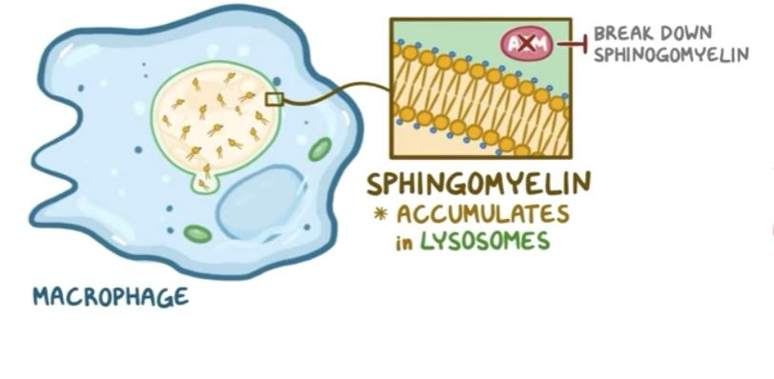
Niemann-Pick Disease
Least common of genetic disturbances of lipid metabolism.
Inherited as autosomal recessive trait.
Results from lysosomal accumulation of sphingomyelin due to Deficiency of Sphingomyelinase.

Slide 14
Classification
Type A – infantile or acute neuropathic
Type B – chronic non neuropthic(less common)
Type C – biochemical and genetically distant form. The mutant gene is 18q11-12

Slide 15
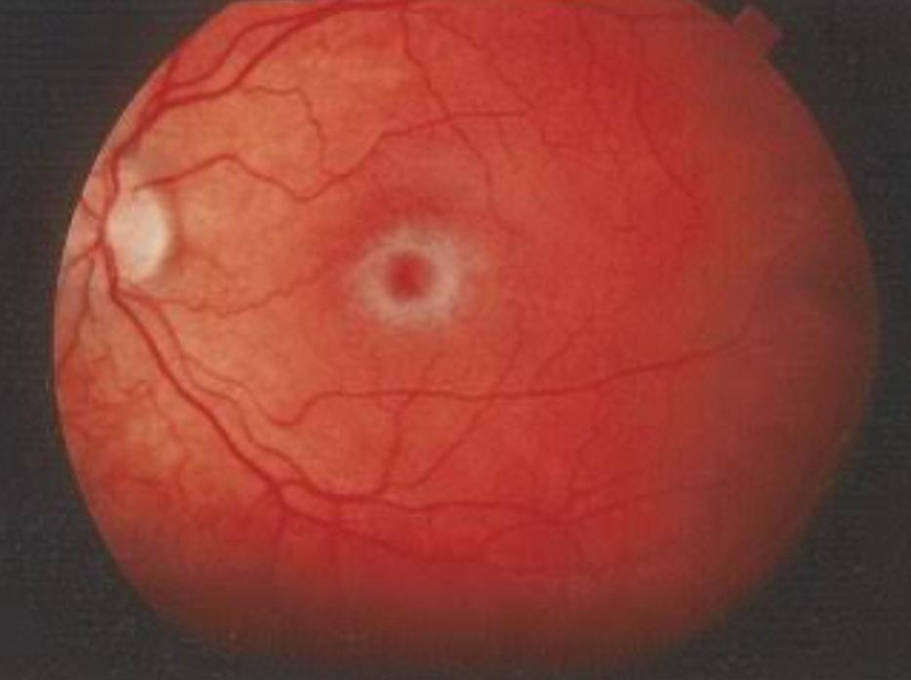
Type A
Severe infantile form with extensive neurological involvement, viseral accumulation of sphingomyelin
Hepatosplenomegaly, minor dysmorphy, brownish pigmentation is skin
Retinal examination shows macular cherry red spots.
Child may die around 1.5 to 3yrs due to cachexia

Slide 16
Type B
Organomegaly is common (hepatosplenomegaly)
No nervous involvements
Bruising
Epistaxis
Retarded body growth
Delayed puberty
Joint pain, abdominal pain
diarrhea
Macular halo and cherry red spots

Slide 17
Type c
Autosomal recessive disorder
Due to mutation of NPC1 and NPC2 genes
Affects anyone from perinatal to adult age
Spleen and lungs are commonly involved
Neurological manifestation.
Cerebellar ataxia
Dysarthria
Dysphagia
Dementia

Slide 18
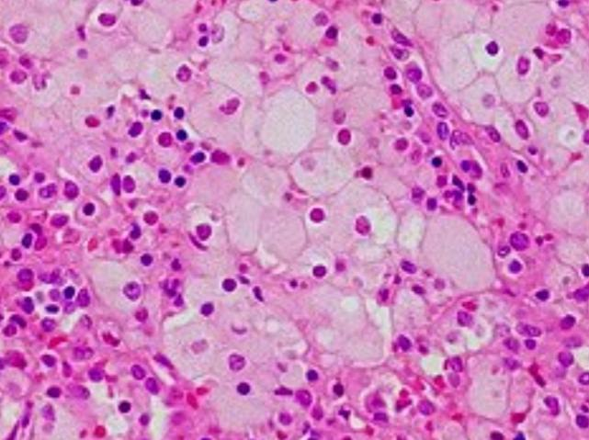
Histology
Affected cells become enlarged(Niemann Pick cells) Due to accumulation of sphingomyelin and cholestrol in the lysosomes of cells
Foamy cytoplasm- numerous vacuoles

Slide 19
Treatment
Antibiotic therapy
Organ transplant
Enzyme replacement therapy

Slide 20
Letterer Siwe Disease
Acute, histiocytic disorder Belongs to langerhan cells disorder Spectrum
Occurs in infants, usually below 3 yrs of age

Slide 21
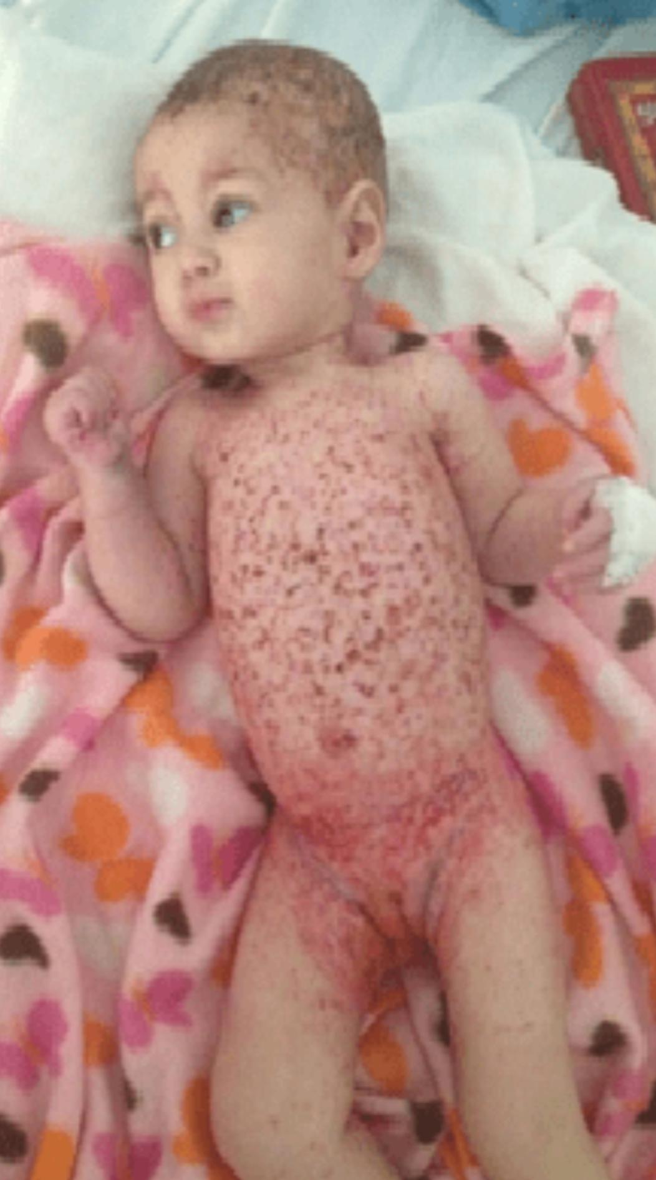
Clinical features
Skin rash(trunk scalp and extremities)
Erythematous purpuric ulceration
Low grade spiking fever with malaise and irritability
Splenomegaly, hepatomegaly, lymphadenopathy
Nodular or diffused involvement of visceral organs like lungs And GIT
Progressive anemia as well as leukopenia

Slide 22
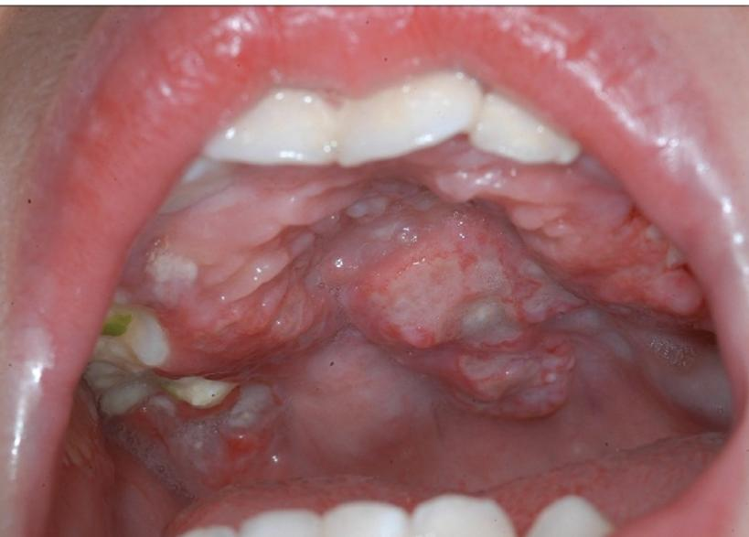
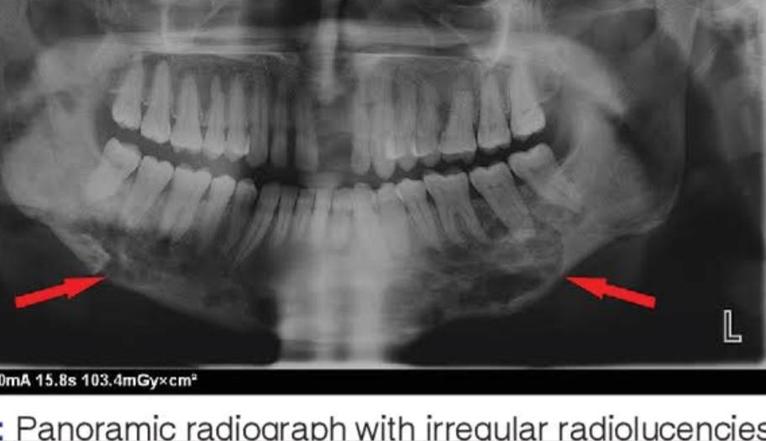
Oral manifestation
Ulcerative lesions
Gingival hyperplasia
Destruction of bone of mandible and
maxilla may occur
Loosening and premature loss of teeth

Slide 23
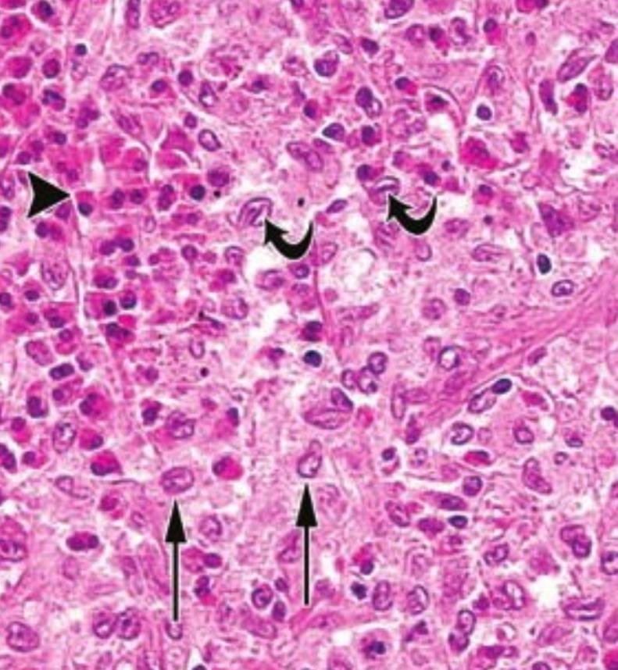
Histology
Histiocytic proliferation with or without
eosinophils
Cytologically altered histiocytes resemble
histiocytic lymphoma

Slide 24
Treatment
Chemotherapy in combination with vincristine and prednisolone has been tried in chronic form of LCD with success but in Letterer Siwe Disease it is uncertain
Prognosis is poor
Course of disease is rapid and terminates fatally in short time

Slide 25
THANK YOU

