Slide 1
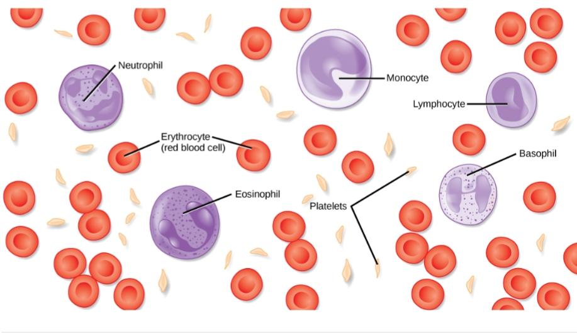
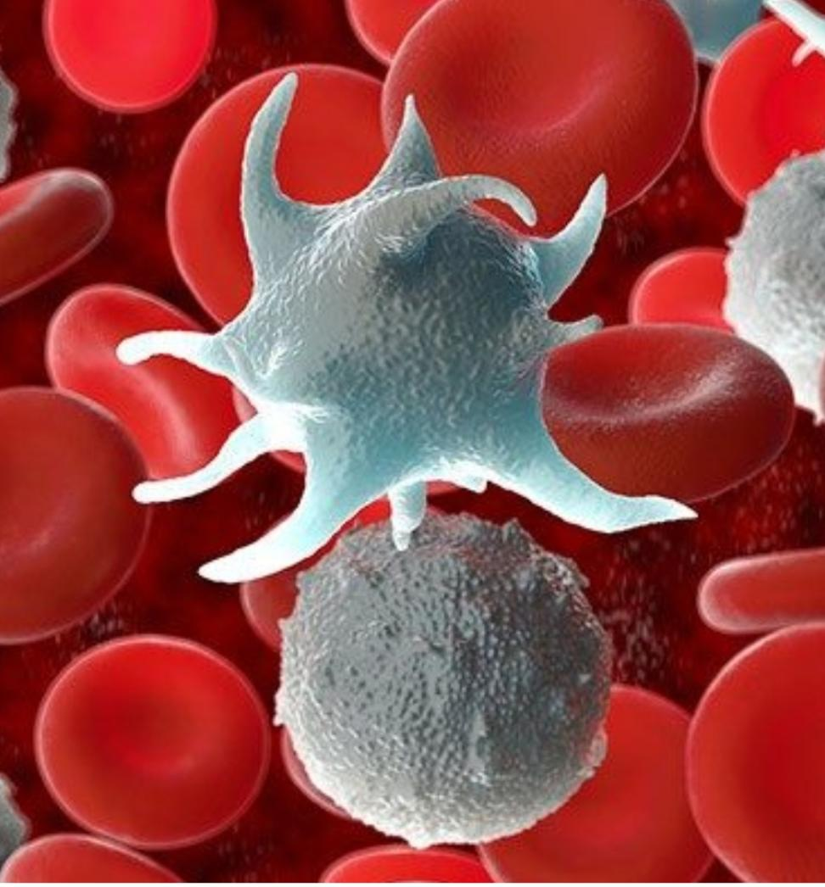
Disorder’S of paltelets
By- Asmita Arun RANVIR

Slide 2
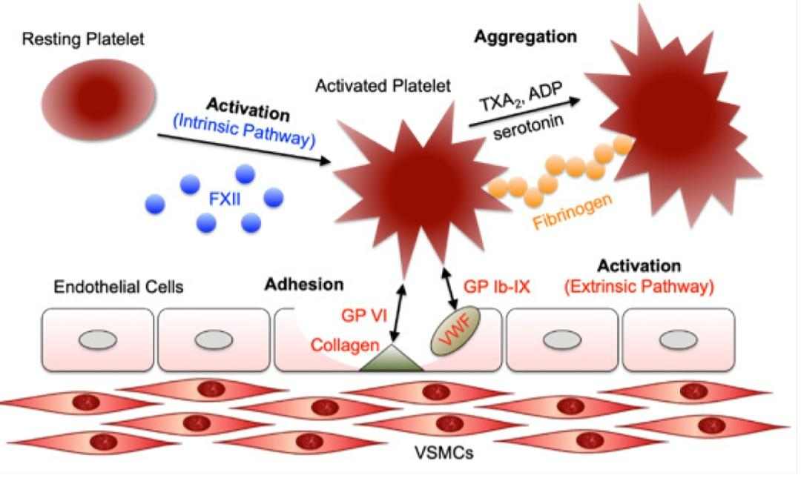

Slide 3
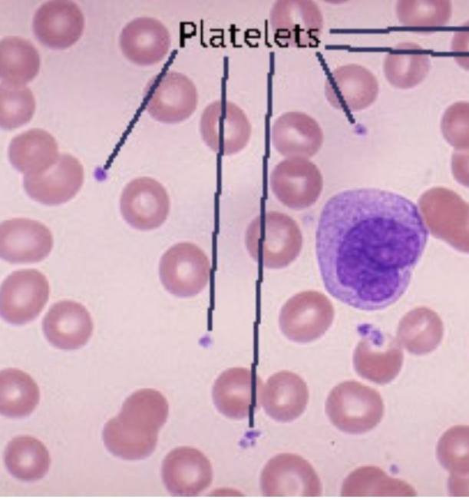
Thrombocytopathia
It is also called as Thrombocytopathic Purpura
the qualitative abnormality in platelet function may be referred to as thrombocytopathia.
It is further divided as-
          Hereditary
          Acquired

Slide 4
Hereditary
Further divided as-
          Disorder of platelet adhesion
          Disorder of platelet aggregation
          Disorder of platelet secretion

Slide 5
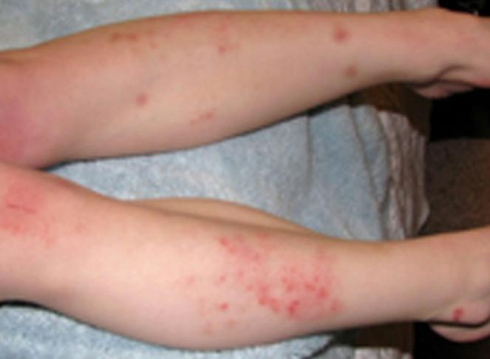
1. Disorder of platelet adhesion-
It is caused by defective adhesion of platelet to Underlying subendothelial matrix.
  Ex- 1. von Willebrand’s Disease
  (Pseudohemophilia, vascular hemophilia, vascular purpura)
  Caused due to deficiency of von Willebrand’s factor.
  2. Bernard- Soulier Syndrome –
  Caused due to deficiency of platelet membrane glycoprotein.

Slide 6
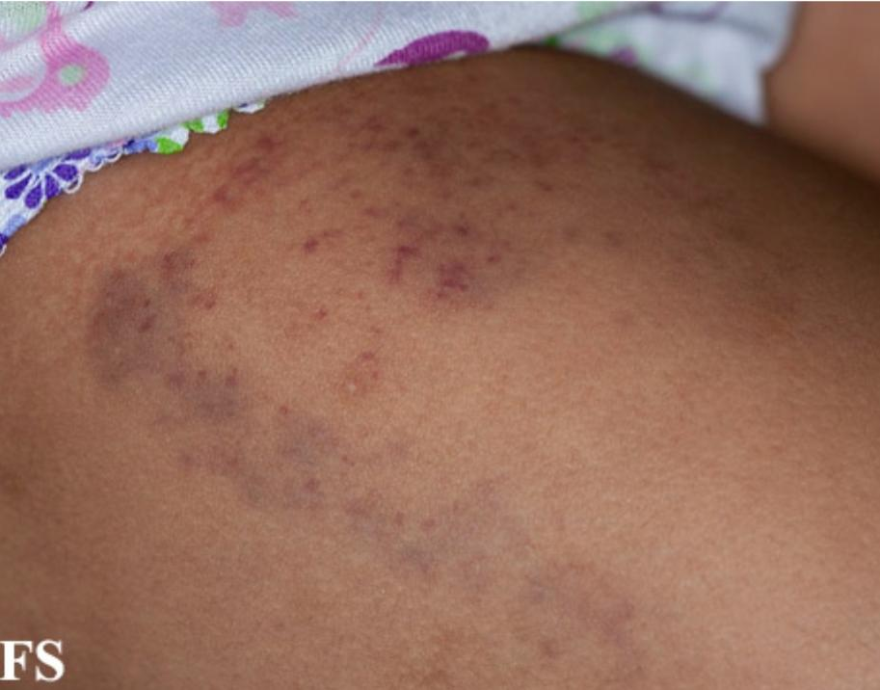
2. Disorder of platelet aggregation -
Absence of platelet aggregation and platelet plug formation.
Ex – 1. Glanzmann thrombasthenia is a bleeding disorder that is characterized by prolonged or spontaneous bleeding starting from birth.

Slide 7
3. Disorders of platelet secretion/ activation
Most common hereditary disorder And lead to mild bleeding disorders.

Slide 8
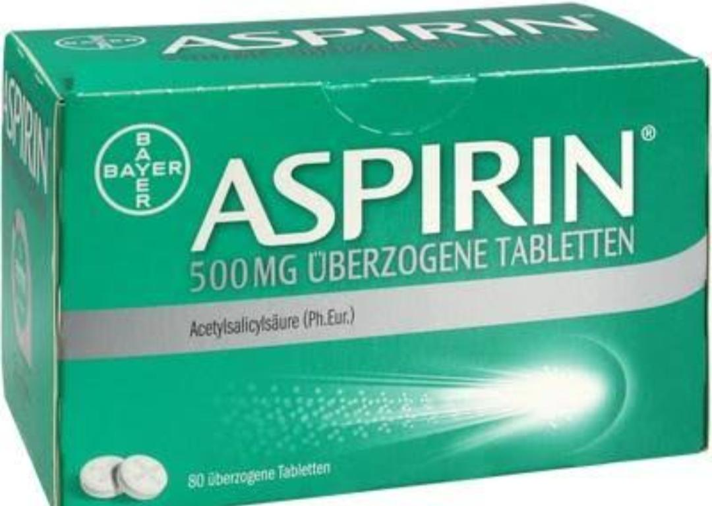
Acquired
This common form Of platelet dysfunction is mainly caused
by drugs and less frequently by certain medical conditions
and procedures.
1. Drugs – As side effects
Non steroidal anti-inflammatory druGs
Ex- aspirin

Slide 9
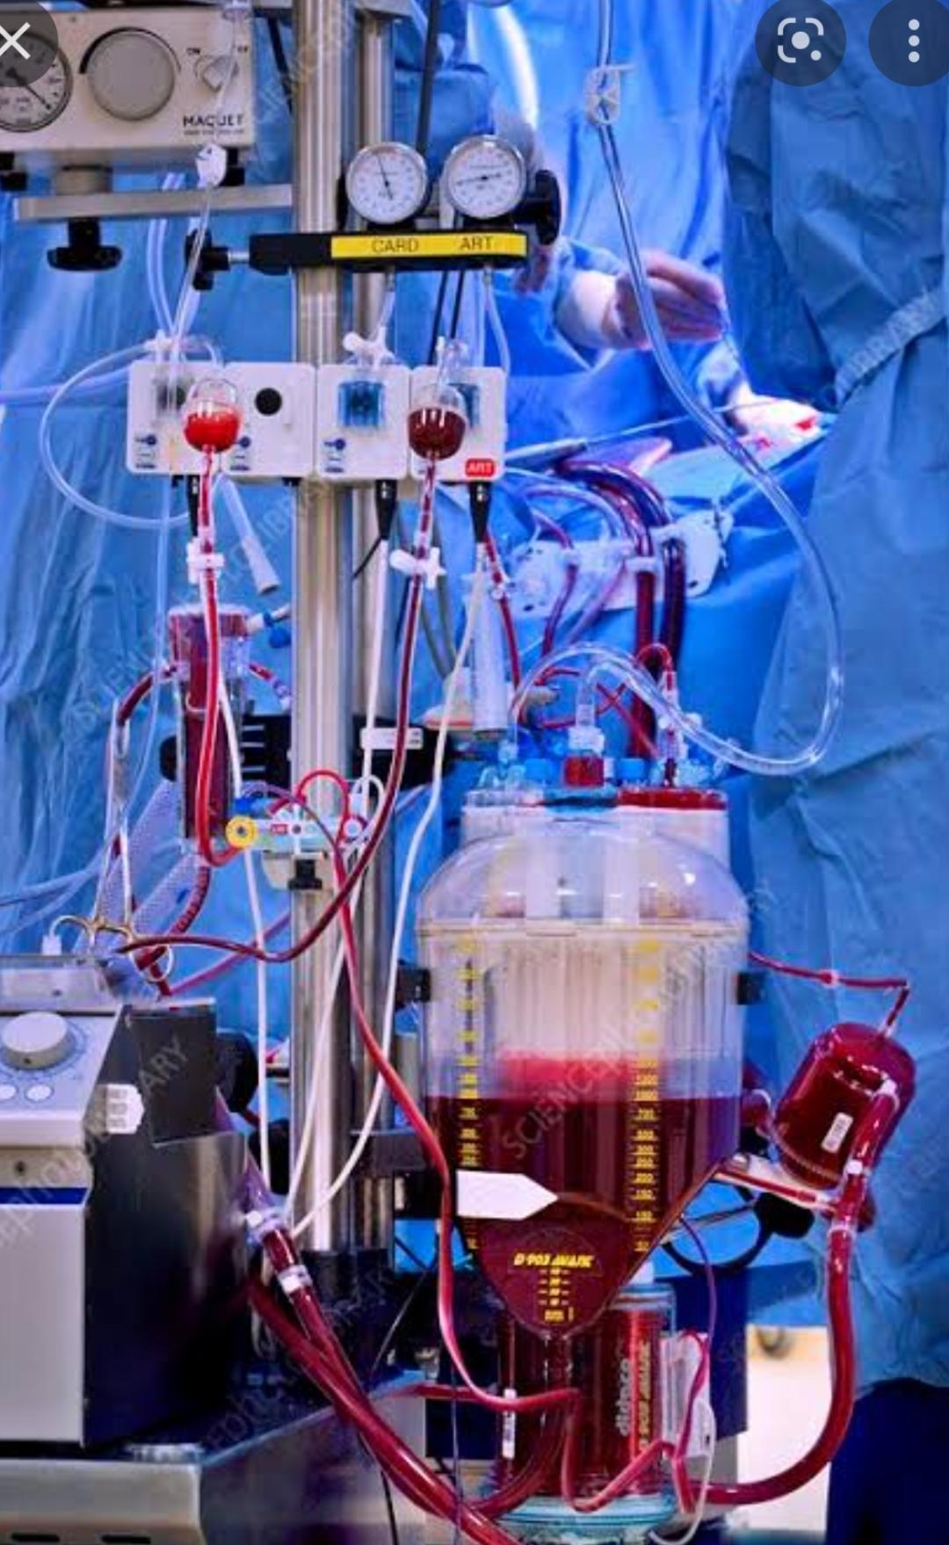
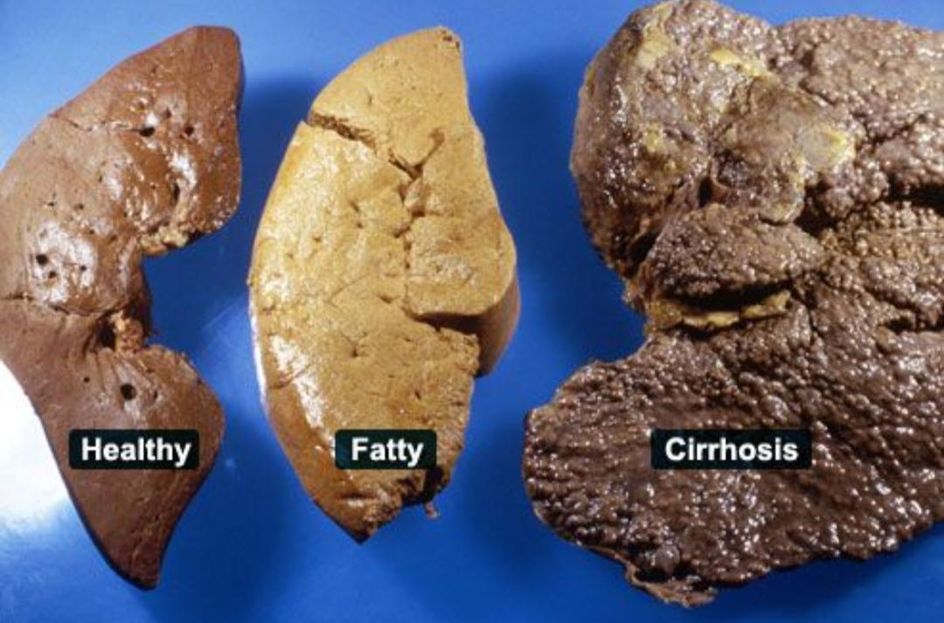
2. Medical conditions- like uremia, multiple myeloma, cirrhosis.
3. Procedures- like cardiopulmonary bypass

Slide 10
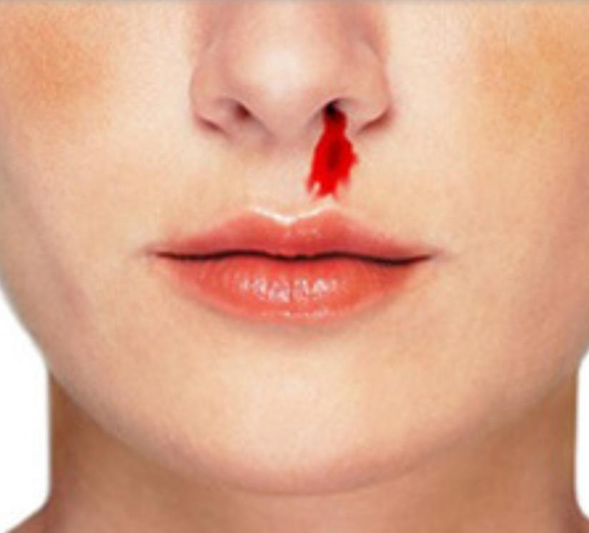
Clinical Features- 1. Repeated epistaxis
2. Prolonged bleeding after medical procedures And trauma.
3. Bleeding is – 1. Mild- most cases
2. Severe – rarely.

Slide 11
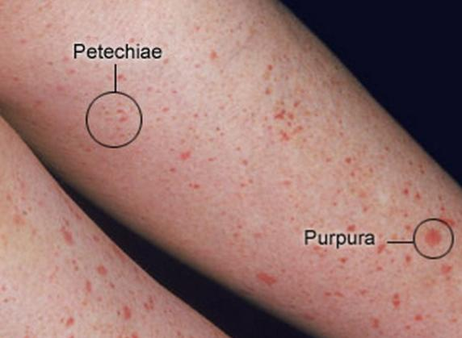
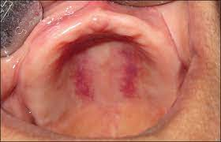
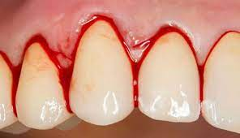
Oral manifestation –
1. Spontaneous Gingival bleeding is common,
2. mucosal ecchymose
3. Excessive and prolonged bleeding from dental Extractions
4. Patechiea

Slide 12
Lab findings –
1.platelet count is low
  2. Bleeding time may be normal or increased

Slide 13
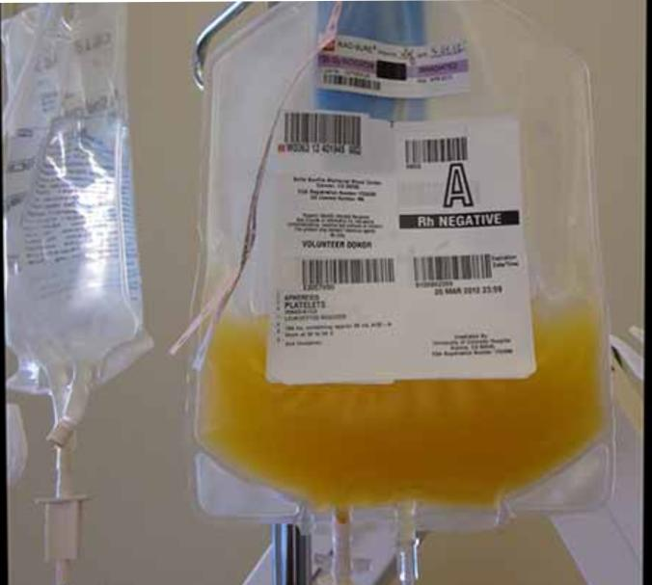
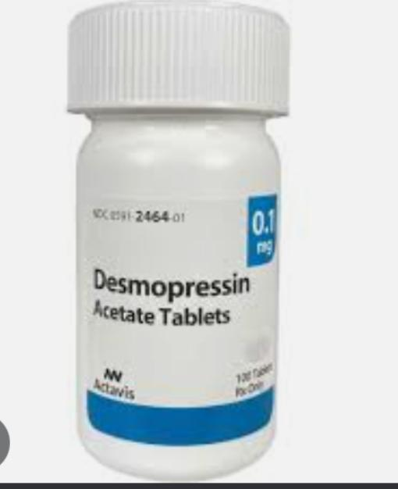
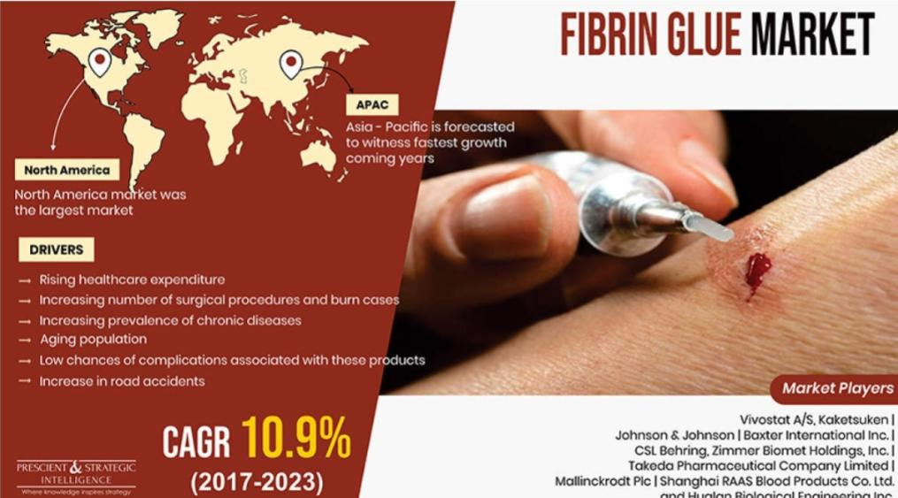
Treatment –
1. administration of Desmopressin – releases vwf from Endothelial cells and reduce postsurgical bleeding
2.Fibrin glue
3. Platelet transfusion

Slide 14
Thrombocytopathia
Heriditary. Acquired
  Disorders of platelet adhesion. 1.Drugs
  Disorders of platelet aggregation 2. Medical conditions
  dsorders of platelet activation 3. Medical procedures

