Slide 1
Oral pathology
BY ROLL NO :51,52,53,54

Slide 2
ERYTHROBLASTOSIS FETALIS
Congenital hemolytic anemia due to Rh incompatibility results from the destruction of fetal blood brought about by a reaction between maternal and fetal blood factors .
It occurs during transplacental transmission of maternal antibodies to fetal blood cells.
Rh is a factor found in human RBC.

Slide 3
Pathogenesis
It is due to inheritance by the fetus of a blood factor from father that acts as foreign antigen to the mother.
The Transplacental transfer of this antigen ,actually transplacental leaks of red cells, from fetus to the mother results in immunization of the mother and formation of antibodies which then transferred back to the fetus by the same route ,produce fetal hemolysis .
When father is Rh positive and the mother is Rh negative ;the fetus inherits the paternal factor ,which may then acts as an antigen to the mother and immunize her with resultant antibody formation.

Slide 4
Pathogenesis
Rh antigens : C,D,E if any of it is present then the person is Rh positive .If any of it is absent their place is taken by less potent Hr antigens ,known as c,d and e.
Thus ,three Rh or Hr genes are inherited are inherited from each parents ,constituting three pairs of factors.
Any combination of C,D,E and c,d,e is possible. But the only combination producing an Rh negative person is cde-cde.
The D antigen ,by far the strongest, is most frequently responsible for the clinical manifestations of erythroblastosis fetalis and the 85%of population generally considered Rh positive actually have D antigen homozygously (D-D) or heterozygously (D-d).The 15% who are Rh negative have d antigen homozygously (d-d).

Slide 5
Pathogenesis
Mathematically according to laws of random mating ,there should be 10 cases of erythroblastosis fetalis in every 100 pregnancies. Clinically, it has been found that only one case in every 200,pregnancies occurs.
There are several possible explanations for this discrepancy.
# In some cases mother may be unable to form antibodies even though immunized by the Rh positive fetus.
#Even ,though the fetus is Rh positive, transplacental transfer of the antigen does not occur , so that there is no maternal immunization.
#It is seen that women have reduced immunologic responsiveness during pregnancy.
But , subsequent pregnancy might cause further immunization and antibody formation ,so hemolysis occur. So it is seen that why first pregnancy is uneventful , while erythroblastosis fetalis occurs in succeeding pregnancies.

Slide 6
Continued……
The frequency of erythroblastosis fetalis of Rh incompatibility has shown great decrease in recent years .
Because ; at present Rh negative mother is given Anti D gamma Globulin to prevent immunization , since it binds to antigenic receptor sites on fetal red cells ,making them non- immunogenic

Slide 7
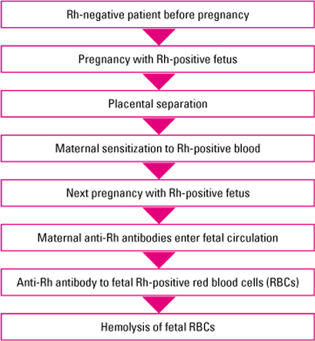


Slide 8
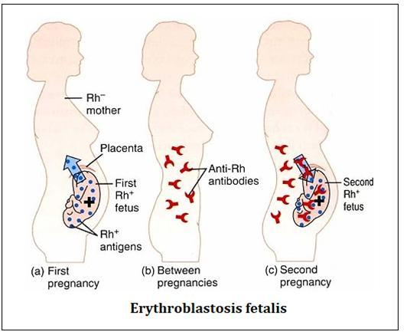

Slide 9
Clinical Features
Manifestations of disease depends upon the severity of the hemolysis.
#Some infants are still born.
#Those born alive suffer from pallor jaundice, anemia, compensatory erythropoiesis, both medullary and extramedullary edema resulting in fetal hydrops.
Severe anemia and jaundice do not begin to develop until at least several hours after birth and frequency not for several days.
The most important aid in diagnosis of the disease is a positive direct Coombs test on cord blood.

Slide 10
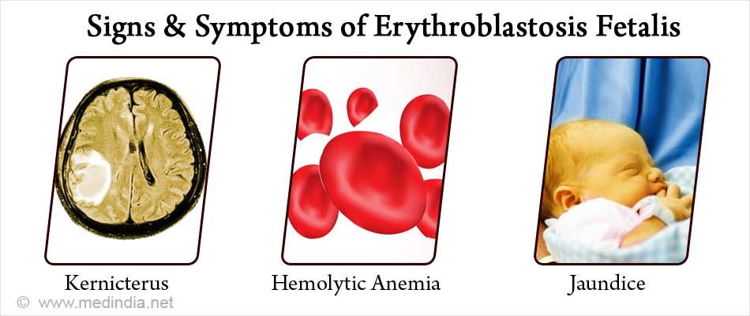

Slide 11
Oral Manifestations
Erythroblastosis Fetalis may be manifested in the teeth by deposition of blood pigment in the enamel and dentin of the developing teeth, giving them a green, brown or blue hue.
Ground sections of these teeth give a positive test for bilirubin. The stain is intrinsic and does not involve teeth or portions of teeth developing after cessation of hemolysis shortly after birth.
Enamel Hypoplasia is also reported occurring in some cases of erythroblastosis fetalis . Characteristic ring like defect occurs which has been termed the Rh hump by Watson .
So , dentist may expect to see more children with peculiar pigmentations of teeth characteristic of the condition, aware of its nature.

Slide 12
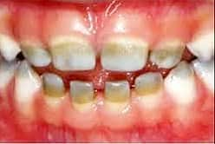

Slide 13
Laboratory Findings
The RBC count at birth may be less than 1,000,000 cells per cubic mm to near a normal level.
There are characteristically large number of normoblasts, or nucleated red cells, in circulating blood.
Ultimately ,severe anemia usually develops within a few days .
TREATMENT :
No treatment for tooth pigmentation is needed , since it affects only the deciduous teeth and presents only a temporary cosmetic problem.

Slide 14
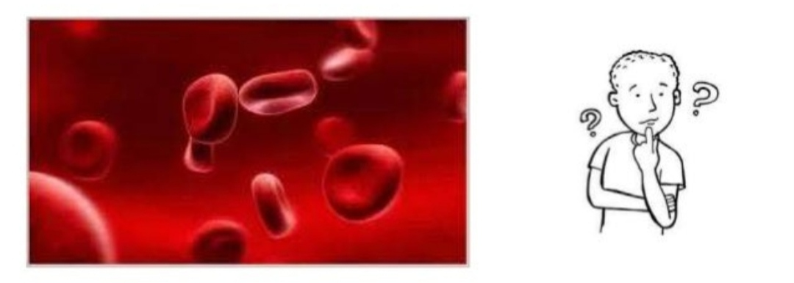
POLYCYTHEMIA
Divya Patel

Slide 15
POLY CYTHEMIA
    POLY = many or more
    CYTHEMIA = a “condition involving cells in blood”

Slide 16
DEFINATION
  Polycythemia is defined as abnormal increase in the number of red blood cells in periferal blood, usually with an increase haemoglobin level.
  TYPES :
  Relative polycythemia
  Primary polycythemia
  Secondary polycythemia

Slide 17
RELATIVE POLYCYTHEMIA
It is an apparent increase in the number of circulating red blood cells that occurs as a result of loss of body fluid with hemoconcentration of cell
It is seen in cases of excessive loss of body fluids such as chronic vomiting, diarrhea or loss of electrolyres with acompanying loss of water.

Slide 18
PRIMARY POLYCYTHEMIA
It is characterized by increase in number of circulating RBC’s and of the hemoglobin level as a result of an abnormality of bone marrow.

Slide 19
SECONDARY POLYCYTHEMIA
Secondary polycythemia is caused due to absolute increase in RBC mass resultant to enhanced stimulation of RBC production.
In general, the stimulus responsible for producing secondary polycythemia is either bone marrow anoxia or production of an erythropoetic stimulating factors.

Slide 20
POLYCYTHEMIA VERA
The most prominent feature is an absolute increase in number of circulating red blood cells and in total blood volume because of uncontrolled Red blood cell production.
This is accompanied by increase white blood cell and platelet production which is due to abnormal clone of the hematopoietic stem cells.
The bone marrow of patients with polycythemia vera shows normal and abnormal stem cells.
The clonal proliferation of abnormal stem cells interfere with or

Slide 21
CLINICAL
FEATURES
Headache or dizziness
Weakness
Lassitude
Tinnitus
Visual disturbances
Mental confusion
Slurring of the speech
Inability to concentrate
The skin is flushed or diffused reddened as a result of capillary engorgment.

Slide 22
ORAL MANIFESTATION
Oral mucous membrane appear deep purplish red, the gingiva and tongue being most prominently affected. The cyanosis is due to presence of reduced hemoglobin in amounts exceeding 3mg/dl. The gingivae are often engorged and swollen and bleed upon the slightest provocation.

Slide 23
TREATMENT
No specific treatment for polycythemia is known although several methods are used for relieving its symptoms.
The patient may be periodically bled or substances may be administeted either to destroy blood cells or to interfere with its formation.

Slide 24
Diseases of WBC
-KRITIKA PATIL

Slide 25
INTRODUCTION

Slide 26
LEUKOCYTOSIS

Slide 27
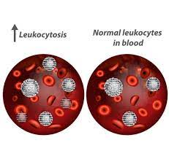
LEUKOCYTOSIS
DEFINITION:
An increase in number of leukocytes more than 11000/cubic mm is referred to as leukocytosis
(normal WBC count-
4000 to 11000/cubic mm)

Slide 28
CAUSES
Increase in WBC usually reflects a response to infection or inflammation.
Occasionally it may be result of primary pathology affecting bone marrow.
Other causative factors-trauma, stress, allergic reactions, drugs, haemolytic anaemia , heredity conditions, malignancy.

Slide 29
Types of leukocytosis
NEUTROPHILIA
EOSINOPHILIA
BASOPHILIA
LYMPHOCYTOSIS
MONOCYTOSIS

Slide 30
NEUTROPHILIA
Neutrophilia is defined as a higher neutrophil count in the blood than the normal reference range of absolute neutrophil count.
CAUSES:
  Acute infections , including local infections-certain bacilli , fungi, viruses ; certain general infections-rheumatic fever, diphtheria and smallpox
  Inflammatory conditions-coronary thrombosis, gout, burns
  Acute hemorrhage
  Acute hemolysis
  Malignant neoplasms

Slide 31
EOSINOPHILIA
Eosinophilia is a condition in which the eosinophil count in the peripheral blood exceeds 5×10⁸/L (500/μL).
CAUSES:
  Allergic disorders-bronchial asthma, hay fever
  Skin diseases
  Parasitic infections
  Malignant disease-especially with metastasis or necrosis
  Loeffler syndrome
  Inherited anamoly

Slide 32
BASOPHILIA
An abnormally high basophil level is called basophilia .
CAUSES:
  Blood diseases- Chronic myelocytic leukemia, erythmia, chronic anaemia, Hodgkin disease
  Splenectomy
  Infections –chronic inflammation of accessory sinuses, smallpox, chickenpox
  After injection of foreign proteins
  Myxedema
  Some cases of nephrosis

Slide 33
LYMPHOCYTOSIS
Lymphocytosis is increase in number or proportion of lymphocytes in the blood.
CAUSES:
  Feature of infection particularly in children
  In adults-chronic lymphocytic leukemia and lymphomas
  Acute viral infections- infectious mononucleosis, hepatitis
  Chronic infections- tuberculosis, secondary and congenital syphilis
  Hemopoietic disorders

Slide 34
MONOCYTOSIS
Monocytosis is an increase in the number of monocytes circulating in the blood.
CAUSES:
  Bacterial infections- tuberculosis, syphilis, brucellosis
  Protozoal and some rickettsial infections – malaria, kala azar, Rocky mountain spotted fever
  Lymphoma, leukemia and other hemolytic disorders
  Lipid storage disease- Gaucher disease
  Malignant neoplasms

Slide 35
LEUKEMIA

Slide 36
Introduction
Leukemia are group of neoplastic diseases that lead to excessive production of leukocytes , which are usually present in the circulation in an immature form.

Slide 37
Classification
Leukemia is classified as follows:
Leukemia
Lymphoid leukemia
(lymphoblastic , lymphocytic)
Myeloid leukemia
(myelogenous)
Acute lymphocytic Chronic lymphocytic
Leukemia. Leukemia
Acute myelogenous Chronic myelogenous
Leukemia leukemia

Slide 39
Classification
The first type of classification is by how fast the leukemia progresses:
Acute leukemia. In acute leukemia, the abnormal blood cells are immature blood cells (blasts). They can’t carry out their normal functions, and they multiply rapidly, so the disease worsens quickly. Acute leukemia requires aggressive, timely treatment.
Chronic leukemia. There are many types of chronic leukemias. Some produce too many cells and some cause too few cells to be produced. Chronic leukemia involves more-mature blood cells. These blood cells replicate or accumulate more slowly and can function normally for a period of time. Some forms of chronic leukemia initially produce no early symptoms and can go unnoticed or undiagnosed for years.

Slide 40
The second type of classification is by type of white blood cell affected:
Lymphocytic leukemia. This type of leukemia affects the lymphoid cells (lymphocytes), which form lymphoid or lymphatic tissue. Lymphatic tissue makes up your immune system.
Myelogenous (my-uh-LOHJ-uh-nus) leukemia. This type of leukemia affects the myeloid cells. Myeloid cells give rise to red blood cells, white blood cells and platelet-producing cells.

Slide 41
Types of Leukemia
Acute lymphocytic leukemia (ALL). This is the most common type of leukemia in young children. ALL can also occur in adults.
Acute myelogenous leukemia (AML). AML is a common type of leukemia. It occurs in children and adults. AML is the most common type of acute leukemia in adults.
Chronic lymphocytic leukemia (CLL). With CLL, the most common chronic adult leukemia, you may feel well for years without needing treatment.
Chronic myelogenous leukemia (CML). This type of leukemia mainly affects adults. A person with CML may have few or no symptoms for months or years before entering a phase in which the leukemia cells grow more quickly.

Slide 42
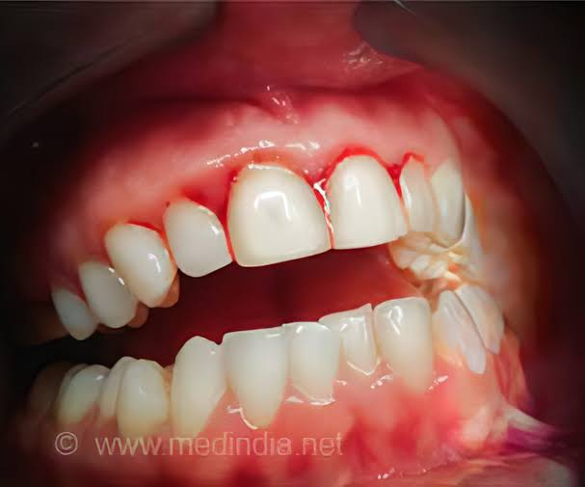
Oral manifestations
Oral manifestations occur frequently in leukemic patients and may present as initial evidence of the disease or its relapse.
The symptoms include gingival enlargement and bleeding, oral ulceration, petechia, mucosal pallor, noma, trismus and oral infections.

Slide 43
INFECTIOUS MONONUCLEOSIS
By- Aditi

Slide 44
Introduction:-
Infectious Mononucleosis also known as Glandular fever and Kissing Disease.
It is a Hetrophile- Positive Infectious Mononucleosis(IM) which is viral Infection characterized by Fever, Sore throat and Atypical lymphocytosis.
Epstein – Barr Virus (EBV) is the cause of Infectious Mononucleosis.
The majority of cases more than 90% are caused by Epstein – Barr virus, which is in Herpesvirus family.

Slide 45
History:-
Infectious Mononucleosis was first described by Sprunt and Evans in 1920 In the Johns Hopkins Medical Bulletin. Since the 1800s, Infectious Mononucleosis has been recognized as a clinical syndrome comprising Fever, Pharyngitis and Adenopathy.
The term Glandular fever was used by German Physicians in 1889.
The Virus was named Mononucleosis because Its associated with an increase in certain WBCs called Lymphocytes in blood.
EB virus is transmitted via intimate contact with body secretions, primarily Oropharyngeal secretions Or Intimate exchange of saliva. For this reason this condition is called as ‘Kissing Disease’.

Slide 46
Etiology:-
The Epstein-Barr virus (EBV), also called human herpes virus 4 (HHV- 4),is one of eight viruses in the human herpes Virus Family, and is one of the common Viruses in human.
The virus is approximately 122nm to 180nm in diameter and is composed of double helix (Spiral) of DNA and containing about 85 genes.

Slide 47
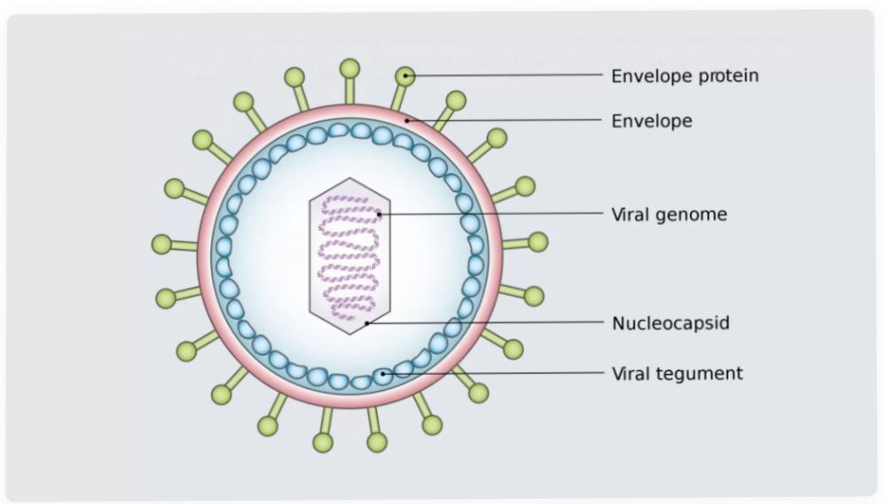
EBV VIRUS

Slide 48
Transmission:-
EBV Virus is spread by contact with oral secretions (is spread via Saliva).
EBV Virus has been transmitted by blood transfusions and by bone marrow Transplantation.
More than 90% of Asymptomatic Seropositive individuals shed the virus in oropharyngeal secretions.
Shedding is increasedin Immunocompromised patients and those with IM.

Slide 49
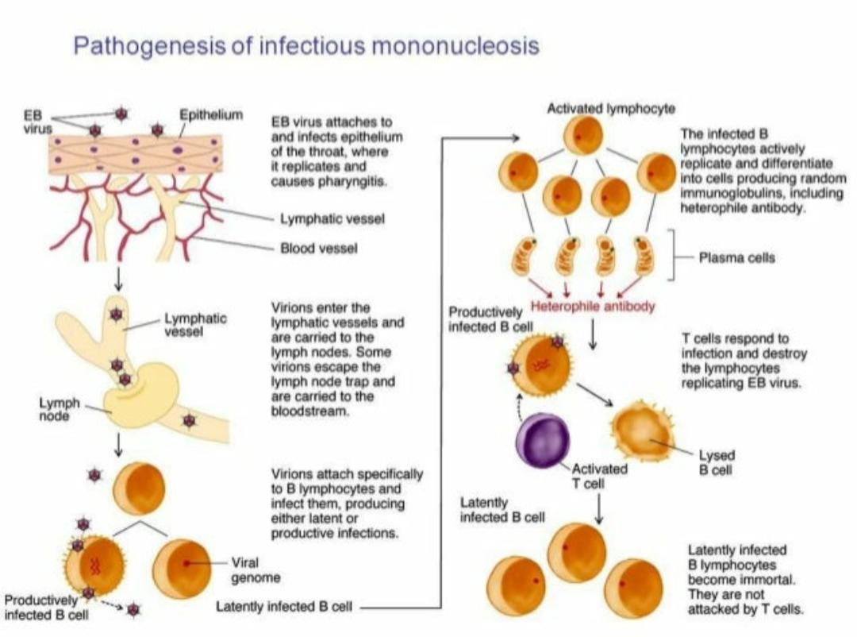
Pathogenesis of IM :-

Slide 50
EBV Virus can infect both B cells and Epithelial cells.
The virus infects the Epithelium of the Oropharynx and the salivary glands and is shed from these cells.
The Virus replicates first within Epithelial Cells in the pharynx which causes Pharyngitis, or sore throat and later primarily within B cells.
The Host immune response involves Cytotoxic (CD-8 Positive) T cells against infected B Lymphocytes, resulting in enlarged, Atypical Lymphocytes.
The virus then spreads through bloodstream. The Proliferation and expansion of EBV -infected B cells along with reactive T cells during IM results in Enlargement Of Lymphoid tissues.

Slide 51
Polyclonal activation of B cells leads to the production of antibodies to host cells and viral proteins.
EBV Infection of Epithelial cells results in Viral replication and production of Virions.
Cellular Immunity is more Important than Humoral Immunity in controlling EBV Infection.
In the Initial phase of Infection, suppressor T cells, natural killer cells, and nonspecific Cytotoxic T cells are important in controlling the proliferation of EBV- infected B cells.
If T Cell Immunity is Compromised, EBV infected B cells may begin to proliferate and it is a step towards Neoplastic transformation.

Slide 52
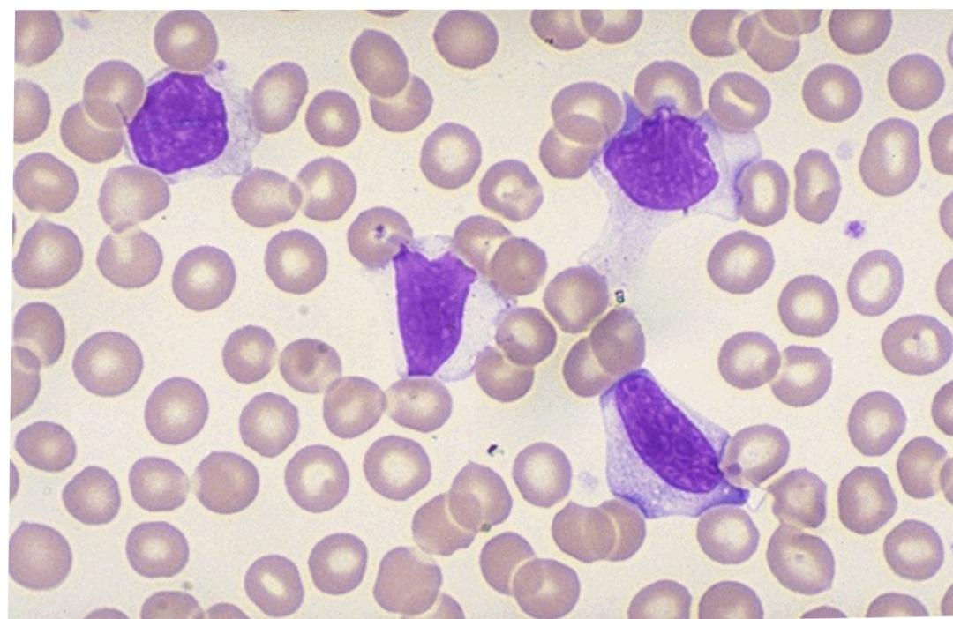

Slide 53
Clinical Manifestations
Infectious Mononucleosis is characterized is characterized by Fever, Sore Throat, Headache, Chills, cough, Nausea or Vomiting and Lymphadenopathy. Splenomegaly and Hepatitis also occur.
Lymphadenopathy and Pharyngitis are most prominent during first 2 weeks of the Illness.
While sphenomegaly is more prominent during the second and third weeks.
Spleen enlargement is common in the second and third weeks, although this may not be apparent on Physical Examination.

Slide 54
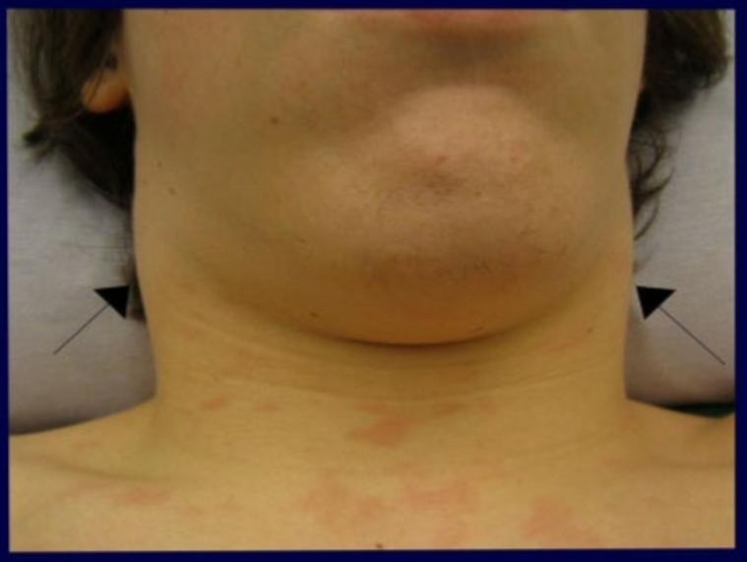
Lymphadenopathy most often affects the posterior Cervical Nodes .

Slide 55
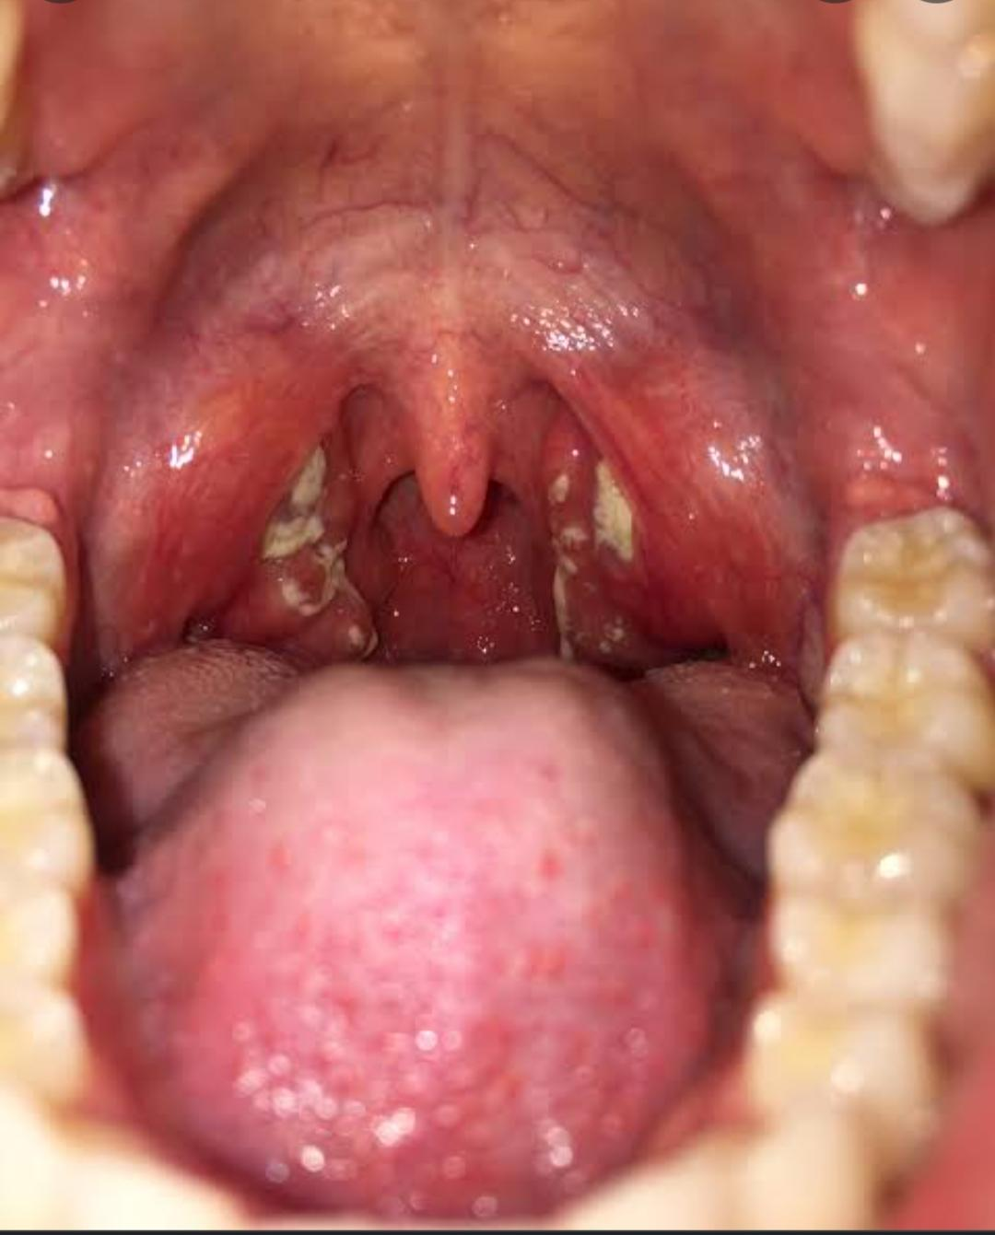
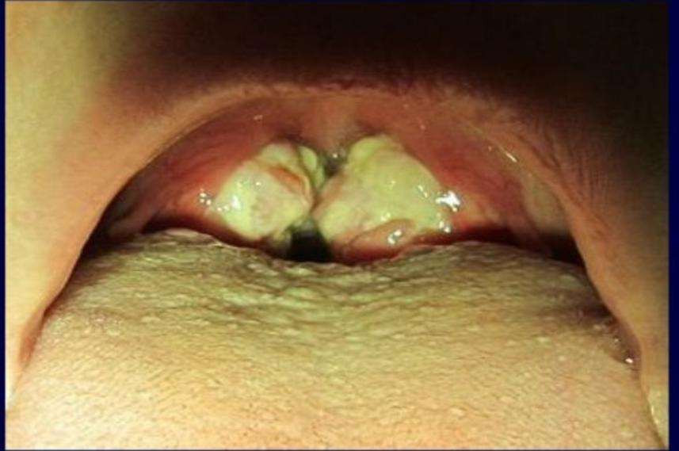
Pharyngitis often the most prominent sign can be accompanied by Enlargement of Tonsil.

Slide 56
The Incubation period For IM in young adults is 4-6 weeks.
Most of the EBV Infections in Infants and Young Children either are Asymptomatic or present as mild Pharyngitis with or without Tonsillitis.
Adolescent and Adults Develop typical Infectious Mononucleosis Syndrome ( up to 75% of Infections).

Slide 57
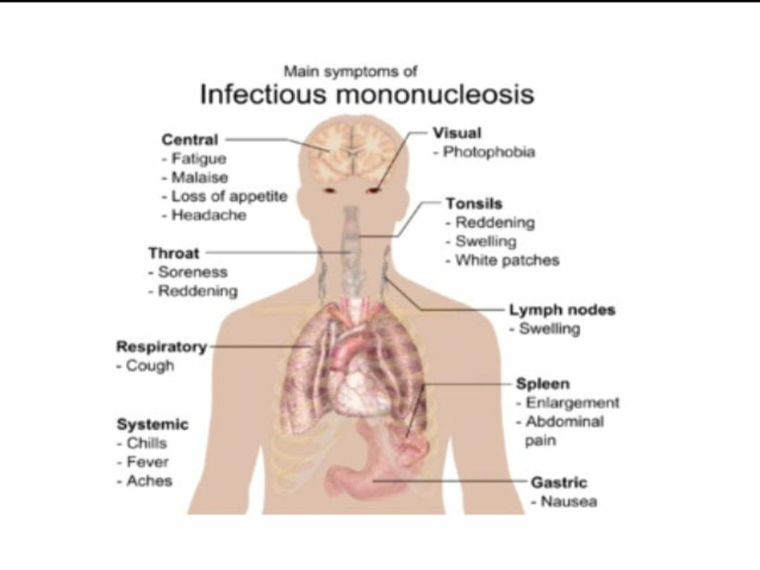

Slide 58
Oral Manifestations:-
There are apparently no specific oral Manifestations of IM, although Secondy Lesions do occur.
The oral Manifestations occur in one third of the patients and chbriefly comprise of Acute Gingivitis and Stomatitis, the appearance of white or grey membrane in various areas.
Necrotizing Ulcerative Gingivitis is common. Stomatitis may be the first sign of the disease in patients.
Oedema of the soft palate and uvula has also been reported.
Haemorrhage of soft palate near junction of Hard and soft palate are present in 25% patients.
About one-third patients with haemorrhagical tendency exhibit Oronasopharyngeal bleeding, including bleeding from the Gingiva.

Slide 59
Laboratory Findings:-
The patient exhibits Atypical Lymphocytes in the circulating blood, as well as Antibodies to EB Virus, and increased Hetrophile Antibody titer.
In IM however titer may rise upto 1:4096. This is referred to as Paul- Bunnell Test and is both Characteristics and Pathognomonic of the disease.
Agglutination of horse RBCs on exposure to EB Virus Hetrophile antibodies (Monospot test) is highly specific test. In Acute infection, the viral Core Antigen Antibody of IgM class titer against EBV is increased.
The Increase in IgM Viral coat- Antigen(VCA) Antibodies may be accompanied by an increase in IgG VCA antibodies and an increase in IgG EBV nuclear Antigen (EBNA antibodies).

Slide 60
EBNA appears after 1-2 months and persist throughout life.Thus, the presence of this antibody suggest previous exposure to the antigen.
The Erythrocyte Sedimentation rate is elevated in most patients with EBV Infectious Mononucleosis. Increase in white blood cell count is common.
In fact, IM is defined partly on the basis that the patient has more than 50% lymphocytosis of which 10% or more are the Atypical form.
Thrombocytopenia is also present in some patients.

Slide 61
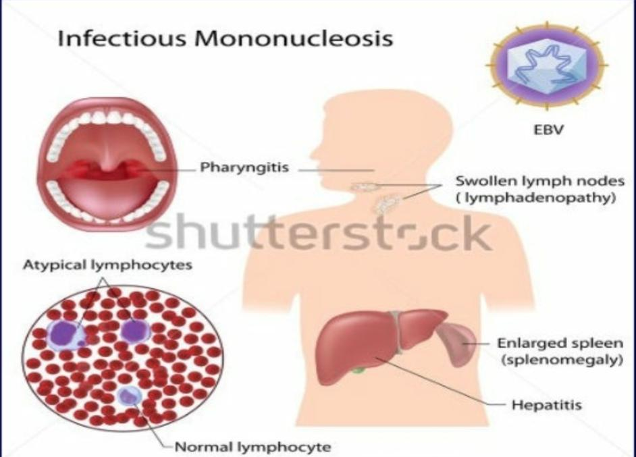

Slide 62
Treatment:-
There is no specific Treatment for this disease.
Bed rest, adequate diet and drinking plenty of Fluilds are probably as great benefit as any other form of therapy.
The illness resolves without treatment, but Symptoms may last from several weeks to months.
Short term Steroid therapy has been used occasionally, but result are Inconsistent.

Slide 63
THANK YOU!

