Slide 1
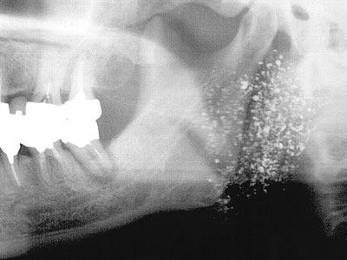
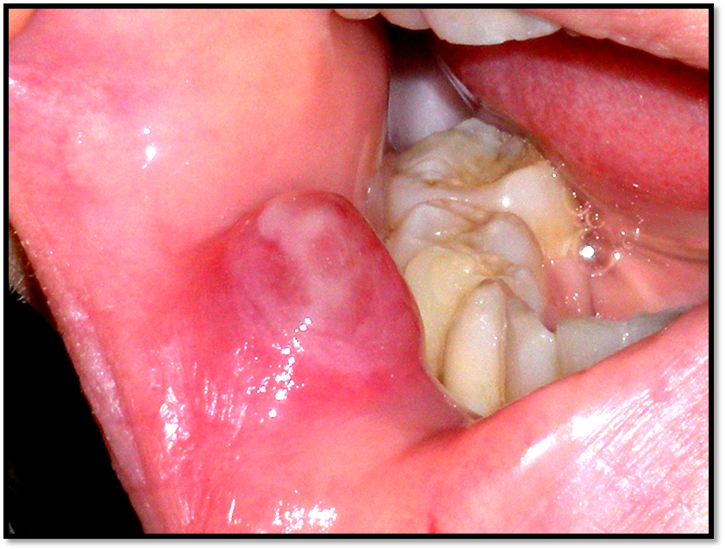
SALIVARY GLAND DISEASES

Slide 2
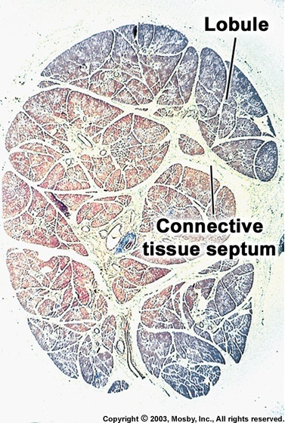
SALIVARY GLAND HISTOLOGY

Slide 3
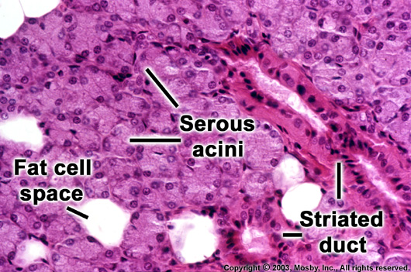
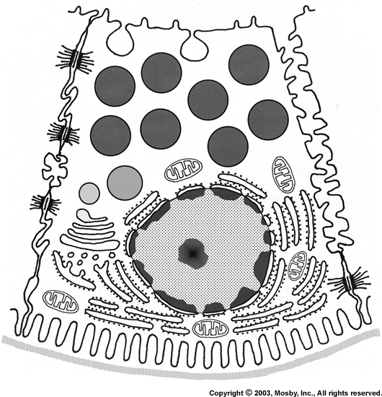
SEROUS CELL

Slide 4
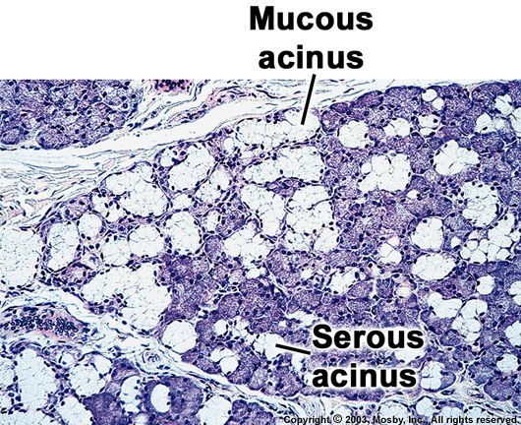
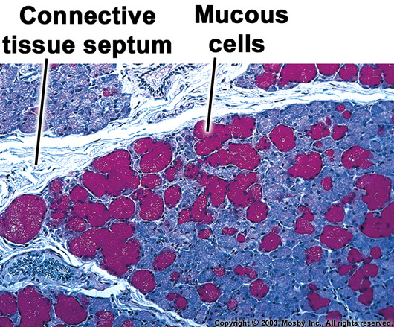
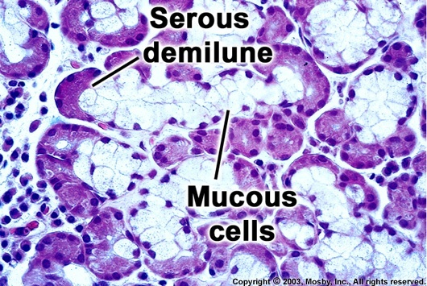
MUCOUS CELL

Slide 5
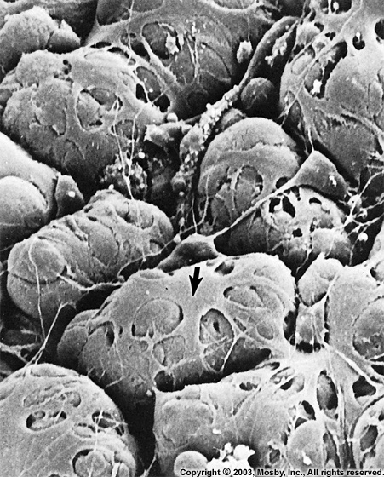
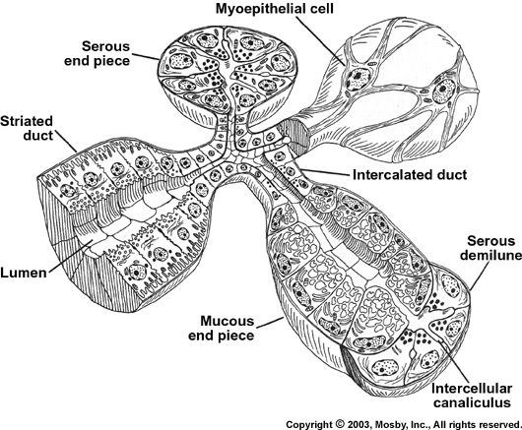
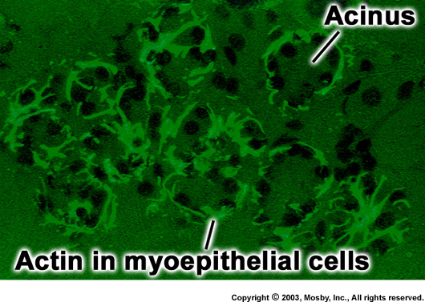
MYOEPITHELIAL CELL

Slide 6
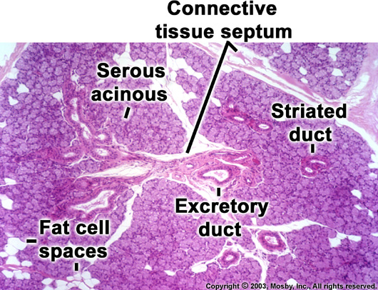
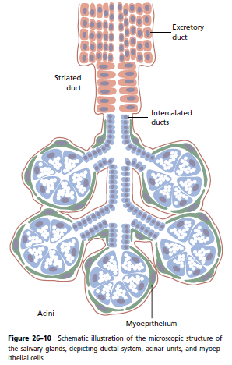
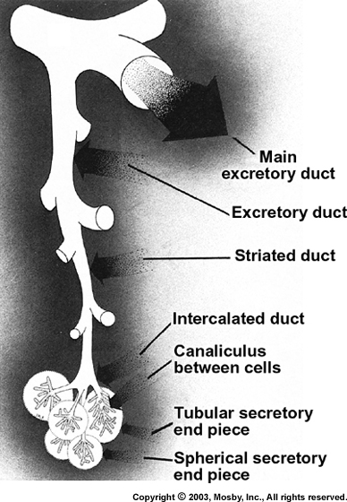
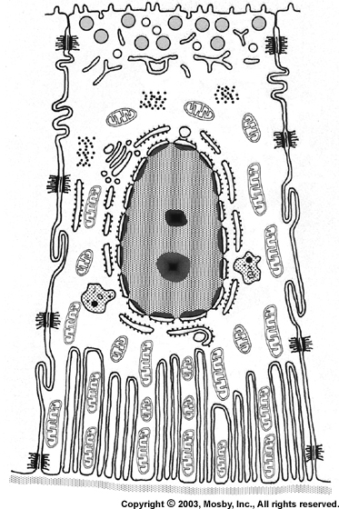
Salivary gland Ducts:

Slide 7
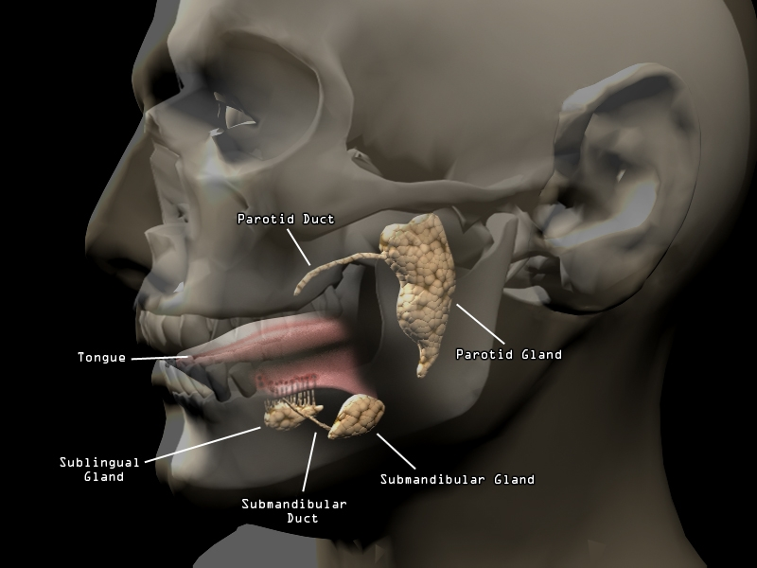
SALIVARY GLANDS

Slide 8
CLASSIFICATION OF SALIVARY GLAND DISEASES
Developmental Anomalies:
Aplasia
Hyperplasia
Atresia
Aberrancy
Diverticuli
Cheilitis glandularis
Stafne’s bone defect
Anterior Lingual Depression
Reactive Lesions:
Mucus retention cyst & extravasation cyst
Sialolithiasis
Post radiation sialadenitis
Chronic necrotizing sialometaplasia
Infective Lesions:
Bacterial sialadenitis
Viral sialadenitis
Immune-mediated Diseases:
Mikulicz’s disease
Sjogren’s syndrome

Slide 9
Miscellaneous Diseases
Heerfordt’s syndrome
Sialosis
Ptyalism & Aptyalism
HIV associated S.G disease
Tumor Like lesions-adapted from WHO Classification 1991
1.Sialadenosis
2.Necrotising Sialometaplasia
3.Oncocytosis
4.Benign Lymphoepithelial Lesion
5.Salivary gland cysts
6.Chronic sclerosing sialadenitis of submandibular salivary glands
7.Chronic Lymphoid Hyperplasia

Slide 10
XEROSTOMIA/ DRY MOUTH:
Subjective sensation of dry mouth.
Not a disease but a symptom of certain diseases.
ETIOLOGY
Temporary Permanent
Psychological 1. Aplasia
Duct calculi 2. Sjogren’s syndrome
Sialoadenitis 3. Systemic diseases
Drugs 4. Radiotherapy
(ZYBAN) 5. Surgical desalivation
Notes:
Psycho- anxiety depression exam tension
syst,. Disea- Dm, vit a def. anemia

Slide 11
Sr. No. | Category | Drugs
1 | Anxiolytics | Alprazolam, Diazepam, Triazolam
2 | Psychostimulant | Methamphetamine
3 | Anti-acne preparations | Isotretinoin
4 | Anticholinergic antispasmodic ( for GI) | Atropine sulphate,Dicyclomine, Glycopyrrolate, Hyoscamine sulphate, Propamtheline bromide
5 | Anticholinergic antispasmodic ( Urinary) | Oxybutynin chloride
6. | Antidepressant | Tricyclics
7 | Antidiarrhoeal | Diphenoxylate HCl
8 | Antihistaminic | Diphenhydramine HCl, Brompheramine maleate
9 | Antihypertensive | Clonidine HCl, Prazocin HCl
10 | Diuretic | Chlorthalidone, Bendroflumethazide, Hydrochlorothiazide
11 | Antiparkinsonian | Biperiden HCl, Benztropin mesylate
12 | Antipsychotic | Lithium carbonate, Thioridazine,Trifluoperazine

Slide 12
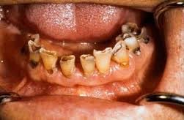
CLINICAL FEATURES
Thick and ropey saliva.
MUCOSA: Dry, atrophic, inflamed, pale and translucent, ed candidiasis.
TONGUE: Atrophy of papilla, fissured, burning, pain.
TEETH: Dental caries and difficulty in wearing dentures.
TREATMENT: Determine the etiology
Salivary substitutes
Sugar free chewing gums
Notes:
Pilocarpine, civemeline is given it is a Ach agonist therefore used as sialagogues.
Biotene tooth paste
Fluoride gel

Slide 13
APLASIA / AGENESIS
Congenital absence of the salivary glands both major and minor salivary gland due to complete failure of their development or genesis is called Salivary gland aplasia
Seen in:
Hemifacial microsomia
LADD syndrome
Treacher Collins syndrome
COMPLICATIONS: Increased caries, burning sensation, oral infection, taste aberration & difficulty in denture retention.
Notes:
Diagnosis after exclusion of sjogrens & radiation

Slide 14
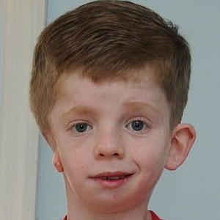
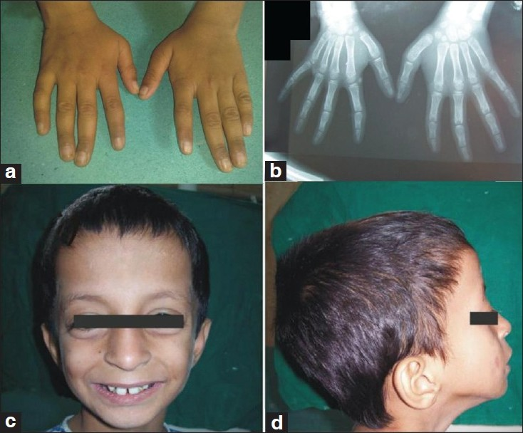

A
C
B

Slide 15
ATRESIA:
Congenital occlusion/ absence of 1 or more of S.G duct resulting in xerostomia
ABERRANCY:
Condition in which S.G are found farther than normal from their usual location (mainly minor S.G)
CLINICAL SIGNIFICANCE: Site of development of neoplasm.
Eg. Stafne’s bone cyst, Anterior Lingual Depression
Notes:
Gingival salivary gland choristoma

Slide 16
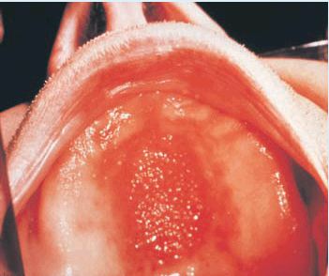
HYPERPLASIA
ETIOLOGY:
Drugs.
Aging
Sjogren’s syndrome
DM
Alcoholism
Starvation
CLINICAL FEATURES: Small swelling on hard palate or junction of hard & soft palate.

Slide 17
ACCESSORY DUCT & DIVERTICULI:
Small pouches or out pocketing of the ductal system of one of the major S.G.
STRICUTRES & STENOSIS:
ETIOLOGY:
Irritation from prosthetic appliance.
Intraductal tumor formation.
Acute trauma.

Slide 18
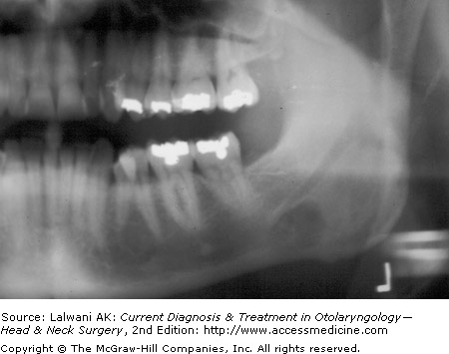
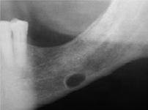
STATIC BONE CYST/ STAFNE BONE CYST
Developmental inclusion of glandular tissue is found within, or more commonly, adjacent to lingual surface of the body of the mandible within a deep and a well circumscribed depression.

Slide 19
MUCOCELE:
ETIOLOGY:
Traumatic severance of the salivary duct.
Biting of lip/ cheek
Pinching of lip by extraction forceps
Mucin spillage in surrounding tissues
CLINICAL FEATURES:
Seen in children & young adults.
Predominantly on lower lip (lateral to midline). Rarely on buccal mucosa & floor of the mouth.

Slide 20
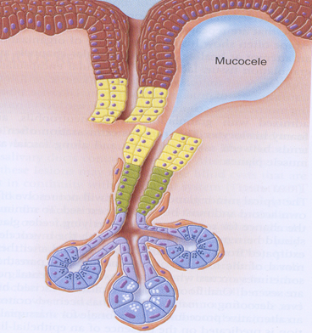
Notes:
Psedo cyst beco no epi lining
Appear as a raised dome shaped vesicle and pt may give a history of rupture and refilling.

Slide 21
TYPES:
SUPERFICIAL B. DEEP
Occurs on soft palate, RM region i. On the lower lip
Blue in color ii. Normal color
HISTOLOGICAL FEATURES:
Wall of the cavity is made up of compressed fibrous C.T & fibroblasts.
Cyst cavity is filled with mucin & contain leucocytes & foamy histiocytes.
S.G acini lying adjacent may show sialadenitis, breakdown of individual acinar mucous cells, dilatation of intra & inter lobular ducts.
Notes:
Treatment excision

Slide 22
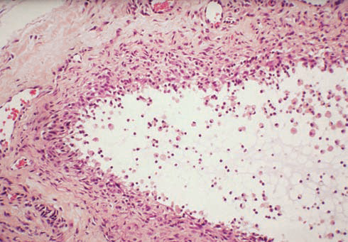
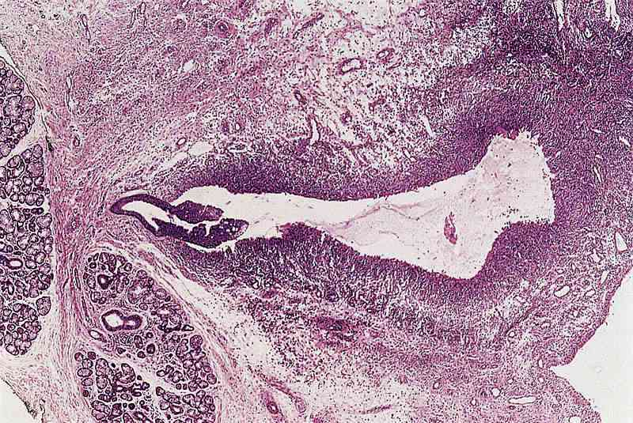
MUCOUS EXTRAVASATION CYST:

Slide 23
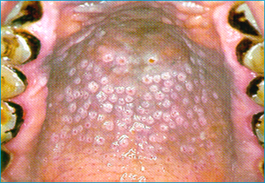
SALIVARY DUCT CYST/ SIALOCYST/ MUCUS RETENTION CYST:
ETIOLOGY:
Obstruction of the duct intra ductal pressure
formation of epithelium lined cavity.
CLINICAL FEATURES:
Seen in adults.
Appears similar to mucocele.
Major/ minor S.G may be involved
Multiple retention type mucoceles in Stomatitis Nicotina
Notes:
True cyst… If seen in older people in buccal mucosa or lip then called as Oncocytic cyst.

Slide 24
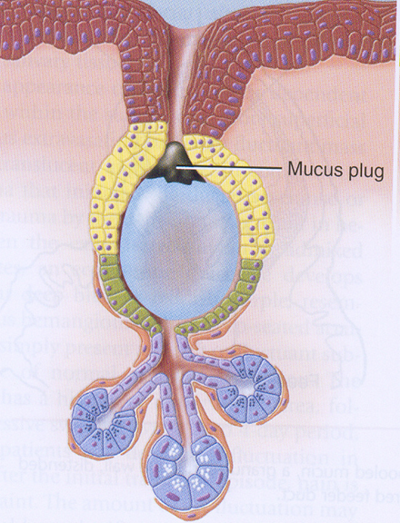
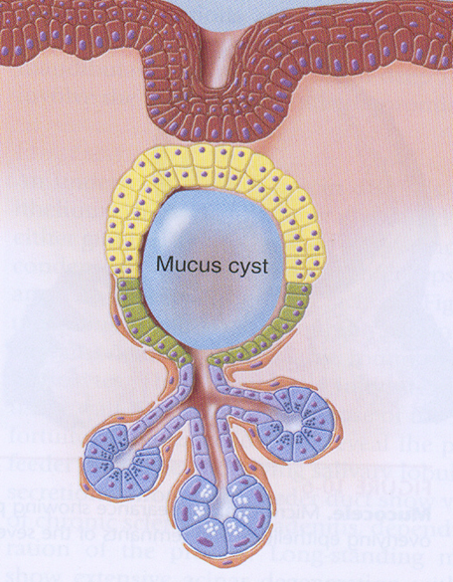

Slide 25
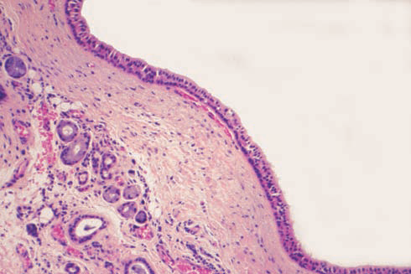
HISTOLOGICAL FEATURES:
Epithelial lining of cuboidal/ columnar, surrounding thin or mucoid secretions

Slide 26
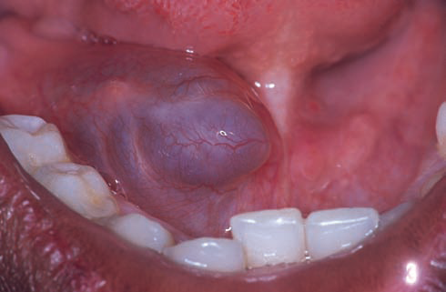
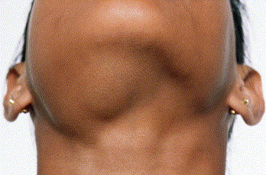
RANULA

Slide 27
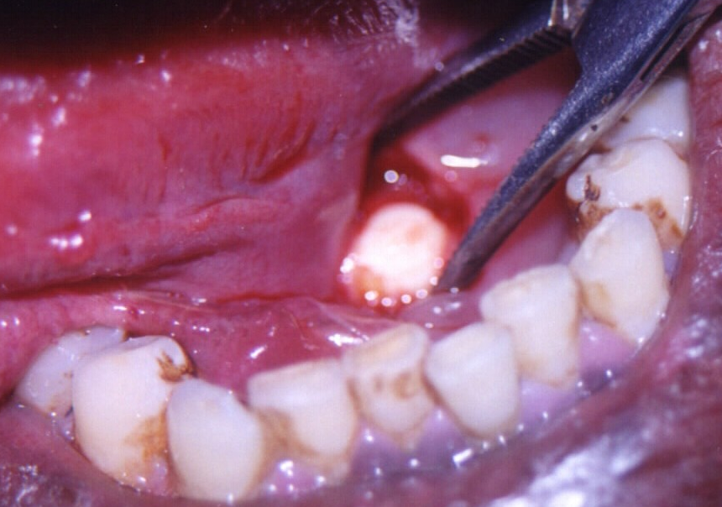
SIALOLITHIASIS:
Calcareous concretions in S.G/ duct.
Deposition of Ca⁺⁺ around nidus which may be desquamated epithelial cell, bacteria or their products, foreign body.
Not caused by derangements in
Ca⁺⁺ & Phosphorous metabolism.
Notes:
CLINICAL FEATURES:
Seen in middle age.
60-80% in submandibular S.G
May be seen as a firm mass in the duct.
Moderate to severe pain during/ after meals due to salivary flow.

Slide 28
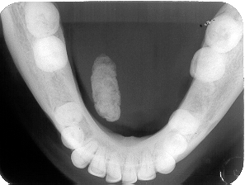
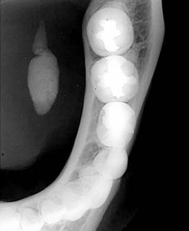
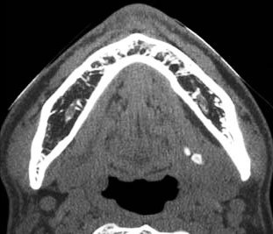

Slide 29
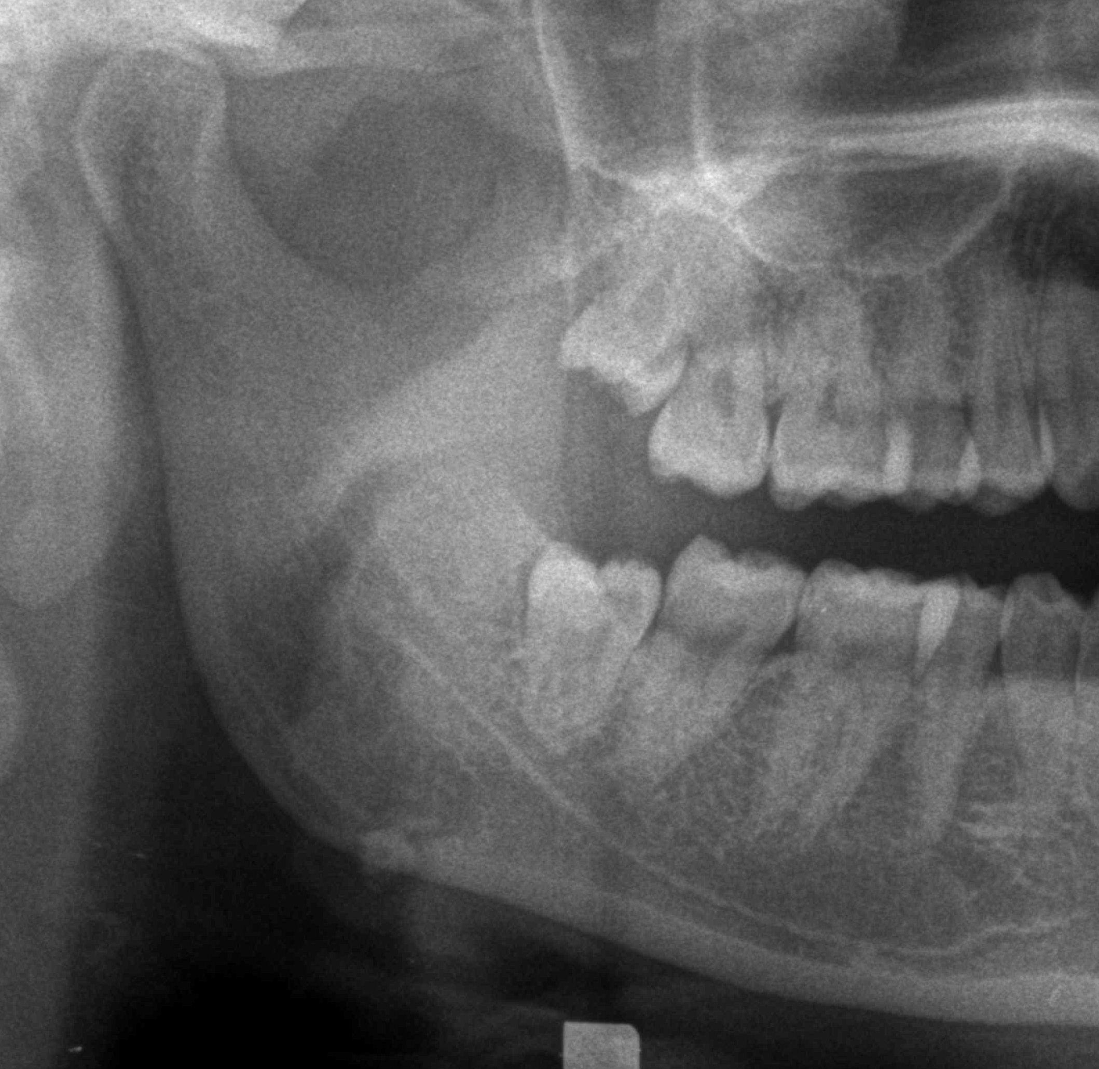
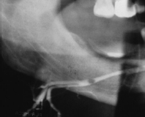
Small sialolith at the proximal end of duct
Uncalcified sialolith

Slide 30
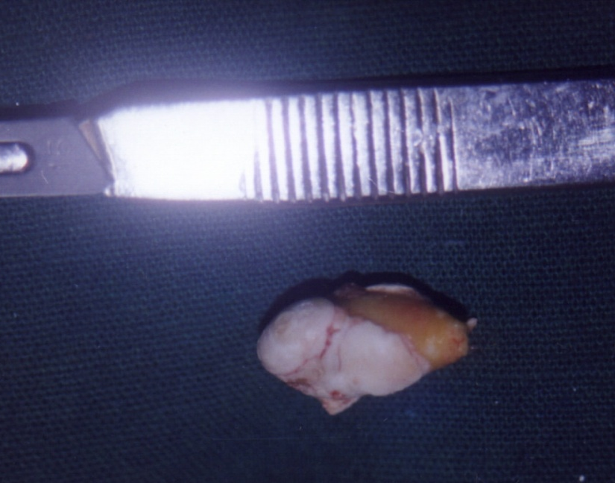
HISTOLOGICAL FEATURES:
Concentric laminations around a central nidus of amorphous debris.
Periductal inflammation is seen and gland shows sialadenitis.
Notes:
TREATMENT: Removed

Slide 31
POST-RADIATION SIALADENITIS:
Complication of radiotherapy.
Severity of damage to the S.G is directly proportional to the dose of radiation.
S.G coming in the field of radiation show destruction of acinar cells with subsequent fibrosis of the gland and xerostomia.
Histologically loss of secretory granules with edema and neutrophilic infiltration is seen.

Slide 32
SJOGREN’S SYNDROME:
Described by Henrik Sjogren in 1933.
It is a triad of:
Keratoconjunctivitis sicca
Xerostomia
Rheumatoid arthritis.
PRIMARY SJOGREN SYNDROME- Dry mouth+ dry eyes.
SECONDARY SJOGREN SYNDROME- Primary SS+ RA+SLE+PAN+Scleroderma

Slide 33
ETIOLOGY:
Genetic
Hormonal
Infections
Immunological
Autoimmune.
In combination of the above
Altered immunologic response- the main factor.
75% cases- Anti-salivary duct antibody.
HLA system- HLA-DR3 & HLA-DRw52

Slide 34
CLINICAL FEATURES:
Mostly occurs in females. Ratio--10:1 (middle aged.)
Swelling is usually bilateral may be painful or slightly tender, intermittent or persistent in nature.
Xerostomia
Difficulty in swallowing, altered taste, or difficulty in wearing dentures.
Oral mucosa may be red and tender due to secondary infections. Denture sore mouth

Slide 35
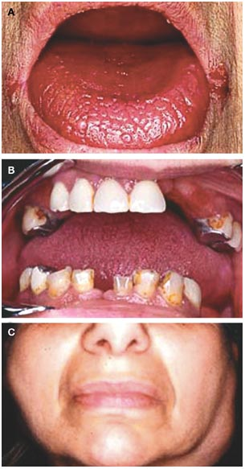
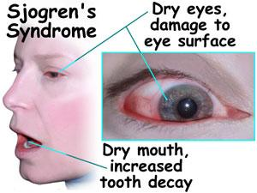
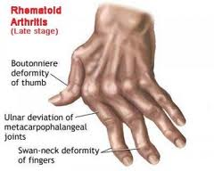
v

Slide 36

BRANCHLESS FRUIT LAIDEN TREE

Slide 37
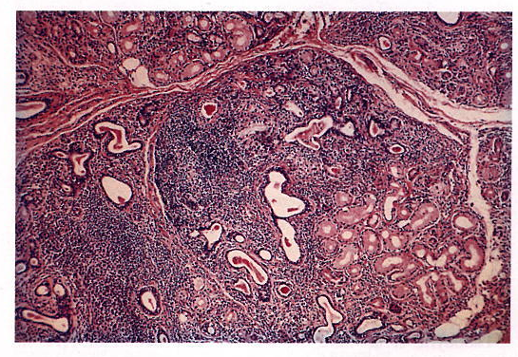
HISTOLOGICAL FEATURES
3 types of changes can be seen in major glands
Intense lymphocytic infiltration of the gland replacing all acinar structures– lobular architecture preserved
There may be proliferation of ductal epithelium and myoepithelium to form- “epimyoepithelial islands”.
Atrophy of the glands sequential to the lymphocytic infiltration.

Slide 38
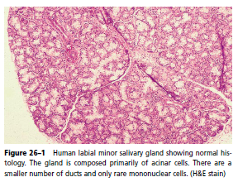
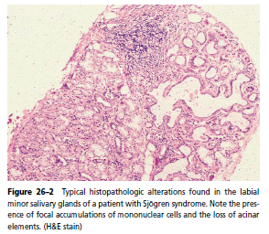

Slide 39
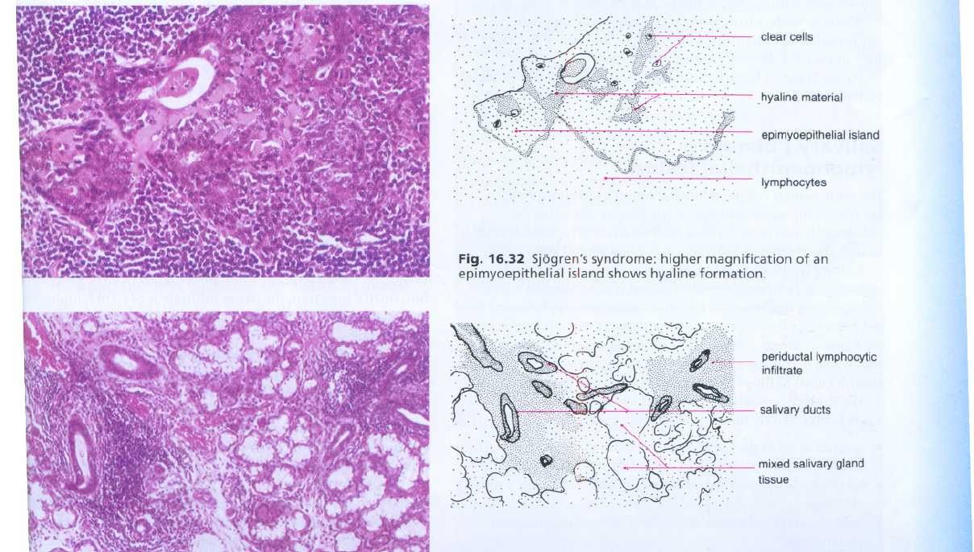

Slide 40
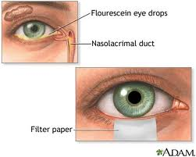
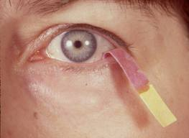
LABORATORY FINDINGS:
ESR and IgG increased.
Positive R.A. Factor in 75% cases.
Anti- nuclear antibodies present- ANAs
Anti-SS-A(anti-Ro) & Anti–SS–B
( Anti- La) found in primary SS.
Increase in lactoferrin & β2 macroglobulin.
Total protein is increased.
Shirmer test

Slide 41
Sjogren’s syndrome diagnostic criteria based on Combined European- American consensus
1. Ocular symptoms | Troublesome dry eyes persisting for more than 3 months Recurrent sensation of sand or gravel in eyes. Tear substitutes use>3times a day
2. Oral symptoms | Dry mouth every day> 3 months Recurrent swollen S.G as an adult Need fluids to aid in swallowing foods
3. Objective evidence of dry eyes (at least 1 present) | Schirmer test (<5mm in 5min) Rose Bengal score( >4)
4. Objective evidence of S.G involvement (atleast 1 present) | S.G scintigraphy (delayed uptake) Parotid sialography Unstimulated salivary flow<1.5ml in 15 min.)
5. Histopathological Features | Lacrimal gland biopsy sample with score >1 Minor S.G, score >1
6. Lab abnormality | Anti 60-kDa Ro (SS-A)
4/6 must be present for classification as SS, but 1 of the 4 must be either 5 or 6

Slide 42
NECROTIZING SIALOMETAPLASIA:
Uncommon locally destructive inflammatory condition characterized by necrosis of minor S.G of the palate along with surface epithelium and underlying C.T
CLINICAL FEATURES:
Seen in adults, males> females.
75% cases on posterior palate
One or two deep seated punched out ulcerations.
Presence of grey granular lobules at the base of ulcer representing necrosed minor S.G

Slide 43
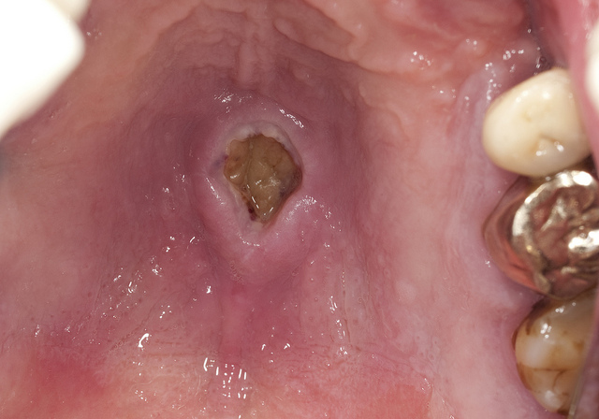
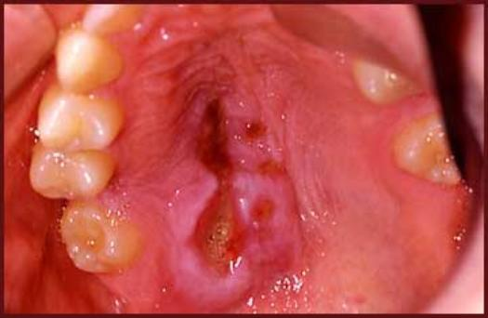
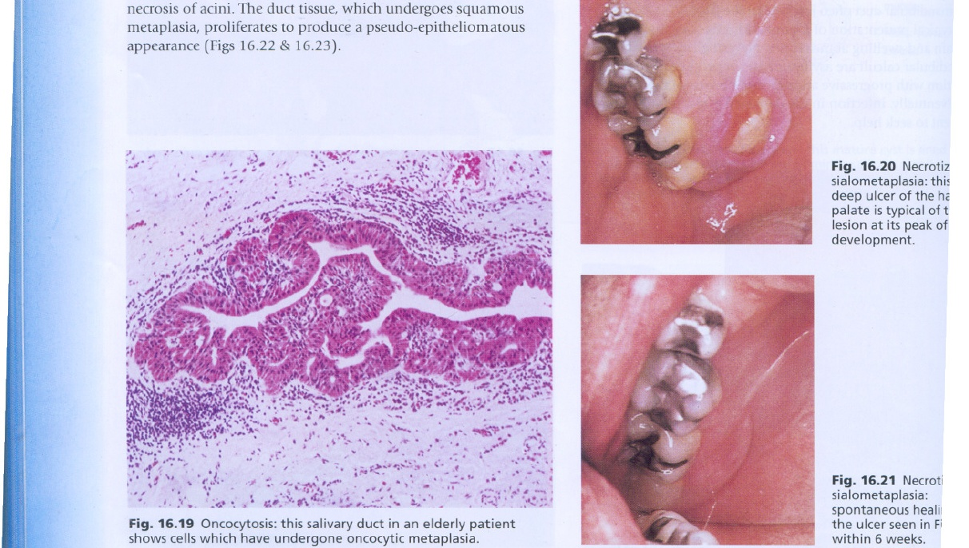
Patient may report that:
“PART OF MY PALATE
FELL OUT”
Notes:
Craterifoem ulcer in d palate that simulates a malignant process. Perforation of palatal bone.

Slide 44
HISTOLOGICAL FEATURES:
Base of ulcer shows absence of epithelium which is replaced by necrotic debris.
The minor S.G show features of coagulation necrosis.
Acinar necrosis followed by squamous metaplasia of salivary ducts.
Lobular architecture is preserved.
Liberation of mucin associated with inflammatory response.
TREATMENT: Self healing in 1-3 months time
Notes:
Preserved lobular architecture is diagnostic clue.
Sq. metaplasia ---- d/d- scc and mec but, sq. proliferation has bland cytologic appearance

Slide 45

Notes:
Necrosis f the acini occurs but still the morphology of the gland is maintained.

Slide 46


Squamous metaplasia

Slide 47


Slide 48
ONCOCYTOSIS
Onco derived from “onkoustai” which means to swell
Jaffe first coined the term oncocytoma.
Focal replacement of normal glandular tissue with enlarged eosinophilic epithelial cells with granular cytoplasm.
Seen in older people & considered a sequelae of aging.
Parotid gland most commonly involved.
Notes:
Onco derived from onkoustai which means to swell
Jaffe first coined the term oncocytoma
Many investigators acknowledge focal and diffuse oncocytosis as non-neoplastic but would caution that some oncocytic foci may have the potential for neoplastic growth

Slide 49

An oncocyte is a large round to polyhedral well defined cell characterized by bright eosinophilic cytoplasm prominent granularity (due to excessive mitochondria) and a central small dense nucleus

Slide 50

Oncocytes may show transition to clear cells as a result of intra cytoplasmic glycogen.
Oncocytes stain positive with PTAH
The lobular architecture of glands remain intact

Slide 51
Ultrastructure
Oncocytes show cytoplasm packed with large, pleomorphic mitochondria.
ELLIS: The cause is not known, and the attempt to increase the number and surface area of mitochondria is a compensatory mechanism to correct a cellular functional defect
BATSAKI: Oncocytes are biochemically deficient since they have reduced levels of oxidative enzymes.
This deficiency is thought to trigger a compensatory mechanism at the organelle level in the form of mitochondrial hyperplasia.

Slide 52
VIRAL SIALADENITIS:
MUMPS/ EPIDEMIC PAROTITIS:
Acute, contagious, viral infection characterized chiefly by unilateral or bilateral swelling of S.G, usually parotid.
Affects children or young adults.
Incubation period is 2-3 weeks.
Transmitted through saliva or nasal droplets.
Headache, fever, chills, pain on mastication, firm-rubbery swelling of S.G causing elevation of the ear.

Slide 53

PATHOGENESIS:
Once transmitted replicates in respiratory epithelium
spread to local L.N & develop viremia
Perivascular & interstitial
mononuclear cell infiltrate
S.G- Edema and necrosis of
acinar & epithelial duct cells.

Slide 54


Slide 55
COMPLICATIONS:
Pancreatitis, meningitis, oophoritis, orchitis etc.
DIAGNOSIS:
Detection of virus specific antibodies in the serum.
Detection of virus in urine 7days before onset or 9 days after onset of parotitis.
TREATMENT:
Vaccine.
Notes:
First licensed in 1968 however nt protective to ind. Already exposed to virus and those in incubation state.

Slide 56
NUTRITIONAL “MUMPS”:
Chronic, asymptomatic, bilateral enlargement of parotid gland in population suffering from malnutrition like hypoproteinemia, anemia, under weight etc.
CHEMICAL “MUMPS”:
Due to administration of certain chemicals like I₂, tri-iodothyronine, isoproterenol.
Iodine mumps
Notes:
Iodine mumps.

Slide 57
CYTOMEGALIC INCLUSION DISEASE/ S.G VIRUS DISEASE:
Seen in infants less than 2years.
No C/F. may be an accidental finding in patients died of blood dyscrasias, purpura, pertussis.
Transplacental infection may occur.
Intranuclear/ cytoplasmic inclusions in cells of S.G are pathognomonic of disease.
Notes:
H/P : characteristic feature - large, doubly contoured “owl-eye” inclusion bodies with in the nucleus or cytoplasm of duct cells of the parotid gland. A cic infiltration of macrophages and lymphocytes seen.

Slide 58


Slide 59
BACTERIAL SIALADENITIS:
ACUTE POSTOPERATIVE PAROTITIS:
It is a retrograde infection seen in debilitated patients suffering from dehydration, suppression of salivary secretion, after surgical procedure.
Thus decreased salivary flow will allow ascension of microorganisms through duct into gland.
CLINICAL FEATURES: Severe pain, rapid swelling of parotid gland, edema of cheek & peri-orbital area, trismus, headache & purulent discharge expressed from parotid duct.
TREATMENT: Antibiotics

Slide 60


Slide 61


Slide 62
CHRONIC NON-SPECIFIC SIALADENITIS:
Insidious, inflammatory disease of major S.G characterized by intermittent swelling of glands which may lead to development of clinically obvious fibrous masses.
Etiology: S.G calculi and subsequent pyogenic bacterial infection, radiation therapy, allergens.
Seen in children & sometimes subsides spontaneously by puberty.
Sialography:
Stenson’s duct shows characteristic “sausaging” which reflects combination of ductal dilation and ductal strictures from scar formation.

Slide 63



Slide 64

MIKULICZ SYNDROME/ BENIGN LYMPHOEPITHELIAL LESION:
It is abnormal enlargement of salivary gland & lacrimal gland.
1st reported by Johann Mikulicz in 1888.
Mikulicz Disease: Cause is unknown.
Mikulicz Syndrome: cause is known.
ETIOLOGY: Autoimmune.
Notes:
Syndrome--- TB, Sarcoidosis, Lymphoma

Slide 65

CLINICAL FEATURES:
Middle aged adults.
Females> males.
Xerostomia, decreased tears, painless swellings( tumefaction)
CLASSIC SIGNS: dry mouth, dry eyes, enlarged S.G & L.G
HISTOLOGICAL FEATURES:
Diffuse & orderly lymphocytic infiltrate.
Destruction or replacement of acini with the persistence of islands of epithelial cells which probably represent residua of gland ducts.
Epimyoepithelial islands are seen
Notes:
Treatment supportive and symptomatic.

Slide 66

PTYALISM/ SIALORRHEA:
Increased salivary secretion.
ETIOLOGY:
Stomatitis & ulceration.
Metal poisoning.
Psychological factors.
Major surgery in the oral cavity.
Abnormal neuro-secretory stimulation.
New prosthesis.
Idiopathic.
TREATMENT:
Anticholinergic medications can be given.

Slide 67
APTYALISM/ HYPOSALIVATION:
Decrease or complete cessation of salivary secretion.
CAUSES:
Aplasia & atresia of S.G.
Radiotherapy.
Sjogren’s syndrome.
Sialolithiasis.
Pernicious and iron deficiency anemia.
Fluid loss due to vomiting, diarrhea.
Polyurea.
Hereditary ectodermal dysplasia.
Notes:
CLINICAL FEATURES:
Soreness, burning sensation.
Difficulty in swallowing.
Atrophy of tongue papilla.
Increased dental caries.
Halitosis.
Candidiasis.

Slide 68


SIALOSIS/ SIALADENOSIS:
Non-neoplastic, non-inflammatory enlargement of S.G
Females> males, B/L, parotid gland is the commonly involved.
Found in association with DM, alcoholism, malnutrition.
CLINICAL FEATURES: unilateral/bilateral enlargement of S.G.
SIALOGRAPHIC FEATURE: leafless tree appearance
HISTOLOGIC FEATURES:
Hypertrophy of acinar cells
Nuclei pushed towards base & cytoplasm engorged with zymogen granules.
Notes:
Leafless tree appearance becoz of compression of the duct by hypertrophic acinar cells. Diameter of acinar cells increases 2-3 times that of normal. The nuclei tends to be basally situated, and the cytoplasm tends to be packed in granules. Inflammatory cells are absent but individual fat cells may be seen in the interstitial tissue. Acinar cell atropy due to autonomic neuropathy

Slide 69
HIV ASSOCIATED S.G DISEASE:
Chronic parotitis in children at risk from AIDS is said to be virtually pathognomonic of HIV infection.
In adults with HIV infection, painless swelling of salivary glands, often with cyst formation may be seen.
SS-A or SS-B antibodies are not detectable and rheumatoid or antinuclear factors are no more frequent.
In Sjogren's syndrome, the infiltrate is mainly of CD4 Iymphocytes, but, in HIV infection, the dense infiltrate is of CD8 Iymphocyte

Slide 70
DIAGNOSIS OF S.G DISEASES:
Radiography
Sialography
Xeroradiography
Scintigraphy
Sialometry & sialochemistry
Computed tomography
MRI
USG
Notes:
Schirmer test

Slide 71




NORMAL SIALOGRAPHIC APPEARANCES
Parotid gland- Leafless tree / Tree in winter appearance
Submandibular gland – Bush in winter appearance
(Rankow-Salivary Gland Pathologies, White&Pharoah- Oral Radiology)

Slide 72






Sialolithiasis: 1. Tree in autumn 2. Pseudodiverticuli
(Rankow-Salivary Gland Pathologies, White&Pharoah- Oral Radiology)

Slide 73




SIALODOCHITIS: Sausage-string / link
(Rankow-Salivary Gland Pathologies, White&Pharoah- Oral Radiology)

Slide 74




SIALADENITIS: Apple tree in blossom
Sialectasis
(Rankow-Salivary Gland Pathologies, White&Pharoah-Oral Radiology, Eric Whaites-Oral Radiology)

Slide 75





SJOGREN’S SYNDROME
Punctate / Globular / Cavitary / Destructive sialectasis
Snowstorm / Mulberry tree/ Branchless fruit laden tree/ Cherry blossom

Slide 76


(Rankow-Salivary Gland Pathologies, Eric Whaites-Oral Radiology)

Slide 77





SPACE OCCUPYING LESIONS benign tumors- Ball-in-hand appearance
(Rankow-Salivary Gland Pathologies)

Slide 78
REFERENCE:
Textbook of Oral Pathology, Shafer’s.
Textbook of Oral Pathology, Neville.
Textbook of Oral Pathology, Anil Ghom’s
Orban’s Oral Histology & Embryology
Cawson’s Atlas.
Textbook of Radiology, White & Pharoah.
Articles.
Internet.

Slide 79


