Slide 1

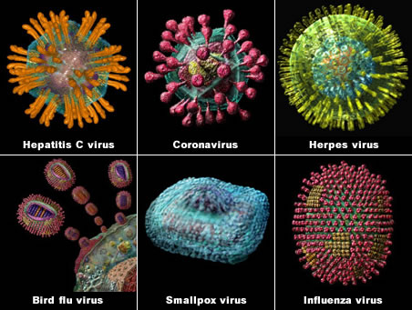
Viral Lesions of the Oral Cavity

Slide 2
Contents:
Introduction
Virus: Structure Classification Pathogenesis
DNA Viruses
RNA Viruses
Latest Updates

Slide 3
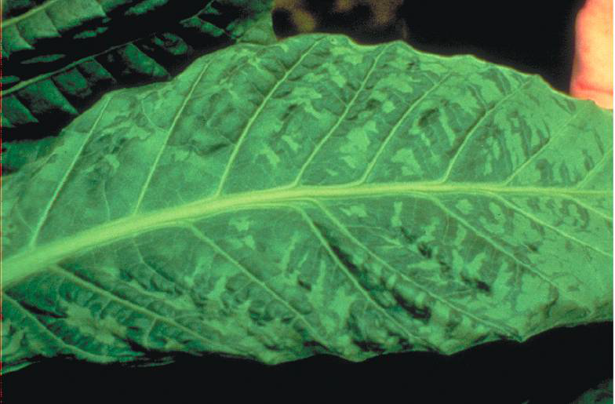
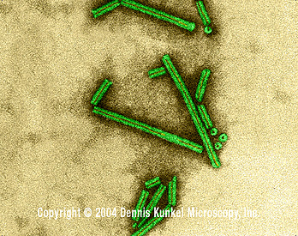
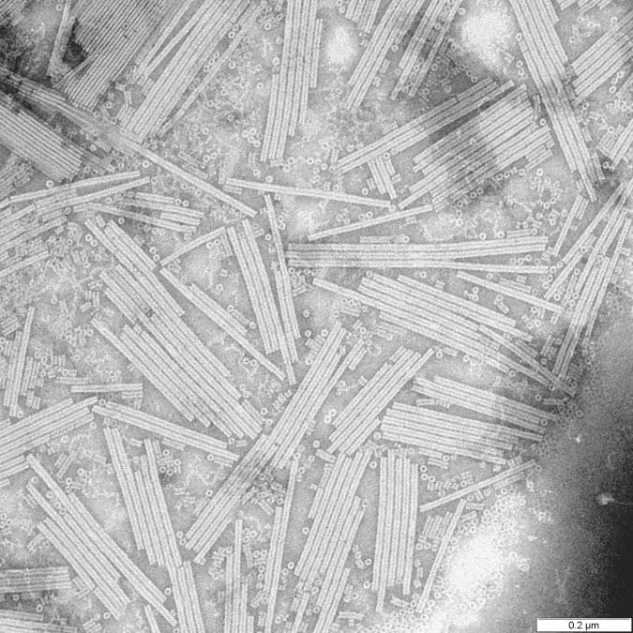
Introduction
Dimitri Iwanowski discovered of the tobacco mosaic disease (1892)

Slide 4
Virus:
The Latin word “Virus” means “Venom” or “Poison”.
Viruses are ultramicroscopic, metabolically inert & infectious organisms.
They live & multiply in the living cells.
Size: Largest is 300nm (poxvirus) Smallest 20 nm (parvovirus)

Slide 5
Structure of Viruses

Slide 6
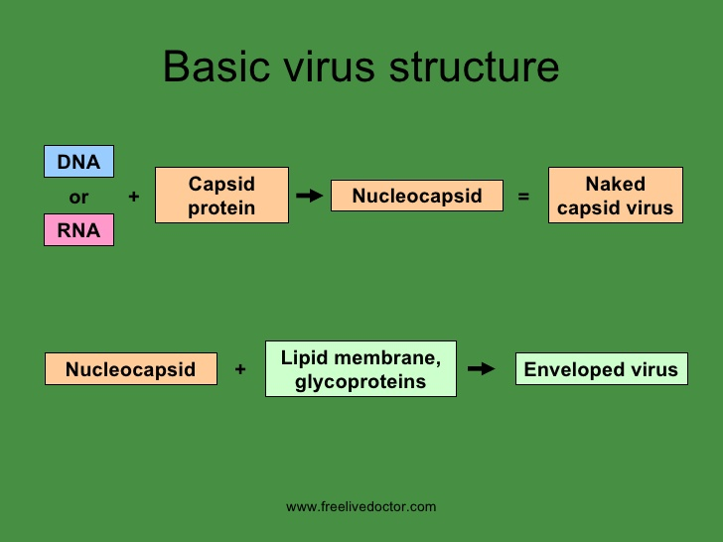
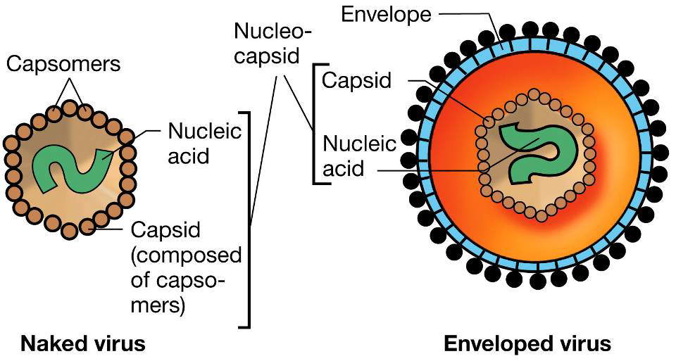
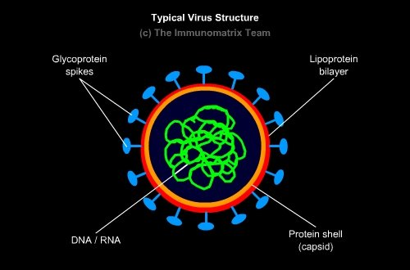
Structure & Shape:

Slide 7
Classification of Viruses

Slide 8
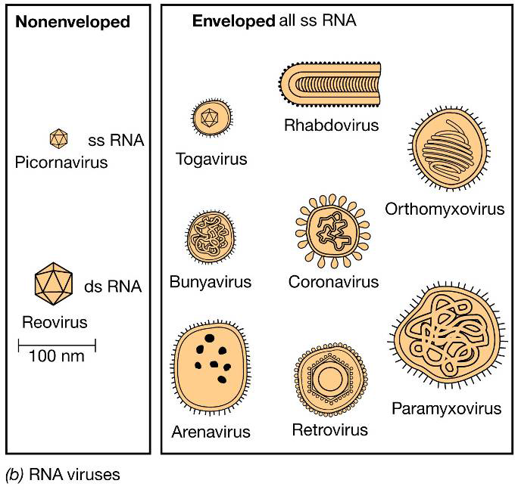
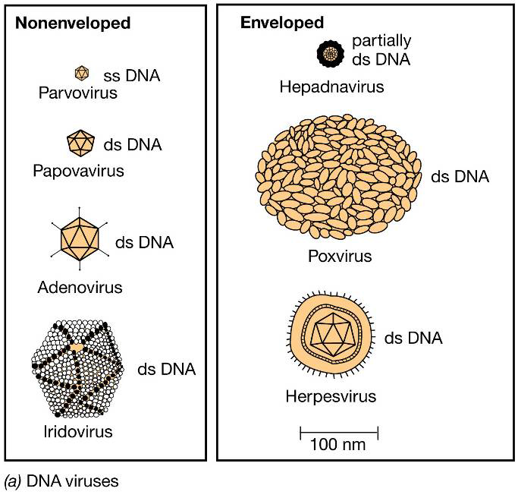

Slide 9
Pathogenesis of Viral Infection

Slide 10
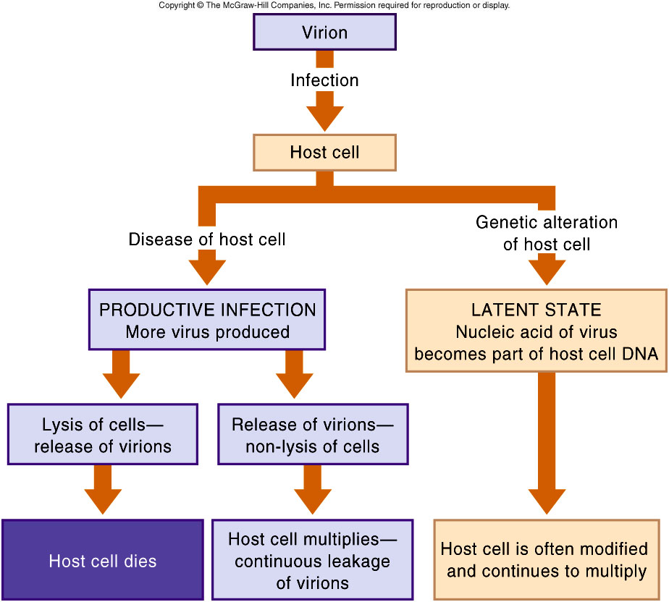

Slide 11
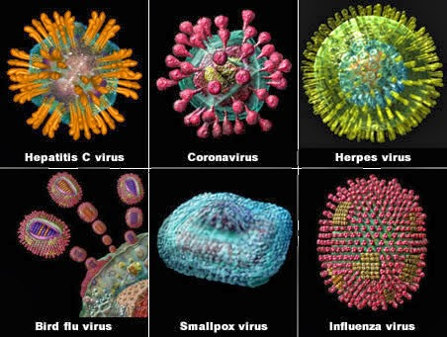
DNA Viruses: Herpes Viruses

Slide 12
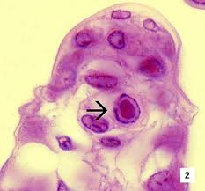
Herpesvirus family:
They form Cowdry type A intranuclear (Lipschutz) inclusion bodies.
Divided into 3 subfamilies depending on their biological, physical & genetic properties.
Enveloped double stranded DNA viruses.
Capsid icosahedral with 162 capsomeres.
They replicate in host cell nucleus.
Characteristic features:

Slide 13
Types of Herpes Virus:
Herpes simplex Virus 1
Herpes simplex Virus 2
Varicella Zoster Virus
Cytomegalovirus
Epstein-Barr Virus
Human Herpes Virus 6
Human Herpes Virus 7
Human Herpes Virus 8
Simian Herpes Virus

Slide 14
Herpes-virus family
Alpha herpes viruses
Beta herpes viruses
Gamma herpes viruses
Herpes Simplex
Varicella Zoster
Cytomegalovirus
HHV 6
HHV 7
Epstein-barr
HHV 8
8 different types of herpes viruses are known whose primary hosts are humans, called “ Human herpes virus types 1-8 ”

Slide 15
Official Name | Common Name | Subfamily | Site of latent infection
Human herpes virus type 1 | Herpes simplex virus type 1 | alpha | Neurons
Human herpes virus type 2 | Herpes simplex virus type 2 | alpha | Neurons
Human herpes virus type 3 | Varicella zoster virus | alpha | Neurons
Human herpes virus type 4 | Epstein-barr virus | gamma | Lymphoid tissues
Human herpes virus type 5 | Cytomegalovirus | beta | Secretory glands, kidneys
Human herpes virus type 6 | Human B cell lymphotropic virus | beta | Lymphoid tissues
Human herpes virus type 7 | R K virus | beta | -------------------
Human herpes virus type 8 | --------------- | gamma | -------------------

Slide 16
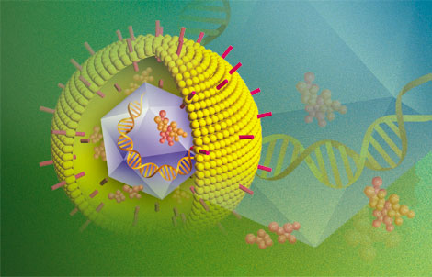
Alpha Herpes Viruses:
Herpes Simplex

Slide 17
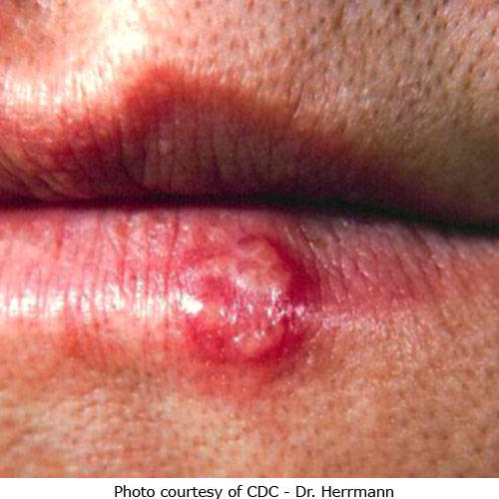
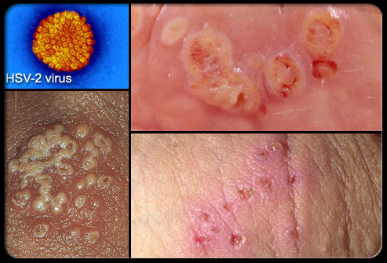
Herpes Simplex: acute infectious disease
More virulent
Carcinoma of Uterine Cervix
Types
HSV type 1
HSV type 2

Slide 18
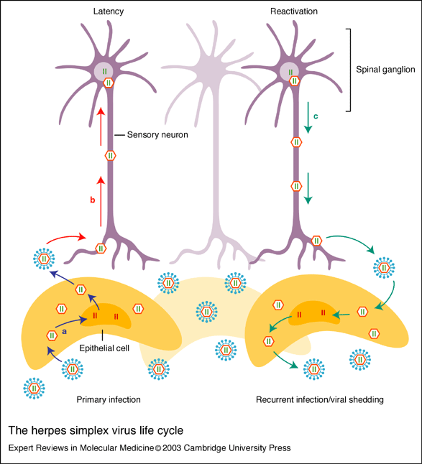
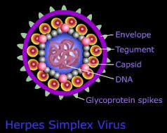
Structure:
HSV Life
cycle:

Slide 19
Herpes infection
Primary
Infection
Sub-clinical
Infection
Secondary / Recurrent
Infection
No circulating antibodies
Severe systemic manifestations
Circulating antibodies

Slide 20
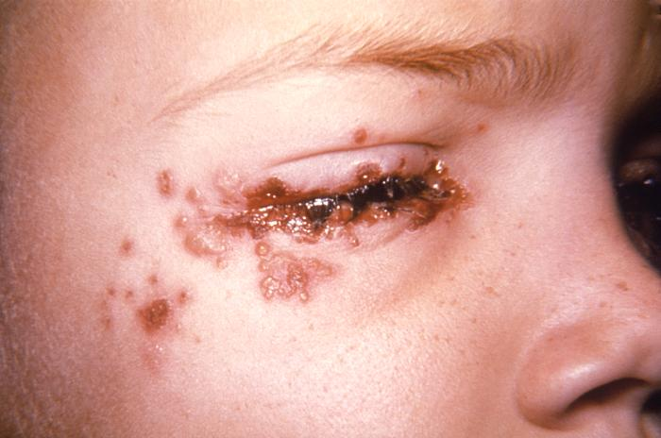
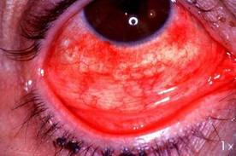
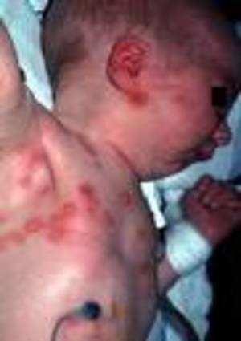
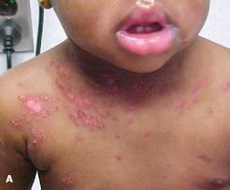
Swelling & congestion of palpebral conjunctiva
Corneal lcers
Vesicles of eyelids
Herpetic Conjunctivitis / Keratoconjunctivitis
1.
Herpes simplex
of newborn
3.
Herpetic Eczema
Superimposed on pre-existing eczema
2.

Slide 21

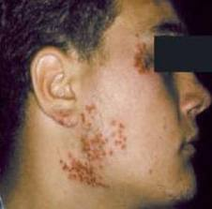
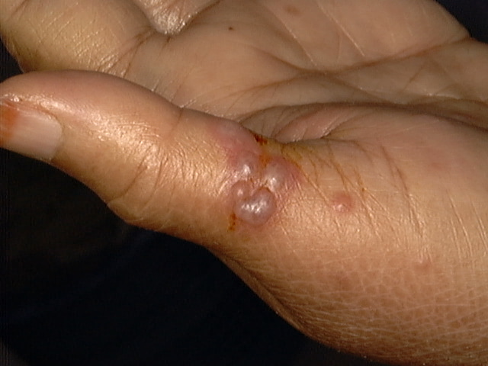
Herpetic
gladiatorum
4.
Herpetic whitlow
5.
6.
Herpetic meningo-encephalitis: sudden fever, increased intracranial pressure, paralysis, death

Slide 22
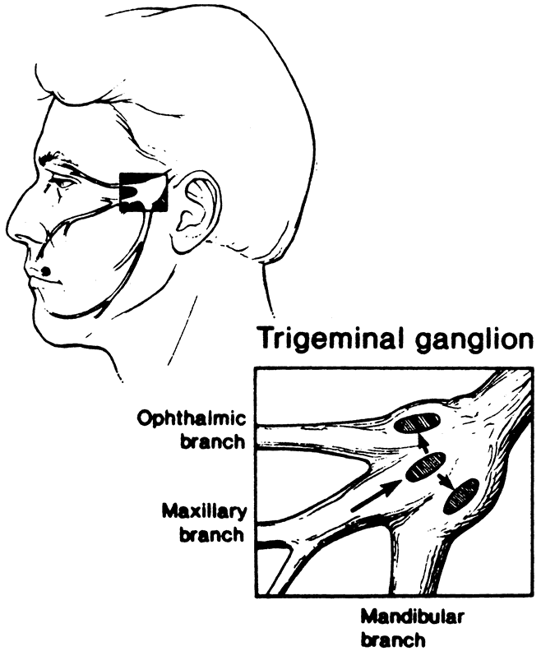
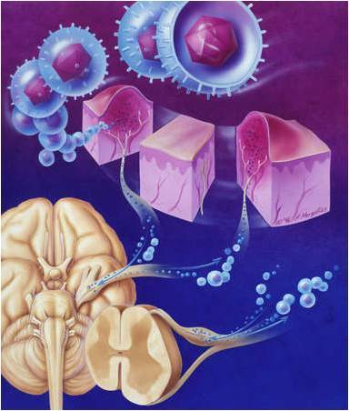
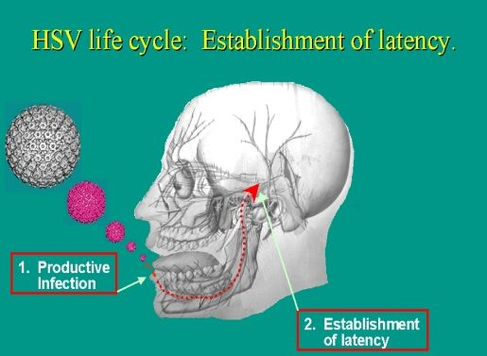
Primary Herpetic Gingivostomatitis
Etiology: HSV I
Pathogenesis

Slide 23
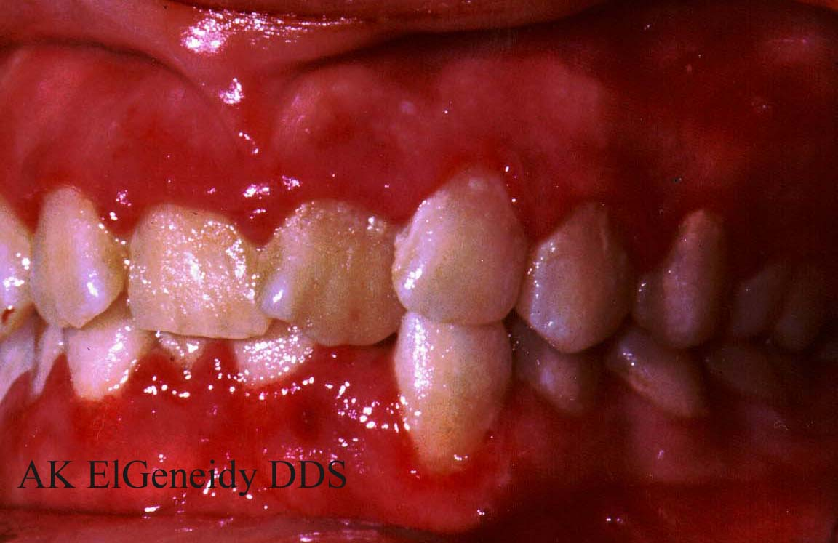
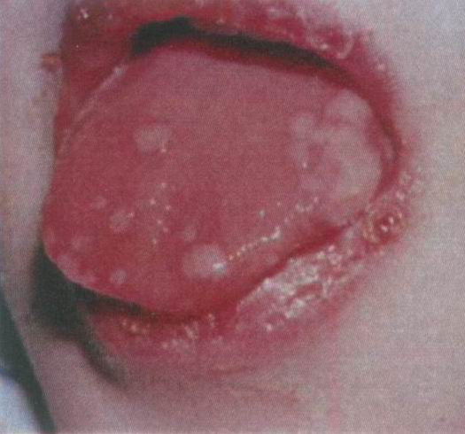
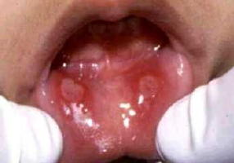
Seen in children & young adults
1.
2.
3.

Slide 24
Fever, irritability, headache, pain on swallowing, regional lymphadenopathy
Mouth becomes painful
Gingiva– inflammed, oedematous
Yellowish fluid filled blisters develop
They rupture to leave small, ragged, painful ulcers covered by gray membrane
Surrounding erythematous halo
Heal without scarring

Slide 25
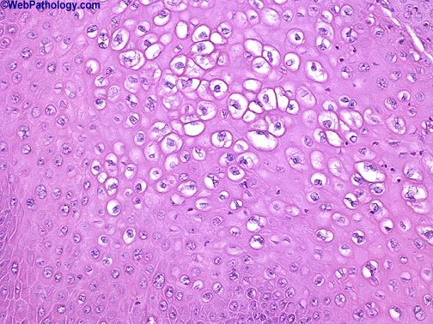
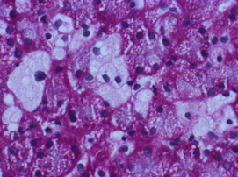
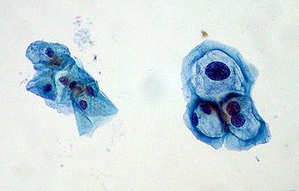
Primary Herpetic Gingivostomatitis
Histo-pathological features:
Ballooning degeneration
Tzanck cells
Herpetic vesicle is in intra-epithelial fluid filled blister.
Infected cells swollen, pale cytoplasm & large vesicular nucleus termed as “BALLOONING DEGENERATION”
Intra-nuclear inclusions “LIPSCHTUZ BODIES”

Slide 26
Recurrent or Secondary Herpetic Labialis & Stomatitis:
Trigger factors:
Trauma
Fatigue
Menstruation, Pregnancy
URTI
Emotional upset
Allergy

Slide 27
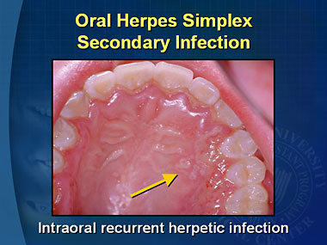
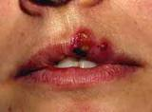
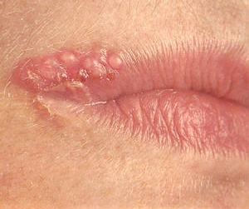
Recurrent or Secondary Herpetic Labialis & Stomatitis:

Slide 28
Alpha Herpes Viruses:
Varicella Zoster
First isolated by Weller
Von Bokay in 1889, Varicella & Herpes Zoster are different manifestations of the same virus infection.

Slide 29
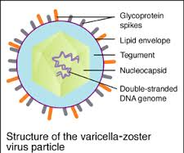
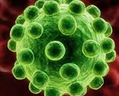
Varicella (Chickenpox) & herpes zoster are manifestations of the same virus infection, so the virus is called “Varicella Zoster”.
Contact with either zoster or chickenpox may lead to chickenpox & not zoster.
Chickenpox
Primary infection in non-immume individual
Herpes zoster
Reactivation of latent virus with decrease in immunity

Slide 30
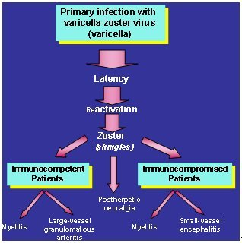
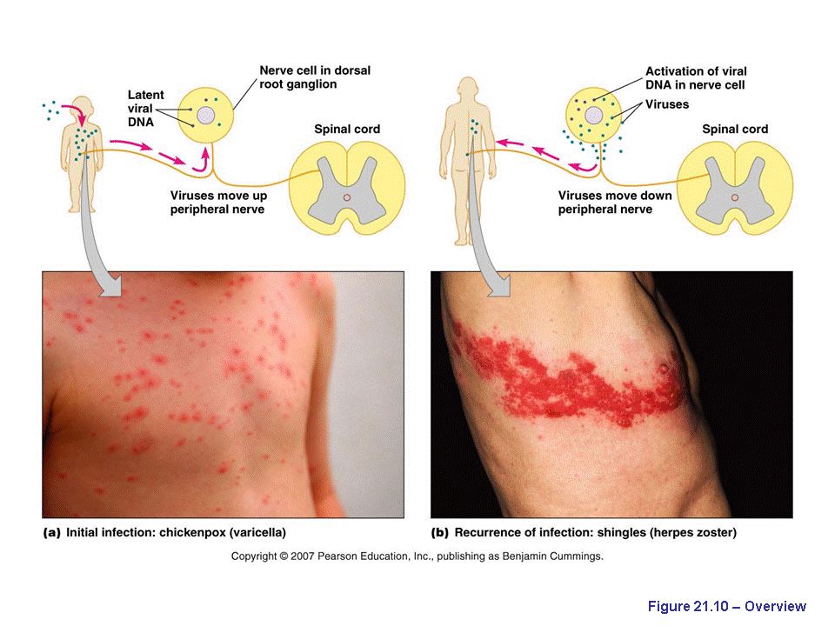

Slide 31
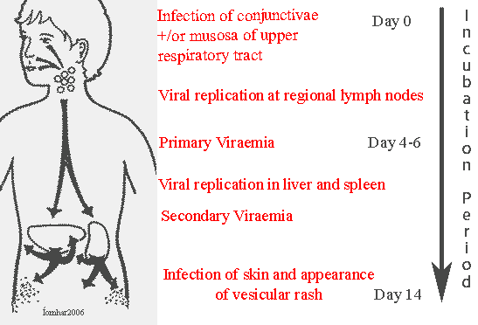
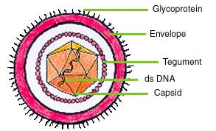
Chickenpox (Varicella):
Acute,
contagious disease

Slide 32
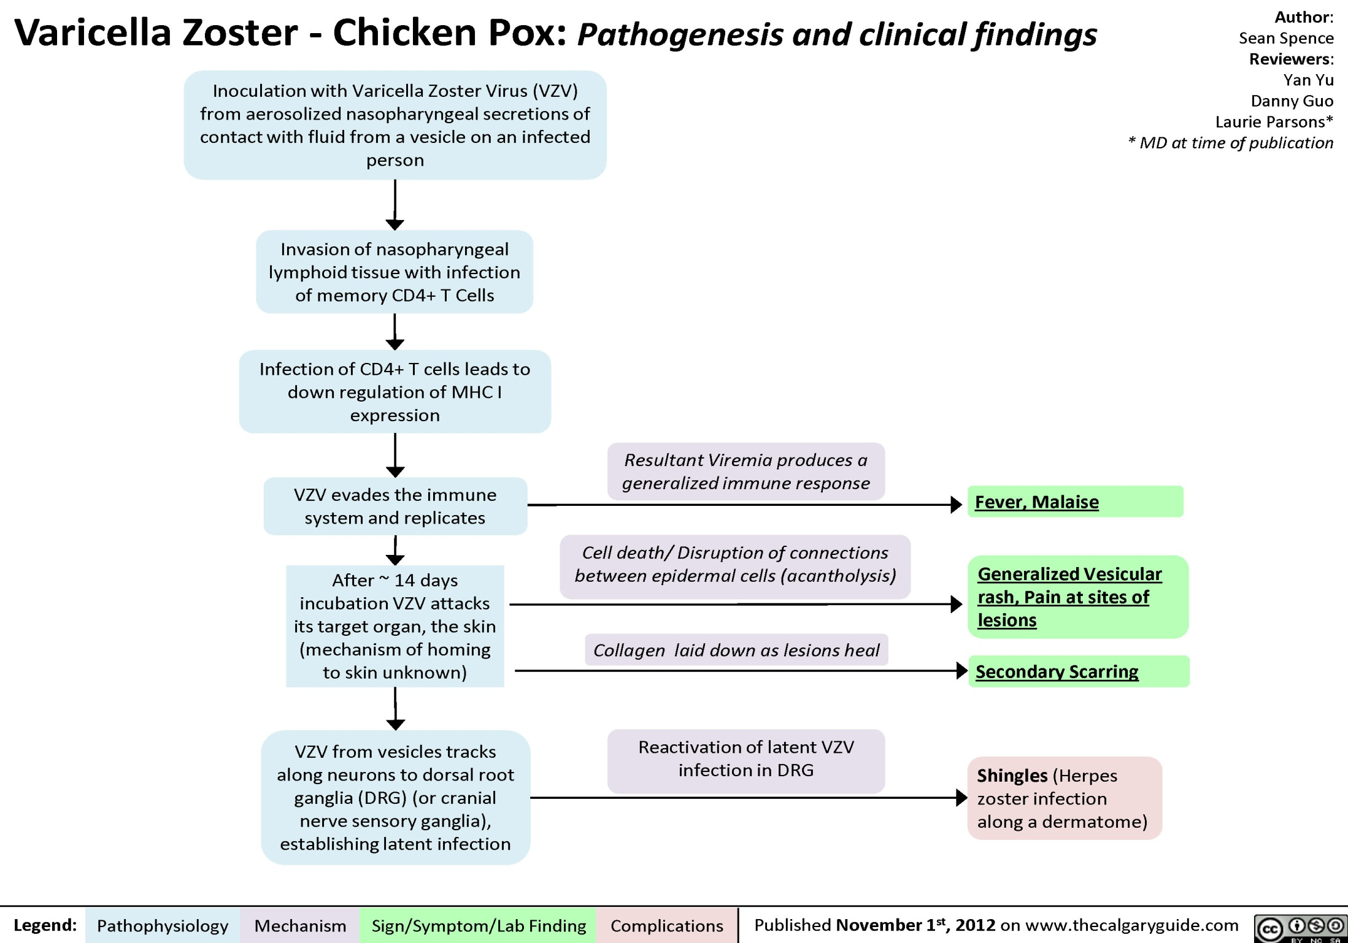

Slide 33
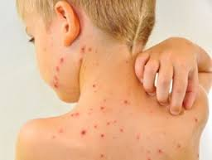
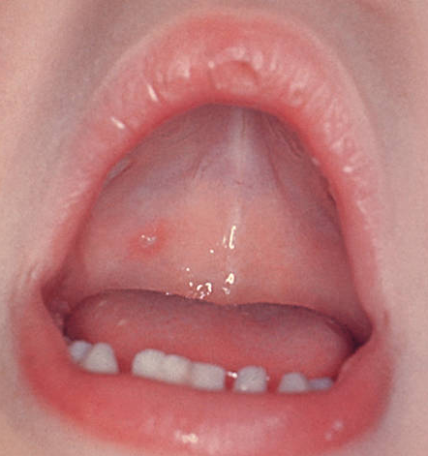
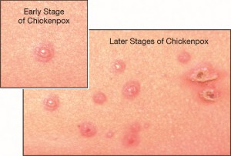
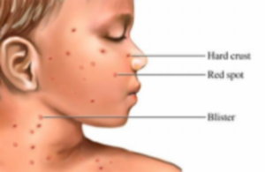
Infectious: 2 days before & 5 days after the onset of lesions
Dew drops

Slide 34
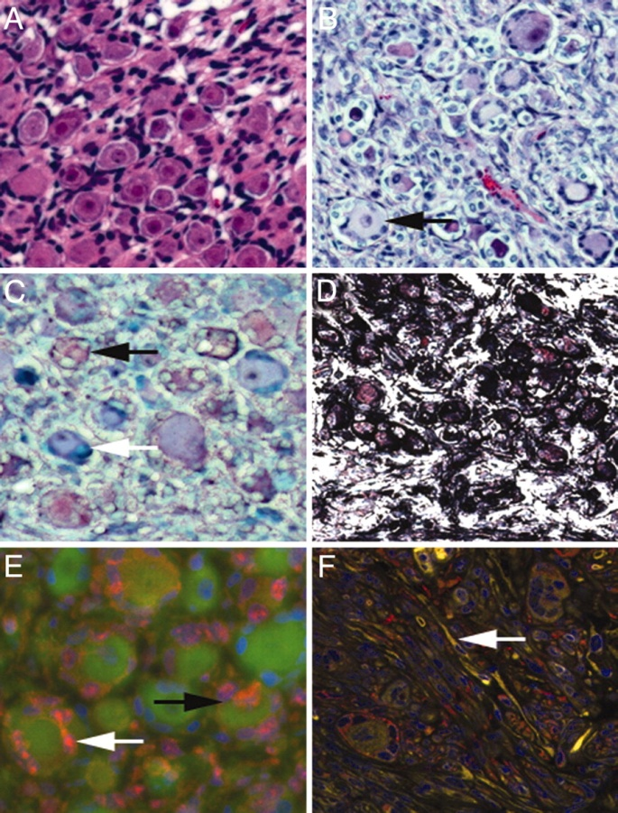
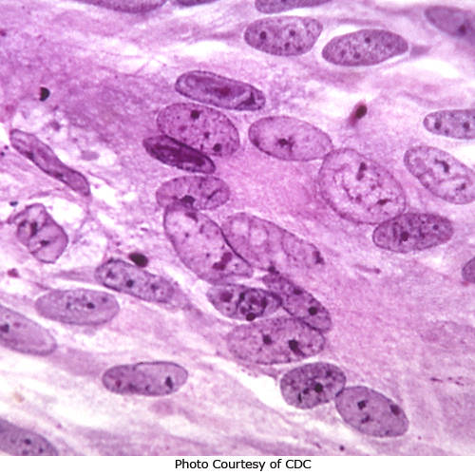
Multi-nucleated giant cells.
Cowdry Type A intra-nuclear inclusion bodies.

Slide 35
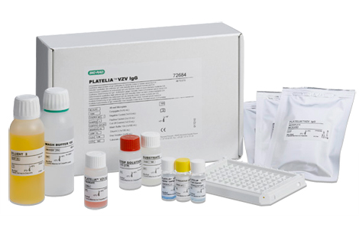
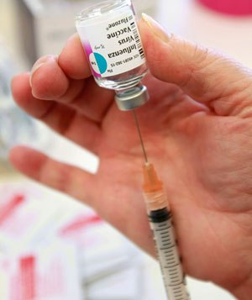
Varicella vaccine:
Children: 1-12 yrs – a single dose
Adults: 2 doses, 6-10 weeks apart

Slide 36


Herpes Zoster: Shingles, Zona
Herpein: to creep & Zoster: girdle
Acute, infectious, extremely painful viral disease

Slide 37

Herpes Zoster: Shingles, Zona
4.
3.
5.
2.
6.
1.

Slide 38



7.
8.
9.
10.

Slide 39


Unilateral lesions
Extremely painful vesicles
Hunt’s Syndrome / James Ramsay Hunt’s Syndrome
Facial paralysis
Pain in ext. auditory meatus & pinna of ear.
Vesicular eruptions in oral cavity & oropharynx .
Hoarseness, tinnitus & vertigo

Slide 40
Beta Herpes Viruses:
Cytomegalovirus
1921 called as “Cytomegalia”
Earlier in 1926, called as “Salivary Gland Virus”.
1960, Weller named them as “Cytomegalovirus”.
Largest in herpes-virus family, 150-200 nm.

Slide 41


Slide 42
Blood
transfusion
Immuno-compromised patients
Mother to child
Mode of
Transmission
CMV
infected blood
Transplant patients
Cancer therapy
HIV / AIDS patients
Intra-uterine inf.
During birth / milk

Slide 43

Cytomegalic Inclusion Disease: (Salivary Gland Virus Disease)
The infected ductal epithelial cells with a large purple intra-nuclear inclusion surrounded by a clear halo.
Ill-defined basophilic cytoplasmic inclusions are also seen.

Slide 44



Round and discrete intra-nuclear inclusion surrounded by a white thin halo – “Owl’s Eye”
Foci of cytomegalic cells are found in fatal cases in the epithelial tissues ...

Slide 45
Other manifestation are:
Birth defects
Mental retardation in infants
Cytomegalovirus mononucleosis
A/w Kaposi’s sarcoma in AIDS.
In AIDS patients damages the immune response further.

Slide 46
Gamma Herpes Viruses:
Epstein-Barr Virus
1964, Epstein, Barr & Achong found this new virus in cultures lymphoma cells, thus the name.
Specifically affecting cells of B lymphocyte lineage.
Source of infection is saliva.

Slide 47


Structure of EBV:

Slide 48


Pathogenesis:

Slide 49

Epstein-Barr virus (EBV) leads to:
EBV invades & replicates within the salivary glands or pharyngeal epithelium, and is shed into the saliva and respiratory system.
3.
Lymphomas in AIDS patients & Transplant patients
4.
1.
2.

Slide 50
Human Herpes Virus Types
6, 7 & 8

Slide 51
HHV-6:
Isolated in 1986, from peripheral blood of patients with lympho-proliferative disease, called HHV-6.
Spreads through saliva.
2 variants: A & B
In Children: Exanthem Subitum
In adults: Infectious Mononucleosis Focal Encephalitis In immunodeficient: pneumonia disseminated disease

Slide 52
HHV-7:
HHV-8:
Isolated in 1990, from peripheral CD4 cells of a healthy person.
Transmitted through saliva.
It shares with HIV the same CD4 receptor on the T cells, thus leads to further depletion of CD4 T cells in HIV infected patients.
Isolated in 1994, from DNA sequences from tissues of Kaposi’s sarcoma from AIDS patients.
Also isolated in Kaposi’s sarcoma in persons not infected with HIV, so also known as Kaposi’s sarcoma-associated herpes virus (KSHV).

Slide 53
DNA Viruses: Pox Viruses
Smallpox
Molluscum Contagiosum

Slide 54

Smallpox (Variola):
Completely eradicated.
First vaccination introduced by Jenner in 1796.
Last case in world reported in Somalia in 1977 & in Africa in 1978 in lab in London.

Slide 55





Slide 56
Differences between Chickenpox and Smallpox rash
 | Chickenpox | Smallpox
How initial symptoms differ | 0 to 2 days of mild illness pass before the rash develops. | 2 to 3 days of severe illness pass before the rash develops.
 | Lesions first appear on the face or trunk. | Lesions first appear in the throat or mouth, then on the face, or on the upper arms.
How the rash lesions differ | Lesions develop in successive fashion. While some are new, others are crusting over (in "crops"). | Lesions develop at the same time, and they look alike on any one section of the body, such as the abdomen, arms, or face.
 | Lesions change rapidly, crusting over within 24 hours. | Lesions change slowly, scabbing over after 9 to 15 days.
 | Lesions sit on the skin surface like a "dewdrop on a rose petal." | Lesions become firm, dome-shaped, and deep in the skin

Slide 57


 | Chickenpox | Smallpox
How the rash lesions differ | Rash rarely develops on palms and soles. | Rash commonly develops on palms of the hands and soles of the feet.
 | Lesions are most concentrated on the torso, with fewest on the hands and feet. Lesions can affect the face and scalp, but rarely affect the entire body equally | Lesions are most concentrated on the face, hands, and feet.

Slide 58


Molluscum Contagiosum:
Hemispheric in shape, 5 mm in diameter, multiple, discrete elevated nodules, with central umbilication (keratinized) & slightly red in colour.

Slide 59

Large eosinophillic intra-cytoplasmic inclusion bodies called “Henderson-Paterson Inclusions”.
Accumulate in the crater formed by the distinctive umbilication of the dome-shaped lesion.

Slide 60
RNA Viruses: Picornavirus
Herpangina
Acute Lymphonodular pharyngitis
Hand, foot & mouth Disease
Foot & mouth disease

Slide 61
Herpangina
Aphthous Pharyngitis
Vesicular Pharyngitis
Zahorsky in 1920

Slide 62

Coxsackie group A virus
Incubation period: 2-10 days
A summer disease, common in children.

Slide 63



Clinical features:
Sore throat, low-grade fever, head-ache, rhinorrhea

Slide 64
Acute Lymphonodular Pharyngitis
Steigman & co-workers in 1962
Caused by Coxsackie A10 virus
Marked similarities to Herpangina.

Slide 65


High-grade fever & sore throat
Raised, discrete, whitish or yellowish to dark pink solid papules surrounded by narrow zone of erythema
Not vesicular & do not ulcerate. Commonly involving uvula
Papules consists of hyper-plastic lymphoid aggregates & intra-cytoplasmic viral inclusion

Slide 66
Hand, Foot & Mouth Disease
Robinson & co-workers in 1958
Caused by Coxsackie A16 virus

Slide 67




Maculo-papular, exanthematous & vesicular lesions of the skin
Intra-cytoplasmic viral inclusions
Oral lesions are
numerous, small,
multiple vesicular & ulcerative

Slide 68
Foot & Mouth Disease
Apthous fever, Hoof & mouth disease, Epizootic stomatitis
Rarely affects humans

Slide 69


Vesicular lesions of the skin
Small vesicles rupture rapidly & heal in 2 weeks

Slide 70
RNA Viruses: Paramyxovirus
Measles
Mumps

Slide 71

Measles
(Rubeola, Red spots, Morbilli)

Slide 72


Respiratory system Blood invasion of
T -lymphocytes suppression of cellular immunity

Slide 73

3 stages:
Pre-eruptive / prodormal
Eruptive
Post-eruptive

Slide 74



Red macules which blanch on pressure
Oral lesions appear before rash.
Disappear after the appearance of rash.
Koplik’s spots

Slide 75


Muti-nucleated giant cells called Warthin-Finkeldey Giant Cells

Slide 76

In India, Edmonton-Zagreb (E-Z strain) 5ml of vaccine subcutaneously.
1st dose: 9mths
2nd dose: 15-18 mths

Slide 77

RNA Viruses: Togavirus
Rubella

Slide 78
Rubella (German Measles):
Difference from Ruboela (Measles):
Koplik’s spots absent
Oral mucous membrane not inflamed.
Complications are rare, except in 1st trimester of pregnancy resulting in congenital defects as: - enamel hypoplasia - blindness - deafness - cardio-vascular abnormalities

Slide 79


Slide 80

Mumps (Epidemic Parotitis)
Caused by Paramyxovirus

Slide 81




Acute, contagious viral infection.
Unilateral or bilateral involvement of salivary glands

Slide 82

Pathogenesis

Slide 83


Perivascular & interstitial mononuclear cell infiltrates, edema & necrosis of acinar & epithelial duct cells

Slide 84
Diagnosis: Swabs from saliva, CSF & throat
ELISA
Serum amylase is elevated
Treatment: Vaccination
Complications:
Death due to CNS or cardiac involvement
In adult males: Orchitis leading to complete sterility
In pregnancy then leads to abortion

Slide 85

Hepatitis Viruses

Slide 86


Slide 87

Hepatitis B: Hepadnaviridae
5.
2.
3.
1.
4.
Notes:
DNA polymerase: DNA dependent DNA polymerase
RNA dependent reverse transcriptase

Slide 88

HBV
Chronic
Hepatitis
Cirrhosis
Primary Hepatic Cancer
Hepato-cellular Carcinoma is the only human cancer which is vaccine preventable

Slide 89

Latest Updates

Slide 90
Ref: Pleiotrophic Mechanisms of Virus Survival & Persistence.
Craig Miller
Oral Surg Oral Med Oral Patho Oral Radio Endod; 2005; 100:27-36
Viruses develop numerous strategies for avoiding host defences during infection as:
Regulating apoptosis
Inhibiting interferon production
Modulating the MHC-I
Limiting cytokine & chemokine production

Slide 91
Ref: Pleiotrophic Mechanisms of Virus Survival & Persistence.
Craig Miller
Oral Surg Oral Med Oral Patho Oral Radio Endod; 2005; 100:27-36
Regulating apoptosis:
Targeting p53
Targeting Fas death receptor
Producing caspase inhibitors
Producing Viral Bcl-2 homologs
Herpes viruses:
Encode FLICE-inhibitory proteins that block Trail mediated cell death
CMV encode vMIA (inhibitors of apoptosis)
HSV-1 encode ICPa & ICP27 (anti-apoptotic agents), modulate apoptosis at several levels.
Inhibiting interferon production:
EBV, HPV & Adenoviruses encode: proteins that inhibit JAK-STAT signalling pathways required for IFN production.
Modulating the MHC-I:
HSV produces: proteins that degrade & down-regulate MHC-I leading to shutting off of host cell protein synthesis by gene Virion Host Shut Off.

Slide 92
Ref: Pleiotrophic Mechanisms of Virus Survival & Persistence.
Craig Miller
Oral Surg Oral Med Oral Patho Oral Radio Endod; 2005; 100:27-36
Viral Persistence: as they are able to down-regulate key processes that if left unattended would result in cell death.
HSV-1 & -2: ability to auto-regulate 2 life-cycles.
Lytic infection in epithelium
Latent infection of neurons
HSV encodes proteins LANA & latency–associated transcripts (LATs) that appear to regulate viral transcription during latency.

Slide 93
Ref: Comparison of the Tzanck test and polymerase chain reaction in the diagnosis of cutaneous herpes simplex and varicella zoster virus infections.
Atilla Ozcan MD
International Journal of Dermatology, 2007, vol. 46 (11); 1177–1179
Although PCR was superior to the Tzanck test, the Tzanck test has also been proven to be a reliable diagnostic method, with a sensitivity of 76.9% and a specificity of 100%.
They have recommend the use of Tzanck test as :
Easy
Quick
Reproducible
Inexpensive diagnostic test
So more often in dermatologic practice, especially in cutaneous herpes virus infections.

Slide 94

Ref: Histopathology For The Diagnosis Of Infectious Diseases
E Gupta
Indian Journal of Medical Microbiology, (2009) 27(2): 100-6
Histopathological examination of tissue biopsies for the identification of infectious organisms is a very important diagnostic tool.
Presence of inhibitors like dead tissue debris, fibers, etc. also delays isolation.
Culture alone cannot distinguish between colonization & true tissue invasion.

Slide 95

Ref: Virus Taxonomy: Ninth Report of the International Committee on Taxonomy of Viruses
International Committee on Taxonomy of Viruses; 2012
GENUS: MIMIVIRUS
Type species: Acanthamoeba polyphaga mimivirus
Characteristic features:
The presence of many proteins never seen in any other virus is one of the unique features of mimivirus.
In addition to the full DNA replication and transcription apparatus usually found in large eukaryotic DNA viruses (such as the poxviruses).
The Double Stranded DNA Viruses

Slide 96
Ref: Virus Taxonomy: Ninth Report of the International Committee on Taxonomy of Viruses
International Committee on Taxonomy of Viruses; 2012
Mimivirus was isolated in the context of a pneumonia epidemic but more specific PCR-based studies failed to detect mimivirus in large numbers of pneumonia patients.
Size of its particle, mimivirus is internalized by various professional phagocytic cells, including human macrophages in vitro.
At the moment, there is little evidence that mimivirus is a human pathogen.

Slide 97
Ref: World Health Officials Debate Whether To Destroy Last Existing Samples of Smallpox
Rebecca Boyle
Posted 04.13.2011
Two labs possess the last known live samples of the variola virus — the Centers for Disease Control and Prevention in Atlanta & a Russian facility in Siberia.
Officials in the U.S. and Russia have said they will fight efforts to set a destruction date, arguing the viruses are needed for research and to guard against bioterrorism.
Some fear nations like North Korea or Iran may possess secret samples, although those countries deny it.

Slide 98
Ref: Update on the current status of cytomegalovirus vaccines Heungsup Sung
Expert Rev Vaccines. 2010 November ; 9(11): 1303–1314.
CMV is the most commonly recognized cause of congenital viral infection in developed countries.
There are no licensed HCMV vaccines currently available.
Recently reported results of a Phase II trial of a glycoprotein B vaccine for the prevention of HCMV infection in sero-negative women of childbearing age.
Recent advances in the study of the biology of HCMV, particularly with respect to epithelial & endothelial cell entry of the virus, which have implications for future vaccine design.

Slide 99
Ref: Hepatitis B virus-induced Hepatocellular Carcinoma.
Tong HV
J Viral Hepato. 2013 Oct;20(10):687-98
Hepatitis B virus infection is a high-risk factor for hepatocellular carcinoma.
The human major histocompatibility complex class I chain-related gene A (MICA) is a ligand that plays a crucial role in modulating innate immune responses, tumour surveillance and regulate disease susceptibility during HBV infection.

Slide 100
Ref: The role of Epstein-Barr virus in cancer.
Pattle SB
Expert Opinion Biological Theory; 2006 Nov;6(11):1193-205.
EBV has two distinct life cycles in the human host:
Lytic form: of infection that produces new infectious virions.
Latent form: of infection that allows the virus to persist in a dormant state for the lifetime of the host.
EBV has evolved a life cycle that mimics the natural differentiation pathway of antigen-activated B cells, giving the virus access to its site of latent infection, the resting memory B cell.
Its presence in various stages of B-cell development, and its ability to infect certain epithelial cells, can have pathogenic consequences, and can contribute to the development of a diverse group of lymphomas and carcinomas.

Slide 101
Ref: Epstein-Barr Virus in Burkitt’s Lymphoma.
Kathryn T. Bieging
Cell Cycle. 2010 March ; 9(5): 901–908.
Burkitt’s lymphoma (BL) is characterized by translocation of the MYC gene to an immunoglobulin locus.
Inactivation of the p53 pathway is a major step to tumor formation.
All EBV-associated malignancies is the expression of one or more latent membrane proteins. Of the three latent membrane proteins, have known to have oncogenic activity.

Slide 102
Ref: Nasopharyngeal Carcinoma: The Role of the Epstein-Barr Virus
Eugene A. Chu
Medscape J Med. 2008; 10(7): 165.
The etiology of NPC is multi-factorial and includes genetic susceptibility, exposure to carcinogens, and prior infection with the Epstein-Barr virus (EBV).
Though EBV is certainly implicated in the pathogenesis of NPC, the exact mechanism and pathway by which it exerts its effects are unknown.
EBV studies, circulating plasma EBV DNA levels, have shown utility in staging, prognosis, and post-therapeutic monitoring.
Patients with high plasma EBV DNA levels are at increased risk for distant metastasis.

Slide 103

Conclusion

Slide 104




“Sometimes the questions are complicated and the answers are simple.”
― Dr. Seuss

Slide 105

References

Slide 106
Textbook of Microbiology – Anant Narayan
Textbook of Pathology – Robbins
Textbook of Pathology – Harsh Mohan
Textbook of Oral Pathology – Shafer
Textbook of Oral Pathology – Neville
11 Reference Articles included.

Slide 107
Thank You
Notes:
Why no antibiotics given for viral infections???
Antiviral drugs???
Acyclovir??? Vellacyclovir??
Why unilateral in zoster??
Where else warthin finkledey giant cells???? Measels & ???????????

