Slide 1
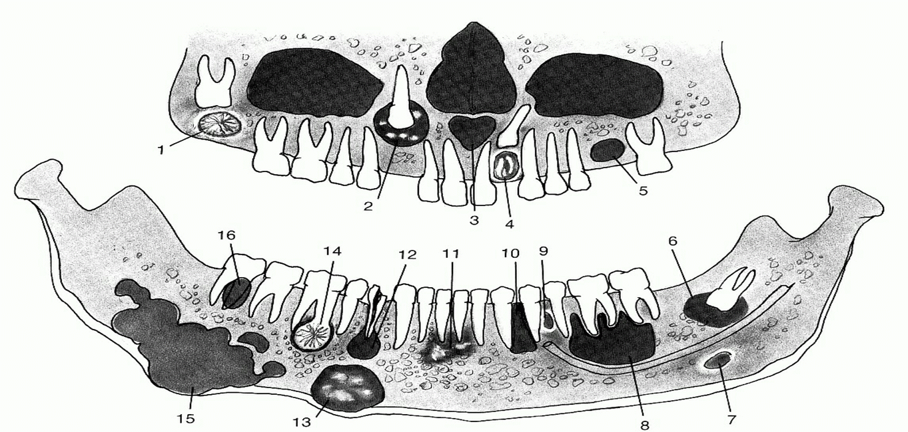
ODONTOGENIC CYSTS
MRINAL SHETE
Notes:
The term cyst is derived from the Greek work “Kystis” which means a bladder or sac. “Kyso” – “I hold”

Slide 2
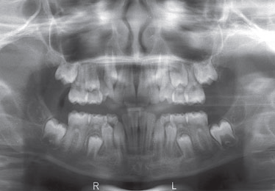
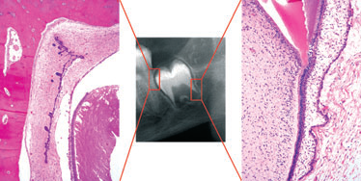
REVIEW Lesions of the jaws P J Slootweg Histopathology 2009, 54, 401–418
Notes:
Fig- A, Panoramic radiograph, showing that in childhood, the jaw is crowded by both deciduous and fully or partly developed permanent teeth. B, Detail showing one of the tooth germs together with histological details to illustrate the ubiquitous presence of epithelium in the jaw: in the dental follicle (left) and at the developing root tip with the enamel organ mimicking ameloblastoma (right). Dental papilla tissue that may be confused with myxoma lies adjacent to the enamel organ.
As the enamel organ elongates through downward proliferation, it creates a tube that maps out the form and size of the roots of the teeth.1 Therefore, remnants of odontogenic epithelium can be found in the jaw bone at a level as deep as the root tips of the teeth (Figure 1A,B). Those that lie in the connective tissue that connects the tooth with the jaw, the so-called periodontal ligament, are known as rests of Malassez. Corresponding epithelial remnants in the gingiva are named rests of Serres

Slide 3
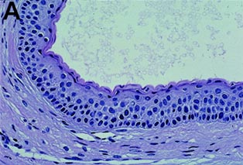
DEFINITION
Cyst is an epithelial lined sac filled with fluid or semifluid material. ( Killey and Kay 1966)
A cyst is a pathological cavity having fluid, semifluid or gaseous contents and which is not created by the accumulation of pus, which may or may not be lined by epithelium. (Kramer, 1974).

Slide 4
CLASSIFICATION OF CYSTS (BY SHEAR)
CYSTS
Cysts of the Jaws
Cysts of the Maxillary antrum
Cysts of the Soft tissues of Face, Mouth & Neck

Slide 5

CYSTS OF THE JAWS
Epithelial
Non-epithelial
1.Solitary bone cyst
2.Aneurysmal bone cyst
Developmental
Inflammatory
1.Radicular cyst
2.Residual cyst
3.Paradental cyst
4.Inflammatory collateral cyst
1. Gingival cyst of infants
2. Odontogenic keratocyst
3. Dentigerous cyst
4. Eruption cyst
5. Lateral periodontal cyst
6. Gingival cyst of adults
7. Botryoid odontogenic cyst
8. Glandular odontogenic cyst
9.COC
1.Nasopalatine duct cyst
2.Nasolabial cyst
3.Midpalatal raphae cyst
4.Globulomaxillary cyst
5.Median palatine, median mandibular cyst

Slide 6
WHO classification of cysts
A. DEVELOPMENTAL:
ODONTOGENIC CYSTS:
1. Gingival cyst of infants
2. Primordial cyst
3. Dentigerous cyst
4. Eruption cyst
5. Lateral periodontal cyst
6. Gingival cyst of adults
7. Glandular odontogenic cyst
NON- ODONTOGENIC CYSTS:
Nasopalatine duct cyst
Globulomaxillary cyst
Nasolabial cyst
B. INFLAMMATORY CYSTS
Raducular cyst
Apical and lateral cyst
Residual cyst
Paradental cyst

Slide 7
CLASSIFICATION
ODONTOGENIC CYSTS
DEVELOPMENTAL
Dentigerous cyst
Eruption cyst
Odontogenic keratocyst
Gingival cyst of newborn
Gingival cyst of adults
Lateral periodontal cyst
Botryoid odontogenic cyst
Calcifying odontogenic cyst
Glandular odontogenic cyst
INFLAMMATORY
Radicular cyst
Residual cyst
Paradental cyst
Mandibular infected buccal cyst

Slide 8
CLASSIFICATION BY TISSUE OF ORIGIN
Derived from Rests of Malassez
Periapical cyst
Residual cyst
Derived form Reduced Enamel Epithelium
Dentigerous cyst
Eruption cyst
Derived from Dental Lamina
OKC
Gingival cyst of newborn
Gingival cyst of adults
Lateral periodontal cyst
Glandular odontogenic cyst
Unclassified
Paradental
cyst
Calcifying
odontogenic
cyst

Slide 9
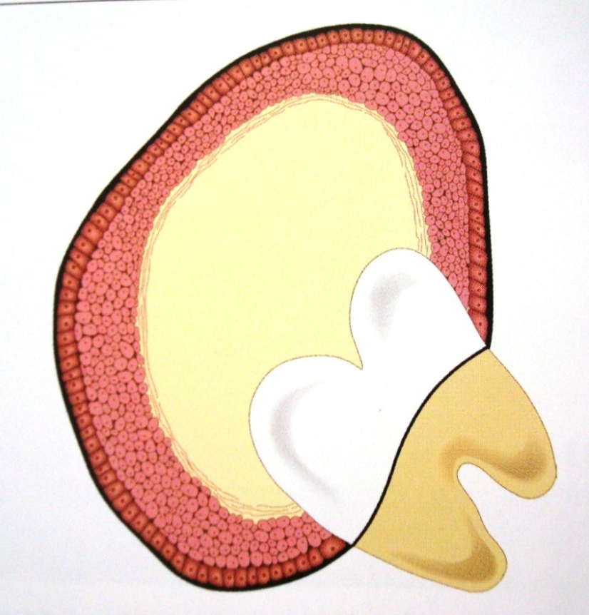
DENTIGEROUS CYST
Dentigerous means ‘tooth bearing’. (by Browne)
Def: It is an odontogenic cyst that surrounds the crown of an impacted tooth; caused by fluid accumulation between the reduced enamel epithelium and the enamel surface resulting in a cyst in which the crown is located within the lumen.
Notes:
It is an odontogenic cyst that surrounds the crown of an impacted tooth.
Most common type of cyst (20% of all jaw cysts)
Nearly always associated with the crown of the normal permanent teeth, seldom associated with the deciduous teeth

Slide 10
PATHOGENESIS
Origin can be
Intrafollicular
Extrafollicular
First theory was proposed by Toller (1967) who suggested that the origin of dentigerous cyst is due to the breakdown of the proliferating cells of the follicle following impeded eruption.

Slide 11
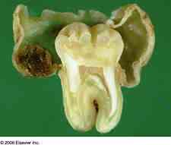
INTRAFOLLICULAR THEORY
1. In this the cyst develops due to the accumulation of fluid either between the layers reduced enamel epithelium or within the enamel organ itself.
- Not associated with enamel hypoplasia
2. Fluid accumulation within the enamel organ itself by degeneration of stellate reticulum cells at an early stage of development.
- Associated with enamel hypoplasia
Notes:
Enamel hypoplasia is a feature of this type of dentigerous cyst

Slide 12
For the frequent presence of enamel hypoplasia with dentigerous cyst, Shear concluded that the presence of foci of enamel hypoplasia diminish the adherence of the reduced enamel epithelium to the crown of the tooth,
provides the starting point for the development of the cyst.

Slide 13
EXTRAFOLLICULAR ORIGIN
1. Dentigerous cysts develop by accumulation of fluid between the reduced enamel epithelium and the enamel surface.
2. Crown of an permanent tooth may erupt into radicular cyst of its deciduous predecessor.
3. Follicular OKCs: impacted tooth erupts in to a pre-existing OKC.
Notes:
few dentigerous cysts showed projections which resemble Tomes processes of ameloblasts into the lumen into the superficial layers of the epithelium. This suggested that the superficail cells are derived from the ameloblasts and in these cases the dentigerous cysts developed by 1

Slide 14
HOW DOES FLUID ACCUMULATION TAKES PLACE ? Main in 1970
1
Pressure exerted by an erupting tooth on an impacted follicle due to eruptive force.
2
3
Increased hydrostatic pressure exerted by pooling of this fluid causes separation of the follicle from the crown, with or without reduced enamel epithelium
Obstructs venous outflow and thereby induces rapid transduction of serum across the capillary wall

Slide 15
CLINICAL FEATURES
Age - 2nd to 3rd decade of life
Sex – more in males (3:2)
Site – mandibular 3rd molars, max. 3rd molars, max. cuspid
Mostly solitary in occurrence
Associated syndromes –
a. Cleidocranial dysplasia
b. Maroteaux-Lamy syndrome
Notes:
In the case of mandibular third molars, the frequency of impaction is roughly the same as the frequency of cyst formation, whereas the maxillary third molars have a much higher frequency of impaction than cyst involvement, suggesting that this tooth has a much lower relative risk of developing a dentigerous cyst than its mandibular counterpart
Maroteaux-Lamy syndrome: is an autosomal recessive lysosomal storage disorder described in 1963 by Dr. Pierre Maroteaux and Dr. Maurice Lamy
face showing coarse facies: frontal bossing, enlarged tongue, thick lips, abnormal dentition and gingival hyperplasia, claw-hand deformity, curvature of spine (lumbar kyphosis, scoliosis, lordosis), cranium showing thickened diploic space and Jshaped sella.

Slide 16
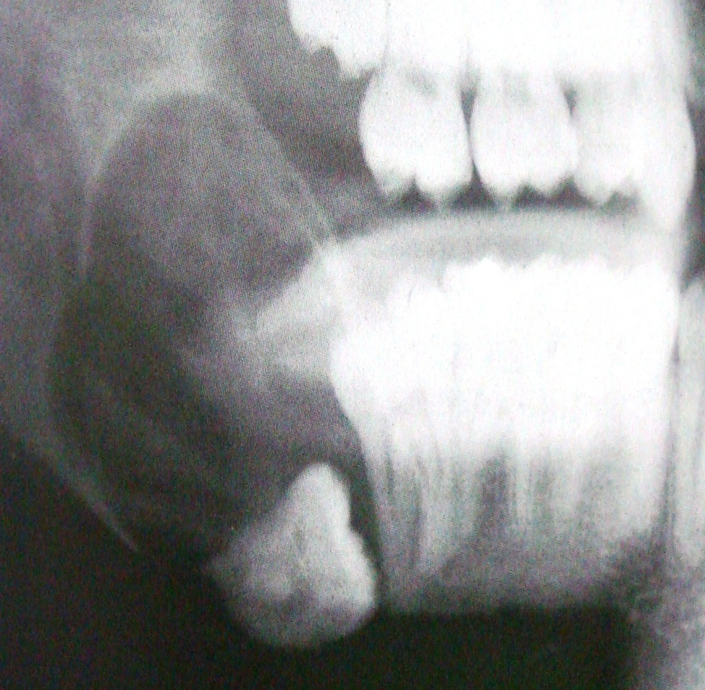
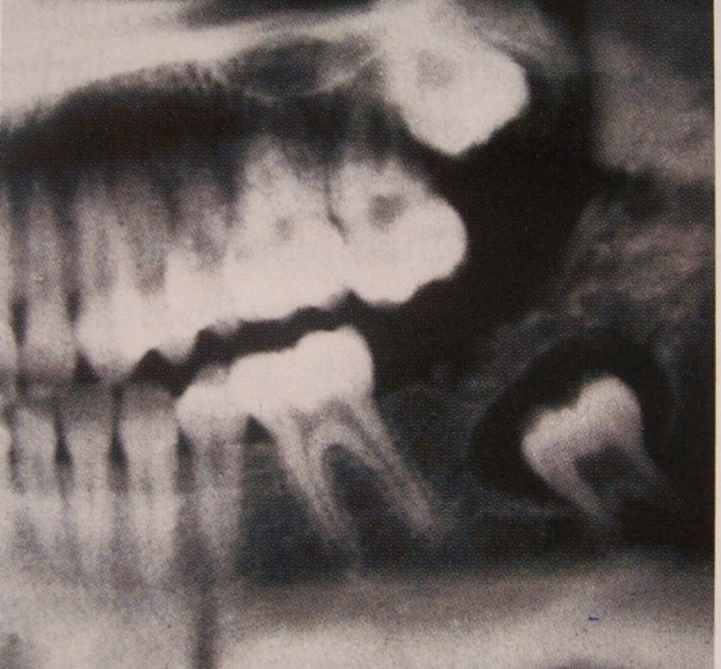
RADIOGRAPHIC FEATURES
Unilocular radiolucent area associated with the crown of the impacted teeth
Well defined sclerotic margins unless secondarily infected

Slide 17
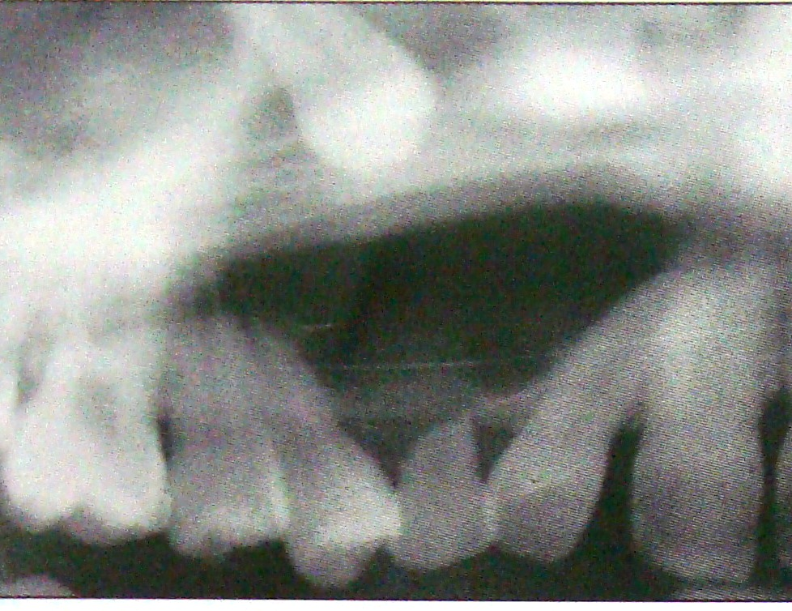
Expansion of bone, severe root resorption, displacement of teeth
Root resorption of adjacent teeth
Usually causes no pain unless secondarily infected
Notes:
Root resorption is due to its origin from the dental follicle and the ability of the dental follicle to resorb roots of the deciduous teeth. Also could be due to the production of the prostaglandins E2 & E3 by dentigerous cyst and the ability of the E2 to resorb cementum and dentin.

Slide 18
Distinction between follicle and dentigerous cyst
is difficult on radiograph
Follicular space – 3 to 4mm
Cyst – more than 5mm
Notes:
Normal follicular space – 3-4mm; dentigerous cyst usually more than 5mm

Slide 19
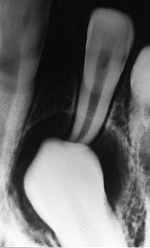
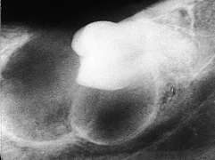
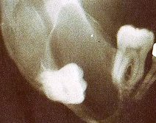
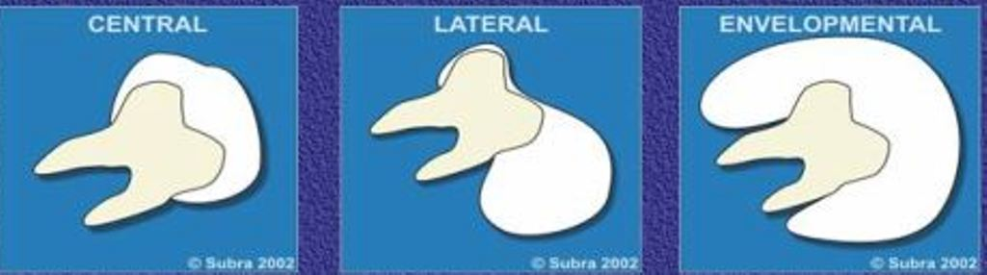
RADIOLOGIC VARIANTS OF DENTIGEROUS CYST
CENTRAL VARIANT
LATERAL VARIANT
CIRCUMFERENTIAL VARIANT
Notes:
Three radiological variations of the dentigerous cyst may be observed. In the central variety the crown is enveloped symmetrically. In these instances, pressure is applied to the crown of the tooth and may push it away from its direction of eruption. In this way, mandibular third molars may be found at the lower border of the mandible or in the ascending ramus and a maxillary canine may be forced into the maxillary sinus as far as the floor of the orbit. A maxillary incisor may be found below the floor of the nose.
The lateral type of dentigerous cyst is a radiographic appearance that results from dilatation of the follicle on one aspect of the crown. This type is commonly seen when an impacted mandibular third molar is partially erupted so that its superior aspect is exposed.
The so-called circumferential dentigerous cyst in which the entire tooth appears to be enveloped by cyst
Acc to MOURSHED
Class 1: dc a/w completely unerupted tooth
a. fail to erupt due to lack of space in dental arch
b. -----”--------------- malpositioning of tooth germ
c. dc a/w unerupted supernumerary tooth
Class 2: dc a/w partially erupted tooth

Slide 20
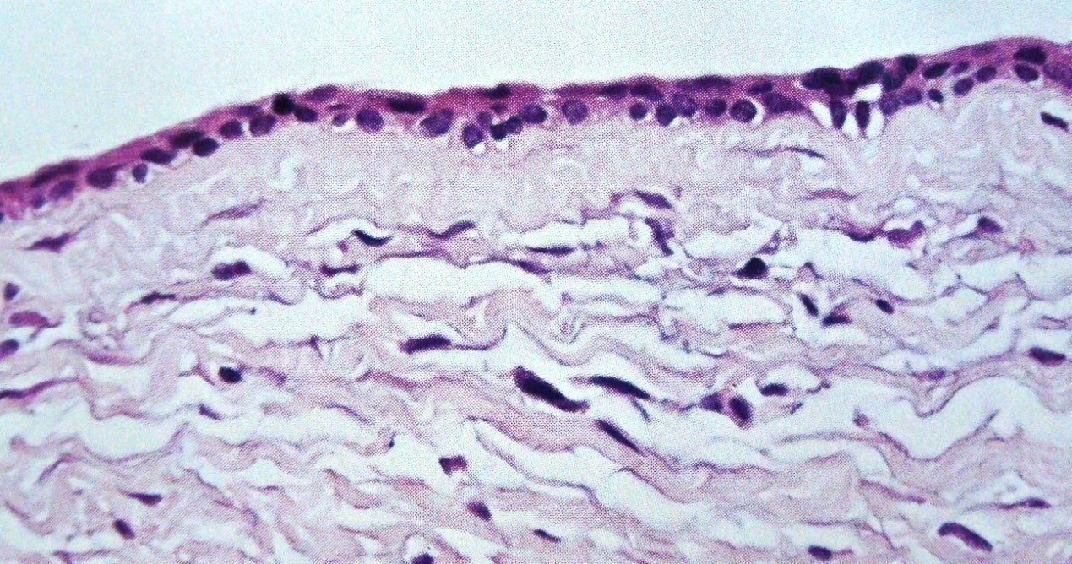
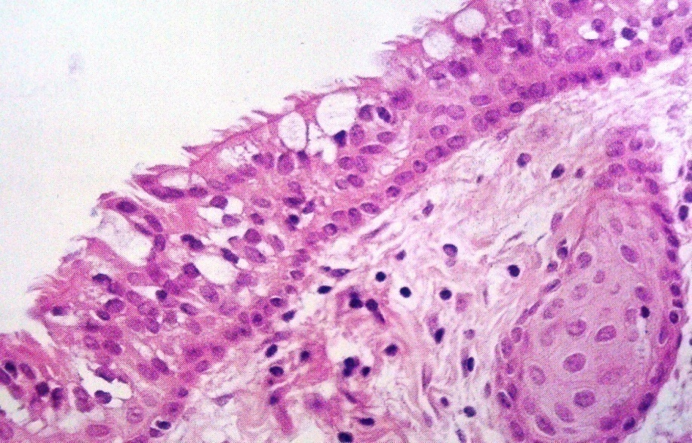
HISTOPATHOLOGY
Thin connective tissue wall, lined by stratified squamous epithelium, only 2-3 cell layers resembling reduced enamel epithelium
Lining epithelium is pleuripotential- may show mucous producing cells and sometimes ciliated cells, sebaceous, lymphoid follicles

Slide 21
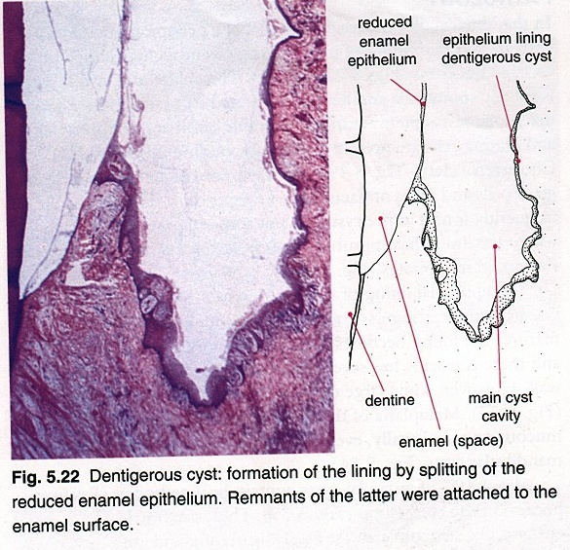
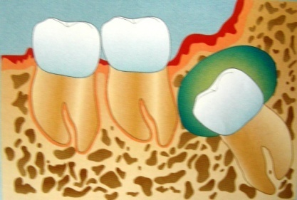

Slide 22
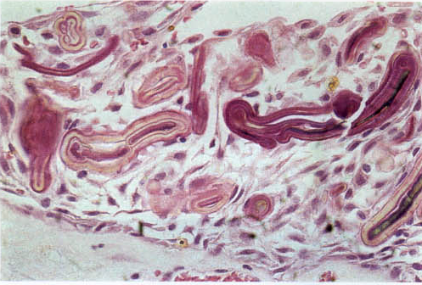
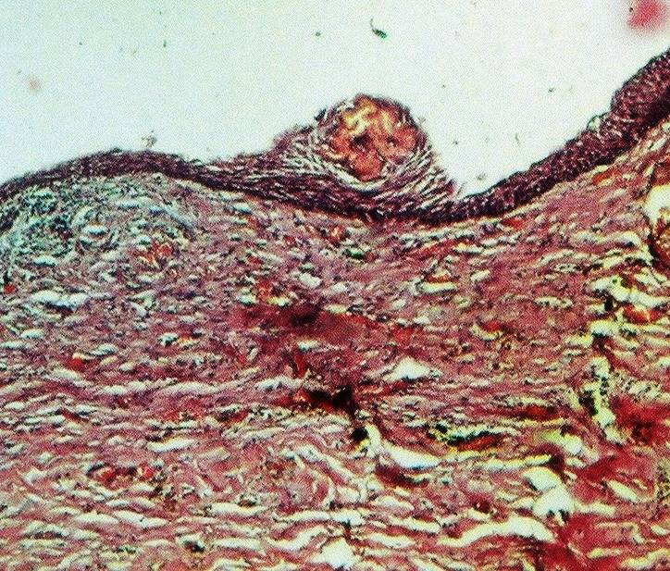
RUSHTON BODIES
Notes:
Cyst with inflammation show the presence of Rushton or Hyaline bodies
These are peculiar, linear, often curved, hyaline bodies with variable stainability and which are of questionable nature and unknown origin

Slide 23
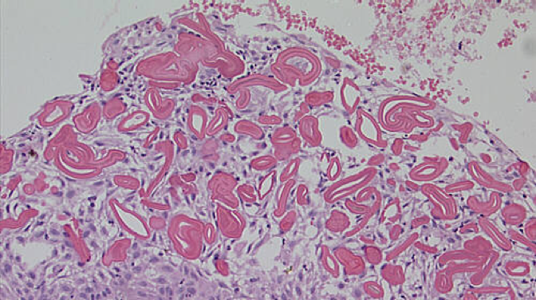
Rushton or Hyaline bodies origin
Rushton in 1955 --- hyaline bodies resemble in appearance and liability to fracture, the keratinized secondary enamel cuticle of Gottlieb.
Shear in 1961 --- (using histochemical studies) they are of odontogenic epithelial origin and are form of keratin.
Wertheimer et al in 1966 --- secondary product of odontogenic epithelial cells

Slide 24
Bouyssou and Guilhem in 1965 and Sedano and Gorlin in 1968 --- Haematogenous origin
- Derived from thrombi in venules of C.T that became vericose and strangled by epithelial cuffs which encircled them and they reacted histochemically as Haemoglobin.
- Thrombi shrink centrifugally and undergo splitting or they may calcify.
Morgan and Heydan in 1975 --- derived from degenerating RBCs.
Notes:
Types of rushton bodis:

Slide 25
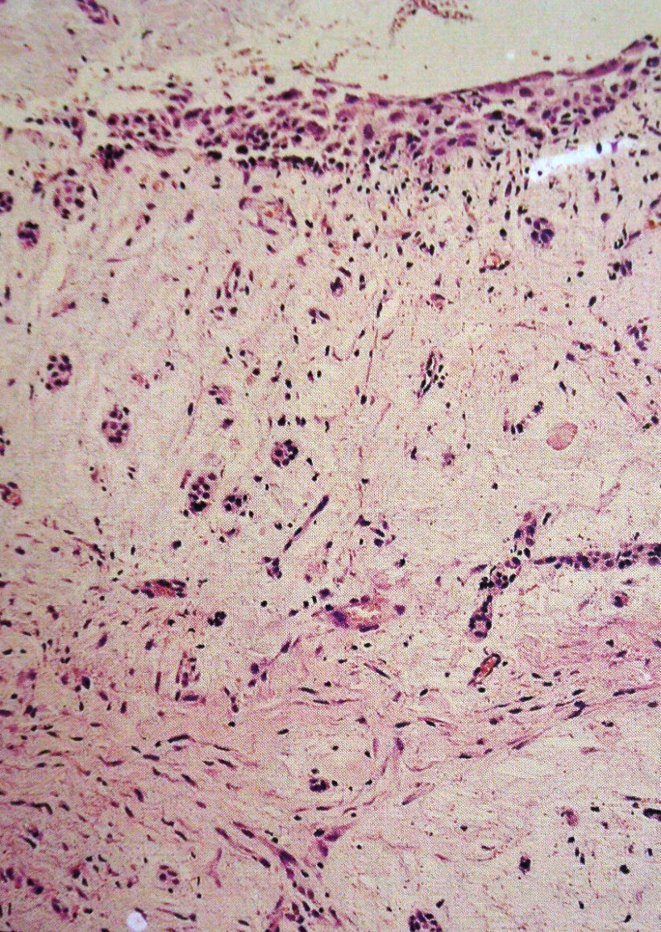
CONNECTIVE TISSUE WALL
Notes:
Adjacent connective tissue may show islands of odontogenic epithelium which appear inactive, similar to a dental follicle When the islands appear be to active, the picture could be similar to a ameloblastoma

Slide 26
POTENTIAL COMPLICATIONS
Development of an ameloblastoma either from the lining epithelium or from rests of odontogenic epithelium in the wall of the cyst
Development of squamous cell carcinoma form the same two sources
Development of mucoepidermoid carcinoma form the lining epithelium of dentigerous cyst which contains mucous secreting cells or cells with this potential
Notes:
Occurrence of ameloblastoma is far more pronounced in dentigerous cyst than in other odontogenic cyst
This change is not obvious clinically, hence it is an absolute requisite that all tissues from dentigerous cysts be submitted to a oral pathologist for thorough gross and microscopic examination
Tumor manifest itself in the form of nodular thickenings in the cyst wall

Slide 27
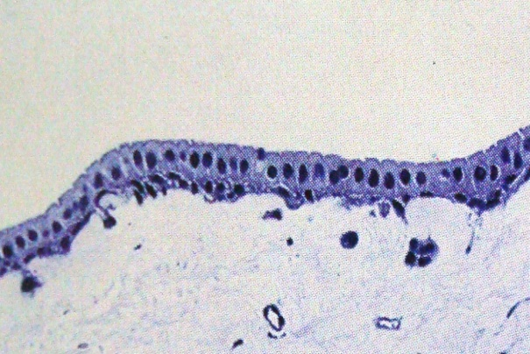
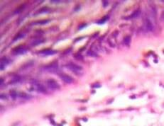
VICKER AND GORLIN’S CRITERIA
Hyperchromatism of the basal cell nuclei
Palisading with polarization of the basal cells
Cytoplasmic vacuolization with intercellular spacing in the lining epithelium
Cuboidal / columnar basal cells
Subepithelial Hyelinization.
Notes:
When observed together are manifestations of impending neoplasia

Slide 28
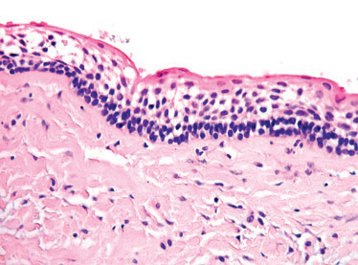
Presence of sprouting or budding and protruding of epithelial islands from the lining epithelium has been claimed to be evidence of neoplastic transformation.
Squamous metaplasia in long standing cyst lining appear to precede the development of carcinomatous change.
Notes:
Pic- In unicystic ameloblastoma, the tumorous epithelium is confined to the surface that lines the cystic cavity. In case of dropping off of this epithelium in the underlying stroma, treatment should be the same as for the other subtypes.

Slide 29
Dentigerous cyst and mucoepidermoid carcinoma
Several sources have been proposed for central MEC:
Mucous metaplasia of odontogenic cyst epithelium.
Entrapment of salivary tissues from submandibular, sublingual or minor salivary glands from retromolar area.
Maxillary sinus epithelium.
Iatrogenic entrapment of minor salivary glands
Reference: Neoplasms associated with odontogenic cysts K.M.K Masthan
journal of Dentistry and Oral hygiene 2011, vol-3(10)

Slide 30
EXAMINING THE CYSTIC FLUID
Cystic fluid: Pale, straw colored fluid
Thin, watery in consistency
Soluble protein levels in DC: 6.75gm/dl (Skaug- 1973)

Slide 31
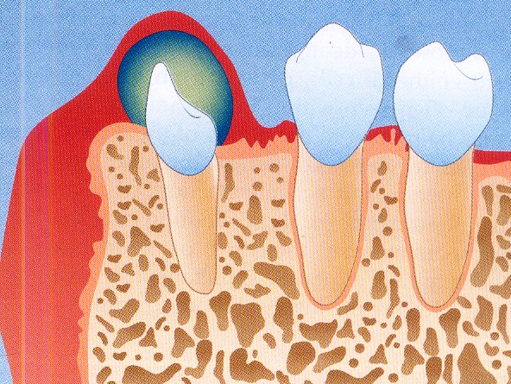
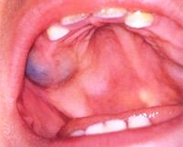
ERUPTION CYST
Defined as a odontogenic cyst with histologic features of a dentigerous cyst, that surrounds the crown of a tooth that has erupted through the bone but not soft tissue and is clinically visible as a soft fluctuant mass on the alveolar ridges.

Slide 32
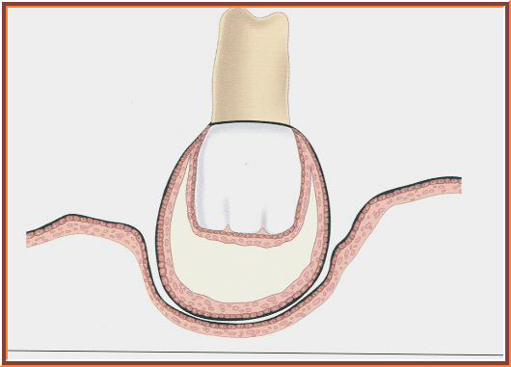
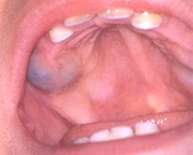
It is a dentigerous cyst occuring in soft tissues (Shear)
The eruption cyst occurs when a tooth is impeded in its soft tissue overlying the bone
Pathogenesis is similar to dentigerous cyst

Slide 33
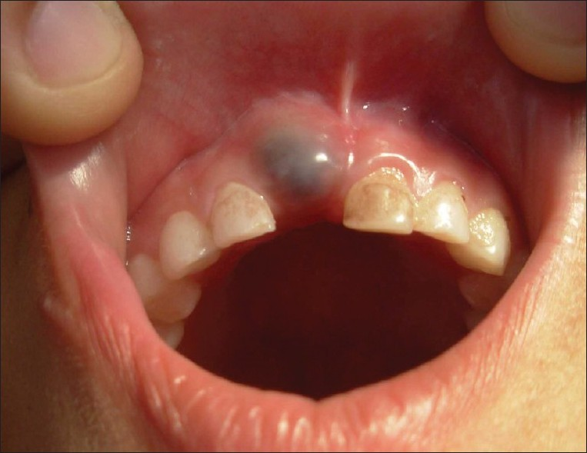
CLINICAL FEATURES
Occurs more frequently clinically, as they rupture and are not submitted for histological examination
More common in children, but can occur in adults
Both dentitions can be involved
Occurs commonly anterior to the 1st molar

Slide 34
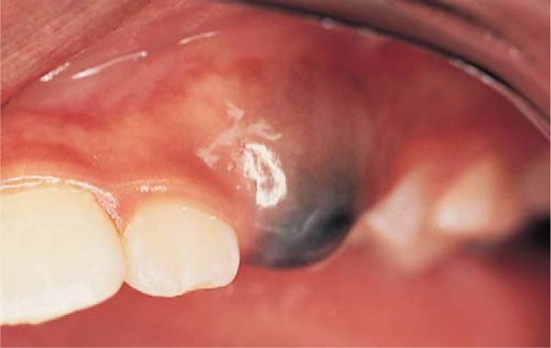
Lesion appears to be circumscribed, often fluctuant transparent swelling of the alveolar ridges
Sometimes cystic cavity may contain blood and may appear deep purple, hence the name “Eruption hematoma”
Usually painless unless secondarily infected
Notes:
( BLUE –DOMED CYST OF SEWARD)

Slide 35
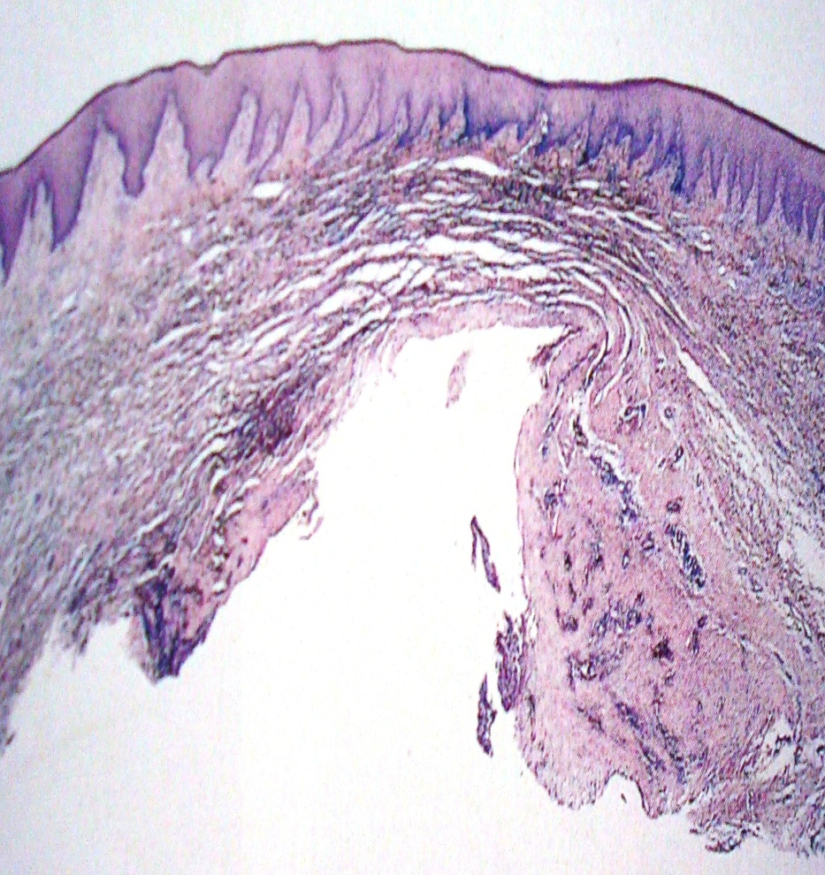
HISTOPATHOLOGY
Superior aspect is covered by stratified squamous epithelium
This is separated from the cyst by a strip of dense connective tissue which usually shows a mild chronic inflammatory cell infiltrate

Slide 36
ERUPTION CYST
Histopathology-
Oral epithelium
Gingival C.Tissue
(Acellular, densely collagenous & eosinophilic)
Follicular C. Tissue
(Densely cellular, less collagenous & basophilic)
Cyst epith. Lining (2-3 cell layer str. squamous)
Cystic lumen

Slide 37
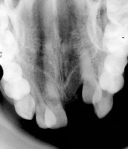
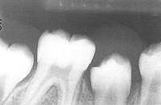
RADIOGRAPHIC FEATURES
Notes:
May show a soft tissue shadow, usually no bone involvement, dilated and open crypt is seen
TREATMENT- No treatment required. Surgically exposing the crown may aid in eruption

Slide 38
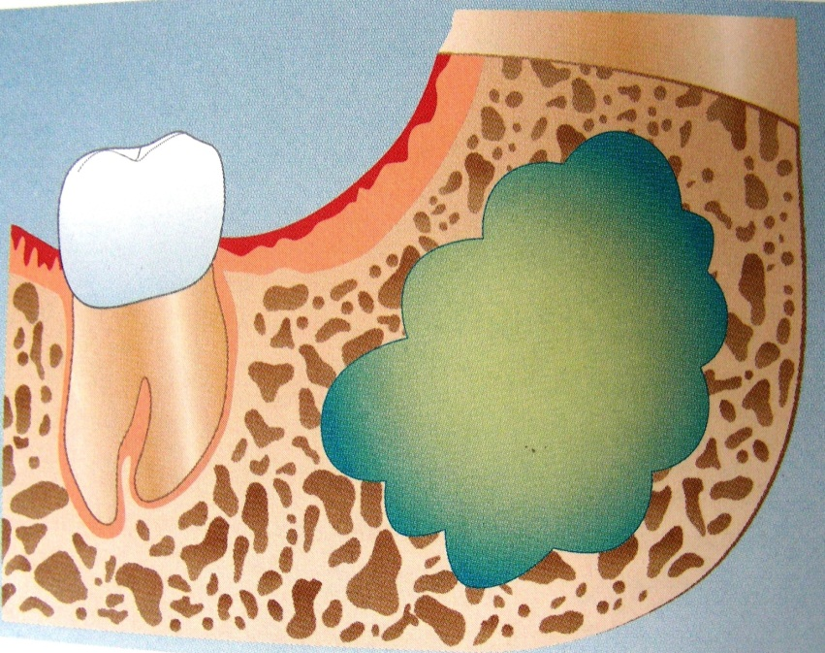
ODONTOGENIC KERATOCYST (OKC)

Slide 39
HISTORY
Called as “Cholesteatoma”(Hauer 1926, Kostecka 1929)
Philipsen (1956) gave the term “ODONTOGENIC KERATOCYST”
Mikulicz in 1876 described it as “dermoid cyst”

Slide 40
Shear (2003) referred it as “Keratocystoma”
Philipsen & Reichart (2004)
“Keratinizing cystic odontogenic tumor”
Philipsen (2005)
“Keratocystic odontogenic tumor”
Notes:
At a recent meeting of international association of o pathologists in june 2006--- term OKC should be used

Slide 41
Initially called as “primordial cyst” (Robinson 1945) & (Forssell 1979)
Primordial Cyst
Defined as cyst which arises by breakdown of the stellate reticulum of the enamel organ before any mineralized tissue is formed and hence develops in place of a tooth which may be one of the normal series or a supernumerary tooth.
So, it is found in place of a tooth rather than associated with it.

Slide 42
ORIGIN
Dental lamina or its remnants
From offshoots of basal layer of oral epithelium
Notes:
The 2 theories for origin are compatible as both dental lamina and basal cell hamartias have common parentage– stomodeal ectoderm and both are influenced by ectomesenchyme. (altini and shear 1976)
In Rx- to avoid post-op recurrence- overlying attached mucosa shud b excised.

Slide 43
CLINICAL FEATURES
3rd most common cyst after radicular and dentigerous cyst
Age – 1st – 9th decade
-Highest peak in 2nd to 3rd decade
-Bimodal age occurance
Sex – M>F
Site – mandible > maxilla

Slide 44
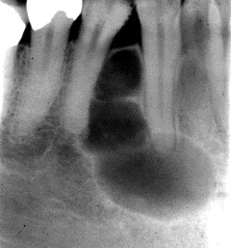
May complaint of pain, swelling or discharge
Expands in medullary cavities, hence clinically observable expansion of bone is late.
Causes displacement of teeth
Most patients are free of symptoms until the cyst has developed a large size

Slide 45
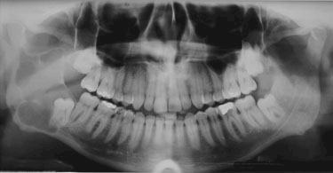
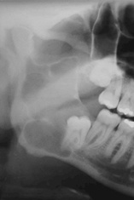
RADIOHRAPHIC FEATURES
Notes:
Scalloping– unequal growth activity in different parts of cyst lining

Slide 46
Types of OKC (Main-1970a):
Extraneous
Replacemental
Collateral
Envelopmental
Replacemental variety is also called as PRIMORDIAL Cyst

Slide 47
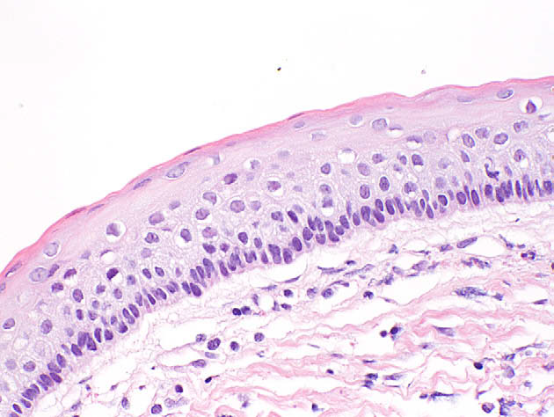

Histologic features:

Slide 48
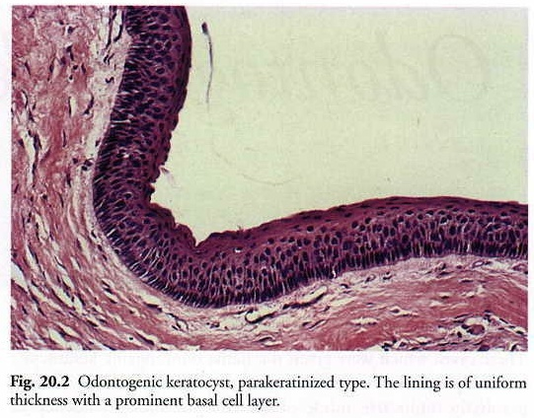
FOLLICULAR KERATOCYST
Corrugated epith. with Parakeratinized lining
Polyhedral cells
OKC
Palisaded basal cells(Picket fence appearance)
Erupting tooth
A type of Keratocyst
A tooth surrounded by its follicle erupts into a keratocyst cavity in the same way as it erupts in the oral cavity.
Thin Fibrous Capsule free from inflammatory infiltrate

Slide 49
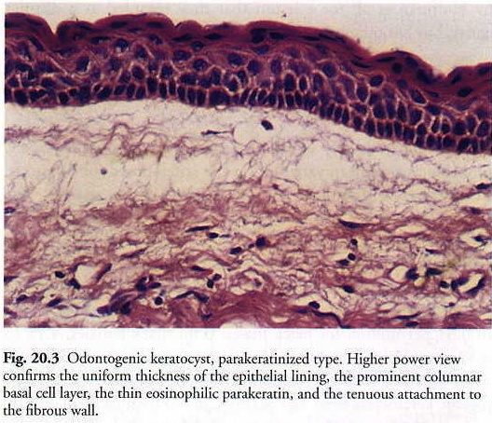
Thin Fibrous Capsule free from inflammatory infiltrate

Slide 50
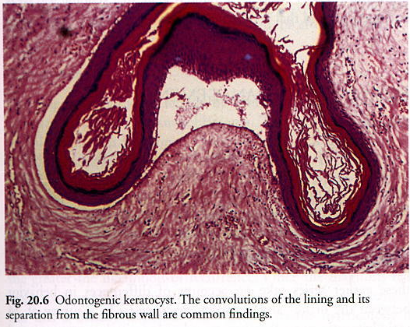

Slide 51
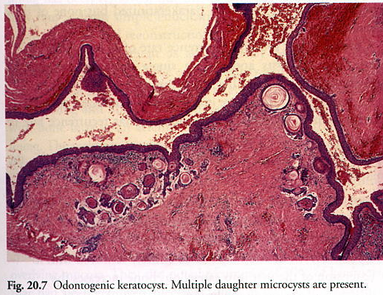

Slide 52
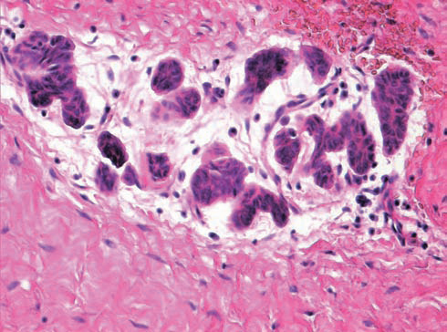
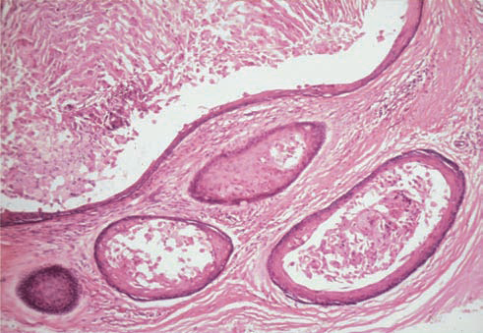
EXAMINING THE FIBROUS CAPSULE
Notes:
EXAMINING THE FIBROUS CAPSULE
Thin with few cells.
Widely separated stroma, rich in mucopolysaccharides.
Mild inflammatory infiltrate.
Satellite cysts, epithelial rests & budding basaloid cells.
Mucous metaplasia, hyaline bodies & cholesterol clefts sometimes present.

Slide 53
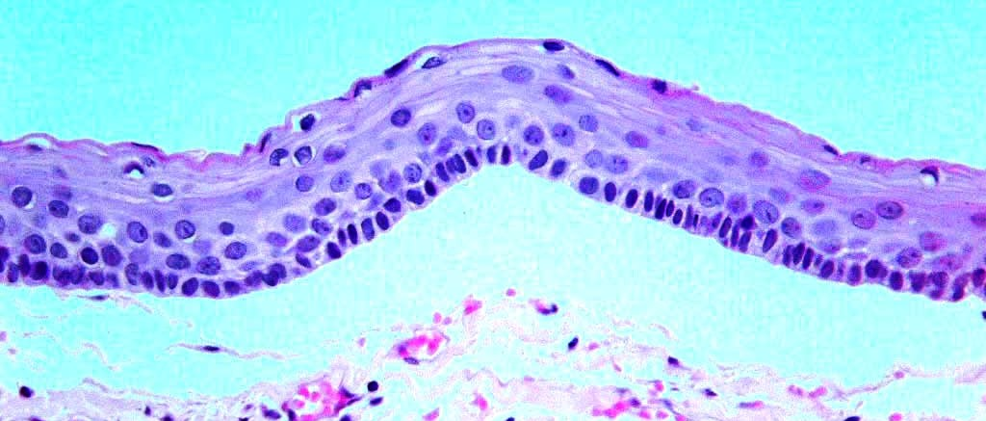
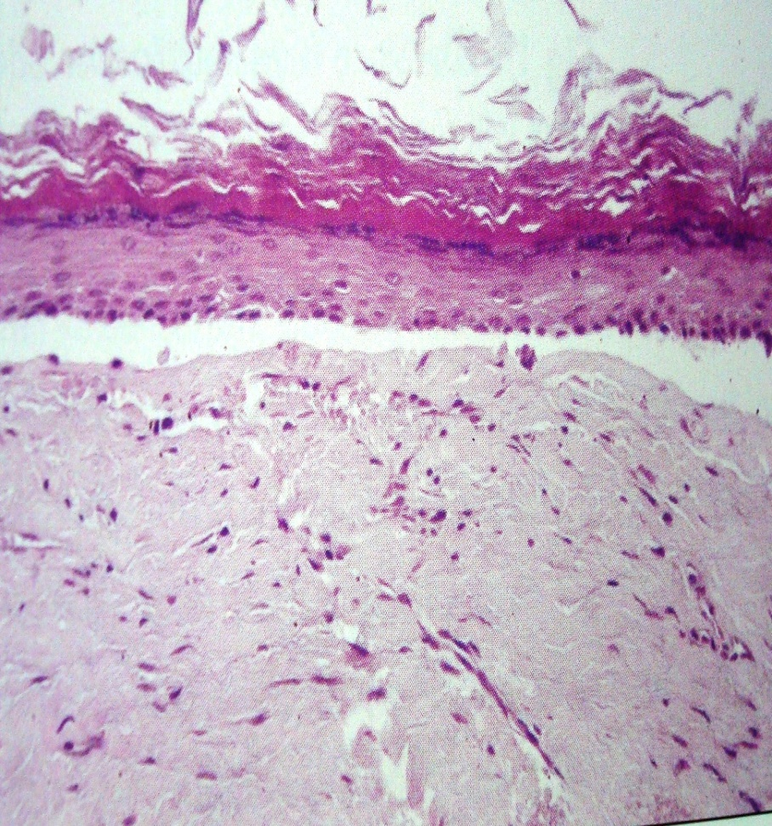
HISTOLOGIC VARIANTS OF OKC
Parakeratinized – 80-90%
Orthokeratinized – 7-10%

Slide 54
Orthokeratinized OKCs | Parakeratinized OKCs
Always in dentigerous association | Not always
Less aggressive | Aggressive
Usually around mandibular 3rd molars | With or without an associated tooth
No hyperchromatic basal cell layer | Hyperchromatic basal cell layer
Flat basal cell layer | Cuboidal to columnar basal cell layer
Shows a male predilection | No such predilection
Has a predilection for posterior mandible | No such predilection

Slide 55
ENLARGEMENT
Rate of growth
Proliferation of epithelium & CT was in clusters & irregular. Not homogenous.
Role of osmolality
Raised osmolality is not the sole cause.
Role of inflammatory exudate
Contributed significantly to its osmotic & hydrostatic pressure & hence expansile growth of OKC
Mean mitotic activity was 9
Mural growth in form of epithelial proliferation was also responsible

Slide 56
Role of glycosaminoglycans
Role of collagenolytic activity.
Collagenase activity might influence the expansion.
Role of IL, TNF, MMP’s, tenascin, fibronectin
Increase in bone resorption
Release of these molecules contributes to osmotic and hydrostatic pressure. Hence in expansile growth.
The collagen fibres were loosely packed & might be composed of procollagen, intermediates or pathologic collagens rather than tightly packed fibres
Hyaluronic acid, Chondriotin 4 sulfate and Heparin sulfate.

Slide 57
EXAMINING THE CYSTIC FLUID
Soluble protein levels in OKC: < 3.5gm/dl (Toller 1970)
Aspirating cystic fluid & demonstrating keratinized squames in stained films.
A keratocyst antigen (KCA) was demonstrated in the fluid of OKC which was localized to epithelial cells.
Notes:
Albumin: globulin was more.
Inflammatory cyst had altered permeability of epithelium so had a higher protein content than uninflammed.

Slide 58
Highest recurrence rate:
Tendency to multiplicity
Satellite cysts
Lining is thin & fragile
Lining weakly attached to fibrous wall
Extension of cyst in to cancellous bone
Other ramnent of dental lamina contribute for second lesion

Slide 59
p53, PCNA, Ki-67, Calretinin
These markers are expressed in actively proliferating cells, particularly in neoplasms.
The presence of p53 in the nucleus was identified in the basal cells.
PCNA staining was positive in all the basal and most parabasal cells.
All p53 positive cells were also positive for PCNA thus proving the cells to be proliferating.
Review Biological pathways involved in the aggressive behavior of the keratocystic
odontogenic tumor and possible implications for molecular oriented treatment – An overview
Oral Oncology 46 (2010) 19–24
Notes:
The p53 gene has a short half-life in normal cells and cannot be detected immunocytochemically,
but when it mutates, the p53 protein product is more stable and can be detected using this procedure.
PCNA was defined as a
36kD nuclear protein associated with the cell cycle, being
an auxiliary protein of DNA polymerase-δ, the distribution
of which in the cell cycle increases through G1, peaks
at the G1/S interphase and decreases through G2 phase.

Slide 60
Ki67 & calretinin showed a similar staining pattern as PCNA and this could point out to an abnormal control of cell cycle.
p63 labeling was also more intense and diffuse in OKC thus pointing towards the abnormal control of cell cycle, leading to an intrinsic growth potential.
There was over expression of bcl-2 to varying degrees in syndrome group rather than sporadic.
Review Biological pathways involved in the aggressive behavior of the keratocystic
odontogenic tumor and possible implications for molecular oriented treatment – An overview
Oral Oncology 46 (2010) 19–24
Notes:
Calretinin has been shown to be expressed in a high proportion of solid, unicystic and multicystic ameloblastomas (Altini et al., 2000; Coleman et al., 2001). It is a 29kDa calcium-binding protein which is expressed in the central and peripheral nervous systems as well as in many other normal and pathological human tissues
Bcl-2 stops apotosis

Slide 61
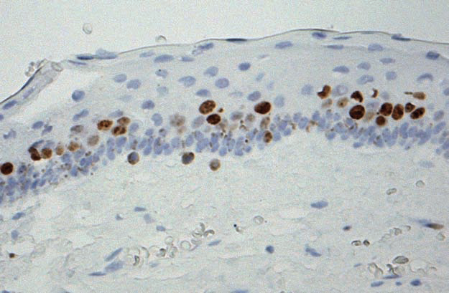
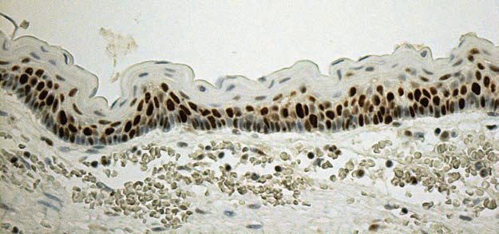
Plentiful proliferating cell nuclear antigen (PCNA) positive cells in the basal and suprabasal layers of an odontogenic keratocyst.
Moderate numbers of Ki-67-positive cells are present in the suprabasal layers of this odontogenic keratocyst.

Slide 62
JAW CYST- BASAL CELL NEVUS, BIFID RIB SYNDROME, GORLIN & GOLTZ SYNDROME.
First described by Binkley and Johnson in 1951.
Thoroughly reviewed by Gorlin & co workers.
Caused by mutations in patched (PTCH) gene, mapped to chromosome 9q22.3-q31
Transmitted as autosomal dominant.
Notes:
hereditary cutaneomandibular polyoncosis,

Slide 63
The Nevoid Basal Cell Carcinoma Syndrome (NBCCS) is an inherited medical condition involving defects within multiple body systems such as the skin, nervous system, eyes, endocrine system, and bones.
Although primarily being known as Nevoid Basal Cell Carcinoma Syndrome, 10% of people with the condition do not develop basal cell carcinomas (BCCs).
Notes:
Complete penetrance and variable expressivity

Slide 64
SYNONYMS:
NBCCS
Gorlin Goltz syndrome,
Basal cell nevus syndrome
5th phacomatosis
Multiple BCC syndrome
Multiple basalioma syndrome
Multiple nevoid basal cell- epithelioma- jaw cysts-bifid rib syndrome
Hereditary cutaneomandibular polyoncosis.

Slide 65
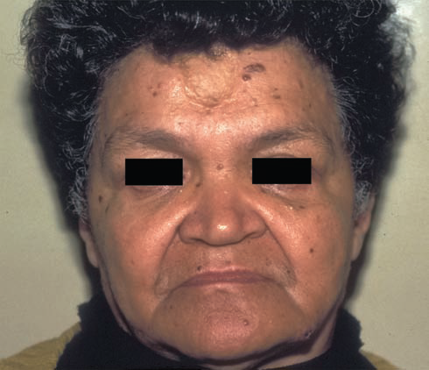
CLINICAL FEATURES
Cutaneous Anomalies:
BCC, palmar & plantar pitting.
2. Dental & Osseous Anomalies: OKC, bifid rib.
3. Opthalmic Anomalies: hypertelorism, congenital blindness.
4. Neurologic Anomalies: mental retardation

Slide 66
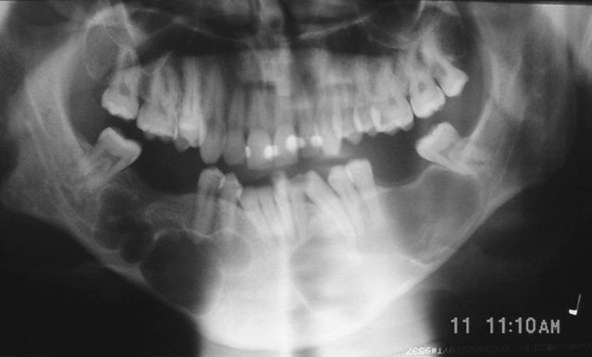
BASAL CELL NEVUS SYNDROME

Slide 67







MAJOR CRITERIAS
Nevoid basal Cell Carcinoma Syndrome
Positive family
history
Notes:
Diagnostic Criteria for Gorlin Syndrome:
Diagnostic criteria is given by Evans et al. These criteria were modified by Komones et al in 1997. Gorlin syndrome can be established when two major or one minor criteria are present.
Major Criteria
1. More than two basal cell carcinomas or one BCC under the age of 20 years.
2. Histologically proven odontogenic keratocyst of the jaws.
3. Three or more cutaneous palmar or plantar pits.
4. Bifid, fused or markedly splayed ribs.
5. First degree relative with NBCCS.

Slide 68






MINOR CRITERIAS
Nevoid basal Cell Carcinoma Syndrome
Notes:
Minor Criteria Any one of the following features:
1. Proven macrocephaly after adjustment for height
2. One of several orofacial congenital malformation, cleftlip or palate, frontal bossing, coarse face, moderate to severe hypertelorism.
3. After skeletal abnormalities, marked pectus deformity, marked syndactyly of the digits.
4. Radiological abnormalities, bridging of the sella turcia vertebral anomalies such as hemivertebra, fusion or
elongation of the vertebral bodies modeling defects of hands and feet
5. Ovarian fibroma.
6. Medullobalstoma
2 major 2 minor
( Lorenzo Lo Muzio, Pierfrancero Nocini, Paulo Maurizo. Early diagnosis of Nevoid basal cell carcinoma syndrome. J Am Dent Assoc 1999;130(5):669-74.)

Slide 69
Sonic Hedgehog (SHH) in morphogenesis of the craniofacial complex
In a growing embryo, cells develop differently in the different positions.
The Hedgehog signaling pathway gives information to the cells, which are needed to make the embryo develop properly.
Key regulator of development.
Notes:
, conserved from flies to humans. It plays a key role in regulating vertebrate organogenesis, such as in the growth of digits on limbs and organization of the brain……It controls cell division of adult stem cells and has been implicated in development of some cancers. Mutations in the human sonic hedgehog gene, SHH, cause holoprosencephaly type 3 (HPE3) as a result of the loss of the ventral midline. Sonic hedgehog is secreted at the zone of polarizing activity (ZPA), which is located on posterior side of a limb bud in an embryo. The sonic hedgehog transcription pathway has also been linked to the formation of specific kinds of cancerous tumours.

Slide 70

The Odontogenic Keratocyst: A Cyst, or a Cystic Neoplasm? J Dent Res 90(2) 2011 T.J.li
Notes:
Figure 4. Hedgehog (Hh) signaling pathway. In the absence of ligand, the Hh signaling pathway is inactive
(A). In this case, the transmembrane protein receptor PTCH1 or PTCH2 inhibits the activity of Smoothened (SMO), a seven-transmembrane protein. The transcription factor GLI, a downstream component of Hh signaling, is prevented from entering the nucleus through interactions with cytoplasmic proteins, including Suppressor of fused (SUFU). As a consequence, transcriptional activation of Hh target genes is repressed. Activation of the pathway
(B) is initiated through binding of any of the 3 mammalian ligands—Sonic hedgehog (SHH shown in the Fig.), Desert hedgehog, or Indian hedgehog—to PTCH1 or PTCH2. Ligand binding results in relieving PTCH1’s inhibition of SMO, thus activating a cascade that leads to the translocation of an active form of the transcription factor GLI to the nucleus. Nuclear GLI activates the expression of target genes that are important for embryonic development, controlling cell proliferation and cell fate. The Hh pathway can be blocked at different levels
(C). Several specific SMO inhibitors, such as Cyclopamine and small-molecule inhibitors Cur61414 and GDC-0449, have been identified to block activation of the Hh pathway caused by oncogenic mutations. Antibodies (Ab) directed against Sonic Hedgehog (SHH) could inhibit ligand activity. Antisense oligonucleotides targeting the transcripts of GLI may also provide novel ways of treating Hh-responsive tumors.

Slide 71
Two hit mechanism for the pathogenesis of OKC
Many of the cysts arise with the allelic loss at 9q22.3.
The defect in the gene is either the mutation occurred at very early stage of embryogenesis or might undergo point mutation at a later age.
In the syndrome associated OKC’s, with PTCH gene inactivation there was a loss of control of proliferative activity in the lining and this could act synergistically with the over expression of cyclin D, leading to neoplastic potential.

Slide 72
Two hit mechanism
The process by which a tumor supressor gene is inactivated
1st hit: is a mutation in one allele, which, although it can dominantly be inherited, has no phenotypic effect.
2nd hit: refers to loss of other allele and is known as loss of heterozygosity (LOH)
In KOTs, this leads to dysregulation of the oncoproteins cyclin D1 and p53.
LOH in 9q22.3– q31 region has been reported in many epithelial tumors, including OSCC, BCC, Transitional cell carcinoma.
Notes:
Loh IS A FEATURE OF TUMORIGENIC TISSUE

Slide 73
Analysis of the neoplastic nature and biological potential of sporadic and nevoid basal cell carcinoma syndrome associated keratocystic odontogenic tumour
The results implied that heparanase expression may be correlated with the neoplastic properties of KCOT, particularly in NBCCS-associated cases.
In sporadic KCOT, heparanase expression was comparatively weak and uneven. However, basal and keratinized cells showed moderate expression.
J Oral Pathol Med (2007) 36: 550–4

Slide 74

Sporadic NBCCS
It is known that heparanase is rare in the normal tissue and often increases in tumors and promotes tumor invasion, angiogenesis and metastasis
Keratocystic odontogenic tumor, previously known as odontogenic keratocyst, is a benign cystic lesion, but it often shows locally destructive behaviour and high recurrence rate

Slide 75
OKC’s are first sign of NBCCS.
Have appeared in early 2nd decade. This suggest OKC arise earlier in patients with NBCCS than without NBCCS.
The appearance of 2 or more recurrent OKC’s or appearance of OKC in young patient should lead dental practitioner to suspect that patient has NBCCS

Slide 76
Property | OKC with syndrome | OKC without syndrome
Age of occurrence | Single peak at 10-30 years. | Bimodal- 15-45 years & 55-65 years
Gender distribution | Females> males (17:1) | Males> females (1.7:1)
Site | Maxilla | Mandible-ramus area
Recurrence | More | Less
Index of activity | Higher | Lower
Satellite cysts | Common | uncommon
Ki67 | Greater (hence more proliferative) | lesser
Pathogenesis | Mutation is already present in the germ line & only single mutational event is required in somatic cells to cause homozygous inactivation | Two independent mutational events are required in somatic cells.
Notes:
Index of activity= solid proliferations, satellite cyst, ameloblastomatoid proliferation, mitotic rate

Slide 77
Reclassification of OKC to tumor : Keratinizing Cystic Odontogenic Tumor
In 1967 Toller suggested that OKC may best be regarded as benign neoplsm rather than cyst based on its clinical behaviour.
Behavior: KOT is locally destructive and recurrence rate is high.
Histopathology: proliferation and budding of basal layer in to the connective tissue
Genetics: PTCH gene involvement

Slide 78


GINGIVAL CYST OF INFANTS
Multiple or solitary, superficial raised nodules on the edentulous ridges of infants
Derived from rests of dental lamina
Asymptomatic and produce no discomfort to the infants
Notes:
Cysts in the anterior portion of the jaws are displaced lingually with respect to the deciduous incisors
Those in the posterior region are seen occlusal to the molars

Slide 79

Bohn’s nodules and Epstein’s pearls are two similar lesions
Epstein’s pearls are cystic keratin filled nodules found along the mid-palatine raphe, probably derived from entrapped epithelial remnants along the line of fusion.
Bohn’s nodules are keratin filled cysts scattered over the palate and apparently derived from palatal salivary gland structures.
Notes:
Epstein’s pearls are keratin filled nodules found along the midpalatine raphe, probably derived from entrapped epithelial remnants along the line of fusion.
Bohn’s nodules are keratin filled cysts scattered over the palate and apparently derived from palatal salivary gland structures

Slide 80


HISTOPATHOLOGY
True cysts with thin epithelial lining which lacks rete ridges
Lumen is usually filled with desquamated keratin occasionally containing inflammatory cells
Notes:
RX--- Usually no treatment is required Disappear by opening onto the surface of the mucosa or through disruption by erupting teeth

Slide 81


GINGIVAL CYST OF ADULTS
Developmental odontogenic cyst of the gingival soft tissue.
Derived from the rests of the dental lamina
Contain a lining of embryonic epithelium of cuboidal cells and distinctive focal thickenings like Lateral periodontal cyst.

Slide 82

POSSIBLE SOURCES OF CYST FORMATION
Heterotopic glandular tissue
Degenerative changes in a proliferating epithelial peg
Remnants of dental lamina, enamel organ or epithelial islands of periodontal membrane
Traumatic implantation of epithelium
Notes:
The last 2 appear to be the etio. On the basis there do appear to be two recognizable forms of gingival cyst
1) Arising from cystic transformation of dental lamina or rests of Serres
2) Arising from traumatic implantation of surface epithelium
Wysocki et al concluded that it does arise from the postfunctional rests of dental lamina and thus represents the extraoseous counterpart of lateral periodontal cyst.

Slide 83


CLINICAL FEATURES
More common in adults (over 40yrs of age)
Site – canine-premolar area
Small well circumscribed lesion on the gingiva
Usually seen in the attached gingiva or interdental papilla

Slide 84

HISTOPATHOLOGY
1.Epithelium ranges in thickness from 1-3 layers of flat cuboidal cells to thick stratified squamous epithelium without rete ridges
2.Many epithelial cells have pyknotic nuclei and show perinuclear cytoplasmic vacuolization
Notes:
Epithelial plaques are similar to lateral periodontal cyst

Slide 85

Glycogen-rich clear cells are present especially in the focal thickenings of the lining
Rests of dental lamina may be present in the connective tissue

Slide 86


Notes:
Local surgical excision

Slide 87


LATERAL PERIODONTAL CYST
Slow growing, non-expansile developmental odontogenic cyst
Occurs on a lateral periodontal position.

Slide 88

VARIOUS THEORIES AND PATHOGENESIS
Develops as a dentigerous cyst along the lateral surface of the crown and as the tooth erupts,
the cyst assumes a position in approximation to the lateral surface of the root

Slide 89
Proliferation of rests of Malassez in the periodontal ligament – stimulus is unknown
As a primordial cyst of a supernumerary tooth – more occurrence of supernumerary teeth in premolar area
Proliferation and cystic transformation of rests of dental lamina
Notes:
2) The stimulus for the proliferation of the rests of malassez is unknown
3) Originates as a primordial cyst of a supernumerary tooth germ, as the lateral periodontal cyst has a predilection for the premolar area and even the supernumerary teeth also have a predilection for the premolar teeth
4) Proliferation and cystic transformation of the rests of dental lamina, which are in the post functional state and therefore have only a limited growth potentila that is in accordance with the usual size of the cyst.

Slide 90
Wysocki et al concluded that the lateral periodontal cyst and gingival cyst of adults share a common histogenesis from the post functional dental lamina rests.
These two cysts are basically central / intraosseous and peripheral / extraosseous manifestations of the same lesion

Slide 91

CLINICAL FEATURES
Chiefly in adults (mean age-50yrs)
Predilection for canine-premolar area
Male = Female

Slide 92



RADIOGRAPHIC FEATURES
Radiolucent area in apposition to the lateral surface of the tooth
May or may not be well circumscribed
Most lesions have definite borders and surrounded by a rim of sclerotic bone

Slide 93


HISTOPATHOLOGY
Thin non-keratinized epithelium usually 1-5 cell thick which resembles reduced enamel epithelium
Cuboidal or columnar cells may be seen in the lining epithelium

Slide 94


Focal thickened plaques of proliferating lining cells may be seen projecting into the lumen
Many of the epithelial lining cells have a clear, vacuolated, glycogen rich cytoplasm
Notes:
Clear cells forming epithelial thickenings are the histological hallmark of the lateral periodontal cyst. RX----Surgical enucleation

Slide 95

Lateral periodontal cyst
Gingival cyst of adults
Notes:
gca– frm REE by dilatation of follicle after eruption of tooth
Lpc– frm REE dilation of follicle before eruption of tooth

Slide 96

BOTRYOID ODONTOGENIC CYST
This is a cystic lesion with clinical and radiologic features of a lateral periodontal cyst
Weathers and Waldron (1973) first suggested the term botryoid odontogenic cyst because the gross specimen resembled a cluster of grapes
Notes:
They termed it as botryoid odontogenic cyst because the gross specimen resembled a cluster of grapes

Slide 97


ORIGIN AND PATHOGENESIS
Notes:
It is a polycystic variant of the lateral periodontal cyst developing through cystic transformation of multiple islands of rests of dental lamina. The epithelial lining of the lateral periodontal cyst and the botryoid odontogenic cyst Is similar as are its clinical features including age of predilection and site of occurance.

Slide 98
CLINICAL FEATURES
Age – 5th to 7th decade of life
Site – more in the anterior mandibular region
Usually asymptomatic but may cause pain

Slide 99

RADIOLOGIC FEATURES
Mostly it is a multilocular radiolucency, but can be unilocular as well

Slide 100

HISTOPATHOLOGY
Similar to lateral periodontal cyst
It is multicystic with thin fibrous connective tissue septa

Slide 101

Cystic cavities are lined by thin nonkeratinised epithelium but occasionally may be lined by stratified squamous epithelium
Lining may contain plaque like thickenings
Clear cells are also present
Notes:
Plaque like thickenings are similar to the lateral periodontal cyst

Slide 102
GLANDULAR ODONTOGENIC CYST
An unusually large solitary or multilocular odontogenic cyst probably derived from rests of dental lamina, consisting of a stratified squamous epithelium containing numerous mucous secreting cells.
First described by Padayachee and Van Wyk (1987) as ‘sialo-odontogenic cyst’
Gardner et al (1988) used the term ‘glandular odontogenic cyst’
Also called as ‘mucoepidermoid odontogenic cyst’ (Sadeghi et al 1991)
Notes:
Shares some of its histological features with lateral odontogenic cyst and botryoid odontogenic cyst

Slide 103


CLINICAL FEATURES
Age –2nd to 9th decade
(peak in 6th decade)
Sex – more in males
Site – mandible (ant. region)
Rare cystic lesion usually produces a painless swelling
Aggressive or potentially aggressive lesion
Recurs if not adequately excised

Slide 104


RADIOGRAPHIC FEATURES
Could be a well-defined unilocular or multilocular lesion
Can cause cortical expansion while larger lesions perforate the cortical plates
Can cause displacement and resorption of teeth

Slide 105


HISTOPATHOLOGY
Cyst is lined in parts by non-keratinised stratified squamous epithelium with chronic inflammatory cell infiltrate in the connective tissue wall
Diagnosis is made when the superficial layer of the epithelial lining consists of columnar or cuboidal cells called as ‘Hobnail’.
Notes:
Kaplan and co-authors1 recently stated that ‘‘due to similarities in microscopic characteristics between GOC
and lesions such as botryoid cyst, radicular and dentigerous cysts with mucous metaplasia and more importantly
low-grade mucoepidermoid carcinoma, a definitive diagnosis can be difficult to make.’’ Nevertheless, they added that a diagnosis of GOC had to be based on the mandatory presence of the five major features. These are squamous epithelium, varying thickness, cuboidal eosinophilic (‘‘hobnail’’) cells, mucous (goblet) cells and intraepithelial glandular or duct-like structures.1 Although it is unlikely that any reports used such strict criteria, this statement clearly indicates that the histopathology alone may be considered to be insufficiently specific in each and every case of GOC.----- SYSTEMATIC REVIEW Glandular odontogenic cyst: systematic review DS MacDonald-Jankowski -- Dentomaxillofacial Radiology (2010) 39, 127–139

Slide 106

These cuboidal or columnar cells have cilia or filliform extensions of the cytoplasm
The epithelium has a glandular or pseudo glandular structure with intraepithelial crypts or microcysts
Columnar cells with cilia
Numerous goblet cells may be present.
Sometimes the epithelium may be thin similar to reduced enamel epithelium.
Notes:
2. The lining of the glandular odontogenic cyst consists of different kinds of epithelium that may form glandular spaces

Slide 107

Epithelial thickenings or plaques may also be present.
These plaques are identical to lateral periodontal cyst, botryoid odontogenic cyst, and gingival cyst of adults.

Slide 108


Intraepithelial gland-like structures lined with mucous cells.
(b) Mucicarmine stain
(a) Alcian blue stain

Slide 109
Glandular odontogenic cyst: a challenge in diagnosis and treatment; I Kaplan, Y Anavi, Oral Diseases (2008) 14
The major criteria include:
Squamous epithelial lining, with a flat interface with the connective tissue wall, lacking basal palisading.
Epithelium exhibiting variations in thickness along the cystic lining with or without epithelial spheres’ or whorls’ or focal luminal proliferation.
Cuboidal eosinophilic cells or ‘hob-nail’ cells.
Mucous (goblet) cells with intraepithelial mucous pools, with or without crypts lined by mucous producing cells.
Intraepithelial glandular, micro-cystic or duct-like structures.
Notes:
A set of criteria for histological diagnosis has been proposed. These were divided into major and minor criteria, where we suggest that at least focal presence of each of the major ones is mandatory for diagnosis, while the minor criteria can support the diagnosis but are not mandatory.

Slide 110
The minor criteria include:
• Papillary proliferation of the lining epithelium.
• Ciliated cells.
• Multicystic or multiluminal architecture.
• Clear or vacuolated cells in the basal or spinous layers.
Applying this set of criteria will help narrow down the list of differential diagnosis
Glandular odontogenic cyst: a challenge in diagnosis and treatment I Kaplan, Y Anavi, A Hirshberg Oral Diseases (2008) 14, 575–581.

Slide 111

Glandular odontogenic cyst: a challenge in diagnosis and treatment I Kaplan, Y Anavi, A Hirshberg Oral Diseases (2008) 14, 575–581.

Slide 112
CALCIFYING ODONTOGENIC CYST
OTHER NAMES
Keratinizing and /or calcifying odontogenic cyst (Gold 1963)
Gorlin cyst.
Gorlin Gold cyst.
Cystic keratinizing tumor.
Dentinogenic ghost cell tumor
Keratinizing ameloblastoma.
Dentinoameloblastoma
J Oral Pathol Med (2008) 37: 302–308

Slide 113
HISTORY
First described by Gorlin et al in 1962
1971 WHO classification described COC as “non-neoplastic cystic lesion.”
1992 replaced this phrase with “most lesions appear non-neoplastic.”
COC repesents a heterogenous group of lesions that exhibit a variety of clinicopathologic and behavioural features. Because of this there has been a disagreement on the terminology and classification.
Notes:
Actual description was given by Rywkind in 1932 who considered it to be a variant of cholesteatoma.

Slide 114
Gorlin et al | 1962 | Calcifying Odontogenic Cyst
Gold | 1963 | Keratinizing Calcifying Odontogenic Tumor (KCOT)
Fejerskov & Krogh | 1972 | Calcifying Ghost cell Odontogenic Cyst (CGCOT)
Freedman et al | 1975 | Cystic Calcifying Odontogenic Tumor (CCOT)
Praetorius et al | 1981 | Dentinogenic Ghost cell Odontogenic Tumor (DGCT)
Ellis & Shmookler | 1986 | Epithelial Ghost cell Odontogenic Tumor (EGCOT)
Colmenero | 1990 | Odontogenic Ghost cell Tumor (OGCT)
Ref: So-called COC: review and discussion on the terminology and classification Makoto Toida JOPM 1998, 27, 49-52

Slide 115
CLASSIFICATION
Studies by Praetorius et al (1981) has concluded that what was previously considered as a COC actually comprises two entities, a cyst and a neoplasm.
Calcifying odontogenic cyst
Cystic (Type1)
Unicystic (Type1a)
Odontome producing (Type1b)
Neoplastic (Type2)
Ameloblastomatous proliferating (Type1c)
Notes:
In 1981, Prætorius et al. proposed a widely used classification which tried to resolve the question on the cystic or neoplastic nature of the COC. They proposed that it could be divided into cystic and neoplastic types. The cystic variety was classified as simple unicystic (type1a), odontome producing (type 1b) and ameloblastomatous proliferating (type 1c).

Slide 116
BY HONG et al
Cystic
Nonproliferative
Proliferative
Neoplastic
Ameloblastoma ex calcifying odontogenic cyst
Peripheral epithelial odontogenic ghost cell tumor
Ameloblastomatous
Associated with odontome
Central epithelial odontogenic ghost cell tumor
Oral Surg Oral Med Oral Pathol 72:56,1991

Slide 117
PRAETORIUS 2006
Group 1- ‘Simple’ cysts
Calcifying odontogenic cyst (COC)
Group 2- Cysts associated with odontogenic hamartomas or benign neoplasms: calcifying cystic odontogenic tumours (CCOT).
The following combinations have been published:
CCOT associated with an odontome.
CCOT associated with adenomatoid odontogenic tumor.
CCOT associated with ameloblastoma.
CCOT associated with ameloblastic fibroma.
CCOT associated with ameloblastic fibro-odontoma.
CCOT associated with odonto-ameloblastoma

Slide 118
Group 3 -Solid benign odontogenic neoplasms with similar cell morphology to that in the COC, and with dentinoid formation.
Dentinogenic ghost cell tumor
Group 4 -Malignant odontogenic neoplasms with features similar to those of the dentinogenic ghost cell tumor.
Ghost cell odontogenic carcinoma

Slide 119
SUGGESTED CLASSIFICATION (By hong et al)
1.Non-neoplastic (simple cystic) variants (CGCOC)
2. Neoplastic variants.
With non-proliferative epithelial lining.
With non-proliferative/ proliferative epithelial lining associated with odontomas.
With proliferative epithelial lining
With unicystic, plexiform ameloblastomatous prolifertaion of epithelial lining
Benign type (CGCOT)
a. Cystic subtype
α. SMA ex epithelial cyst lining.
b. Solid subtype
α. peripheral ameloblastoma like
β. SMA like
Malignant type
a. Cystic subtype
b. Solid subtype
Notes:
(By hong et al)
A calcifying ghost cell odontogenic cyst .ˇ
b Also classified as compound (or complex) cystiC ghost cell odontomas.ˇ
c Does not complelely fulfill the histopathologic criteria of ear1y ameloblastoma as suggested by VICkers and GOI1in."ˇ
d Calcifying ghOOcell odontogenic tumorˇ
2Aa alpha WJ!tlhiStOpathologIC features of earty ameloblastoma as suggested byVickers and Gor1in.12ˇ
2Ab alpha Resembling a peripheral ameloblastoma (see chap!:er 6). hence termed peripheral epithelial OOOntogenic ghost cellˇ
ru= .
2Abbeta Often called central epithelia l odontogeniC gtlOst ceetumor.
2B Odontogenic ghost cell carcinoma (for details. see chapt er 26).

Slide 120
CLINICAL FEATURES:
Intraosseous variant: bony hard swelling of the jaw.
Extraosseous variant: local gingival growths.
Symptomless.
AGE: Cystic variant: 2nd and 6th decade.
Neoplastic variant: Mean age of 62 years.
Peripheral: 53.8 years.
Gender: COC’s with odontomas M:F- 1.5 :1
without odontomas M:F- 1: 1.9
LOCATION: Maxilla>Mandible (C-PM region)
79% CENTRAL, 21% PERIPHERAL.

Slide 121


RADIOGRAPHIC FEATURES:
Uni/Multilocular radiolucency.
Radio-opaque masses may be seen in cases associated with odontomas.
Root resorption and divergence.
Associated with unerupted tooth in 1/3rd cases.
Peripheral lesions show saucerization of bone.

Slide 122


RADIOGRAPHIC FEATURES

Slide 123
PATHOGENESIS
The epithelial lining of a calcifying odontogenic cyst a has the ability to induce the formation of dental tissues in the adjacent connective tissue wall
Praetorius et al (1981) concluded that the COC was a unicystic process that developed from reduced enamel epithelium or remnants of odontogenic epithelium in the follicle, gingival tissue or bone.
Origin: central coc: frm REE or remnants of odonto epi
peripheral coc: frm remnants of d. lamina or frm surface epi
Notes:
Origin: central coc: frm REE or remnants of odontogenic epi &
peripheral coc: frm remnants of d. lamina or frm surface epi… ( richart)
COC that have other features of odontogenic tumours develop these secondarily, or whether the cysts themselves were secondary phenomena in pre-existing odontogenic tumours.

Slide 124
According to the 1992 WHO classification the COC is:
“A cystic lesion in which the epithelial lining shows a well-defined basal layer of columnar cells, an overlying layer that is often many cells thick and that may resemble stellate reticulum, and masses of 'ghost‘ cells that may be in the epithelial cyst lining or in the fibrous capsule.
The 'ghost' epithelial cells may become calcified. Dysplastic dentin may be laid down adjacent to the basal layer of the epithelium. and in some instances the cyst is associated with an area of more extensive dental hard tissue formation resembling that of a complex or a compound odontoma."

Slide 125


HISTOPATHOLOGY
Notes:
The black arrows indicate some areas of "ghost-cell" keratinization. The red arrows point to a row of epithelial cells exhibiting odontogenic differentiation in the form of palisaded nuclei drawn back from the connective tissue in "reverse polarization". Areas of stellate reticulum can be seen, similar to what is seen in follicular ameloblastoma. Solid-type COCs are also called Dentinogenic Ghost Cell Tumors, and some seem to behave like ameloblastoma, with a propensity for local infiltration of the surrounding bone.
Epithelium may be 6-8 cell thick
Remarkable feature of COC is presence of ghost cell keratinization. When the ghost cells are in the epi. Then the spinous cell layre may be widley separated by intercellular edema and the epi. Around the ghost cells may be convuluted.

Slide 126
GHOST CELLS:
Pale, eosinophilic, balloon shaped, elliptic epithelial cells which have lost their nuclei, having faint outline of original nuclei, hence the term ‘ghost’.
May be present in epithelium or connective tissue and produce a giant cell reaction.
Dystrophic calcification occurs, initially as fine basophilic granules and later as small spherical bodies
Notes:
The ghost cells are enlarged, ballooned, ovoid or elongated elliptoid epithelial cells. They are eosinophilic and although the cell outlines are usually well-defined, they may sometimes be blurred so that groups of them appear fused. A few ghost cells may contain nuclear remnants but these are in various stages of degeneration and in the majority all traces of chromatin have disappeared leaving only a faint outline of the original nucleus. The ghost cells represent an abnormal type of keratinisation and have an affinity for calcification. They have the same histological reactions as keratin, giving a yellow fluorescence with rhodamine B
Various IHC studies have been carried out to find the nature of ghost cells. Since 1964 it was thought that g.c are abnormal keratinization but use of CK have failed to demonstrate positive staining. Recently thought to be coagulative necrosis of odo. epi. They were found to be positive for enamelin sheathilin and amelogenin.

Slide 127


Intra epithelial ghost cells
Notes:
Pretorius 1975--- The ghost cells represent an abnormal type of keratinisation and have an affinity for calcification. They have the same histological reactions as keratin, giving a yellow fluorescence with rhodamine B
Hong et al– 1991--- Various IHC studies have been carried out to find the nature of ghost cells. Since 1964 it was thought that g.c are abnormal keratinization but use of CK have failed to demonstrate positive staining. Recently thought to be coagulative necrosis of odo.epi. They were found to be positive for enamelin sheathilin and amelogenin.
Coc
Odontomas
Ameloblastic Odontomas
Ameloblastic Fibro- Odontomas
Ameloblastomas
Carniophrayngiomas
Cutaneous Calcifying Epithelioma Of Malherbe

Slide 128

Notes:
Diagram illustrating location of the ghost cells in cystic calcifying odontogenic cyst (COC) (A and B) and neoplastic COC (C and D).
A, The most characteristic histopathologic feature of the COC is the presence of ghost cells within the epithelial component (arrow).
B, Ghost cell masses are also in the connective tissue wall of the COC (arrow), as occurs when the lining epithelium has been disrupted by large numbers of swollen ghost cells.
C, The solid variant shows islands of odontogenic epithelium of varying sizes in a fibrous stroma.
The epithelial islands show peripheral palisaded columnar cells and central stellate reticulum, which resemble ameloblastoma. Nests of ghost cells are seen within the epithelium (arrow). In some cystic lesions, the ghost cells fuse and form extensive sheets of an amorphous, acellular eosinophilic material that may fill the lumen of the cyst. In a few instances, it may be difficult to distinguish between a proliferative cyst and a neoplasm.
D, In some neoplastic COCs, foci of ghost cells appear to have extruded into the fibrous connective tissue stroma (arrow).

Slide 129
ORIGIN OF GHOST CELLS
Pretorius 1975 --- The ghost cells represent an abnormal type of keratinisation and have an affinity for calcification.
They have the same histological reactions as keratin, giving a yellow fluorescence with rhodamine B
Hong et al 1991--- Various IHC studies have been carried out to find the nature of ghost cells. Since 1964 it was thought that g.c are abnormal keratinization but use of CK have failed to demonstrate positive staining.
Recently thought to be coagulative necrosis of odo.epi. They were found to be positive for enamelin, sheathilin, and amelogenin.

Slide 130
According to Poul and Takata et al amelogenin is localized to ghost cells
The accumulation of the enamel matrix within the cells may be due to their inability to secrete their products. The inability of the matrix to mature into prismatic enamel is due to the absence of dentin and of odontoblasts.
Aberrant keratinization – minor contribution
Hong et al – feature of coagulative necrosis of odontogenic epithelium
Reference: Paul D. Freedman, Oral surg. July, 1975
Notes:
The cells appear to elaborate enamel matrix represented by swollen individual “ghost cells” and by sheets of fused “ghost cells.”

Slide 131

The calcifications present in the calcifying odontogenic cyst are probably dystrophic in nature and not the result of physiologic maturation and mineralization of enamel matrix.
Paul D. Freedman, Oral surg. July, 1975

Slide 132

Atubular DENTINOID material is seen in cyst wall close to epithelium lining, adjacent and in contact with ghost cells. It is a metaplastic process.
Notes:
Dentinoid– either inflammatory or metaplastic response to gc in cyst wall OR they represent true inductive effect??? But 1st is favoured…

Slide 133

Van – Gieson stain – for demonstration of ghost cells and dentinoid material
Red staining - dentinoid and yellow staining - ghost cells
Notes:
Red- dentinoid and yellow- ghost cells

Slide 134
ANALYSIS OF GHOST CELLS IN CALCIFYING CYSTIC ODONTOGENIC TUMORS BY CONFOCAL LASER SCANNING MICROSCOPY
Many hypotheses have been made about the nature of ghost cells
As abnormal keratinized bodies
Might represent simple cell degeneration or a form of enamel matrix
Ghost cells might be derived from the apoptotic process of odontogenic cells or represent different stages of normal and abnormal keratin formation, therefore deriving from metaplastic transformation of odontogenic tumors.
Oral Surg Oral Med Oral Pathol Oral Radiol Endo 2007;104:391-4

Slide 135

3 types of ghost cells are described in this study.
These represent 3 different maturative stages of the same kind of cell, with varying extents of keratin expression.
(1) Ghost cells scarcely detectable (green arrow)
(2) ghost cells well resolved (red arrow)
(3) ghost cells that showed an excellent resolution by CLSM (black arrow)

Slide 136
Gorlin et al suggested that the COC is an oral counterpart of the cutaneous calcifying epithelioma of Malherbe (pilomatricoma), it is more likely to be the oral counterpart of the intracranial craniopharyngioma due to immunologic similarities
Both lesions demonstrate similar immunoreactivity to low and high molecular weight cytokeratin and involucrin – a protein that is characteristic of terminally differentiated keratinocytes

Slide 137



(HP1) Hair protein-1
Pilomatrioma
COC
Ref: Epression of hard alpha Keratins in Pilomatrioma, Craniopharyangioma and COC American J of Clinical Patology 2005 (123) Kaoru Kusama, Yoichi K
Craniopharyangioma
Notes:
There are 2 other tumors displaying shadow cells or their analogue, ghost cells: craniopharyngioma of the pituitary gland3,4 and calcifying odontogenic cyst (COC) of the jaw.5 Recent studies have documented the similarity of the accumulation and alteration of â-catenin in these 3 types of tumors, suggesting an important role of activation of the Wnt-â- catenin-TCF-Lef (T-cell factor/lymphoid enhancer factor) pathway in the pathogenesis of these tumors.6-10 It has been reported that this activated pathway induces differentiation to hair shafts.
Immunoreactivity for phosphothreonine, detected in hard á-keratins, also was found in transitional, shadow, and ghost cells. The appearance of shadow or ghost cells might represent differentiation into hair in these 3 kinds of tumors

Slide 138

RADICULAR CYST
(Periapical cyst, Apical periodontal cyst, Root end cyst)
Arises from epithelial proliferation due to an inflammatory stimulus
Epithelial lining is derived from the epithelial cell rests of Malassez
It is a true cyst
Notes:
Periapical cyst, Apical periodontal cyst, Root end cyst (MOST COMMON- 60% of all cysts)

Slide 139
CLINICAL FEATURES
Most common cystic lesion of the jaws
Age – rarely in 1st decade. Large cases in 4th and 5th decade. Highest peak in the 3rd decade
Sex – more in males
Site – All tooth bearing areas.
Max. ant. teeth most commonly affected
Notes:
Caries, high prevalance of palatal invaginations, traumatic injuries

Slide 140

CLINICAL PRESENTATION
Mostly symptomless
Commonest complaint is of a slow growing swelling
Initial enlargement is bony hard, later it exhibits a springiness
Maxilla – buccal and palatal enlargement
Mandible – usually buccal

Slide 141
Pain and infection may also be present
Radicular cyst in deciduous teeth are rare
Multiple radicular cysts:
-Multiple dens-in-dente
-Dentinogenesis Imperfecta
Notes:
Pulpal and periapical infections in deciduous teeth tend to drain more readily than those of permanent teeth and the antigenic stimuli that evoke the changes leading to the formation of radicular cysts may be different.

Slide 142


RADIOLOGICAL FEATURES
Difficult to differentiate between a periapical granuloma and a small radicular cyst
Classical description – round to ovoid radiolucency surrounded by a radio-opaque margin

Slide 143


Contd…
In infected or rapidly enlarging cysts, the radio-opaque line may be absent and a D/D of odontogenic keratocyst should be considered
Radicular cyst on the lateral margin of the tooth in association with the accessory canal must be differentiated from the lateral periodontal cyst

Slide 144
PATHOGENESIS
Can be divided into –
1. Phase of initiation
2. Phase of cyst formation
3. Phase of enlargement
Notes:
1. Phase of initiation - It is generally agreed that the epithelial linings of these cysts are derived from the epithelial cell rests of Malassez in the periodontal ligament which come to lie in periapical granulomas associated with teeth with necrotic, often infected, pulps. Thus, the epithelial cell rests are initiated to proliferate by inflammation as a result of necrotic debris and bacterial antigens derived from the dead pulp. A key factor, which may initiate the inflammation and immune response and may directly cause epithelial proliferation, is now thought to be bacterial endotoxins released from the necrotic pulp. Meghji et al. (1996). Immunological studies have made an important contribution in understanding periapical granulomas and radicular cysts, and both humoral and cell-mediated reactions have been implicated in the pathogenesis. Studies have
also shown an important role for inflammatory cytokines in the proliferation of epithelial cell rests. Immunoglobulin G (IgG) is the predominant class of immunoglobulin. The antigens involved were presumed to be derived from bacteria. When these antigens gain entrance to the pulp or periapical tissues at certain concentrations, antigen–antibody complexes may form and coactivate complement, leading to increased vascular permeability and a leucotactic response (Pulver et al., 1978). Complement activation may also occur directly under the influence of endotoxins. The presence of both IgE-containing cells and mast cells, some of which undergo degranulation, suggested that anaphylactic hypersensitivity reactions may also have a role in periapical granulomas. There is evidence that proliferating odontogenic epithelium is associated with the presence of an acute inflammatory cell infiltration (Shear, 1963a). A feature of this infiltrate is that the polymorphonuclear leucocytes are found in the proliferating epithelium (Shear, 1964; Cohen, 1979; Johannessen et al., 1983; Johannessen, 1986). It is now apparent that it is endotoxins and inflammatory cytokines that are the main stimulators of the epithelial proliferation (Browne and Smith, 1991; Meghji et al., 1996, Nair, 2003) as well as acting as pro-inflammatory and chemotactic molecules. the epithelial lining of radicular cysts may synthesise cytokines (IL1, IL-6, IL-8, TNF) that are known to be important in directly stimulating epithelial proliferation.
2. Phase of cyst formation - The next phase in the pathogenesis of a radicular cyst is the process by which a cavity comes to be lined by the proliferating odontogenic epithelium. Two possibilities have been generally recognised, both of which are feasible and which may operate independently of one another. One concept proposes that the epithelium proliferates and covers the bare connective tissue surface of an abscess cavity or a cavity which may occur as a result of connective tissue breakdown by proteolytic enzyme activity (Summers, 1974). The other, and perhaps more widely supported theory, postulates that a cyst cavity forms within a proliferating epithelial mass in an apical granuloma by degeneration and death of cells in the centre.
3. Phase of enlargement - Toller’s studies provided evidence for the hypothesis that osmosis makes a contribution to the increase in the size of cysts. Lytic products of the epithelial and inflammatory cells in the cyst cavity provided the greater numbers of smaller molecules which raised the osmotic pressure of the cyst fluid. Toller (1948) showed that the internal hydrostatic pressures in 51 radicular cysts ranged from 56.6 to 95.0cm water with a mean of 70.0 cm. This figure was higher than that of capillary blood pressure and as the cyst expanded there was resorption of the surrounding bone. More recent studies have provided evidence for osteoclast recruitment and differentiation in the walls of odontogenic cysts including radicular cysts (Tay et al., 2004). Bone resorption is a complex process involving highly coordinated interactions between osteoblasts and osteoclasts that are modulated by the RANKL/RANK/OPG system. Receptor activator of nuclear κB ligand (RANKL) is secreted primarily by activated T cells and binds a cell surface receptor (RANK) to promote osteoclast differentiation and activation. Tay et al. (2004) showed immunostaining for RANKL within the fibrous wall of radicular cysts. That RANKL was involved in osteoclast recruitment was confirmed by the demonstration of tartrate-resistant acid phosphatase (TRAP) and calcitonin- receptor positive osteoclasts adjacent to the RANKL positive cells. Collagenases also contribute to breakdown of the connective tissues and collagenolytic activity has been demonstrated in homogenates of radicular cyst walls and it has been suggested that this might influence their expansion

Slide 145

macrophage
helper T cell
eosinophil
Proliferation of Epithelial Cell Rests, Formation of Apical Cysts, and Regression of Apical Cysts after Periapical Wound Healing JOE — Volume 33, 8, August 2007
Notes:
Figure 2. Schematic illustration of the major mechanisms that activate proliferation of epithelial cell rests in apical periodontitis. M, macrophage; TH, helper T cell;
ERM, epithelial cell rests of Malassez; OC, osteoclast; EO, eosinophil; PMN, polymorphonuclear leukocyte; IL, interleukin; TNF, tumor necrosis factor; PGs,
prostaglandins; EGF, epidermal grow factor; IGF, insulin-like growth factor; TGF-a, transforming growth factor-alpha.

Slide 146
PATHOGENESIS
Can be divided into –
1. Phase of initiation
2. Phase of cyst formation
3. Phase of enlargement
Notes:
1. Phase of initiation - It is generally agreed that the epithelial linings of these cysts are derived from the epithelial cell rests of Malassez in the periodontal ligament which come to lie in periapical granulomas associated with teeth with necrotic, often infected, pulps. Thus, the epithelial cell rests are initiated to proliferate by inflammation as a result of necrotic debris and bacterial antigens derived from the dead pulp. A key factor, which may initiate the inflammation and immune response and may directly cause epithelial proliferation, is now thought to be bacterial endotoxins released from the necrotic pulp. Meghji et al. (1996). Immunological studies have made an important contribution in understanding periapical granulomas and radicular cysts, and both humoral and cell-mediated reactions have been implicated in the pathogenesis. Studies have
also shown an important role for inflammatory cytokines in the proliferation of epithelial cell rests. Immunoglobulin G (IgG) is the predominant class of immunoglobulin. The antigens involved were presumed to be derived from bacteria. When these antigens gain entrance to the pulp or periapical tissues at certain concentrations, antigen–antibody complexes may form and coactivate complement, leading to increased vascular permeability and a leucotactic response (Pulver et al., 1978). Complement activation may also occur directly under the influence of endotoxins. The presence of both IgE-containing cells and mast cells, some of which undergo degranulation, suggested that anaphylactic hypersensitivity reactions may also have a role in periapical granulomas. There is evidence that proliferating odontogenic epithelium is associated with the presence of an acute inflammatory cell infiltration (Shear, 1963a). A feature of this infiltrate is that the polymorphonuclear leucocytes are found in the proliferating epithelium (Shear, 1964; Cohen, 1979; Johannessen et al., 1983; Johannessen, 1986). It is now apparent that it is endotoxins and inflammatory cytokines that are the main stimulators of the epithelial proliferation (Browne and Smith, 1991; Meghji et al., 1996, Nair, 2003) as well as acting as pro-inflammatory and chemotactic molecules. the epithelial lining of radicular cysts may synthesise cytokines (IL1, IL-6, IL-8, TNF) that are known to be important in directly stimulating epithelial proliferation.
2. Phase of cyst formation - The next phase in the pathogenesis of a radicular cyst is the process by which a cavity comes to be lined by the proliferating odontogenic epithelium. Two possibilities have been generally recognised, both of which are feasible and which may operate independently of one another. One concept proposes that the epithelium proliferates and covers the bare connective tissue surface of an abscess cavity or a cavity which may occur as a result of connective tissue breakdown by proteolytic enzyme activity (Summers, 1974). The other, and perhaps more widely supported theory, postulates that a cyst cavity forms within a proliferating epithelial mass in an apical granuloma by degeneration and death of cells in the centre.
3. Phase of enlargement - Toller’s studies provided evidence for the hypothesis that osmosis makes a contribution to the increase in the size of cysts. Lytic products of the epithelial and inflammatory cells in the cyst cavity provided the greater numbers of smaller molecules which raised the osmotic pressure of the cyst fluid. Toller (1948) showed that the internal hydrostatic pressures in 51 radicular cysts ranged from 56.6 to 95.0cm water with a mean of 70.0 cm. This figure was higher than that of capillary blood pressure and as the cyst expanded there was resorption of the surrounding bone. More recent studies have provided evidence for osteoclast recruitment and differentiation in the walls of odontogenic cysts including radicular cysts (Tay et al., 2004). Bone resorption is a complex process involving highly coordinated interactions between osteoblasts and osteoclasts that are modulated by the RANKL/RANK/OPG system. Receptor activator of nuclear κB ligand (RANKL) is secreted primarily by activated T cells and binds a cell surface receptor (RANK) to promote osteoclast differentiation and activation. Tay et al. (2004) showed immunostaining for RANKL within the fibrous wall of radicular cysts. That RANKL was involved in osteoclast recruitment was confirmed by the demonstration of tartrate-resistant acid phosphatase (TRAP) and calcitonin- receptor positive osteoclasts adjacent to the RANKL positive cells. Collagenases also contribute to breakdown of the connective tissues and collagenolytic activity has been demonstrated in homogenates of radicular cyst walls and it has been suggested that this might influence their expansion

Slide 147

The role of endotoxin and cytokines in the pathogenesis of odontogenic cysts,
S. Meghji, W. Qureshi ; Archs Oral Biol. Vol. 41, No. 6, pp. 523 531, 1996
Notes:
A proposed scheme of cellular interactions leading to bone destruction by (A) radicular cysts and (B) keratocysts and follicular cysts. (A) Bacterial endotoxins from the non-vital tooth pulp stimulate epithelial cell-rest proliferation directly, and indirectly by the stimulation of cytokine synthesis by lymphocytes, monocytes and fibroblasts. This system also maintains cyst epithelial growth after establishment of the capsule.

Slide 148
GROSS PATHOLOGY
Gross specimen may be spherical or ovoid intact cystic mass
Thickness of wall may vary – thin to 5mm thick
Yellow mural nodules of cholesterol may be seen
Fluid is usually brown due to breakdown of blood. When cholesterol is present, they impart a shimmering gold or straw colour

Slide 149

Cholesterol crystal in a cyst aspirate seen in a unstained smear
Their presence indicate inflammation
Cystic fluid:
Clear, pale yellow
Thin watery to thick
Protein content: 7.48 gm/dl ( Ksaug- 1973)

Slide 150

HISTOPATHOLOGY
Cyst is lined wholely or in part by stratified squamous epithelium
Thickness ranges from 1 cell to 50 cell thick (majority between 6 to 20 cells)

Slide 151


Contd…
Lining may be proliferating and show arcading and forking pattern.
Inflammatory cell infiltrate in the proliferating epithelial lining may be PMN leukocytes and may also show chronic inflammatory cells
Notes:
Reason: appearance is appreciated in 3-dimensional picture. Epithelial cells proliferate in different planes forming mass. Cores of vascular conn tissue extend into epithelial mass from all directions resulting in arcading & rings.

Slide 152


Mucous cells or ciliated cells may be seen. These are seen mainly in the cysts of the maxilla, but can also be seen in the mandibular cysts (result of metaplasia)
Hyaline or Rushton bodies can be seen in the epithelium of radicular cyst
+ve for– orecin, mallory aldehyde fuchin, PAP, Gomori
-ve for-- PAS

Slide 153


Notes:
Figure 3.6. Photomicrographs of paraffin sections of radicular cysts with foamy macrophages and cholesterol clefts in a cyst cavity (A) and cyst wall (B). (A) The epithelium (E) was seen to separate the capsule (C) from the cyst cavity (CC). Foamy macrophages (arrows) were readily identified within cyst cavities, as
were cholesterol clefts (ChCl). (B) Cholesterol clefts (ChCl) were readily identified, while foamy macrophages (arrows) were sometimes found within the cyst capsule. (H&E, Bars = 50 ìm).

Slide 154


Cholesterol clefts:
Cholesterol clefts can be seen in many radicular cysts but not all.
Once the cholesterol crystals are deposited in the tissues they behave as foreign bodies and evoke a foreign body giant cell reaction
Some authors suggested that the giant cells are derived from pericytes
Notes:
Theroies of cholesterol formation
the main source of cholesterol was from disintegrating red blood cells in a form that readily crystallises in the tissues.
serum accumulates in the tissues because of the relative inaccessibility of normal lymphatic drainage.
3) that slow but considerable accumulation of cholesterol could occur through degeneration and disintegration of lymphocytes, plasma cells and macrophages taking part in the inflammatory process, with consequent release of cholesterol from their walls.
4) The possibility that circulating plasma lipids were a further source of cholesterol in cysts,

Slide 155
The fibrous capsule of the radicular cyst is mainly composed of condensed collagen peripherally and a loose connective tissue adjacent to the epithelial lining
Layers of fibrous capsule (Toida et al in 1990)
Inner granulomatous
Intermediate
Outer fibrous connective tissue layer
Varying intensities of acute and chronic inflammatory cell infiltrate & Remnants of odontogenic epithelium may be seen in the fibrous capsule

Slide 156
Types of Radicular Cyst:
Nair in 1998 & Simon in 1980
True Radicular Cyst:
Close cavity entirely lined by epithelium.
Apical pocket Cyst:
(Bay Cyst- by simon)
Epithelium is attached at the root apex so that the lumen opens into the affected the root canal
Notes:
BASED ON RELATIONSHIP BETWEEN TEETH AND LINING

Slide 157
COMPLICATIONS
Squamous cell carcinoma arising from lining epithelium of radicular cyst
Before diagnosing following possibilities should be considered:
Possibility of a cyst and neoplasm developing independently adjacent to each other and ultimately fusing
Careful examination of the patient and detail history to exclude the possibility of a neoplasm arising from a oral mucosa

Slide 158
Another possibility is that the lesion was a epithelial neoplasm, which underwent a secondary cystic change
Browne and Gough (1972) suggested that squamous/ keratin metaplasia in long-standing radicular cysts may precede malignant change and examples of epithelial dysplasia are occasionally seen in jaw cysts without any evidence of carcinomatous transformation.

Slide 159


RESIDUAL CYST
These are actually periapical cysts from the teeth that have bee removed
May be found associated with any of the teeth

Slide 160

PARADENTAL CYST
Inflammatory cyst
Uncertain origin
Found on the distal aspect of the vital mandibular 3rd molars
Also called as inflammatory periodontal cyst or collateral cyst

Slide 161
ORIGIN AND PATHOGENESIS
Craig (1976) suggested that the cyst arises from either the cell rests of Malassez or the reduced enamel epithelium
Ackerman, Cohen and Altini (1976) favored the origin from the reduced enamel epithelium.
Praetorius (1989) concluded that the cyst was of inflammatory origin initiated by pericoronitis
Notes:
1. He favoured the reduced enamel epithelium as the source because in his study the rests of malassez appeared to be inactive and if the rests were responsible then the lesion should be equally distributed around the root surface. He concluded that the cyst originated from hyperplasia of the REE and then cystic change in the REE.
2.Ackerman, Cohen and Altini concluded that it was a result of unilateral expansion of the dental follicle secondary to inflammation with destruction of the periodontium and the alveolar bone

Slide 162
CLINICAL FEATURES
Age – 10-40 years of life
Sex – more in males
Site – mostly located distally and distobucally to third molars
Involved teeth are vital

Slide 163



RADIOGRAPHIC FEATURES
Non widening of the PDL space
Usually the lesion is superimposed on the buccal root face

Slide 164
HISTOPATHOLOGY
Lined by hyperplastic nonkeratinised stratified squamous epithelium
Intense inflammatory cell infiltrate is associated with the cyst
Histologically can not be differentiated from radicular cyst
Notes:
Enucleation and extraction of the associated molar

Slide 165
MANDIBULAR INFECTED BUCCAL CYST
Has certain characteristic of a paradental cyst and is regarded by same workers as a variant of it
Affects the perm. mandibular 1st and 2nd molar rather than the wisdom teeth and affects the younger age group
Praetorius (1989) regarded the mandibular infected buccal cyst as a paradental cyst and said that the age differences reflect the dates of eruption of involved teeth

Slide 166
Diagnostic features are –
Young age of the patient
Mandibular molar site
Buccal periostitis
Vital pulp
Radiographic preservation of the continuity of the lamina dura
Cyst is always situated on the buccal surface of a mandibular molar, most frequently the 1st permanent molar after partial or complete eruption

Slide 167

RADIOGRAPHIC FEAURES
There is involvement of the periosteum, new bone may be laid down either as a linear band or laminated if there are 2 or more layers
Cyst will be seen on the buccal aspect of the affected tooth

Slide 168
CYSTIC FLUID- A CLUE FOR DIAGNOSIS
Analysis of cystic content may provide an important clue for diagnosis.
Protein content: Radicular cyst - 7.48g%
Dentigerous cyst- 6.75g%
OKC- 3.5g%
Cholesterol is seen in 40% radicular and dentigerous cyst, only 20% OKC shows cholesterol.
80% OKC fluid shows epithelial cells.
Some observations on the fluids of odontogenic cysts R, M, BROWNE et al , JOP 1976: 5: 74-87

Slide 169
(PSEUDOCYSTS)
SOLITARY BONE CYST
Syn:
Traumatic bone cyst
Simple bone cyst
Haemorrhagic bone cyst

Slide 170
Occurs in mandible
Resembles solitary bone cyst located in the metaphyses at the upper end of the humerus & the femur in children & adolscents.

Slide 171
CLINICAL FEATURES
Uncommon lesion.
Howe used these criteria to determine the lesion:
Cyst should be single
No epithelial lining
Show no evidence of acute or prolonged infection
Should contain principally fluid & not soft tissue

Slide 172
Age: young individuals, peak incidence 2nd decade of life.
Sex: males
Site: majority in mandible, maxilla is reported (anterior maxilla)
Mandible: body, symphyseal area.
Patient c/o swelling.
h/o significant trauma to the area
Pain
Labial parasthesia
`

Slide 173
RADIOGRAPHIC FEATURES
Radiolucent area with an irregular but definite edge & slight cortication.
Occlusal view: radiolucency extending along cancellous bone.
Little effect on the buccal & lingual plates.
Scalloping is a prominent feature of simple bone cysts & occurs both between teeth & away from teeth.
Lamina dura may or may not be lost & occasional root resorption may occur.

Slide 174
PATHOGENESIS
Following trauma to a bone,
which causes intramedullary haemorrhage,
only a failure of early organization of the haematoma in some marrow spaces &
subsequent liquifaction of the clot can lead to the formation of a traumatic cyst.

Slide 175
Other theories:
Cystic degeneration of primary bone tumors
Result of faulty calcium metabolism such as in hyperparathyroidism.
Ischemic necrosis of fatty marrow
End result of low grade chronic infection.
Osteoclasis… disturbed balance between osteoclasis and repair of bone after trauma

Slide 176
HISTOLOGICAL FEATURES
Loose vascular fibrous tissue membrane of variable thickness with no epithelial lining.
Haemosidrin pigments.
Small multinucleate cells scattered.
Adjacent bone shows osteoclastic resorption on its inner surface.

Slide 177
DEVELOPMENTAL LINGUAL MANDIBULAR SALIVARY GLAND DEPRESSION
Syn:
Static bone cavity or defect of the mandible
Static bone cyst
Stafne cyst or defect

Slide 178
Unusual form of slightly aberrant salivary gland tissue wherein a developmental inclusion of glandular tissue is found within or, more commonly, adjacent to the lingual surface of the body of the mandible within a deep & well circumscribed depression.
First recognized by Stafne in 1942
Males predilection.

Slide 179
RADIOGRAPHIC FEATURES
Ovoid radiolucency located between the inferior alveolar canal & inferior border of the mandible in the region of the 2nd or 3rd molars.
Differentiated from traumatic or haemorragic bone cyst: lies superior to inferior alveolar canal.
Anterior variant: round or ovoid radiolucency in the area between central incisors & 1st premolars exists.

Slide 180


Slide 181


Slide 182
Surgical exploration of these cavities has indicated that they represent developmental defects on the lingual aspects of the mand which are occupied by a lobe of normal submandibular salivary gland.

Slide 183
ANEURYSMAL BONE CYST
Uncommon solitary lesion of bone.
Term was suggested to describe the characteristic ‘blow out’ of the bone seen in the radiographs of the lesion.

Slide 184
Lesion has been known to regress after incomplete removal.
Similar to & probably related to other reactive non neoplastic processes:
Giant cell reparartive granulomas of the jaws

Slide 185
CLINICAL FEATURES
Young persons, occurring under the age of 20 yrs
No gender predilection.
A h/o traumatic injury preceding development of the lesion.
Lesions are also seen in long bones & vertebral column, clavicle, rib, skull & bones of the hands & feet.

Slide 186
Produce firm swellings—painful.
Swelling & malocclusion frequently become progressively worse.
Displacement of teeth (vital)
Lesion perforates the cortex & is covered by periosteum or thin shell of bone, it may exhibit springiness or ‘egg shell crackling’, but not pulsatile.
Difficulty in opening of the mouth: impingement of the lesion on the capsule of TMJ.

Slide 187
RADIOLOGICAL FEATURES
Ovoid or fusiform expansion of the bone & may balloon the cortex.
Unilocular, multilocular or honeycomb-like.
Displacement of the teeth
Root resorption.

Slide 188


Slide 189
PATHOGENESIS
No. of theories:
Trauma
Cyst results from a vascular disturbance: sudden venous occlusion or the development of an arteriovenous shunt.
Secondary phenomenon arising from prexisting bone lesion.

Slide 190
4 phases:
1. osteolytic initial phase
2. Active growth phase- rapid destruction of bone & subperiosteal blown out pattern
3. mature stage- stage of stabilization…… formation of peripheral bony shell and interal bony septa….. Soap-bubble Appearance
4. healing phase- ossification

Slide 191
PATHOLOGY
At operation an intact periosteum & a thin shell of bone usually covers the cyst. When this is removed, dark venous blood wells up. Bleeding may be profuse & difficult to control until the cyst has been removed.
‘Blood soaked sponge’
Cyst contains variable amounts of soft tissue consisting of friable vascular tissue which subdivides the cavity into a number of blood filled locules.

Slide 192
Pathogenesis
Result of persistant local alteration in hemodynamics>>> increased venous pressure>>>>> subsequent development of dialated and engorged vascular bed in the transformed bone area.
Lesion represents an exuberant attempt at the repair of hematoma of bone. Similar to CGCG.
but, in ABC hematoma maintains a circulatory connection with the damaged vessel.
3. Secondary reactive lesion of bone

Slide 193
HISTOLOGICAL FEATURES
Capillaries & blood filled spaces of varying size lined by flat spindle cells & separated by delicate loose textured fibrous tissue.
Small multinucleate cells & scattered trabaculae of osteoid & woven bone.
Solid areas: sheets of vascular tissue, containing large no. of multinucleate giant cells, fibroblasts, haemorrhage & haemosidrin.

Slide 194


Slide 195


Slide 196


Slide 197
TREATMENT
Determined by the nature of the associated lesion.
Curretage
Complete excision
Bone grafting

