Slide 1
polycythemia
Abnormal increase in the absolute RBC mass and
Hb in the peripheral blood
It may be only a relative manifestation
caused by loss of plasma volume or an absolute manifestation caused
by a primary polycythemia or erythremia (polycythemia rubra vera)
of unknown etiology and secondary polycythemia or erythrocytosis
due to some known stimulus.
By pankaj choure

Slide 2
01
Relative polycythemia
02
Primary polycythemia
CONTENTS
03
secondary polycythemia
04
Polycythemia vera

Slide 3

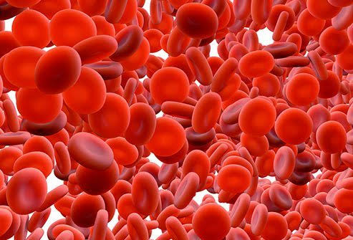

01
Relative polycythemia
#
apparent increase in the number of
circulating RBCs that occurs as a result of the loss of blood plasma
with hemoconcentration of cells.
#
Relative polycythemia is seen in cases of excessive loss
of body fluids such as chronic vomiting, diarrhea, or loss of
electrolytes with accompanying loss of water
#
This increase in the number of RBCs
is only relative to the total blood volume and, therefore, is not a true
polycythemia
#
It is also seen in obese
hypertensive men in whom hypertension or its treatment by diuretics
is believed to cause volume reduction and Gaisböck syndrome or

Slide 4
01
Primary polycythemia
which includes polycythemia rubra vera
and the familial and congenital forms of the condition is
characterized by low serum EPO levels and a true idiopathic
increase in the number of circulating RBCs and of the Hb level.

Slide 5
01
secondary polycythemia.
Common causes of secondary polycythemia
High serum EPO levels characterize secondary polycythemia.
Compensatory in response to hypoxia
• Decreased available oxygen – living at high altitudes
• Chronic obstructive pulmonary disease
• Cardiovascular disease resulting from arteriovenous malformations
• Hemoglobin abnormalities with high O2 affinity
• Exposure to carbon monoxide – smoking and vehicle exhaust
• Renal hypoxia
Excessive erythropoietin secretion
• Paraneoplastic – malignant and benign tumors that secrete erythropoietin
This group includes all those conditions in which the absolute
increase in erythrocyte mass is a response to reduced oxygen
concentration, increased demand for oxygen, and increased EPO
secretion.

Slide 6
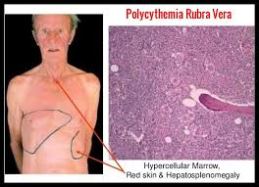
01
Polycythemia vera

Slide 7
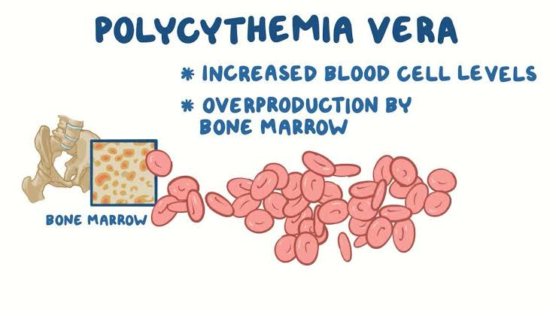
01
Polycythemia vera
a type of blood cancer.
. It causes your bone marrow to make too many red blood cells.
.These excess cells thicken your blood, slowing its flow, which may cause serious problems, such as blood clots.

Slide 8
01
Polycythemia vera
Clinical features.
The disease has an estimated prevalence of 22 cases/100,000
population and typically affects adults older than 60 years. It is male
predominant and affects men almost twice as much as women.
headache, dizziness, weakness, lassitude,
tinnitus, visual disturbances, hypertension, and excessive sweating at
night.
increased red cell mass, HCT, and the commonly associated increase
in total blood volume

Slide 9
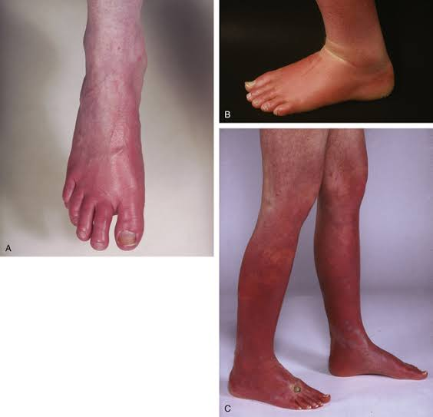
01
Polycythemia vera
Oral manifestations.
oral mucous membranes appear deep purplish red.
gingivae
may be engorged and swollen
gingiva
and tongue are most prominently affected
reduced Hb in amounts exceeding 5 mg/dL.

Slide 10
01
Polycythemia vera
diagnosis,
Treatment
Hemoglobin > 16.5 g/dL in men and > 16.0 g/dL in women,
Busulfan
Bone marrow biopsy showing hypercellularity
aspirin daily to reduce thrombotic events
Serum erythropoietin level below the reference range
Myelosuppressive therapy

Slide 11
THANK YOU

