Slide 1
Premalignant lesions and conditions

Slide 2
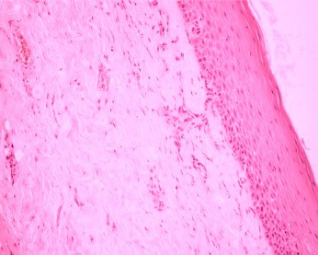
contents
Definitions.
Classification.
PMD (Potentially malignant disorders)
Recent advances.
Conclusion.
References.

Slide 3
definition
A premalignant lesion is “A morphologically altered tissue in which oral cancer is more likely to occur than in its apparently normal counterpart”
-WHO workshop 1978
Premalignant condition is ‘a generalized state associated with a significantly increased risk of cancer’.
-WHO workshop 1978

Slide 4
Whats the Normal Tissue response to Injury
Trauma
Ulcer
Fibrosis
Epithelial proliferation
Epithelial hyperplasia
Epithelial Atrophy
Necrosis
or
Epithelial Dysplasia
Potentially Malignant Disease

Slide 5
Premalignant lesions | Premalignant conditions
Leukoplakia | Oral submucous fibrosis
Erythroplakia | Oral lichen planus
Leukokeratosis nicotina palatinae | Actinic keratosis
Candidiasis | Syphilis
Carcinoma in situ | Discoid lupus erythematosus
 | Sideropenic dysphagia

Slide 6
Pmd (potentially malignant disorder)
“It is a group of disorders of varying etiologies, usually tobacco characterized by mutagen associated, spontaneous or hereditary alterations or mutations in the genetic material of oral epithelial cells with or without clinical and histo-morphological alterations that may lead to oral squamous cell carcinoma transformation”
(Ref -Oral potentially malignant disorders: Precising the deﬁnition)
- Oral Oncology journal (2012)

Slide 7
NEW CLASSIFICATION FOR ORAL POTENTIALLY MALIGNANT DISORDERS
SARODE, SARODE, KARMARKAR, TUPKARI(Ref - Oral Oncology xxx, 2011)
CLASSIFIED OPMD INTO 4 GROUPS:
Group I:
Morphologically altered tissue in which external factor is responsible for the etiology and malignant transformation.
Group II:
Morphologically altered tissue in which chronic inflammation is responsible for malignant transformation (chronic inflammation mediated carcinogenesis).
Group III:
Inherited disorders that do not necessarily alter the clinical appearance of local tissue but are associated with a greater than normal risk of PMD or malignant
transformation.
Group IV:
No clinically evident lesion but oral cavity is susceptible to Oral squamous cell carcinoma.

Slide 8
Group I: Morphologically altered tissue in which external factor is responsible for the etiology and malignant transformation.
1. Habit related
a. Tobacco associated lesions
Leukoplakia
Tobacco pouch keratosis
Stomatitis palatine nicotini
b. Betel nut associated
Oral submucous fibrosis
c. Sanguinaria-associated keratosis
2. Non-habit related
Actinic cheilosis
Chronic candidiasis
Certain strains of Candida have been shown to produce nitrosamines a chemical carcinogen (external factor) and hence, candidiasis is included under Group I.

Slide 9
Group II: Morphologically altered tissue in which chronic inflammation is responsible for malignant transformation (chronic inflammation mediated carcinogenesis).
Group II a. Chronic inflammation caused by internal derangement.
1. Lichen planus
2. Discoid lupus erythematosus
Group II b: Chronic inflammation caused by external factors.
1. Chronic mucosal trauma
2. Lichenoid reactions
3. Poor oral hygiene
4. Chronic infections
Chronic bacterial infections
Chronic viral infections
Chronic fungal infections
5. Other pathologies associated with prolonged untreated chronic inflammation of the oral cavity.

Slide 10
Group III: Inherited disorders that do not necessarily alter the clinical appearance of local tissue but are associated with a greater than normal risk of PMD or malignant transformation.
1. Inherited cancer syndromes
Xeroderma pigmentosum
Ataxia telangiectasia
Fanconi’s anemia
Li Fraumeni syndrome
2. Diskeratosis congenita
3. Epidermolysis bullosa
4. White sponge nevus
5. Darier’s disease
6. Hailey–Hailey disease

Slide 11
Group IV: No clinically evident lesion but oral cavity is susceptible to Oral squamous cell carcinoma.
1. Immunosupression
AIDS
Immunosupression therapy (for malignancy or organ
transplant)
2. Alcohol consumption and abuse
3. Nutritional deficiency
Sideropenic dysphagia
Deficiency of micronutrients

Slide 12
leukoplakia
Oral leukoplakia, as defined by the WHO, is
“ A predominantly non-scrapeble white lesion of the oral mucosa that cannot be characterised as any other definable lesion.”
(Ref – WHO workshop 2012)
J Oral Pathol Med (2012) 36: 575–80

Slide 13
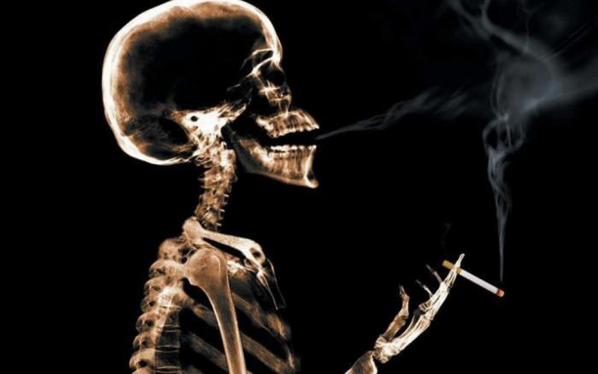

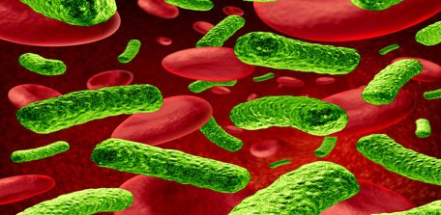


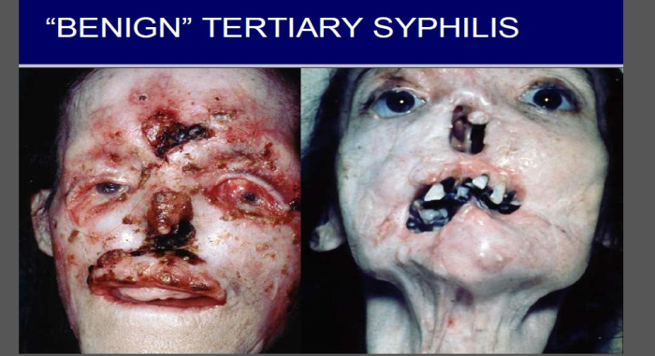
etiology
The exact etiology is unknown.
But some predisposing factors can be identified that are
PREDISPOSING FACTORS ARE BEST REMEMBERED AS 6 S
Smoking , Spirit , Sharp tooth , Spicy food , Syphilis, Sepsis

Slide 14
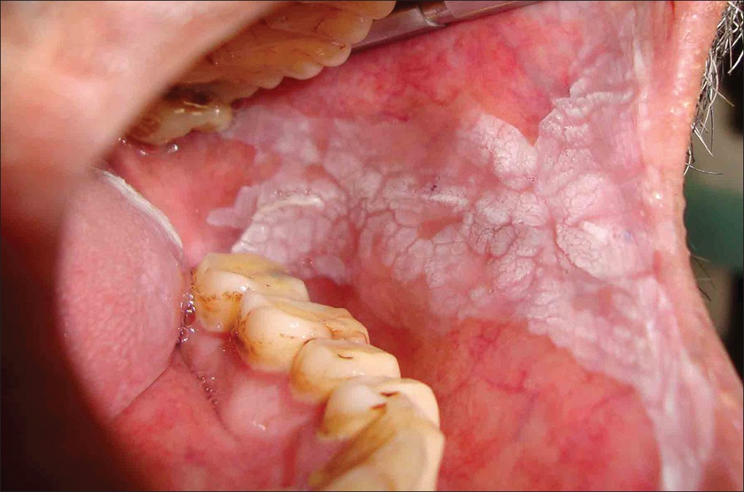
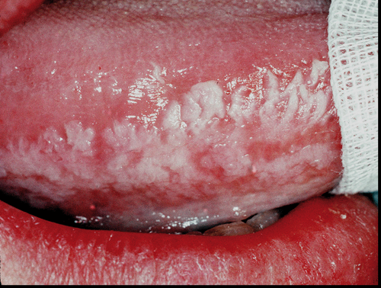
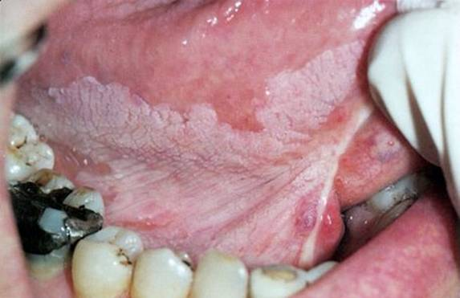
Clinical features
Male predilection
Mostly occurs in 4th to 7th decade of life.
Oral leukoplakias are found on the Upper and lower alveolus(36%) buccal mucosa(22 %) , lips (11%), palate (11%), floor of mouth (9%), gingiva(8%), Tongue(7%), retromolar trigone(6%)

Slide 15
Clinical Types
Homogenous
Non-homogenous

Slide 16
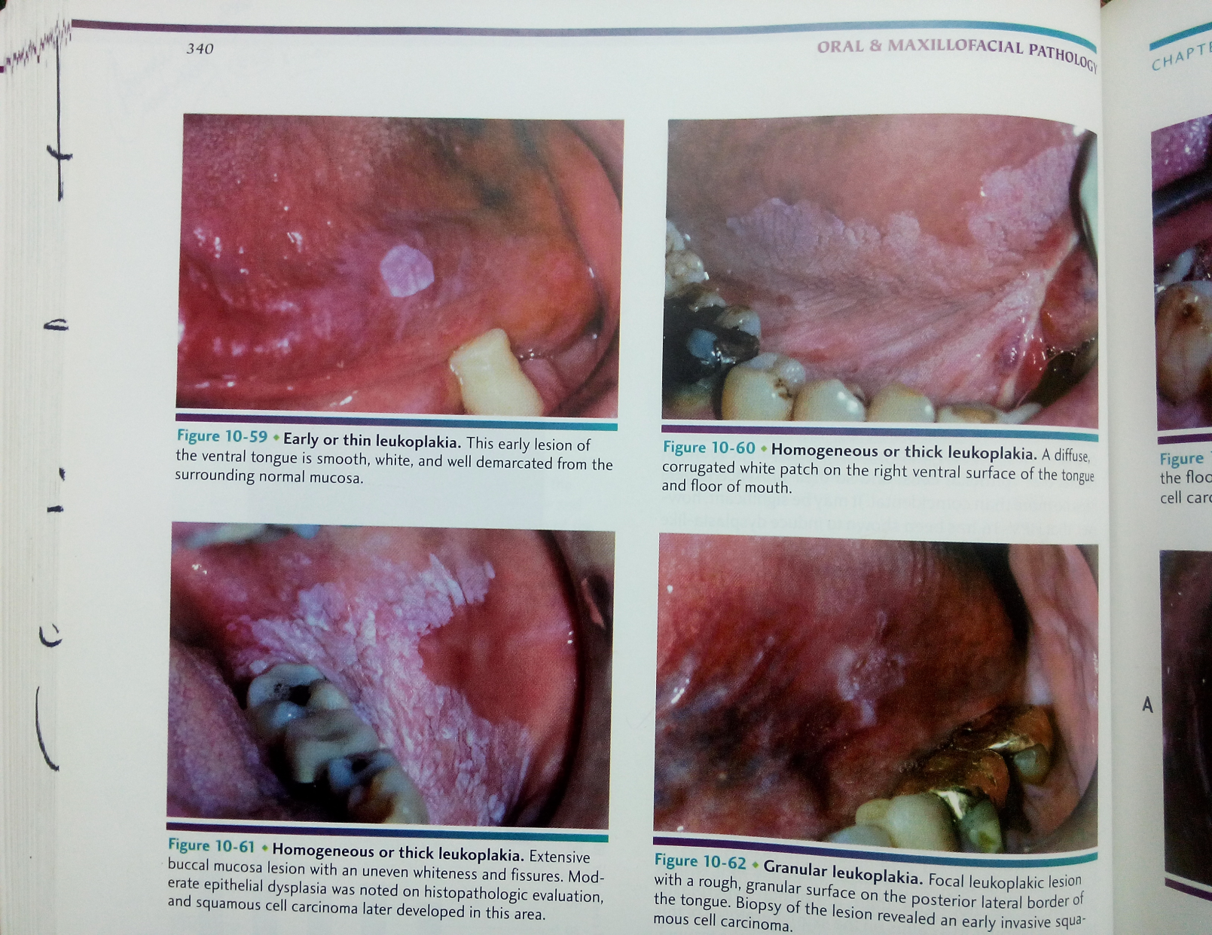
HOMOGENOUS-
Uniform white patch lesion with smooth or corrugated surface sometimes, slightly raised mucosa. Usually plaque like, some are smooth, may be wrinkled or criss-crossed by small crack or fissure.
Malignant transformation – 1 to 7%.
Types –
Smooth
Furrowed
Ulcerative

Slide 17
NON-HOMOGENOUS LEUKOPLAKIA
TYPES -
Ulcerative or Erosive
Verrucous (proliferative verrucous leukoplakia) or Nodular
Speckled (High malignant transformation)
(Ref- WHO workshop 1994)
Notes:
Ulcerative – 5 %
Verrucous (4% - 15%)
Speckeled (28%)

Slide 18
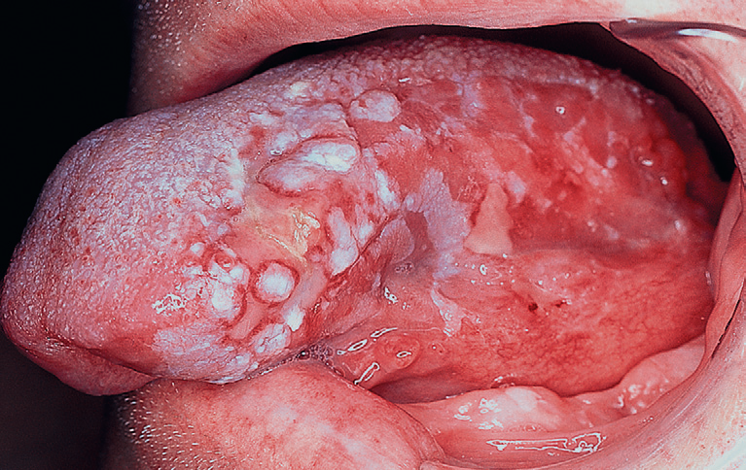
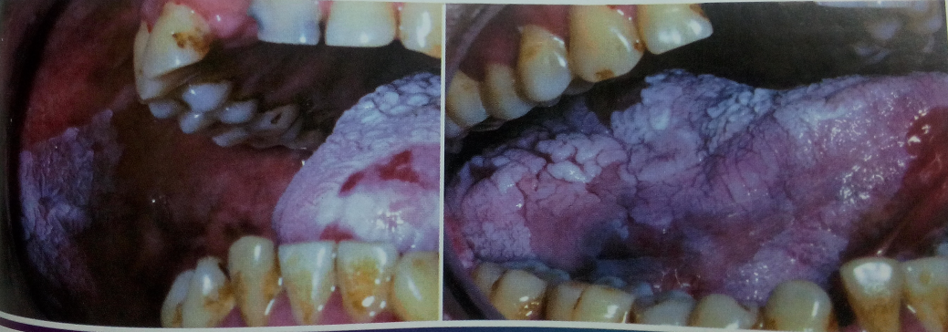
Ulcerative- Red ulcerative lesion (Atrophic epithelium ) with small white specks or nodules over it.
Verrucous -Warty surface (white lesion with hyperplastic surface) or Heaping up of the surface or like a nodule on an erythematous background. white lesion with a granular surface is associated with candida.
Speckled- Mixed red and white patches on an irregular surface.

Slide 19
Hairy leukoplakia
Hairy leukoplakia is a condition that is characterised by irregular white patches on the side of the tongue and occasionally elsewhere on the tongue or in the mouth.
Etiology -
It is a form of leukoplakia often arises in response to chronic irritation. Hairy leukoplakia is associated with Epstein-Barr virus (EBV) and occurs primarily in HIV-positive individuals.
Notes:
Anti-retroviral drugs -- Acyclovir , valacicyclovir
Gention violet – dye used for hairy leukoplakia and candidiasis

Slide 20
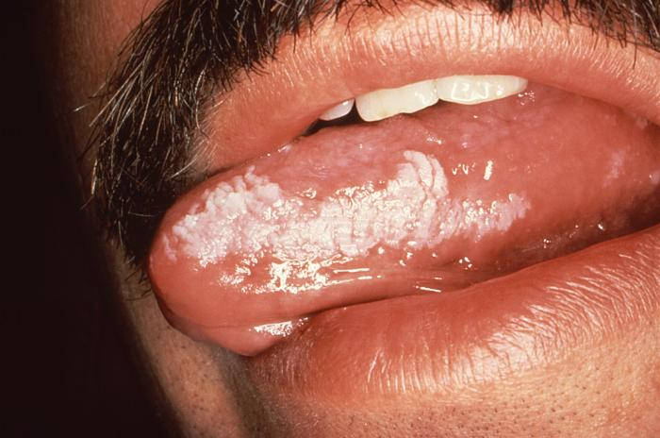
Clinical features
Male predilection
Most common in 40 – 60 years of age
(Recent studies show higher incidences in young adults)
It occurs on the lateral margins of the tongue often bilaterally. The lesions are white, sometimes corrugated and may be proliferative to produce a shaggy carpet like appearance

Slide 21
Clinical Staging
A clinical staging system for oral leukoplakia
(OL-system) on the lines of TNM staging was recommended by WHO in 2005 taking the size (L) and the histopathological features (P) of the lesion into consideration.

Slide 22
Clinical Staging
Lx: Size not specified.
L1: Single or multiple lesions together <2 cm.
L2: Single or multiple lesions together 2-4 cm.
L3: Single or multiple lesions together >4 cm.
Px: Epithelial dysplasia not specified.
P0: No epithelial dysplasia.
P1: Mild to moderate epithelial dysplasia.
P2: Severe epithelial dysplasia.
Stage I: L1 P0.
Stage II: L2 P0.
Stage III: L3 P0 or L1/ L2 P1.
Stage IV: L3 P1 or Lx P2.

Slide 23
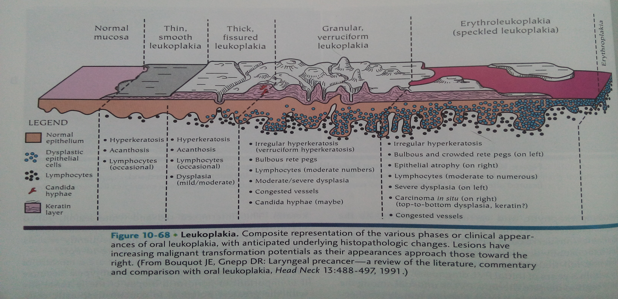
Histopathology
Leukoplakia is purely a clinical terminology and histopathologically it is reported as epithelial dysplasia.
WHO in 2005 proposed five grades of epithelial dysplasia based on architectural disturbances and cytological atypia.

Slide 24
HISTOLOGICAL GRADING OF LEUKOPLAKIA
1. Squamous Hyperplasia –
2. Mild Dysplasia – better prognosis.
3. Moderate Dysplasia.
4. Severe Dysplasia.
5. Carcinoma in-situ – poor prognosis.
It has been recently proposed to modify the above 5-tier system into a binary system of ‘high risk’ and ‘low risk’ lesions to improve clinical management of these lesions.

Slide 25
Differential diagnosis
White sponge nevus
Acute pseudomembranous candidiasis
Leukoedema
Lichen planus (plaque type)
Notes:
White sponge nevus - Noted in early life, family history, large areas involved, genital mucosa may be aﬀected - Biopsy not indicated
Acute pseudomembranous candidosis - The membrane can be scraped oﬀ leaving an erythematous/raw surface - Swab for culture
Leukoedema - Bilateral on buccal mucosa,it cant be made disappear on stretching.
Lichen planus - other form such as reticular is also associated

Slide 26
TREATMENT AND PROGNOSIS
The first step in treatment is to arrive at a definitive histopathologic diagnosis.
Therefore, a biopsy is mandatory and will guide the course of treatment. Tissue to be obtained for biopsy, should be taken from the clinically most "severe" areas of involvement .
Multiple biopsies of large or multiple lesions may be required.

Slide 27
I . NON-SURGICAL TREATMENT
Chemoprevention
  L-Ascorbic Acid (Vitamin C)
  α-Tocoferol (Vitamin E)
  Retinoic Acid (Vitamin A)
  Vitamin A derivative, isotretinoin, and 13-cis retinoic acid: 28,500IU per day.
  Beta-carotene 150,000 IU of beta-carotene twice per week for six months.
  Bleomycin-Topical bleomycin in treatment of oral leukoplakia was used in dosages of 0.5%/day for 12 to 15 days or 1%/day for 14 days.

Slide 28
II. Surgical Management
SURGICAL MANAGEMENT:
FOUR methods are available for the removal of leukoplakia
patches of the oral mucosa
Scalpel excision / Stripping
Electrocautery
Cryotherapy
CO2 Laser therapy
Notes:
Scalpel excision or CO2 laser and elecrocautery used to remove leukoplakia will have specimen for histopathological examination whereas this is not possible using cryotherapy. Recurrences rate is about 20% regardless of the method.

Slide 29
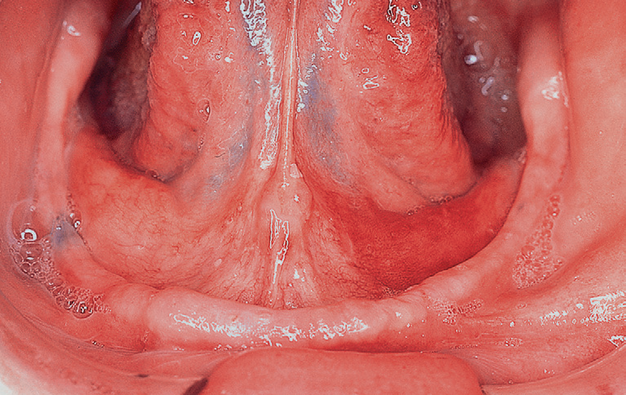
Erythroplakia
Also known as ERYTHROPLASIA OF QUEYART
This was first described by Queyart in 1911 as a lesion occurring on glans-penis.
It is clinically similar to conditions such as candidiasis, tuberculosis, histoplasmosis and non-specific conditions such as denture irritation.
WHO definition :-
A fiery red patch that cannot be characterized clinically or pathologically as any other definable disease.

Slide 30
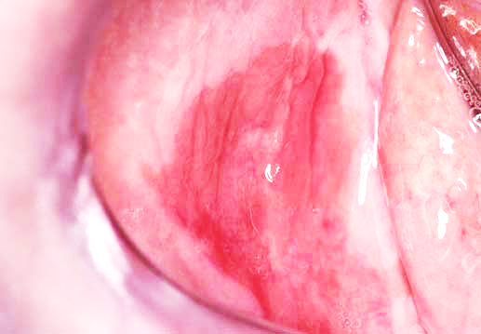
Etiology
Unknown
Contributing factors include tobacco use, alcohol consumption.
Incidence -
It is more common in males and occurs more frequently
in the 6th and 7th decade of life.
CLINICAL FEATURE
Red, often velvety, well-defined patches.
Most commonly present on
floor of mouth, retromolar
trigone area, lateral tongue.
Usually asymptomatic.
May be smooth to nodular.

Slide 31
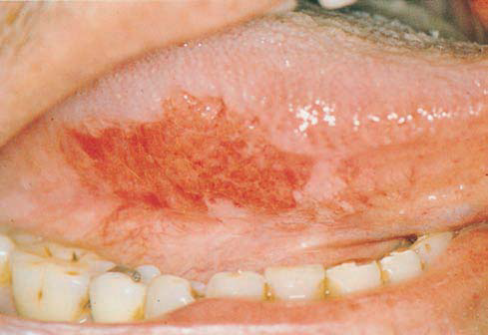
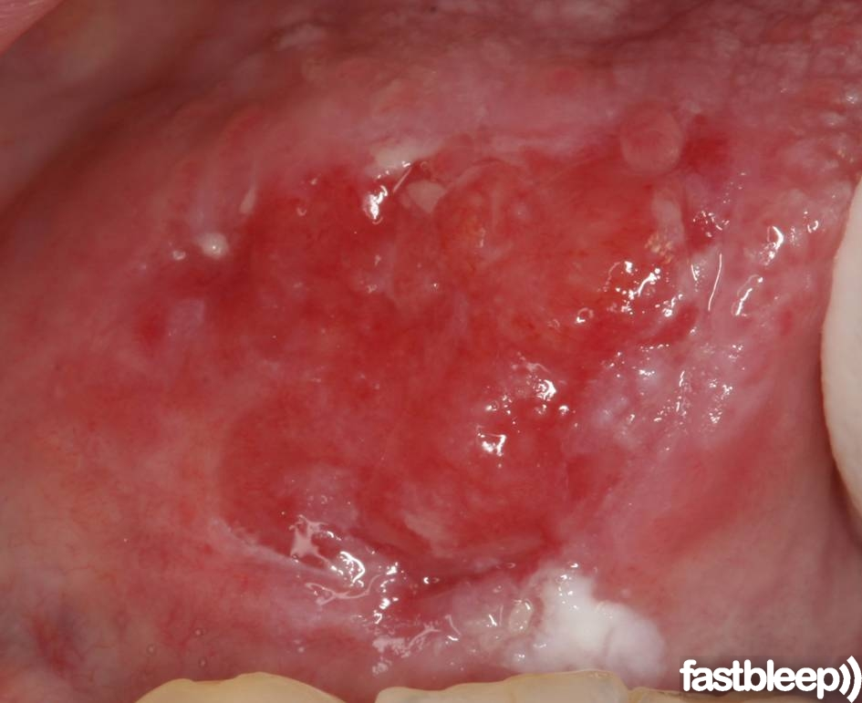
Homogenous form which appears as a bright red, soft velvety lesion with straight or scalloped well demarcated margins, often quite extensive in size, commonly found on the buccal mucosa and sometimes on the soft palate, more rarely on the tongue and floor of the mouth.
Speckled leukoplakia / erythroplakia which is soft, red lesions that are slightly elevated with an irregular outline and a granular or fine nodular surface speckled with tiny white plaques.

Slide 32
Diagnosis-
Appearance; History of tobacco/alcohol use.
Biopsy results.
Differential Diagnosis-
Erythematous (atrophic) candidiasis
Kaposi’s sarcoma
Ecchymosis
Contact stomatitis
Vascular malformation
Squamous cell carcinoma
Geographic tongue/ erythema migrans

Slide 33
Treatment-
The treatment is same as that for invasive carcinoma or carcinoma-in-situ like surgery, radiation and cauterisation.
Surgical excision if proven dysplastic/ malignant.

Slide 34
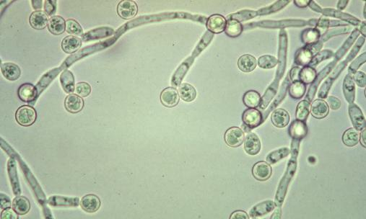
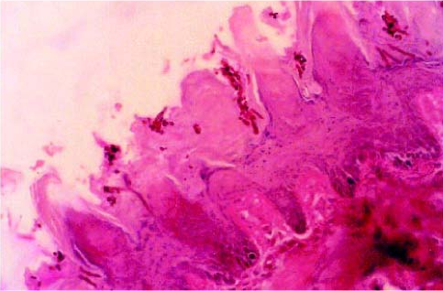
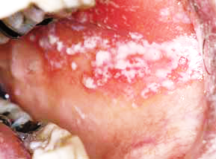
Candidiasis
Etiology
Infection with a fungal organism of the Candida species, usually Candida albicans.
Associated with predisposing factors: most commonly, immunosuppression, diabetes mellitus, antibiotic use, or xerostomia (due to lack of protective effects of saliva).

Slide 35
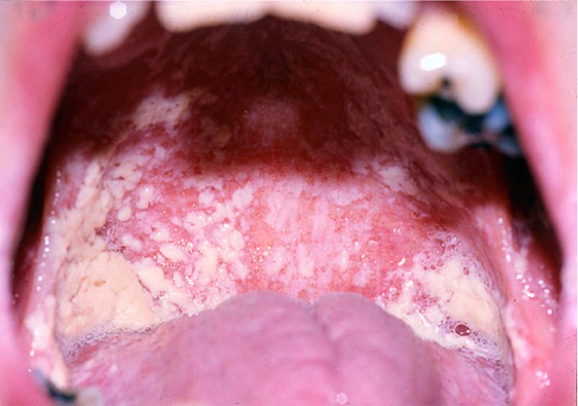
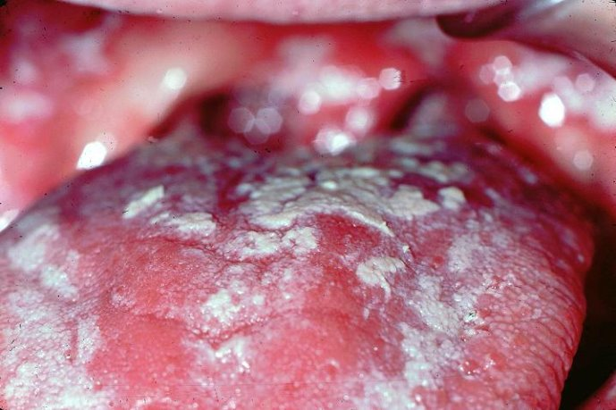
Clinical Presentation
Acute (oral thrush)
Pseudomembranous.
Painful white plaques representing fungal colonies on inflamed mucosa.
Erythematous (acute atrophic): painful red patches caused by acute Candida overgrowth and subsequent stripping of those colonies from mucosa.

Slide 36
Clinical Presentation-
Chronic
Atrophic (erythematous): painful red patches; organism difficult to identify by culture, smear, and biopsy.
“Denture-sore mouth” : a form of atrophic candidiasis associated with poorly fitting dentures; mucosa is red and painful on denture-bearing surface.
Median rhomboid glossitis: a form of hyperplastic candidiasis seen on midline dorsum of tongue anterior to circumvallate papillae.
Perleche: chronic Candida infection of labial commissures; often co-infected with Staphylococcus aureus.
Hyperplastic/chronic hyperplastic: a form of hyperkeratosis in which Candida has been identified; usually buccal mucosa near commissures; cause and effect not yet proven.
Syndrome associated: chronic candidiasis may be seen in association with endocrinopathies.

Slide 37
Diagnosis-
Microscopic evaluation of lesion smears
Potassium hydroxide preparation to demonstrate hyphae
Periodic acid–Schiff (PAS) stain
Culture on proper medium (Sabouraud’s, corn meal, or potato agar)
Biopsy with PAS, Gomori’s methenamine silver (GMS), or other fungal stain of microscopic sections

Slide 38
Differential Diagnosis
Leukoplakia
Erythroplakia
Atrophic lichen planus
Histoplasmosis
White lesion due to denture irritation

Slide 39
Treatment-
Topical or systemic antifungal agents.
For immunocompromised patients: routine topical agents after control of infection is achieved, usually with systemic azole agents.
Correction of predisposing factor, if possible.
Some cases of chronic candidiasis may require prolonged therapy (weeks to months).
Prognosis-
Excellent in the immunocompetent host.

Slide 40
Topical therapy
Nystatin oral suspension (100,000 units/mL); rinse 5 mL and swallow 4 times/day
Clotrimazole (Lotrimin) solution 1%; rinse 5 mL and swallow 4 times/day
Systemic therapy
Fluconazole (Diflucan) 100 mg #15; 2 tablets on the first day, 1 tablet days 2–7, 1 tablet every other day for days 8–21
Ketoconazole (Nizoral) 200 mg #21; 1 tablet every day with breakfast × 21 d

Slide 41
ORAL SUBMUCOUS FIBROSIS
This condition was first described by Joshi (1952) and by Schwatz among East Indian Women.
This is an insidious chronic disease affecting any part of oral cavity including pharynx. It is considered to be POTETIALLY MALIGNANT DISORDER .

Slide 42
DEFINITION
(J.J Pindborg and Sirsat 1966)
  “ It is an insidious chronic disease affecting any part of the oral cavity and sometimes the pharynx. Although occasionally preceded by or associated with vesicle formation ,it is always associated with juxta-epithelial inflammatory reaction followed by a fibro-elastic changes of the lamina propria with epithelial atrophy leading to stiffness of the oral mucosa and causing trismus and inability to eat.”

Slide 43
EPIDEMIOLOGY
OSMF is a crippling fibrotic disorder seen commonly in India and Indian subcontinent. Sporadic cases are seen in Malaysia, Nepal, Thailand and South Vietnam.
Population between 20 to 40 years of age are most commonly affected .
Incidence of OSMF in India is 0.2-0.5% of population.

Slide 44
Etiology of OSMF:
Exact etiology is unknown. The predisposing factors are,
1. Chronic Irritation
- Chilies, Lime, Areca nut, Tobacco.
2. Defective iron metabolism
3. Bacterial Infection
4. Collagen disorder
5. Immunological disorders
7. Genetic disorder.

Slide 45

Chronic irritation:-
Pathogenesis of OSMF lies in the continuous action of mild irritants.
Chillies:-
"Capsaicin" an active extract from capsicum.
The active principle irritants of chillies (Capsicum annum and Capsicum frutescence) .

Slide 46
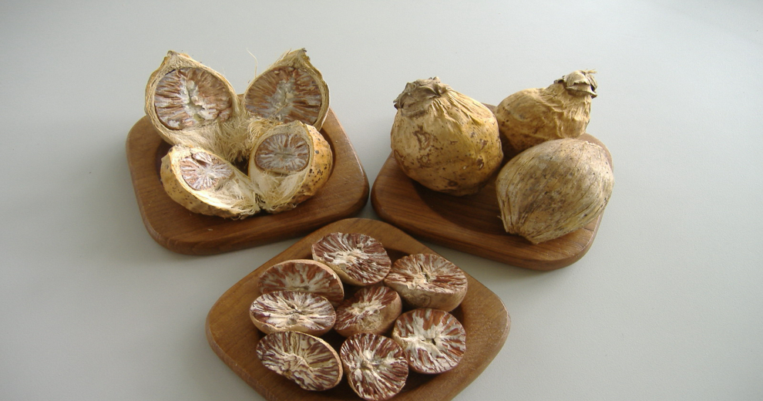
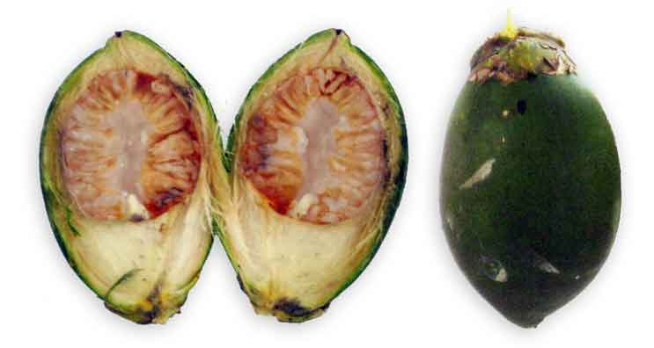
Areca nut
It contains,
ARECOLINE, ARECAIDINE
-Fibroblast proliferation
-Stimulate collagen synthesis
TANNIN, CATHECHIN-
- Makes collagen fibrils resistant to collagenase.

Slide 47
CLINICAL FINDINGS
The data regarding the sex predilection is conflicting. Earlier it was thought to be common in females.
But at present, study ratio shows 2.3: 1=M:F
Age group - 2nd to 4th decade of life.

Slide 48
Initial symptoms | Later
Burning sensation on eating spicy food Blisters on the palate Ulceration or recurrent stomatitis Excessive salivation Defective gustatory sensation Dryness of mouth. | Difficulty in opening mouth Inability to whistle, blow Difficulty in swallowing Referred pain to the ear Changes in tone of the voice due to vocal cord involvement Sometimes deafness due to occlusion of eustachian tubes
Notes:
When fibrosis involves pharynx-

Slide 49
COMMON SITES INVOLVED-
Buccal mucosa, faucial pillars, soft palate, lips and hard palate.
The fibrous bands in the buccal mucosa run in a vertical direction, sometimes so marked that the cheeks are almost immovable.
In the soft palate the fibrous bands radiate from the pterygomandibular raphe or the faucial pillars and have a scar like appearance.

Slide 50
The uvula is markedly involved, shrinks and appears as a small fibrous bud.
The faucial pillars become thick, short, and extremely hard.
The tonsils may be pressed between the fibrosed pillars.
The lips are often affected and on palpation, a circular band can be felt around the entire lip mucosa.
When gingiva is affected, it is fibrotic, blanched and devoid of its normal stippled appearance.

Slide 51
PALE AND BALD TONGUE

Slide 52
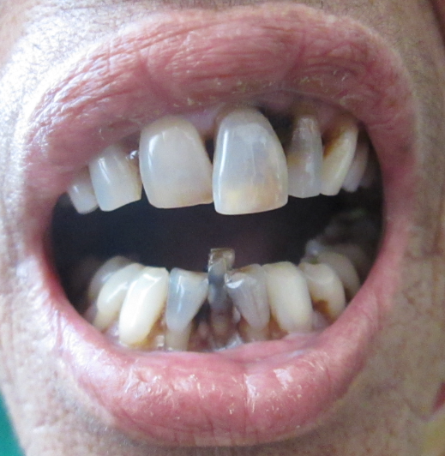
Trismus

Slide 53
Staging of OSMF:
Stage I : Stage of stomatitis & vesiculation
Stage ll : Stage of fibrosis
Stage III :Stage of sequelae and complication
(Ref -Pindborgh JJ-1989)

Slide 54
Stage I : Stomatitis & vesiculation
Stomatitis includes erythmatous mucosa,
vesicles, mucosal ulcers, melanotic mucosal
pigmentation.

Slide 55
Stage II: (Fibrosis):-
There is inability to open mouth completely and stiffness in mastication. As disease advances there is difficulty in blowing out cheek & protruding tongue. Sometimes pain in ear and speech is affected. On examination there in increasing amount of fibrosis in the submucosa. This causes blanching of mucosa.
Lips & checks become stiff & lose their normal resistance. Shortening & disappearance of uvula in advanced cases.
Mucosa of floor of mouth show blanching & stiffness

Slide 56
Stage III (Sequelae & Complication)
Patient presents with all the complaints as in stage II. Also there may be evidence of leukoplakia.
Changes in mucosa are whitish or brownish black.
Pindborg et al (1967) found that OSMF was found in 40% cases of oral cancer than in general population (1.2%).

Slide 57
Recent classification for OSMF
- Chandramani More et al 2011
Clinical staging –
S1 -Stomatitis or blanching of oral mucosa
S2 –Presence of fibrous bands over buccal mucosa, oropharynx with or without stomatitis.
S3 - Presence of fibrous bands over buccal mucosa, oropharynx and any part of oral cavity with or without stomatitis.
S4 a – Anyone of above stage with potentially malignant disorders
Eg- leukoplakia, erythroplakia.
S4 b – Anyone of above stage with oral carcinoma

Slide 58
Recent classification for OSMF
- Chandramani More et al 2011
Functional staging -
M1- Interincisal mouth opening upto or > 35 mm
M2- Interincisal mouth opening between 25-35 mm
M3 - Interincisal mouth opening between 15-25 mm
M4 - Interincisal mouth opening <15 mm

Slide 59
DIAGNOSIS IS BASED ON :
Clinically appreciable blanching and pallor.
Palpable bands and restriction-of mouth opening.
Severe burning sensation of mouth, aggravated by use of even moderate spicy food.
Biopsy report.

Slide 60
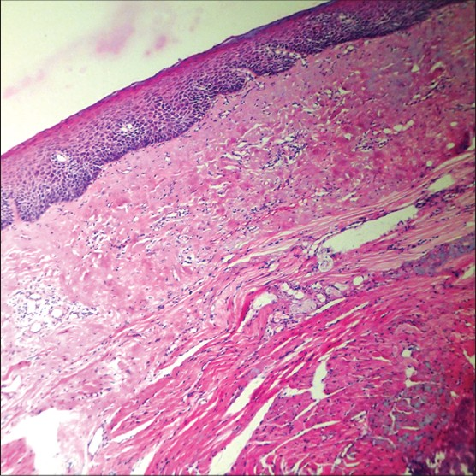
Histopathological findings -
Atrophic Oral epithelium.
Loss of rete pegs .
Epithelial atypia may be observed.
Hyalinization of collagen bundles.
Fibroblasts decreased and blood vessels obliterated.

Slide 61
Pathogenesis of oral submucous fibrosis

Slide 62
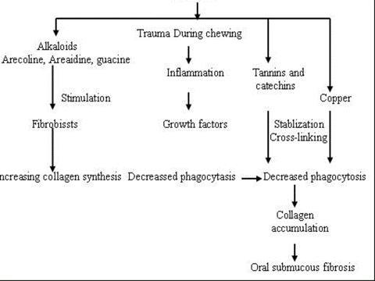

Slide 63
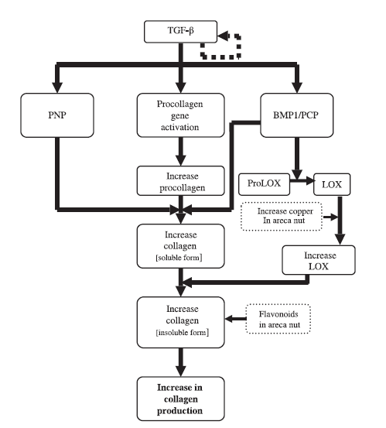
Collagen production pathway
Molecular pathogenesis of OSMF-J Oral Pathol med-2005-34;321-8

Slide 64
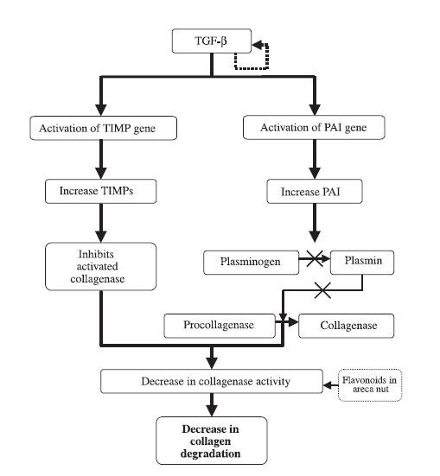
Collagen degradation pathway

Slide 65
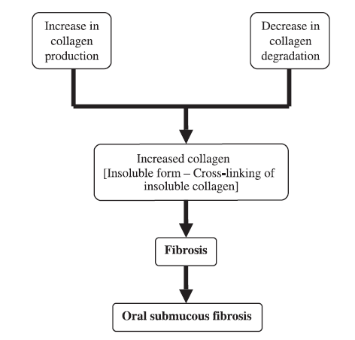

Slide 66
MANAGEMENT -
Various modalities of treatment have been tried.
1.Restriction of habits/ Behavioral therapy.
2. Non-surgical therapy.
3. Surgical therapy.
4. Oral Physiotherapy.

Slide 67
Restriction of habits/behavioral therapy-
The consumption of pan, betel nut, chillies, spices, & commercially available, pan masalas, guthkas with or without tobacco is increasing in India. So people should be encouraged to stop these habits.
Affected patients should be explained about the disease and possible malignant potential of OSMF.
Possible irritants should be removed.
Nutritional supplements.

Slide 68
NON-SURGICAL THERAPY:-
Antioxidants
Intralesional injections of hyaluronidase. Hydrocortisone
Use of Placentrix 2ml solution at interval of 3 days.
Topical application -
4% Acetic acid (At PH 6.5) 3 times daily.
5 Fluorouracil
Systemic administration of immunomodulators -
Levamisole 150mg for 3 weeks ,orally
Dapsone 75 mg O.D for 90 days, orally
Notes:
40 mg of triamcinolone acetonide is injected submucosally into faucial pillars, retro-molar area and buccal mucosa. On average 150 to 200 mgs of corticosteroids are injected in divided doses at 10 days interval for a period of 2 to 3 months.
The human placental tissue extract has growth stimulation effects and also development of immune system. This contains water soluble factors which are growth stimulant for keratinocytes. It increases hummoral immune mechanism by increase in IgM levelsslecific for bacterial toxins
It contains nucleotides, vitamins , amino acids, fatty acids and trace elements.
Vitamins present are vitamin E, B1, B2, pantothenic acid, B6, nicotinic acid, biotin, P aminobenzoic acid, folic acid, B12, choline inositol.
4% acetic acid has capability of solubilizing cross-linked molecules in collagen and it causes collagenolysis
5 fluorouracil is immunomodulator

Slide 69
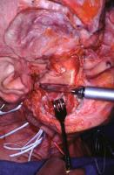
SURGICAL TREATMENT -
Fibrotomy (scalpel, electrocautery, laser)
Coronoidectomy & Temporalis myotomy
Extraction of third molars
Reconstruction
(Bilateral nasolabial flaps, Pedicled tongue flaps, Buccal fat pad, Split
thickness skin grafting, Collagen membrane & Temporalis fascia)
Notes:
Temporalis myotomy and coronoidectomy are performed in case of degenerative changes in temporalis muscle.

Slide 70
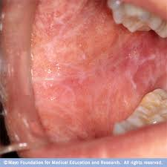
Lichen Planus
Etiology-
Unknown.
Autoimmune. T cell–mediated disease targeting basal keratinocytes.
Lichenoid changes associated with galvanism, graft-versus-host disease (GVHD), certain drugs, contact allergens.

Slide 71
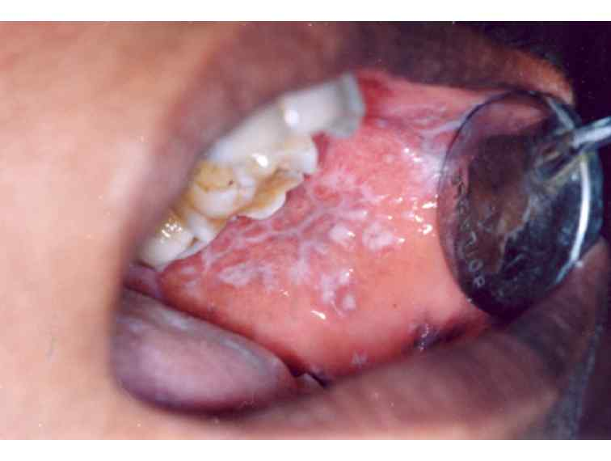

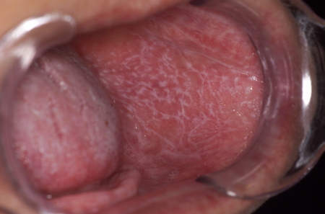
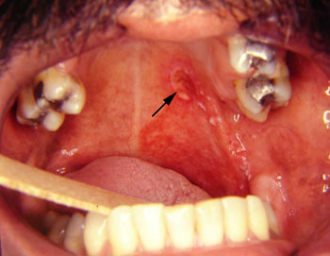
Incidence -
Up to 3 to 4% of Indian population has oral lichen planus
0.5 to 1% of population has cutaneous lichen planus; 50% also have oral lesions.
More common in White females (60%)
Occurs in 4th to 8th decades of life.
Clinical Presentation-
Variants: reticular (most common oral form); erosive (painful); atrophic, papular,(plaque types); bullous (rare)
Bilateral and often symmetric distribution
Oral site frequency: buccal mucosa (most frequent), then tongue, then gingiva, then lips (least frequent)

Slide 72
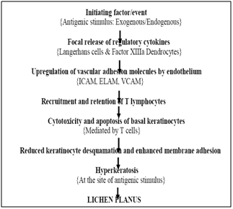

Slide 73
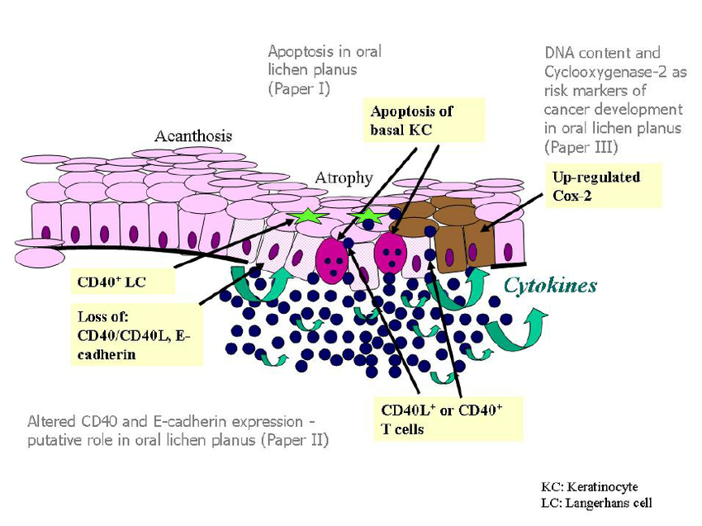

Slide 74
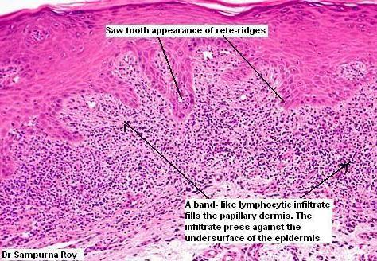
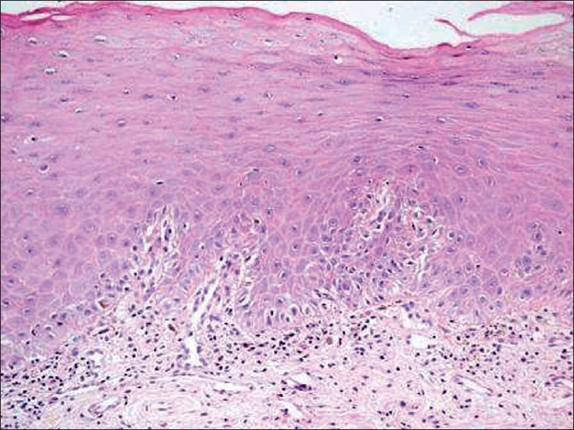
Diagnosis-
Examination of oral mucosa, skin
H/O galvanism, GVH disease.
Biopsy
Direct-immunofluorescence–fibrinogen and cytoid bodies at interface help confirm
Differential Diagnosis-
Lichenoid drug eruptions
Erythema multiforme
Lupus erythematosus
Contact stomatitis
Mucous membrane pemphigoid

Slide 75
Treatment of Oral Lichen Planus-
Mild to moderate: topical corticosteroids
Severe: systemic immunosuppression, chiefly prednisone.
Topical tacrolimus ointment

Slide 76
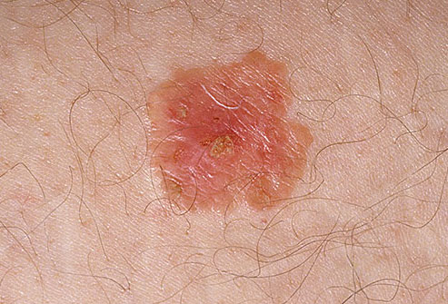
INTRA EPITHELIAL CARCINOMA
This occurs frequently on the skin(Bowen’s disease) but
also on mucous membrane.
Incidence -
Shafer also found the occurrence as 23% in floor of the mouth, 22% on the tongue, 20% on the lip.
It is more common in elderly men.
Treatment
The lesions are surgically excised, irradiated or cauterised.

Slide 77
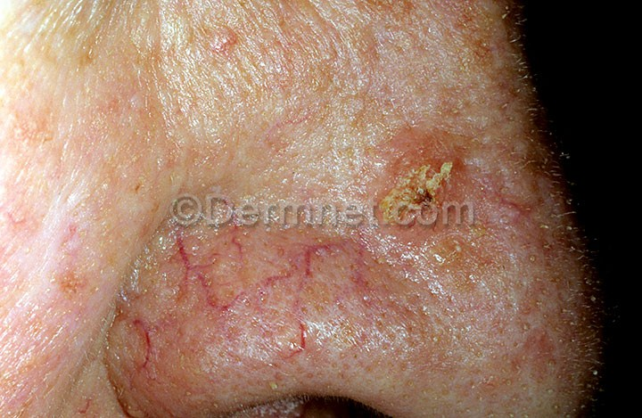
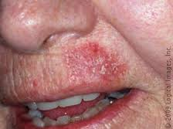
ACTINIC (SOLAR) KERATOSIS, ELASTOSIS AND CHELITIS
Actinic keratosis is also potentially malignant disorder associated with long term exposure to radiation and may be found on the vermilion border of the lips as well as other exposed skin surfaces.
Clinical features -
On the skin surfaces and the vermilion border of the lip, the lesion is crusted and keratotic.
On the labial mucosa exposed to sun, a white area of atrophic epithelium develops with underlying scarring of the lamina propria referred to as elastosis. When this atrophic tissue abrades or ulcerates, it is called actinic chelitis.
Treatment
5 flurouracil is found to be effective.
But dysplastic changes in epithelium remains. So adequate follow-up is required unless surgical removal is done.
Notes:
Malignant transformation in these lesions are considered to be around 10%.

Slide 78
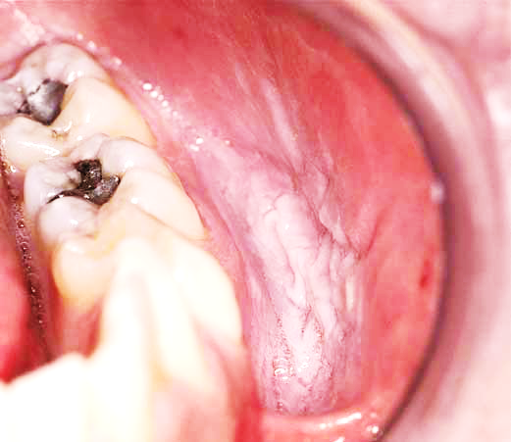
Smokeless Tobacco Keratosis
(Snuff Pouch)
Etiology
Persistent habit of holding ground tobacco within the mucobuccal vestibule.
Clinical Presentation-
Usually in men in Western countries and India.
Mucosal pouch with soft, white, fissured appearance.
Leathery surface due to chronic tobacco use over many years.
Differential Diagnosis-
Leukoplakia (idiopathic)
Mucosal burn (chemical/thermal)

Slide 79
Treatment
Discontinuation of habit.
If dysplasia is present, stripping of mucosal site.
Prognosis
Generally good with tobacco cessation.
Malignant transformation to squamous cell carcinoma or verrucous carcinoma occurs but less frequently.

Slide 80
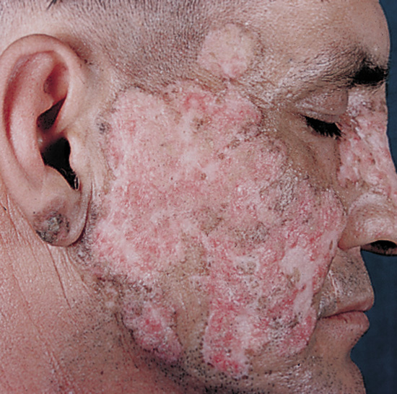
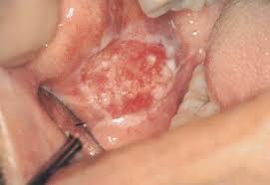
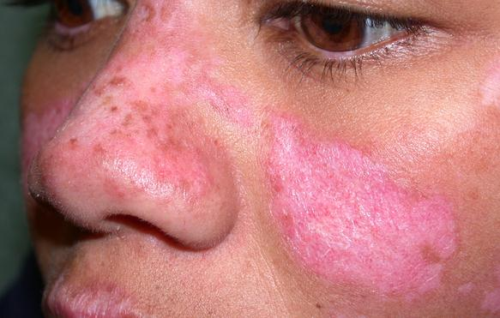
DISCOID LUPUS ERYTHEMATOSIS
WHO has defined the oral lesions of DLE as “circumscribed, slightly elevated, white patches that may be surrounded by a (red) telengiectatic halo. A radiating pattern of very delicate white lines is usually observed. The oral lesion may or may not be accompanied by skin lesion.”
Clinical differentiation from leukoplakia and lichen planus is difficult. Immunofluorenscent techniques usually show a good correlation between the clinical appearance of the oral lesion and their histologic counterpart.
The incidence of malignant transformation is very less.

Slide 81
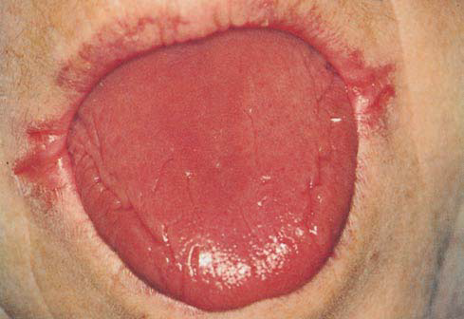
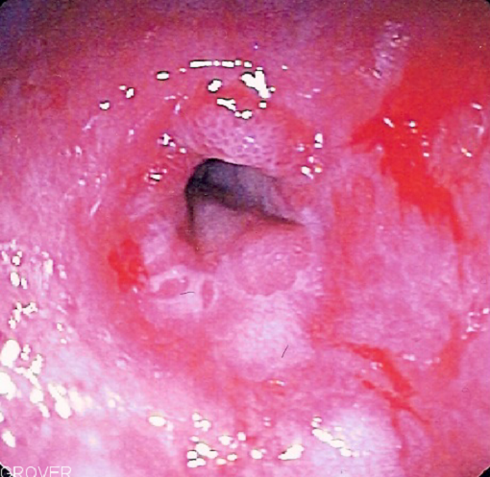
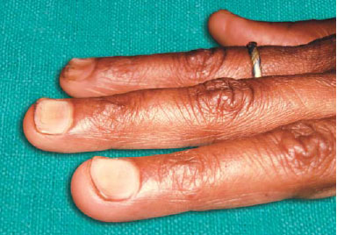
SIDEROPENIC DYSPHAGIA (PLUMMER VINSON SYNDROME)
Iron deficiency anaemia is one manifestation of Plummer-Vinson syndrome and was first described by Plummer in 1914 and by Vinson in 1922 under the term ‘hysterical dysphagia’.
Iron deficiency anaemia occurs especially in women.
The clinical features are pale skin and mucous membrane, spoon shaped nails (Koilonychia), atrophic glossitis, tongue is smooth and glazy. It is accompanied by dysphagia and oesophageal webs.
Laboratory findings show hypochromic microcytic anaemia of varying degree.
The patients respond well to iron therapy and high protein diet.
Notes:
PATERSON BROWN KELLY SYNDROME

Slide 82
Chair side Technique of early diagnosis
A number of techniques have been developed to supplement clinical examination and improve the diagnosis of early oral malignancy. They include
    chemiluminescent illumination (ViziLite™, a trademark of Zila, Inc., Phoenix, USA),
    toluidine blue supravital staining test and
    oral exfoliative cytology.

Slide 83
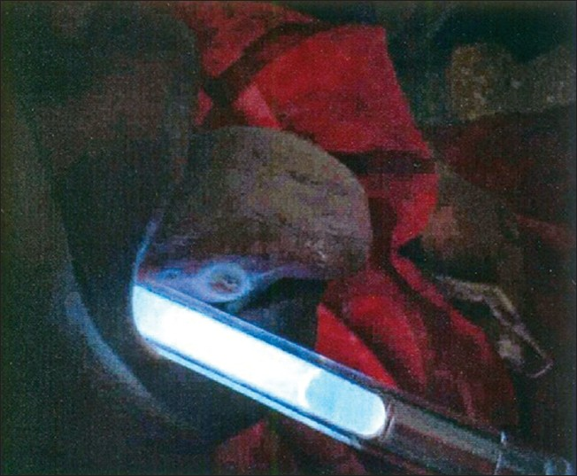
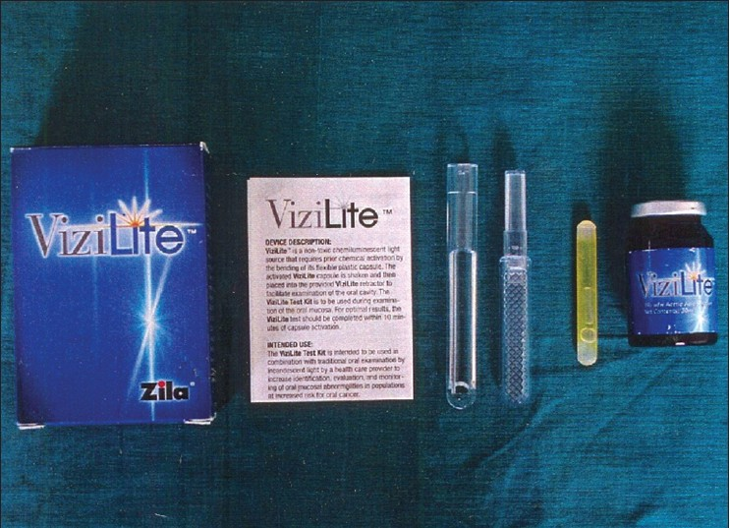
Vizilite / chemiluminescent illumination
ViziLite™ is an oral examination device that is claimed to improve identification, evaluation and monitoring of oral mucosal abnormalities in those with increased risk of oral cancer.
The specific ViziLite™ wavelength is absorbed by normal cells and reflected by abnormal cells due to their higher nuclear-cytoplasmic ratio.
As a result, atypical mucosal abnormalities appear bright white.

Slide 84


Toludine blue
The topical application of toluidine blue, an acidophilic, metachromatic nuclear stain has been used in the in vivo evaluation of neoplastic changes of the cervix (Richart, 1963) and the oral cavity (Shedd et al., 1967, Myers, 1970).
Areas of carcinoma have a strong affinity for the dye, whereas the normal mucosa does not.
This response permits detection of small and early lesions and also permits their surface delineation.

Slide 85


Exfoliative cytology
Oral exfoliative cytology examines the morphological characteristics of exfoliated (or) scraped off superficial cells of the oral mucosa.
The exfoliated cells are stained by Papanicolaou stain.
Exfoliative cytology is of diagnostic references in ulcerated oral carcinomas and erosive leukoplakias and is of importance in mass screening programme (or) where biopsy is not feasible.

Slide 86
Recent advances
Stem Cell Therapy -a non-surgical form of treatment using Autologous Bone Marrow Stem Cells-
Stem Cell Therapy- to treat OSMF and to change the malignant potential.
claims -successfully treatment of patients with OSMF by using this medical technology.

Slide 87
Nano particles for oral cancer diagnosis are more accurate and less invasive to the body. Many cancer cells have a protein, epidermal growth factor receptor (EGFR), non cancer cells have much less of this protein. By attaching gold nano particles to an antibody for EGFR, researchers have been able to bind the nanoparticles to the cancer cells which show different light scattering and absorption spectra than benign cells. Pathologist can thereafter use these results to identify malignant cells in biopsy sample.

Slide 88
CONCLUSION
Patient presenting with Potentially malignant disorders should undergo a careful examination to identify any causative factors, which are best eliminated at the first stage of the treatment. However, many patients may not have any obvious causative factor. A biopsy of the lesion is necessary to demonstrate the histological features of the lesion and detect any existing invasive carcinoma. Frequent monitoring of histopathological changes is essential to obtain an accurate assessment of histological activity of the lesion and to try to predict its future behavior. The subsequent management of the patient depends on how “high risk” the lesion is.

Slide 89
references
Books -
[1] R.A.Cawson’s essentials of Oral Pathology and Oral
Medicine . 7th Edition
[2] Burkitts Oral Pathology 5th Edition
[3] Shafer, Hine & Levy: A textbook of oral pathology.
Articles –
Nanotechnology : A new era in dentistry JADA 2012
2. Oral potentially malignant disorders: Precising the deﬁnition.
Otorhinolaryngology clinics –An International journal may-sept. 2009
4. Classification of OSMF. Swati Gupta, Jigar joshi , JIAOMR
5. NEW CLASSIFICATION FOR ORAL POTENTIALLY MALIGNANT DISORDERS
S. SARODE, SARODE, KARMARKAR, TUPKARI
(Ref - Oral Oncology xxx, 2011)
6. Precancerous lesions of oral cavity.
-Uday pawar, Pankaj C. Otorhinolaryngology International Journal 2009.

Slide 90
THANK YOU

