Slide 1
MECHANICAL PROPERTIES
OF DENTAL MATERIALS

Slide 2
CONTENTS
INTRODUCTION
TYPES OF STRESS
STRAIN
STRESS STRAIN RELATIONSHIP
PROPORTIONAL LIMIT
ELASTIC LIMIT
YOUNG’S MODULUS
RESILIENCE
FLEXIBILITY

Slide 3
CONTENTS
YIELD STRESS
TOUGHNESS
DUCTILITY AND MALLEABILITY
FRACTURE TOUGHNESS
ULTIMATE STRENGTH
COMPRESSIVE STRENGTH
TENSILE STRENGTH, DIAMETRAL TENSILE STRENGTH
SHEAR STRENGTH
FLEXURAL STRENGTH
FATIGUE STRENGTH

Slide 4
INTRODUCTION
In the oral environment, restorations are subjected to heavy masticatiory forces. These forces act on teeth and/ or material producing different reactions that lead to deformation, which can ultimately compromise their durability over time.
It is important to introduce some concepts that are extremely relevant to understand the performance presented by such materials under specific test conditions.

Slide 5
DEFINITION
Mechanical properties are subset of physical properties that are based on the laws of mechanics that is the physical science that deals with energy and forces and their effects on the bodies.
These properties are expressed most often in units of stress and strain.

Slide 6
STRESS
When an external force is applied to acts a body, an internal force, equal in magnitude and opposite in direction to the applied force is set up in the body.
This internal resistance to the external force is called “STRESS”
Denoted by “S” or “σ”
Designated as force per unit area (σ=N/m²)
Commonly stress is reported in terms of mega Pascals. Where, Pascal = 1 N / m².
Notes:
When a specific force or load is applied to a body, a
reaction of the same intensity and with opposite direction is produced. It results in an internal tensionIn a simple way of interpretation, it is possible to quantify the reaction resulted by the applied external load.

Slide 7
TYPES OF STRESS
Depending on the type of force applied, following stresses are produced
Axial (Tensile and Compressive )
Shear (sliding)
Flexural

Slide 8
COMPRESSIVE STRESS
When a body is subjected to compressive forces (two axial sets of force are applied to a sample directed towards each other in a straight line, in order to approximate the molecular structure of the material, an internal resistance developed in the body to oppose this force is called compressive stress.
Compressive force
Compressive stress

Slide 9
DEFINITION OF COMPRESSIVE STRESS:
Ratio of compressive force to cross-sectional area perpendicular to the axis of applied force OR It is the force per unit area produced in the body in response to an externally applied force, which tends to compress (shorten) the material.
It is accompanied by compressive strain.
Notes:
Reference : Craig RG. Mechanical properties. In Restorative dental materials. 10.ed. St. Louis: Mosby, c1997. p. 56-103.

Slide 10
Since most of masticatory forces are compressive in nature, it is important to investigate materials under this condition.
Tooth | Average masticatory force (N)
Second molar | 800
First molar | 390
Bicuspids | 288
Cupids | 208
Incisors | 155
Notes:
Reference : Craig RG. Mechanical properties. In Restorative dental materials. 10.ed. St. Louis: Mosby, c1997. p. 56-103.

Slide 11
TENSILE STRESS
When a body is subjected to tensile force (two sets of forces directed away from each other in a straight line) which tries to stretch or elongate the body, a resistance is developed in the body which is equal in magnitude and opposite in direction to the applied force.
This internal resistance of the body to tensile force is called tensile stress.
Tensile force
Tensile stress

Slide 12
DEFINITION OF TENSILE STRESS
It is the force per unit area produced in the body in response to an externally applied force, which tends to stretch(elongate ) the material.
It is accompanied by tensile strain.

Slide 13
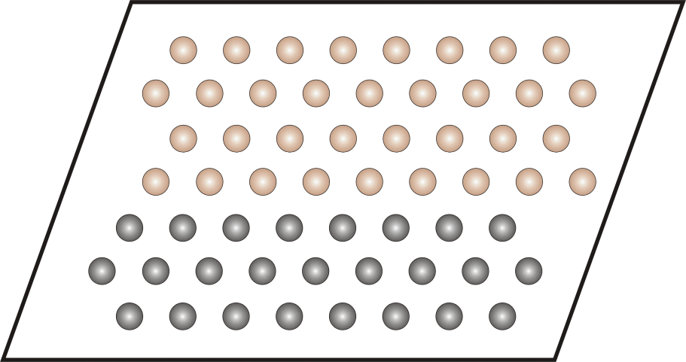
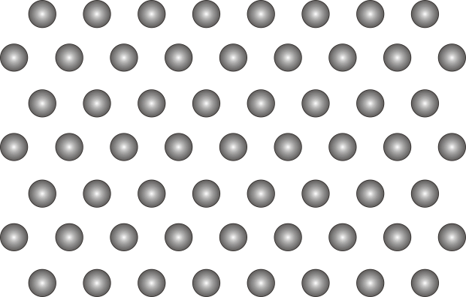
SHEAR STRESS
Shear is a result of two sets of forces directed parallel to each other , but not along the same straight line.
Shear stress is the force per unit area produced in the body in response to an externally applied force, which tends to slide one portion of a body over another.

Slide 14
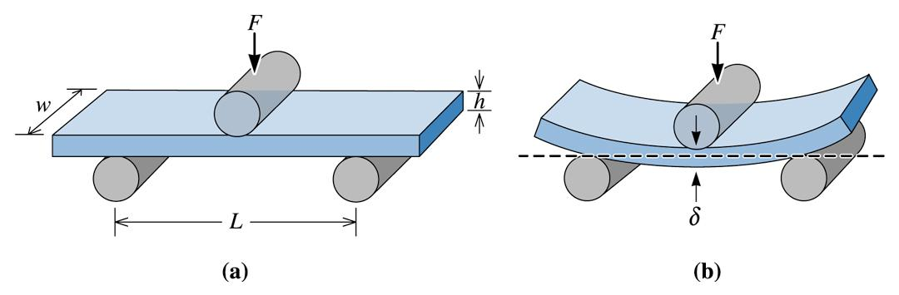
COMPLEX STRESSES
Tensile and compressive stresses along with shear, are the three simple examples of stress which form the basis of all other more complex stress patterns.
FLEXURAL STRESS:
Also called as bending stress.
Produced by bending forces over the dental appliance.

Slide 15
STRAIN
The application of an external force to a body results in a change in dimension of that body. The magnitude of which depends on the applied force and the properties of the material.
The numerical value of strain is given by the expression
Strain = Change in length/Original length.=ΔL/L
Strain is dimensionless quantity because a unit length is divided by unit length.

Slide 16
The stain may be recoverable, that is the material will return to its original length after removal of the applied force (elastic strain), or the material may remain deformed, in which case the strain is non-recoverable(plastic strain).
A third possibility is that the strain may be partially recoverable(visco elasticity).

Slide 17
STRESS-STRAIN RELATIONSHIP
Each type of stress is capable of producing a corresponding deformation in the body.
Therefore, stress and strain are not independent and unrelated properties, but they are closely related and may be seen as cause and effect.
The relationship of stress and strain is often used to characterize the mechanical properties of materials.

Slide 18
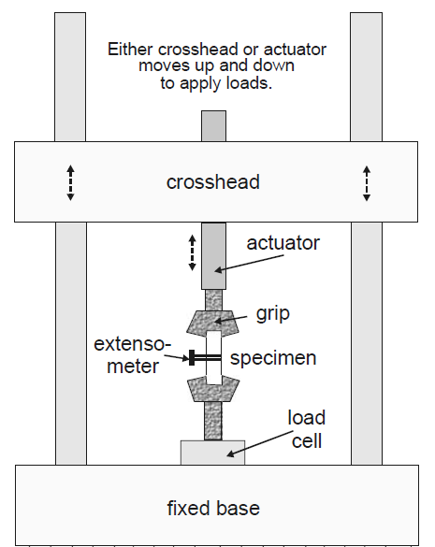
Stress- strain data are generally obtained using a mechanical testing machine, which enables strain to be measured as a function of stress and recorded automatically in the form of a graph called stress strain curve.
Stress-Strain relationship
Parts of universal
testing machine

Slide 19

Click on it to watch a video related to tensile test and stress strain graph

Slide 20
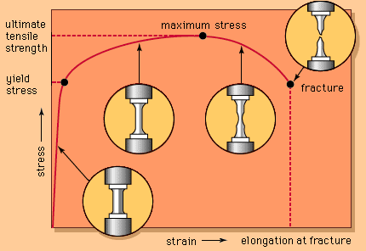
Stress strain curve for a hypothetical material subjected to increased tensile stress until failure is shown in the figure.

Slide 21
PROPORTIONAL LIMIT
As the stress is increased, the strain is increased. In the initial portion of the curve, from O to A, the strain is linearly proportional to the stress. When a stress that is higher than the value registered at A is achieved, the strain changes are no longer linearly proportional to the stress changes. Hence the value of the stress at A is known as the proportional limit.
A
σ y
Proportional limit
Stress
Stress directly proportional
to strain
Ultimate tensile
strength
O
Strain

Slide 22
Proportional limit is defined as the greatest stress that a material will sustain without deviation from the linear proportionality of stress to strain

Slide 23
ELASTIC LIMIT
Defined as the maximum stress that a material can withstand without permanent deformation.
Above elastic limit, a material undergoes irreversible plastic deformation and below the elastic limit, it shows reversible elastic deformation.
NOTE
Elastic deformation → Bonds stretched→ No permanent damage
Plastic deformation → Bonds broken→ Permanent damage

Slide 24
Below elastic limit, no permanent deformation occurs in a structure. When the stress is removed, the structure will return to its original dimensions and the material is considered to be showing elastic nature.
The region of stress-strain curve before the elastic limit is called the elastic region.
EL
Loading
Stress
Unloading
Strain

Slide 25
The application of stress greater than elastic limit results in permanent or irreversible strain in the specimen and the region of the stress strain curve beyond the elastic limit is called the plastic region.
EL
Stress
Elastic Deformation Plastic Deformation
Strain

Slide 26
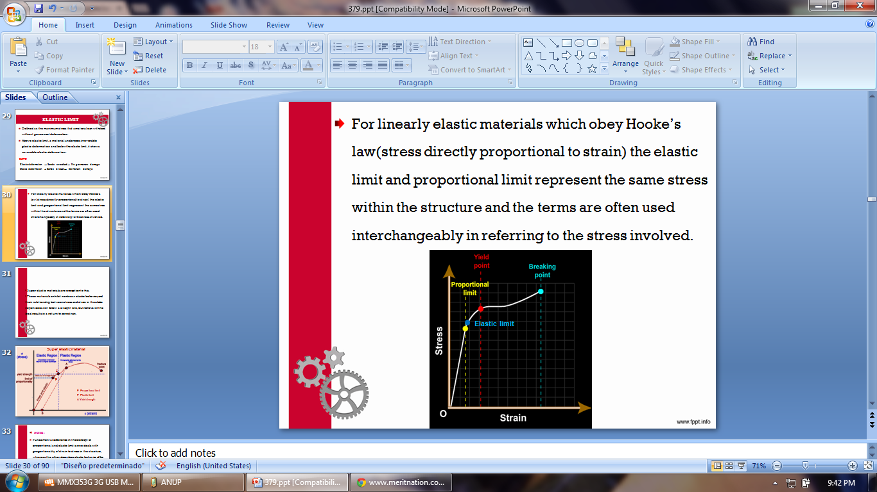
For linearly elastic materials which obey Hooke’s law(stress directly proportional to strain) the elastic limit and proportional limit represent the same stress within the structure and the terms are often used interchangeably in referring to the stress involved.

Slide 27
Super elastic materials are exception to this.
These materials exhibit nonlinear elastic behavior, and their relationship between stress and strain in the elastic region does not follow a straight line, but removal of the load results in a return to zero strain.

Slide 28
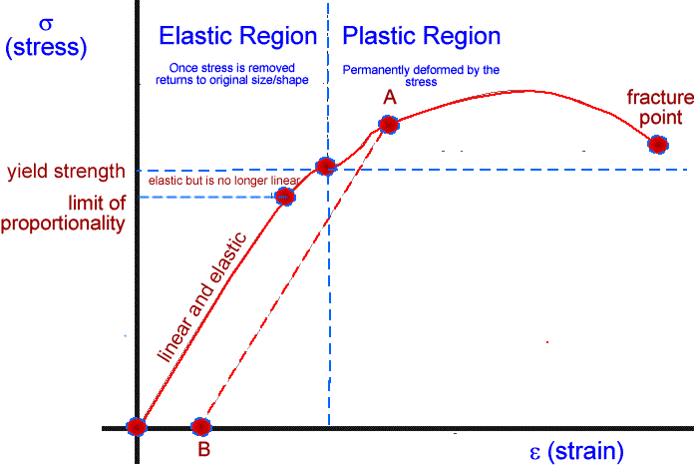
Super elastic material
E
P
P- Proportional limit
E- Elastic limit
A-Yield strength

Slide 29
NOTE :
Fundamental difference in the concept of proportional and elastic limit is one deals with proportionality of strain to stress in the structure, whereas the other describes elastic behavior of the material.

Slide 30
MECHANICAL PROPERTIES BASED
ON ELASTIC DEFORMATION
There are several important mechanical properties measuring reversible deformation and include
Elastic modulus ( young’s modulus or modulus of elasticity or Hooke’s law )
Dynamic young’s modulus
Flexibility
Resilience
Poisson’s ratio

Slide 31
YOUNG’S MODULUS / ELASTIC
MODULUS / MODULUS OF ELASTICITY
When a material deforms elastically, strain for a given stress is always the same and the two are related by Hooke´s Law (stress is directly proportional to strain):
σ α ∈
σ =E ∈
∴E= σ/ε
where,
σ is stress [ MPa ]
E modulus of elasticity /constant of proportionality [MPa]
ε strain [unitless or %]

Slide 32
From the Hooke’s law the modulus of elasticity is defined as the ratio of the stress to the strain in the linear or elastic portion of stress strain curve.
E is measured by the slope of stress strain graph.
It desribes relative stiffnes or rigidity of a material.

Slide 33
Therefore, it follows that lesser the strain for a given stress, greater will be the stiffness and higher the Young’s modulus (E) and viceversa.
Stress
Stress
Greater E ⇒ Stiffness
Lesser E ⇒ flexiblility
Strain
Strain

Slide 34
Elastic modulus of a material is a constant and is unaffected by the amount of stress induced in a material.
Thus it is not a measure of strength. Material with a high elastic modulus can have either high or low strength values.
Stress
Stress
Stiff and
Strong
Stiff and
Weak
Strain
Strain

Slide 35
APPLICATIONS
The metal frame of a metal-ceramic bridge should have a high stiffness. If the metal flexes, the porcelain veneer on it might crack or separate. Such a material would possess a comparative high modulus of elasticity.
A polyether material have greater stiffness than all other elastomeric impression materials. Thus a greater force is needed to remove a impression tray from undercuts in mouth.

Slide 36
NOTE:
The modulus of elasticity is an inherent property of the material and cannot be altered appreciably by heat treatment, work hardening, or any other kind of conditioning.
This property is called structure insensitivity.

Slide 37
Elastic modulus of materials
Materials | Elastic modulus (GPa)
Enamel | 84
Dentin | 17
Gold (type IV)alloy | 90-95
Amalgam | 28-59
Co-Cr partial denture alloy | 218-224
PMMA | 2.4
Silicone elastomer for maxillofacial prosthesis | 0.002-0.003
Feldspathic porcelain | 69-70
Craig 12th edition

Slide 38
DYNAMIC YOUNG’S MODULUS
Can be measured by dynamic method.
Ultrasonic longitudinal and transverse wave transducers and appropriate receivers are used.
The velocity of sound wave and density of material are used to calculate elastic modulus.

Slide 39
RESILIENCE
It indicates the amount of energy necessary to deform a material to proportional limit. OR it is amount of energy absorbed by a structure, when it is stressed to proportional limit.
Resilience is measured by the area under the elastic portion of stress strain curve.
σ
Resilience
ε

Slide 40
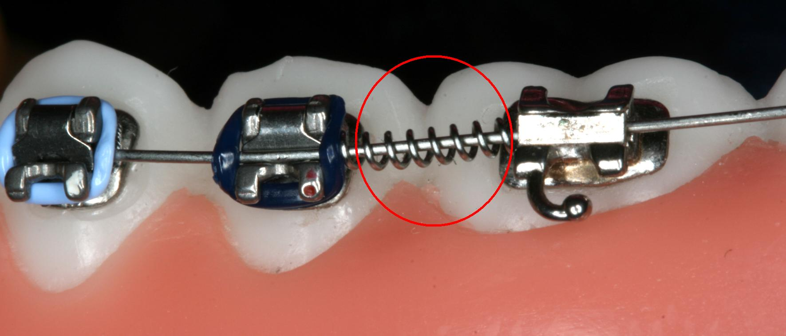
Resilience has particular importance in the evaluation of orthodontic wires . It determines the magnitude of the force that can be applied to the tooth and how far the tooth can move before the spring is no longer effective.

Slide 41
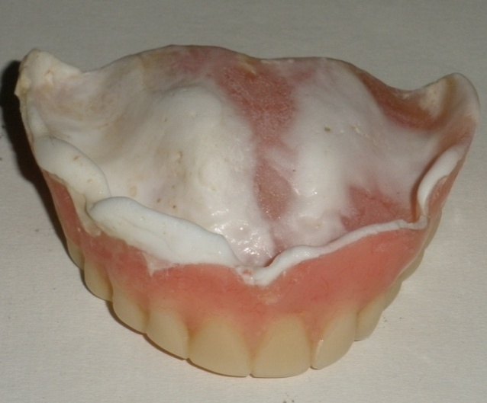
Elastomeric soft liners absorb considerable amounts of energy without being permanently distorted when stressed and the energy stored is released when the material springs back to its original shape after removal of the applied stress. Therefore, these materials act as cushion between the hard denture base and soft tissues to reduce masticatory forces transmitted by prosthesis to the underlying tissues.

Slide 42
If large proximal strains are developed during compressive loading, a proximal inlay might absorb the energy and cause excessive movement of the adjacent tooth when the absorbed energy is released.
Hence the restorative material should exhibit a moderately high elastic modulus and relatively low resilience.

Slide 43
FLEXIBILITY
It is the maximum elastic (recoverable) strain that occurs when a material is stressed to proportional limit.
Therefore, it follows that greater the strain for a given stress in a material, greater will be it’s flexibility.
Proportional limit
σ
ε
Flexibility

Slide 44
APPLICATIONS:
Restorative materials should withstand high stresses and show minimum distortion or should have minimum flexibility.
Impression materials should have large flexibility or elastic deformation to withdraw through severe undercuts without permanent deformation.
Maxillofacial materials and soft denture reliners should have high flexibility.

Slide 45
MECHANICAL PROPERTIES BASED
ON PLASTIC DEFORMATION
There are several important mechanical properties measuring irreversible deformation and include
Yield strength
Toughness
Ductility and malleability
Fracture toughness
Ultimate tensile strength
Fracture strength

Slide 46
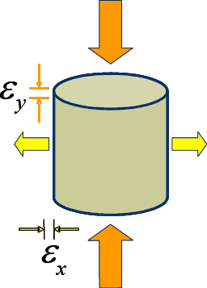

POISSON’S RATIO
When a tensile force is applied along one axis to produce elongation, compressive strain is produced at right angles, proportionately.
Within elastic range the ratio of lateral to the axial
strain is called Poisson's ratio.
Dental materials have Poisson's ratio
value in range of 0.3 to 0.5.

Slide 47
YIELD STRENGTH (PROOF STRESS)
Irregularities along the straight line region of the stress versus-strain plot may represent minor deviations from Hooke’s law and cause some uncertainty in determining the precise point at which the selected line deviates from linearity(proportional limit).
Thus a different property, yield strength, is used in cases where the proportional limit cannot be determined with sufficient accuracy.

Slide 48
Yield strength is the stress required to produce a small-specified amount of plastic deformation.
To determine the YS for a material at 0.2% offset, a line is drawn parallel to the straight line region, starting at a value of 0.002, or 0.2% of the plastic strain, along the strain axis and is extended until it intersects the stress-strain curve.
The stress corresponding to this point is the yield strength.
Yield Strength
Stress
0.002 0.004
Strain

Slide 49
Yield strength indicates a functional failure of a material.
Although the term strength implies that the material has fractured, it is actually intact but has sustained a specific amount of plastic strain (deformation)
A restoration exhibiting a permanent deformation will be no more serving the purpose in spite of the fact that it didn’t fracture.
Yield stress is more important than the ultimate stress, because yield stress represents the clinical failure.

Slide 50
Yield strength determines whether the material is strong or weak.
Yield Strength
Yield Strength
Stress
Strong
Brittle
Strong
Ductile
Stress
Strain
Strain
Yield Strength
Yield Strength
Stress
Stress
Weak
Brittle
Weak
Ductile
Strain
Strain

Slide 51
TOUGHNESS
DEFINITION:
It is the amount of elastic and plastic deformation energy required to fracture a material.
Toughness is indicated as the area under the elastic and plastic portions of a stress strain curve/total area under stress strain curve

Slide 52
Difference between resilience and toughness
Toughness is the total amount of energy a material can absorb up to the point of fracture.
Whereas resilience represents the energy required to stress a material to it’s proportional limit OR The maximum amount of energy a material can absorb without undergoing permanent deformation.
Proportional limit
Stress
Stress
RESILIENCE
TOUGHNESS
Strain
Strain

Slide 53
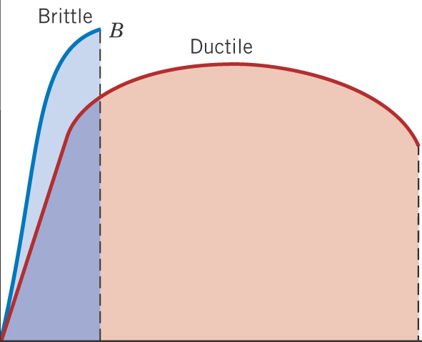
A material capable of absorbing large amount of energy
is termed a tough material.The opposite of toughness is brittleness.
Toughness of the ductile materials is higher than toughness of brittle materials.

Slide 54
Toughness is not as easy to calculate as resilience, and the integration is done numerically.
If a sample is being tested with an automated rig attached to data logging equipment then the toughness can be reported at the end of the run.
In case of a complex curve however there is little choice but to count the squares under the curve.

Slide 55
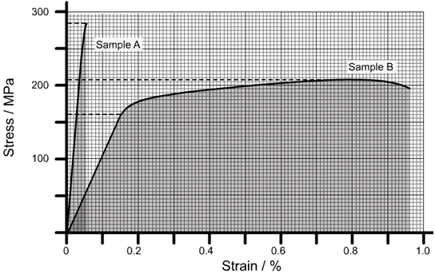
Each large square is 50 MPa x 0.1% (0.001) = 50,000 J m⁻3. Each small square is 1/100th of this (500 J m⁻³).
Sample A: large squares = 0, small squares = 195 => 97.5 kJ m⁻³.
Sample B: large squares = 26, small squares = 816 => 1.71 MJ m⁻³.

Slide 56
DUCTILITY
DEFINITION
Relative ability of a material to deform physically under a tensile stress before it fractures.
Ductility represents the ability of a material to sustain large permanent deformation under tensile load before it fractures. For example, a metal that can be drawn readily into a long, thin wire is considered to be ductile.
A material that undergoes very little plastic deformation is brittle.

Slide 57
Ductility(elongation) can measured with an extensometer while the material is being tested or calculated from the stress strain curve by drawing a line from the point of fracture, that is parallel to the elastic region of the stress- strain curve.Where this line meets the strain axis is the measure of the ductility of the material, and is frequently presented in terms of percentage elongation.
Yield Strength
Fracture
Elastic region
Stress
DUCTILITY
Strain

Slide 58
Percent elongation gives an indication of the workability of an alloy and is calculated as follows
% elongation=(Increase in length/Original length)X100
Alloys | Percentage elongation
Ni-Cr | 2.4
Co-Cr | 1.5
Co-Ni-Cr | 8-10

Slide 59
Ductility is otherwise measured by 3 common methods
a) Percent elongation after fracture:
The simplest and most commonly used method is to compare the increase in length of a wire or rod after fracture in tension to its length before fracture.
Two marks are placed on the wire as the gauge length (for dental, materials, the standard gauge length is usually 51mm) the wire or rod is then pulled a part under a tensile load.

Slide 60
The fractured ends are fitted together, and the gauge length is again measured, the ratio of the increase in length after fracture to the original gauge length is called the present elongation and represents ductility.

Slide 61
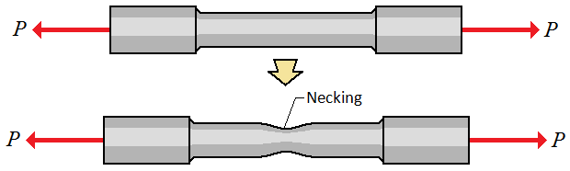
b) The reduction in area of tensile test specimens:
The necking or cone-shaped constriction that occurs at the fractured end of a ductile wire after rupture under tensile load, the percentage of decrease in cross-sectional area of the fractured end in comparison to the original area of the wire or rod is referred to as the reduction in area.

Slide 62
c) The cold bend test:
The material is clamped in a vise and bent around a mandrel of specified radius, the number of bends to fracture is counted, with the grater the number, the greater is the ductility of the material.

Slide 63
Materials that experience a large amount of permanent deformation are said to be ductile.
Materials that undergo little or no plastic behavior are said to be brittle. A brittle material fractures at or near its proportional limit.
Stress
Ductile
Stress
Brittle
Strain
Strain

Slide 64
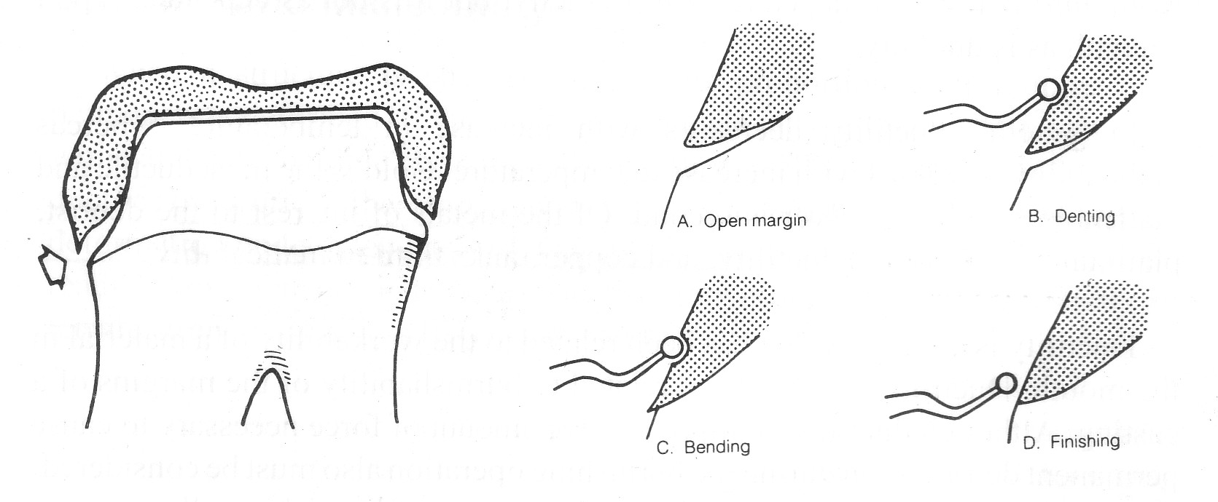
Importance of ductility in dentistry:
Clasps can be adjusted, orthodontics appliances can be prepared, crowns or inlays can be burnished if they are prepared from alloys of high values of percentage elongation.
Burnishing
Open margin

Slide 65
MALLEABILITY
DEFINITION
The ability of a material to sustain considerable permanent deformation without rupture under compression, as in hammering or rolling into a sheet, is termed malleability.
Gold is most ductile and malleable and silver stands the second.
Platinum is third most ductile and copper is third most malleable.

Slide 66
Ductility of metals in decreasing order | Malleability metals in decreasing order
Gold | Gold
Silver | Silver
Platinum | Aluminum
Iron | Copper
Nickel | Tin
Copper | Platinum
Aluminum | Lead
Zinc | Zinc
Tin | iron
Craig 12th edition

Slide 67
FRACTURE TOUGHNESS
DEFINITION:
Fracture toughness is the resistance of a brittle material to catastrophic propagation of flaws under an applied stress.
Fracture toughness is an indication of the amount of stress required to propagate a preexisting flaw.

Slide 68
Flaws or cracks may arise naturally in a material or nucleate after time in service.
In either case, any defect generally weakens a material, and as a result, sudden fractures can arise at stresses below the yield stress.
Sudden catastrophic fractures typically occur in brittle maerials that do not have ability to plastically deform and redistribute stresses.

Slide 69
It is imperative to realize that ceramics, in contrast to metals, are brittle materials and are known to undergo catastrophic failure due to inherent flaws.
For them strength is more of a “conditional” than an inherent material property.
Therefore, strength data alone cannot be directly extrapolated to predict structural performance.
Resistance to fracture in ceramics is determined by fracture toughness.

Slide 70
ULTIMATE STRENGTH
DEFINITION:
It can be defined as the maximum stress a material can withstand before failure in compression, tension , shear or flexure loading. It is the highest point on stress strain curve and corresponds to necking in ductile materials.
It is often different from the fracture strength which is the stress at the point of fracture.
Ultimate strength
Stress
Fracture strength
Strain

Slide 71
An alloy that has been stressed to near ultimate strength will be permanently deformed, so a restoration receiving that amount of stress during function would be useless.
The yield strength is often of greater importance than ultimate tensile strength because it is a estimate of when a material will start to deform permanently.

Slide 72
TENSILE STRENGTH
For ductile materials, the tensile strength can be measured directly using tensiometer or dumbbell shaped cylindrical specimen, is clamped rigidly at the ends and pulled apart to fracture.
Brittle materials may fracture at clamping points due to stress concentrations.

Slide 73
MATERIALS | TENSILE STRENGTH
Dental porcelain | 50-100 MPa
Amalgam | 27-55 MPa
Resin- Based composite | 30-90MPa
Alumina ceramic | 120MPa

Slide 74
DIAMETRAL TENSILE STRENGTH
This test is especially useful for brittle materials like cements and ceramics.
The small size of some dental restorations has made the preparation of large dumbbell shaped tensile specimens impractical and also clamping stress during testing of small tensile specimens of plastics and ceramics frequently cause premature fracture.
As a result, the tensile properties of these materials are usually estimated by the diametral tensile test.

Slide 75
This test involves diametric compression of a disc with a thickness one-half its diameter between two plates until fracture occurs. The compressive force introduces tensile stresses normal to the diameter under load, and failure is tensile in character.
The tensile strength is calculated
as σ=2P / πDT
Where,
P ⇒ load
D ⇒ Diameter of the disc
T ⇒ Thickness of the disc
P
Fracture plane
Tension
T
P

Slide 76
COMPRESSIVE STRENGTH
It is the ability of a material to withstand axial forces.
The sample of the material to be tested is constructed in the shape of a cylinder of known dimensions, usually 6x4 mm in diameter. It is then conditioned for up to 24hrs at mouth temperature and often in water to simulate intraoral conditions after placement.
The cylinder is placed between the platens of a load testing machine and the upper paten is driven down at a constant speed until the specimen fractures.

Slide 77
The ultimate load applied over the surface area is then calculated. To reduce the variation that may occur during specimen preparation, a number of specimens are produced and tested.
The mean of the values at fracture
are used to determine the
compressive strength of the material.

Slide 78
DRAWBACKS OF THE COMPRESSIVE TEST
1. The test for compressive strength is not a good discriminator between different material types. The manner in which the test is carried out is obviously not representative of what occurs in the mouth. When masticatory load is applied to the restoration, the tooth tissue surrounding the restoration will act as a support and help withstand the occlusal forces encountered.

Slide 79
2. As the sample is constrained by friction at points of contact with the platens of the tester, there is an increase in the cross sectional area, with the material taking up a barrel shape.
This gives rise to complex stress pattern in a material that cannot be analyzed easily, which makes the interpretation of compression test very difficult.

Slide 80
Material | Compressive strength (MPa)
Enamel | 384
Dentin | 297
Amalgam | 189
Feldspathic porcelain | 149
Resin composite | 225
Conventional GIC | 180-200
Resin modified GIC | 170-200

Slide 81

SHEAR STRENGTH
It is the maximum shearing stress at shear failure. push-out or punch test method, (i.e. applying an axial load to push out a sample through the other side is used in this test.
Shear load
Resin cement
Lithium Disilicate
Acrylic resin

Slide 82
FLEXURAL STRENGTH/ TRANSVERSE BENDING
(3- POINT BENDING)/ (MODULUS OF RUPTURE):
The flexural strength of a material is its ability to bend before it breaks.
Flexural stress is produced by bending forces and may generate all three types of stress in a structure.

Slide 83
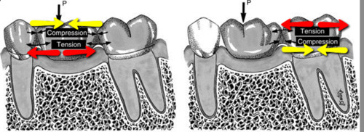
It can occur in fixed partial dentures or cantilever structures.
Lower portion of the beam is in tension, upper portion is in compression and sides reveal shear stresses.

Slide 84
To evaluate flexural strength of a dental material, bar-shaped specimen with dimension of 25 mm in length X 2 mm in width X 2 mm in height is generally used (ISO 9917 – 212).
Specimens are placed on two supports and a load is applied at the center.

Slide 85
The load at yield is the sample specimen’s flexural strength that is calculated by the following formula: 3Pl/2bd²
where,
P= the ultimate load at fracture,
l= the distance of the supports,
b= the width of the specimen,
d= the thickness of the specimen.
This test is also known as three-point bending test

Slide 86
FRACTURE STRENGTH
It is the stress at which a material fractures.
IMPORTANT NOTE:
Ductile materials under tensile load, do not fracture at the point at which maximum stress occurs but fracture at a lower stress value.
Ultimate strength
Stress
Fracture strength
Strain

Slide 87
Reason: After the maximum tensile force is applied, the specimen begin to elongate excessively, resulting in necking or a reduction of cross-sectional area.
In engineering stress strain graph, stress is calculated from force and original cross sectional area and the actual reduction in cross sectional area is not accounted.
Accordingly, the stress at the end of the curve is less than at some intermediate point on the curve.
Therefore, in materials that exhibit necking, the ultimate and fracture strengths are different.
For brittle material like ceramic, they are same points.

Slide 88
REVISION FOR PREDICTION OF PROPERTIES
FROM STRESS STRAIN CURVE
Depending on the inclination of the curve in elastic region.
Stress
Stress
Stiff
Flexible
Strain
Strain
Predicting property - Elastic modulus

Slide 89
Depending on the amount of plastic deformation
Stress
Stress
Ductile
Brittle
Strain
Strain
Predicting property – Plastic strain

Slide 90
Depending on the height of curve.
Stress
Stress
Strong
Weak
Strain
Strain
Predicting property – Yield strength

Slide 91
FATIGUE STRENGTH
Stress values well below the ultimate tensile strength can produce premature fracture of a dental prosthesis or material because microscopic flows grow slowly over many cycles of stress. This phenomenon is called fatigue failure
Fatigue strength is the stress at which a material fails under repeated loading.
Fatigue tests are performed by subjecting a specimen to alternating stress applications below the yield strength until fracture occurs.

Slide 92
Failure under repeated or cyclic loading is dependent on magnitude of load and the number of loading repetitions.
The S-N curve shows that when stress is sufficiently high, the specimen will fracture at a relatively low number of cycles. As the stress is reduced, the number of cycles required to cause failure increases.
Stress
Fatigue strength
10³
10⁴
10⁵
10⁶ cycles

Slide 93
For some materials, a stress at which the specimen can be loaded an infinite number of times without failing is eventually approached. This stress is called endurance limit.
Stress
Endurance limit
10³
10⁴
10⁵
10⁶
Cycles to failure

Slide 94
Importance of fatigue strength
Stress applications during mastication may approach 3,00,000 flexures per year, whereas the greater stress generated by removing and inserting clasp retained RPD from the mouth amounts to less than 1500 per year.
Restorations should be designed so the clinical cyclic stresses are below the fatigue limit.

Slide 95
REFERENCES
Phillips 11th edition.
Craig 12th edition.
Anderson’s applied dental materials 6th edition.
Introduction to dental materials. By Richard Van Noort 6th edition.
A clinical guide to applied dental materials.

Slide 96
THANK YOU

