Slide 1
GYPSUM PRODUCTS
Dept of prosthodontics,DYPDS pune

Slide 2
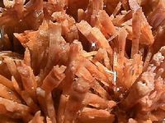
INTRODUCTION
Gypsum is a naturally occurring mineral found in various parts of the world, particularly in Germany and Nova Scotia.
Chemically, the gypsum is nearly pure Calcium Sulfate Dihydrate (CaSO₄.2H₂O).
Gypsum was first found in mines around the city of Paris so it is called as Plaster Of Paris.
Gypsum under SEM
2/68

Slide 3
APPLICATIONS
A. GENERAL
For preparing statues and in construction work.
B. IN ORTHOPEDICS
For splinting and making plaster cast.
C. IN DENTISTRY
Impression of oral and maxillofacial structures.
To make moulds cast and dies over which dental prosthesis and restoration are made.
To attach casts to an articulators.
For bite registration .
As dental investments.
3/68

Slide 4
CLASSIFICATION
According to ADA Specification No.25:
Type 1 - Impression plaster.
Type 2 - Dental plaster.
Type 3 - Dental stone or medium strength stone.
Type 4 - Improved stone or high strength stone.
Type 5 - Dental stone, high strength, high expansion.
4/68

Slide 5
MANUFACTURE OF GYPSUM PRODUCTS
The process of heating gypsum for manufacturing plaster is known as Calcination.
Depending on the method of calcination,different types of gypsum products i.e calcium sulphate hemi hydrate are obtained.
5/68

Slide 6
MANUFACTURE OF GYPSUM PRODUCTS
110⁰-130⁰C
130⁰-200⁰C
200⁰-1000⁰C
CaSO₄. 2H₂O
Gypsum
(calcium sulfate dihydrate)
CaSO₄. ½ H₂O
Plaster or stone
(calcium sulfate hemihydrate
CaSO₄
Hexagonal
anhydrite
CaSO₄
Orthorhombic anhydrite
6/68

Slide 7
CHEMICAL &PHYSICAL NATURE OF GYPSUM PRODUCTS
Gypsum is the dihydrate form of CaSO4 denoted as CaSO4.2H2O.
On heating it loses 1.5 g mol of its 2g mol of water & is converted to CaSO4.1/2H2O
When mixed with water , the reverse reaction is seen:
CaSO4.1/2H2O + 11/2H2O CaSO4.2H2O+ 3900cal/gmol.
7/68

Slide 8
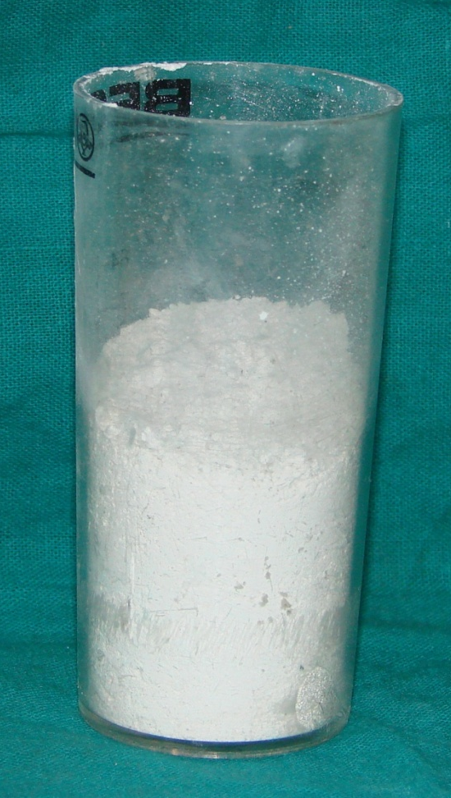
MANUFACTURE OF DENTAL PLASTER: (POP)
Gypsum is heated to a temperature of about 110 to 120ºC (230 to 250ºF) in order to drive off part of the water of crystallization.
This produces irregular, crystals with capillary pores- ß-hemihydrate.
Procedure is carried out in a kettle, vat or rotary kiln open to air –Dry Calcination.
8/68

Slide 9
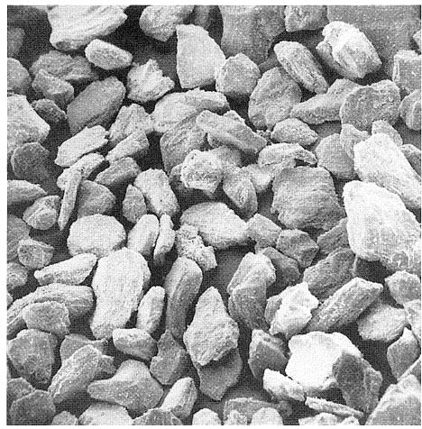
MICROSCOPICALLY
Fibrous aggregate of fine crystals with capillary pores.
Powder particles of plaster of Paris (ß-hemihydrate)
9/68

Slide 10
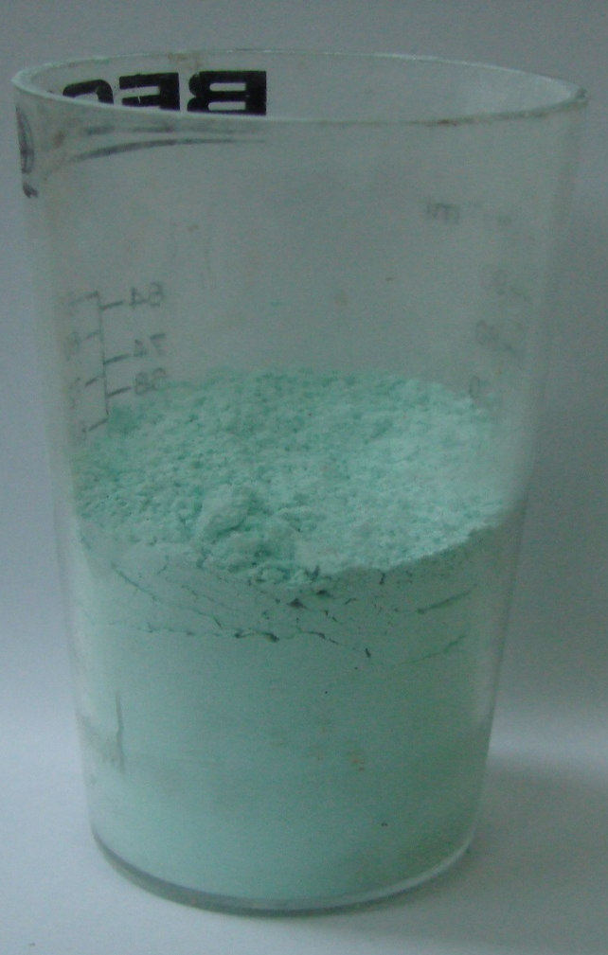
MANUFACTURE OF DENTAL STONE
Gypsum is calcined under steam pressure in an autoclave at 120⁰C to 130⁰C at 17 lbs/sq. inch for 5 to 7 hours-Wet Calcination.
Product obtained is much stronger and harder then beta hemihydrate.
10/68

Slide 11
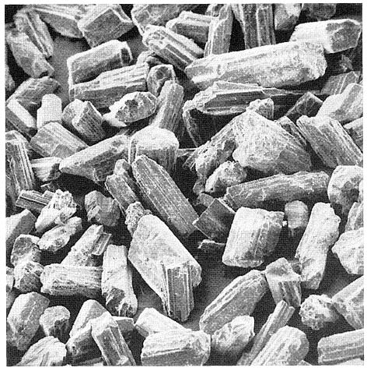
MICR0SCOPICALLY
Crystals in the form of rods and prisms- α hemihydrate
Powder Particles of dental stone(α-hemihydrate)
11/68

Slide 12
Differences between α and ß- hemihydrate
α-hemihydrate (Dental Stone) | ß- hemihydrate (Dental Plaster)
Crystals in the form of rods or prisms and compact. | Spongy irregular in shape and porous.
Wet Calcination. | Dry Calcination.
Low setting expansion . | High setting expansion.
Set gypsum is stronger and harder. | Set gypsum is of lower strength.
High abrasion resistance. | Low abrasion resistance.
12/68

Slide 13
MANUFACTURE OF IMPROVED STONE
Gypsum is boiled in a solution of a salt such as CaCl2(30%).
CaCl2 is washed away with hot water.
They have even higher density & yield an even stronger set & are more resistant to abrasion.
Microscopically cuboidal in shape.
13/68

Slide 14
THEORIES OF SETTING
Colloidal theory / Gel theory
Hydration theory
Dissolution precipitation theory/ crystalline theory
14/68

Slide 15
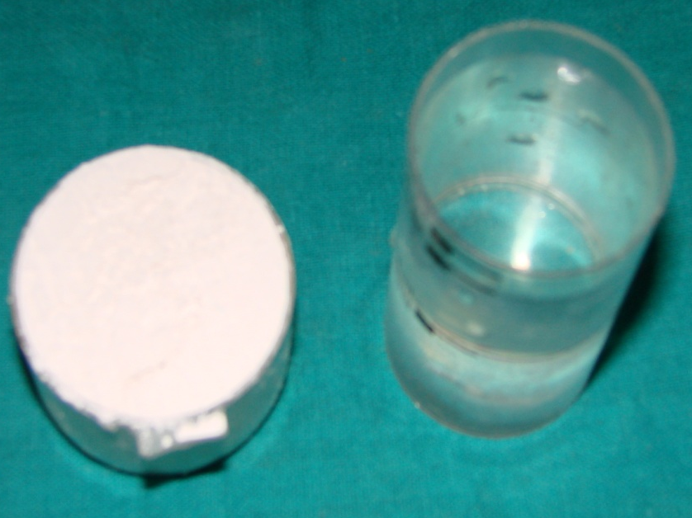
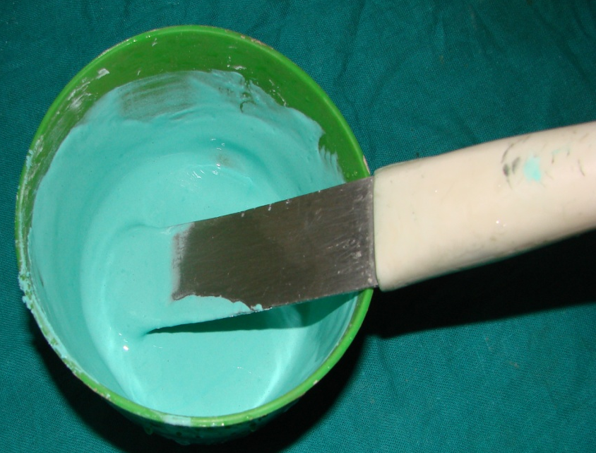
WATER/POWDER RATIO
WATER/POWDER RATIO : Important factor in deciding the physical and chemical properties of the final product.
Higher water-powder ratio:-
Longer setting time & weaker will be the gypsum product.
15/68

Slide 16
WATER/POWDER RATIO AFFECTED BY:-
Shape & compactness of crystals:-
Irregular, spongy plaster particles need more water then the denser stone.
Small amounts of surface active materials like gum arabic plus lime(calcium carbonate) reduce water requirement of all gypsum products.
Particle size distribution, grinding of the powder breaks up needle like crystals. Improves packing characteristics & reduces the water needed.
16/68

Slide 17
RECOMMENDED W/P RATIO
* Impression plaster : 0.50 to 0.75.
* Dental plaster : 0.45 to 0.50.
* Dental stone : 0.28 to 0.30.
* Type IV : 0.22 to 0.24.
* Type V : 0.18 to 0.22.
17/68

Slide 18
EXCESS WATER
The actual amount of water necessary to mix the calcium sulfate hemihydrate is greater than the amount required for the chemical reaction (18.61gm of water per 100 gm of hemihydrate).This is called excess water.
The excess water itself does not react with the hemihydrate crystals. It is lost by evaporation once the gypsum is set.
The excess water serve only to aid in mixing the powder particles & is replaced by voids.
18/68

Slide 19
MANIPULATION:
A smooth mix should be obtained.
Water is dispensed into a mixing bowl.
The powder is added & allowed to settle into the water for about 30sec.
It minimizes the amount of air incorporated into the mix.
19/68

Slide 20
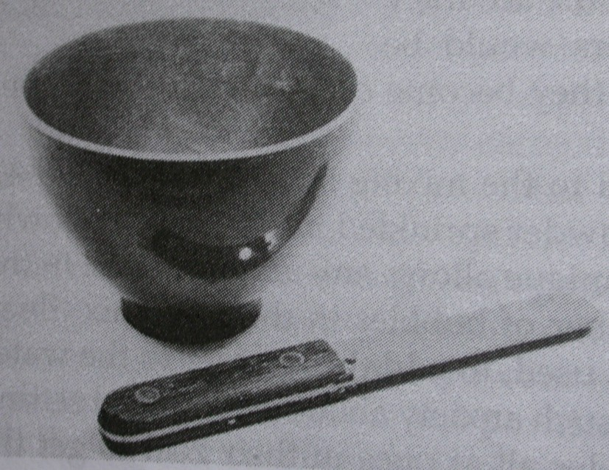
SPATULATION CAN BE CONTINUED BY HAND USING A METAL SPATULA WITH A STIFF BLADE.
20/68

Slide 21
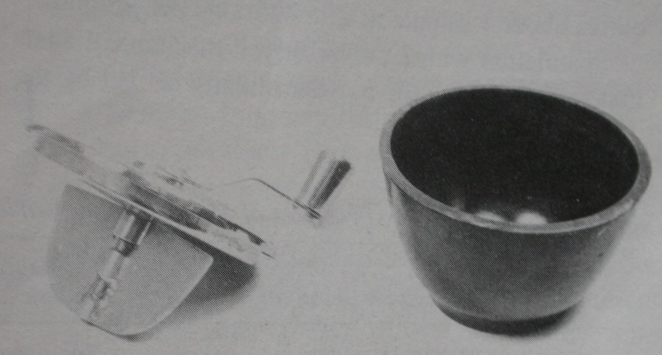
MECHANICAL SPATULATION
Is to wet & mix the powder uniformly with the water required about 1min at 2 revolutions per sec.
It involves stirring the mixture vigorously & at the same time wiping the inside surfaces of the bowl with the spatula.
21/68

Slide 22
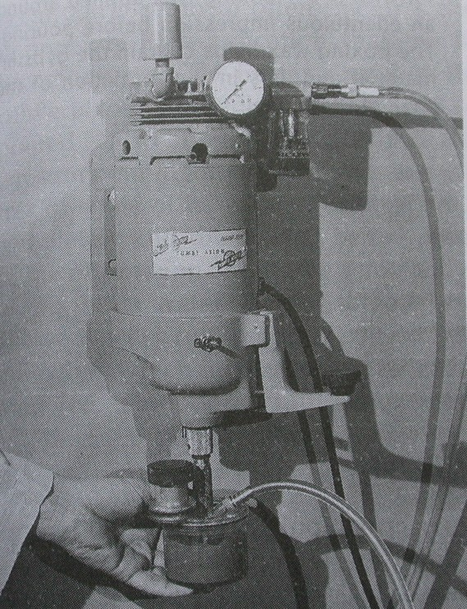
A POWER DRIVEN MECHANICAL SPATULATOR.
22/68

Slide 23
PROPORTIONING
Important to keep the amount of water as low as possible.
Decreased amount of water increases the viscosity of the mix.
The lowest limit of the viscosity permissible is governed by the ability of the water- plaster mixture to remain in position in the tray while the impression is being taken.
23/68

Slide 24
MIXING
BOWL: flexible rubber/ plastic parabolic in shape.
It should be smooth & resistant to abrasion.
No corners in which powder can collect/ stagnate.
SPATULA: stiff blade
A flexible blade drags when it is forced through a thick mixture.
End of the blade should be rounded to conform to the shape of the mixing bowl.
HANDLE: readily grasped by hand.
24/68

Slide 25
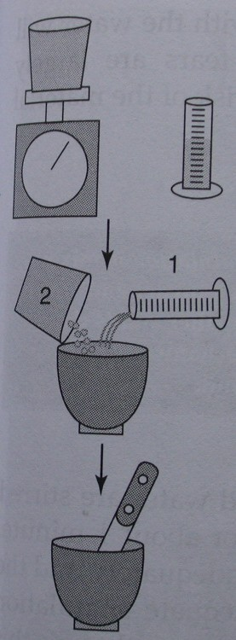
MIXING
25/68

Slide 26
PROPERTIES
The important properties of gypsum products are :
Setting time
Setting expansion
Strength
Hardness and abrasion resistance
Reproduction of detail .
26/68

Slide 27
SETTING TIME
MIXING TIME is the time form the addition the powder to the water until mixing is complete.
WORKING TIME is time available a workable mix ,i.e. one that maintains an even consistency that may be manipulated.
SETTING TIME The time elapsing from the beginning of mixing until the material hardens is called setting time.
27/68

Slide 28
INITIAL SETTING TIME :
As the reaction proceeds, however, more hemihydrate crystal react to forms dihydrate crystals. The viscosity of the mass is increased, and it can no longer be poured. The material becomes rigid (but not hard). It can be carved but not moulded. this is known as initial setting time.
FINAL SETTING TIME :
The time at which the material can be separated `form the impression without distortion or fracture.
28/68

Slide 29
MEASUREMENT OF SETTING TIME
LOSS OF GLOSS METHOD
As reaction proceeds, the gloss disappears form the surface of plaster mix (Sometimes used to indicate initial set).
EXOTHERMIC REACTION
The temperature rise of the mass may also be used for measurement of setting time, as the setting reaction is exothermic.
PENETRATION TESTS
By using penetrometers.
29/68

Slide 30
TYPES OF PENETROMETERS:
VICAT NEEDLE
GILLMORE NEEDLE
INTITAL GILLMORE TEST FOR INTIAL SET:
It is measured in terms of their ability to resist penetration by needles.
Heavier needles have a smaller tip diameter than lighter one and applies greater pressure
30/68

Slide 31
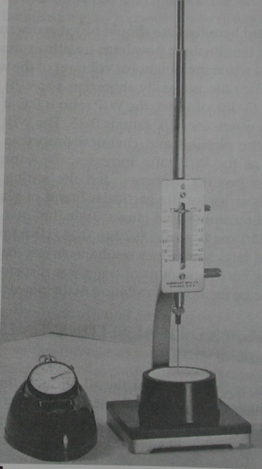
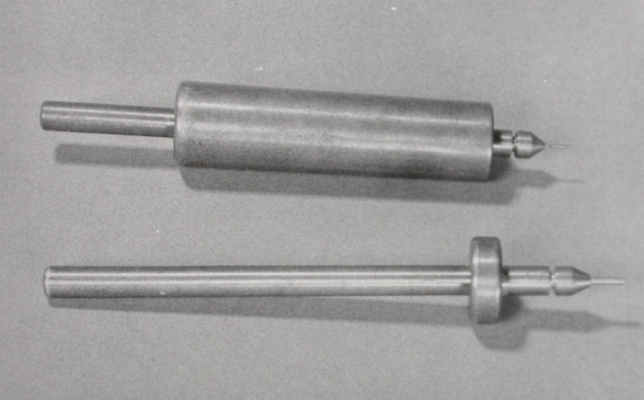
The smaller 113.4 gms(1/4th pound) needle has a 2.13mm point(1/12th inch in diameter).
31/68

Slide 32
The mixture is spread out and the needle is lowered on to the surface
The time at which it no longer leaves an impression is called the initial set. Noted as ‘initial gillmore’.
It indicates partial progress of a setting reaction.
32/68

Slide 33
GILLMORE TEST FOR FINAL SETTING TIME:
The next stage in the setting process is measured by the use of the heavier gillmore needle - 453.6 gms(1pound) in weight and 1.06mm in diameter(1/24th inch)
The elapse time at which this needle leaves only a barely perceptable mark on the surface is called the Final Setting Time
This is the time at which chemical reaction is practically completed
Ready for use criterion:
It is a subjective measure of the time at which the set material may be safely handled.
33/68

Slide 34
VICAT TEST FOR SETTING TIME:
The rod holding the needle weighs 300 gms, the needle is 1 mm in diameter and 5cm long
Next stage in the reaction is determined by the vicat penetrometer
The needle with a weighted plunger rod is supported and held just in contact with the mix
The time elapse from the start of the mix until the needle no longer penetrates to the bottom of the mix is known as the setting time.
34/68

Slide 35
FACTORS AFFECTING THE SETTING TIME
Manufacturing process.
Mixing and spatulation time
Water/ powder ratio
Temperature
Modifiers
35/68

Slide 36
FACTORS CAN BE DIVIDED INTO THOSE
CONTROLLED BY MANUFACTURER:
By control of neucleating agent in hemi-hydrate powder.
CONTROLLED BY OPERATOR:
Temperature
Water/ powder ratio
Mixing time
Modifiers
36/68

Slide 37
MANUFACTURING PROCESS
IMPURITIES
When calcification is not complete so that gypsum particles remain, or if the manufactures adds gypsum - Setting time shortened
FINENESS
Finer the particles size of hemihydrate - the faster the mix hardens;and a more rapid rate of crystallization occurs.
37/68

Slide 38
MIXING AND SPATULATION
Longer and faster the plaster is mixed -Faster it will set
WATER / POWDER RATIO
More the water used for mixing ,the fewer the unit volume-Setting time will be prolonged .
TEMPERATURE
If temperature of the mix increased beyond 50 C-retardation of setting time.
50 C-100 C: converted back to hemihydrate.
100 C -No reaction take place.
0
0
0
0
38/68

Slide 39
MODIFIERS (Accelerators and Retarders)
Modifiers are chemicals added in order to alter some of the properties and make it more acceptable to the dentist.
If the chemical added, it decreases the setting time, it is called an Accelerator
If it increases the setting time ,it is called a Retarder.
39/68

Slide 40
ACCELERATORS
Finely powdered gypsum (terra alba 1%)
In low concentration –
Sodium sulfate (upto3.4%)
Potassium sulfate (2 to 3%)
Sodium chloride (upto2%)
40/68

Slide 41
RETARDERS
Higher concentration – Sodium chloride and Sodium sulfate (above3.4%)
Acetates
Borates
Citrates
Tartates
Inorganic salts like ferric sulfate, chromic sulfate, aluminum sulfate
41/68

Slide 42
RETARDERS
Borax (1-2%)is the most effective retarder..
Colloids such as
Gelatine
Glue
Agar
Coagulated blood etc.
42/68

Slide 43
SETTING EXPANSION
Normal setting expansion
Hygroscopic setting expansion
NORMAL SETTING EXPANSION(0.05 to 0.5%)
All gypsum product show a linear expansion during setting, due to the outward thrust of the growing crystals during setting.
43/68

Slide 44
Ca (SO4) .H2O + 3 H2O 2 CaSO4. 2 H2O
MOLECULAR 290.284 54.048 344.332
MASS
DENSITY
(gm/cm ) 2.75 0.997 2.32
EQ. VOL. 105.556 54.211 148.405
TOT. VOL. 159.767 148.405
THE NET CHANGE IN VOLUME IS –7.11%
2
3
44/68

Slide 45
The setting expansion without water immersion is called Normal Setting Expansion
Whereas that under water is known as Hygroscopic Setting Expansion
Crystal interlocking
The setting expansion is due to
Hydrostatic pressure that develops in water during setting
45/68

Slide 46
HYGROSCOPIC SETTING EXPANSION:
If setting process is allowed to occur under water, the setting expansion may be more than double in magnitude.
Reason for increased expansion is the additional crystal growth permitted by allowing crystals to grow freely, rather than being constrained by the surface tension when the crystals form in air
The basic mechanism of crystal growth is the same in both.
Both phenomenon are true setting expansion
46/68

Slide 47
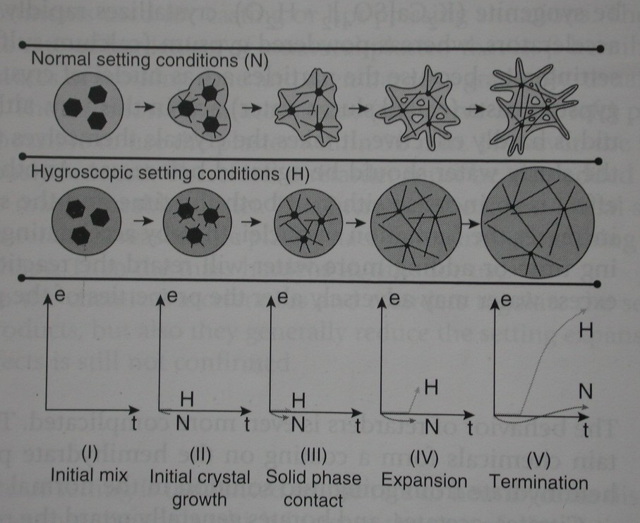
HYGROSCOPIC SETTING EXPANSION
47/68

Slide 48
CONTROL OF SETTING EXPANSION
Increased Setting Expansion:
Increased spatulation
Sodium chloride and ground gypsum
Reduced Setting expansion
Increase in W/P ratio.
Modifiers-K2SO4.
Sodium chloride
Borax
48/68

Slide 49
IMPORTANCE OF SETTING EXPANSION
Undesirable in impression plaster, dental plaster and stone as it will result in an inaccurate cast or change in the occlusal relation if used for mounting.
Increased setting expansion is desired in case of investment materials as it helps to compensate the shrinkage of the metal during casting.
49/68

Slide 50
STRENGTH
The strength increases rapidly as the material hardens after the initial setting time.
Expressed in terms of Compressive strength
The compressive strength is inversely related to the W/P ratio of the mix.
50/68

Slide 51
FACTORS AFFECTING STRENGTH
THE FREE WATER CONTENT;
The greater the amount of free water in the set stone ,the less the strength
WET STRENGTH;
Strength when the excess free water is present in the set gypsum.
DRY STRENGTH;
Strength of gypsum when excess water is lost due to evaporation.
It is two or three time greater than the wet strength
51/68

Slide 52
TEMPERATURE:
Gypsum is stable only below about 40⁰C.
Loss of water of crystallization occurs rapidly at 100⁰C - shrinkage and reduction in strength
W/P RATIO;
The more the water ,the greater will be porosity and less the strength
SPATULATION;
Within limits , the strength increases with increased spatulation
ADDITION OF ACCELERATORS AND RETARDER:
Lowers strength
52/68

Slide 53
EFFECT OF W/P RATIO ON THE COMPRESSIVE STRENGTH OF GYPSUM PRODUCTS
MATERIAL | W/P RATIO | COMPRESSIVE
 | (ml/g) | STRENGTH (MPa)
Model plaster | 0.45 | 12.5
 | 0.50 | 11.0
 | 0.55 | 9.0
Dental stone | 0.27 | 31.0
 | 0.30 | 20.5
 | 0.50 | 10.5
Dental stone,(High strength) | 0.24 | 38.0
 | 0.30 | 21.5
 | 0.50 | 10.5

Slide 54
TENSILE STRENGTH
Gypsum is brittle material ;thus weaker in tension than compression.
The one hour tensile strength of model is approximately 2.3 MPa .when dry tensile strength doubles .
Tensile strength of dental stone is twice than that of plaster .
54/68

Slide 55
HARDNESS AND ABRASION RESISTANCE
This is related to the compressive strength .
The higher the compressive strength of the hardening mass, the higher the surface hardness.
The hardness of gypsum product increased by impregnating the set gypsum with epoxy or methyl methacrylate monomer.
Impregnating set gypsum with resin increases abrasion resistance.
55/68

Slide 56
REPRODUCTION OF DETAILS
Gypsum dies do not reproduce surface details as well as electroformed dies or epoxy dies because surface of set gypsum is porous on a microscopic level .
Air bubbles are often formed at the interface of impression and gypsum cast because freshly mixed gypsum does not wet some rubber impression materials well .
56/68

Slide 57
The incorporation of some nonionic surfactant in polysulfide and silicone impression material improves the wetting of impression.
The use of vibration during pouring reduces the presences of air bubbles. Gypsum products reproduce detail accurately.
57/68

Slide 58
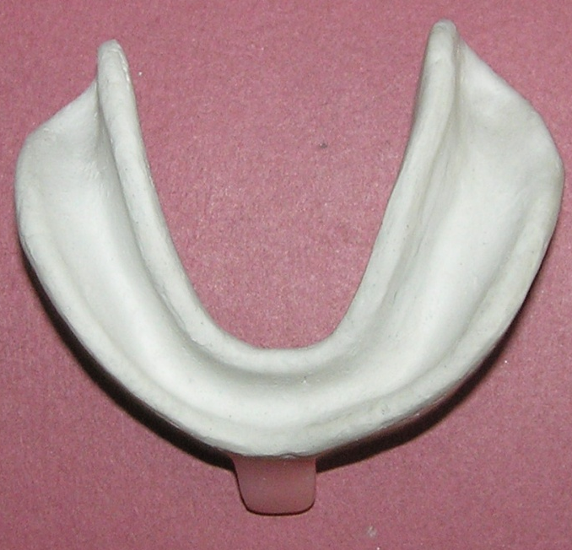
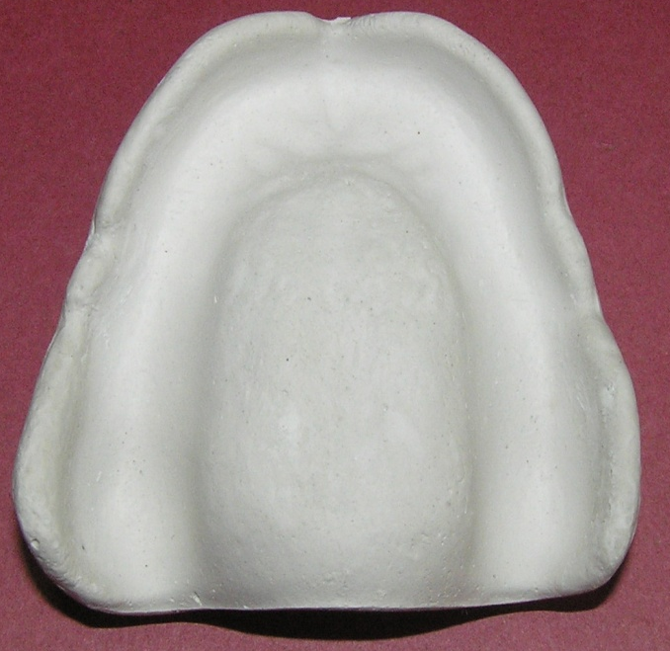
TYPE 1 OR IMPRESSION PLASTER
Impression plaster was one of the earliest impression materials in dentistry.
Fractured to remove it form undercut areas in the mouth.
The fractured pieces were then reassembled outside and a cast was poured.
Plaster is primarily restricted to a final or wash impression in the construction of full denture.
58/68

Slide 59
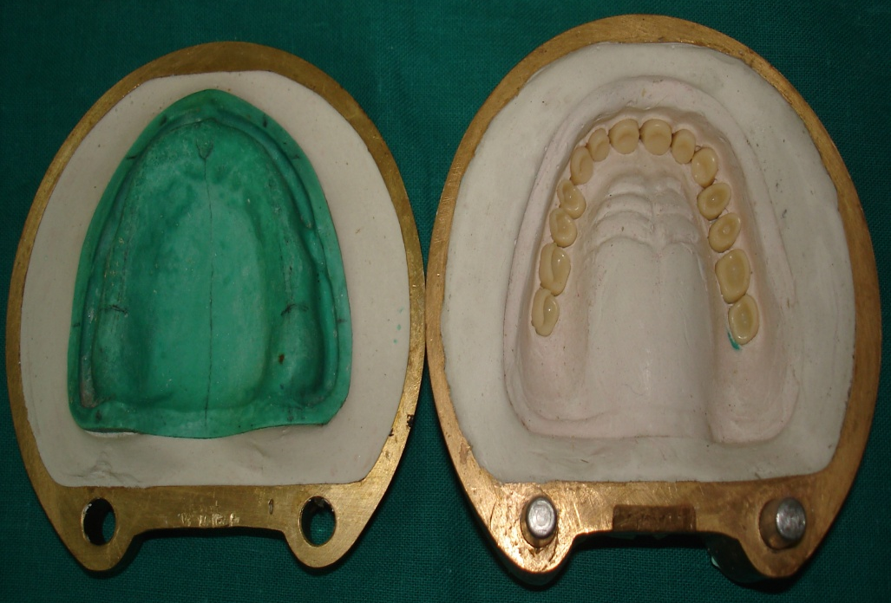
MODEL PLASTER (TYPE- II)
This model plaster or laboratory type II plaster is now used primarily to fill a flask in denture construction when setting expansion is not critical and strength is adequate.
59/68

Slide 60
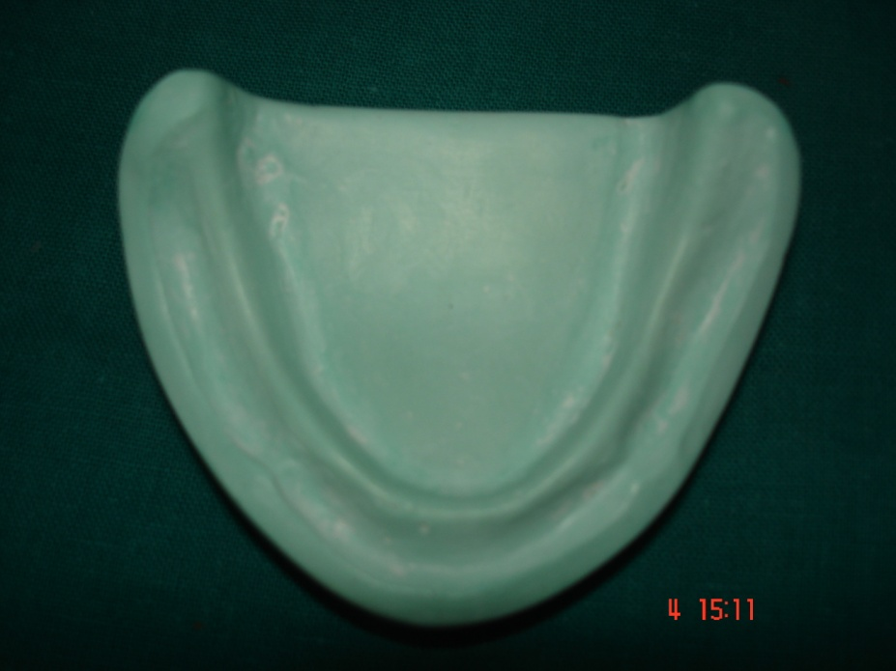
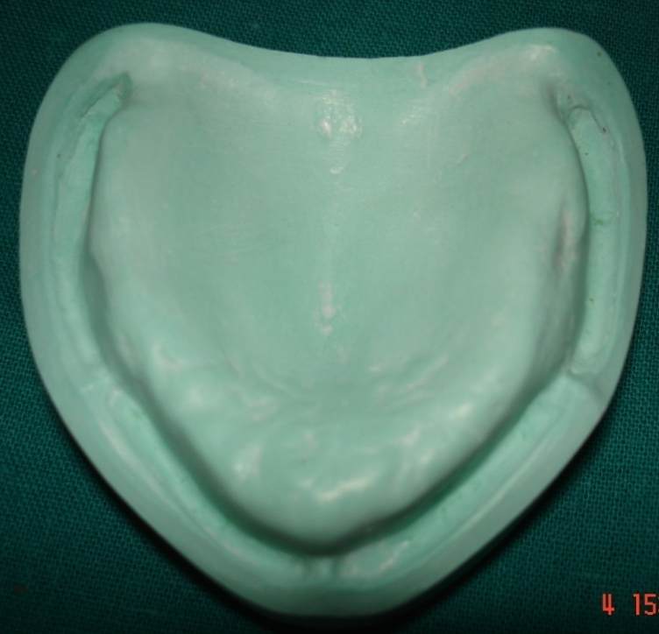
DENTAL STONE (TYPE III)
It is intended for construction of cast in fabrication of full denture that fit soft tissues.
60/68

Slide 61
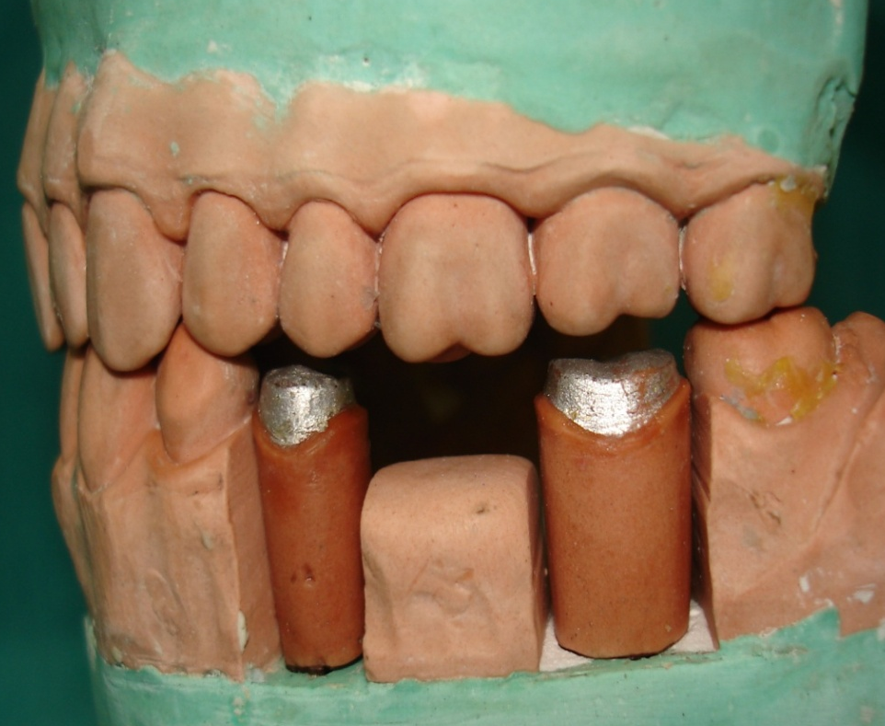
DENTAL STONE , HIGH STRENGTH TYPE(IV)
Synonyms Die stone
Die stone is the strongest and hardest variety of gypsum product. It is used when surface hardness and high strength is required ,e .g. dies used inlay ,crown and bridge wax patterns.
61/68

Slide 62
TYPE V OR DENTAL STONE ,HIGH STRENGTH, HIGH EXPANSION
Higher compressive strength than type IV stone
Improved strength is attained by making it possible to lower w/p ratio even further .
Setting expansion is increased from a maximum of 0.1% to 0.3% This is for compensating for the shrinkage of base metal alloys ,during solidification.
62/68

Slide 63
TYPICAL PROPERTIES * OF THE FIVE TYPES OF GYPSUM PRODUCTS
 |  |  | 2 – Hr setting expansion (%) |  | 1- Hr compressive strength⁺
Type | W/P ratio | Setting time (min) | Min | Max | (Mpa) | ( psi)
1. plaster impression | 0.40-0.75 | 4±1 | 0.00 | 0.15 | 4.0 | 580
II. Plaster, model | 0.45-0.50 | 12±4 | 0.00 | 0.30 | 9.0 | 1300
III. Dental Stone⁺ | 0.28-0.30 | 12±4 | 0.00 | 0.20 | 20.7 | 3000
IV Dental stone, high strength | 0.22-0.24 | 12±4 | 0.00 | 0.10 | 34.5 | 5000
V dental stone, high strength, high expansion | 0.18-0.22 | 12±4 | 0.10 | 0.30 | 48.3 | 7000
63/68

Slide 64
SYNTHETIC GYPSUM:
Alpha & beta-hemihydrate are made from the byproducts or waste products of phosphoric acid production.
Japan & Germany have been succeeded in its production.
More expensive.
64/68

Slide 65
CARE FOR THE CAST
Gypsum cast has to be soaked in 'slurry water'.
If the cast is washed in ordinary water, surface layer may dissolve, hence slurry water is used to preserve surface details. Such a procedure also causes a negligible expansion.
65/68

Slide 66
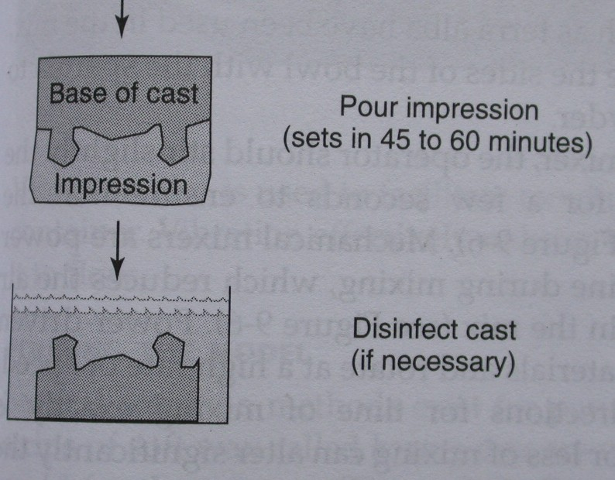
INFECTION CONTROL:
1) Iodophore sprays.
2) Immersion in disinfectant.
3) Overnight gas sterilization for patients with known cases.
4) 1:10 dilution of a 5% sodium hypochlorite for 30 min.
5) Ethylene oxide.
66/68

Slide 67
SUMMARY
A unique dental material which is easy to manipulate and sets to a hard and strong mass, because of its property it is widely used in dentistry, medical and for general purposes such as construction and statues,and other routine uses etc.Gypsum products are immensely useful in dentistry in general and prosthodontics in particular.
67/68

Slide 68
REFERENCES
Dental Material’s, Properties & Dental Manipulation
By R.G.Craig, O’brien, Powers
Clinical Restorative Material’s & Technique
By Leinfelder, Lemons
Applied Dental Material’s
By J.Mc CABE
Skinners Science Of Dental Materials
By Ralph.W.Phillips
The Clinical Handling Of Dental Material
By B.G.Smith & P.S.Wright
68/68

Slide 69
THANK YOU

