Slide 1
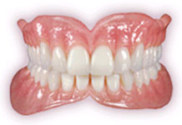
Arrangement of Teeth

Slide 2
Introduction -
Complete Denture Prosthodontics involves the replacement of the lost natural dentition and associated structures of the maxilla and mandible for patients who have lost all their remaining natural teeth. Arrangement of teeth for a complete denture is a pivotal step in fabrication of such a prosthesis.

Slide 3
Natural v/s Artificial Occlusion
Type of support
Proprioception
Response to pressures of occlusion
Effect of malocclusion
Effect of non-vertical forces
Act of incision
Act of mastication
Necessity for a bilaterally balanced occlusion.

Slide 4
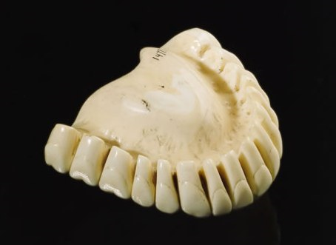
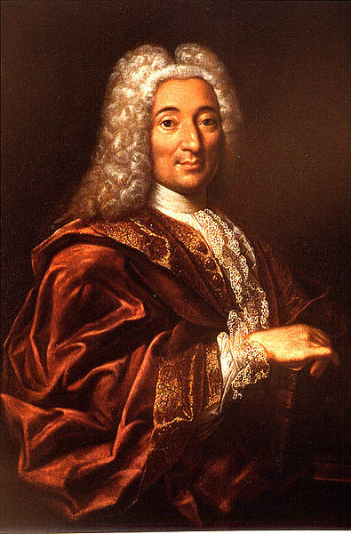
Review of Literature
Prior to 18th century artificial teeth were made of wood , ivory, animal teeth and human teeth.
In 19th century – Ash Of England is believed to be the first to to design teeth that occluded properly.
1678- 1761 - Pierre Fauchard used human teeth in hippopotamus or elephant ivory dentures .

Slide 5
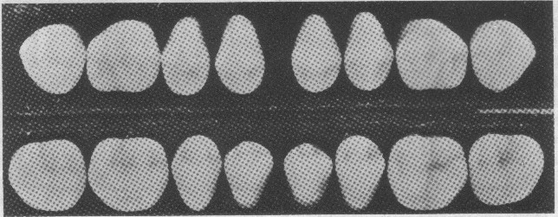
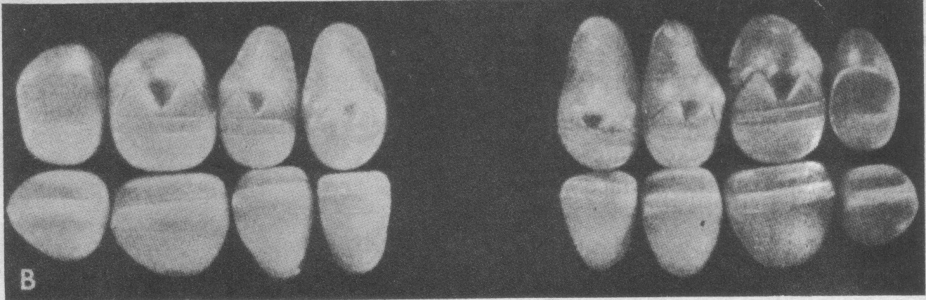
In 1914 - Dr. Alfred Gysi of Switzerland – first anatomic porcelain tooth , were called Trubyte .
- Geometric theory of tooth selection –
presented by Dr. J. Leon Williams.
In 1922 - Victor Sears – Chewing members Tooth .
In 1927 - Victor Sears – Channel Tooth .
Gysi – Crossbite posterior teeth .

Slide 6
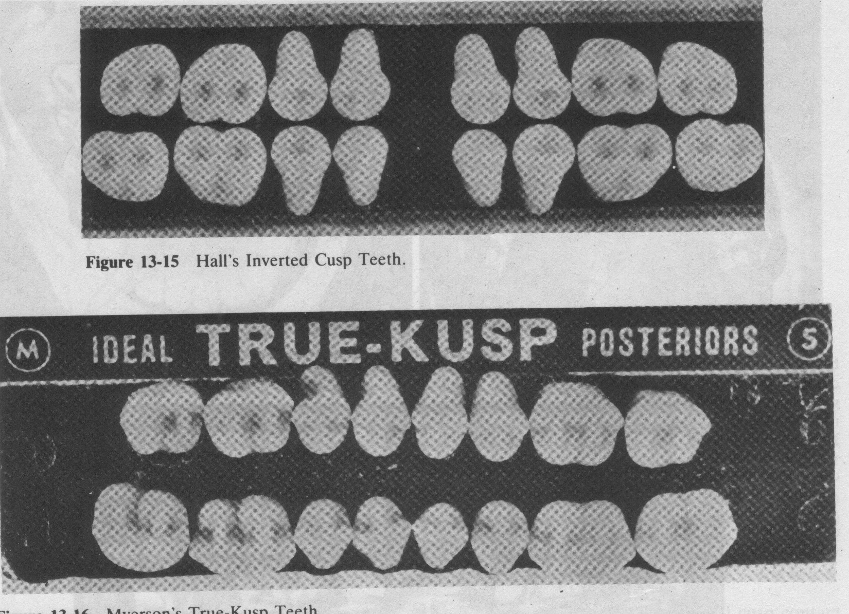
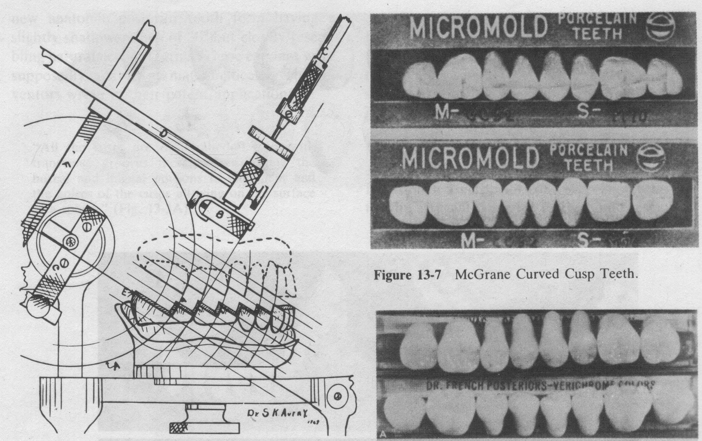
In 1929 - Hall introduced Inverted Cusp teeth - first flat plane teeth
Myerson shortly introduced Truecusp – cuspless posterior teeth
In 1930 - Avery Brothers designed
the Scissor bite teeth.

Slide 7
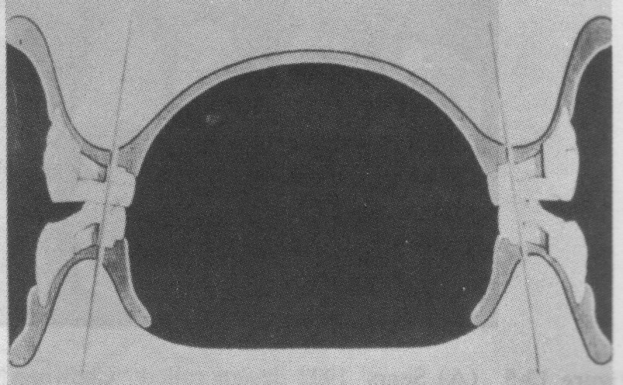
In 1931 - Fish gave concept of a Neutral Zone in complete denture construction .
In 1932 - Pilkington and Turner anatomic posterior tooth
In 1934 - Nelson described Chopping Blocks - flat occlusal surfaces with numerous transverse ridges.
In 1935 - French designed severely modified teeth .
a
In 1936 - McGrane marketed Curved Cusp posterior tooth.

Slide 8
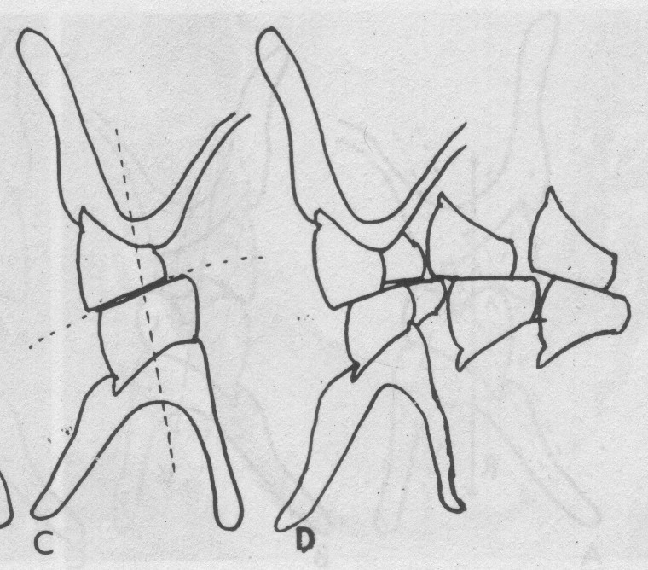
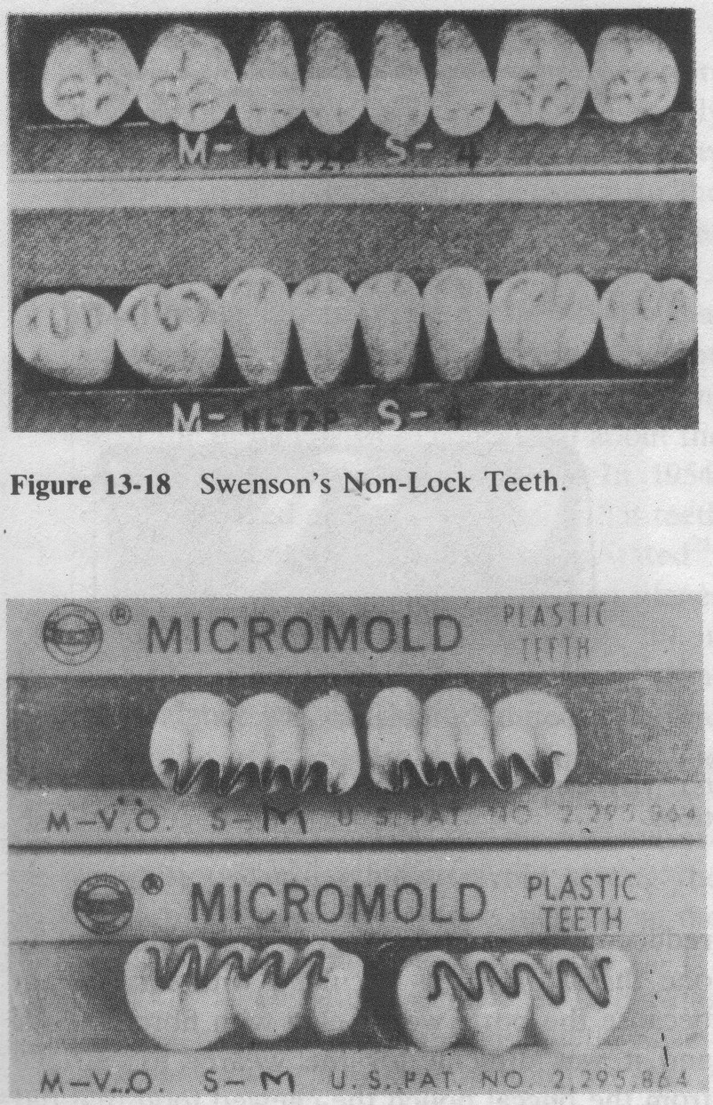
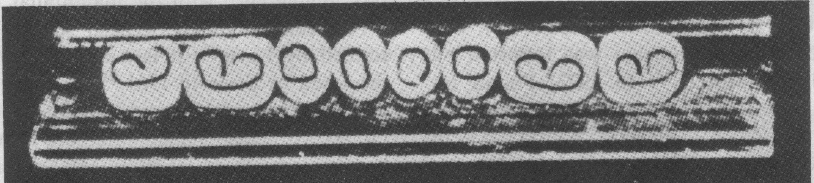
In 1937 - Max Pleasure proposed to modify the occlusal surfaces of lower posterior teeth to a Reverse Curve by tilting the tooth buccally.
In 1939 Swenson designed Nonlock posteriors with Sluice ways for shredding and allowing food to clear the occlusal table.
a
In 1942 - John Vincent introduced a change in materials by using metal inserts in resin posteriors.

Slide 9
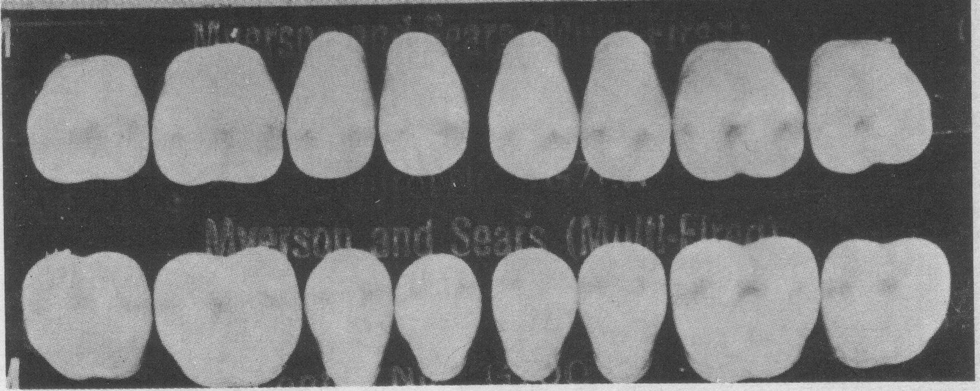
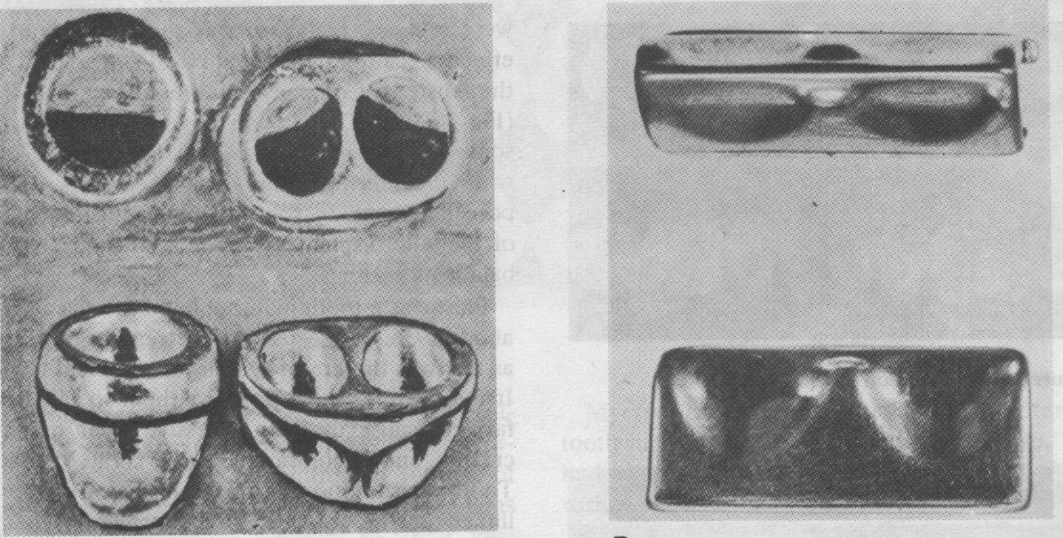
In 1946 - Hardy designed metal insert upper and lower posterior -Vitallium Occlusal - ‘VO’ .
In 1951 - Myerson Tooth Corporation introduced the first cross-linked acrylic teeth in a flat occlusal scheme called the Shear Cusp tooth.
- Schultz- Gold Occlusal surfaces.
In 1952 - Coe Masticators designed
by Cook.

Slide 10
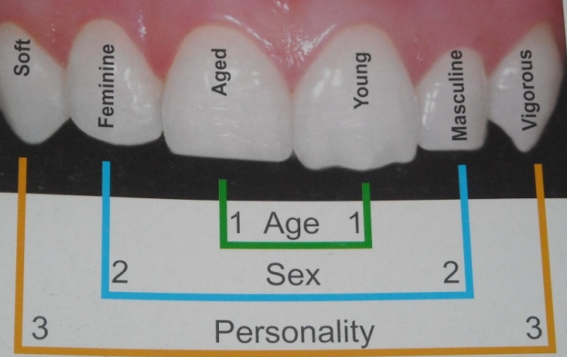
In 1954 - Earl pound stressed on the principle of esthetics – ‘replacing the teeth in the natural position from which they came ’.
In 1956 - John P Frush And Roland D Fisher introduced the word “Dentogenic” in prosthetic dentistry for the selection of anterior teeth in complete denture prosthodontics based on sex, age and personality.

Slide 11
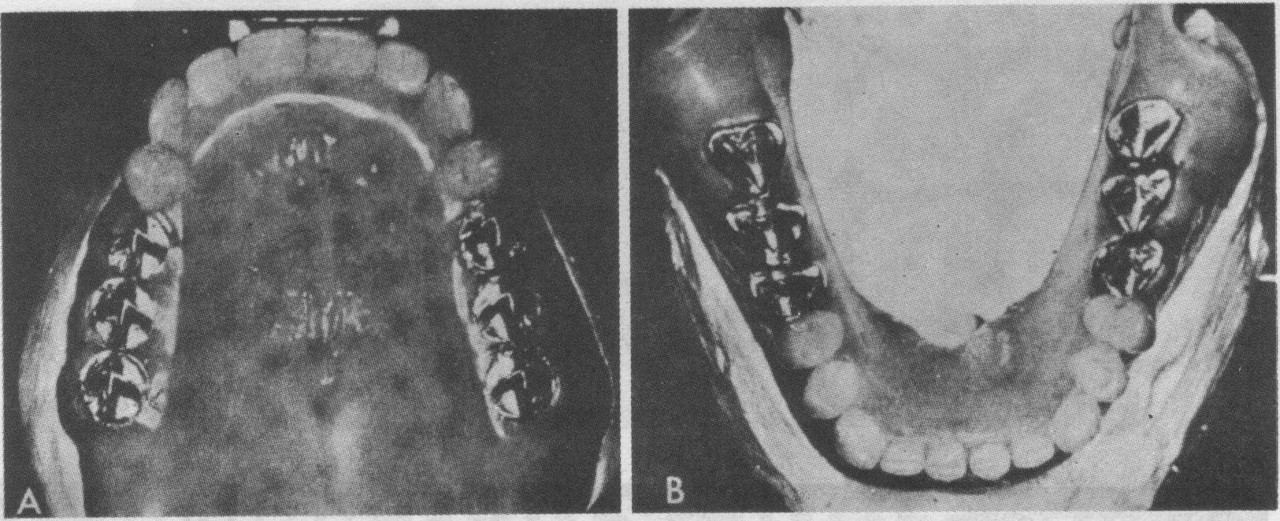
In 1957 - Bader introduced cutter bar scheme by opposing upper porcelain cuspless teeth with a metal cutting bar replacing 2nd premolar, molars .
in 1961 - Sosin replaced maxillary second bicuspid and molars with cleat shaped vitallium forms called cross-blades.

Slide 12
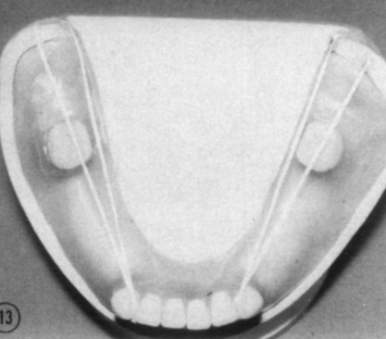
In 1961 - Wright et al believed that posterior mandibular denture teeth should be arranged directly over the center of the denture stress-bearing area.
In 1966 - Wright described tongue function and its relation to the occlusal plane and mandibular denture stability.
In 1973 - Pound recommended that the lingual surfaces of mandibular posterior denture teeth should occupy an area called Pound’s Triangle.
Pound’s triangle

Slide 13
Basic principles of teeth arrangement

Slide 14
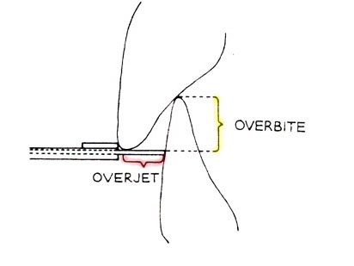
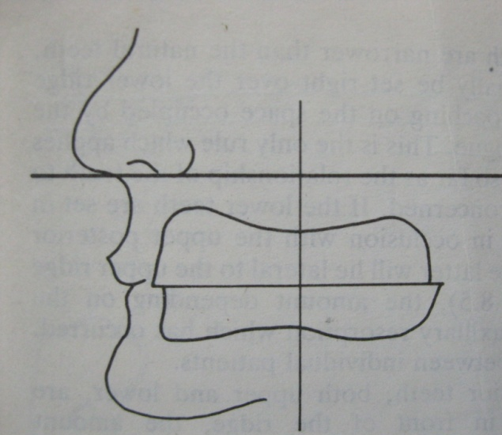
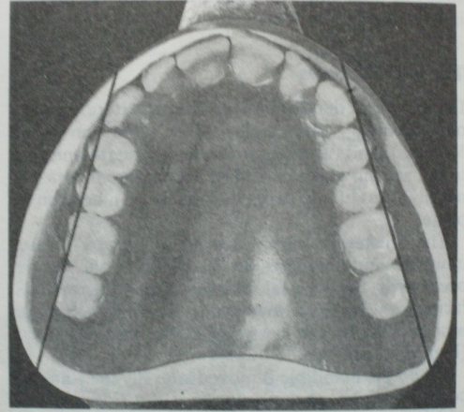
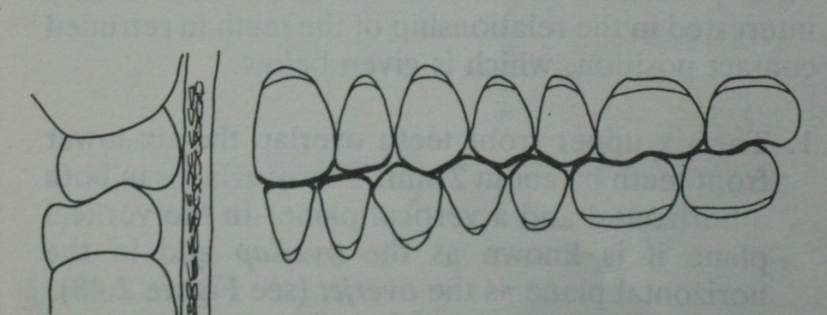
Imaginary root of maxillary anterior teeth are expected to pass through the crest of the ridge.
Overjet and Overbite
Arch form –curvature of upper anteriors
Alignment of posterior teeth
Orientation with the plane of occlusion
Incisive papilla
Soft- tissue reflection
}
As a guide to placement of anterior teeth

Slide 15
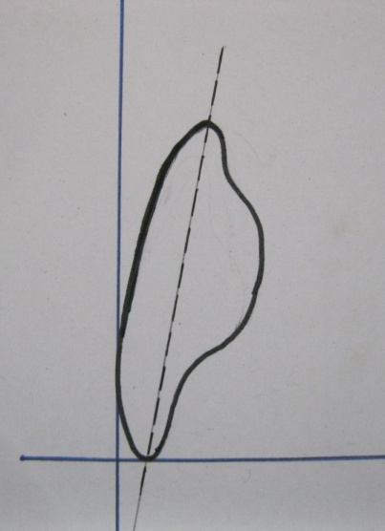
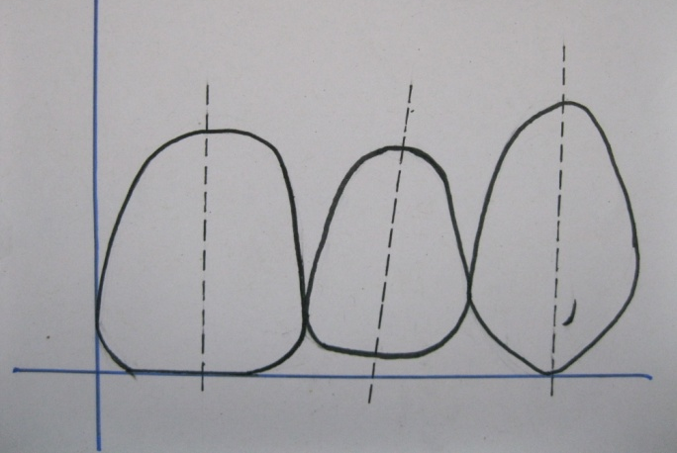
Arrangement Of Maxillary Central Incisor
Labiolingual inclination | Mesiodistal inclination | Arch relation | Plane relation | Position
Slight incisal tilt | Perpendicular | Along curve of arch- 85degree | In contact with plane of occlusion | (According to type of arch) Square arch ; tapered arch ; ovoid arch .

Slide 16
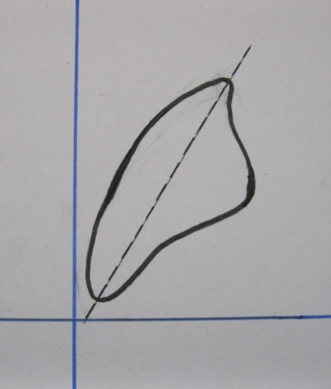
Arrangement Of Maxillary Lateral Incisor
Labiolingual inclination | Mesiodistal inclination | Arch relation | Plane relation | Position
Definite labial tilt – neck is depressed | Slight distal tilt | Distal half rotated lingually 45-55degree | Above the plane | (According to type of arch) Square arch ; tapered arch ; ovoid arch .

Slide 17
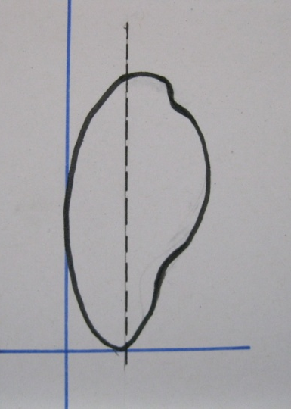
Arrangement Of Maxillary Canine
Labiolingual inclination | Mesiodistal inclination | Arch relation | Plane relation | Position
Upright, perpendicular-neck prominent | Upright, parallel to midline | Turning point of arch -30 degree | Tip of canine contact plane | (According to type of arch) Square arch ; tapered arch ; ovoid arch .

Slide 18
Arrangement Of Mandibular Central Incisor
Labiolingual inclination | Mesiodistal inclination | Arch relation | Plane relation
Vertical , erect | Perpendicular | Parallel to curve of arch- 90 | All teeth are slightly above the plane of occlusion and are placed lingual to the maxillary anteriors.
Arrangement Of Mandibular lateral Incisor
Labiolingual inclination | Mesiodistal inclination | Arch relation | Plane relation
Vertical , erect | Slight distal tilt at the neck | Along the curve of arch- 45-55 | All teeth are slightly above the plane of occlusion and are placed lingual to the maxillary anteriors.

Slide 19
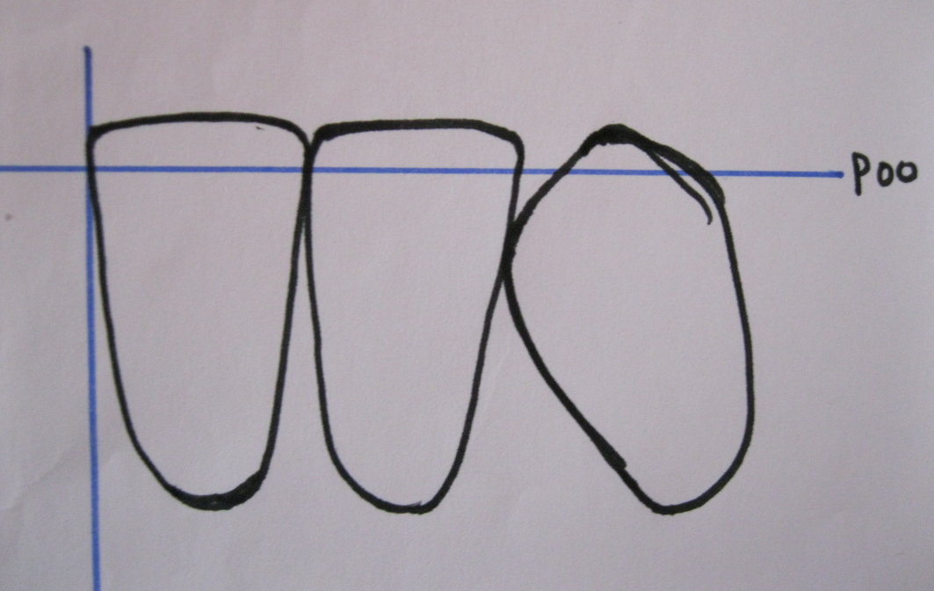
Arrangement Of Mandibular canine
Labiolingual inclination | Mesiodistal inclination | Arch relation | Plane relation
Vertical , erect- neck slightly prominent | Distally tilted; leans towards the midline | Turning point of arch -30 | All teeth are slightly above the plane of occlusion and are placed lingual to the maxillary anteriors.

Slide 20
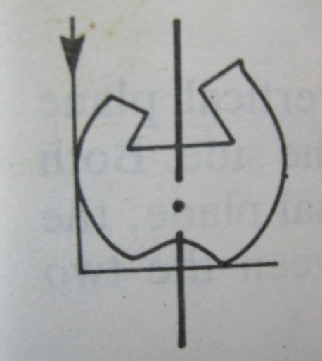
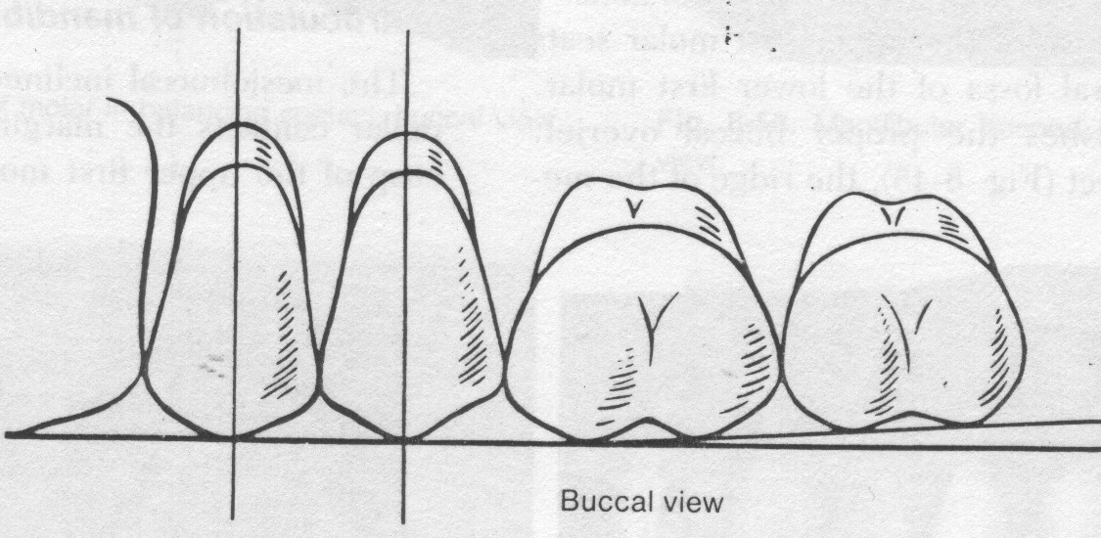
Arrangement Of Maxillary First premolar
Plane relation | Relation with vertical axis | Arch relation | Position
Buccal cusp contact plane of occlusion ; palatal cusp 1mm above . | Parallel to vertical axis | Along crest of residual alveolar ridge . | The buccal surfaces of all posterior teeth make contact with a straight-edge laid from the labial surface of the canine backwards

Slide 21
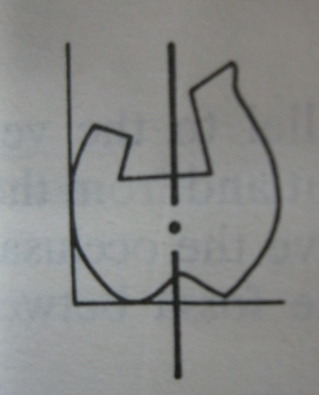
Arrangement Of Maxillary second premolar
Plane relation | Relation with vertical axis | Arch relation | Position
Buccal and palatal cusp contact plane of occlusion | Parallel to vertical axis | Along crest of residual alveolar ridge . | The buccal surfaces of all posterior teeth make contact with a straight-edge laid from the labial surface of the canine backwards

Slide 22
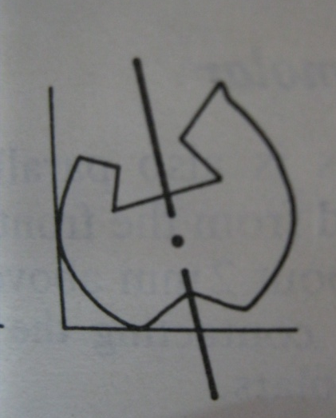
Arrangement Of Maxillary First molar
Plane relation | Relation with vertical axis | Arch relation | Position
mesiopalatal cusp contacts plane of occlusion | Slopes Distally and buccally | Along crest of residual alveolar ridge . | The buccal surfaces of all posterior teeth make contact with a straight-edge laid from the labial surface of the canine backwards

Slide 23
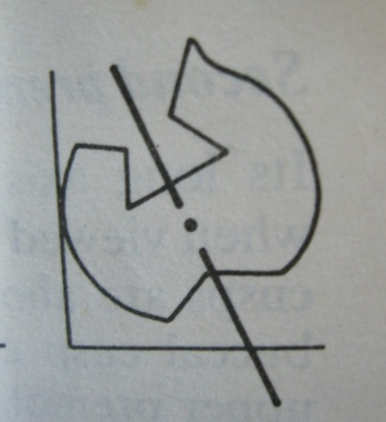
Arrangement Of Maxillary second molar
Plane relation | Relation with vertical axis | Position
All four cusps are clear of occlusal plane but mesiopalatal cusp is nearest . | Slopes more steeply -distally and buccally | The buccal surfaces of all posterior teeth make contact with a straight-edge laid from the labial surface of the canine backwards

Slide 24
Arrangement Of Mandibular First premolar
Plane relation | Relation with vertical axis | Arch relation | Position
Buccal cusp above plane of occlusion; palatal cusp below. | Parallel to vertical axis | Along crest of residual alveolar ridge . | The buccal surfaces of all posterior teeth make contact with a straight-edge laid from the labial surface of the canine backwards

Slide 25
Arrangement Of Mandibular Second premolar
Plane relation | Relation with vertical axis | Arch relation | Position
Buccal and palatal cusp above plane of occlusion -2mm | Parallel to vertical axis | Along crest of residual alveolar ridge . | The buccal surfaces of all posterior teeth make contact with a straight-edge laid from the labial surface of the canine backwards

Slide 26
Arrangement Of Mandibular first molar
Plane relation | Relation with vertical axis | Arch relation | Position
All four cusps are above of occlusal plane - B,D cusps higher than M,L cusps | Slopes mesially and lingually | Along crest of residual alveolar ridge . | The buccal surfaces of all posterior teeth make contact with a straight-edge laid from the labial surface of the canine backwards

Slide 27
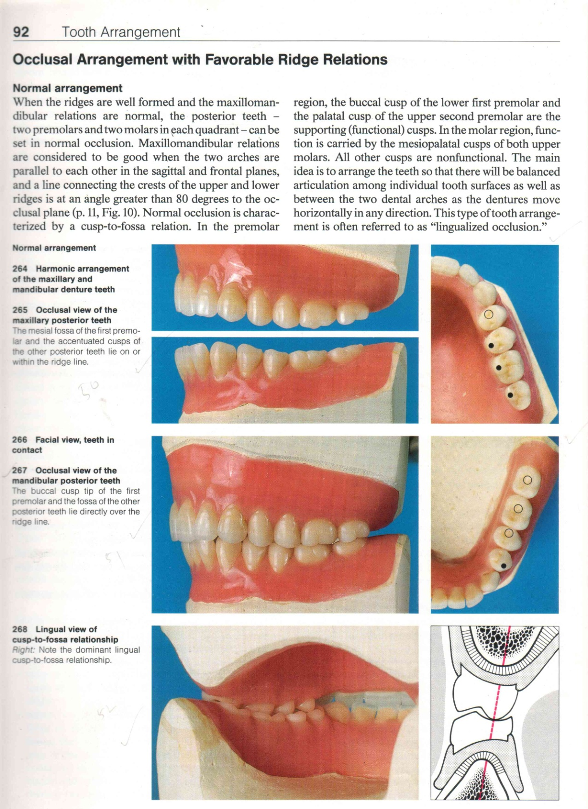
Arrangement Of Mandibular second molar
Plane relation | Relation with vertical axis | Position
All four cusps are above of occlusal plane, more than first molar. | Slopes more steeply -mesially and lingually | The buccal surfaces of all posterior teeth make contact with a straight-edge laid from the labial surface of the canine backwards

Slide 28
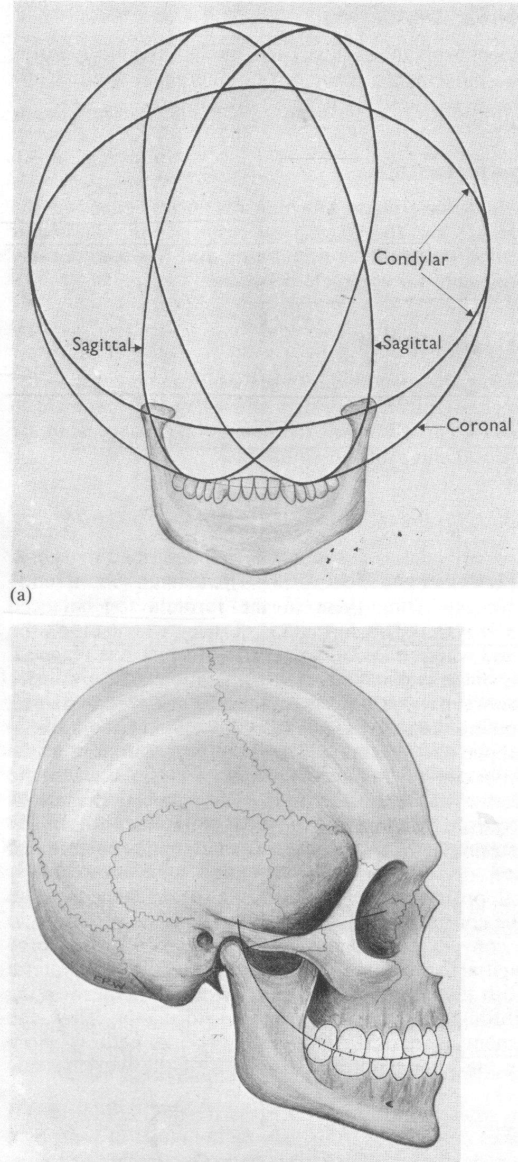
Compensating curves
Compensating curves are the artificial curves introduced into the denture in order to facilitate the production of balanced articulation. They are the artificial counterparts of the curve of spee and curve of monsoon which are found in the natural dentition.

Slide 29
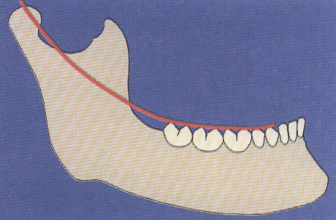
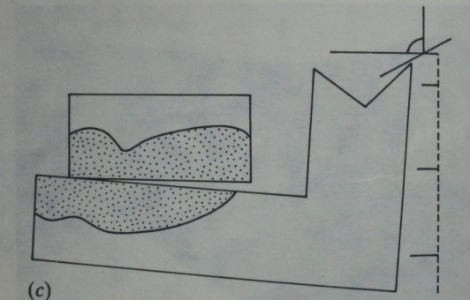
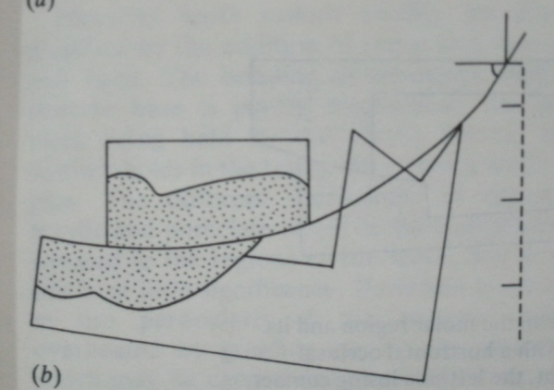
Anteroposterior curve
Compensates for the Curve Of Spee in natural dentition.
CURVE OF SPEE is defined as ‘Anatomic curvature of the occlusal alignment of the natural teeth beginning at the tip of the lower canine and following the buccal cusps of the natural premolars and molars , continuing to the anterior borders of the ramus is called Curve Of Spee’ .
- Graf Von Spee.

Slide 30
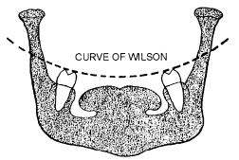
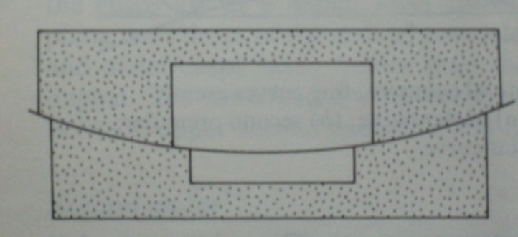
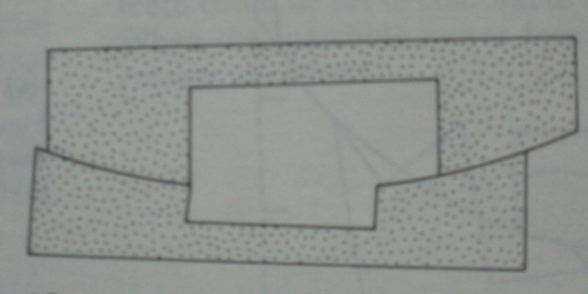
Lateral curves
These curves run transversely from one side of the arch to the other .The following curves come in this category –
Monsoons curve
Wilsons / anti-monsoon curve
Pleasure curve

Slide 31
Arrangement of teeth
Anatomic Vs Non-anatomic teeth
Resin Vs porcelain teeth
Abnormal jaw relations
Neutral zone
Teeth arrangement and phonetics

Slide 32
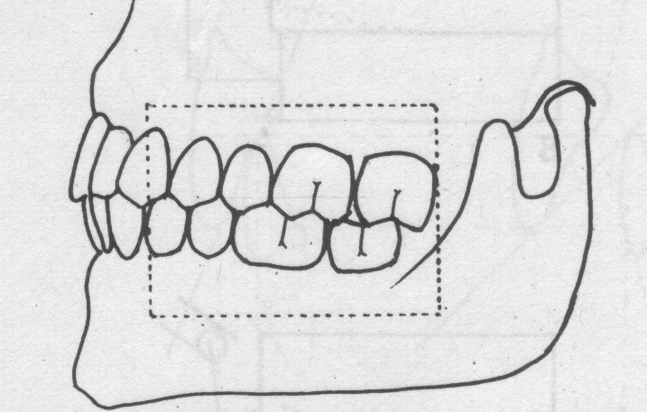
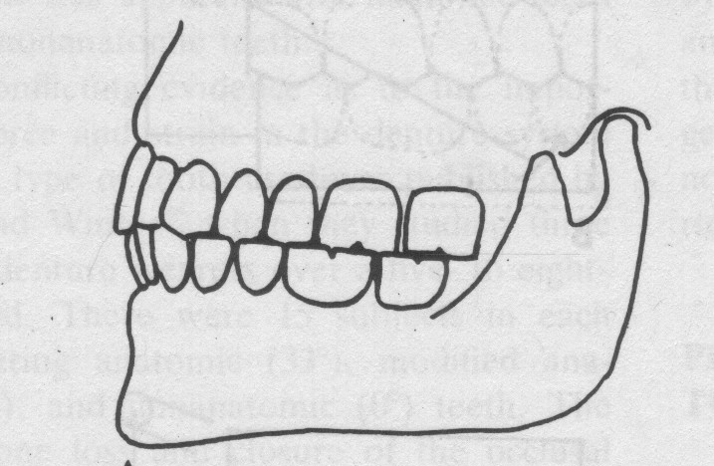
Types Of Posterior Teeth
(based on anatomy of occlusal surface)
  The anatomic teeth
  The nonanatomic

Slide 33
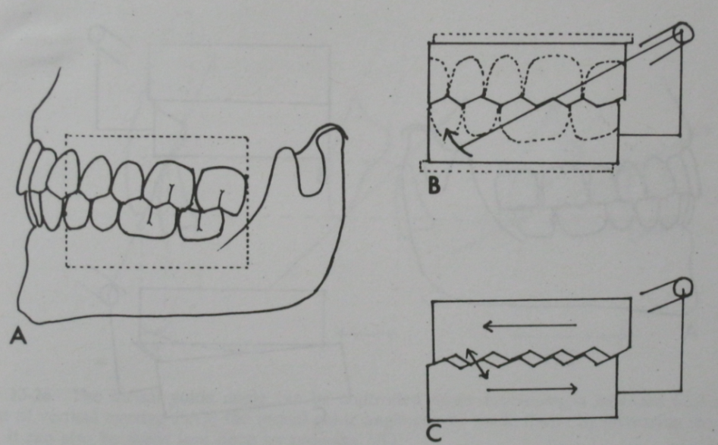
Anatomic teeth
Cuspal anatomy is similar to the natural tooth
In case of natural tooth -?
In an edentulous mouth , situation differes
Difficulty encountered in-
  Harmonious Balanced occlusion
  Horizontal forces generated
  Feature – efficient in grinding food
  Hence, certain mandatory requirements

Slide 34
Non - Anatomic Teeth
PRIMARY OBJECTIVE – preservation of tissues
Main advantage-
Freedom of movement
Lack of interferences
No horizontal forces
Drawbacks-
Indications -
  Flat ridges
  Knife edge ridge
  Large interridge space
  Milling type of chewing pattern with broad excursions
  Improper neuromuscular coordination.

Slide 35
Acrylic teeth
Porcelain teeth
Significant wear
Fracture toughness
Retention – chemical bond
Easily ground
Silent on contact
Minimal abrasion
Discolours
Dimensional change
Insignificant Wear
Britlle
Retention – Mechanical
Difficult To Grind
Sharp Impact Sound
Abrasion Of Opposing Natural Teeh
Colour is stable
Dimensionally Stable

Slide 36
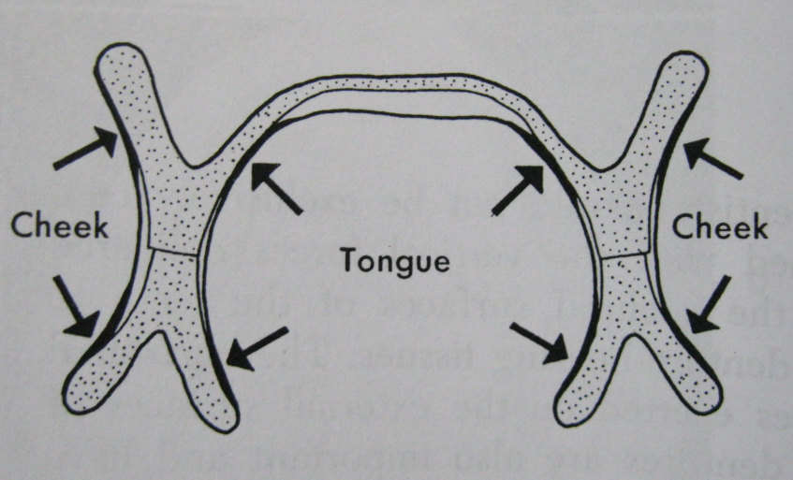
Neutral zone
Position of each tooth
Outward force Vs inward force
Potential denture space
Neutral zone is the area between the tongue on one side and the cheeks and lips on the other, where opposing soft tissue displacing forces create a zone of neutral or minimal muscular force, the teeth should be placed as far as possible with respect for these muscle forces.
Neutral zone affects - 7

Slide 37
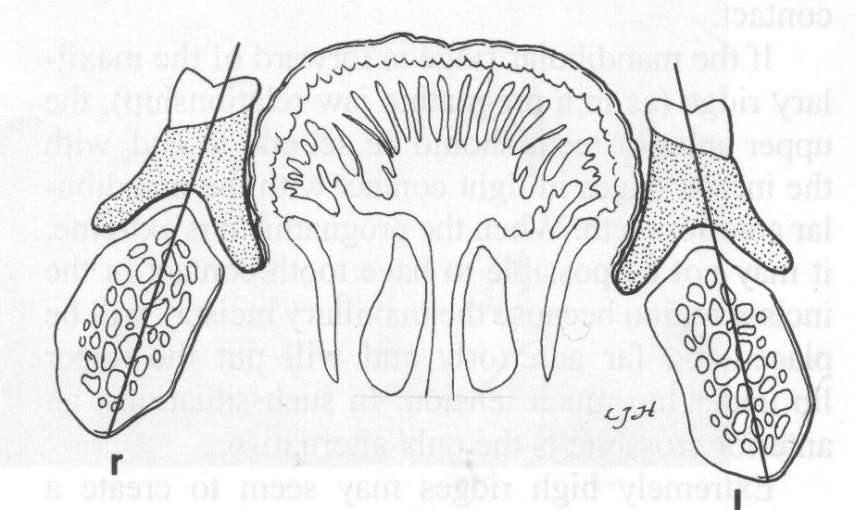
In 1931 - Fish gave concept of a Neutral Zone in complete denture construction .
In 1966 - Wright described tongue function and its relation to the occlusal plane and mandibular denture stability.
In 1973 - Pound recommended that the lingual surfaces of mandibular posterior denture teeth should occupy an area called Pound’s Triangle.
- Modification by Halperin
Pound’s triangle

Slide 38
Arrangement Of Teeth In Abnormal Jaw Relations
Class II jaw relation –
  Maxillary protrusion
  Wider upper arch
Class III jaw relation –
  Mandibular protrusion
  Wider upper lower arch

Slide 39
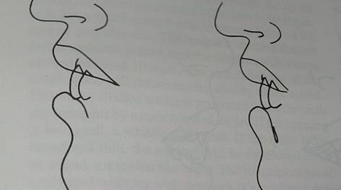
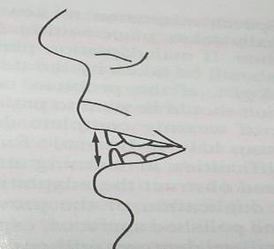
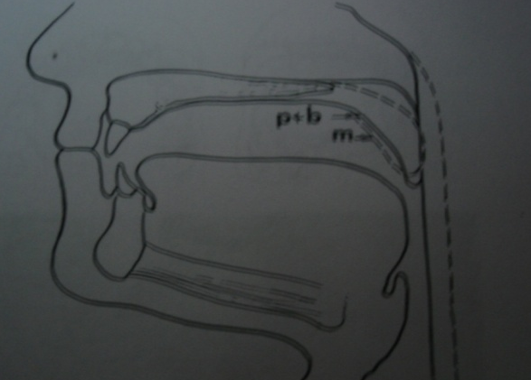
Teeth Arrangement and Phonetics
SOUNDS -
bilabial | labiodental | linguodental | alveolar | palatal
p | F | n | t | Sh
b | v | l | d | Ch
m |  |  | s | J
 |  |  | r | z

Slide 40
Conclusion
The nature of the supporting structures for complete dentures and the forces directed to them by occlusion creates a special biomechanical problem . Therefore considering the biologic, physiologic and mechanical principles is of utmost importance while arranging teeth for such a man-made occlusion.

Slide 41
References
-Zarb- Bolender’s Prosthodontic Treatment For Edentulous Patients ( 12th edition, Chpt 19, pg379-426).
- Rahn AO, Heartwell CM Jr. Textbook of complete dentures. 5th ed. Philadelphia: Lippincott,Williams & Wilkins; 1993. p. 352-6 41.
- Sharry JJ. Complete denture prosthodontics.3rd ed. New York: McGraw-Hill; 1974. p.241-65.
Sheldon Winkler: Essentials of complete denture Prosthodontics,2nd edition
Clinical dental prosthetics, A.Roy Mcgregor 3rd edn; varghese publishing house.
- Wright CR. Evaluation of the factors necessary to develop stability in mandibular dentures J Prosthet Dent 1966;16:414-30.
- Pound E. Lost--fine arts in the fallacy of the ridges. J Prosthet Dent 1954;4:6-16
Payne AG. Factors influencing the position of artificial upper anterior teeth. J Prosthet Dent 1971;26:26-32.
Arrangement of artificial teeth in abnormal jaw relation: Maxillary protrusion and wider upper arch.-B.K Goyal and k Bhargava J Prosthet. Dent. July 1974. volume 32,no 1; 107 -111.
Arrangement of artificial teeth in abnormal jaw relation: Maxillary protrusion and wider upper arch.-B.K Goyal and k Bhargava J Prosthet. Dent. october 1974. volume 32,no 1; 107 -111.

Slide 42
Thank you

