Slide 1
Laboratory Procedures for Complete Dentures

Slide 2
Laboratory Procedures for Complete Dentures
Primary Cast
Custom Tray Fabrication
Beading/Boxing of Secondary Impression
Master Cast
Denture Base Fabrication
Occlusal Rim Fabrication
Articulation
Teeth Setup
Investing the trial dentures
Curing
Trimming/Finishing and Polishing

Slide 3
Denture Processing
Steps
Investing
Dewaxing
Packing of acrylic resin
Curing
Devesting
Trimming
Finishing
Polishing

Slide 4
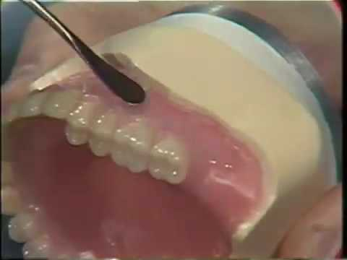
Sealing
Sealing of cast with wax to prevent plaster from
getting under the base

Slide 5
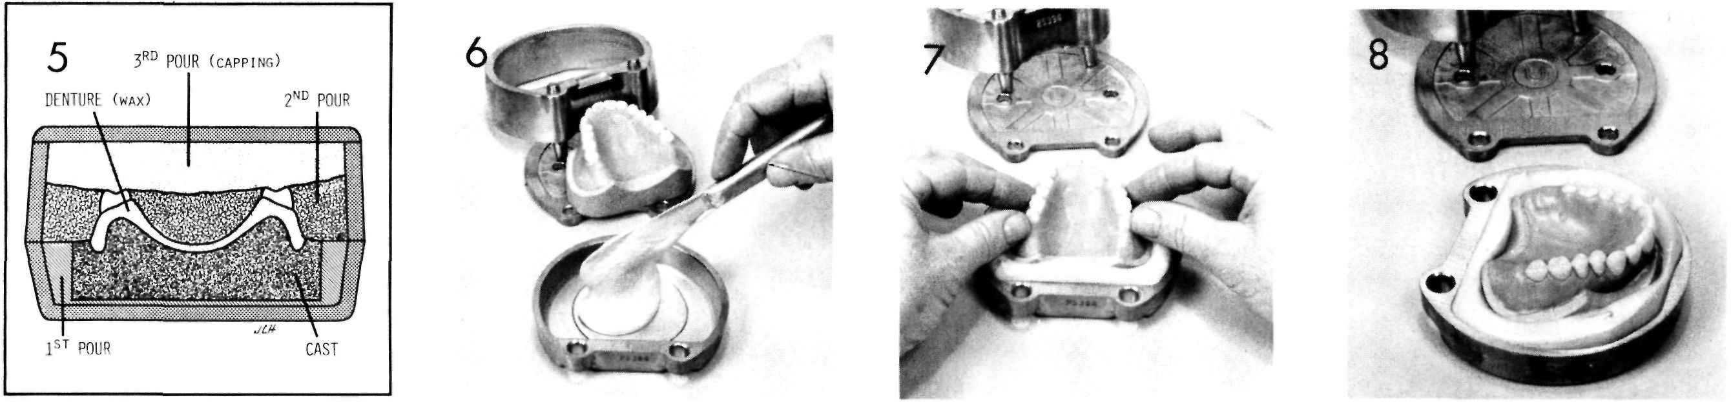
Investing

Slide 6
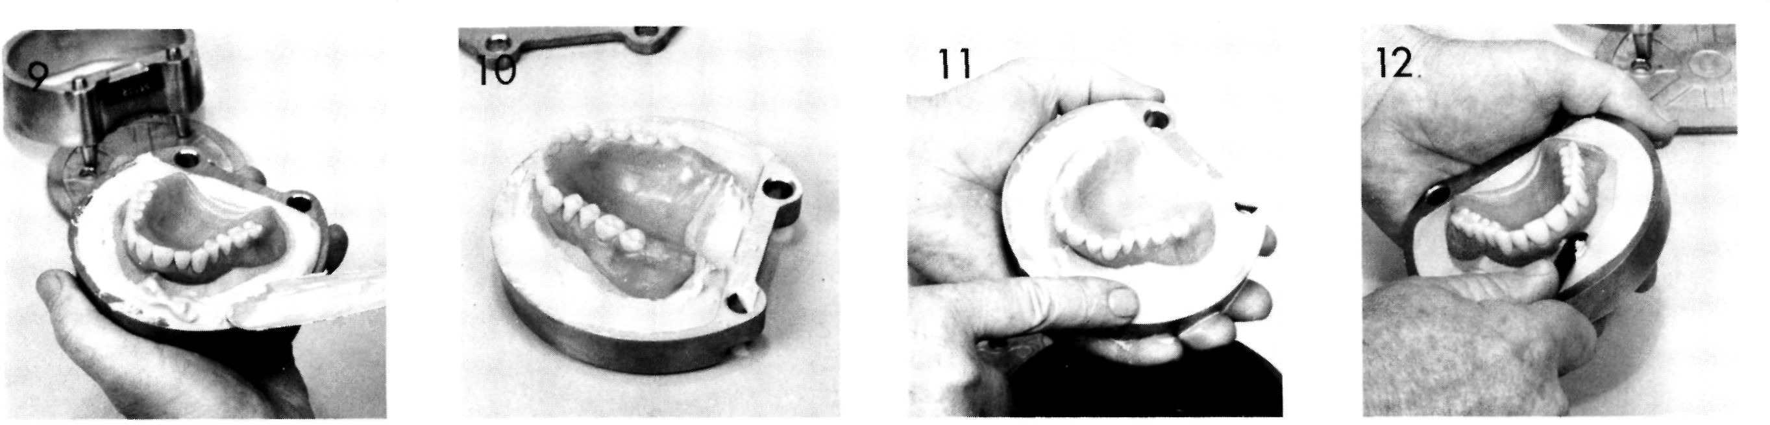

Slide 7
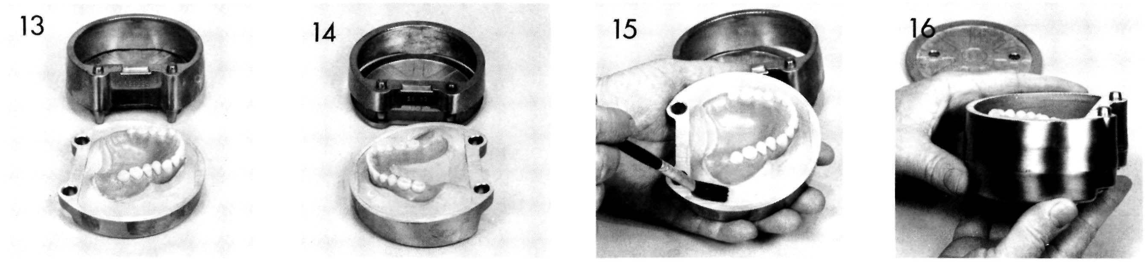

Slide 8
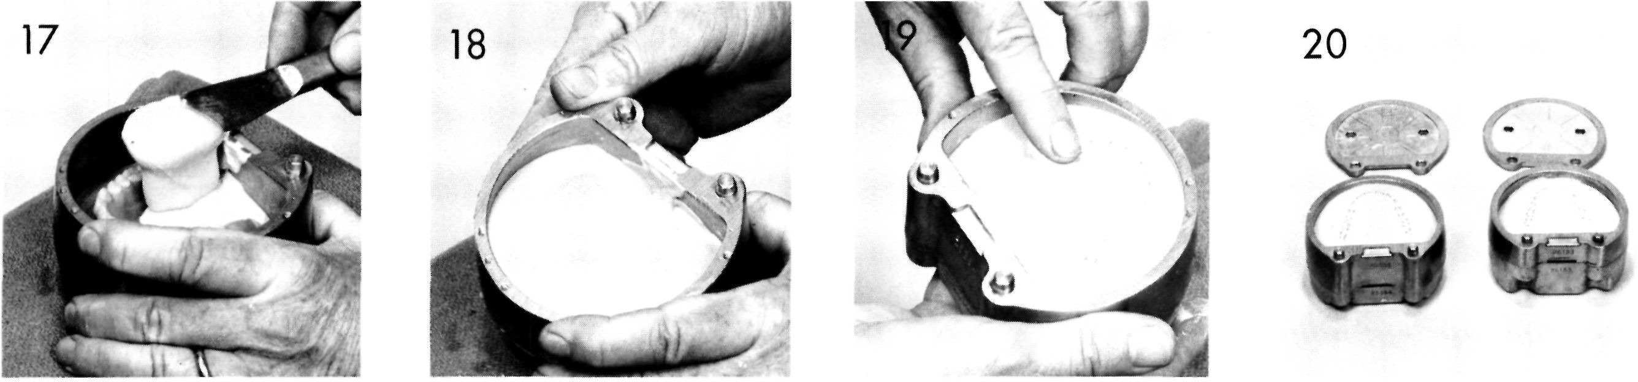

Slide 9
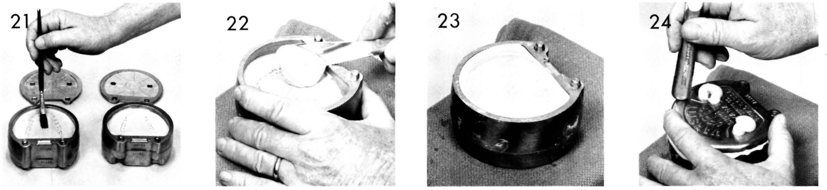

Slide 10
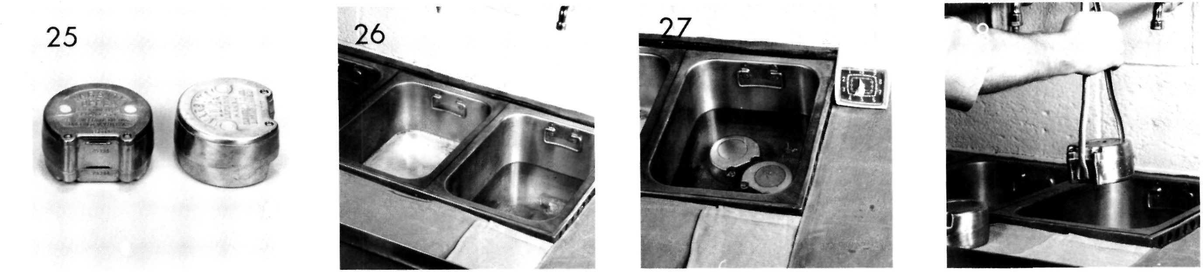
Dewaxing

Slide 11
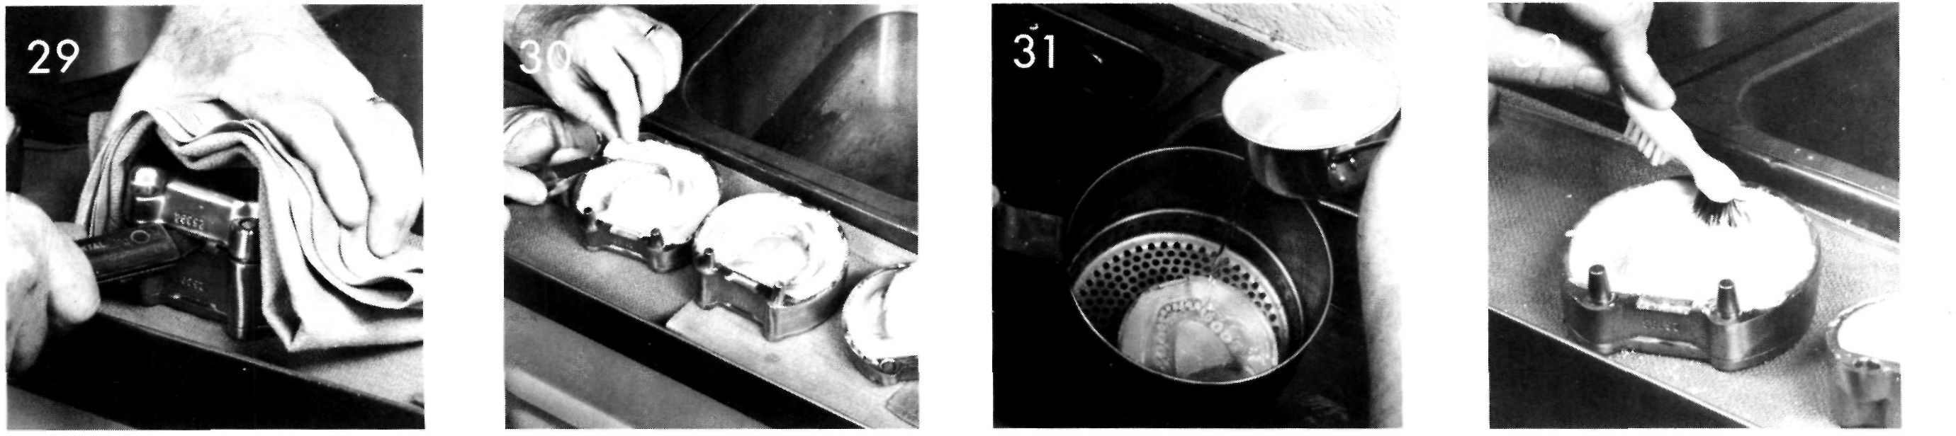
Dewaxing

Slide 12
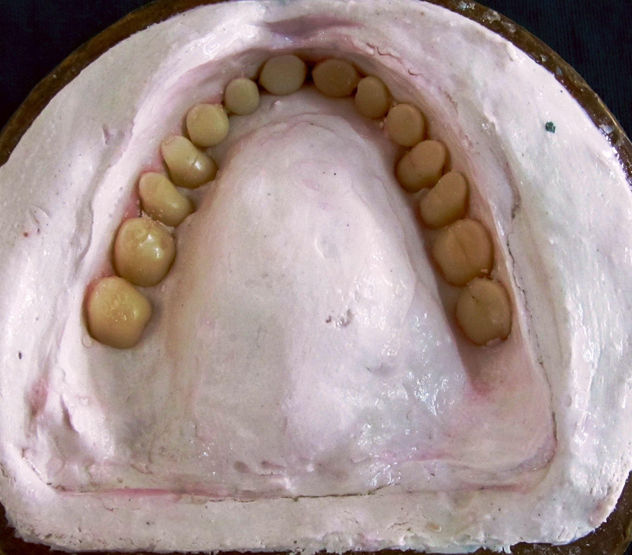
Dewaxing

Slide 13
Application of Separating Media
Tin foil
Cellulose lacquers
Solution of alginated compounds
Calcium oleate
Soft soaps
Sodium silicate
Starches
Most commonly used separating medium is sodium
alginate solution which is also called as cold
mould seal

Slide 14
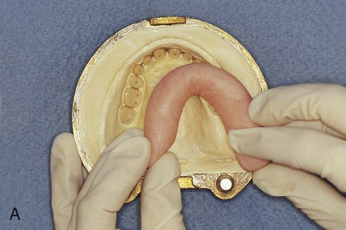
Packing

Slide 15
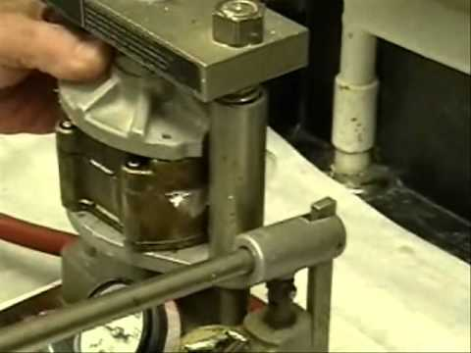
Remove excess flash

Slide 16
Curing of Dentures
Short Curing Cycle
Processing at 74ºC for 2 hours with terminal boil
at 100ºC for one hour
Long Curing Cycle
Processing at 74ºC for 8 hours with no terminal
boil
Processing at 74ºC for 8 hours with terminal boil
at 100ºC

Slide 17
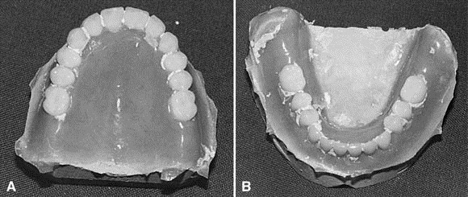
Deflasking & retrieval

Slide 18
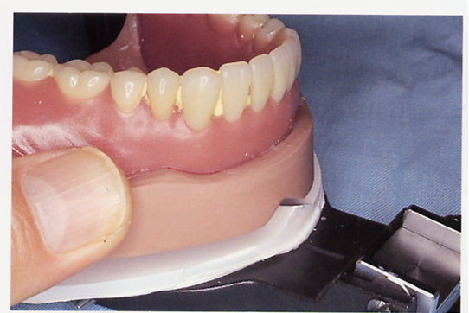
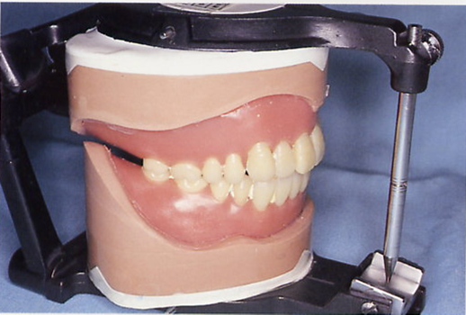
LAB REMOUNT PROCEDURE
Remount the denture with cast on articulator using original plaster index attached with mounting rings of articulator.
Programme articulator in centric relation position
Verify the contact of incisal pin with incisal guide table.

Slide 19
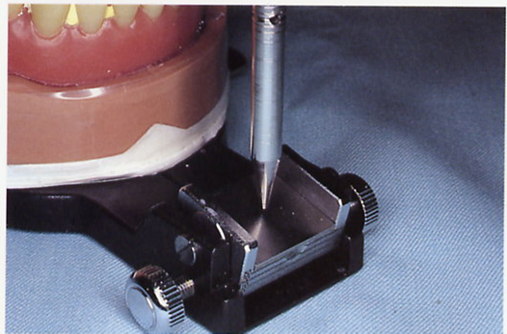
Separation of incisal pin if less than 2mm,
laboratory remount to be carried out for eliminating occlusal disharmony.
If the gap is more than 2mm better repeat the dentures.
Gap

Slide 20
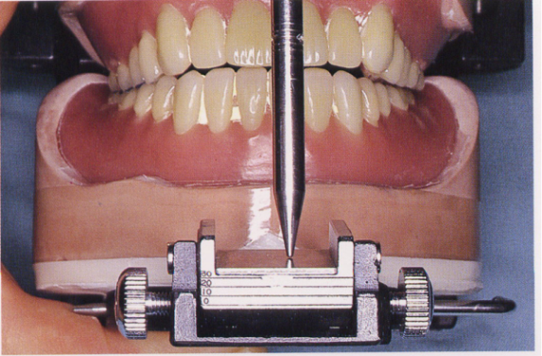
Correction done by selective grinding procedure
(Negative Coronoplasty)
Point is on masticatory cusp tip :
-Deepen and widen its corresponding fossa (PLUNGER CUSP LAW) .
b. Non working side contact (Masticatory cusp) on balancing side
  Premature contact during eccentric relation if noticed on masticatory cusp –then modify the cusp .
-Repeat till the “multiple centric contact ” developed .
“Incisal pin contacts incisal guide table ”.

Slide 21
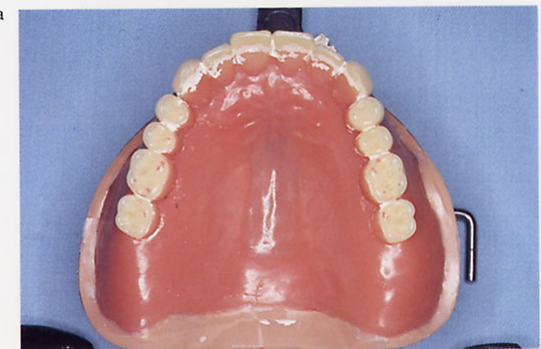
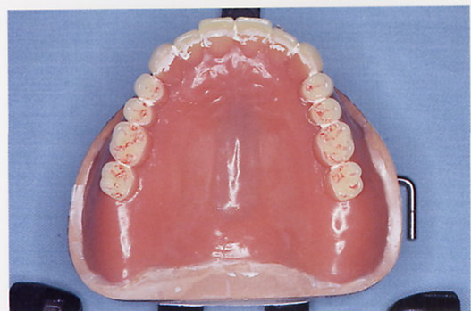
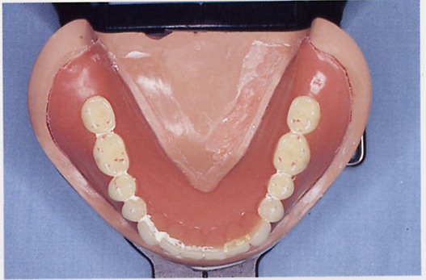
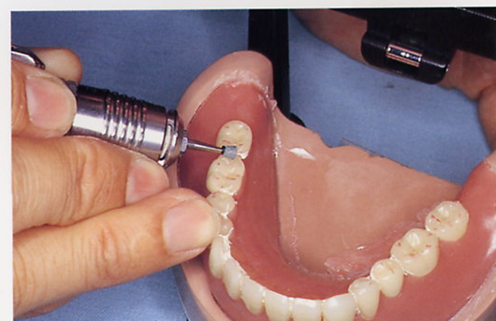
c. Eliminating high points in eccentric relation:
1). Lateral relation:
-Follow “BULLS LAW ”
– grinding occlusal inner inclines of buccal of upper & lingual of lower cusp .
- Never modify mesiopalatal cusp of maxillary second molar .
Premature incisal contact – palatal aspect of upper or labial edge/ aspect of lower incisors

Slide 22
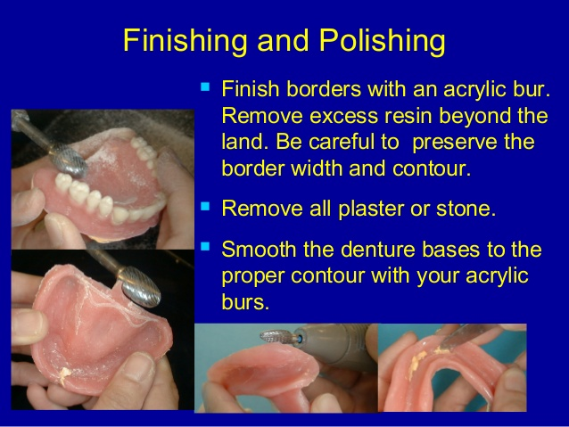
Finishing & polishing

Slide 23
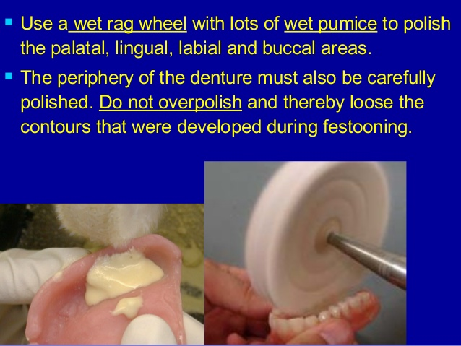

Slide 24
Thank You

