Slide 1
HISTORY TAKING,
DIAGNOSIS AND TREATMENT PLANNING FOR COMPLETE DENTURE PATIENTS
Part -I

Slide 2
“ When u listen, hear;
When u look, see;
When u touch, feel ”.
-Allison

Slide 3
INTRODUCTION
Successful complete denture therapy begins with a thorough assessment of the patients physical & psychological condition & determining a treatment that will deliver a functionally and esthetically acceptable complete denture.

Slide 4
DIAGNOSIS
Dia + gnosis = to differentiate + knowledge
According to GPT 8,
Diagnosis is defined as determination of nature of disease.
It is the examination of the physical state, psychological makeup , & understanding the need of patients to ensure a predictable result.

Slide 5
According to Boucher ,
Planned observation to determine & evaluate the existing conditions,
decision making based on the condition observed.
According to Winkler ,
Examination of physical status,
Evaluation of mental or psychological make up,
Understanding of needs of each patient
To ensure a predictable result.

Slide 6
OBSERVING THE PATIENT
RECORDING THE HISTORY
a) DENTAL HISTORY
b) MEDICAL HISTORY
CLINICAL EXAMINATION
a) EXTRA ORAL
b) INTRA ORAL
RADIOLOGICAL INTERPRETATION

Slide 7
OBSERVING THE PATIENT
MOTOR SKILLS: Walk, Level of coordination & steadiness.
Unusual gait
Parkinson’s diseases or severe arthritis.
Dizziness
Side effect of medication or cerebrovascular accident.
Vertigo
Orthostatic hypotension, overcorrected BP, or cerebral ischemia.

Slide 8
Patient with respiratory distress
Emphysema, asthma, congestive heart problems or heavy smoking.
Patients under psychotropic drugs
Uncontrollable chewing movements, licking of lips, uncoordinated tongue movements, tongue tremors, twitching of nose.
These complications may often result into Prosthodontic failures.

Slide 9
De Van stated,
“Meet the mind of the patient before meeting the mouth of the patient”.

Slide 10
Dr. M.M. House in 1950 classified patient psychology into 4 types-
Philosophic
Exacting
Indifferent
Critical/ Hysterical

Slide 11
Philosophic- they are easy going, congenial, mentally well adjusted, cooperative & confident of the dentist.
They have ideal attitude for successful treatment.
Exacting- These patients had bad results with previous treatment & are doubtful that anyone can help them.
Proper handling & extra time given during & after treatment can make them excellent patients.

Slide 12
Indifferent- they seek treatment because of insistence & have little concern for their oral health.
They give up easily & require more time to follow instructions regarding use of dentures.
Little appreciation for the efforts of the dentist.
Critical- These patients find fault with every thing that is done for them & are never happy with their previous dentists.
A firm control of these patients is essential & the dentist must direct all treatment & decisions.

Slide 13

NAME
For the purpose of record maintenance and identification.
Most patients liked to be called by their name, this has a psychological effect as well.

Slide 14
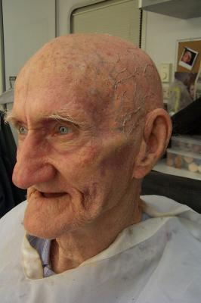
AGE
Learning capabilities, neuromuscular control diminishes with age.
Tissues lose elasticity and resiliency.
Reduced ability to withstand stress may
restrict some procedures

Slide 15
GENDER
Esthetics
Influence of Sex hormones on the supporting structures.
Women regard appearance above the efficient functioning of the replacement teeth.
Physiologic change in women (menopause),
Productive of many problems which mitigate against easy denture construction

Slide 16
OCCUPATION
People making public appearances,
(artists, actors, salesmen, public speakers, singers, teachers)
Esthetics and Phonetics.
Tradesmen, Mechanics, or Laborers Functional efficiency.
People like beauticians,(open bobby pins with teeth),
Place leverage on the front of the denture and cause problems
in function.

Slide 17
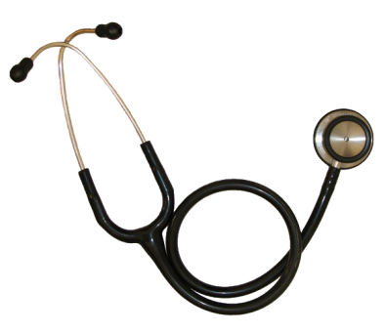
MEDICAL HISTORY
Debilitating diseases - diabetes, osteoarthritis , CVS,CNS disorders& tuberculosis are more common in geriatrics.
Require specific instructions on denture\tissue care & special follow-up appointments to observe the response of the soft tissues.

Slide 18
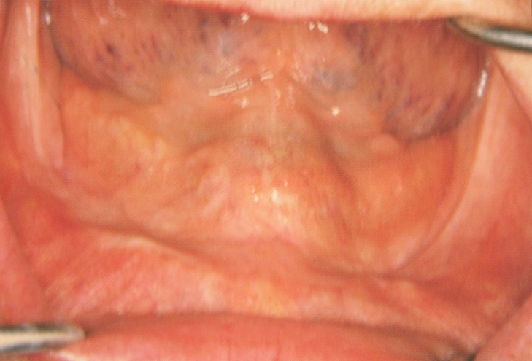
DIABETES MELLITUS
Impaired carbohydrate metabolism due to insulin deficiency
Patient suffering from DM will show—
Osteoporosis.
Residual alveolar bone resorption
Delayed wound healing.
Prone to infection.
Mucostatic impression technique.
Avoidance of surgical interventions.

Slide 19
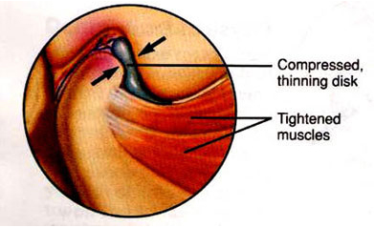
OSTEOARTHRITIS
Affects elderly above 45 yrs of age
M:F ratio 2:1
Clinical features:-
- pain ,crepitation & restricted mandibular movements
- muscles of mastication become tender.
Frequent occlusal corrections should be made.
Difficulty in wearing and cleaning of denture.

Slide 20
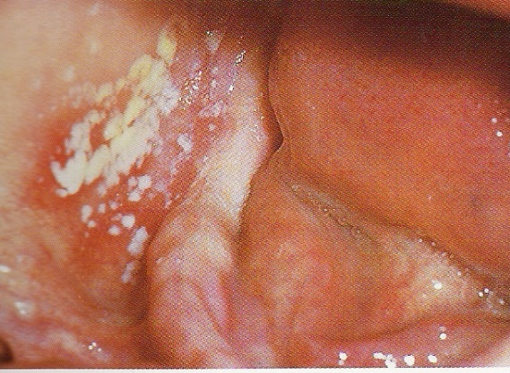
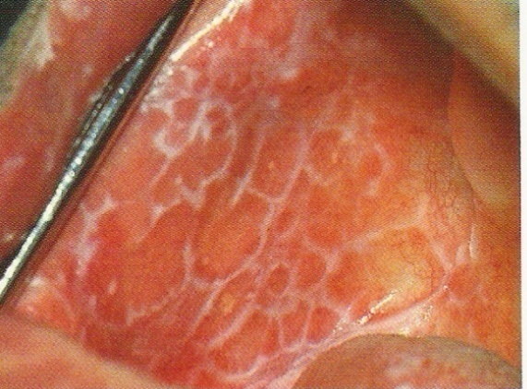
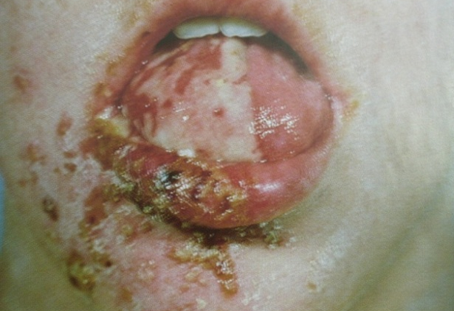
INFECTIOUS DISEASES
Bacterial, Viral, Fungal
  Tuberculosis
  Syphilis
  Herpes simplex
  Hepatitis A&B
  HIV
  Candidiasis

Slide 21
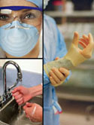
Precautions:
  Prevent cross contamination
  Self precaution & protection
  Disposable instruments
  Disinfections of impression

Slide 22
CARDIOVASCULAR SYSTEM
Angina pectoris:
  Avoid anxiety, exertion
  Physician consultation .
  Emergency drugs.
Myocardial infarction (MI):
  Patient with history of MI avoid treatment for 6 months.
  Physician consultation & reassurance of patient
Infective bacterial endocarditis:
  Prophylactic Antibiotic therapy prior to surgical procedures.

Slide 23
CENTRAL NERVOUS SYSTEM11
Emotional disturbances
  Clinical features:
  Mild anxiety to anxiety neurosis, depression, phobia, disorientation.
  Severe cases -psychiatric consultation.
  Patient motivation & reassurance.
  In such patients avoid flickering lights and instruments which can cause harm.

Slide 24
PARKINSONISM
It is a degenerating disease affecting basal ganglia.
Clinical features:
expressionless face with staring look
soft rapid speech,
altered gait, muscle rigidity,
tremors in mandible, tongue, fingers, hands.
Patient should be educated about difficulty in eating, speech & retaining mandibular denture.

Slide 25
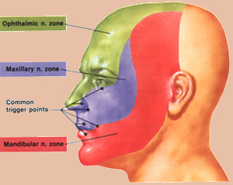
TRIGEMINAL NEURALGIA
Clinical features–
Searing, stabbing ,lancinating
type of pain initiated on touching trigger zone.
Patients should be first treated for Trigeminal neuralgia then continued with Prosthodontic treatment

Slide 26
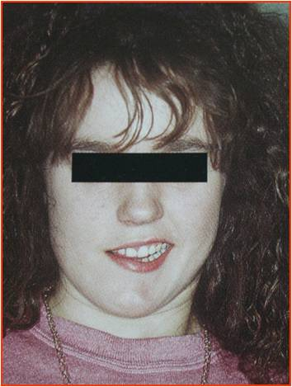
BELL`S PALSY
Facial nerve palsy : cold, trauma, injection of L.A drugs, nerve impingement ,injury of the nerve during surgery.
Difficulty in making impression, eating & speech.
- To avoid cheek biting over contouring
denture base on the affected side
- Excessive horizontal overlap in posteriors.

Slide 27

DRUG HISTORY
Antihistaminics, antihypertensive, antiparkinsonic,
antidepressants, atropine cause xerostomia.
Cholinesterase, epinephrine, sialogouges cause Sialorrhea .
Hypoglycemic shock - Insulin.
Behavioral changes & confusion - antidepressants,
corticosteroids, antiparkinsonism, antihistaminic.

Slide 28
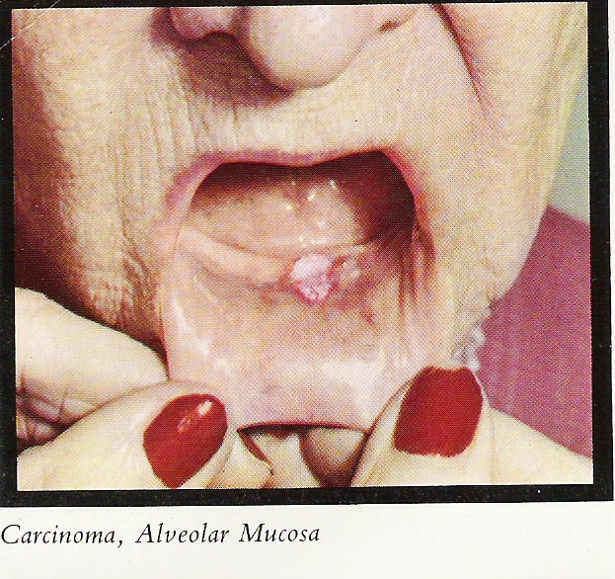
RADIATION THERAPY
Patients undergoing radiation therapy should have a waiting period before complete denture construction.
They should be examined frequently for radionecrosis.
CLIMACTERIC CONDITIONS
Like menopause can cause glandular changes, osteoporosis & psychiatric changes which can affect the efficiency of the denture.

Slide 29
DENTAL HISTORY
Chief complaint-
Helps to assess whether the patient’s expectations are realistic or unrealistic & psychological classification.
Reveals information about:
Previous dental experiences
Patient’s concern to his oral health
Patient’s education and motivation level

Slide 30
Reason for loss of Teeth
Pretreatment Records
Previous Dentures
Period of Edentulousness

Slide 31
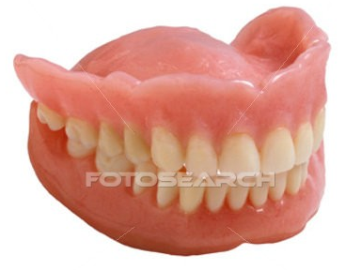
CURRENT / EXISTING DENTURES
Retention & stability .
Jaw relation.
Patient comfort .
Denture wear or breakage -
may indicate bruxism.
Period for which the patient has been wearing the
denture & the amount of resorption associated with it.

Slide 32
HISTORY TAKING,
DIAGNOSIS AND TREATMENT PLANNING FOR COMPLETE DENTURE PATIENTS
Part -Ii

Slide 33
Extra-oral Examination

Slide 34
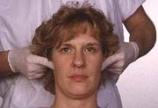
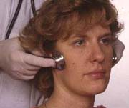
TMJ Examination
Examined for range of movements, pain, muscles of mastication, joint sounds upon opening & closing.
  Rapid jaw movement on command
  Digital perception of tmj sounds

Slide 35
TEMPOROMANDIBULAR DISORDERS
Pain on opening/ closing movements of mandible.
Clicking sound, crepitations
Deviation of mandible on opening
Muscle tenderness
Limitation of mandibular movement
The centric relation depends upon structural & functional harmony of osseous structures ,the intra articular tissues capsular ligaments.

Slide 36
RECOMMENDED MANAGEMENT STRATAGIES
  Symptomatic treatment with medicines
  Control or reduction of contributory factors
  Treatment of pathologic sequelae
  Patient’s counselling
  TMJ problem may have to be treated by alteration of existing prosthesis, recovering lost occlusal VD, exercise, rest or drug therapy.

Slide 37
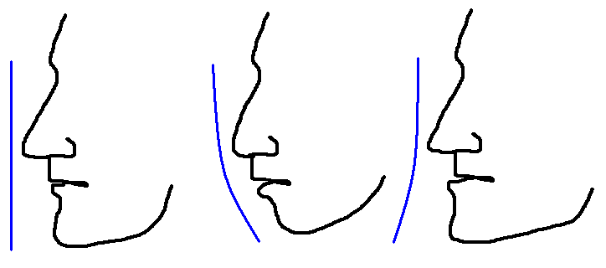
PROFILE
Profile view will indicate the relation of
the maxilla to the mandible.
CLASS I
CLASS II
CLASS III

Slide 38
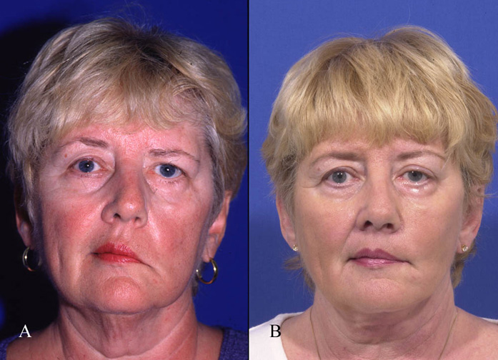
FACIAL SYMMETRY
- Symmetrical
- Asymmetrical
(swellings, hemi facial hypertrophy/atrophy,
congenital, unilateral ankylosis, etc)

Slide 39
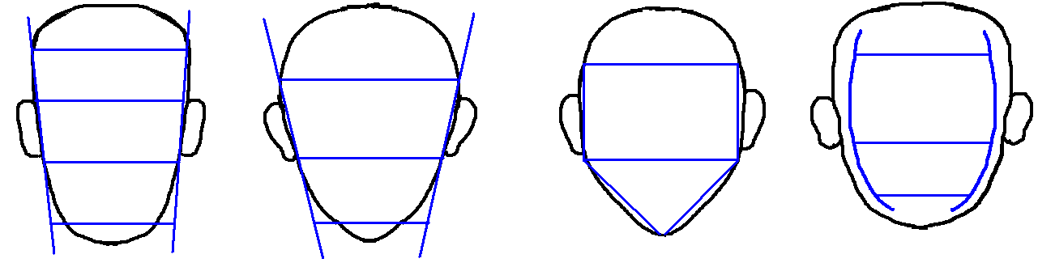
SHAPE OF FACE
Classifiation by LEON WILLIAM
SQUARE
TAPERED
SQUARE TAPERING
OVOID

Slide 40
TONE OF FACIAL TISSUES
It depends on the age & health of the patient
According to House-
Class I—Normal tone & placement of facial muscles of mastication & expression.
Class II--Displays normal function but slightly decreased tone.
Class III--Decreased muscle tone function

Slide 41
COMPLEXION
Skin of face--Dark,Medium,Fair
Hair color-- Black, brown, blond.
Eyes-- Blue ,gray, brown, Black.
The color of the skin guides in shade selection of the teeth . .

Slide 42
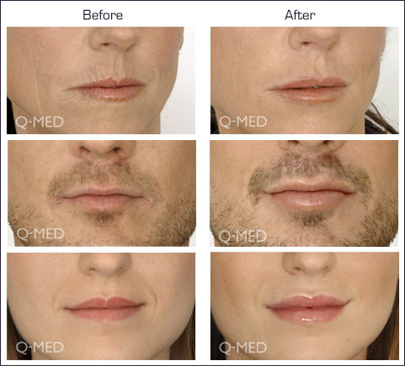
LIPS
  Support
  Thickness
  Length
  Fullness

Slide 43
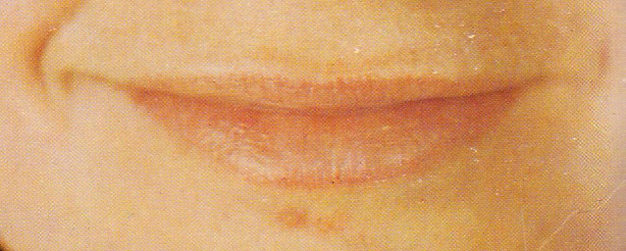
Lip support- classified as;
Adequately supported
Unsupported
If the tissues around the mouth has wrinkles & the rest of the face does not, significant improvement can be expected.
If wrinkles are long standing
then they may not disappear at once .

Slide 44
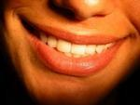
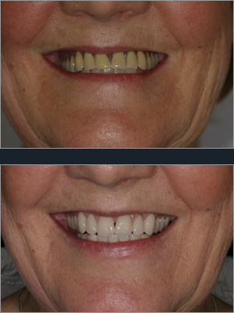
LIP THICKNESS
Thick lips need less support from the artificial teeth .
Thin lips rely on labiolingual position of the tooth for their fullness & support.

Slide 45
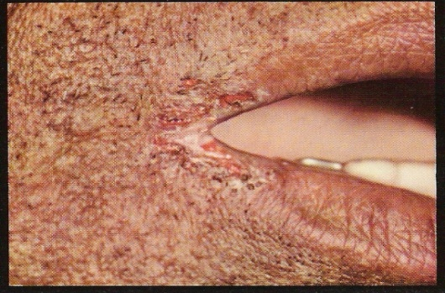
LIP LENGTH
Normal or medium
Long (reveals very little of anterior teeth)
Short (allows the display of denture base)
HEALTH OF LIPS - fissures, cracks or ulcers indicate vit B deficiency, candidiasis or prolong over closure of mouth due to decrease VD.

Slide 46
Neuromuscular co-ordination
NEUROMUSCULAR CO-ORDINATION
Excellent Fair
Poor
Poor neuromuscular co-ordination affects impression recording & jaw relation recording.
Advise for tongue & mouth exercises.

Slide 47
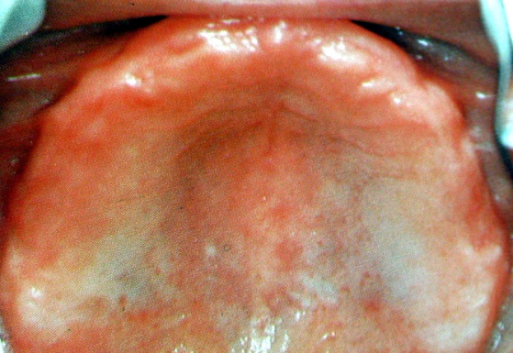
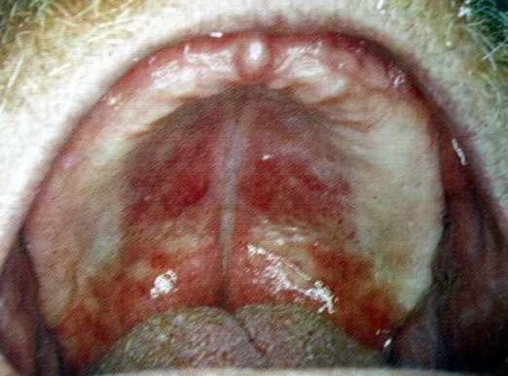
INTRAORAL EXAMINATION
Color of mucosa- healthy pink
Redness indicates inflammatory changes due to ill fitting dentures, smoking, infection or systemic diseases.
White patches may indicate an area of frictional keratosis

Slide 48
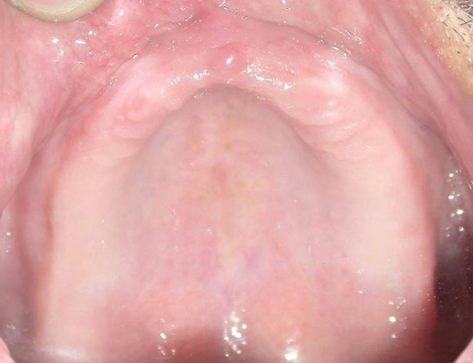
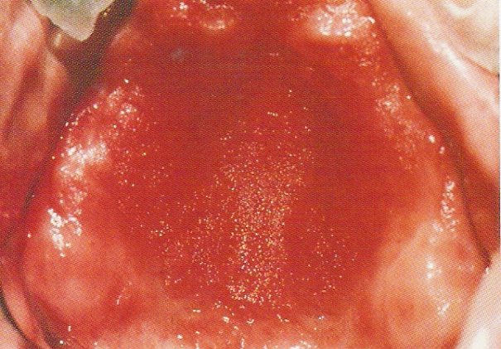
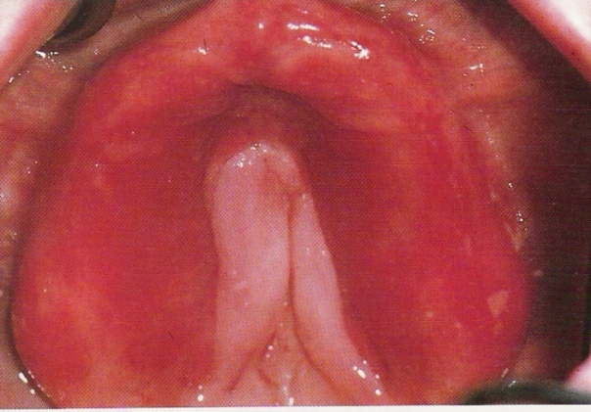
CONDITION OF MUCOSA
class 1 : healthy mucosa
class 2 : irritated mucosa
class 3 : pathologic mucosa

Slide 49
SALIVA
Major salivary glands should be examined for patency
Saliva can be classified as-
class 1 : normal quality & quantity of saliva. Cohesive & adhesive properties are ideal.
class 2 : excessive saliva. Contains much mucus.
class 3 : xerostomia.

Slide 50
Excessive saliva complicate impression making
Lack of saliva hampers retention, mucosal irritation
Thick ropy saliva dislodgement of denture due to hydraulic pressure
Copious amount adds to gagging

Slide 51
SIALORRHEA
Increased flow of blood through the salivary glands and their excessive stimulation.
Sialorrhea in denture wearers is due to-
Emotional stress
Painful affliction of the oral cavity
Reflex stimulation of the dentures.

Slide 52
Causes:
Incorrect centric jaw relation registration
Excessive vertical dimensions
Overextension & excessive thickness of denture borders
Excessive pressure on oral mucosa
Management
Correction of the dentures
Reassurance /psychotherapy of the patient
Atropine sulfate administration orally

Slide 53
XEROSTOMIA
Symptom associated with alterations of salivary function.
Causes
Drugs
Diabetes mellitus
Radiation
Infection of the salivary glands.
Nutritional deficiency

Slide 54
Management
  Denture use limited to short periods.
  Nutritious diet/soft and moist food.
  Chewing sugarless gums and frequent liquid intake.
  Good denture hygiene maintenance.
  Fluoride application
  Pilocarpine therapy.
  Salivary substitutes.

Slide 55
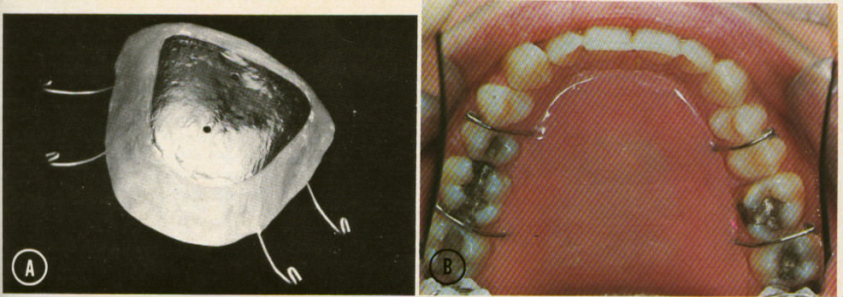
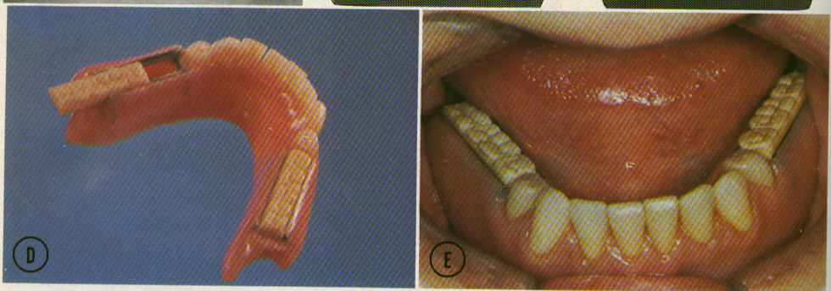
ARTIFICIAL SALIVA RESERVOIRS

Slide 56
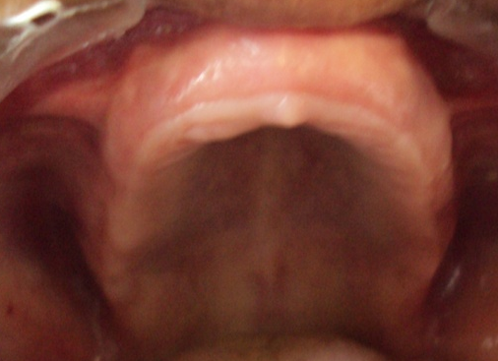
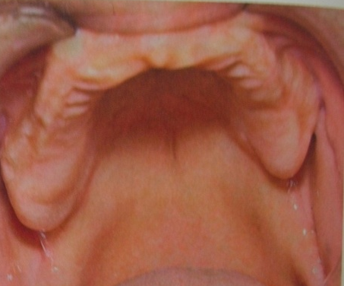
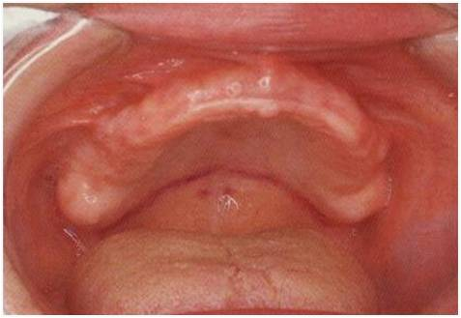
RESIDUAL ALVEOLAR RIDGE
ARCH SIZE
class 1 : large [ ideal retention & stability]
class 2 : medium [good retention& stability]
class 3 : small [difficult to achieve good retention & stability]
large
medium
small

Slide 57
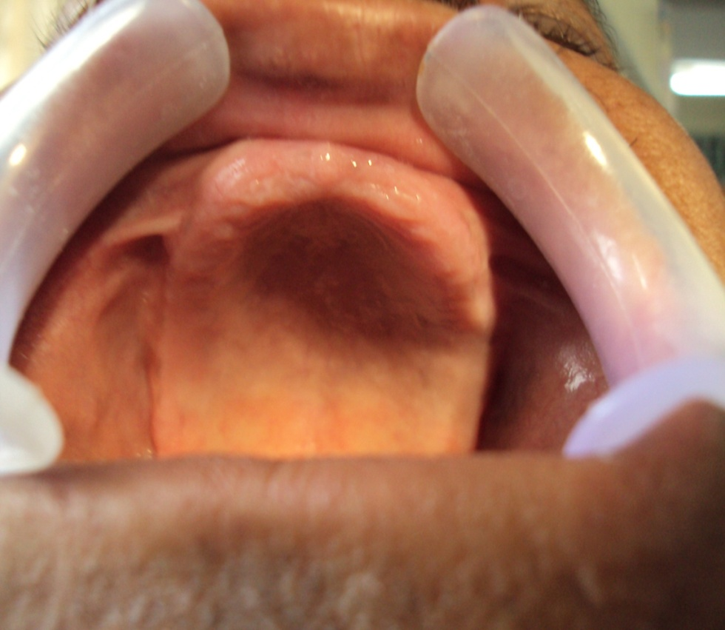
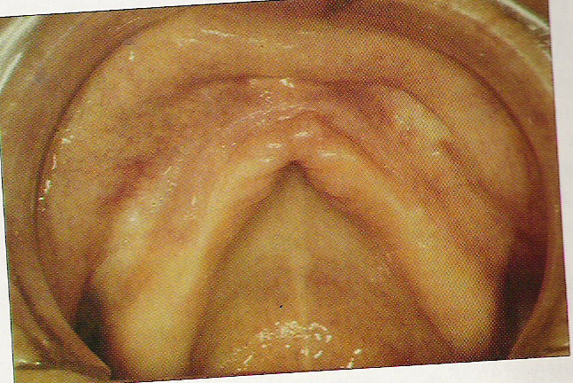
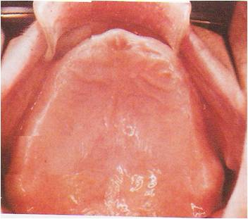
ARCH FORM
Plays a role in support of denture & tooth selection.
House classified as-
Square arch form
Tapering arch form
Oval arch form

Slide 58
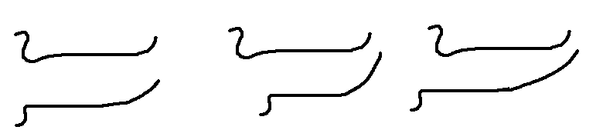
RIDGE RELATION
Positional relation of the mandibular ridge to the maxillary ridge.
Classified as-
Normal
Retrognathic
Prognathic

Slide 59
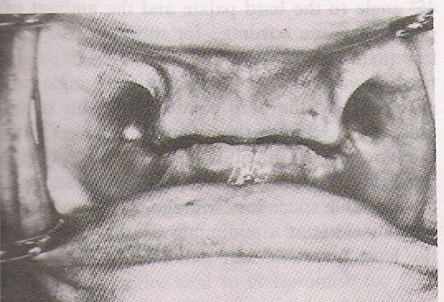
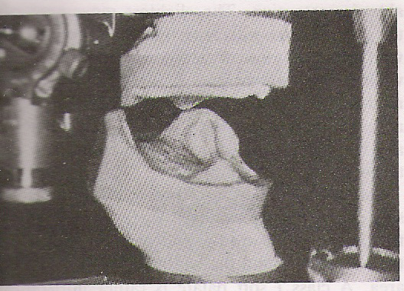
INTER-ARCH SPACE
  Normally 16-20mm adequate for accommodating teeth.
Inter-arch space - retention & stability of denture.
Inter-arch space makes teeth arrangement difficult, however stability of denture

Slide 60

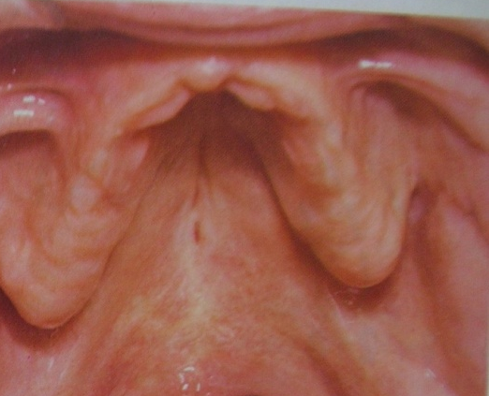

HARD PALATE
V shaped: retention is less. Peripheral seal easily broken.
Flat: reduced resistance to lateral & rotatory forces.
U shaped: ideal for retention
U-SHAPED
V-SHAPED
FLAT

Slide 61
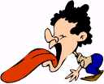
GAG REFLEX
Normal defense mechanism designed to prevent foreign bodies from entering the trachea.
Causes:
Systemic disorders
Psychologic factors
Physiologic factors
Iatrogenic factors.

Slide 62
Poses problems during making of impression.
Denture insertion may also be difficult
Usually careful handling of impression procedures & constant reassurance will suffice.
Prosthodontic
Pharmacologic
Psychologic
reassurance
Clinical

Slide 63
TONGUE
The orofacial musculature, external surfaces:
retention and stability
Teeth :
positioned in the neutral zone
The polished surface :properly shaped so normal musculature will retain the denture.
Base of tongue:
emergency retentive force for some patients

Slide 64
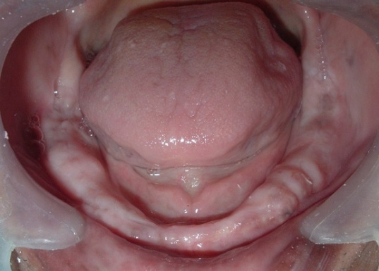
TONGUE SIZE
Large tongue: patient edentulous for a long time have enlarged & powerful tongue (proptosis lingualis) contributing to denture instability & hindrance to impression making.
Small tongue: facilitates impression making but does not provide adequate peripheral seal.

Slide 65
TONGUE MOVEMENT & MUSCULAR COORDINATION
To register a good peripheral training
Maintaining the denture in the mouth during functional activities
To record centric relation

Slide 66
TONGUE POSITION
Important for the prognosis of mandibular dentures.
It guides in evaluating the occlusal height.
Dorsal surface of tongue is nearly in level with occlusal surface of posterior teeth.
At rest tip gently touches the lingual surface of lower anterior teeth.

Slide 67
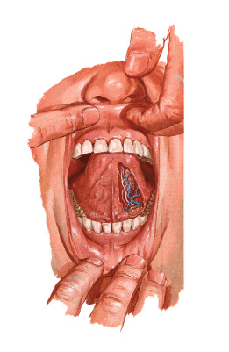
SOFT TISSUE EXAMINATION
FRENUM
According to House
In maxilla as
        High
        Medium
        Low.
In mandible as
Low
Medium
High.

Slide 68

MUSCLE ATTACHMENT
Interfere with denture extension &border seal.
House classified border attachments as-
Class I At least 0.5inches distance between
attachment & ridge crest's
Class II Distance between attachment & ridge crest
0.25 to 0.5inches.
Class III Below 0.25inches

Slide 69
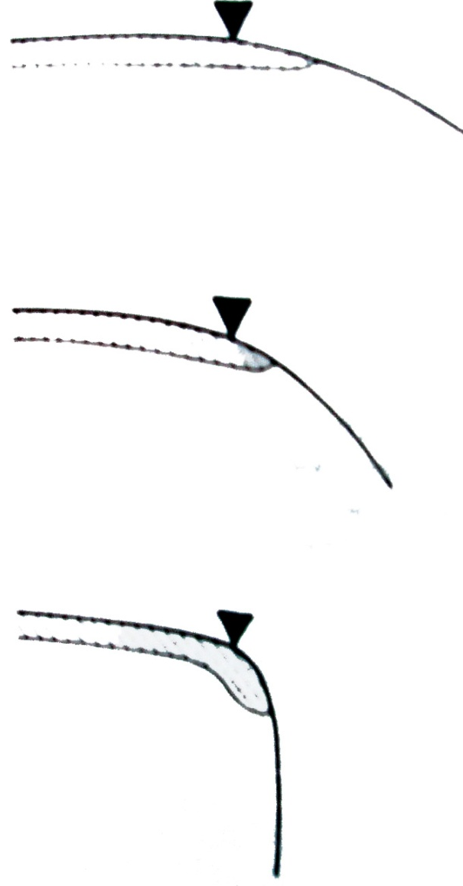
SOFT PALATE
Amount of tissue that accept PPS.
Class I
-Ideal for retention.
Class II
-Good retention is possible.
Cass III
-Poor retention

Slide 70
CONCLUSION
“Treatment plan is not scientific truth, but wisdom,
the plan that a prudent clinician would develop to maximize benefit to the patient from the treatment procedures compared to both cost and risk.
And Diagnosis is the source of that wisdom.”

Slide 71
Spend more time in planning than doing,
So that doing becomes easy.
-P.K. Thomas

Slide 72


