Slide 1
DIAGNOSIS AND TREATMENT PLANNING FOR COMPLETE DENTURE PATIENTS
Part –I i

Slide 2
To learn how to treat a disease one must learn to diagnose,
The diagnosis is the best trump in the scheme of treatment.
-Charcot

Slide 3
DIAGNOSTIC AIDS
  DIAGNOSTIC CASTS
  RADIOGRAPHS
  PHOTOGRAPHS
  PRESENT PROSTHESIS
  ADVANCED DIAGNOSTIC AIDS
Essentials of complete denture Prosthodontics- Winkler

Slide 4
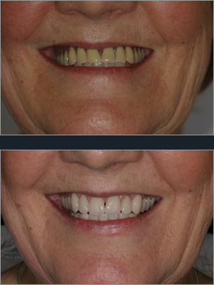
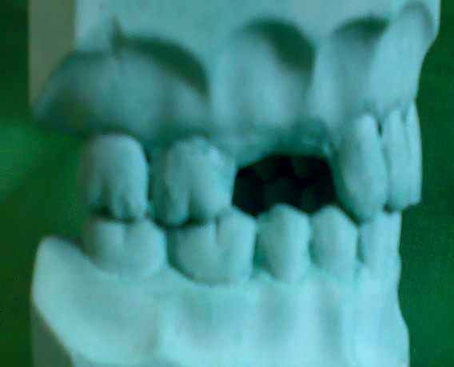
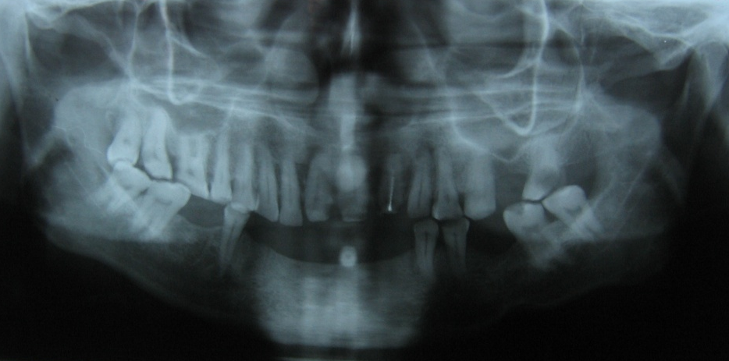
Pre-extraction records
  Photographs showing natural teeth.
  Old radiographs.
  Diagnostic casts
  Radiographs obtained from other dentist.

Slide 5
DIAGNOSTIC CAST
  Better visualization of intraoral structures
  Act as pre extraction record, help in choosing size and shape of artificial teeth.
  Mounted casts – vertical dimension of occlusion.
  Aids in assessment of individual tooth before making decision of extraction.
Essentials of complete denture- Winkler

Slide 6
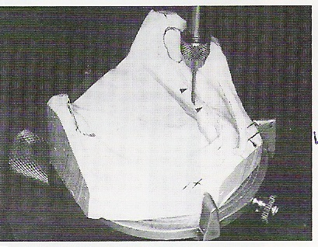
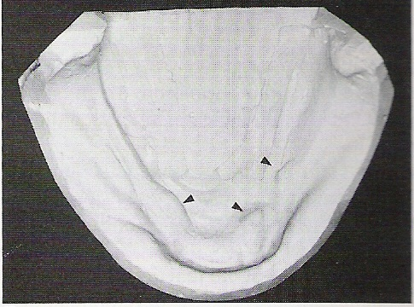
DIAGNOSTIC CAST
  Ridge relationship
  Diagnose missed findings
  Confirm clinical findings
  Measuring & determining relation to other structures
  Decision about preprosthetic surgery
  Undercut surveying.

Slide 7
Radiographic examination
Panoramic radiographs are faster, have reduced patient exposure & images the entire maxilla & mandible.
Panoramic radiographs aid in documenting the amount of ridge resorption.
A panoramic radiograph should be advised routinely, and selective occlusal, periapical views should be used as adjunctive.

Slide 8
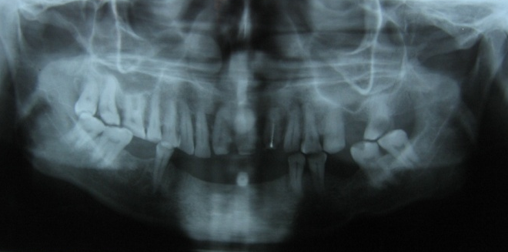
Pathologic Conditions In Edentulous Jaws Can Be Found In 34 To 37% Of Cases,
  Retained roots are most common
  Unerupted tooth, foreign bodies
  Inflammatory or neoplastic abnormalities
  Bone support of remaining teeth.
  Anatomical landmarks – maxillary tuberosity, genial tubercle, mental foramen etc.
  Condition of bone – density, surface texture
Essentials of complete denture - Winkler

Slide 9
Interpretation of opg
5 step analysis(by Chomenco)
1. Screen jaws for defects in structures and reactive new bone formation, bone enlargement and displacement of jaw parts
2. Describe appearance of the lesion, as well as bony changes adjoining the lesion
3. Correlate the radiographic findings with clinical, historical and lab findings
4. Perform a differential diagnosis
5. Estimate the growth of the lesion by the appearance of the jaw structures bordering the lesion.
Essentials of complete denture Prosthodontics- Winkler

Slide 10
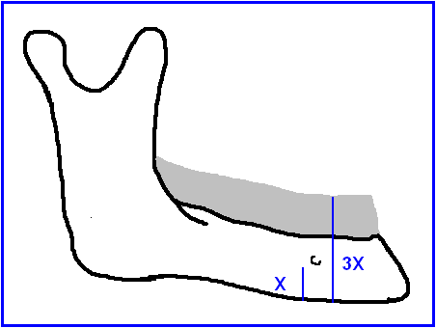
WICAL AND SWOOPE ANALYSIS
Actual bone height can be measured with a radiograph of mandible.
Original bone height is three times the distance from lower border of mandible and inferior margin of mental foramen.

Slide 11
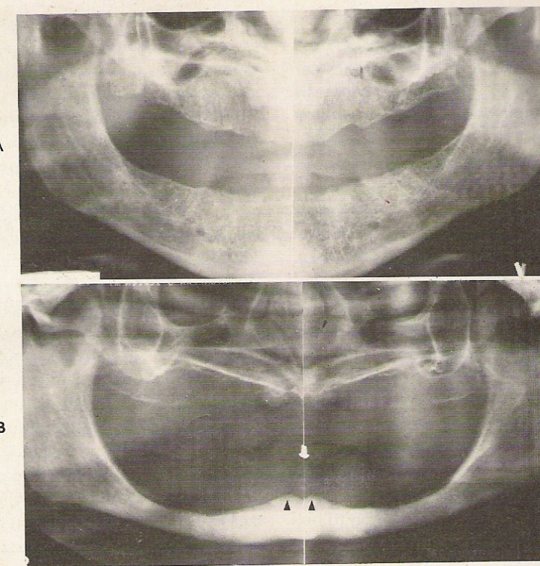
RADIOGRAPHs
Wical and Swoop analysis―
  Class I- Upto 1/3rd of original vertical height lost
  Class II- 1/3rd to 2/3rd of original vertical height lost.
  ClassIII- 2/3rd or more original
  vertical height lost.
JPD July 1974:32:1:7-12

Slide 12
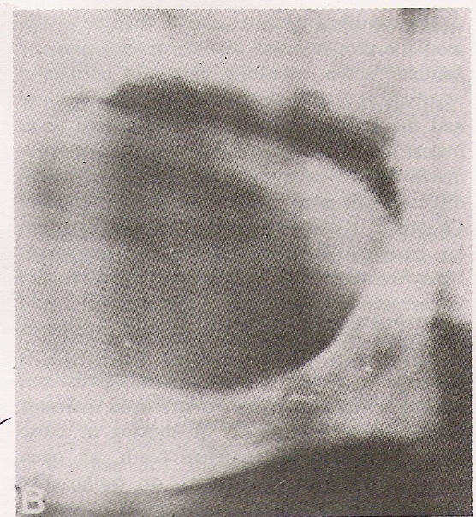
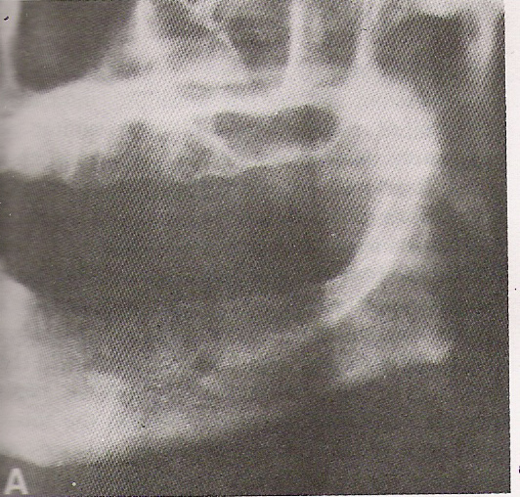
Radiographic examination of the bone density by Misch.
  Dense cortical bone .
  Porous cortical bone.
  Coarse trabacular bone.
  Fine trabacular bone.
JPD-1981:52:455:459

Slide 13
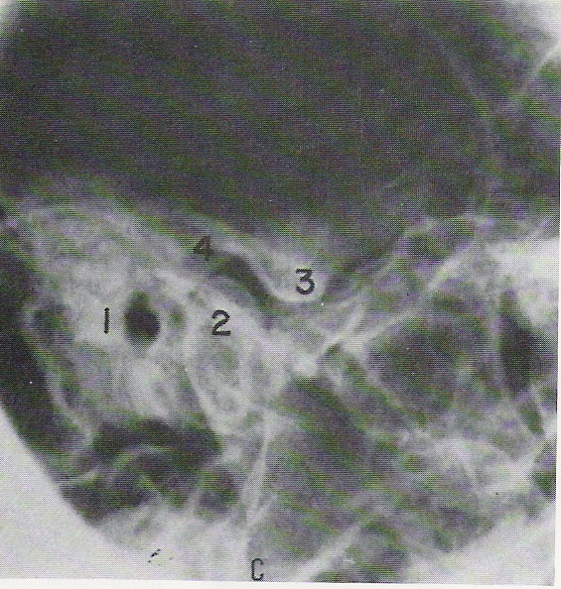
RADIOGRAPHIC EXAMINATION TMJ
Panoramic projection– bilateral view of condyle & fossa relation, oblique, posterior ,anterior view of the joint .
Transcranial projection-lateral view of TMJ.
Transorbital projection-medial &
lateral surface.
Submentovertex view-surface of
condyles

Slide 14
PHOTOGRAPHS
Acts as a guide for harmonization of the denture with facial features of the patient.
To select size, shape, color shade of artificial teeth.
Characterize the arrangement of teeth.
Establish lip support and contour.
JPD 1970-21, 5, 482-88

Slide 15
ADVANCED DIAGNOSTIC AIDS
CT scan
Magnetic resonance imaging
Ultra sound probe
Modified radiographs
Bone densitometer

Slide 16
OTHER INVESTIGATIVE PROCEDERES
To Rule Out DM
  RBS
  FBS
  PPBS
Patient’s BP should be recorded.
BT,CT
Hb gm%.
If any Intra or Extra Oral lesion advise for Biopsy Histopathological Examination .

Slide 17
TREATMENT PLANNING
Treatment planning
developing a course of action that encompasses the ramifications & sequelae of treatment to serve the patients need.
Treatment planning is defined as the sequence of procedures planned for the treatment of a patient after diagnosis( GPT 8)
Essentials of complete denture Prosthodontics- Winkler

Slide 18
TREATMENT PLANNING
Adjunctive care
Prosthodontic care

Slide 19
TREATMENT PLAN
The treatment plan should specify regarding
The treatment procedures
Operating time
Laboratory time
Calendar time
Fees
such that patient informed consent regarding the same can be obtained.

Slide 20
ADJUNCTIVE CARE
Elimination of infection and pathology
Preprosthetic surgery
Tissue conditioning
Nutritional counseling

Slide 21
Patient education:
Information about their dental health & its effect on the treatment outcome.
Limitation of complete denture.
Problems associated with complete denture initially.
Importance of oral &denture hygiene.
Need for regular check up.
Motivation of the patient.
DCNA ,1977 -complete denture.

Slide 22
Strategy for dietary screening & management in dental office
STEP 1- determine dental, medical, personal & social history.
STEP 2- observation for clinical signs of malnutrition-
Symptoms- anorexia, abdominal discomfort, confusion, dyspepsia, insomnia, muscle pain, palpitations, increased susceptibility to infection.
STEP 3- dietary history & evaluation.
STEP 4- dietary diagnosis
STEP 5- provide dietary guidelines.
DCNA 2003;47:355-71

Slide 23
Varity of foods from the 4 food groups should be advised to combine at each meal.
Vegetable-fruit group
Bread-cereal group- whole grain
enriched flour products
Milk-cheese group
Meat, poultry, fish & bean group
Maintaining of ideal body weight.
Avoid fat, saturated fat & cholesterol.
DCNA 2003;47:355-71

Slide 24

Diet counseling:
Diet rich in proteins, calcium, vitamins, minerals, low calorie diet.
If required referred to dietician.

Slide 25
NON SURGICAL METHODS OF TREATING THE ABUSED TISSUES
Resting the denture supporting tissues.
Regular massaging.
Occlusal correction , establishing vertical height
Refitting the dentures.
Drugs to eliminate infection.
Nutritional supplements.
Advise for jaw exercise.
Boucher’s Prosthodontic treatment for Edentulous patients, 11th edition.

Slide 26
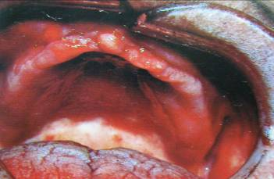
SURGICAL METHOD
Correction of hyperplastic ridge tissue ,epulis fissuratum, papillomatosis ,hyperplastic pendulous tuberosity.
  no response to nonsurgical treatment procedures.
  interferes with stability .
  Advise:
  Electro surgery.
  Excision of the tissues .
Essentials of complete denture- Winkler

Slide 27
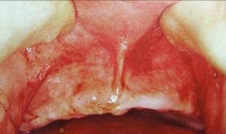
FRENAL ATTACHMENTS
Maxillary labial frenum( broad fibrous band)
Lingual tongue tie
Prominent buccal freni near to crest of ridge.
Treatment advised:
Frenectomy.
Essentials of complete denture- Winkler

Slide 28
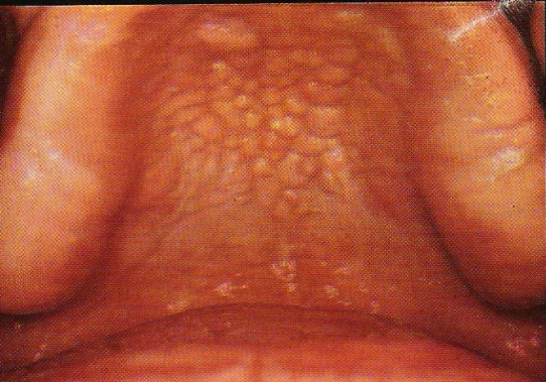
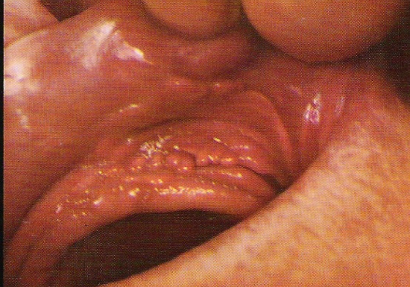
HYPERPLASTIC TISSUE
Epulis Fissuratum (denture border),
Papillary Hyperplasia (under the denture base).
Tissue rest, proper oral hygiene & tissue massage.
Refitting of the existing dentures with tissue conditioners .
If improvement does not occur-surgical correction

Slide 29
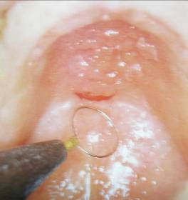
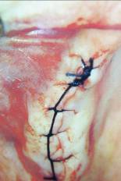
Papillary Hyperplasia
a) Small lesion with sharp curettes:
sharp curettes, micro-abrasion
electrosurgery.
b)Large lesion:
split thickness supraperiosteal flap
Essentials of complete denture- Winkler

Slide 30
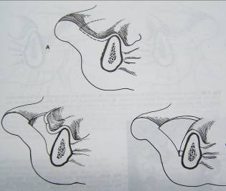
Vestibuloplasty
Surgical procedure designed to restore the alveolar ridge height and/or width by lowering
the muscles attachments & attached mucosa.
Considered only when other non surgical approaches have been exhausted.
Essentials of complete denture- Winkler

Slide 31
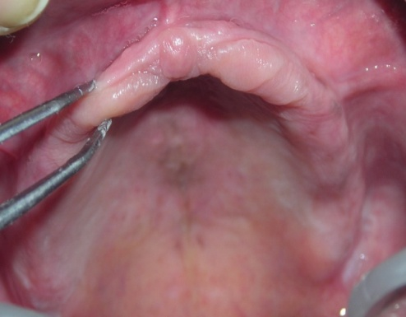
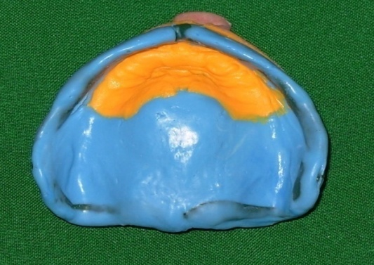
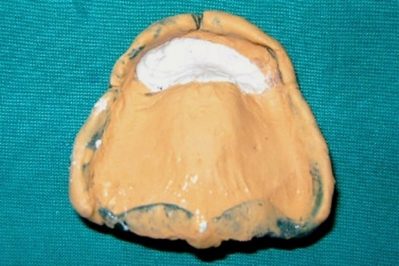
FLABBY TISSUE
Proper relief is to be provided.
Alteration in impression materials and methods
Tissue rest
If very large and movable: surgical correction
William Filler Technique
Zafrulla Khan Technique

Slide 32
OSSEOUS ABNORMALITIES
Ridge undercuts.
Prominent mylohyoid &Internal oblique ridge
Prominent genial tubercle
Residual ridge( sharp, spiny).
Torus palatinus.
Torus mandibularis.
Discrepancies in jaw size.
Ridge augmentation.
Essentials of complete denture- Winkler

Slide 33
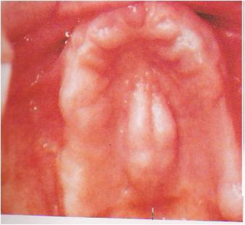
TORUS palatinus
Bony enlargement at the midline of the hard palate.
Covered by thin less resilient tissue
Surgical removal advised if-
extend on PPS
Interferes with speech
Problem in stability due to fulcrum effect on dentures.
Essentials of complete denture- Winkler

Slide 34
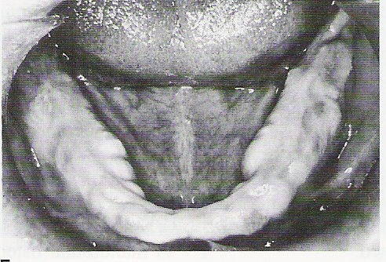
Torus mandibularis
Bony protuberance on lingual aspect of the mandible in the premolar region.
Surgical correction advised when it interferes with lingual seal.
Essentials of complete denture- Winkler

Slide 35
PROSTHODONTIC CARE
Type of prosthesis
Denture base material
Tooth material
Tooth shade/shape
Should be decided as a part of treatment planning.

Slide 36
Type of prosthesis
Conventional complete denture.
Implant supported.
  Previous h/o failures with conventional complete dentures
  Good health, affordable.
  Patient with compromised motor skills, residual ridge resorption.
  Patient desire.

Slide 37
How to care for denture
1- Denture should be kept clean
2- Denture shouldn't clean in boiling water → to avoid distortion of base.
3- Denture should be hold above a container of water during cleaning → to act as a cushion.
4- Denture should be clean after each meal using a brush & Dentifrice → not abrasive powder.

Slide 38
6- Denture should be removed at least 8 hours each 24hour for the reasons:
Pressure can interrupt blood supply → Bone resorption.
Continuous pressure → soft tissue damage → loose denture.
Best time during sleeping to aid in tissue& muscle relaxation.
7- When soreness occur → Pt. should return for examination → Soft liners are a temporary solution& cause an immediate relief.
8- Return to the dentist when denture become loose.

Slide 39
SUMMARY
History includes dental & medical history, expectation & the mental attitude of the patients
Diagnosis involves examination right from patient enters the clinic, from the collection of personnel information and extra & intra oral hard & soft tissue examination.
Diagnosis form the first important milestones for the successful accomplishment & favorable prognosis as the potential problems are identified & accordingly treatment plan is framed.

Slide 40
CONCLUSION
“Treatment plan is not scientific truth, but wisdom,
the plan that a prudent clinician would develop to maximize benefit to the patient from the treatment procedures compared to both cost and risk.
And Diagnosis is the source of that wisdom.”

Slide 41
Spend more time in planning than doing,
So that doing becomes easy.
-P.K. Thomas

Slide 42
REFERENCES
Boucher ‘s Prosthodontic treatment for edentulous patients 11th edition.
Prosthodontic treatment for edentulous patients by Zarb Bolender 12th edition
Essentials of complete denture Prosthodontic by Winkler
Syllabus of complete dentures by Heartwell.4th edition .
Color atlas of common oral diseases by Craig .S .Miller.
A text book of oral pathology by shafer 4th edition

Slide 43
Davidson’s principles & practice of Medicine.
DCNA 1977 complete denture.
BDJ volume 188,No.7:April:8:2000.Complete denture an introduction.
Diagnostic factors in the choice of impression materials & methods by George.A.Buckly D.D.S in JPD March:1995:5:2.
Dr.Robert.H.Spring. Diagnostic procedures ---the patients existing dentures.JPD 1983:49:2:153
Complete Denture Prosthodontic- John J Sharry

Slide 44


