Slide 1
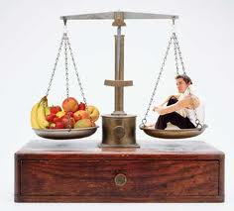
Balanced Diet

Slide 2
Terminologies
Importance of a Balanced Diet
WHO Recommendations
Recommended Dietary Allowances
Recommended Calories
Food Pyramid
Nutritional Importance of Carbohydrates, proteins,Fats vitamins, minerals & water
Geriatric Nutrition
Nutrition for denture wearer
Conclusion
References

Slide 3
To eat is a necessity, but to eat intelligently is an art."
- La Rochefoucauld
"The wise man should consider that health is the greatest of human blessings. Let food be your medicine."
- Hippocrates

Slide 4
Balanced Diet
Regular Exercise
Active Lifestyle
Perfect Health

Slide 5
Nutrition-
The science of how the body utilizes food to meet requirements of development, growth, repair and maintenance
by utilization of food by living organisms.
Diet-
The total intake of substance that furnish nourishment and calories.
Nutrients –
Are the constituents of food necessary to sustain the normal functions of the body .

Slide 6
Balanced diet-
It is defined as diet which contains a variety of food in such quantities and proportions that the need for energy, proteins amino acids, vitamins, minerals, fats, carbohydrates and other nutrient is adequately met for maintaining health, vitality and general well being and also makes a provision for an extra nutrients to withstand short duration of illness.
RDA - Recommended Dietary Allowance
- The average daily dietary intake of a nutrient that is sufficient to meet the requirement of nearly all healthy people.

Slide 7
Carbohydrates: These provide a source of energy.
Proteins: These provide a source of materials for growth and repair.
Fats: These provide a source of energy and help in absorption of fat soluble vitamins.
Mineral : These are required for healthy teeth, bones, muscles ,fluid regulation, Blood pressure regulation .
Fibre: This is required to help your intestines function correctly.
Balanced Diet: we must have the above nutrients in the correct proportions.

Slide 8
Importance of a Balanced Diet
Maintaining the health
Preventing Infections and Diseases
Safeguard from nutritional deficiencies
Weight Control
Healthy Body Growth
Active Lifestyle

Slide 9

WHO recommendations
Achieve an energy balance and a healthy weight
Limit energy intake from total fats and shift fat consumption away from saturated fats to unsaturated fats
Increase consumption of fruits ,vegetables,legumes,whole grains
and nuts
Limit the intake of sugar.
Limit salt consumption from all sources and ensure that salt is iodized

Slide 10
Recommended Dietary Allowances-
Caloric Content of Foods
Indian Man Indian Woman
(60kg) (55kg)
Proteins g/d 60 50
Fats g/d 20 20
Calcium mg/d 400 400
Iron mg/d 28 30
Vit A mg/d 600 600
Thiamine mg/d 1.4 1.1
Riboflavin mg/d 1.6 1.3
Nicotinic acid mg/d 18 14
Pyridoxine mg/d 2.0 2.0
Ascorbic acid mg/d 40 40
Carbohydrate 4 cal/g
Protein 4 cal/g
Fats 9 cal/g

Slide 11
Recommended Calories for Indians
Group | Particulars |  | K Calories
Man | Sedentary work |  | 2350
 | Moderate work |  | 2700
 | Heavy work |  | 3200
Woman | Sedentary work |  | 1800
 | Moderate work |  | 2100
 | Heavy work |  | 2450
 | Pregnancy | + 300
 | Lactation 0 - 6 months |  | + 550
 | 6 - 12 months |  | + 400

Slide 12
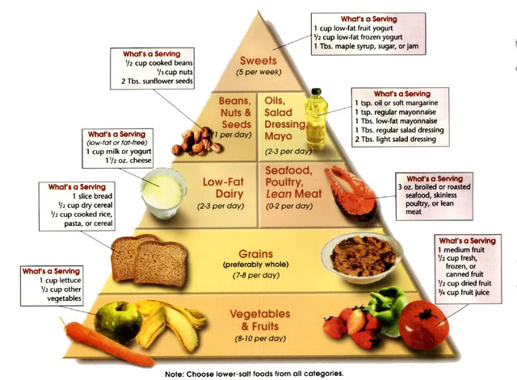
FDB in Denmark in 1978
USDA in 1992 to replace the earlier food groups classification system

Slide 13
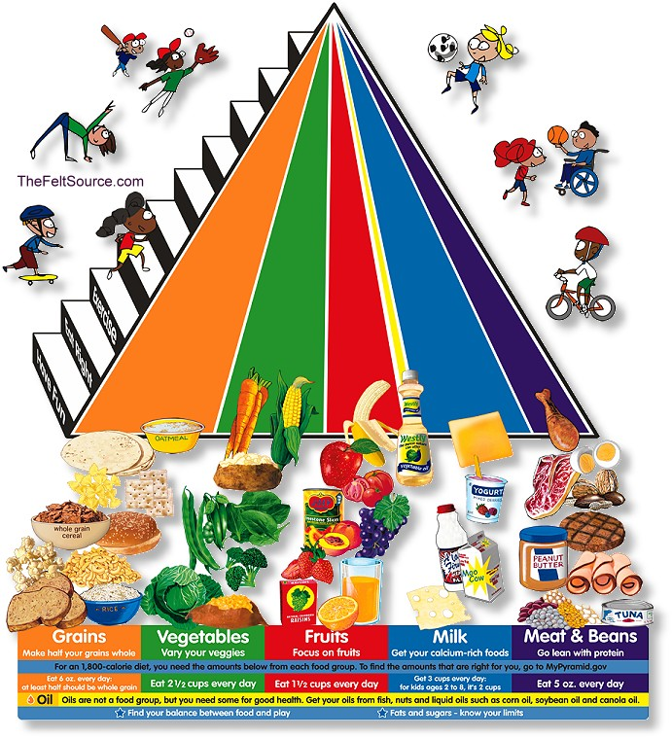
USDA changed the Pyramid in 2005

Slide 14
Geriatric nutrition
Geriatric nutrition applies nutrition principles to delay effects of aging and disease, to aid in the management of the physical, psychological changes commonly associated with growing old.
There is also good evidence that prosthetic failures are often, the result of tissue deficiencies rather than technical deficiencies.
Research indicates that dietary habits, such as restricting one's calorie intake and consuming antioxidants, may increase longevity

Slide 15
Factors that influence the nutritional status of the elderly
NUTRITIONAL STATUS
OF THE ELDERLY
PHYSIOLOGICAL
CHANGES
Pharmacological
PSYCHOLOGICAL
AND SOCIAL
CHANGES
Functional
Sight
Taste
Smell
Teeth
Memory
Body composition
Ability to move
Depression
Lonelyness
Heart disease
Diabetes
Osteoporosis etc.

Slide 16
Oral factors
Xerostomia – 1 in 5
Sense of taste and smell
Oral infectious conditions
Effect of dentures
    Taste & Swallowing
    Chewing ability
    Food choice & Diet quality

Slide 17
Dietary recommendations for Geriatrics
Energy needs decrease.
Average energy consumption of 65-74 yrs
  Women – 1300 Kcal
  Men – 1800 Kcal
RDA : Women – 1600 Kcal
Men – 2400 Kcal
The average calorie requirements are :
  10% less at age 60
  20% less at age 70
  25% less over age 90

Slide 18
Indian Diet Chart
Food Group | Quantity | Sources
Cereals | 300 g | Wheat, Rice, Millets
Pulses | 60g (Veg), 30g(Non-Veg) | Sprouts/dal
Meat | 30 g | Egg / Chicken / Fish
Vegetables | 300 g (minimum) | Peas, Carrot, Pumpkin, Beans, Green Leaf Vegetables etc.
Fruits | 100 g (minimum) | Orange, Apple, Papaya, Guava, Mango etc
Milk & Milk products | 300 g | Cheese, Curd etc
Sugar | 20 g | Confectionary
Fats | 20 g | Oil/ Butter/ Ghee

Slide 19
NUTRIENTS
MACRONUTRIENTS MICRONUTRIENTS
Carbohydrates
Fats
Proteins
Water
Dietary Fibers
Minerals
Vitamins

Slide 20
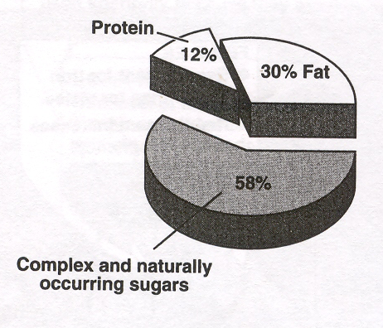
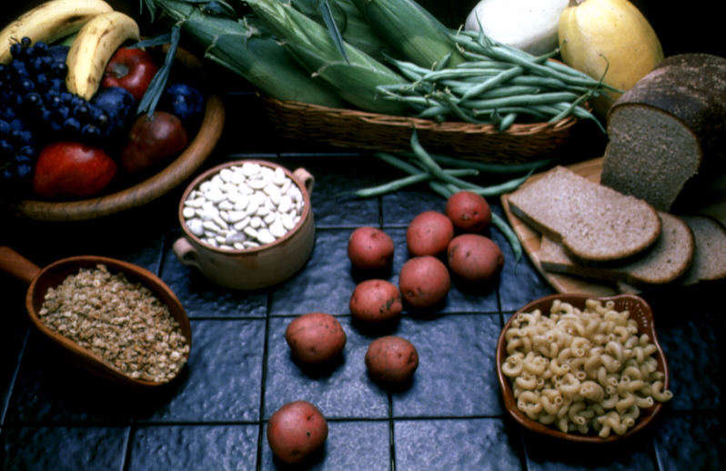
Nutritional Importance of Carbohydrates
(CH2O)n – Hydrated C
Call for an intake of 50-70% of total calories
Provides 4Kcal/g of energy
RDA- Females - 177 gm/day
Males - 287 gm/day
Types of Carbohydrates
Digestable
  - Candy, Sweets, fruits Sugar, pasta, rice, breads, potatoes
Non Digestible/Dietary Fibre- 35-40gm/day
- Pectin, gums, cellulose

Slide 21
Functions
Source of energy
Storage form of energy - Glycogen
Structural component – Glycosaminoglyacans,glycoprotein
Non Digestable – Serve as dietary fibre
Constituent of nucleotide
Detoxification
Enhances fatty acid metabolism
Excessive consumption - Overweight
Insufficient consumption - Ketosis

Slide 22
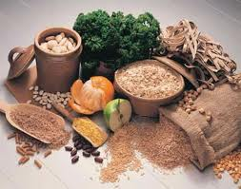
Geriatric considerations for Carbohydrates
Most of them should be from complex carbohydrates
Complex carbohydrates Promote the bowel function
& Reduce cholesterol.
Reduced intake – Gastrointestinal disturbance,
constipation, Colon cancer,
Increased cholesterol - cardiac diseases.
Carbohydrates cause an increase in blood sugar.
Diabetics should be encouraged to keep track of the amount of Carbohydrates they eat.

Slide 23
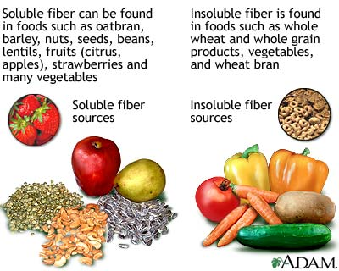
Fibre containing food

Slide 24
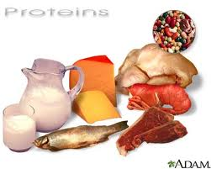
Nutritional Importance of Proteins
Most abundant macromolecules.
Linear chains of Amino acids linked by Peptide bond
Types of Amino Acids
  Nonessential (10) – Can be synthesized by body
  Essential (10) –Can’t be synthesized by the body

Slide 25
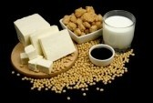
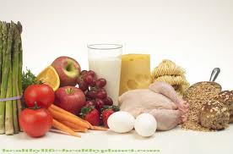
7-15% of Total energy intake
1gm/kg body weight
Sources of Protein
  Animal - Meats,Fish, dairy products
  Vegetable - Beans, nuts, legumes, grains

Slide 26
Types
Catalytic Protein : Enzymes-trypsin,pepsin,glucokinase
Transport Protein :Hb,Lipoproteins
Storage Protein : Apoferritin,Myoglobin
Contractile Protein :Actin,myosine
Structural protein : Collagen,keratin,cartilage.
Regulatory protein : Harmones – Insulin,GH

Slide 27
Functions
Fundamental constituent of tissues & cells.
Important component of blood ,muscle.
Form Enzymes, Hormones,Neurotransmitters,Heamoglobin
Form Immunoglobulin
Maintenance of Osmotic pressure, blood clotting
muscle physiology
Replacing wear & tear in tissues
Starvation…major supplier of energy
Diet should contain adequate Carbohydrates & Fats to provide energy so that
proteins in the diet are most economically used to fulfill other functions essential to life

Slide 28
Geriatric considerations for proteins
Protein requirement increases with aging
1.4gm/kg body weight is optimum.
12% total energy intake.
Too much protein never damages the
health of the elderly person.
Deficiency causes edema.

Slide 29
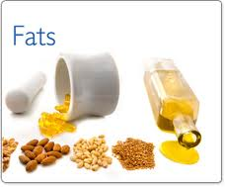
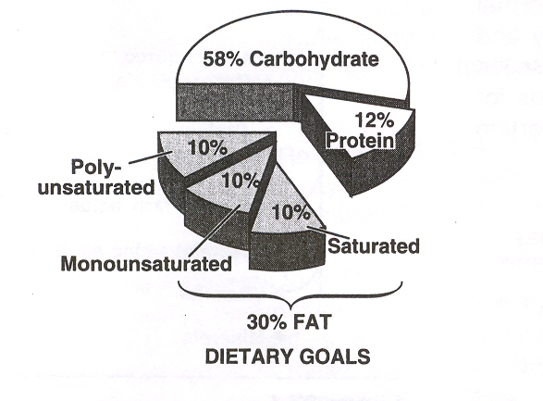
Nutritional Importance of Fats
High energy yielding nutrients
35-45% of calorie intake.
Less than 1/3 of dietary fat
should be saturated
Provides 9Kcal/g of energy

Slide 30
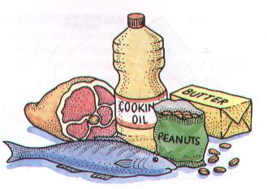
Fats
Types
    Saturated
-Animal sources : Solid at room temperature
    Unsaturated
-Vegetable : Liquid at room temperature
Functions
    Vehicle for absorption of fat soluble vitamins
    Provide essential fatty acids,
    Dietary fat - palatability of food
Geriatric diet: consists of 10-30% total calorie intake
Should avoid Fried food & prefer boiled food.

Slide 31
Minerals
Macrominerals –More than 100mg/day
Na,K,Cl,Ca,Ph,Mg,Su
Microminerals/Trace elements – Less than 100mg/day
Cr,Co,Zn,Cu,Al ,Fl,Mn,Mb I (150 µgm/day and 1 teaspoon of
iodized salt. provides around 400 micrograms)
Functions: 1) Protoplasmic activity
2) Maintenance of body fluids
3) Regulation of acid base balance
4) Part of physiologically important compounds –Hb,Thyroxine
5) Cofactors –Cu,Mg,Mn,Zn

Slide 32
Minerals
Minerals | RDA | Function | Deficiency
Sodium | 1-5gm | Regulates balance of body fluids Nerve function Acid base balance Blood pressure | Headache Weakness, cramps Increased fluid retention in body
Potassium | 2-5gm | Fluid n electrocyte balance Muscle nerve function Release of energy | Muscular weakness Arrythmias Kidney n lung failure
Chloride | 2-5gm | Water balance Osmotic regulation Acid base balance | Headache Weakness, cramps Increased fluid retention in body

Slide 33
Calcium | 800mg/day 1200mg/day (pregnant & lactating mother) | Development of bone n teeth Clotting of blood muscle activity nerve function | Retarded growth Poor tooth formation Increased clotting time Increase in fractures
Phosphorus | 800mg/day | Formation of bones n teeth Muscle activity Acid base balance | Weakness, loss of appetite Retarded growth Porous bone Poor tooth formation
Magnesium | Men-350mg/day Women -300mg/day | Building bones Nerve n muscle function Blood clotting Cofactor | Muscle twitching n tremors Convulsions Leg n foot cramps Shaky hands

Slide 34
Fluoride | 1-4mg | Bone n tooth formation Inc resistance to decay | Inc dental caries
Zinc | 15mg | Wound healing Tissue growth Reproduction | Retarded growth Taste/smell alteration Dec immune function Delayed wound healing Slow physical /sexual maturity
Iron | Adult men &postmenopausal women -10mg Premenopausal – 15-20mg Pregnant-30-0mg | Growth Immune system Hb formation | Loss of weight Gastric disturbances Pallor Anemia

Slide 35
Importance of minerals for geriatrics
Minerals are of considerable importance to the aged person.
RDA of Ca- 800mg/day
Decreased ca absorption- Ca deficiency - bone fragility .
They often experience a rapid and excessive ridge resorption under complete dentures which may be related to negative Ca balance; which is also one of the prime causes o OSTEOPOROSIS.
Deficiency of Zn- Taste acuity, mental lethargy & slow wound healing.

Slide 36
Thus the inclusion of Ca and PO4 in the diet is absolutely important as the prime mineralizing substance of bone .
Minute quantities of trace minerals are also important , which include: Cu, zn, mg, K, Na…
Ca levels may be improved by increasing the intake of milk and milk products plus a VIT D supplement of 400-1000units/day.

Slide 37
Vitamins
Physiological effects Nutrient
promoting proper carbohydrate metabolism vit. B1, B3, B5, B7
necessary for proper function of nervous system vit. B1, B2, B3, B5
necessary for proper function of muscular tissues vit. B1, B12, calcium
aids in energy utilization from food vit. B2
helps in red blood cell formation vit. B2, B6, B12, folic acid
involved in fat, carbohydrate, and protein metabolism vit. B3, B5, B6
necessary for hormonal synthesis and function vit. B5, B6
necessary for proper immune system function vit. B6, vit. C
and wound repair
assists in utilization of other B-complex vitamins vit. B7
necessary for nucleic acid formation vit. B12, Bc
necessary for amino acid metabolism vit. B6, Bc
important in collagen formation and maturation vit. C
necessary for mineralized tissues formation calcium
aids in clotting of blood calcium

Slide 38
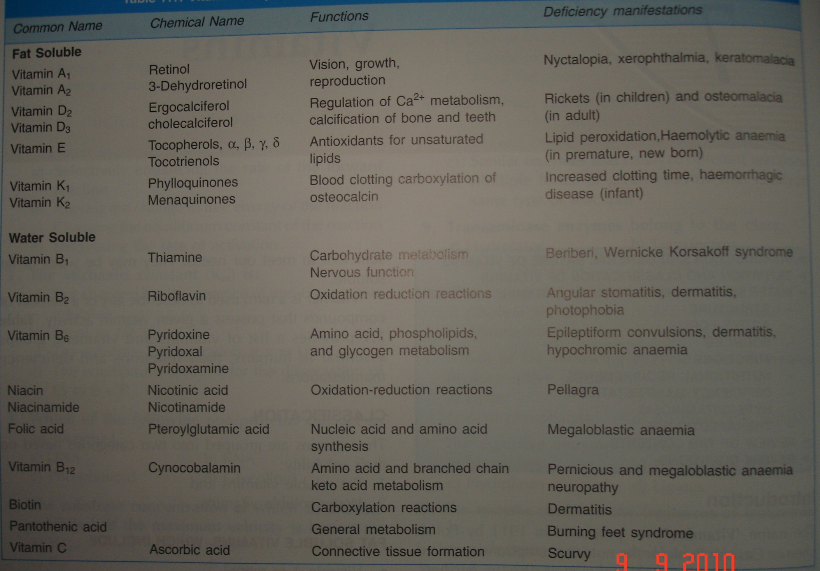

Slide 39
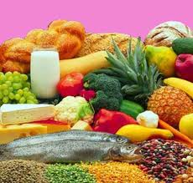
Importance of vitamins
Intake should be increased for the following reasons:
Provide nervous stability.
Provide resistance to bacterial infections.
Improve digestive efficiency by aiding the use of carbohydrates and utilization of mineral elements.
The intake of vitamin A, B-complex, C and D should be increased mainly .

Slide 40
Vitamin A
RDA 800-1000 µgm (1000 µgm)
Deficiency – Bitots spots, Conjunctival & corneal xerosis, Xerosis of skin, Xerostomia, Keratosis of the mucosa & decreased taste acuity
Vitamin B Complex
Thiamine – RDA 500-1000 µgm (1-1.5mg)
Deficiency – Beriberi
Vitamin B6-RDA- 1.2-1.4mg (1.6-2mg)
50-90% of elderly are affected by deficiency
Glossitis

Slide 41
      Vitamin B12-
      RDA – 3.0 µgm
      Deficiency – Fissuring and redness of eyelid corners and mouth
      Vitamin C -
      RDA – 60 µgm
      Deficiency - spongy bleeding gums
      Delayed healing of the wounds
      Painful joints
      Vitamin D –
      RDA – 5 µgm
      Frequently deficient – Bowlegs & beading of ribs

Slide 42
Functions of Water
Comprises about 60% of body weight
Total Body water – 42 ltr
Extacellular –14ltr
Intracellular – 28ltr
Chief component of blood plasma
Aids in temperature regulation
Lubricates joints
Shock absorber in eyes, spinal cord, and amniotic sac.
Helps in excretion
 | Age | (ml/kg body wt)
Infants | Birth-1 | 120-100
Children | 0-10 | 60-80
Adolescents | 11-18 | 41-55
Adults | 19-51 | 20-30

Slide 43
Geriatric considerations for water
Elderly are generally susceptible for negative water balance
At least 30ml/kg body weight/day
Inadequate fluid intake –Dehydration,hypotension,elevated body temprature,dryness of mucosa, decreased urine output

Slide 44
NUTRITION FOR NEW DENTURE WEARER
DIET FOR THE FIRST DAY :
A liquid diet which may consist of fruit juices, milk, etc
DIET FOR THE SECOND AND THIRD DAY :
Soft food that requires a minimum of chewing like , eggs, noodles,rice,boiled cereals,boiled vegetables etc.
DIET FOR THE FOURTH AND LATER :
As the sore spots have healed firmer foods can be eaten.

Slide 45
Foods Recommended for Geriatrics
1) 4 servings of Vegetables & Fruits
2 servings of citrous fruits,green veg,raw cabbage
1 serving of Deep green and yellow veg & fruits
1 serving of potatoes
4 Servings of enriched breads,cereals,flour products
2 Servings of milk and milk based foods
2 Servings of meats ,fish,poultry,egge,dried beans,peas.
2-4 table spoon of unsaturated fats.

Slide 46
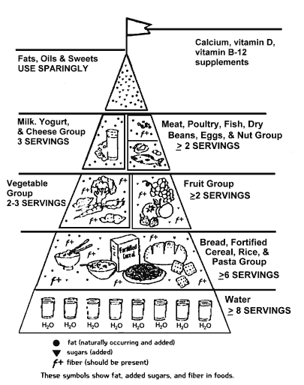
Remodeled Food Guide Pyramid for Elderly

Slide 47
Conclusion
One should always eat
“Breakfast as a King, Lunch like a Rich man and
Dinner like a Poor begger ”
With considerations to carbohydrate, protein, fat, vitamins, minerals salts and fibre in the correct proportions.
If we do not have enough energy containing foods we will feel very tired and work efficiency will be reduced.
Diet plays an important role in success of any treatment so it is very essential to have a balanced diet.
“ Eat healthy and Stay healthy”

Slide 48
References
Text book of geriatric dentistry –Poul Holm,Pederson
Nutrition for geriatric denture patients-JIPs 2006,Vol-6,Issue-6
Text book of biochemistry-AC Deb
Text book of biochemistry –Pankaja Naik
Text book of Physiology –Choudhary
Basic physiology -Guyton

