Slide 1
VERTICAL JAW RELATION

Slide 2
Vertical jaw relation/Vertical dimension
Def^{n}
GPT-8.
  Distance b/w two selected points one on a fixed and
  one on a movable member
  or
  The vertical dimension of face b/w any two arbitrary selected points located one above and one below the mouth , usually in the midline.

Slide 3
Clinical significance
Re-establish the functional position
Functional efficiency
Structural balance.
Esthetics
Phonetics
Comfort

Slide 4
Concepts of Rest Position
As early as 1771, Hunter wrote, “In the lower jaw, as in all the joints of the body, when the motion is carried to its greatest extend, in any direction, the muscles & ligaments are equally relaxed. Hence, it is that commonly & naturally, the teeth of the two jaws are not in contact, nor are the condyles of the lower jaw so far back in the cavities as they can go.

Slide 5
Wallisch (1906) was one of the first to define the physiologic rest position of the mandible.
In the late 1920’s Sicher & Tandler, stated the role of the musculature in controlling the posture of the mandible.
Gillis (1941) defines rest position as “that position from which all mandibular movements begins & to which they return.
Complete Denture Prosthodontics : Sharry 3rd edn

Slide 6
Niswonger (1934)
It is a natural position of the mandible when the opening and closing are in state of equilibrium.
He observed physiologic act of swallowing in 200 patient.
The individual mandibular rest position remains constant throughout life.
Complete Denture Prosthodontics : Sharry 3rd edn

Slide 7
Schlosser (1941) conducted a series of phonetic experiments
Edentulous patients were repeatedly able to bring the mandible to an identical rest position by sounding the letter ‘m’.
Brodie (1942) vertical height remain constant through out life. Boos(1943) and Jaffe (1954) apparently agree with this view.
Complete Denture Prosthodontics : Sharry

Slide 8
Variability of Rest Position
Harris and Hight (1936) the vertical dimension of the face was dependent on the occlusal contacts in the closing movement of the mandible.
Leof (1950) believes that vertical relation is not constant but is readily affected by age, disease & emotion.
Complete Denture Prosthodontics : Sharry 3rd edn

Slide 9
Olsen (1951) the resting position was not rigidly stable.
Coulouriotes (1955) the rest position of the mandible may not remain constant throughout life.
Landa (1954) stresses that the freeway space is never static. It varies as head position changes.
Complete Denture Prosthodontics : Sharry 3rd edn

Slide 10
Atwood (1957) decrease in the vertical dimension of mandibular rest position after the removal of opposing occlusal contacts.
Complete Denture Prosthodontics : Sharry 3rd edn

Slide 11
Classification
Vertical dimension of occlusion
Vertical dimension of rest
Vertical dimension in the other positions.
Vertical dimension of occlusion: (GPT-8)
The distance b/w two points when the occluding members are in contact. OR
It is the relation of the mandible to the maxilla when the occlusal stops are provided by the teeth/occlusion.
Vertical dimension of rest:
The distance b/w two selected point measured when the mandible is in the physiologic rest position.

Slide 12
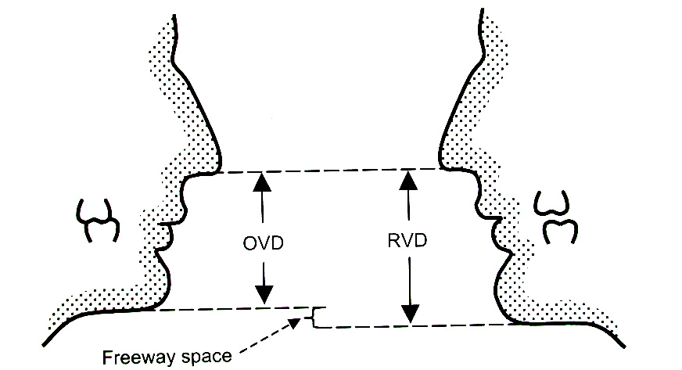
INTEROCCLUSAL DISTANCE /INTEROCCLUSAL REST SPACE.
Difference b/w the resting vertical dimension and vertical dimension of occlusion.
First studied by Dr.M E Niswonger
2-4mm.

Slide 13
Physiologic rest position
GPT-8: The mandibular position assumed when the head is in an upright position and the involved muscles, particularly the elevator and depressor groups, are in equilibrium in tonic contraction, and the condyles are in a neutral, unstrained position
Wallisch (1906)- that position of mandible wherein all muscle action is eliminated & the mandible is passively suspended.
Posselt--- “ postural position of mandible”

Slide 14
Physiologic rest position
Niswonger – ‘neutral position when opening & closing muscles of mandible are in state of equilibrium.’
opening factors— gravity, suprahyoid, infrahyoid, post cervical muscles(extensor )
Closing factors— masticatory muscles & fascial muscles.

Slide 15
Hypothesis
1 st hypothesis(active ): postural position—muscles –minimal contracture to maintain posture of mandible—tonus.
2nd hypothesis:(passive): elastic elements of jaw musculature & not any muscle activity, balance the influence of gravity.

Slide 16
Methods for recording vertical jaw relation
Physiologic methods
Mechanical methods:
  Ridge relation:
  a)distance of incisive papilla from mandibular incisors
  b) parallelism of ridges
  Measurement of former dentures
  Pre-extraction records-
    Profile radiographs
    Casts of teeth in occlusion
    Facial measurements
Physiologic rest position
Phonetics & esthetics as guide
Swallowing threshold
Tactile sense
Patient reported perception of comfort
Boucher’s prosthodontic treatment for Edentulous patient 10th edn

Slide 17
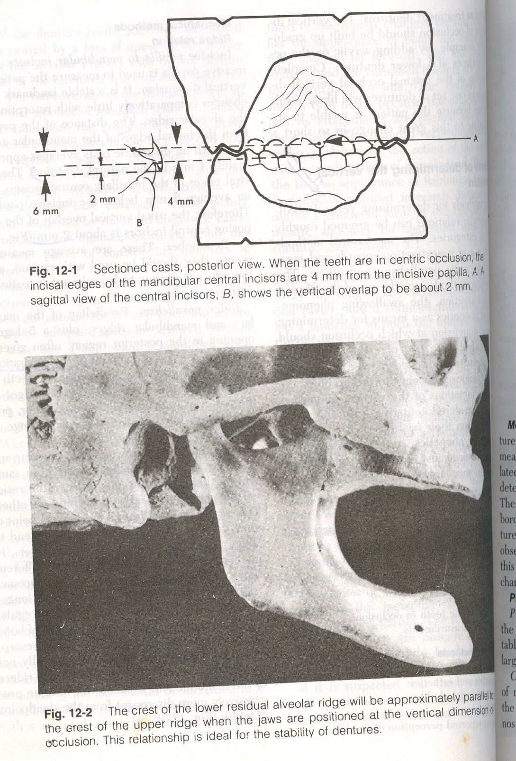
Mechanical methods
Ridge relation:
Distance from Incisive papilla to mandibular incisors

Slide 18
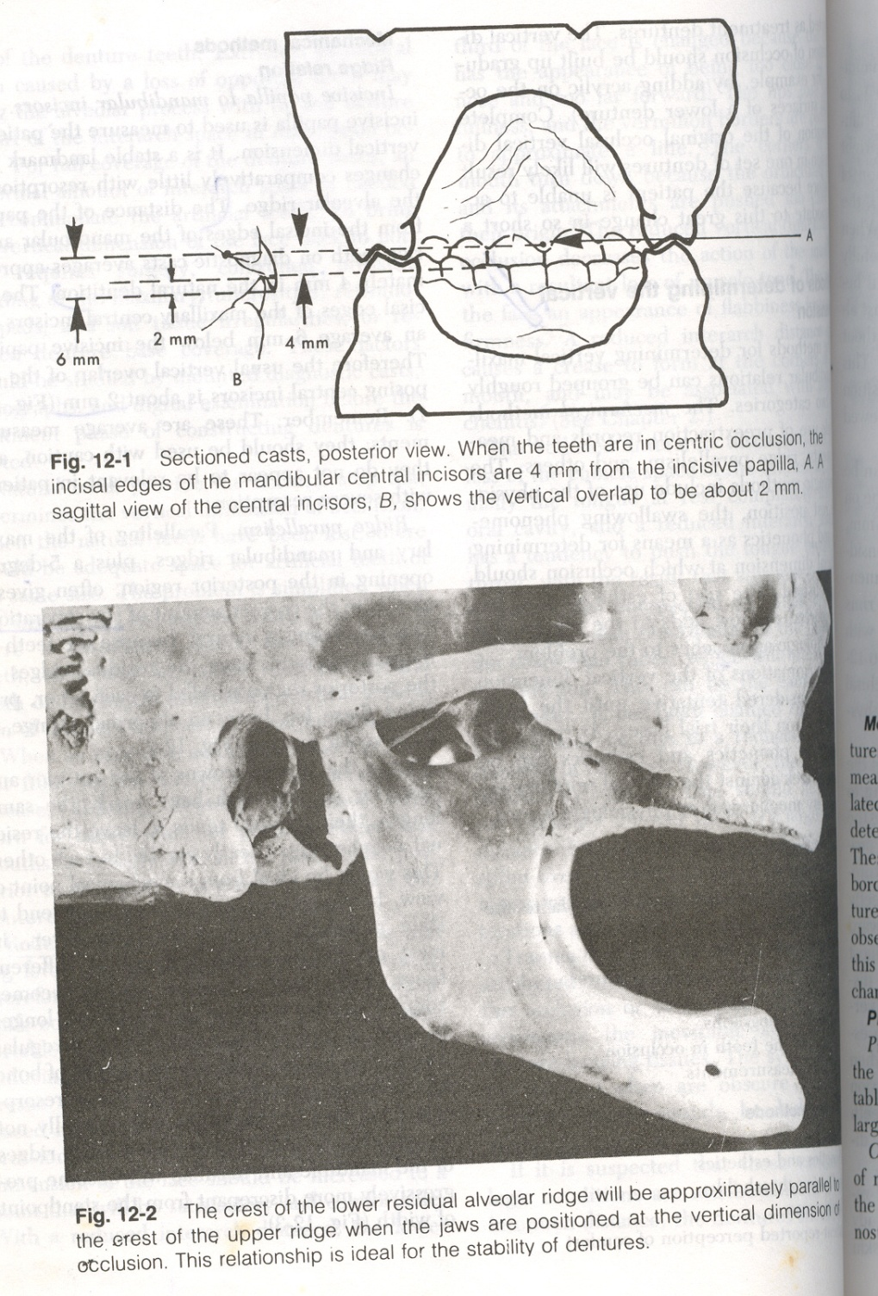
Mechanical methods
Ridge relation:
Parallelism of ridges

Slide 19
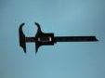
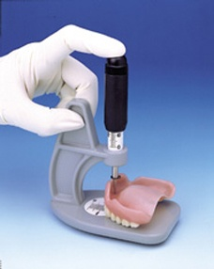
MEASUREMENT OF FORMER DENTURES:
  Dentures –measured---correlated ---patient’s face.
  Measurements - b/w borders of maxillary & mandibular denture------Boley gauge.

Slide 20
PRE – EXTRACTION RECORDS:
    Profile radiographs
    Casts of teeth in occlusion
    Facial measurements

Slide 21
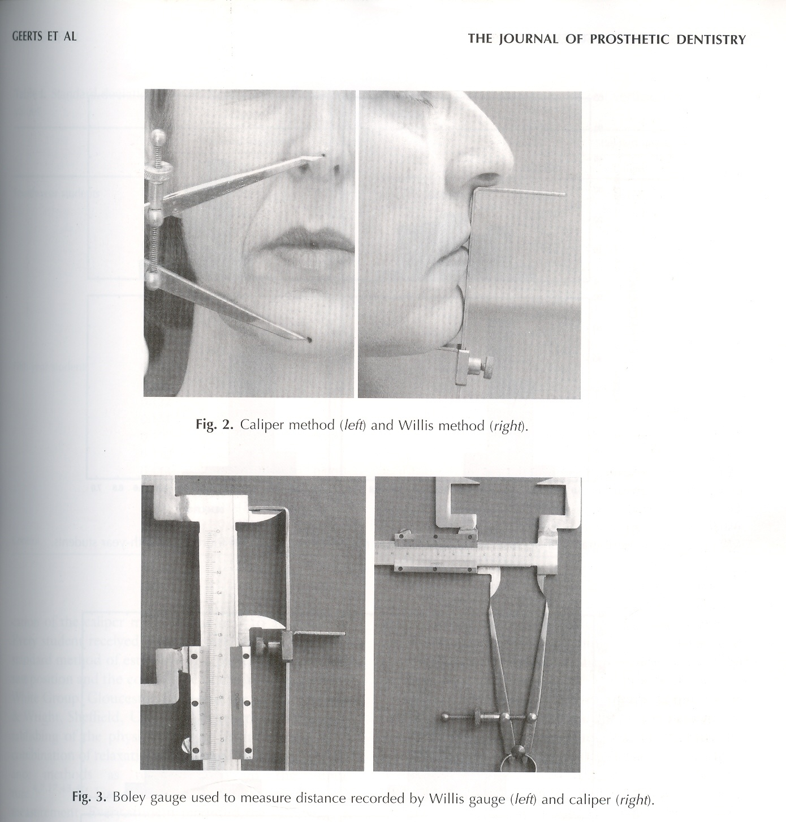
Physiologic methods
  Physiologic rest position

Slide 22
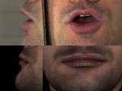
Physiologic methods
  Phonetics & Esthetics

Slide 23
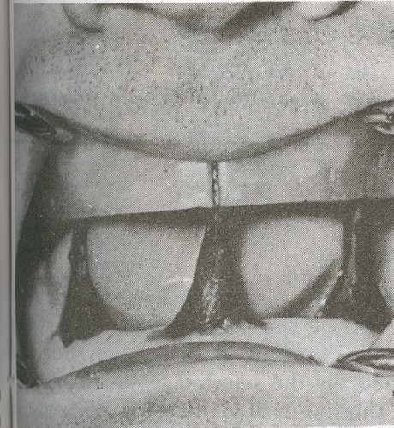
Physiologic methods
  Swallowing threshold

Slide 24
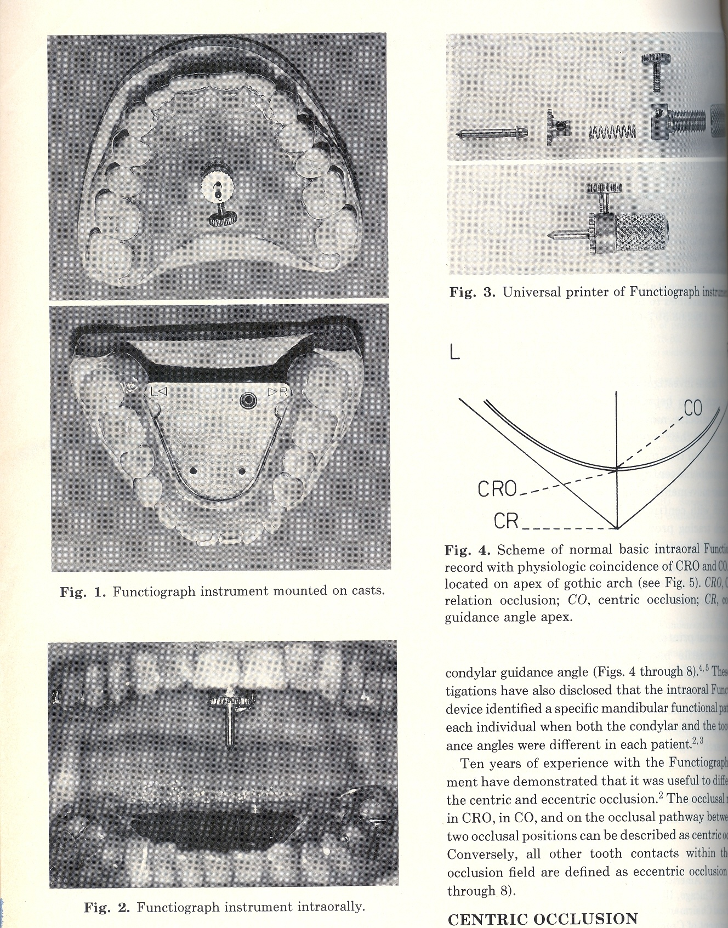
Physiologic methods
  Tactile sense & Patient reported perception of comfort

Slide 25
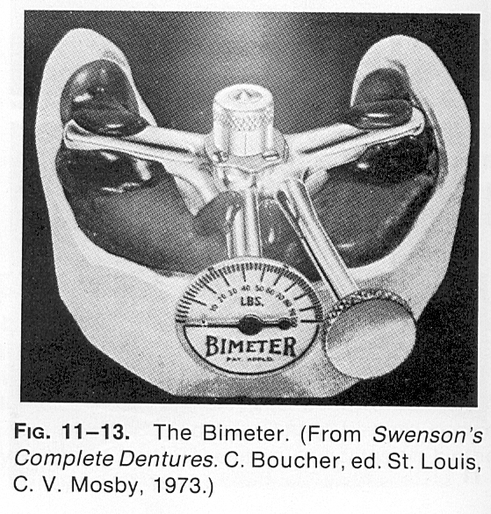
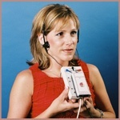
Physiologic methods
Boos bimeter
Electromyography

Slide 26
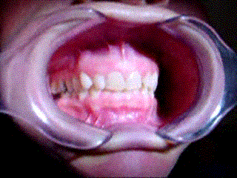
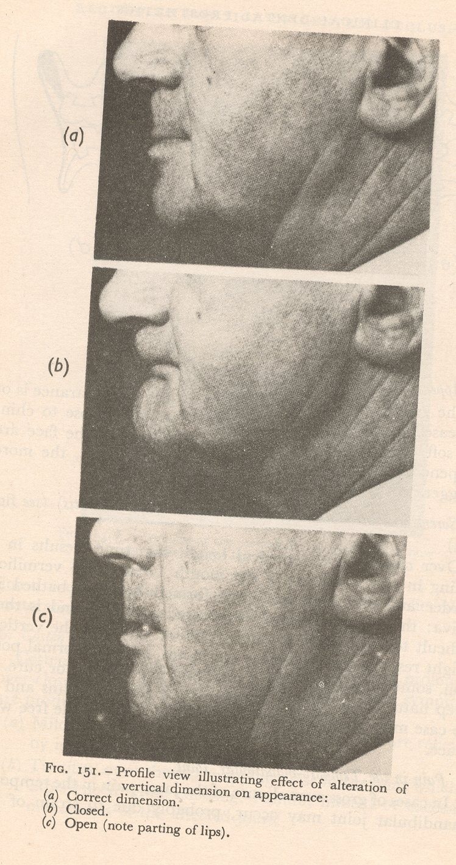
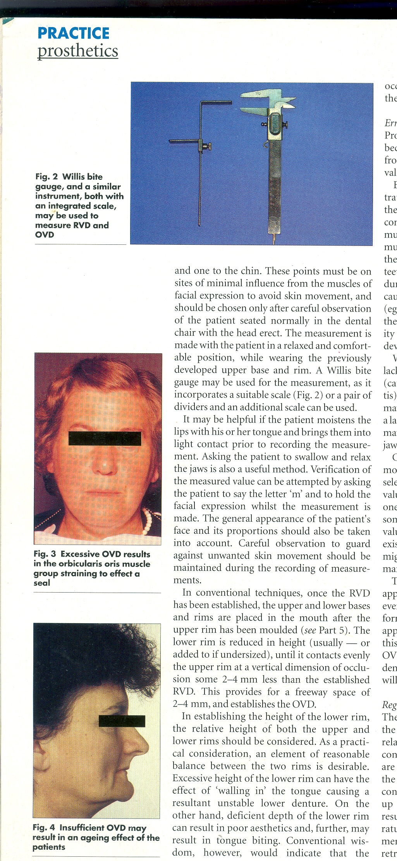
Effect of increased vertical dimension
Increased risk of trauma- clenching of teeth.
Discomfort to patient
Teeth are liable to contact – causing clicking during speech
Trauma & pain – basal seat areas of denture
Loss of freeway space- muscular fatigue
Clicking sound
Elongated appearance of face
Bone resorption
Loss of retension & stability of dentures
Generalised hyperemia.

Slide 27
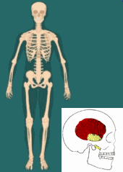
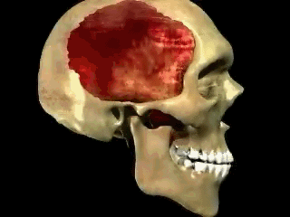
Effect of decreased vertical dimension
Reduced masticatory efficiency
Poor esthetics
Cheek biting/ tongue biting/ lip biting
Denture look
Angular chelitis
Pain in TMJ
Coston’s syndrome
prognathism

Slide 28
Horizontal Jaw relation

Slide 29
Horizontal jaw relations
Centric relation
Eccentric relation
Protrusive record
Lateral record

Slide 30
Centric relation
Most controversial topic in prosthodontics
Def^{n}
“maxillomandibular relationship – condyles articulate –thinnest avascular Portion of disk –anterior superior position- slopes of articular eminence”.—independent of tooth contact. restricted to purely rotary movement – transverse horizontal axis. GPT -8
Most posterior relation of lower to upper jaw- lateral movements can be made at given vertical dimension. Boucher

Slide 31
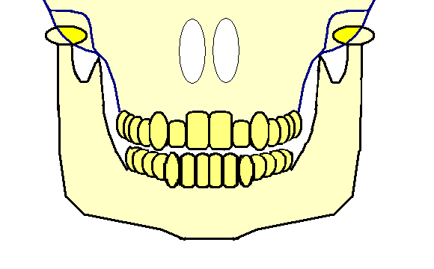
Significance of centric relation
Ideal arch – arch relationship.
Hinge position- only pure rotation without any tanslation
Reproducible position- reliable reference
Reference position for occlusal reconstruction
Posterior border position & posterior limit – mandibular motion.
Centric relation is the terminal hinge relation

Slide 32
REVIEW OF LITERATURE
Philip Pfaff et al in 1756. The dentist of Frederick the Great of Germany, first to describe this technique of "taking a bite". known as the "mush", "biscuit", or "squash" note
Christensen in 1905 used "impression wax" for "bite" records.
In 1910, Greene described a mush bite made from modeling compound in which he used a plaster wash to achieve a more accurate record.

Slide 33
In 1929, Stansbery incorporated a curved plate with a 4-inch radius (corresponding to Monson's curve) mounted on the upper rim. A central bearing screw was attached to a lower plate was injected to a lower plate with a 3-inch radius curve (reverse-Monson curve). After extra oral tracing plaster was injected between the plates to form a biconcave centric registration.

Slide 34
In 1954, Brown recommended repeated closures into softened wax rims.
ShafaghI, et al in 1975 conducted a study to investigate diurinal changes in centric position within a period of one day.
records obtained in the morning showed most antero inferior position of the condyles and at night showed the most postero-superior positioning the condyles

Slide 35
Williamson, E.H. in 1978 and concluded that "the condyles to be significantly more superior in glenoid fossae when anterior guidance was used.
Guichet N.F. in 1978 anterio-posterior distance between the retruded (now CR) and the ICP position was about 1.25 mm (+ 1.00) on average.

Slide 36
Rosner and Goldberg (1986) Records of 75 patients indicated that 60% of the CO records were placed anterior and inferior to CR
Shildkraut et al (1994) orthodontist advocated hand held articulated casts used in orthodontic treatment planning be replaced with the so called prosthodontic mounting with face bow and CR records

Slide 37
Yoshiyuki Watanabe 2009 The gothic arch apex varied, depending on body position. In the supine position,the gothic arch apex and the tapping point were close to the mandibular position determined by bilateral manipulation through digital gothic arch tracer

Slide 38
Methods of recording centric relation
Boucher's
  A) static methods-
    Interocclusal record
    Central bearing device
    Tracing devices
  B)functional methods-chew in technique
    Needles technique
    House technique
    Essig technique
    Patterson technique
Heartwell
  Functional methods
    Needles-house method
    Patterson method
  Graphic method
    Intraoral devices
    Extraoral devices
  Physiological /interocclusal
  check record method
Michael meyer(1982)
  Direct checkbite(interocclusal)record
  Graphic recording(intra/extraoral)
  Functional recording
  cephalometrics

Slide 39
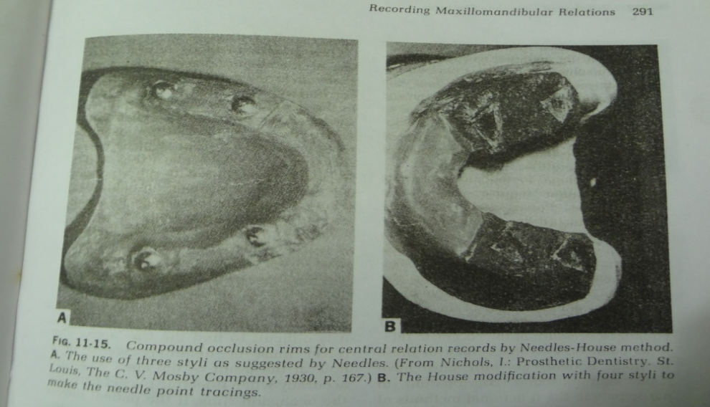
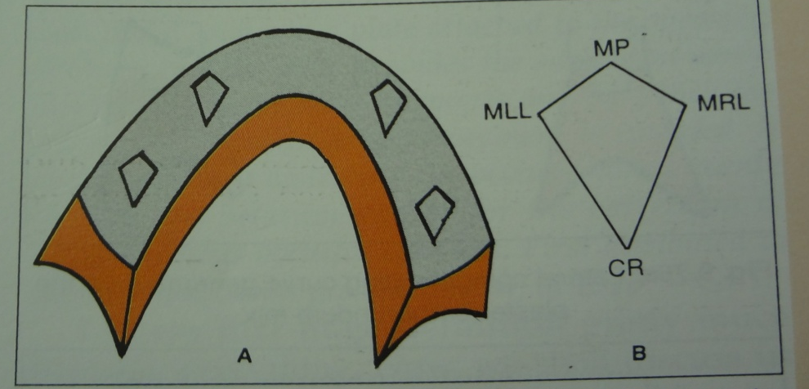
Needles- house method
Needles-3 metal styli-house- 4.
Compound maxillary occlusal rim
4 diamond shaped tracing

Slide 40

Needles- house method
Advantages:
  Easy method
  Used-success-good ridges
Disadvantages:
  Painful
  Uncomfortable
  Cannot be used—flat /flabby ridges
  Movement of occlusion rims- basal seat.

Slide 41
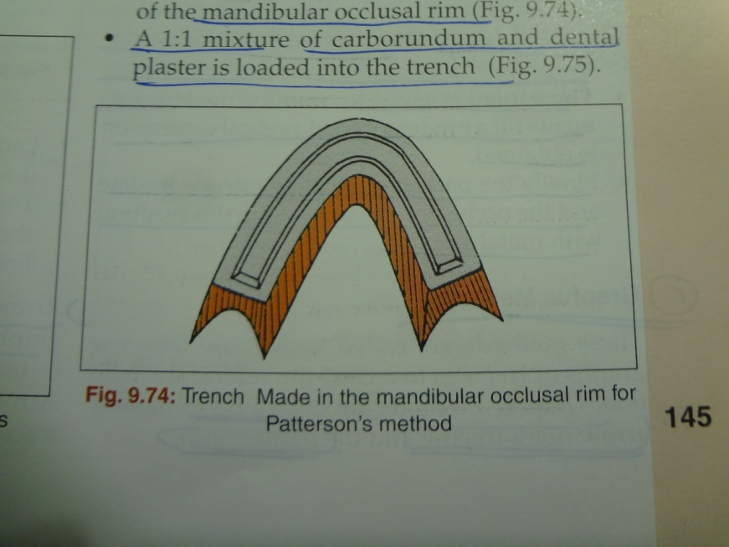
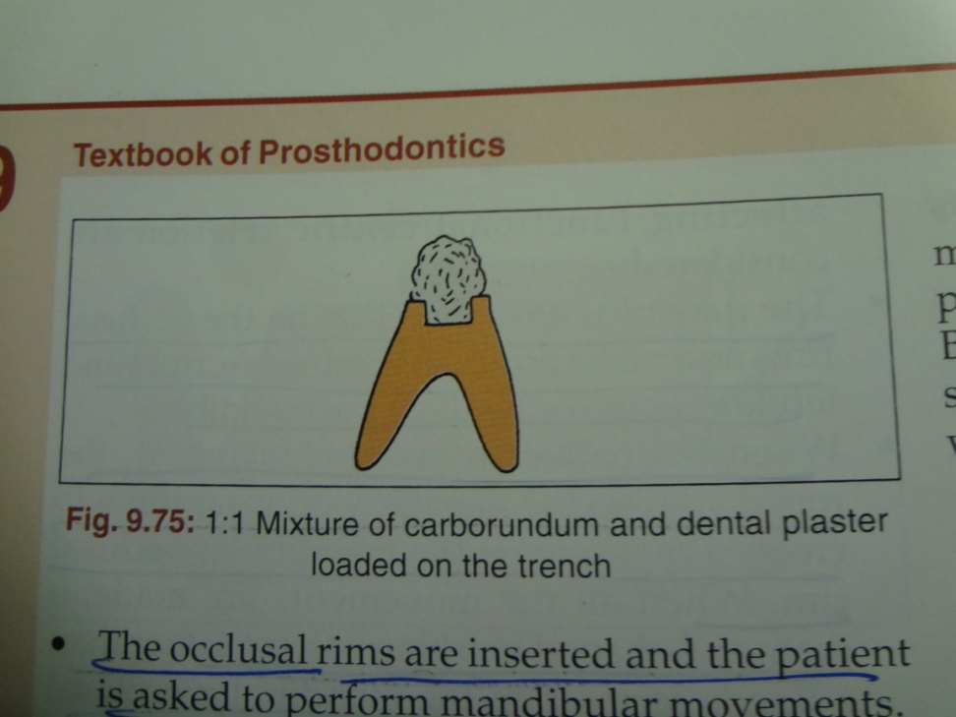
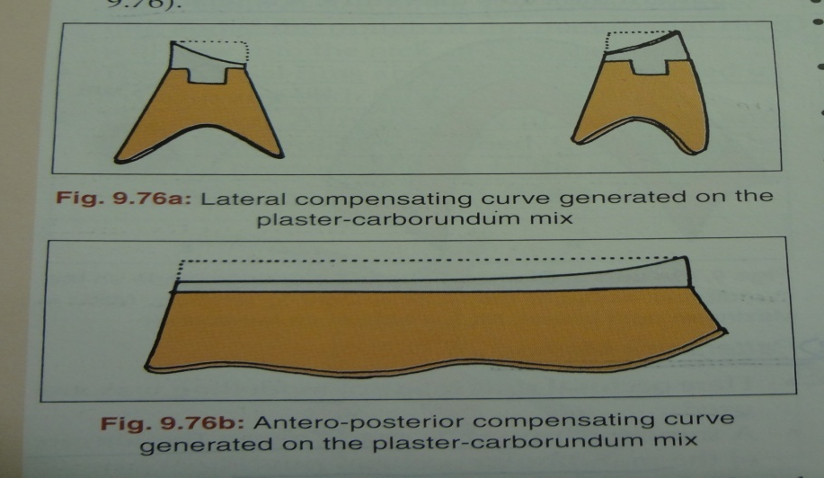
Patterson method
Mixture of ½ plaster + ½ carborundum paste.
Mandibular movements-Compensating curves
Disadvantages: time consuming.

Slide 42
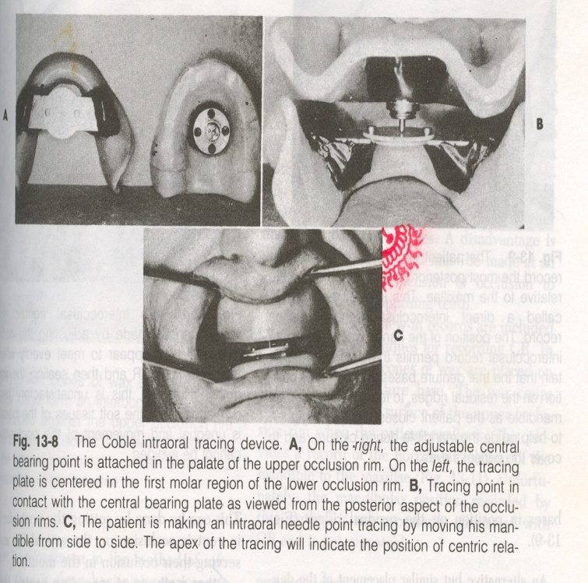
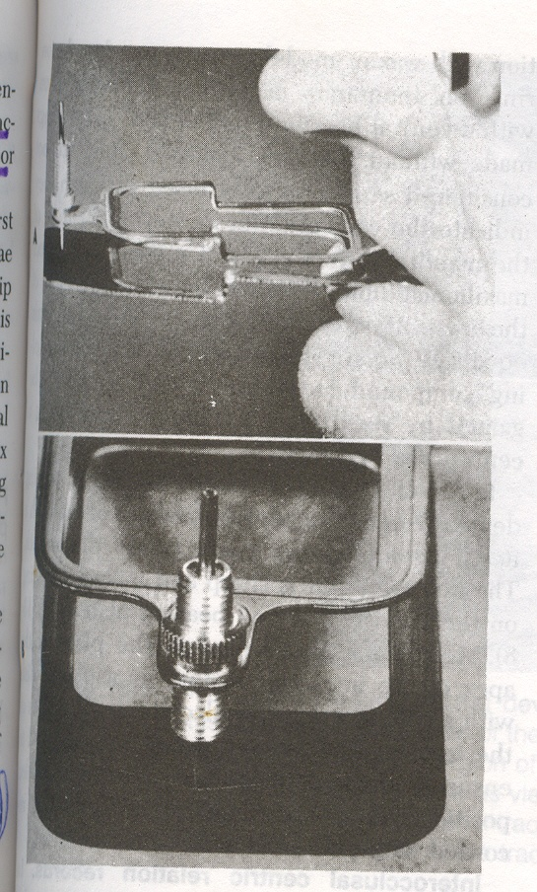
Graphic methods:
Intra oral tracing & devices–
  coble tracer
  Swissdent ball bearing bite tracer
  Micro tracer
Extra oral tracing & devices
  Hight tracer
  Sears tracer
  Phillips extraoral tracer

Slide 43
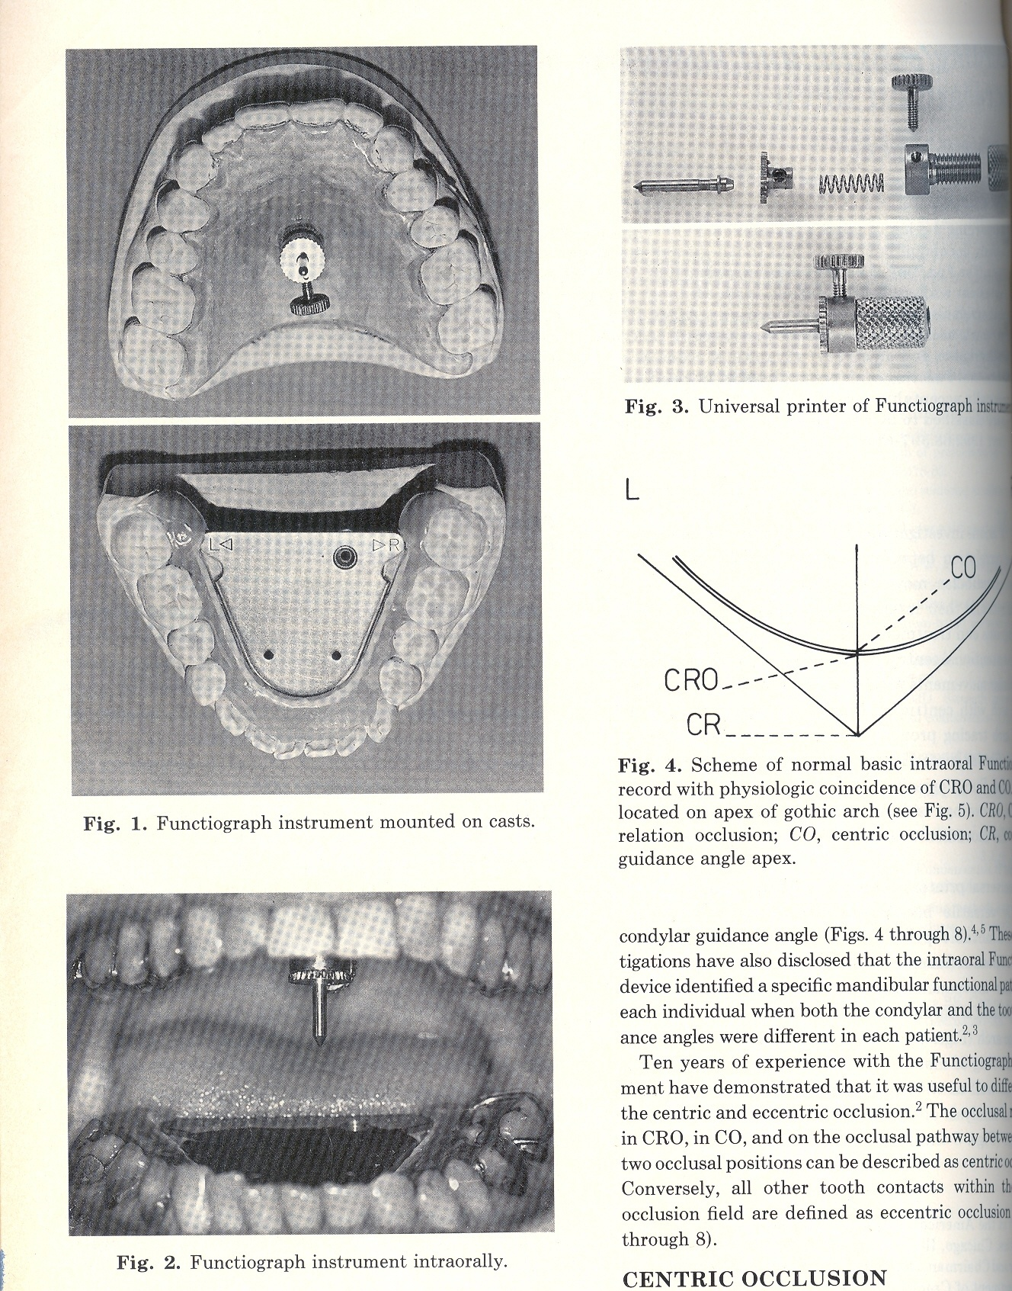
Intra oral tracing
Advantages
  Central bearing pins resists biting pressure
Disadvantages
  Not a visible method
  Difficult to find true apex
  Tracer- definitely seated in a hole
    at point of the apex

Slide 44
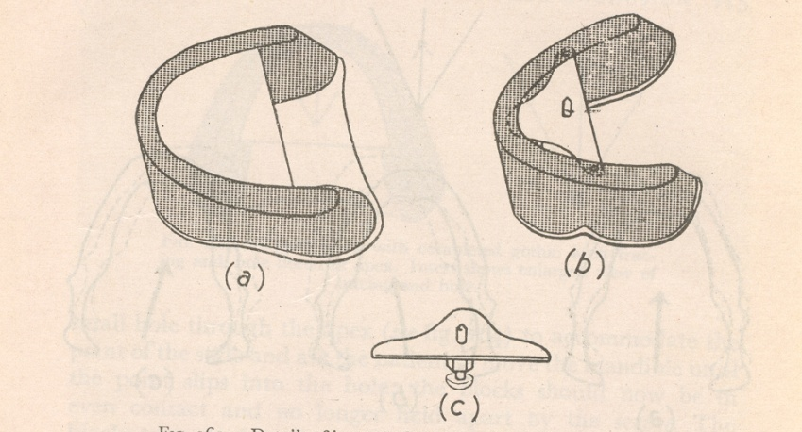
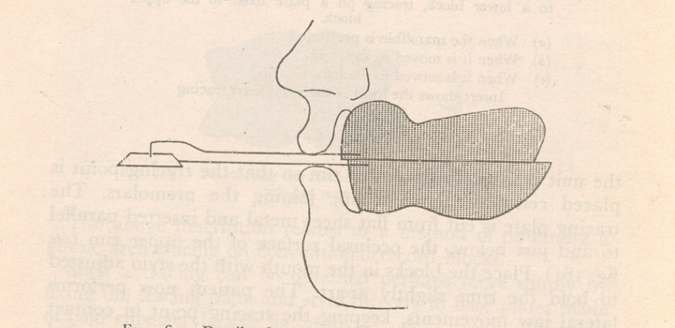
Extra oral tracing
Always combined with an intraoral bearing point- distribute equal pressure on the bases.
More sharper
Tracing plate- mounted on mandibular rim
Advantages
  Larger- apex-easily demarcated
  Visible during tracing
Disadvantage
  Lack of equal pressure on the ridges

Slide 45
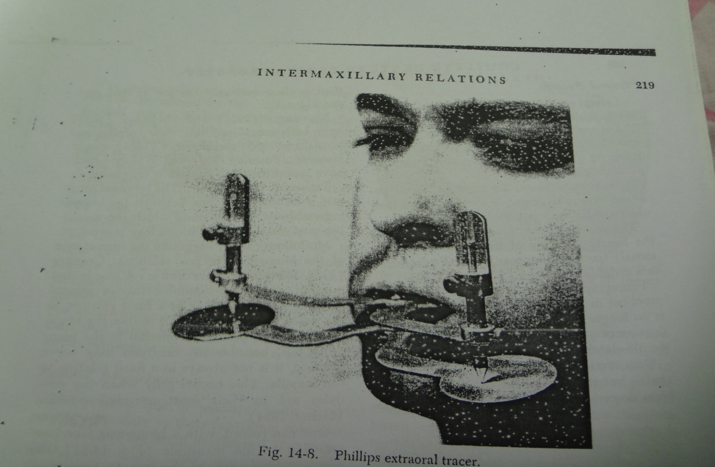
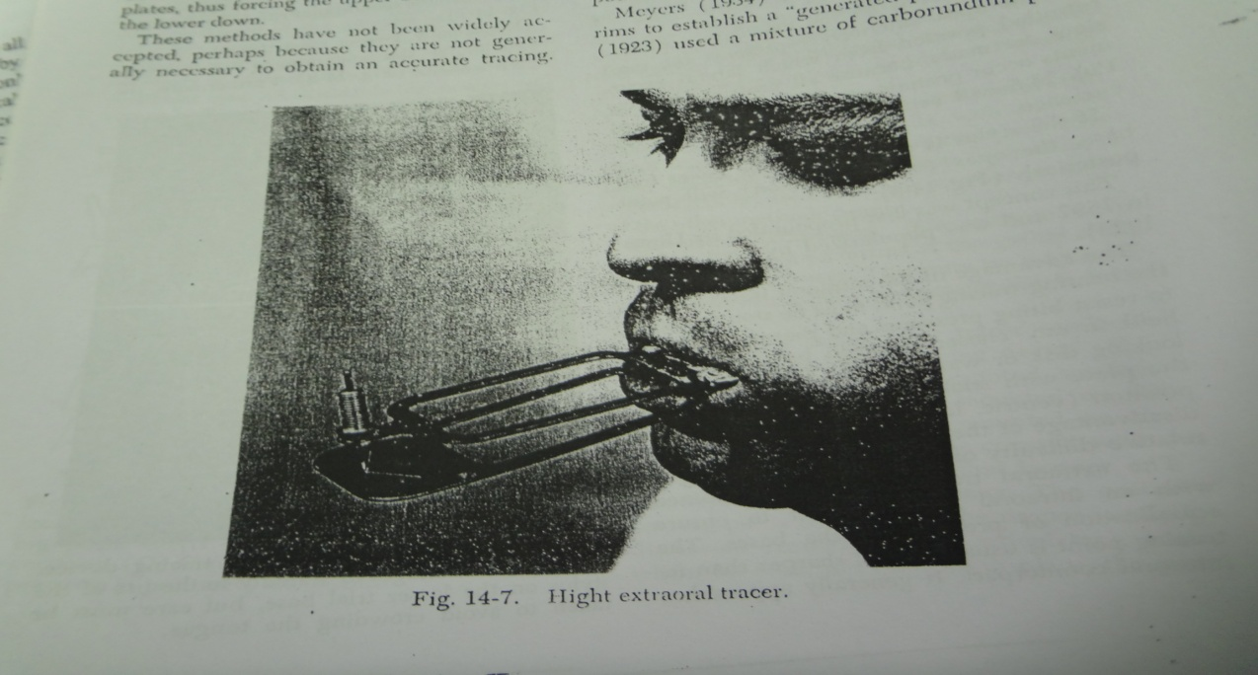

Slide 46
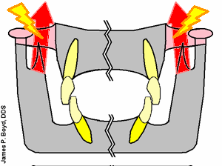
Tactile /interocclusal check record method
Indications
abnormally related jaws
Flabby supporting tissues
Large tongue
Uncontrollable mandibular movement
To check the occlusion of teeth-existing denture

Slide 47
Two steps
Tentative centric rel^{n} using wax occlusal rims
Interocclusal check record using trial denture

Slide 48
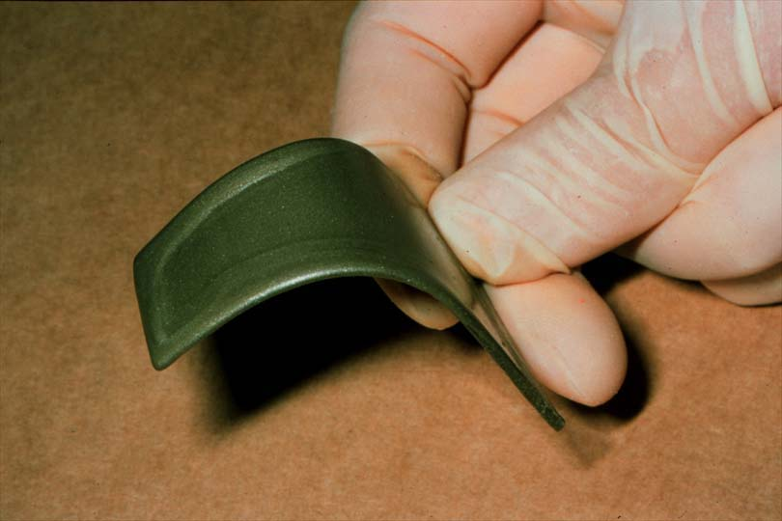
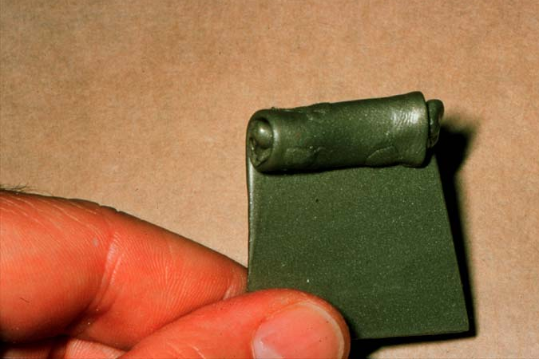
  Alluwax
  Used in interocclusal check record
  Must be dead soft

Slide 49
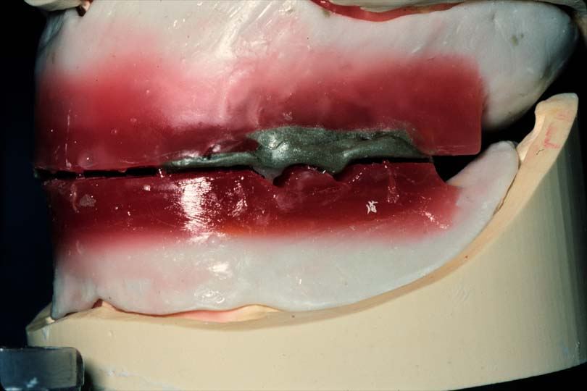
Pressureless/static method
NICK & NOTCH METHOD

Slide 50
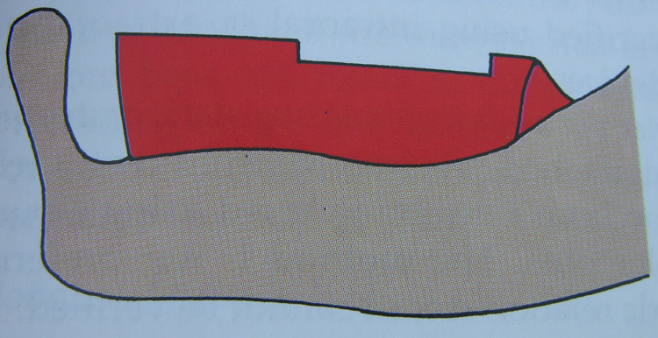
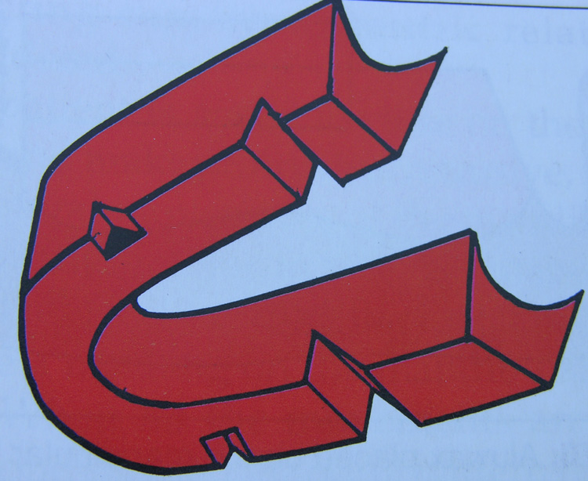
Procedure
3mm of wax is removed
To make a trough
Nicks & notches on maxillary rim
Notch extends along the entire
width of occlusal rim

Slide 51
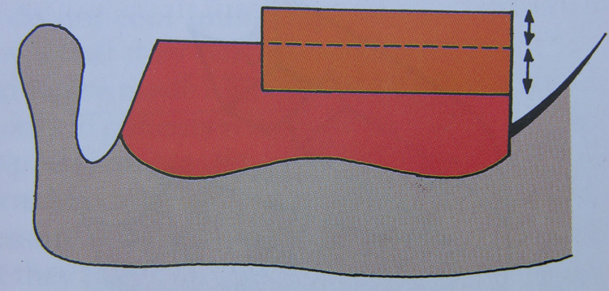
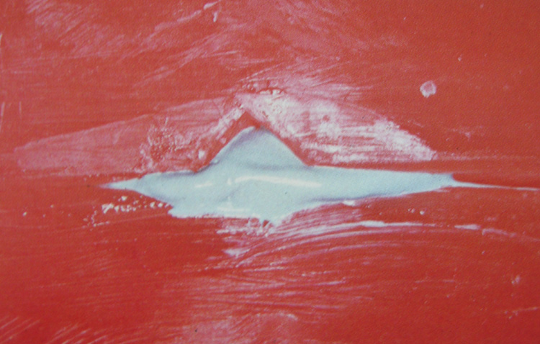
Wax is added on the trough & patient is asked to close in CR.
The mouth should close such that the anterior part of the rim should touch.

Slide 52
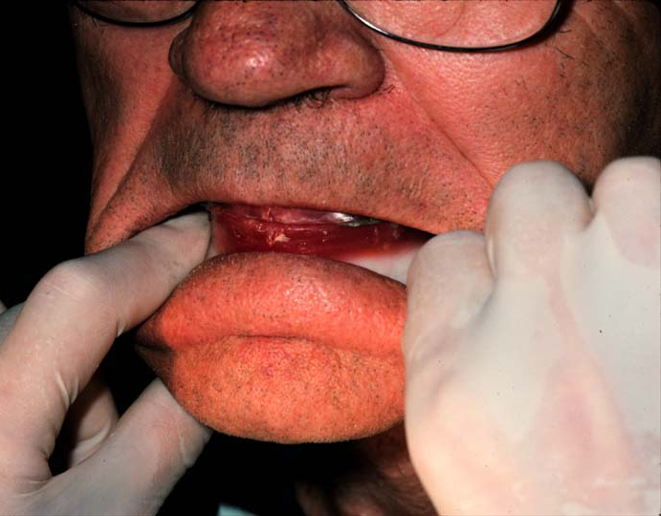
Pressure method
Low wax rim softened in excess of height

Slide 53
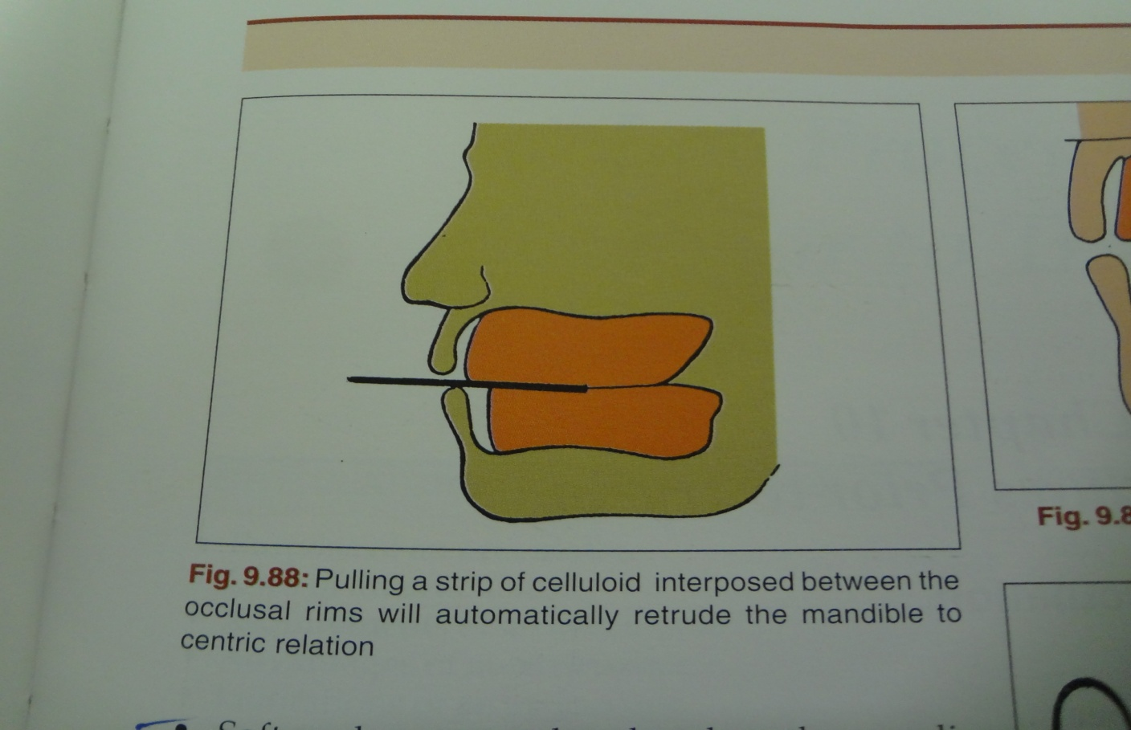
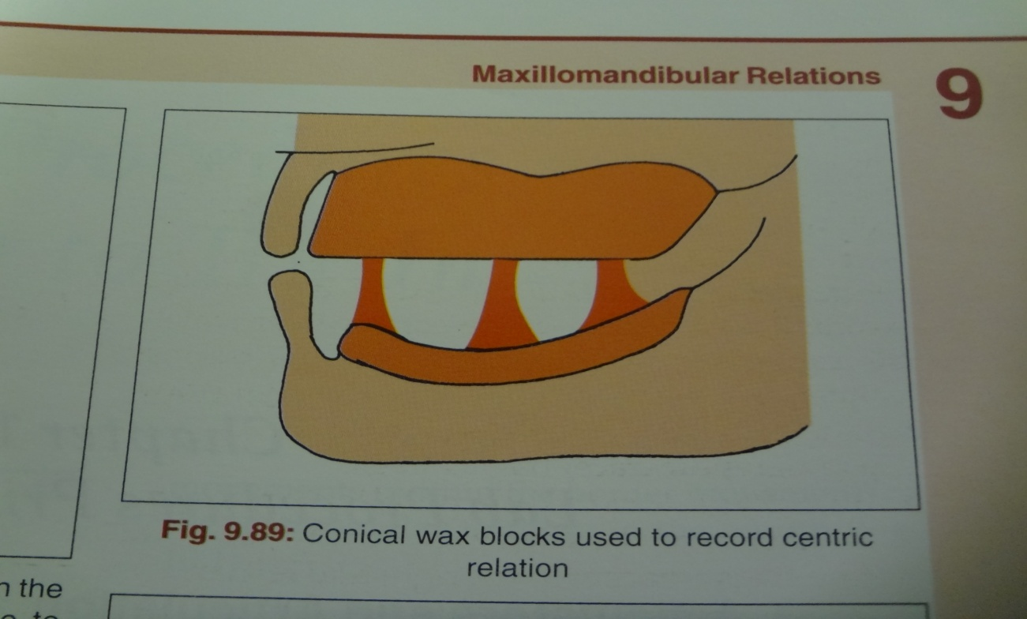
Other methods
  Celluloid strip method
  Softened wax method

Slide 54
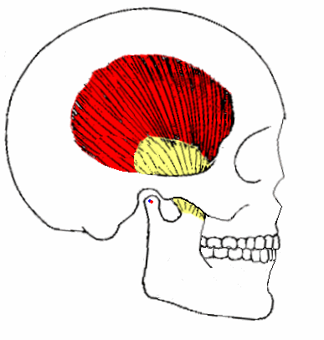
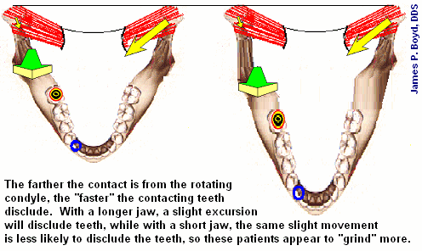
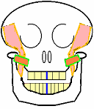
Eccentric relation record
Protrusive relation record
Lateral relation record

Slide 55
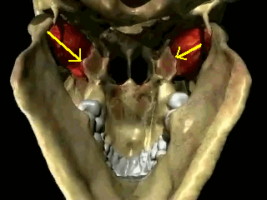
Protrusive relation
Christensen’s phenomenon
Due to downward displacement of the condyles along the articular slope.
Protrusive records are made of-
  Direct protrusive check record
  Graphic method
  Functional procedures

Slide 56
Lateral jaw relations
Bennett movement
  Graphic method
  With check bites of wax
  With positional records of stone/plaster
  Hanau’s formula:
  L = H + 12 L=lateral condylar inclination
  8 H=Horizontal condylar inclination
PANTOGRAPHY

Slide 57
Summary
Since there is no precise scientific method of determining the correct vertical relations, the registration of vertical relation depends upon the clinical experience and judgment of the prosthodontist – an art rather than a science
It is obvious that the skill of the prosthodontist and the cooperation of the patient are probably the most important factors in securing an accurate centric relation records.
The final determination cannot be made by any method until the teeth are set in position in the wax trial dentures and verified in the mouth.

Slide 58
Conclusion
“The true value of our individual work can be measured only by the degree of finesse with which we practice the art of prosthodontistry rather than by the particular school of thought to which we adhere”
Weinberg (1959)

Slide 59
Thank you

