Slide 1
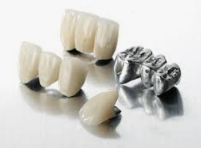
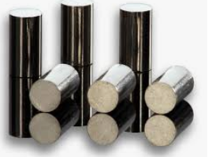
DENTAL CASTING
ALLOYS
Dr. Sanket Jadhav

Slide 2
Metal restorations and prostheses are an integral part of dentistry. Metals and its alloys are among the
strongest materials and provide strength and durability to any structure.

Slide 3
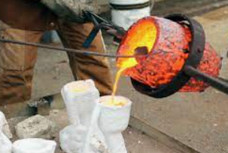
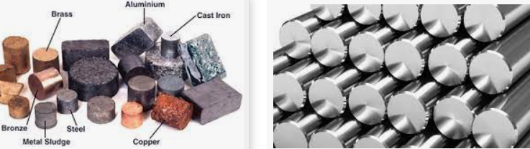
Casting
A process in which a material such as metal or plastic in liquid form/molten state is poured into a mold and allowed to become hard upon cooling, in order to make parts or products.
Alloy
A homogenous mixture of two or more metals, or a metal and a non-metal is called an alloy.
Example-
Brass : Copper and Zinc
Carbon Steel : Iron and Carbon
Stainless Steel- Iron, Carbon and
Chromium

Slide 4
Terminologies
NOBLE METALS-
Resistance to corrosion.
Used for inlays, crowns and FDPs.
Gold, platinum, palladium, rhodium, ruthenium, iridium, osmium, and Silver
PRECIOUS METALS-
The term precious indicates the intrinsic value of the metal.
The eight noble metals are also precious metals and are defined so by
major metallurgical societies and federal government agencies,
e.g. National Institute of Standards and Technology and National Material Advisory Board.

Slide 5
Gold
Pure gold is a soft and ductile metal with a yellow ‘gold’ hue. It has a density of 19.3 g/cm3 and a melting point of 1063 °C.
Gold has a good luster and takes up a high polish. It has good chemical stability and does not tarnish and corrode under normal circumstances.
Silver
Sometimes described as the ‘whitest’ of all metals. It has the lowest density (10.4 g/ cm3 ) and melting point (961°C) among the precious casting alloys. Its CTE is 15.7 × 10-6/°C which is comparatively high. ( In large amounts, it increases tarnish)
Palladium
Density is 12.02 g/cm3 . Palladium has a higher melting point (1552°C). It hardens and whitens the alloy.
Platinum
It has the highest density (21.65 g/cm3 ) highest melting point (1769°C) and the lowest CTE among the four precious metals. Increases strength and corrosion resistance.

Slide 6
BASE METALS-
(also called as ,Non noble, Non-Precious)
Metals which contain no precious elements like gold, silver, platinum or palladium.
But are, important component of dental casting alloys because of their influence on physical properties, control of the amount and their type of oxidation & their strengthening effect.
eg.
Chromium,
cobalt,
nickel,
copper,
Iron, etc

Slide 7
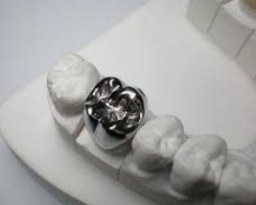
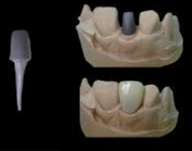
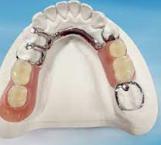
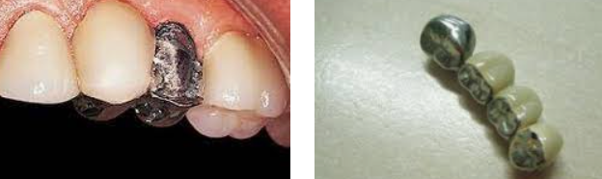
CLASSIFICATION OF DENTAL CASTING ALLOYS
According to use
Alloys for all metal and resin veneer restorations eg. Inlays,posts,resins(acrylic) and composite veneered crowns
Alloys for metal ceramic restorations eg. PFM crowns & FDPs
Alloys for removable dentures

Slide 8
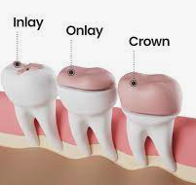
Based on yield strength and percent elongation
Type I Soft
Type II Medium
Type III Hard
Type IV Extra Hard
This 1934 classification was originally intended for gold alloys and were based on hardness.
Types I and II are known as ‘inlay alloys’ and
Types III and IV are known as ‘crown and bridge alloys’.
Type IV is occasionally used for RPD frames)

Slide 9
According to Nobility
High noble alloys have a noble metal (gold, platinum, palladium,ETC ) content greater than 60%, with at least 40% gold.
Noble alloys have a noble metal content of at least 25%, and
Predominantly base alloys have less than 25% noble metal content.
Base metal Chromium,cobalt,nickel,copper,Iron, etc

Slide 10
Based on mechanical properties
Type 0 – Intended for low stress bearing single tooth fixed restorations eg. Small veneered one-surface inlays , veneered crowns
Type 1 – Intended for low stress bearing single tooth fixed restorations eg. Veneered or unveneered one-surface inlays, veneered crowns
Type 2 – Intended for single tooth fixed restorarions eg. Crowns or inlays without restorations on no. of surfaces
Type 3 – Intended for multiple unit fixed restoration eg, bridges
Type 4 – Intended for appliances with thin sections that are subject to very high forced eg. Removable partial dentures, clasps, wide span bridges implant retained superstructures.
Type 5 – Intended for appliances in which parts require the combination of high stiffness and strength eg. Thin removable partial dentures

Slide 11
According to major elements
Gold alloys
Silver alloys
Palladium alloys
Nickel alloys
Cobalt alloys
Titanium alloys

Slide 12
According to three major elements
Gold-palladium-silver
Palladium-silver-tin
Nickel-chromium-molybdenum
Cobalt-chromium-molybdenum
Iron-nickel-chromium
Titanium-aluminium-vanadium

Slide 13
According to the number of alloys present
Binary- two elements
Tertiary- three elements
Quaternary- four elements

Slide 14
CLASSIFICATION ACCORDING TO USE OF DENTAL CASTING ALLOYS
Alloys for all metal and resin veneer restorations: - High noble
- Noble
- Predominantly base metal
- Base metal
2. Alloys for metal-ceramics restorations
- High noble
- Noble
- Predominantly base material
- Base metal
3. Alloys for casting large structures
- High noble
- Noble
- Predominantly base material
- Base material

Slide 15
GENERAL REQUIREMENTS OF CASTING ALLOYS
All cast metals in dentistry have basic common requirements
They must not tarnish and corrode in mouth
They must be sufficiently strong for intended purpose
They must be biocompatible
They must be easy to melt, cast, cut & grind
They must flow well and duplicate fine details during casting
They must have minimal shrinkage on cooling and casting
They must be easy to solder

Slide 16
According to use
Alloys for all metal and resin veneer restorations eg. Inlays,posts,resins(acrylic) and composite veneered crowns
Alloys for metal-ceramic restorations eg. PFM crowns & FDPs
Alloys for removable dentures

Slide 17
a. Alloys for all metal and resin veneer restorations
These alloys were among the earliest alloys available to dentistry.
The early alloys were mostly gold alloys.
Since they were intended for all-metallic and later for resin/acrylic veneered restorations, they just had to meet the basic requirements. Currently, the use of these alloys are slowly declining because of
Increased esthetic awareness has reduced the trend for metal display.
Increasing popularity of all-ceramic and metal-ceramic restorations. Reducing popularity of resin and composite as veneering material.

Slide 18
a. Alloys for all metal and resin veneer restorations
Resin/acrylic facings have a number of disadvantages. –
They wear rapidly (poor wear resistance). –
They may change color (color instability and stain absorption). –
They are porous.
They tend to absorb food material and bacteria.
This makes it unhygienic and gives it a bad odor

Slide 19
a. Alloys for all metal and resin veneer restorations
USES:
Inlays and onlays
Crowns and FDPs
Partial denture frames
Post-cores

Slide 20
a. Alloys for all metal and resin veneer restorations
High noble — Gold alloys
Noble — Silver palladium alloys
Base metal —
Nickel-chrome alloys
Cobalt-chrome alloys
Titanium and its alloys
Aluminum-bronze alloys

Slide 21
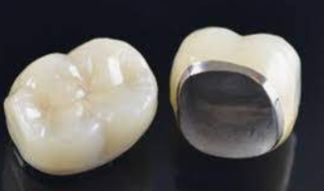
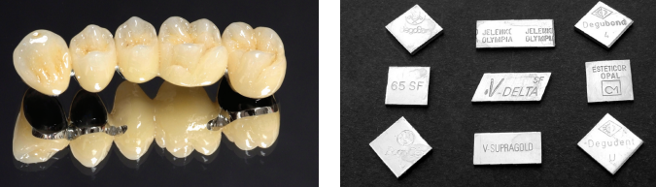
b. Alloys for metal-ceramic restorations eg. PFM crowns & FDPs
Metal-ceramic alloys are those alloys that are compatible with porcelain and capable of bonding to it.
A layer of porcelain is fused to the alloy to give it a natural tooth-like appearance.
Porcelain being a brittle material fractures easily, so these alloys are used to reinforce the porcelain.
Several types of alloys are used to cast substructures for porcelain-fused-to-metal crowns and FDPs.
They may be noble metal alloys or base metal alloys.
All have coefficient of thermal expansion (CTE) values which match that of porcelain.

Slide 22
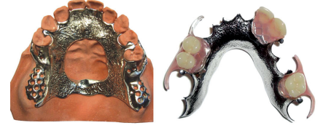
c. Alloys for removable dentures
Larger structures like complete denture bases and partial denture frames are also made from dental alloys.
Being larger structures they require more quantities of alloy, which can make them quite heavy and expensive (if gold were to be used).
Thus it became necessary to develop lighter and more economical alloys.

Slide 23
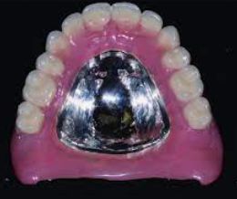
c. Alloys for removable dentures
The alloys for removable denture use are
1. Cobalt-chromium alloys
2. Nickel-chromium alloys
3. Aluminum and its alloys
4. Type IV noble alloys
5. Titanium

Slide 24
SUMMARY
WHAT IS AN ALLOY?
METALS, PRECIOUS METALS, BASE METALS
CLASSIFICATION OF DENTAL CASTING ALLOYS
IDEAL REQUIREMENTS OF DENTAL CASTING ALLOYS
CASTING ALLOYS IN PROSTHODONTICS

