Slide 1
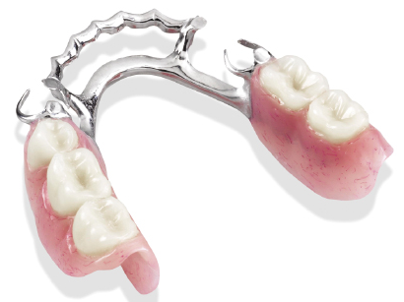
INTRODUCTION TO RPD
AND
KENNEDY’S CLASSIFICATION
Dr. sanket jadhav

Slide 2
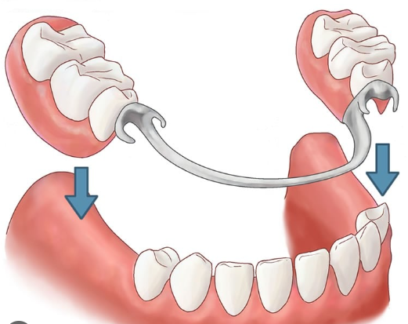
definition
The replacement of missing teeth and
supporting tissues with a prosthesis designed to be removed by the wearer”- GPT.

Slide 3
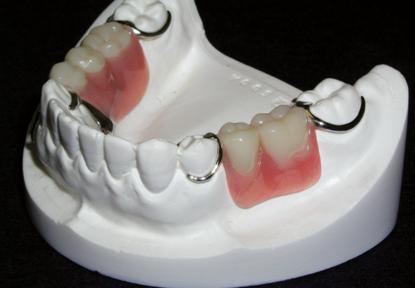
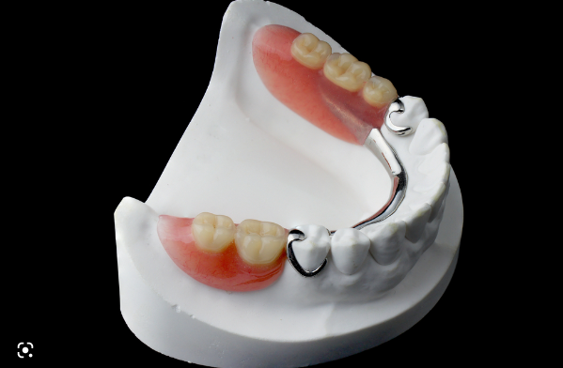
Common terminologies used in (RPD) removable partial denture
Tooth Supported Removable Partial Denture
A partial denture that receives support from
natural teeth at each end of the edentulous space
or spaces.
Tooth-tissue Supported Removable Partial Denture
The denture base that extends anteriorly or
posteriorly and is supported by teeth at one end
and tissue on the other end. They are also called
Distal extension partial dentures.

Slide 4
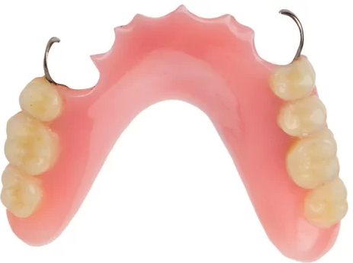
common terminologies used in removable partial denture
Temporary Removable Partial Denture
They are used in patient where tissue changes are
expected, where a permanent prosthesis cannot
be fabricated till the tissues stabilize.
They should never be used as a permanent or prolonged form of treatment
because of the danger of destroying the remaining oral tissues.

Slide 5
common terminologies used in removable partial denture
Temporary Removable Partial Denture
They are used in patient where tissue changes are
expected, where a permanent prosthesis cannot
be fabricated till the tissues stabilize.
They should never be used as a permanent or prolonged form of treatment
because of the danger of destroying the remaining oral tissues.

Slide 6
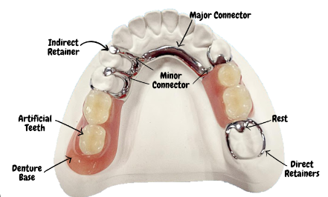
Parts of RPD (removable cast partial denture)

Slide 7
Indications of RPD
The following statement should be considered before planning any treatment for a patient.
Muller De Van (1952) stated, “the preservation of that which remains is of utmost importance and not the meticulous replacement of that which has been
lost.”

Slide 8
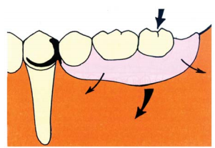
Indications of RPD
1. Length of Edentulous Span
Removable partial dentures are preferred for
longer edentulous arches. Unlike fixed partial
dentures, removable partial dentures can take support from the tissues all along the ridge.
Fixed partial dentures are avoided in cases
with long span edentulous arches because they produce excessive force on the abutment teeth.

Slide 9
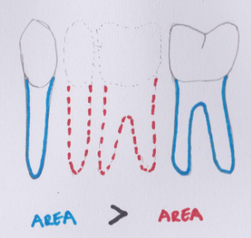
Indications of RPD
Ante’s law determines if a fixed prosthesis can
be used or not.
“Ante’s Law”:
The pericemental surface area
of the abutment teeth to be used for a
fixed partial denture must be equal to
or exceed the peri-cemental surface
area of the teeth being replaced.

Slide 10
Indications of RPD
2. Age
In patients under the age of 17 years, a fixed
partial denture is contraindicated because they have large dental pulps and lack sufficient clinical crown height.
We require sufficient height of
the clinical crown for reduction). In old age, the
reduced life expectancy and frequently failing
health contraindicate the use of expensive fixed
partial dentures.

Slide 11
Indications of RPD
3. Abutment Tooth
Fixed partial dentures can be used only if there is
a posterior tooth for support. When there is no
tooth posterior to the edentulous space to act as
an abutment, a removable partial denture is
preferred. Exceptions: Cantilever fixed partial
Denture.

Slide 12
Indications of RPD
4. Periodontal Support of Remaining Teeth
The periodontal membrane is the structure which
transfers all the load from the teeth to the
underlying bone. When the periodontal support
of the remaining teeth is poor, a fixed partial denture is contraindicated and a removable partial
denture is preferred, because, it requires less support from the abutment teeth.

Slide 13
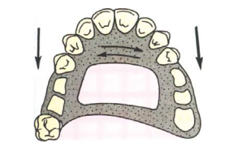
Indications of RPD
5. Cross-arch Stabilization
When the remaining teeth have to be stabilized
against lateral and anterior-posterior forces, a
removable partial denture is indicated.
In removable partial dentures, the
major connectors help to provide cross arch stabilization.

Slide 14
Indications of RPD
6. Excessive Bone Loss
When there is trauma or excessive residual ridge
resorption (bone loss), it is difficult to place the
artificial teeth of a fixed partial denture in an ideal
buccolingual position. In a removable partial
denture, the artificial tooth can be positioned as
per the operators preference and the denture base
can be fabricated to provide the required support
and aesthetics. The denture base also provides
good lip and cheek support such that it re
establishes the normal facial contours.

Slide 15
Classification of RPD
CLASSIFICATION OF PARTIALLY EDENTULOUS ARCHES
Classification of a partially edentulous arch should be done for the following reasons:
• To formulate a good treatment plan.
• To anticipate the difficulties commonly to
occur for that particular design.
• To communicate with a professional about a
case.

Slide 16
Classification of RPD
There are many classifications available for classifying edentulous arches. The most common ones are:
Cummers classification
Kennedy’s classification – Applegates rules
Bailyns
Neurohr
Mauks
Wild
Godfrey
Friedman
Beckett and Wilsons
Swensons
Costa
Avant
Osborne and Lammie

Slide 17
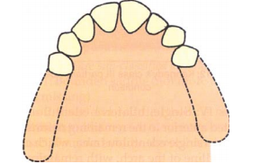
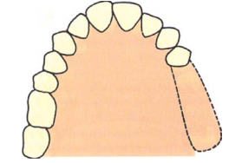
Kennedys Classification
Dr. Edward Kennedy of New York proposed this
classification in 1923. This is the most popular
classification.
Class I: Bilateral edentulous areas located
posterior to the remaining natural teeth i.e.,
there are two edentulous spaces located in the
posterior region without any teeth posterior
to it.
Class II: Unilateral edentulous area located
posterior to the remaining natural teeth, i.e.
there is a single edentulous space located in
the posterior region without any teeth
posterior to it

Slide 18
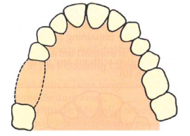
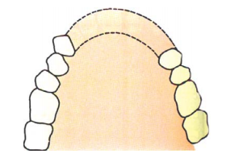
Kennedys Classification
Class III: Unilateral edentulous area with
natural teeth anterior and posterior to it, i.e.
this indicates a single edentulous area which does
not cross the midline of the arch, with
teeth present on both sides (anterior and
posterior) of it.
Class IV: Single, bilateral edentulous area
located anterior to the remaining natural teeth.
This is a single edentulous area, which crosses
the midline of the arch, with remaining teeth
present only posterior to it.

Slide 19
Applegates Rules:
The following rules should be considered to classify partially edentulous arches based on
Kennedy’s classification.
Rule One. Classification should follow rather
than precede extractions that might
alter the original classification.
Rule Two. If the third molar is missing and not
to be replaced, it is not considered
in the classification.
Rule Three. If the third molar is present and is
to be used as an abutment, it is considered in the classification.

Slide 20
Applegates Rules:
The following rules should be considered to classify partially edentulous arches based on
Kennedy’s classification.
Rule Four. If the second molar is missing and
is not to be replaced, it is not considered in the classification.
Rule Five. The most posterior edentulous area
or areas always determine the classification.
Rule Six. Edentulous areas other than those,
which determine the classification,
are referred to as modification spaces and are designated by their
number.

Slide 21
Applegates Rules:
The following rules should be considered to classify partially edentulous arches based on
Kennedy’s classification.
Rule Seven. The extent of the modification is not
considered, only the number of additional edentulous areas, i.e. the
number of teeth missing in the
modification spaces is not considered only the number of additional
edentulous spaces are considered.
Rule Eight. There can be no modification areas
in class IV. Because any additional
edentulous space will definitely be
posterior to it and will determine the
classification.

Slide 22
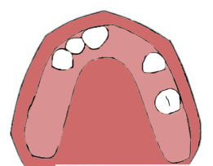

Slide 23
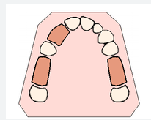

Slide 24
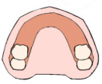

Slide 25
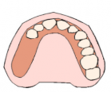

Slide 26
