Slide 1
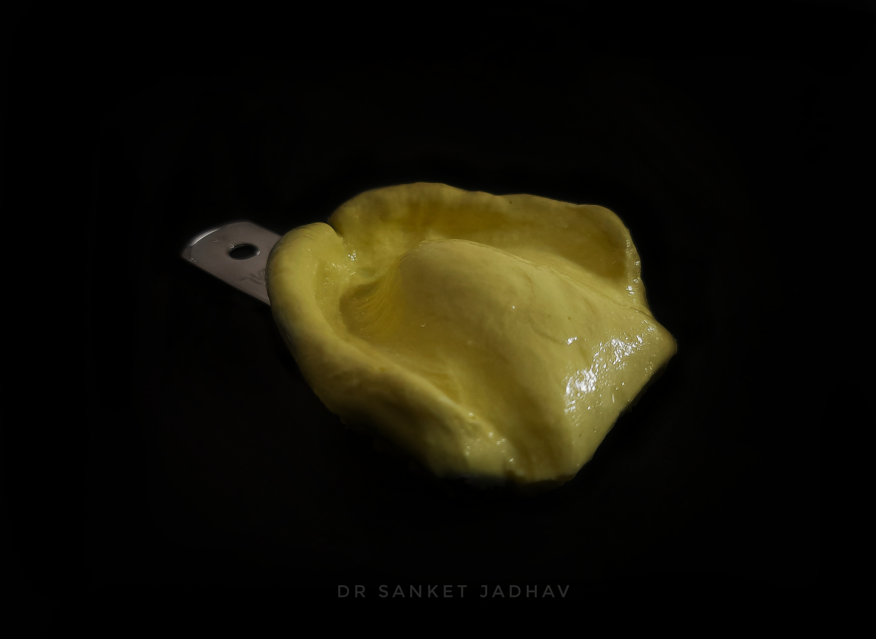
Objectives of Impression Making
Dr. sanket jadhav

Slide 2
An impression should be made with the purpose
of obtaining the following characteristics in the
dentures to be fabricated.
Preservation of remaining structures
Retention.
Esthetics.
Stability.
Support.

Slide 3
Preservation of remaining structures
Muller De Van (1952) stated that, “the preservation of that which remains is of utmost importance and not the meticulous replacement of that which has been lost.”
Impressions should record the details of the basal seat and the peripheral structures in an appropriate form to prevent injury to the oral tissues.
E.g. the stress-bearing and nonstress-bearing areas should be recorded under stress and relief respectively.
This prevents the damage of the oral structures due to the action of improperly distributed forces.
The peripheral tissues should be recorded accurately to prevent over-extension of the denture and tissue irritation.

Slide 4
Retention
Retention
It is defined as “That quality inherent in the prosthesis which resists the force of gravity, adhesiveness of foods, and the forces associated with the opening of
the jaws”- GPT.
Retention is the ability of the denture to withstand displacement against its path of insertion.
The factors that affect retention can be classified as:
• Anatomical factors.
• Physiological factors.
• Physical factors.
• Mechanical factors.
• Muscular factors.

Slide 5
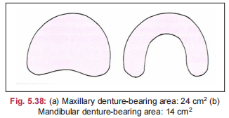
Retention
• Anatomical factors.
Size of the denture-bearing area
Retention increases with increase
in size of the denture-bearing area.

Slide 6
Retention
• Anatomical factors.
Quality of the denture-bearing area
The displaceability of the tissues influences the retention of the denture.
Tissues displaced during impression making will lead to tissue rebound during denture use, leading to loss of retention.

Slide 7
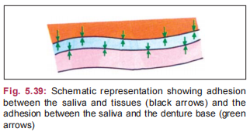
Retention
• Physiological factors
Saliva
The viscosity of saliva determines retention. Thick and ropy saliva gets accumulated between the tissue surface of the denture and the
palate leading to loss of retention. Thin and watery saliva can also lead to compromised retention.
The average flow of saliva is 150 ml/min.
Saliva has gylcoproteins called “MUCINS”, responsible for stringiness of saliva.

Slide 8
Retention
Physical Factors
The various physical factors which affect retention, are:
• Adhesion.
• Cohesion.
• Interfacial surface tension.
• Capillarity or capillary attraction.
• Atmospheric pressure and peripheral seal.

Slide 9
Retention
Physical Factors
The various physical factors which affect retention, are:
• Adhesion.
• Cohesion.
• Interfacial surface tension.
• Capillarity or capillary attraction.
• Atmospheric pressure and peripheral seal.
Adhesion (Fig. 5.39) It is defined as “The physical attraction of unlike molecules to one another.”- GPT.
The role of saliva is very important for adhesion.
In patients with xerostomia, adhesion does not
play a major role.

Slide 10
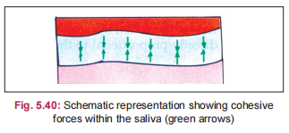
Retention
Physical Factors
The various physical factors which affect retention, are:
• Adhesion.
• Cohesion.
• Interfacial surface tension.
• Capillarity or capillary attraction.
• Atmospheric pressure and peripheral seal.
Cohesion (Fig. 5.40) It is defined as “ The physical attraction of like molecules for each other”.
The cohesive forces act within the thin film of saliva.
Watery serous saliva can form a thinner film and is more cohesive than thick mucous saliva.

Slide 11
Retention
Physical Factors
The various physical factors which affect retention, are:
• Adhesion.
• Cohesion.
• Interfacial surface tension.
• Capillarity or capillary attraction.
• Atmospheric pressure and peripheral seal.
Interfacial surface tension It is defined as “ The tension or resistance to separation possessed by the film of liquid between two well-adapted surfaces”- GPT.
These forces are found within the thin film of saliva separating the denture base from the tissues. This film of saliva tends to resist the displacing forces.
It plays a major role in the retention of a maxillary denture.

Slide 12
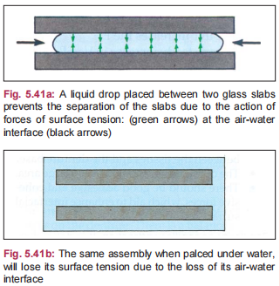
Retention
Physical Factors
Interfacial surface tension

Slide 13
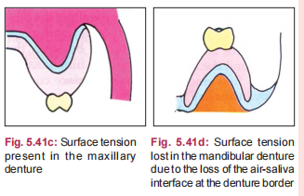
Retention
Physical Factors
Interfacial surface tension

Slide 14
Retention
Physical Factors
The various physical factors which affect retention, are:
• Adhesion.
• Cohesion.
• Interfacial surface tension.
• Capillarity or capillary attraction.
• Atmospheric pressure and peripheral seal.
Capillarity or capillary attraction:
It is defined as, “That quality or state, because of surface tension causes
elevation or depression of the surface of a liquid that is in contact with a solid”-GPT.
A liquid tends to rise in a capillary tube by maximizing its contact along the walls of the tube at the interface between the liquid and glass.
When there is close adaptation between the denture and the mucosa, the thin film of saliva tends to flow and increase its surface contact thereby increasing the retention.

Slide 15
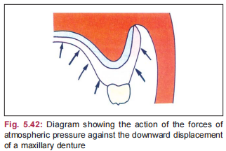
Retention
Physical Factors
The various physical factors which affect retention, are:
• Adhesion.
• Cohesion.
• Interfacial surface tension.
• Capillarity or capillary attraction.
• Atmospheric pressure and peripheral seal.
Atmospheric pressure and peripheral seal
Peripheral seal is the area of contact between
peripheral borders of the denture and the
resilient-limiting structures. This peripheral seal
prevents air entry between the denture surface
and the soft tissue.
To achieve good peripheral seal, the denture
borders should rest on soft and resilient tissues.

Slide 16
Retention
Mechanical Factors
The various mechanical factors, which aid in retention, are:
• Undercuts.
• Retentive springs.
• Magnetic forces.
• Denture adhesives.
• Suction chambers and suction discs.

Slide 17
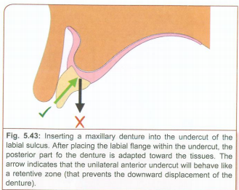
Retention
Mechanical Factors
The various mechanical factors,
which aid in retention, are:
• Undercuts : Undercuts Unilateral
undercuts aid in retention
while bilateral undercuts will
interfere with
denture insertion and
require surgical correction

Slide 18
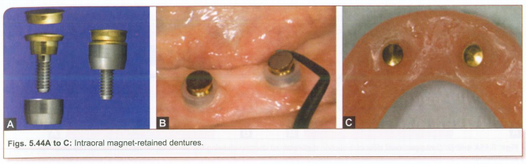
Retention
Mechanical Factors
Magnetic forces
Intramucosal magnets aid in increasing retention of highly-resorbed ridges.

Slide 19
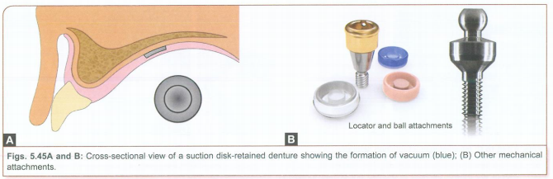
Retention
Mechanical Factors
Suction chambers and suction discs In the past suction chambers in the maxillary dentures were used to aid in retention. The suction chamber creates an area of negative pressure, which increases retention. They are avoided now due to their
potency for creating palatal hyperplasia.

Slide 20
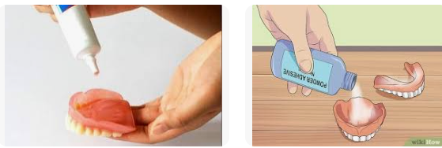


Retention
Mechanical Factors
Denture adhesives They are available as creams or gels or powders. They should be coated on the tissue surface before wearing the denture.

Slide 21
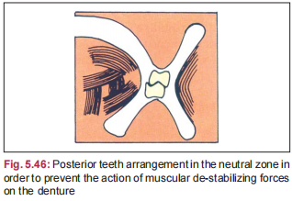
Retention
Muscular Factors
The muscles apply supplementary retentive
forces on the denture. There is a balance between
the forces acting from the buccal musculature and
the tongue. This balance is obtained in the neutral
zone.
Hence, the artificial teeth should be
arranged in the neutral zone to
achieve the best retention possible.

Slide 22
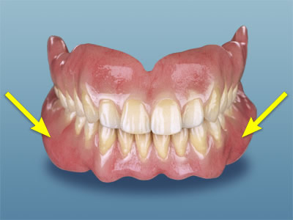
Esthetics
Aesthetics
Aesthetics is one of the prime concerns of the
patient in the complete denture treatment.
The thickness of the denture flanges is one
of the important factors that govern aesthetics.
Thicker denture flanges are preferred in
long-term edentulous patients to give the
required mouth fullness.
Impression should perfectly reproduce the
width and height of the entire sulcus for the
proper fabrication of the flanges.

Slide 23
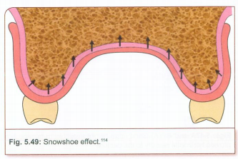
Support
Support is defined as, “The resistance to vertical forces of mastication, occlusal forces and other forces applied in a direction towards the denture-bearing
area.”
In order to provide good support,
the denture base should cover as much
denture-bearing area as possible.
This helps to distribute forces over a
wide area. This ability of the denture
to distribute forces over wide areas due
to an increase in the
denture-base area is termed the
“snowshoe” effect

Slide 24
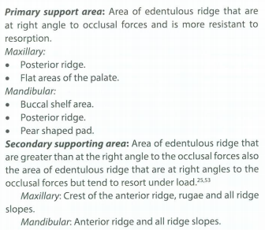
Support
Confining the occlusal
forces to stress-bearing
areas and reliving the
nonstress-bearing areas
will aid to improve support.

Slide 25
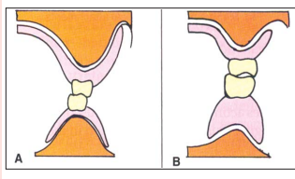
Stability
Stability is the ability of the denture to withstand horizontal forces. The various factors affecting stability are:
• Vertical height of the residual ridge.
• Quality of soft tissue covering the ridge.
• Quality of the impression.
• Occlusal rims.
• Arrangement of teeth.
• Contour of the polished surfaces.
Vertical Height of the Residual Ridge
The residual ridge should have sufficient
vertical height to obtain good stability.

Slide 26
Stability
Stability is the ability of the denture to withstand horizontal forces. The various factors
affecting stability are:
• Vertical height of the residual ridge.
• Quality of soft tissue covering the ridge.
• Quality of the impression.
• Occlusal rims.
• Arrangement of teeth.
• Contour of the polished surfaces.
Quality of Soft Tissue Covering the Ridge
The ridge should provide a firm soft tissue base with adequate submucosa to offer good stability.
Flabby tissues with excessive submucosa offer
poor stability.

Slide 27
Stability
Stability is the ability of the denture to withstand horizontal forces. The various factors
affecting stability are:
• Vertical height of the residual ridge.
• Quality of soft tissue covering the ridge.
• Quality of the impression.
• Occlusal rims.
• Arrangement of teeth.
• Contour of the polished surfaces.
Quality of the Impression
• An impression should be as accurate as possible.
• The impression surface should be smooth and
duplicate all the details accurately

Slide 28
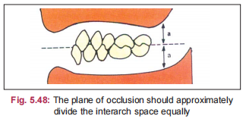
Stability
Stability is the ability of the denture to withstand horizontal forces. The various factors
affecting stability are:
• Vertical height of the residual ridge.
• Quality of soft tissue covering the ridge.
• Quality of the impression.
• Occlusal rims.
• Arrangement of teeth.
• Contour of the polished surfaces.
Occlusal Plane
The occlusal plane should be oriented parallel to the ridge.
If the occlusal plane is inclined, then the sliding forces may
act on the denture, reduce its stability.
The occlusal plane should divide the interarch space equally

Slide 29
Stability
Stability is the ability of the denture to withstand horizontal forces. The various factors
affecting stability are:
• Vertical height of the residual ridge.
• Quality of soft tissue covering the ridge.
• Quality of the impression.
• Occlusal rims.
• Arrangement of teeth.
• Contour of the polished surfaces.
Teeth Arrangement
The position of the teeth and their occlusion play an important role in the stability of the denture.
Balanced occlusion facilitates the even distribution of forces across the denture. Absence of balanced occlusion may produce unbalanced, lever type forces on any one side of the denture leading to loss of stability.

Slide 30
Stability
Stability is the ability of the denture to withstand horizontal forces. The various factors
affecting stability are:
• Vertical height of the residual ridge.
• Quality of soft tissue covering the ridge.
• Quality of the impression.
• Occlusal rims.
• Arrangement of teeth.
• Contour of the polished surfaces.
Contour of the Polished Surface
The polished surfaces of the denture should be harmonious with the oral structures. They should not interfere with the action of the oral musculature.

