Slide 1
Selection of Anterior Teeth
Dr. Sanket Rajendra Jadhav

Slide 2
The learner should be able to understand
The functions expected from the artificial teeth i.e esthetics, phonetics, mastication and comfort
Criteria for selection of anterior teeth- Shade, Size and Shape
Dentogenic concept

Slide 3
Selection of Anterior teeth
Anterior teeth play an important role in the aesthetics of a patient.
They are not subjected to heavy occlusal load like the posteriors.
Hence, aesthetics is given more importance during anterior teeth selection.

Slide 4
Selection of Anterior teeth
SIZE
SHAPE /FORM
SHADE

Slide 5
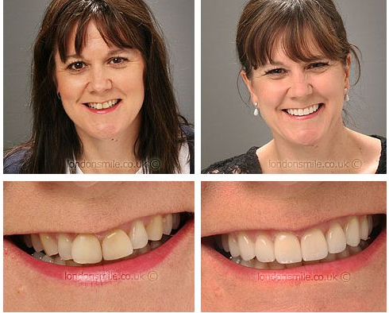

Slide 6
SIZE
Size of the Anterior Teeth
The tooth size should be appropriate to the size of the face and gender of the patient. The following methods are used as a guide to select the size of the teeth:
• Methods using pre-extraction records.
• Methods using anthropological measurements of the patient.
• Methods using anatomical landmarks.
• Methods using theoretical concepts -
Winkler’s concept - physiological, psychological and biomechanical.
Leon Williams concept
Temperamental theory: Dr.Sparzheim
Concept of Harmony: J.W.White

Slide 7
SIZE
Methods using pre-extraction records.
diagnostic casts,
photographs,
radiographs,
teeth of close relatives
preserved extracted teeth

Slide 8
SIZE
Methods using pre-extraction records.
DIAGNOSTIC CASTS,
PHOTOGRAPHS,
RADIOGRAPHS,
TEETH OF CLOSE RELATIVES
PRESERVED EXTRACTED TEETH

Slide 9
SIZE
Methods using pre-extraction records.
Diagnostic casts:
They are prepared before the extraction of the teeth. The operator can obtain an idea about the size and shape of the teeth from these casts. The actual size and shape required can be determined but the shade of the teeth cannot be determined using this method.

Slide 10
SIZE
Methods using pre-extraction records.
Photographs:
These photographs must show at least the incisal edges of the anterior teeth. This method is useful to determine the exact width and outline of the teeth.

Slide 11
SIZE
Methods using pre-extraction records.
Radiographs:
With radiographs, occluso-gingival height and the outline of the teeth can be recorded. But the contour and size cannot be accurately determined, because the radiograph is a two-dimensional image.
Teeth of close relatives: This method is usually followed only if the other records are not available. The size and contour of the patient’s son or daughter’s tooth is taken as reference.
Preserved extracted teeth: This is the best method to determine the size of the anterior tooth. The exact details about the size and contour can be recorded from this method.

Slide 12
SIZE
Methods using Anthropological Measurements of the Patient
Anthropological measurements are usually post-extraction records made directly from the
edentulous patient.

Slide 13
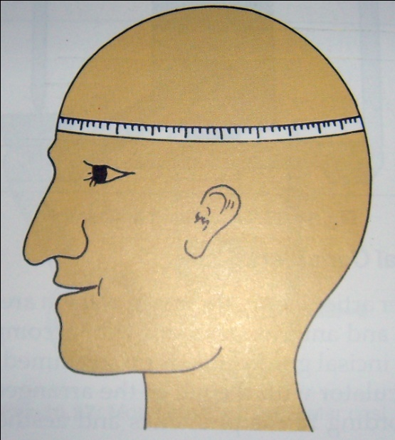
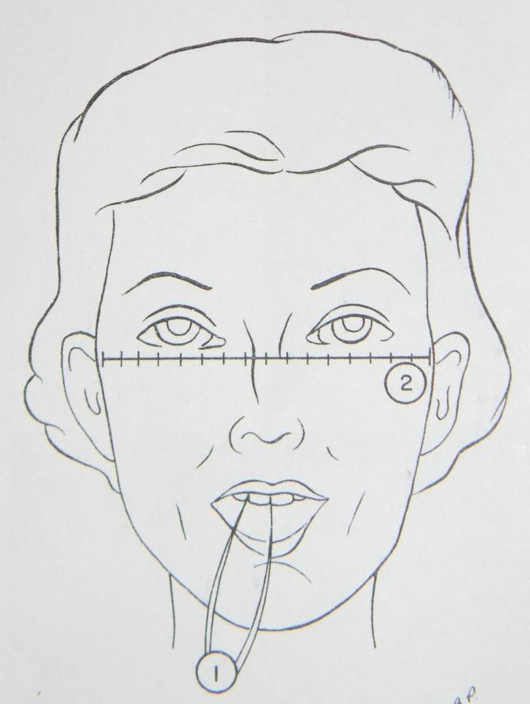
SIZE
Methods using Anthropological Measurements of the Patient
ANTHROPOMETRIC CEPHALIC INDEX:
1. Circumference of Head
Width of Upper Central Incisor = Circumference of Head / 13
2. Bizygomatic Width
Total Width of Upper Anteriors = Bizygomatic Width / 3.3

Slide 14

SIZE
Methods using Anthropological Measurements of the Patient
ANTHROPOMETRIC CEPHALIC INDEX:
Berry’s biometric ratio method: Berry (in 1906)
The formula using the length of the face cannot be used for edentulous patients.

Slide 15
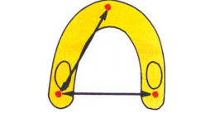
SIZE
• Methods using anatomical landmarks.
Size of the maxillary arch
The distance between the incisive papilla and the hamular notch on one side is added with the distance between two hamular notches. This gives the combined width of all the anterior and posterior teeth of the maxillary arch.

Slide 16

SIZE
• Methods using anatomical landmarks.
Location of canine eminences:
A canine eminence is formed in the region between the canine and the first premolar after extraction of teeth.
The distance between the two canine eminences is measured along the residual ridge.
This measured value gives the combined width of the anterior teeth

Slide 17
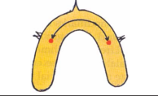
SIZE
• Methods using anatomical landmarks.
Location of the buccal frenal attachments:
The attachments of the buccal frenum are marked on the residual ridge. The distance between the two markings recorded along the residual ridge gives the combined width of the maxillary anteriors.

Slide 18

SIZE
• Methods using anatomical landmarks.
Location of the corners of the mouth:
The corner of the mouth marks the distal end of the canine.
The corners of the mouth are recorded on the occlusal rim and the distance is measured between these markings. The anterior teeth are set within these markings .

Slide 19
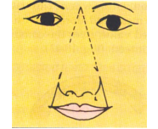
SIZE
• Methods using anatomical landmarks.
Location of the ala of the nose:
The patient is asked to sit upright and look straight. A line passing through the midpoint between the eyebrows and the lateral end of the ala of the nose extended
onto the occlusal rim gives the combined width of the anterior teeth.

Slide 20
Shape
Form of the Anterior Teeth
Form/Shape of the Anterior Teeth :
The form or outline of the anterior teeth can be determined using the following factors:
• Shape of the patient’s face or facial form.
• Patient’s profile.
• Dentogenic concept

Slide 21
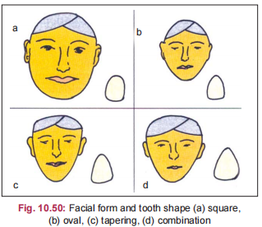
Shape
Form of the Anterior Teeth
Shape of the patient’s face or
facial form:
Classification of the Leon
Williams
      (A)Square
      (B)Ovoid
      (C)Tapering
      (D)Square tapering

Slide 22
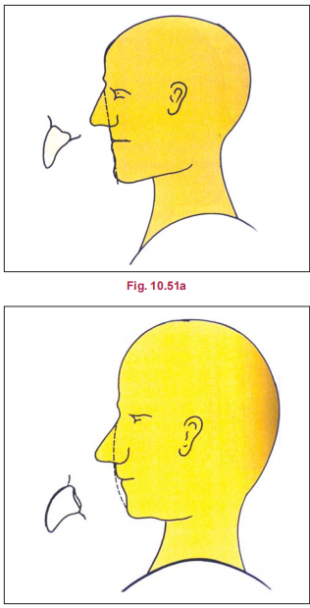
Shape
Form of the Anterior Teeth
Patient’s Profile :
The patient may have a convex,
straight or a concave profile.
The labial form of the anterior teeth should be similar to the facial profile
of the patient.

Slide 23
Shape
Form of the Anterior Teeth
DENTOGENIC CONCEPT:
(Sex, Personality, Age or SPA factor)
It was first described by Frush and Fisher.
According to them, the sex, personality and age
of the patient determine the form of the anterior
Teeth and could be used as guidelines for tooth selection, arrangement, and characterization to ‘‘enhance the natural appearance of the individual.’’

Slide 24
Shape
Form of the Anterior Teeth
DENTOGENIC CONCEPT:
(Sex, Personality, Age or SPA factor)
Sex
The form or shape of the teeth differs in
males and females. The differences in the shape
of the anterior teeth in males and females are:
In females, the incisal angles are more rounded
and the teeth have a lesser angulation.
In males, the incisal angles are rounded to a lesser
degree and the teeth are more angular

Slide 25
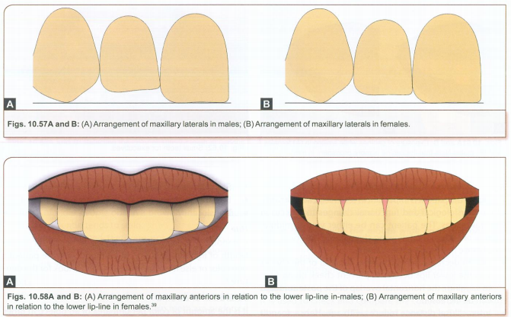
Shape
Form of the Anterior Teeth
DENTOGENIC CONCEPT:

Slide 26
Shape
Form of the Anterior Teeth
DENTOGENIC CONCEPT:
(Sex, Personality, Age or SPA factor)
Personality
The dentist should select and arrange the teeth so that it improves the patient’s personality. The patient can be either vigorous or delicate.
• More squarish, large teeth are selected for
vigorous people.

Slide 27
Shape
Form of the Anterior Teeth
DENTOGENIC CONCEPT:
(Sex, Personality, Age or SPA factor)
Age
The age of the patient is important in teeth selection. Due to decrease in muscle tone, sagging of the cheeks and the lower lips occur. To prevent cheek biting (due to sagging), the horizontal overlap of the posterior teeth can be increased.
• Inter-occlusal distance reduces with age.
Hence, mandibular teeth are more visible than the maxillary teeth.
• Old people usually have abraded teeth with
worn out contacts. Hence, placement of contoured teeth may look artificial.
• Old patients have gingival recession. It can be reproduced in the dentures to provide a natural appearance.

Slide 28
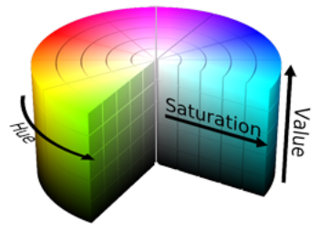
Shade
Shade of the Anterior Teeth
  Teeth must harmonic with the colour in patient face
  With age natural teeth becomes dark.
Before selecting the colour for anterior teeth,
some basic concepts about colour should be understood.
HUE
CHROMA
VALUE

Slide 29
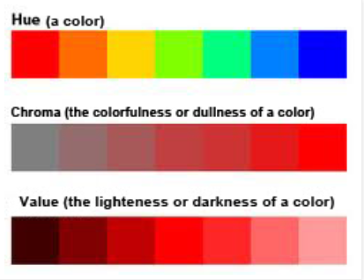
Shade
Shade of the Anterior Teeth
HUE:
It denotes a specific colour produced by a specific wavelength of light. It should be in harmony with the patient’s skin colour or else it will produce an artificial look for the denture.
A ( hue of red-yellow )
B ( Hue of yellow )
C ( hue of grey )
D (hue of red-yellow-grey )

Slide 30
Shade
Shade of the Anterior Teeth
CHROMA : (SATURATION)
It is the amount of colour per unit area of an object.
In other words, it denotes the intensity of the colour.

Slide 31
Shade
Shade of the Anterior Teeth
VALUE:
The relative darkness or lightness of a colour is called “value”.
It guides to produce darker or lighter shades
respectively.
In people with light skin colour, teeth
with lighter shades should be chosen and vice
versa.

Slide 32
Shade
Shade of the Anterior Teeth
The hue and value of a tooth is influenced or determined by the following factors:
• Age.
• Habits.
• Complexion.
• Colour of the eyes.
Age
• Young people have lighter teeth where the colour of the pulp is shown through the
translucent enamel.
• Old people show dark and opaque teeth due to the deposition of secondary dentin and con
sequent reduction in size of the pulp chamber.
• Teeth are more shiny in old people as they get polished due to regular wear of the teeth.
• Teeth of older people obtain a brownish tinge
because exposed dentin tends to stain.

Slide 33
Shade
Shade of the Anterior Teeth
The hue and value of a tooth is influenced
or determined by the following factors:
• Age.
• Habits.
• Complexion.
• Colour of the eyes.
Habits
Smokers, alcoholics and pan chewers have
discoloured teeth due to stains. In such people,
porcelain teeth are preferred because they are not
porous and do not allow percolation.

Slide 34
Shade
Shade of the Anterior Teeth
The hue and value of a tooth is influenced
or determined by the following factors:
• Age.
• Habits.
• Complexion.
• Colour of the eyes.
Complexion
• The colour of the teeth chosen should be in
harmony with the complexion of the patient.
• The colour of the face is more important
because the teeth fall into the framework of
the face.

Slide 35
Shade
Shade of the Anterior Teeth
The hue and value of a tooth is influenced
or determined by the following factors:
• Age.
• Habits.
• Complexion.
• Colour of the eyes.
Colour of the Eyes
• Only the colour of the iris is considered.

Slide 36
Summary
Size
Shape
Shade
Dentogenic concept/ SPA factor
Hue, Value, Chroma

