Slide 1

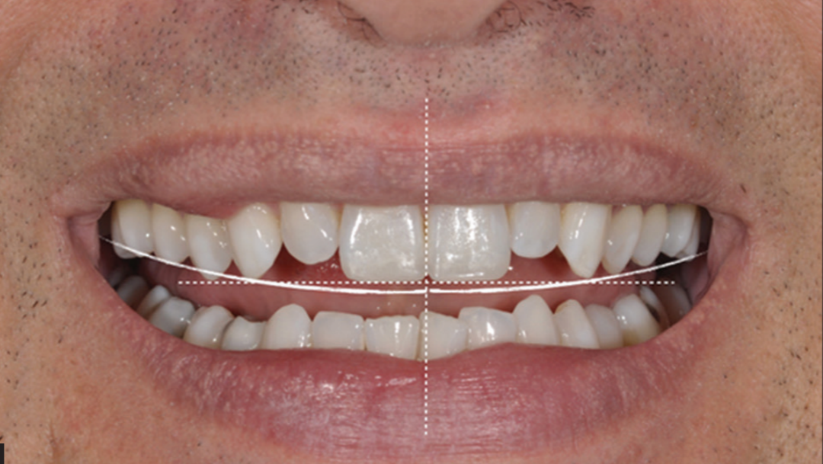
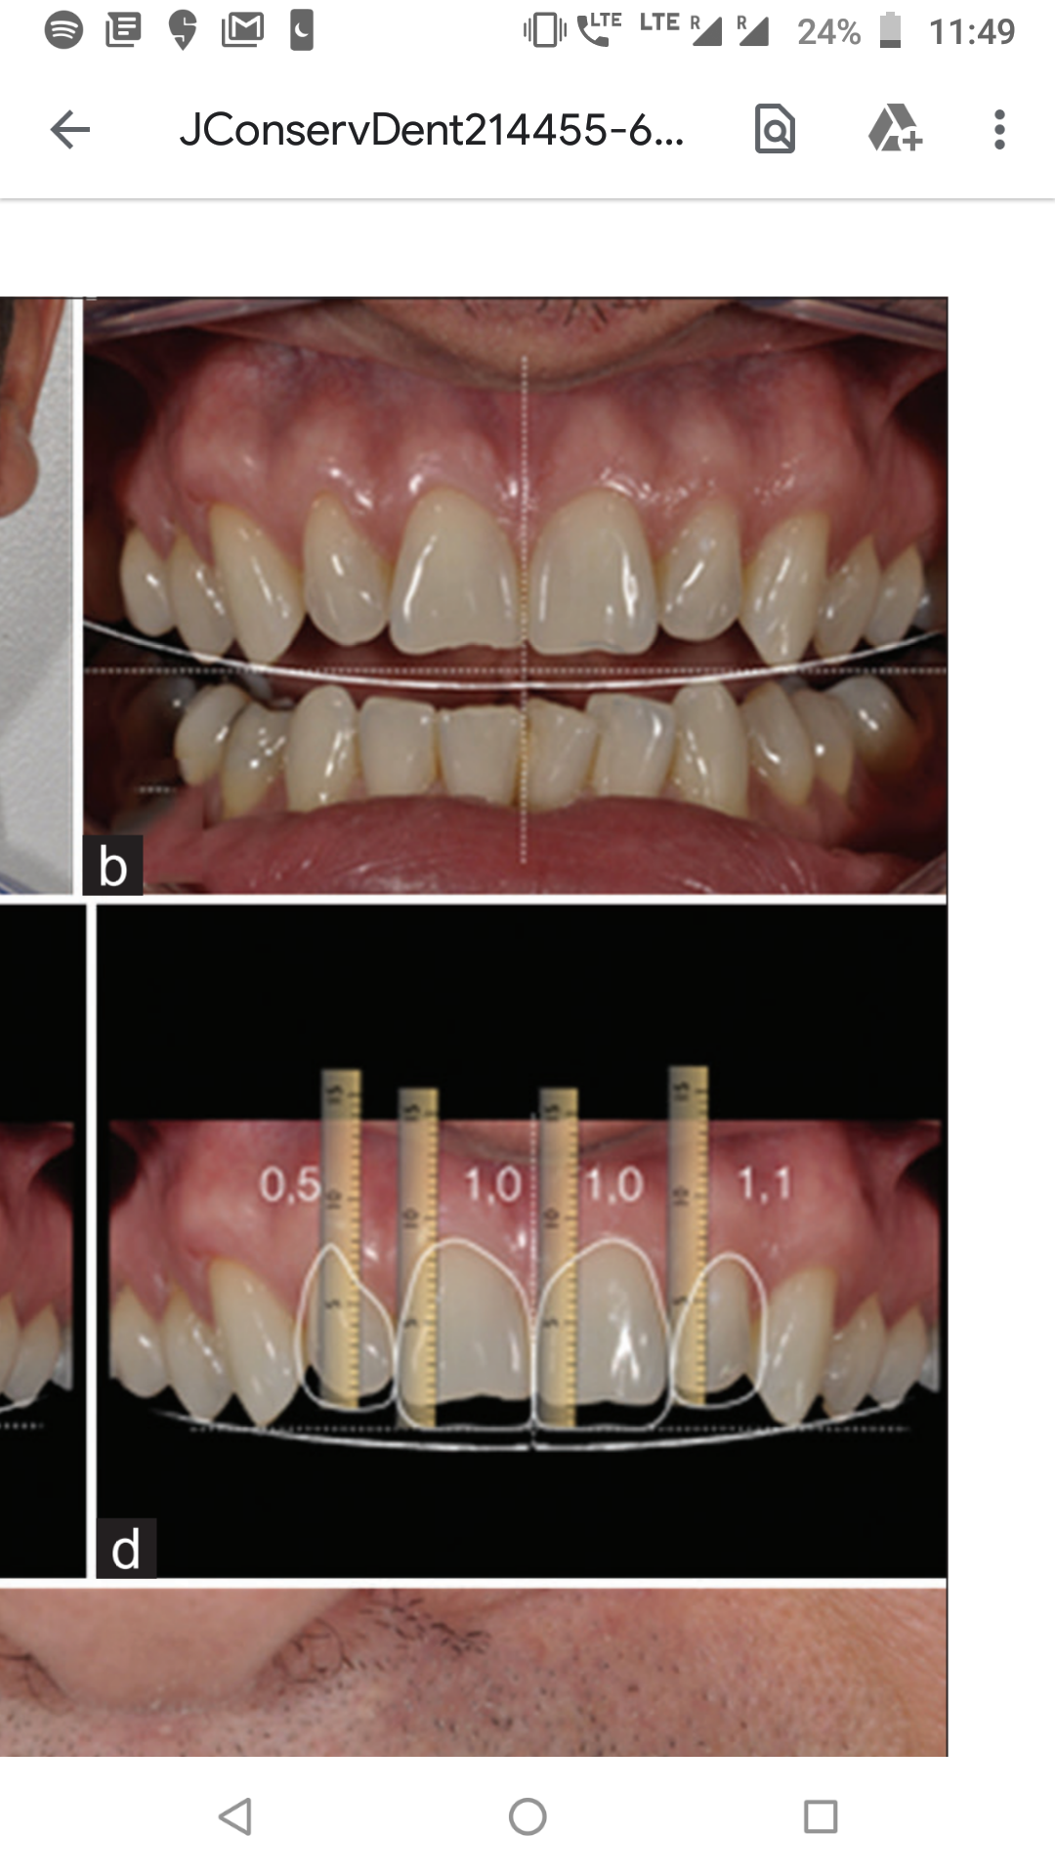
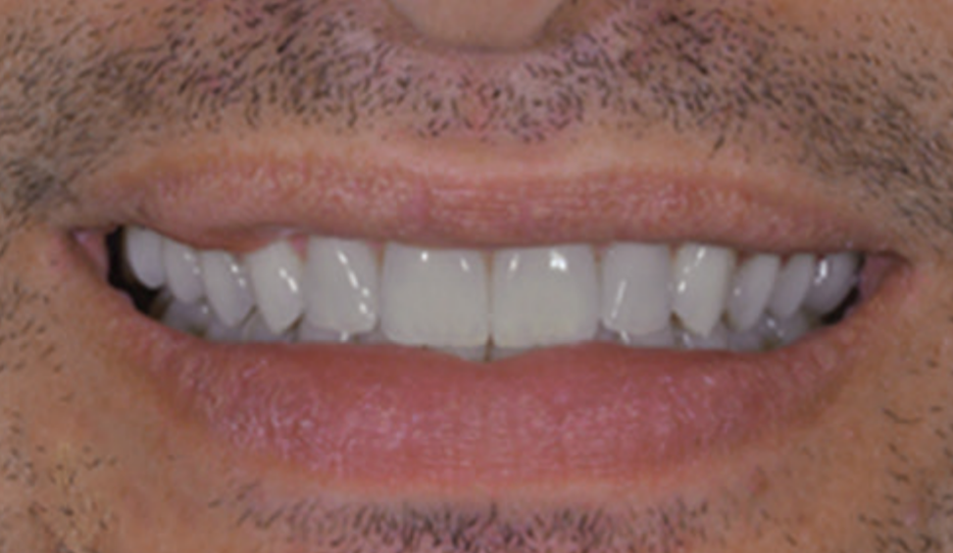
DIGITAL SMILE DESIGN
Everything starts with a smile
Parameters
Facial
Gingival
Dental
INTRODUCTION :
A beautiful smile and harmonic facial esthetics are attributes that contribute to the well-being of any patient.
Smile esthetics are related to form, texture, color and alignment of the anterior teeth as well as intraoral soft tissues, lips and facial esthetics.
GOLDEN
PROPORTION
Mentioned by Lombardi and developed by Levin
62% of lateral Incisor = Canine
DENTAL
PROPORTION
1/16th of height of face from hairline to chin= Height of Central Incisor
1/16th of Interzygomatic width= width of central incisor
FACIAL
PROPORTION
Central Incisor * 0.618=width of lateral incisor
All six anteriors when viewed from front should be in Golden Proportion to Intercommissural width
Rule of thirds divides face into 3 segments vertically
TRICHION superiorly- Ideal Hairline
NASION- Junction between upper and middle thirds
SUBNASALE- Junction of middle and lower third
MENTON Inferiorly.
(If lower third of face is subdivided into thirds, the ideal incisal position is at the junction of upper and middle thirds
WHAT IS DIGITAL SMILE DESIGN (DSD) ?
A digital planning tool which evaluates the esthetic relationship among the teeth, gingiva, smile and face, obtained through lines and digital drawings.
It is a Multi-use conceptual tool that can strengthen diagnostic vision, improve communication and enhance treatment predictability, by permitting careful analysis of patients facial and dental characteristics.
DISCUSSION:
Cosmetic dentistry is the integration of all areas of dentistry, therefore, for a practioner to decide the best treatment option, the dentist must perform a comprehensive esthetic evaluation.
DSD programs incorporate digital technology to the smile design process and used as tools for diagnosis, treatment plan visualization, and communication with the patient and technician.
APPLICATIONS USED :
Photoshop CS6
Keynote
Planmeca Romexis
Cerec SW 4.2
Aesthetic DSD
DTS- Dental Treatment Simulation
Smile Designer Pro
VisagiSMile
REFERENCES:

