Slide 1

Retention in complete denture
Guided by
Dr. Girish Kubasad
Presented by
Rutuja Nirale

Slide 2
Content
Introduction
Definition
Review of literature
Factors affecting retention
Checking retention
Conclusion

Slide 3
Introduction
Successful integration of the prosthesis with the patient’s oral functions plus psychological acceptance of the dentures by the patient.
Denture must meet the functions of esthetic, mastication , phonetics and maintain health of underlying tissues.

Slide 4
Physiologic comfort
Stability
Support
Retention
Retentiveness is one of the prerequisites of success in complete denture prosthetics
Psychologic comfort
Longevity
(Jacobson , JPD 1983 , 49 ,1)

Slide 5
“Denture retention will be a subject perplexing and perpetual, until its troubles find their logical solution in understanding of its physics…”
R. E. Hall (1918)
British Dental Journal, Volume 189, No. 5, September 9 2000

Slide 6
Definition
Retention is that quality inherent in the dental prosthesis acting to resist the forces of dislodgment along the path of placement.
Retention of the denture is the resistance of a denture to dislodgment.
GPT 8

Slide 7
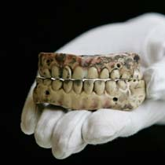
Review of literature
In 1500’s
Two arch-shaped templates of bone, crudely carved from an ox's femur
{Australian Dental Journal 1993,38,3}

Slide 8
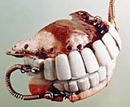
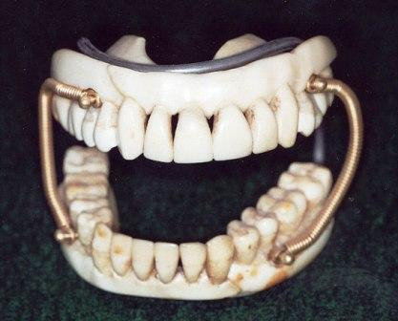
Fauchard 1700s, used steel springs to hold the upper and lower dentures together.
Pfaff (1756) developed more effective impression technique
Improved the fit and shape of dentures
{Australian Dental Journal 1993,38,3}

Slide 9
Factors affecting retention
Physical
Physiological
Psychological
Surgical
Mechanical
{ Hardy and Kapur JPD1958;18(3): 386}

Slide 10
Physical
Adhesion
Cohesion
Interfacial surface tension
Atmospheric pressure
Gravity
{JPD1958;18(3): 386}

Slide 11
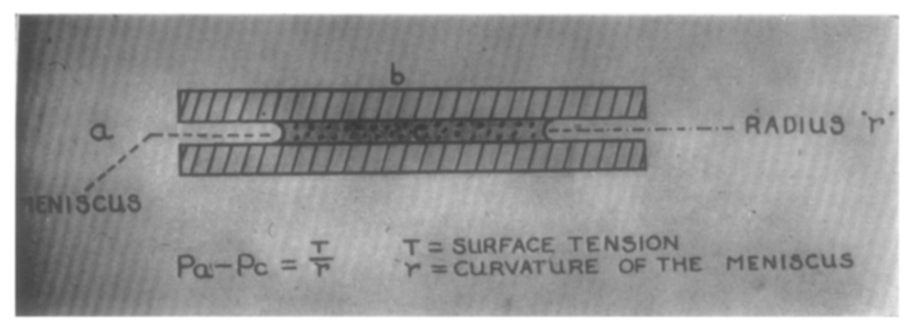
Adhesion
Attraction between two unlike molecules.
Saliva to the mucous membrane
Saliva to denture base
Effectiveness of adhesion – close adaptation of denture base and fluidity of saliva
Amount of retention α Area covered by the denture

Slide 12
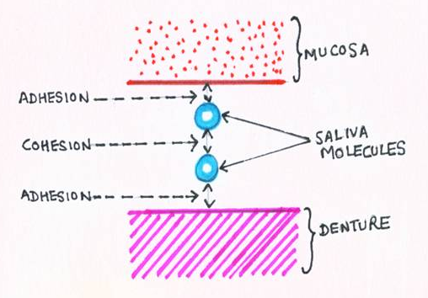
Cohesion
Physical attraction of like molecules for each other
Responsible for maintaining the continuity of water droplet
{Zarb – Bolender Prosthetic treatment for edentulous patient 12th Edt}

Slide 13
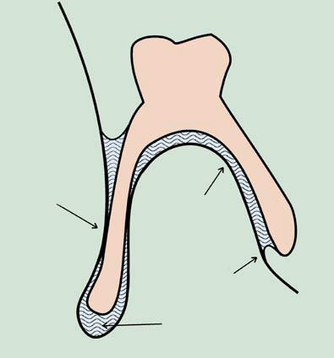
Surface tension
Resistance to separation of two parallel surfaces that is imparted by a film of liquid between them.
Interfacial surface tension
Interfacial viscous tension
Buccal
tissue
compliance
Narrow
space for
viscous flow
Surface
tension
Lowered
pressure
{Zarb – Bolender Prosthetic treatment for edentulous patient 12th Edt}

Slide 14
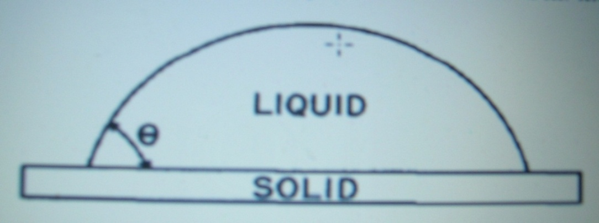
Interfacial surface tension
Dependent on the ability of the fluid to “wet” the rigid surrounding material
Interfacial viscous tension
Force holding two parallel plates together that is due to the viscosity of the interposed liquid.
Ɵ : Contact angle
of wetting

Slide 15
Bohannan ( 1954) stated that the interfacial surface tension is inversely proportional to the thickness of moisture layer between two surfaces. This indicates that better the fit, the more the attraction .
Oslund (1960) found that the greater the surface tension of saliva of the thinner fluid film, the greater was the retention of the denture .
{JPD1954;4 (2), 232}
{JPD1960; 10(4) 658}

Slide 16
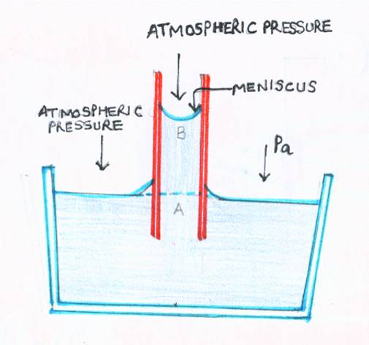
Capillarity
Causes liquid to rise in a capillary tube.
Space between denture base and oral mucosa filled with saliva acts like a capillary tube.
{Zarb – Bolender Prosthetic treatment for edentulous patient 12th Edt}

Slide 17
Atmospheric pressure
Introduced by Ames and the Greene brothers in 1833.
Use of functional denture borders as opposed to passive borders in the fabrication of complete dentures.

Slide 18
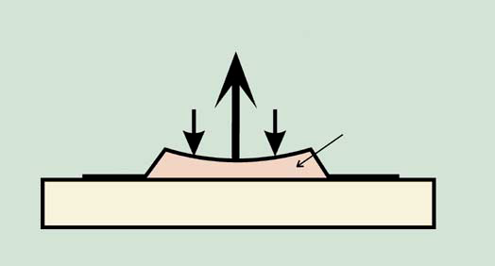
Atmospheric
pressure
Lowered
pressure
Seal
Pressure difference created when denture is dislodged pushes the denture against the basal seat.

Slide 19
Page( 1940) considered atmospheric pressure unimportant in retention . He stated that most important retentive force in complete denture is in interfacial surface tension and considers that this alone is necessary to retain the denture.
Snyder etal (1945) states that reduction in atmospheric pressure concomitantly reduces the retention , with 70%decrease in atmospheric pressure , there was 50% loss in retention.
{Australian Dental Journal 1993,38,3}

Slide 20
Hardy and Kapur (1958) mentioned that adhesion , cohesion and interfacial surface tension can aid in resisting only perpendicular forces and not horizontal and lateral. These forces can be resisted by the retention provided by the atmospheric pressure .
JPD1958;18(3): 386}

Slide 21
Gravity
Force with which the earth attracts all object in its vicinity towards its center.
Retentive force for the mandibular denture and a displacing force for the maxillary denture
{JPD 1971,25,3,230}

Slide 22
Physiologic factors
Saliva
Orofacial musculature
Peripheral seal
Neuromuscular and Neurosensory control

Slide 23
Saliva
Major factor to contribute the retention
Depends on
Viscosity of saliva
Volume of saliva
Thickness of salivary film
Saliva denture contact angle

Slide 24
Stefan’s Law:
F=force
r=radius
k=viscosity
h=thickness of liquid
v=velocity
F = (3/2)π kr⁴ v
h3
Force F
Increase with increase in viscosity
Decrease with increase in thickness
Increase proportionally to the area of opposing surface
{Zarb – Bolender Prosthetic treatment
for edentulous patient 12th Edt}

Slide 25
Oslund (1960) indicated an increase in retention varying from 57% to 150% after stimulation of the palatal mucous secretion
Abdulla(1972) – Increase in the film thickness of saliva reduces the surface tension and also retention was inversely proportion to the salivary film thickness
{JPD1960; 10(4) 658}
{JPD1972: 28 (2), 141}

Slide 26
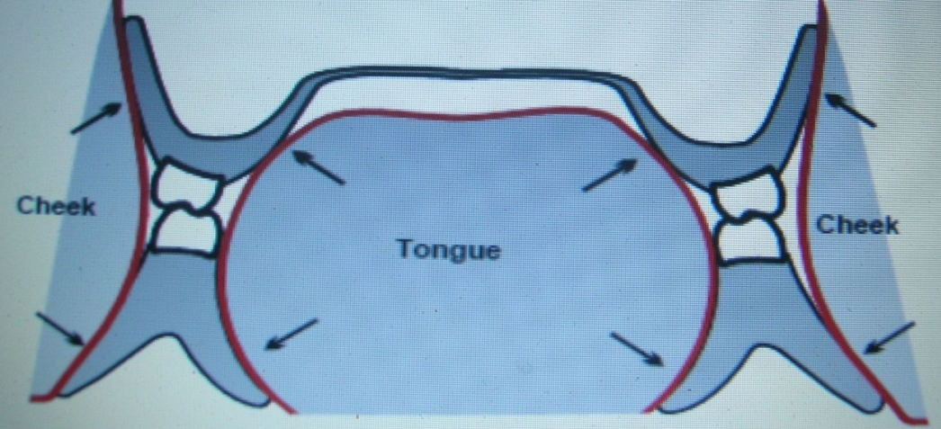
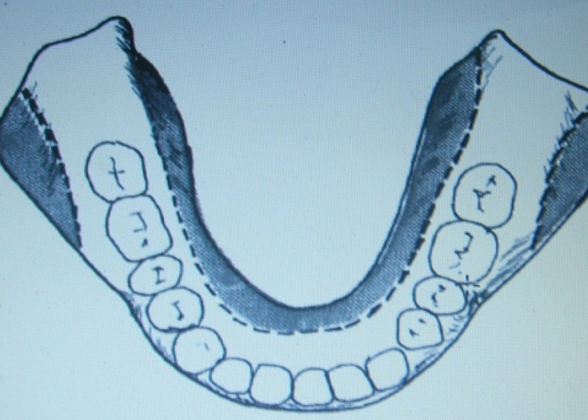
Orofacial musculature
Supply supplementary retentive forces
Teeth are positioned in the neutral zone
Polished surfaces of the denture
{Zarb – Bolender Prosthetic treatment for edentulous patient 12th Edt}

Slide 27
Brill et al(1959) showed experimentally that the oral musculature have an appreciable effect on denture retention.
Fish (1964) explained the importance of shaping the polished surfaces of the dentures.
{JPD 1959, Vol 9 : 761 }
{ JPD 1983 , 49 ,1 }

Slide 28
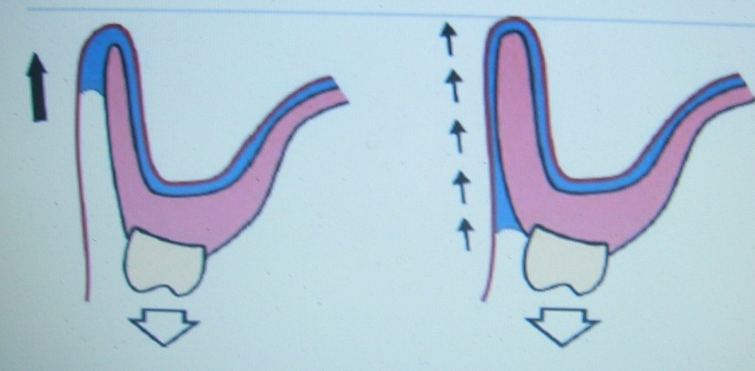
Peripheral seal
The contact of the denture border with the underlying or adjacent tissues to prevent the passage of air or other substances {GPT 8}
Border and facial seal is effectively and efficiently maintained by draping
effect of the lip, cheek and tongue.

Slide 29
Neuromuscular and Neurosensory control
A learned biological phenomenon.
Brill etal ( 1959) stated that normal muscle activity was dependant upon the impulses originating in proprioceptors in muscle and tendons and exteroceptors recording changes in the external environment
{JPD 1959, Vol 9 : 761- 8 }

Slide 30
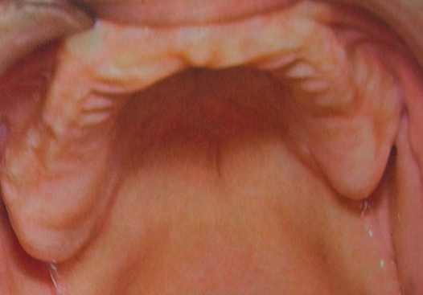
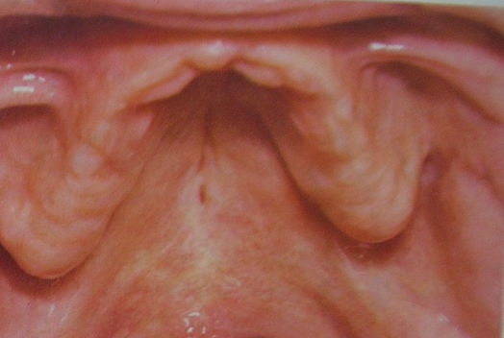
Anatomic Influences on Maxillary Denture Retention –
Posterior palatal seal
Shape of palatal vault
Retrozygomatic space
{Jacobson , JPD 1983 , 49 ,1}

Slide 31
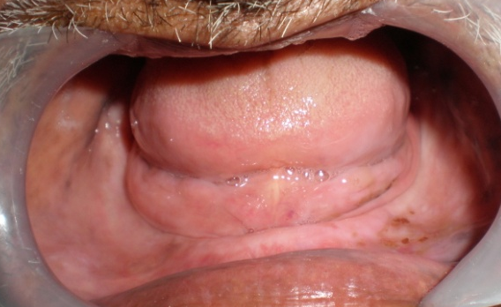
Anatomic Influences on Mandibular Denture Retention –
Movable floor of the mouth
Tongue
Lack of ideal ridge height
{Jacobson , JPD 1983 , 49 ,1}

Slide 32
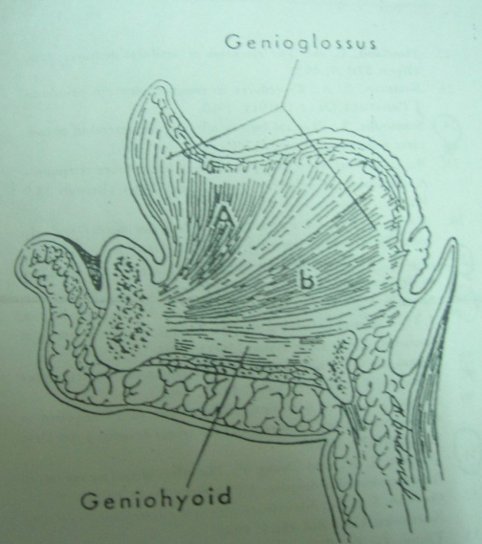
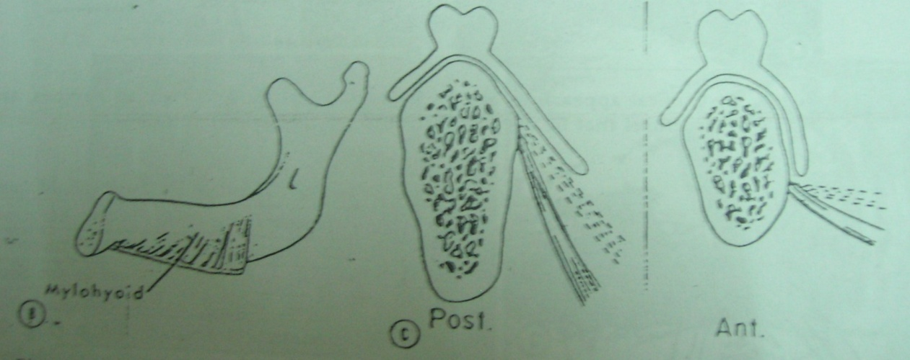
Lingual Mandibular Anatomic Influence
Retromylohyoid space
Mylohyoid muscle
Anterior lingual border
{Jacobson , JPD 1983 , 49 ,1}

Slide 33
Psychological factors
Requires adaptation of learning , muscular skill, and motivation and is related to patient expectation
Learning – acquisition of new activity
Muscular skill- capacity to coordinate muscular activity so as to execute movement
{Zarb – Bolender Prosthetic treatment for edentulous patient 12th Edt}

Slide 34
Surgical
To obtain a more favorable denture bearing area.
Ridge corrective procedure:
Soft tissue corrective procedure
High Frenum attachments and pendulous maxillary tuberosities
Bone corrective procedure
Shaping unfavorable bony ridges
Elimination of undesirable undercut
Resection of mylohyoid ridge
Excision of tori

Slide 35
Ridge extension procedure
- Vestibuloplasty
Ridge augmentation procedure
- Augmentation by bone graft , cartilage graft , alloplastic materials or combination of these .
Correction of abnormal ridge relationship
- Mandibular osteotomy
- Maxillary osteotomy
- Combination
Heartwell , textbook of complete dentures, 5th edition

Slide 36
Mechanical
Undercuts
Denture adhesives or fixatives
Rubber suction discs
Magnets
Implants

Slide 37
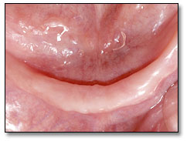
Undercuts
The contour of a cross-sectional portion of a residual ridge or dental arch that prevents the insertion of a dental prosthesis- GPT 8
- Unilateral or bilateral
- Labial or lingual

Slide 38
Common location of undercuts :
Labial portion of Maxillary anterior ridge
Buccal to the maxillary tuberosity region
Retromylohyoid area of the lower ridge
Labial or lingual slopes of the mandibular anterior ridge.
Zarb – Bolender Prosthetic treatment for edentulous patient 12th Edt
{Zarb – Bolender Prosthetic treatment for edentulous patient 12th Edt}

Slide 39
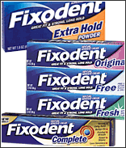
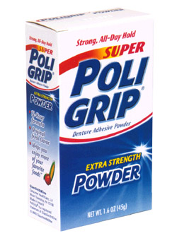
Denture Adhesives
Enhance the retention through
Increasing adhesive and cohesive properties
Eliminating voids

Slide 40
Indication :
Patient with salivary dysfunction
Neurological disorders
Undergone surgical or traumatic modification

Slide 41
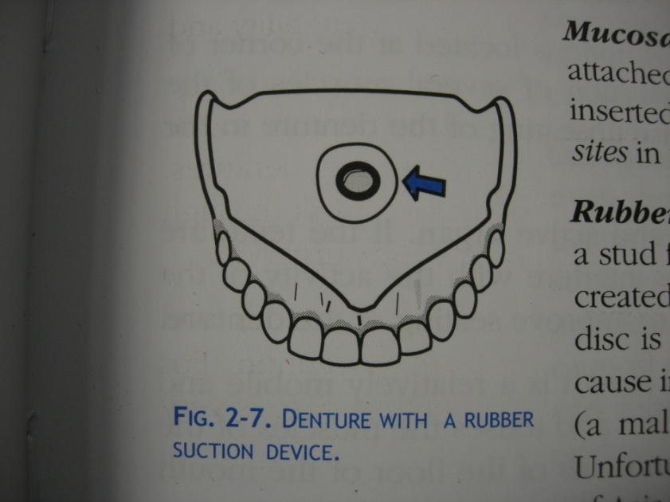
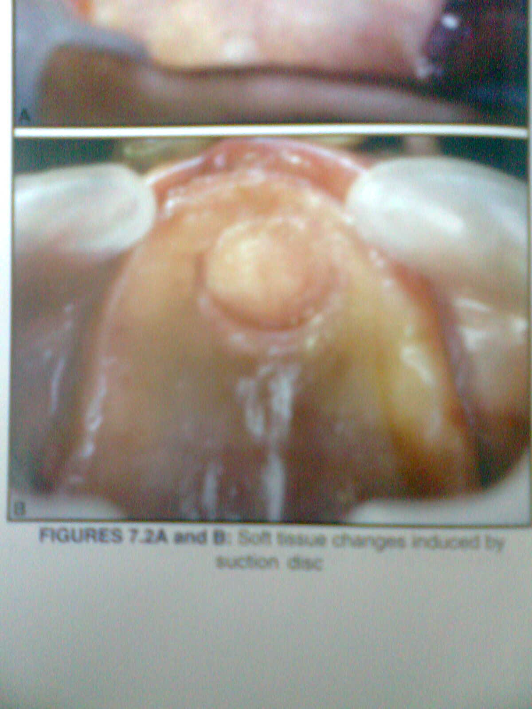
Rubber Suction disc
Rubber disc is fixed into intaglio surface
Partial vacuum created within perimeter of this disc
Drawbacks – Palatal perforation
- Tissue hyperplasia

Slide 42
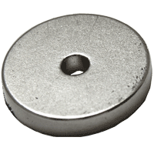
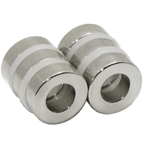
Magnets
Small magnets fixed on the maxillary and mandibular denture
Disadvantage –
Loss of effect of magnet
Soreness of mucous membrane and excessive bone resorption

Slide 43

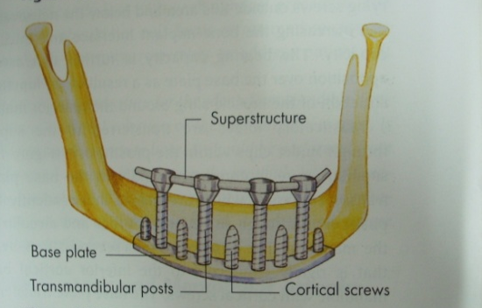
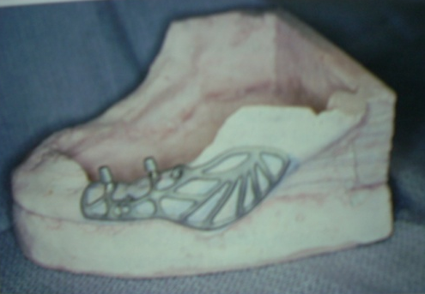
Implants
Endosteal Dental Implant
Eposteal Dental Implant
Transosteal Dental Implant
Mucosal Insert Implant

Slide 44
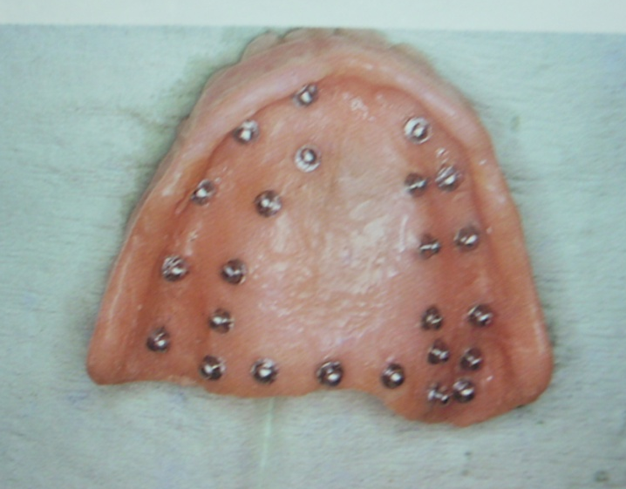
Mucosal Inserts
Any metal form attached to the tissue surface of a removable dental prosthesis that mechanically engages undercuts in a surgically prepared mucosal site.

Slide 45
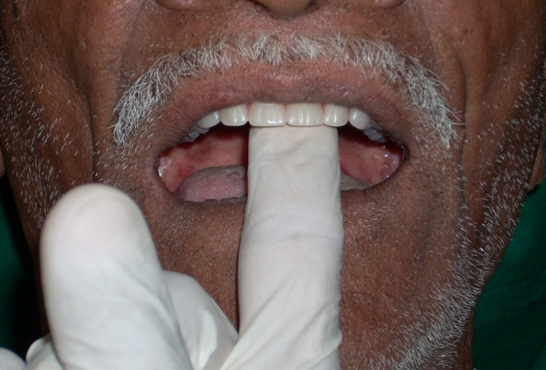
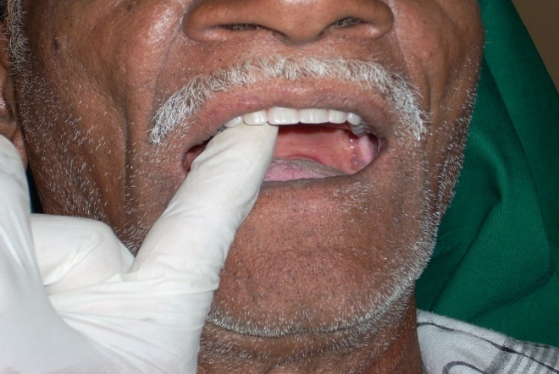
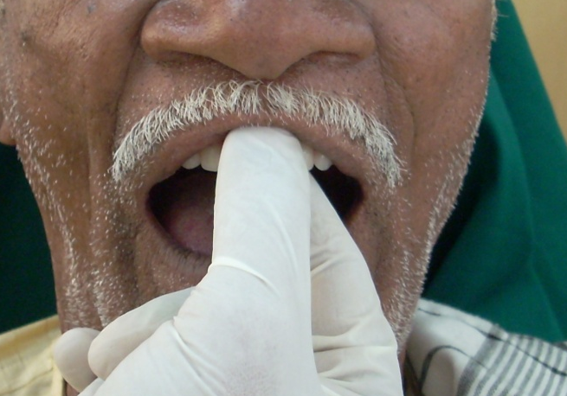
Checking retention
Incisor region
Canine region

Slide 46
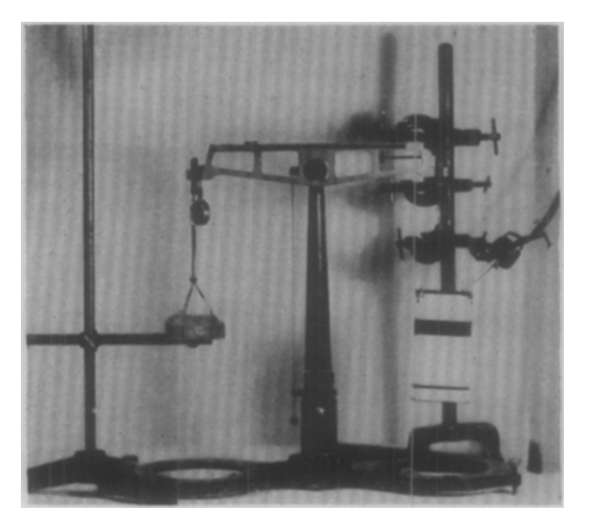
Various instruments to check retention
E. W. Skinner,
JPD1951, 1(3): 229

Slide 47
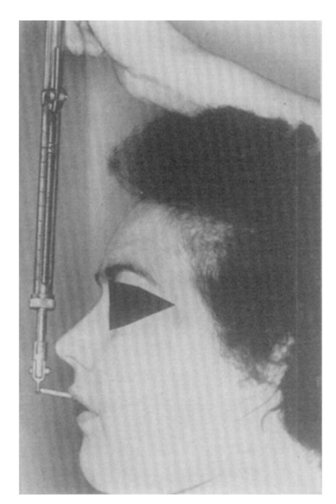
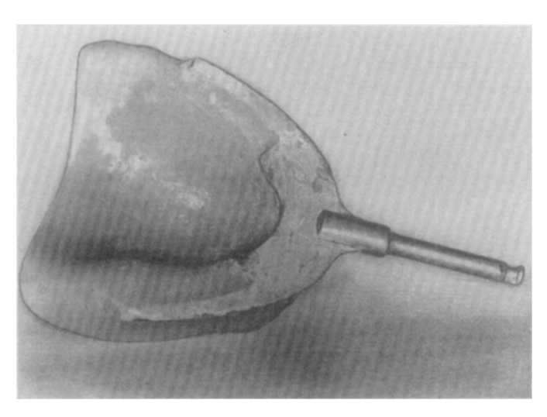
Stig G. Son Ostlund
{JPD1960, 10 (4): 658}

Slide 48
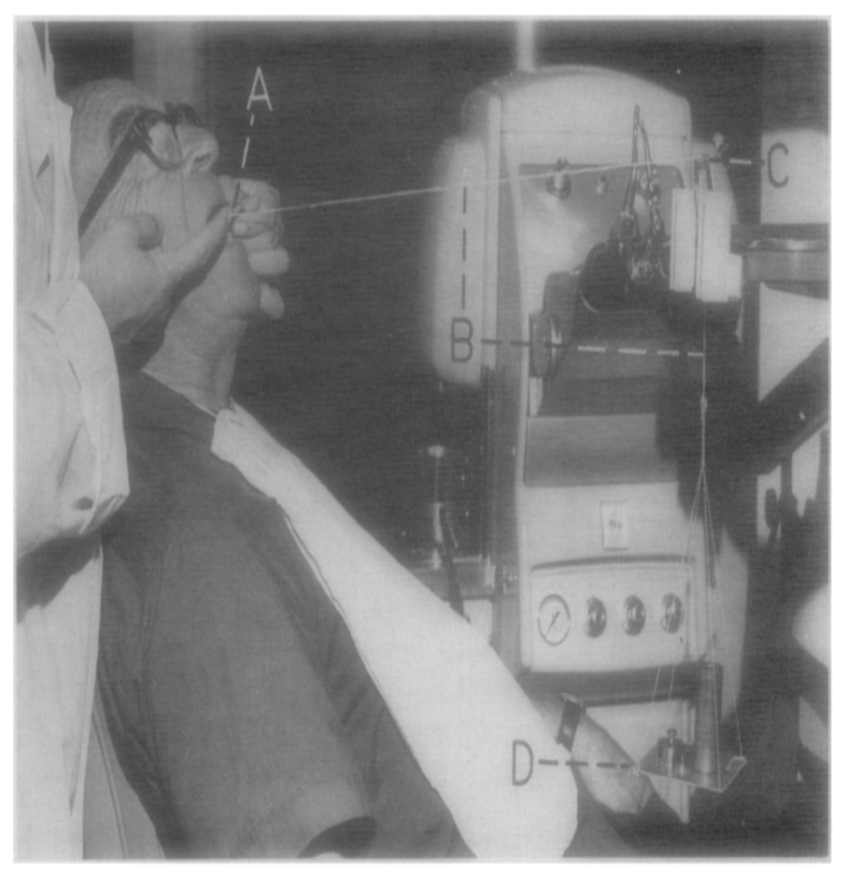
Andreas Csziggr
{JPD May, 1970, 23( 5): 503}

Slide 49
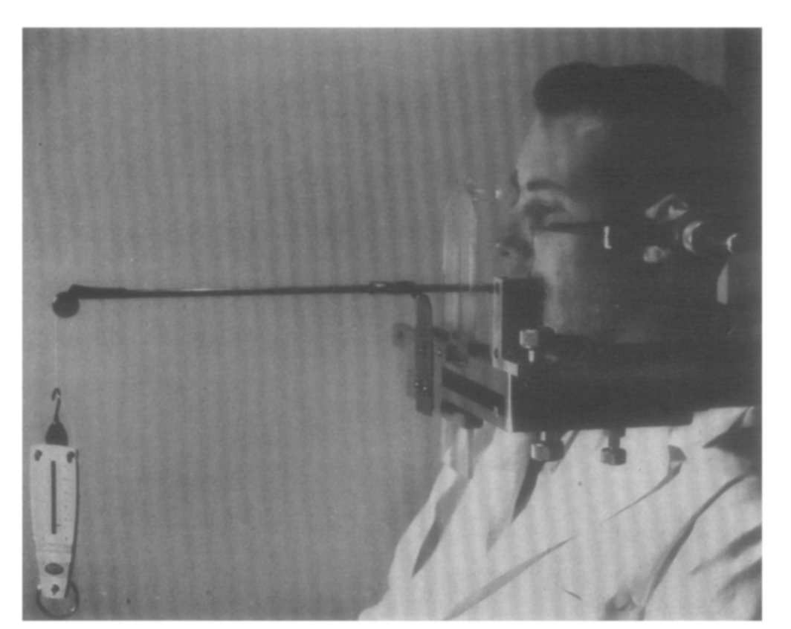
H. D. Gesser
{JPD 1971, 25(3): 236}

Slide 50
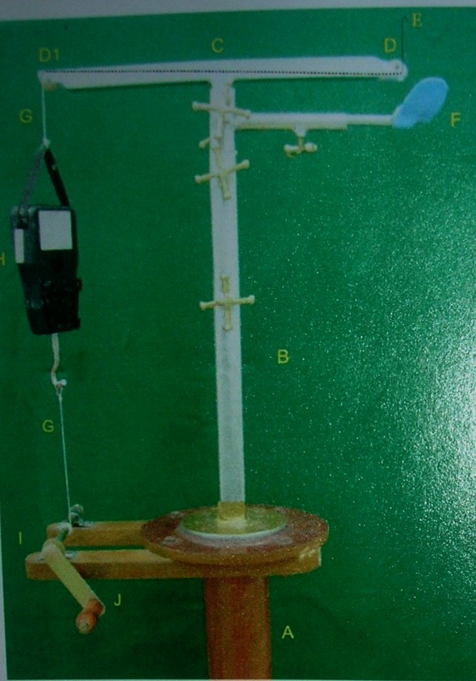
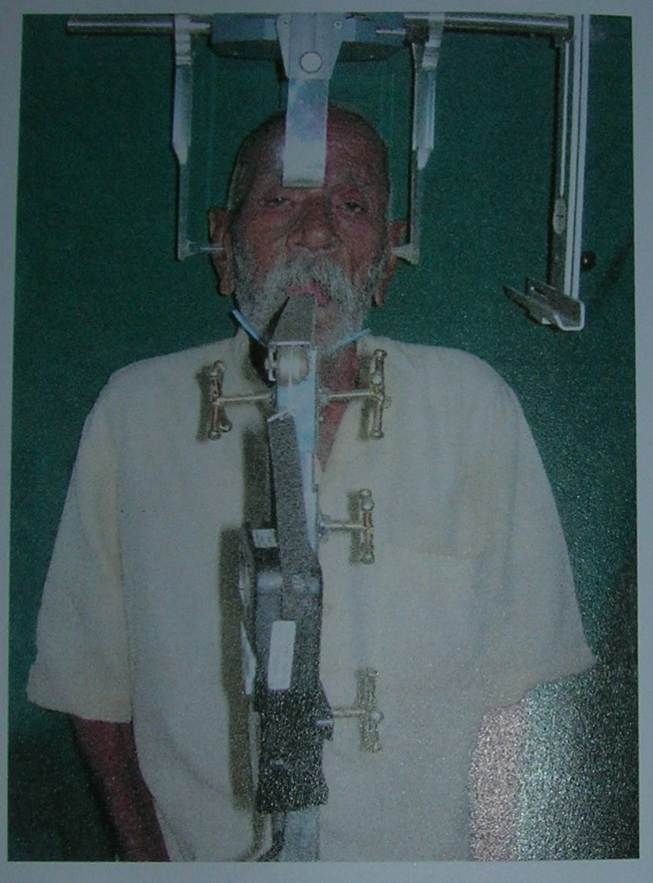
By Dr. R. U. Thombare and Dr. Manmohit Singh
Dissertation submitted to the Nagpur university in 2007 .

Slide 51
Conclusion
“Time will never come when dentures can be made without efforts”
A. H. Patterson
Retention is a complex phenomenon controlled by a great number of factors.

Slide 52
Incorporation of these various factors into the prosthesis through proper design and technique contributes to the success of complete dentures.

Slide 53
References
Zarb,Bolender.Prosthodontic treatment for edentulous patients 2004;Twelfth Ed:Mosby publication
Skinner EW, Chung P. The effect of surface contact in the retention of a denture. JPD 1951;1(3):229
Lammie GA. The retention of complete dentures. J.A.D.A 1957;55:502
Craig RG, Berry GC and Peyton FA. Physical factors related to denture retention. JPD 1960;10(3):459
Stamoulis S.Physical factors affecting the retention of complete dentures. JPD 1962;12(5):857
Stic G:son Ostlund, Saliva and denture retention, JPD1960 :10(4)658
K. W. Tyson, Physical factors in retention of complete upper dentures, JPD 1967 ; 18(2) 90

Slide 54
Irving r. Hardy, krishan k. Kapur, Posterior border seal-its rationale and 1mportance, JPD1958;18(3): 386
Lindstrom RE. Physical-chemical aspects of denture retention and stability: A review of literature. JPD1979;42(4):371
Jacobson TE and Korl AJ. A contemporary review of the factors involved in complete denture retention, stability and support. JPD1983;49(1):5
Brien WJO. Base retention. Dent Clin N Am 1989;24(1):123
Murrey MD, Darwell EW. The evolution of the complete denture base.Theories of complete denture retention-A review. Part 4.
Aus. Dent. J. 1993;38(6):450
B. W. Darvell, R. K. F. Clark, The physical mechanisms of complete denture retention. British Dental Journal, Volume 189, No. 5, September 9 2000

Slide 55
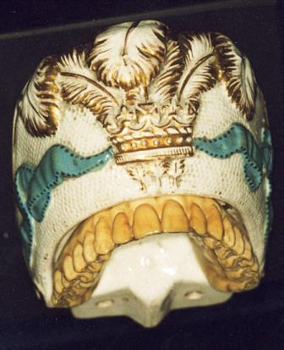
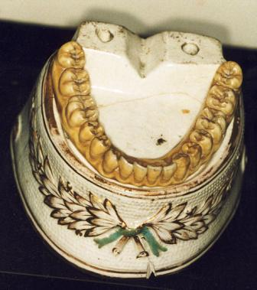
Thank you

