Slide 1
Stability In Complete Denture
Guided by
Dr. Girish Kubasad
Presented by
Rutuja Nirale

Slide 2
Content
Introduction
Definition
Review of literature
Factors affecting stability
Checking stability
Conclusion
References

Slide 3
Introduction
Biological Factors
Physical Factors
Mechanical Factors
Retention
Stability
Support
Psychological Comfort
Physiological Comfort
Longevity
Success of Prosthesis

Slide 4
Intertwined and interdependent phenomenon
Stability
Support
Retention
(Jacobson , JPD 1983 , 49 ,1)

Slide 5
Definition:
That quality of maintaining a constant character or
position in the presence of forces that threaten to disturb it;
the quality of being stable; to stand or endure
2) The quality of a removable dental prosthesis to be firm,
steady, or constant, to resist displacement by functional horizontal or rotational stresses.
3) Resistance to horizontal displacement of prosthesis.
  - GPT8

Slide 6
Review of Literature
Lundquist (1959) - The nature of the buccinator muscle contraction was not able to adapt to changes in the contours of the denture base and hence the denture contours should be designed to harmonize with existing buccinator muscle function
Jooste CH, Thomas CJ. (1992) - The retromylohyoid extension has a stabilizing effect on complete mandibular dentures.
JPD 1959,9: 44-51
IJP 1992, 5: 34-38
Notes:
conducted a clinical study involving the EMG analysis of function of buccinator muscle and he
conducted a study on Complete mandibular denture stability when posterior teeth are placed over a basal tissue incline and concluded that

Slide 7
Ohkubo C, Hosoi T. (1999) The weight of a well-fitting mandibular complete denture did not affect jaw movements and denture stability.
JPD 1999;82:636-42
Notes:
conducted a study on Effect of weight change of mandibular complete dentures on chewing and stability and concluded that

Slide 8
BRILL ( 1907)
Factors of stability :
Maximum area of coverage
Intimacy of contact
Equalization of pressure

Slide 9
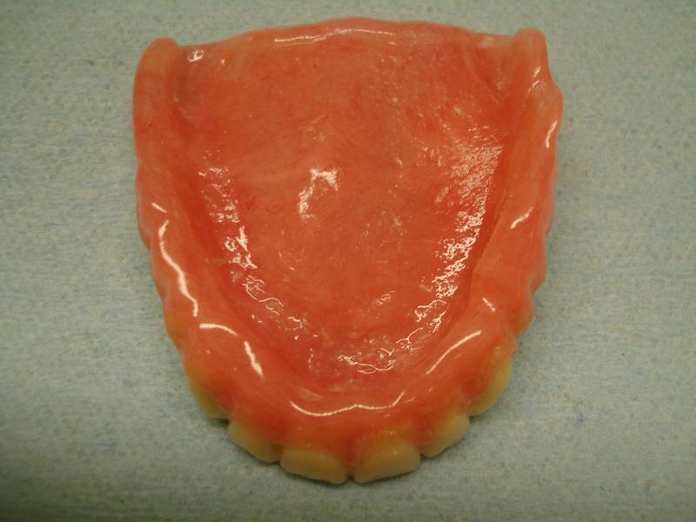
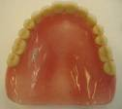
FISH 1948 - three principal factors to complete denture stability.
The impression surface.
The occlusal surface.
The polished surface.
J. Prosthet. Dent. 1983 49: 165

Slide 10
RELATIONSHIP OF THE DENTURE BASE TO THE UNDERLYING TISSUES:
Residual ridge anatomy.
Denture base adaptation.
The mandibular lingual flange.
J. Prosthet. Dent. 1983 49: 165

Slide 11
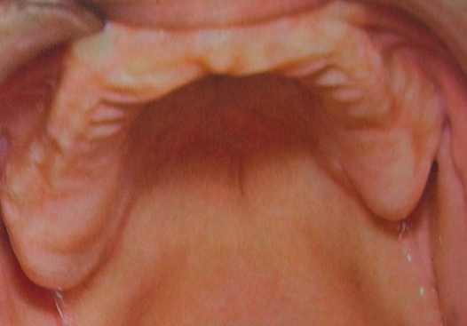
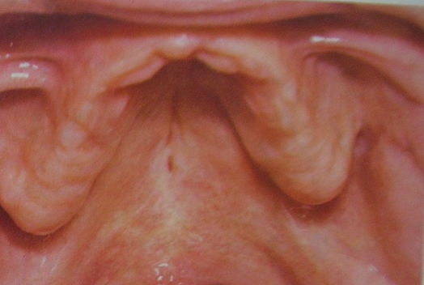
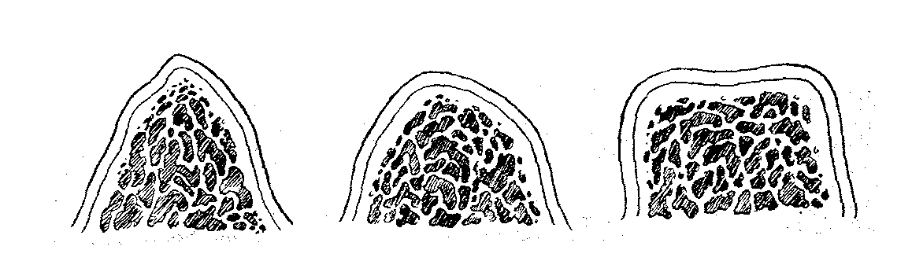
RESIDUAL RIDGE ANATOMY
Ridge Height
Ridge Conformation
The Arch Form
Shape of the Palatal Vault
J. Prosthet. Dent. 1983 49: 165

Slide 12
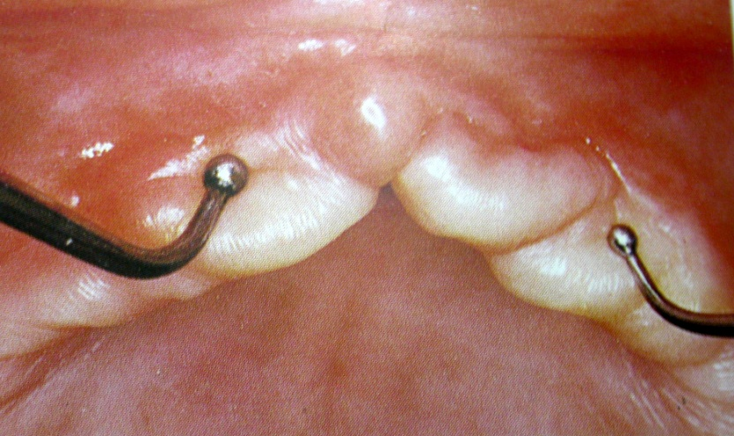
DENTURE BASE ADAPTATION:
Inflamed mucosa.
Distorted or displaced tissues
Hyperplastic tissue.
J. Prosthet. Dent. 1983 49: 165

Slide 13
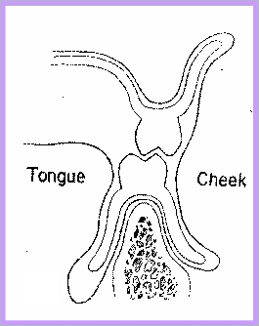
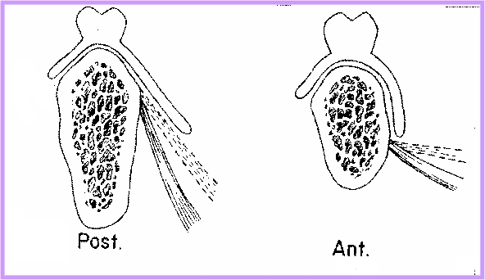
THE MANDIBULAR LINGUAL FLANGE :
At 90° to the occlusal plane.
Effectively resists horizontal
forces.
Jacobson J. Prosthet. Dent. 1983 49: 165

Slide 14
RELATIONSHIP OF THE EXTERNAL SURFACE AND PERIPHERY TO THE SURROUNDING ORO–FACIAL MUSCULATURE:
It facilitate stability by
Permitting the action of certain groups of muscle without any interferences.
Alteration in external contours lead to dynamic seating and stabilizing action
Jacobson J. Prosthet. Dent. 1983 49: 165

Slide 15
RELATIONSHIP OF THE EXTERNAL……
The external surface of the denture
Influence of oro-facial musculature
Modiolus and associated musculature
The neutral zone
Jacobson J. Prosthet. Dent. 1983 49: 165

Slide 16
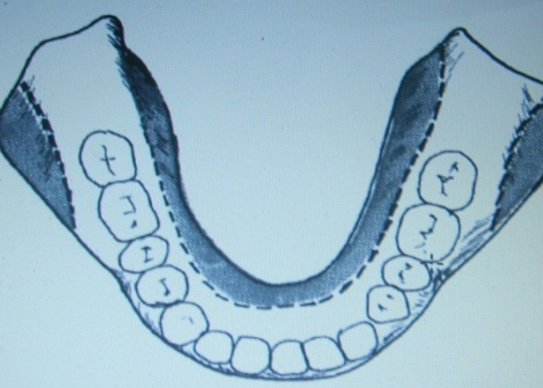
THE EXTERNAL SURFACE OF THE DENTURE :
The principal factor governing complete denture stability.
Lingual and buccal borders of mandibular denture and the buccal borders of maxillary denture can be made concave
Jacobson J. Prosthet. Dent. 1983 49: 165

Slide 17
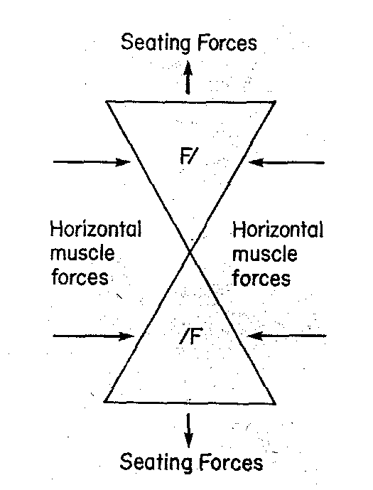
INFLUENCE OF ORO-FACIAL MUSCULATURE:
Basic geometric design
– Triangular
In frontal cross section
Jacobson J. Prosthet. Dent. 1983 49: 165

Slide 18
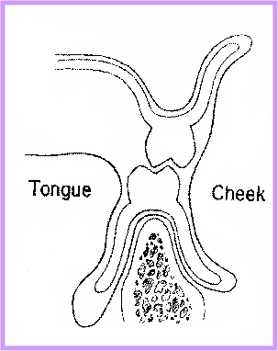
Seating action by Tongue - Lingual flange inclined medially
Flanges Concave Positive Seating
Jacobson J. Prosthet. Dent. 1983 49: 165

Slide 19
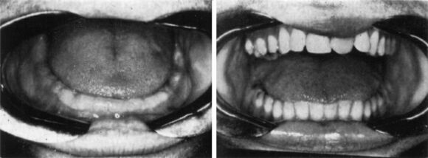
TONGUE The tongue fills the floor of the mouth completely and lateral borders extend onto the occlusal surfaces of the mandibular teeth.
Normal Tongue position
Edentulous mouth
With natural teeth
Wright, JPD 2004;92:509-18

Slide 20
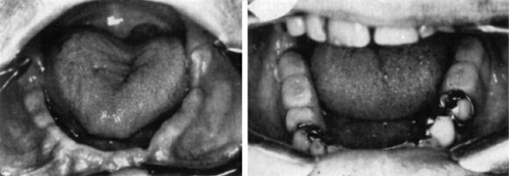
Retracted tongue positions
Failure of the tongue to fill
the floor of the mouth
Lateral borders inside the
mandibular posterior teeth
Wright, JPD 2004;92:509-18

Slide 21
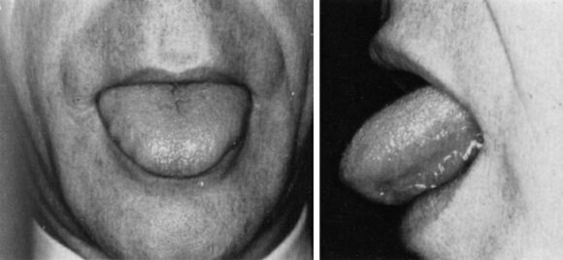
Tongue exercise No. 1. The tongue is thrust out and in rapidly.
Wright, JPD 2004;92:509-18

Slide 22
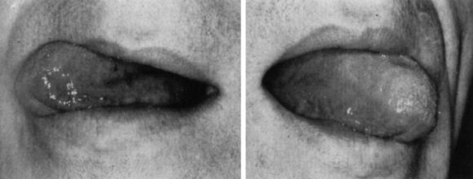
Tongue exercise No. 2. The tongue is swung rapidly from side to side.
Wright, JPD 2004;92:509-18

Slide 23
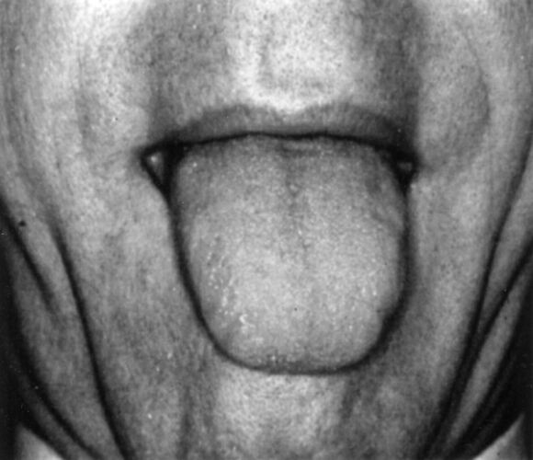
Tongue exercise No. 3.
Trusting the tongue out to its most extended position
And pulling it back quickly
Wright, JPD 2004;92:509-18

Slide 24
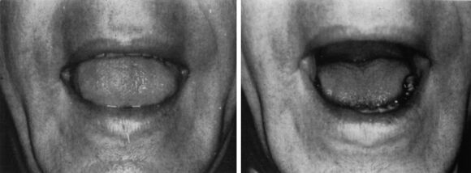
Tongue exercise No. 4. Raising the tongue to its highest position through articulation of ‘eeyuh’
Wright, JPD 2004;92:509-18

Slide 25
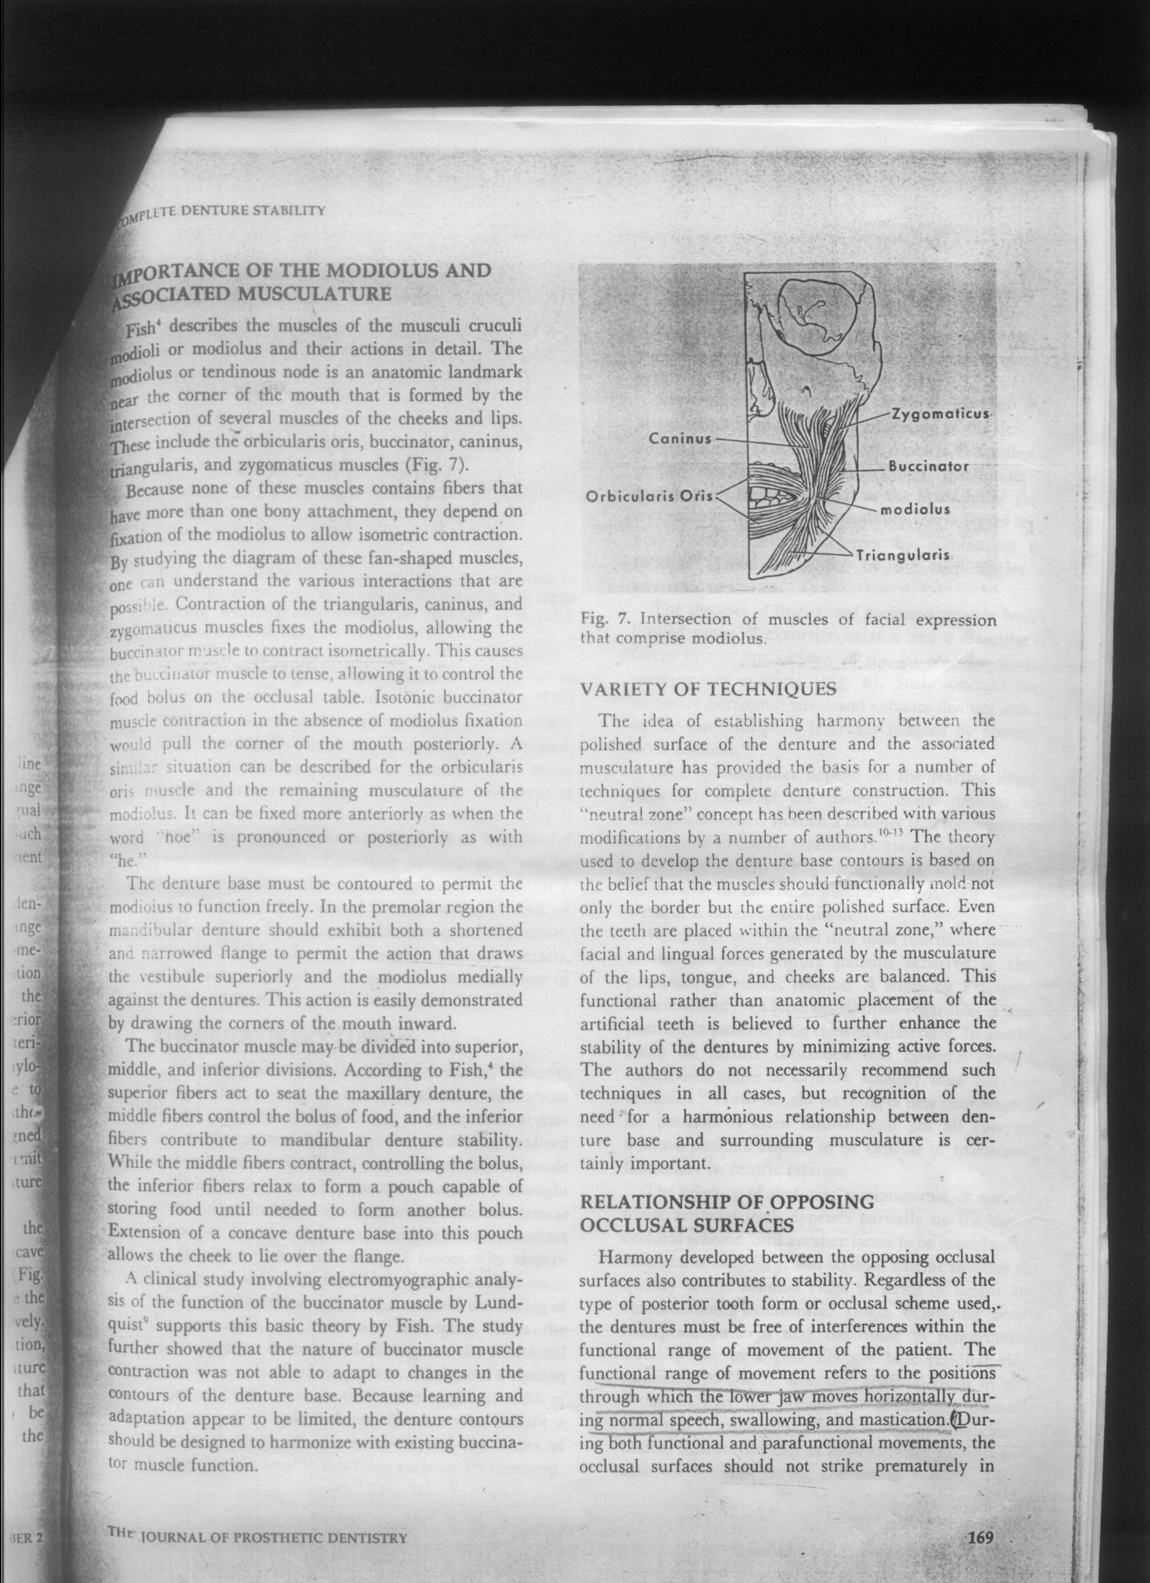
MODIOLUS AND THE ASSOCIATED MUSCULATURE:
A conical prominence present near the corner of the mouth
Intersection of several muscles of the cheeks and lips.
These include
Orbicularis oris,
Triangularis,
Caninus
Buccinator,
Risorius and
Zygomaticus major.
Jacobson J. Prosthet. Dent. 1983 49: 165

Slide 26
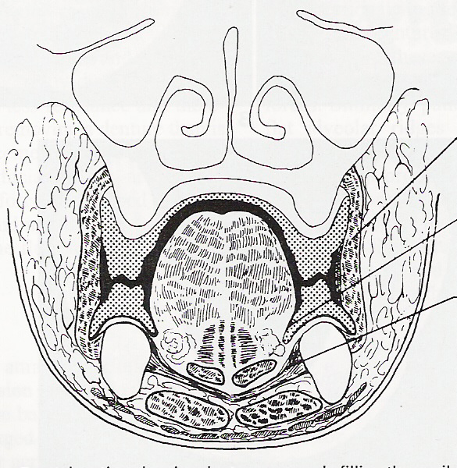
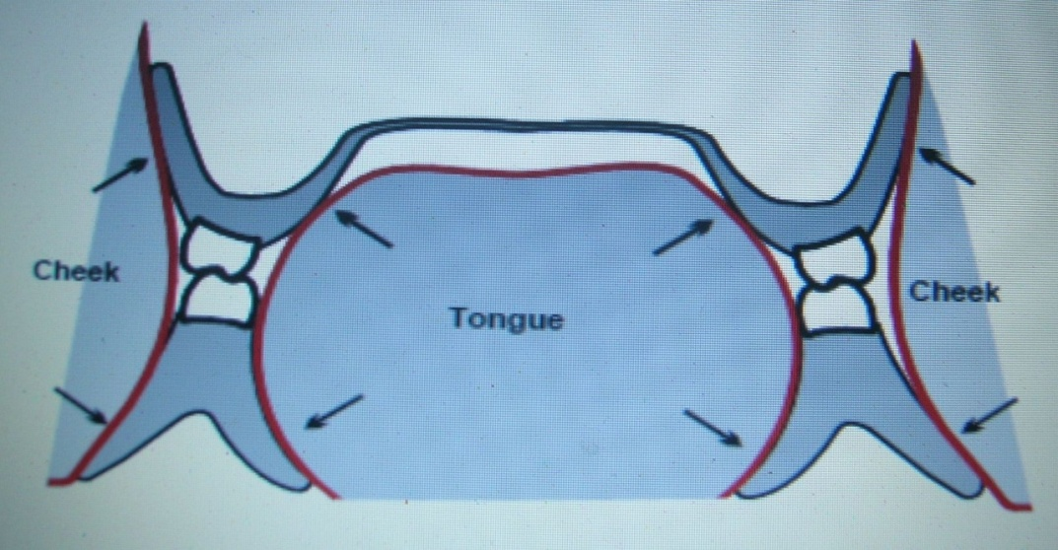
THE NEUTRAL ZONE:
“The most common cause of instability of lower denture is violation of the neutral zone by incorrect arrangement of teeth or incorrect form of labial and lingual flanges of the polished surface ”

Slide 27
RELATIONSHIP OF OPPOSING OCCLUSAL SURFACES:
1. THEORIES OF OCCLUSION:
Balanced occlusion
Lingualized occlusion
Jacobson J. Prosthet. Dent. 1983 49: 165

Slide 28
Balanced occlusion
It is the bilateral, simultaneous, anterior and posterior occlusal contact of teeth in centric and eccentric position.
This provides
Multiple point of contact
Reduces localized stress concentration
Distributes functional occlusal forces
thus ensuring stability of prosthesis
Jacobson J. Prosthet. Dent. 1983 49: 165

Slide 29
Lingualized occlusion
Provide both a limited range of excursive balance and a directing of forces to lingual side of the lower ridge during working side contacts.
Minimize horizontal stress and enhance denture stability by controlling the leverage induced by eccentric tooth contacts.
Jacobson J. Prosthet. Dent. 1983 49: 165

Slide 30
2. SELECTION OF ARTIFICIAL TEETH:
The chosen occlusal scheme
Quality of the residual ridge i.e. Height and conformation.
Weinberg, JPD 1958:8:398-405

Slide 31
3. THE TOOTH POSITION
The wider and larger the ridge and closer the teeth to the ridge to enhance the lever balance.
Wider the ridge, narrower the teeth bucco-lingually greater the balance and vice-versa.
More centered the forces of occlusion antero-posteriorly greater the stability of the base.
Weinberg, JPD 1958:8:398-405

Slide 32
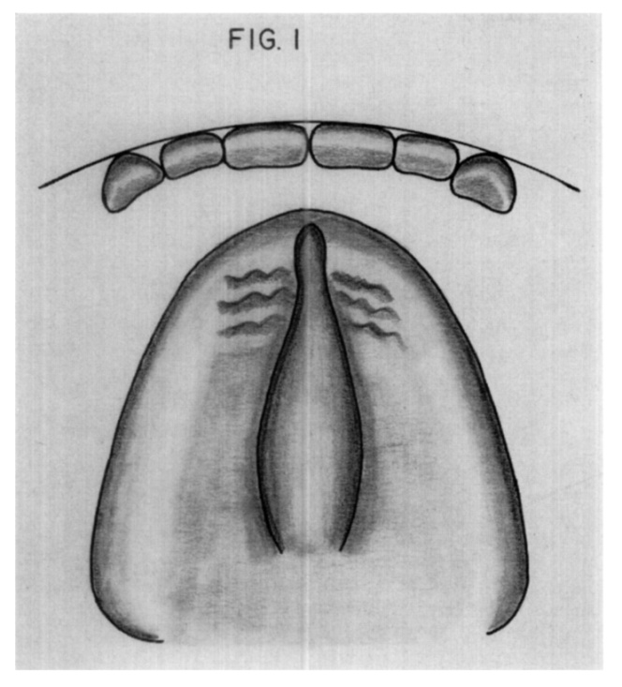
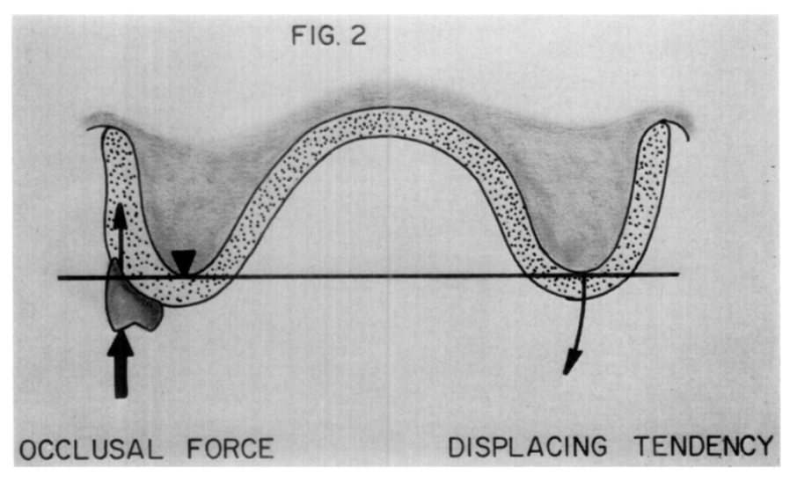
Maxillary anterior tooth position
Arch curvature should correspond to curvature of alveolar ridge, facial contour and maxillary lip position.
Square Arch Position
Weinberg, JPD 1958:8:398-405

Slide 33
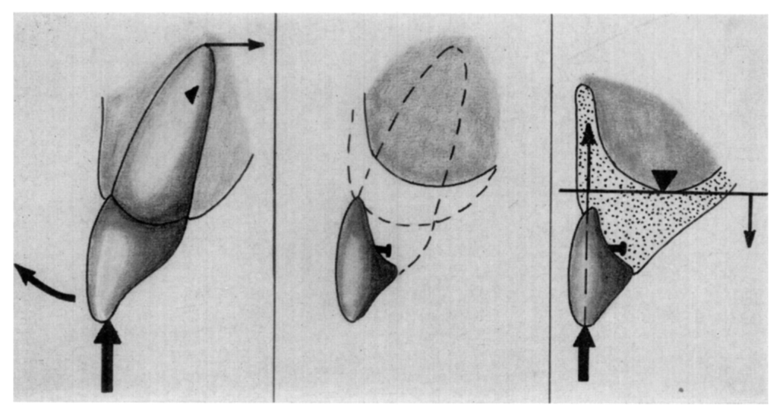
Normal Anterior Alveolar Resorption
Weinberg, JPD 1958:8:398-405

Slide 34
Mandibular Anterior Tooth Position.-
Must Conform To The Maxillary Arch.
Weinberg, JPD 1958:8:398-405

Slide 35
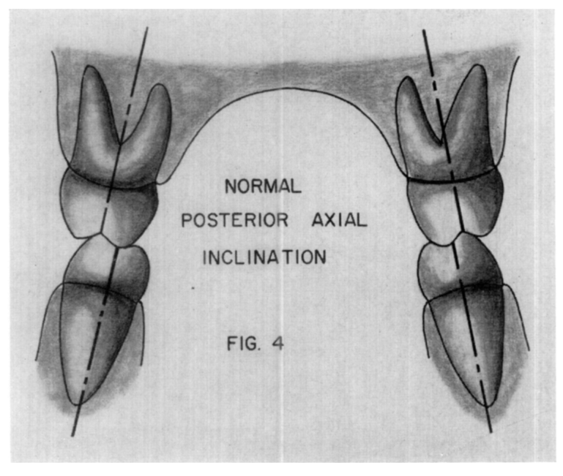
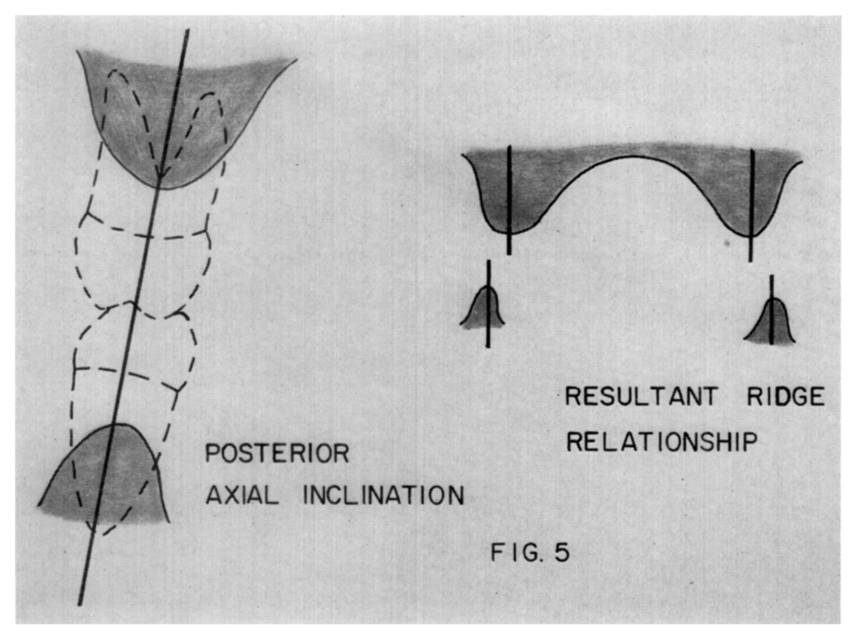
POSTERIOR TEETH POSITIONING
Weinberg, JPD 1958:8:398-405

Slide 36
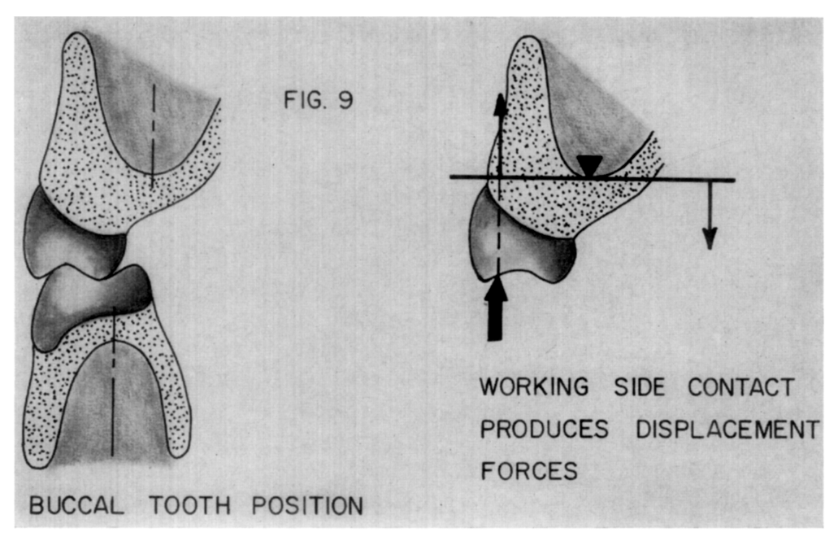
Maxillary
Weinberg, JPD 1958:8:398-405

Slide 37
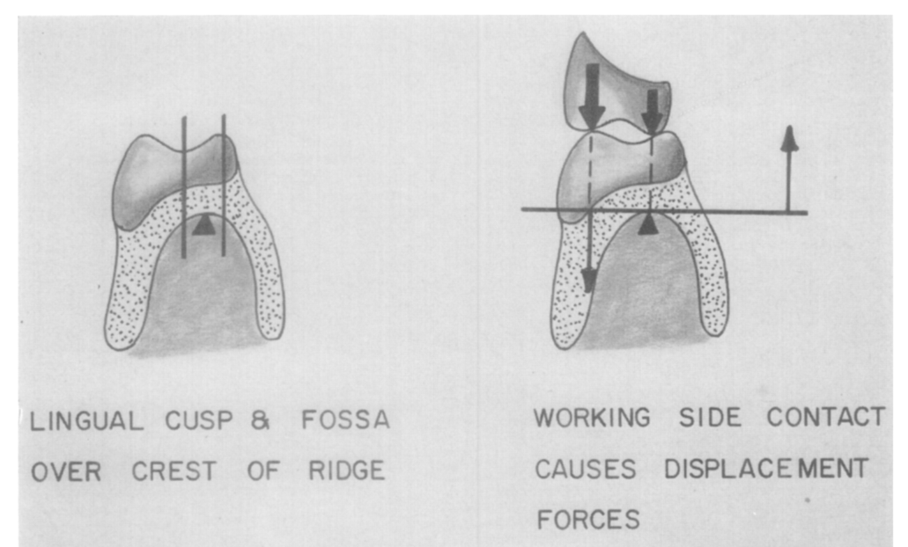
Posterior mandibular tooth position
Weinberg, JPD 1958:8:398-405

Slide 38
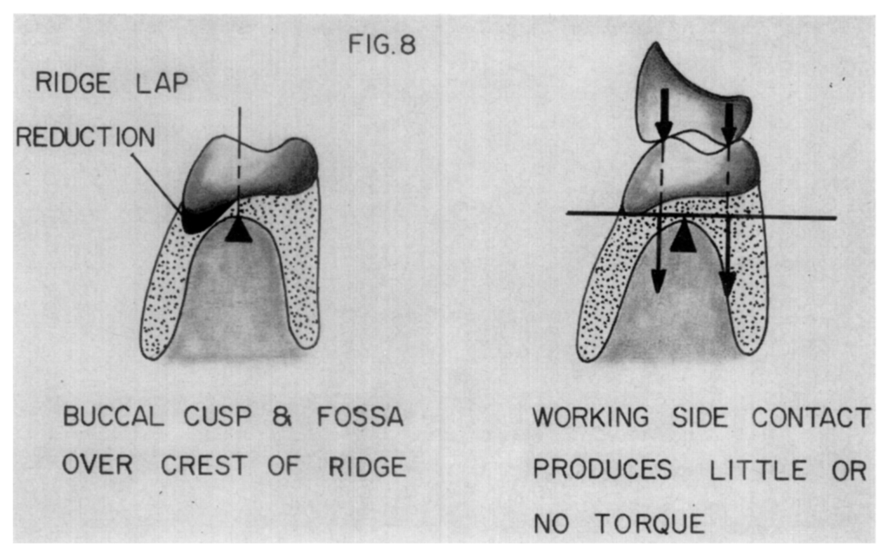
Correct tooth position
Weinberg, JPD 1958:8:398-405

Slide 39
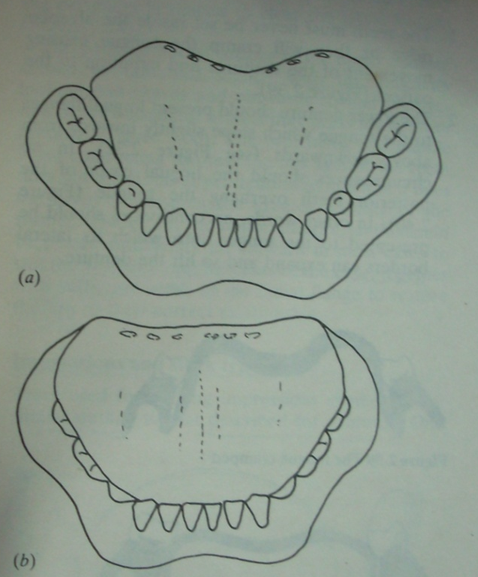
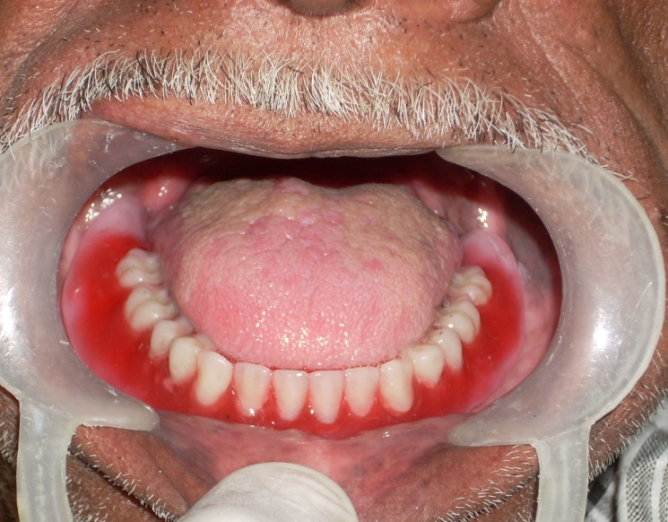
OCCLUSAL PLANE :
Play significant role in denture stability
Mandibular occlusal plane set too high
Can result in Reduced Stability

Slide 40
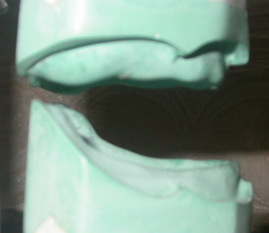
RIDGE RELATIONSHIPS :
Offset ridge relation
Severe posterior cross bite
Class III ridge relation

Slide 41
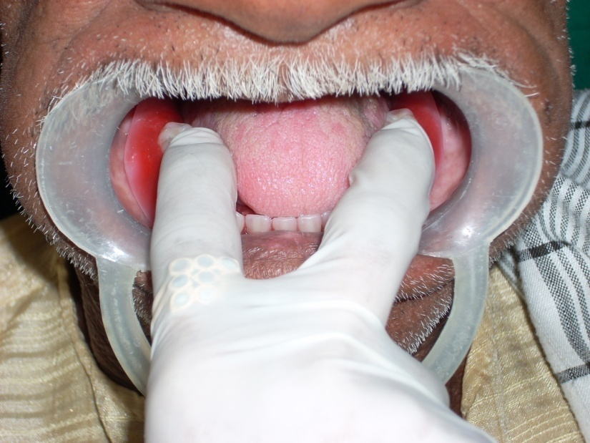
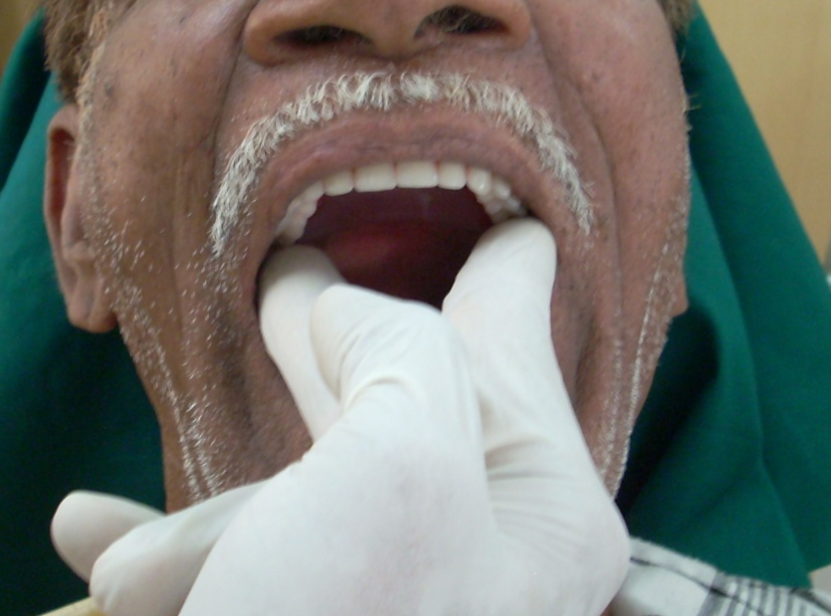
Checking stability of the denture :

Slide 42
CONCLUSION
The factors of stability in complete denture involve the tissue, occlusal and polished surfaces of the denture. Care must be taken in the development of all three of these surfaces to ensure optimal stability of the final prosthesis.

Slide 43
REFERENCES
Zarb - Bolender : Prosthodontic treatment for edentulous patients. Twelfth edition, 2004.
Jacobson T.E. : Contemporary review of factors involved in the complete dentures. JPD. 49: 165, 1983.
Corwin R.Wright, :Evaluation of factors necessary to develop stability in mandibular dentures. JPD. 92:509-518,2004
Wright C.R., Evaluation of the factors necessary to develop stability in mandibular dentures, JPD , 1966, 16, 414–430

Slide 44
5. Lawrence a. Weinberg , Tooth position in relation to the denture base foundation. JPD 1958:8:398-405
6. Donald 0. Lundquist, An electromyographic analysis of the function of theBuccinator muscle as an aid to denturje retention and Stabilization, JPD 1959,9: 44-51
7. Rahn and Heartwell : Textbook of complete denture, 5th edition, 1993.
8. Thomas E. :Stabilizing lower dentures on unfavourable ridges. J. Prosthet. Dent. 12: 420-424, 1962.

Slide 45


