Slide 1
Support in complete denture
Guided by
Dr . Girish Kubasad
Presented by
Rutuja Nirale

Slide 2
Contents
Introduction
Definition
Types of support
Snowshoe principle
Nature of supporting tissue
Anatomic considerations of denture-bearing area
Relief regions
Summary
Conclusion
References

Slide 3
Introduction
Incorporation of certain biological and physical factors are necessary to ensure optimal complete denture support.
Retention
Support
Stability

Slide 4
If the dentures and their supporting tissues are to coexist for a reasonable length of time ,the prosthodontist must fully understand the anatomy of supporting and limiting structures involved.

Slide 5
Complete denture support is
Resistance to vertical movement of the denture base towards tissue.
Counteracts forces towards ridges.
Maintain established - occlusal relation
JPD 1983;49;306.
Notes:
with minimal tissue ward movement & base settling.
and promote optimal function

Slide 6
Definition
Vertical Masticatory forces
Resistance to the vertical movement of the denture base toward the ridge.
Relationship of the denture base and the underlying tissue surface under varying degrees and types of function.
According to Boucher
The resistance to the vertical forces of mastication, occlusal forces and other forces applied in a direction towards the denture bearing area.
DENTURE
BASE
UNDERLYING
TISSUES
Support
GPT 8

Slide 7
Mechanisms of complete denture support
Basic problem lies in treatment of edentulous patients???

Slide 8
Periodontal ligaments
Tissues supporting complete dentures
Entire support area of an arch of teeth – 45 cm²
Maxillary – 22.96 cm²
Mandibular – 12.25 cm²
Bouchers ; Prosthodontic treatment for edentulous patients 12th edition.

Slide 9
Types of support
Considered in two point of view
1.Dentures should conform to the underlying tissues.
2.The denture should maintain this contacts for a period of time.
JPD 1983;49;306.
Notes:
so that the occlusal forces can correctly oppose to one another at initial closure & under functional loading.

Slide 10
Support is achieved
    Through impression procedures
    Directing occlusal forces towards resistant tissues
JPD 1983;49;306.

Slide 11
Factors affecting support
Contour and quality of the residual ridge .
Extent of residual ridge coverage by denture base.
Type and accuracy of the impression registration .
Total occlusal load applied.

Slide 12
Effective support is realized when
    Selective loading of tissues resistant to resorption during function.
    Tissues capable of resisting vertical displacement, make firm contact with denture base.
    Compensate for varying tissue resiliency for uniform denture base movement.
JPD 1983;49;306.

Slide 13
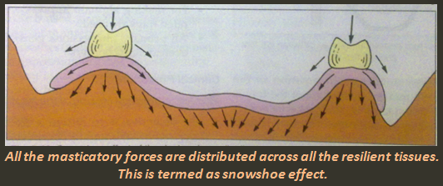
Snowshoe principle
Broader denture bearing area decreases the stress per unit area under the denture base.
Gives a constant occlusal force, decreases tissue displacement ,reduces denture base movement

Slide 14
NATURE OF SUPPORTING TISSUES
  Soft tissues
    Firmly bound to cortex
    Covered by keratinized mucosa
    Resilient submucosa
JPD 1983;49;306.

Slide 15
Strategy of using soft tissue
Mouth tissues should support the denture rather than hold the denture by suspension.

Slide 16
A denture may be supported , suspended, sustained by mucosal base in 3 ways;
A denture is supported ; when the force is basewise and perpendicular, resulting in compressive loads.
A denture is suspended ; when the force is counterbasewise, resulting in tensile loads.
A denture is sustained ; when the force is basewise in one area & counterbasewise in another area.

Slide 17
Hard tissues
Cortical bone
Regions of muscle attachments
Minimizing the pressure in most susceptible area and directing the forces towards relatively resistant to resorption can help to maintain healthy residual ridges .
JPD 1983;49;306.

Slide 18
Bone factor
Intrinsic bone factor
Related to local anatomic and physiologic variation within and between individuals.
JPD 1983;49;306.

Slide 19
Local responds to force by remodeling
Wolff's law
Bone models and remodels in response to the mechanical stresses it experiences so as to produce a minimal structure change that is 'adapted' to its applied stresses.
Notes:
The supporting alveolar bone may differ in its response to stress as compared to basal residual ridge bone.
Response of bone to stress is related to local anatomic and physiologic variations within and between individuals

Slide 20
Pressure tension concept:
pressure stimulates resorption ; tension maintains the integrity or deposition.
Cortical bone more resistant to resorption.
Muscle fiber attachments ensure tension on bone. This minimizes resorptive changes.
JPD 1983;49;306.

Slide 21
Anatomic consideration of the denture bearing area
AS EDWARDS & BOUCHER NOTED;
“Since the success of the complete denture depends largely on the relation of the dentures to anatomic structures which support and limit them, familiarity with the location and character of these structures is essential.”

Slide 22
Mandibular Anatomic consideration
  Mandibular
    Primary stress bearing areas
      Buccal shelf
      Pear shaped pad
    Secondary
      Ridge crest
    Remaining region
      Not useful for support
JPD 1983;49;306.

Slide 23
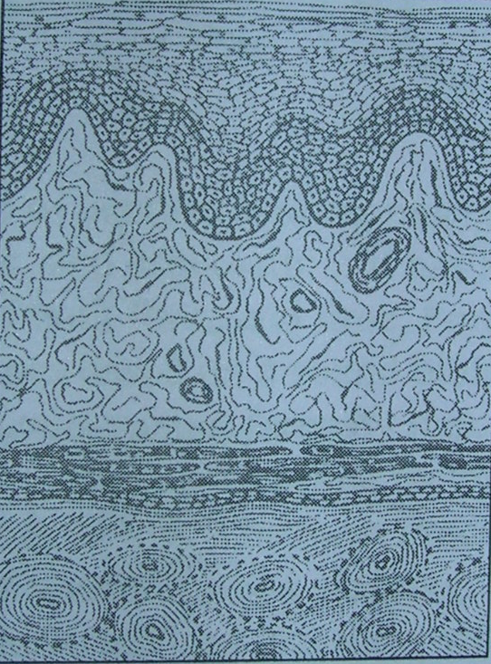
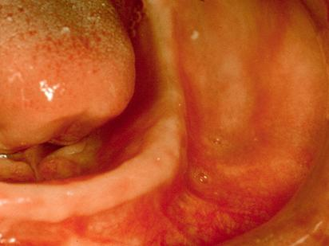
      Buccal shelf
Cortical bone.
Lies at right angles to vertical occlusal forces
JPD 1983;49;306.
A.R.Tencate;Oral histology development structures and function.

Slide 24
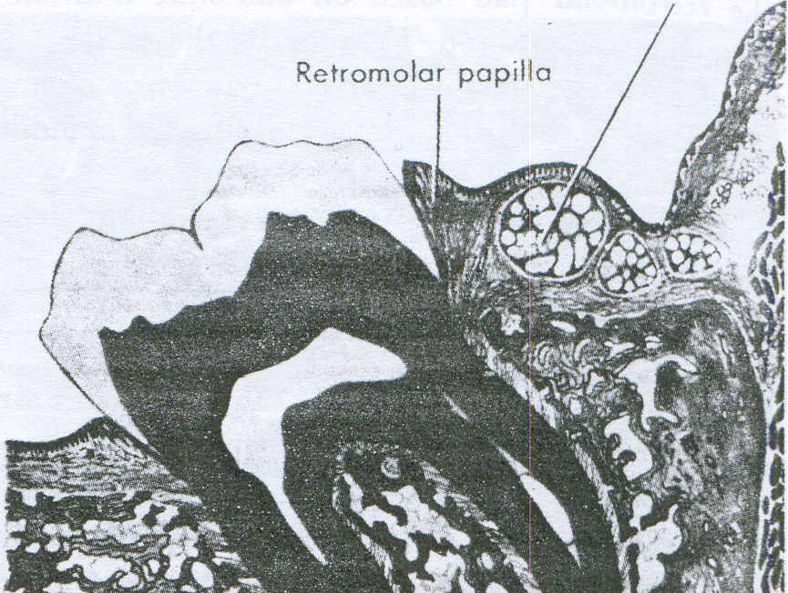
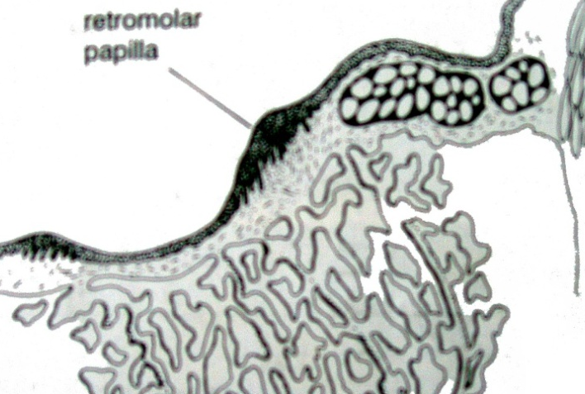
Primary stress bearing area
      Pear shaped pad
Distal extent of keratinized masticatory mucosa
Formed by scaring of extracted 3rd molar and its retromolar papilla.
Denture short of this region
rapid resorption – settling of denture base.
JPD 1983;49;306.

Slide 25
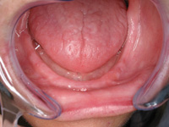
Retromolar pad
Triangular soft pad of tissue at distal end of lower ridge.
Mucosa is composed of;
Thin, nonkeratinized epithelium
Loose alveolar tissue
Submucosa-glandular tissue
fibers –buccinator superior, constrictor temporalis muscle,pterygomandibular raphe
JPD 1983;49;306.

Slide 26
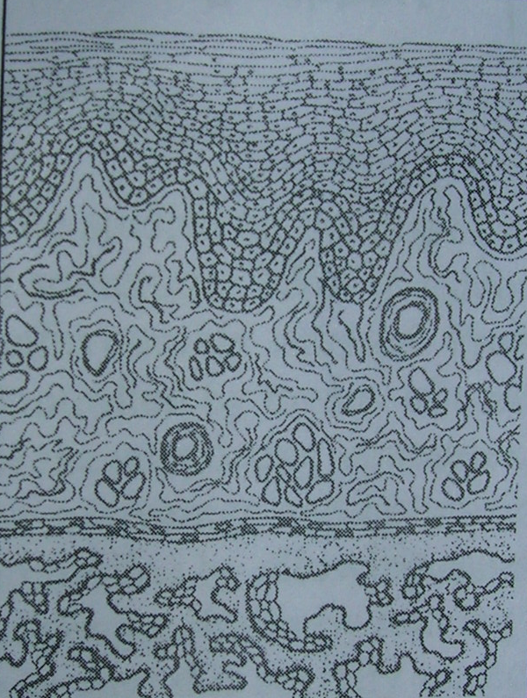
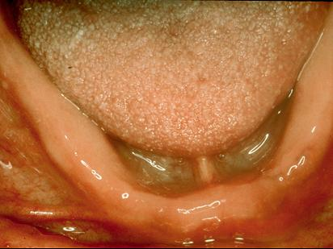
Secondary stress bearing area
      Ridge crest
- Cancellous bone
- Less keratinized alveolar
mucosa

Slide 27
Maxillary Anatomic consideration
  Maxillary
    Primary stress bearing areas
      Horizontal portion of hard palate
    Secondary stress bearing area
      Crest of ridge
    Remaining portion
      Not contributory
JPD 1983;49;306.

Slide 28
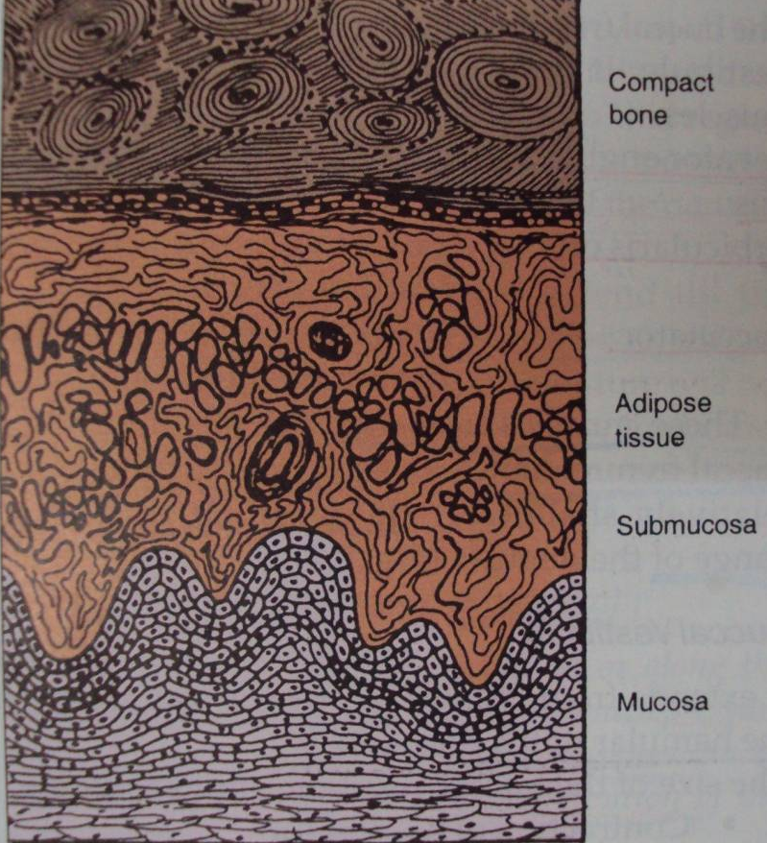
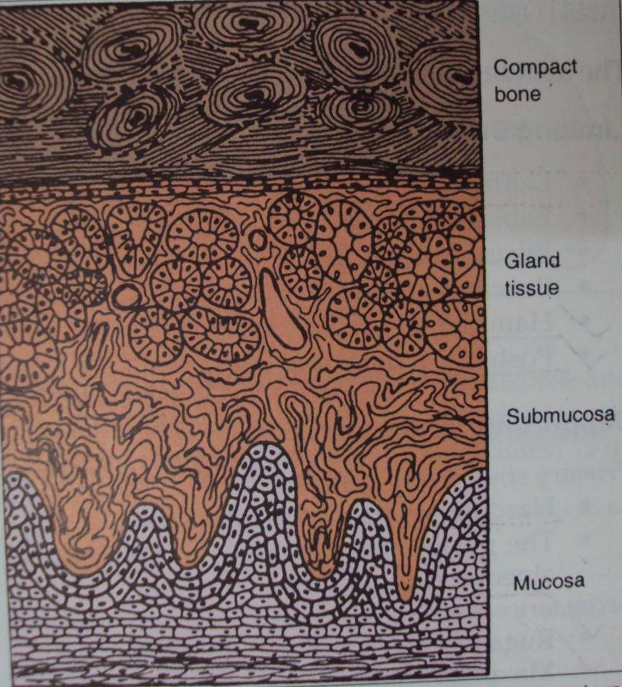
Primary stress bearing area
      Horizontal portion of hard palate
Epithelium keratinized
Submucosa thick and resilient
Bone compact in nature
JPD 1983;49;306.

Slide 29
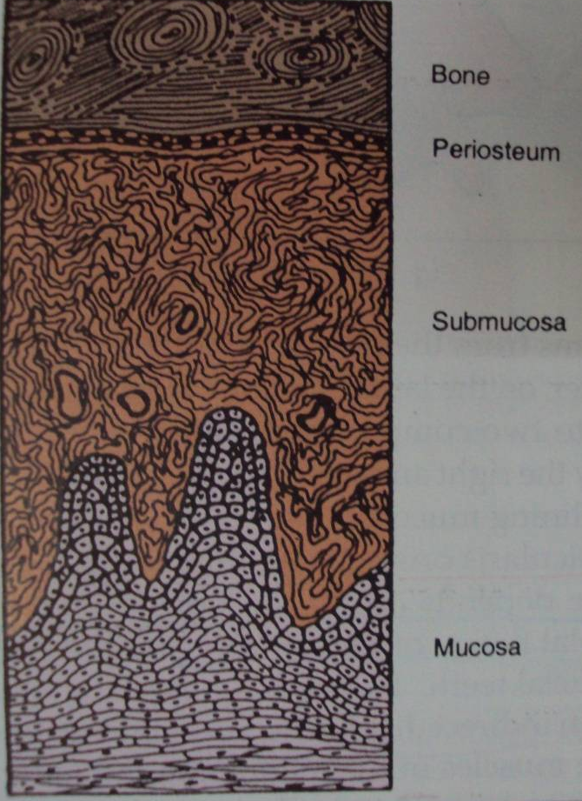
Secondary stress bearing area
      Crest of ridge
The thick submucosal layer,
keratinized,
Cancellous bone
JPD 1983;49;306.

Slide 30
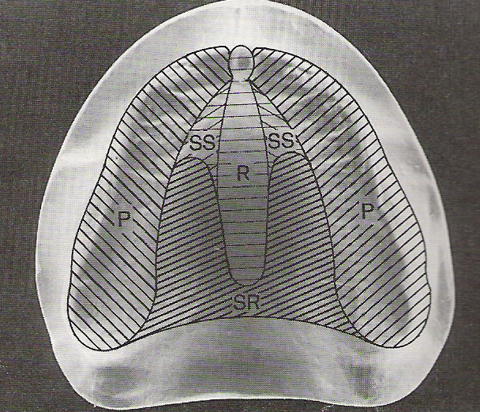
Anatomic consideration
  Relief area
    Tissues susceptible to resorption
    Thin mucosa over hard bone
    Mucosa overlying neurovascular bundles

Slide 31
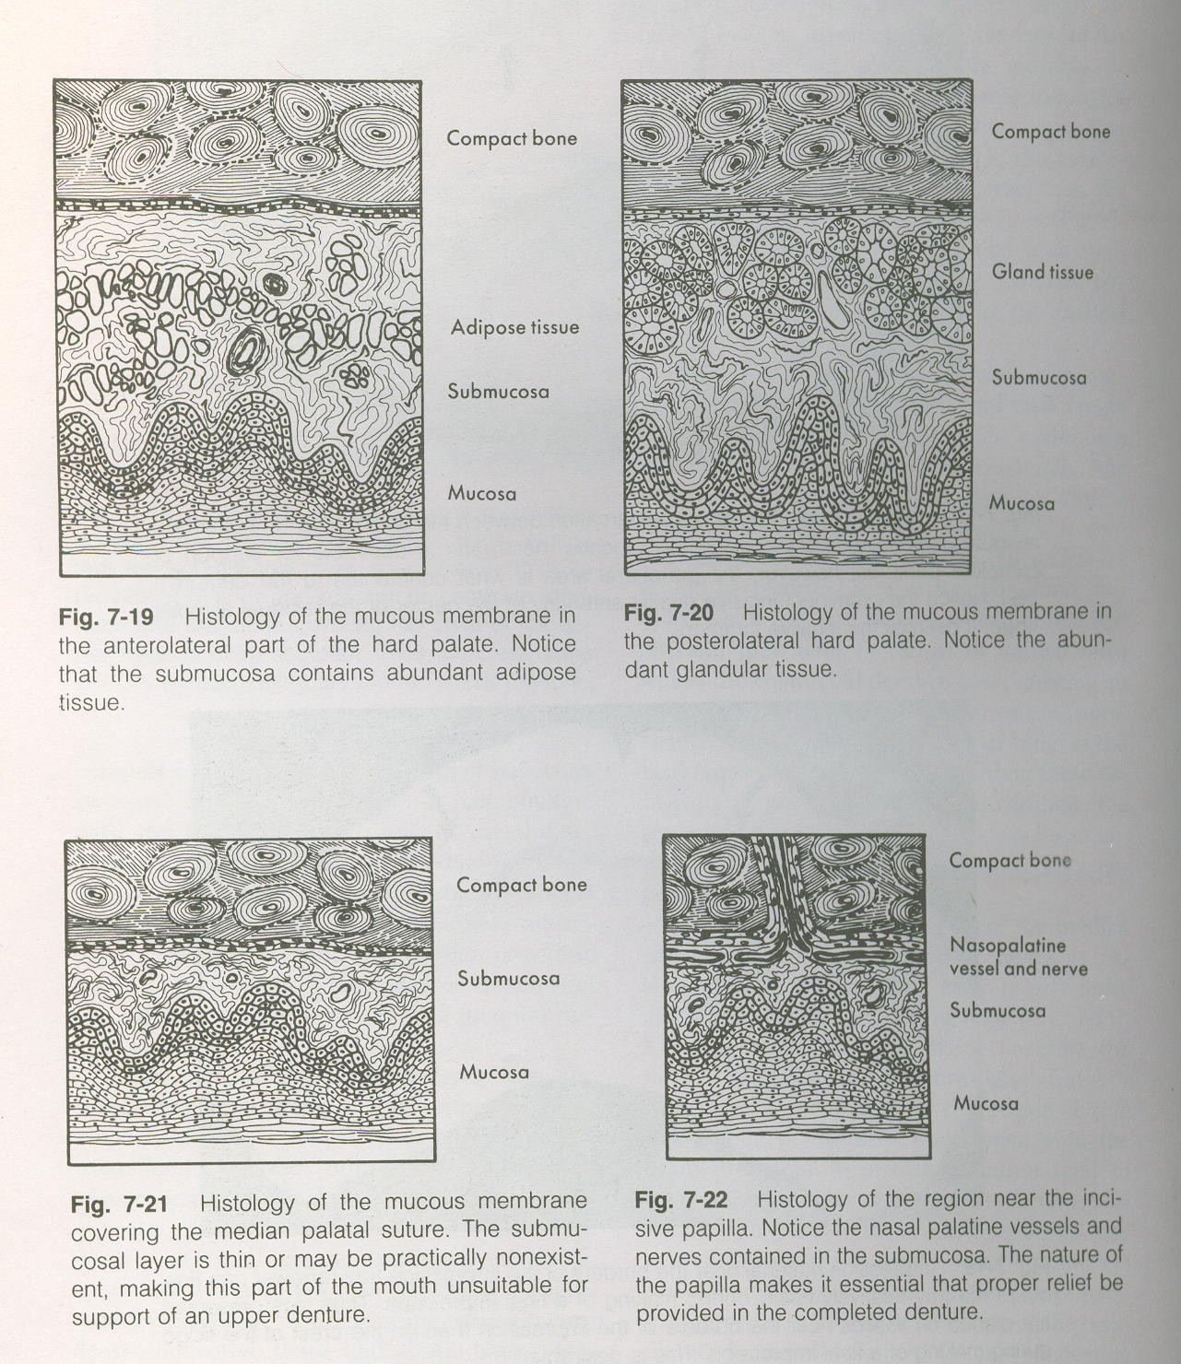
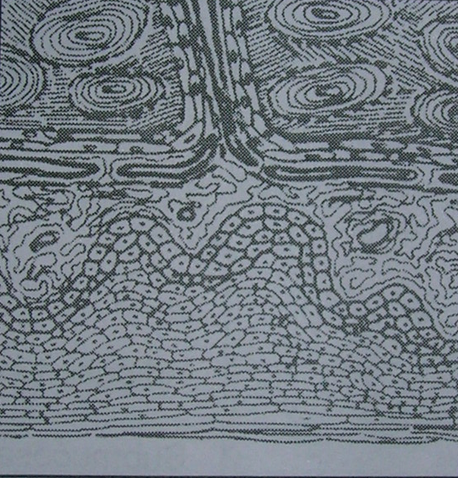
Midpalatine suture and incisive papilla
Submucosa is extremely thin and non resilient

Slide 32
Practical consideration
Principle of impression making – maximal extension of denture bearing area
Tissues vary in their ability to tolerate pressure and transmit it according to their anatomic location and histologic make up.
JPD 1983;49;306.

Slide 33
Desirable impression technique – mild displacement of more resilient tissues
Equalized pressure distribution minimizes localized pressure concentration which otherwise would lead to:
Pressure induced resorption
Mucosal irritation
Base instability
JPD 1983;49;306.

Slide 34
Summary
Dentist must base their technique on understanding the biologic aspects of relationship between denture base and supporting tissue.
Anatomic regions providing primary support should make positive contact with denture base under functional loading .
Areas unable to tolerate stress should be relived of excessive contact with denture base.

Slide 35
Conclusion
Impression techniques , materials and associated procedures should be selected to effect the relationship of the denture base to the underlying tissue that will promote effective and physiologic support for complete dentures.

Slide 36
References
1.A.R.Tencate;Oral histology development structures and function. 4th edition.
2.Bouchers ; Prosthodontic treatment for edentulous patients. 9th & 11th edition.
3.Claud.M.Fraleign –Improvement of tissues for the support of complete dentures.JPD 1959;9;746.
4.Charles M Heartwell ; syllabus of complete dentures.5th edition.

Slide 37
5.Donald .E.Van. Scotter,- The nature of supporting tissue for complete dentures. JPD 1965;15;285.
6.Frank.R.P-Analysis of pressure produced during maxillary impression procedures.JPD 1969 22:400
7. C. P. Oven ,Fundamental of removable partial denture.
8. M.M.Devan –Basic principles for impression making JPD;1952;2;26.
9. T.E.JACOBSON.”A contemporary review of the factors involved in complete denture part 111; support ; JPD 1983;49;306.

Slide 38
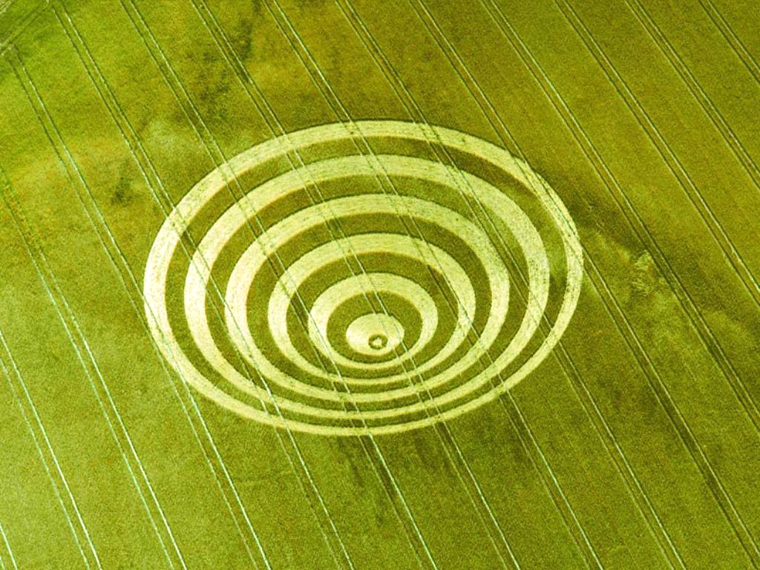
Thank you

Slide 39
Review of literature
FRANK, conducted a study to determine the effect of tray modifications & selection of impression materials on pressures exerted on the denture supporting tissues .
Conclusion:
More pressures were measured at the crest of the ridge than on the palate when no relief was used.
Use of escape vents or relief was equally effective in decreasing pressures & equalizing the pressures on the ridge crest ,palatal area.

Slide 40
bone changes its external shape and internal (cancellous) architecture in response to stresses acting on it.
bone models and remodels in response to the mechanical stresses it experiences so as to produce a minimal-weight structure that is 'adapted' to its applied stresses.

