Slide 1
BORDER MOULDING
PRESENTED BY-
GAURI CAMBLAY
SHRUTIKA DHOLE

Slide 2
Border molding is the shaping of the border area of an impression tray by functional or manual manipulation of the tissues adjacent to the borders to duplicate the contour and size of the vestibule or determining the extension of a prosthesis by using tissue function or manipulation.
-Gpt-8

Slide 3
PURPOSE
SHAPE OF THE BORDER OF THE TRAY IS MADE TO CONFIRM THE BORDERS OF THE LIMITING STRUCTURES ACCURATELY.

Slide 4
CUSTOM TRAY
THE CUSTOM TRAY SHOULD BE 2MM SHORT OF THE VESTIBULE.

Slide 5
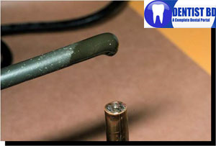
MATERIALS
GREEN STICK IMPRESSION COMPOUND

Slide 6
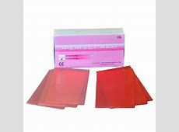
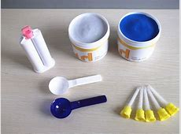
IMPRESSION WAXES SILICON MATERIAL

Slide 7
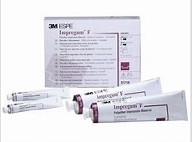
POLY ETHER

Slide 8
TECHNIQUE
THERE ARE TWO TECHNIQUES OF BORDER MOULDING:
1)SECTIONAL/INCREMENTAL BORDER MOULDING-GREENSTICK IMPRESSION COMPOUND
2)SINGLE STEP/SIMULTANEOUS BORDER MOULDING-POLYETHER,IMPRESSION WAXES,SILICON MATERIAL

Slide 9
PROCEDURE
1
At first the flange of custom tray should be reduced until they are 2mm short of the the reflection
2
Green stick compound is softened over flame till it begins to droop
3
Add softened green stick compound along the portion of the tray when border should be intended to be refined.

Slide 10
The material should be tempered with warm water before placing intraorally
The impression compound should be placed according to the sequence
Evaluate the retention and stability of border moulded tray

Slide 11
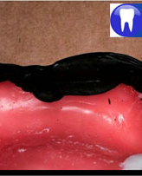
Incremental technique
Distobuccal area:
1)Active: patient is asked to open wide, close and move the mandible from side to side.
2)Passive:The cheek is pulled outward, downward and inward.

Slide 12
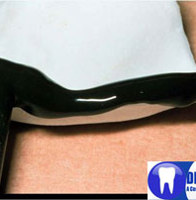
Buccal flange
1)Active: patient is asked to pucker the lips and smile.
2)Passive: cheek is elevated and pulled outward,downward and inward and move backward and forward.

Slide 13
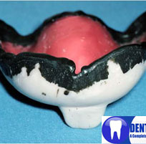
LABIAL FLANGE
1)Active:Patient is asked to pucker,open wide,grimace and smile.
2)Passive:outward,downward and inward.

Slide 14
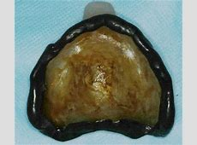
Posterior palatal seal area:
Instruct the patient to open wide.
Hold the patient’s nostrils closed with your fingers and instruct the patient to blow through his nose.
Add an additional layer of compound and insert and have the patient swallow.

Slide 15
THANK YOU .

