Slide 1
FLUID CONTROL
&
SOFT TISSUE MANAGEMENT

Slide 2
FLUID CONTROL
During preparation of teeth
During impression making
During cementation

Slide 3
FLUID CONTROL
Rubber dam
High-volume vacuum
Saliva ejector
Svedopter
Antisialagogues

Slide 4
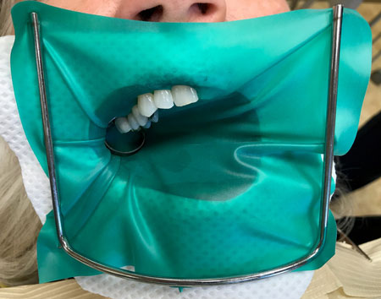
1. Rubber dam
Is the most effective of all isolation devices used in restorative dentistry.

Slide 5
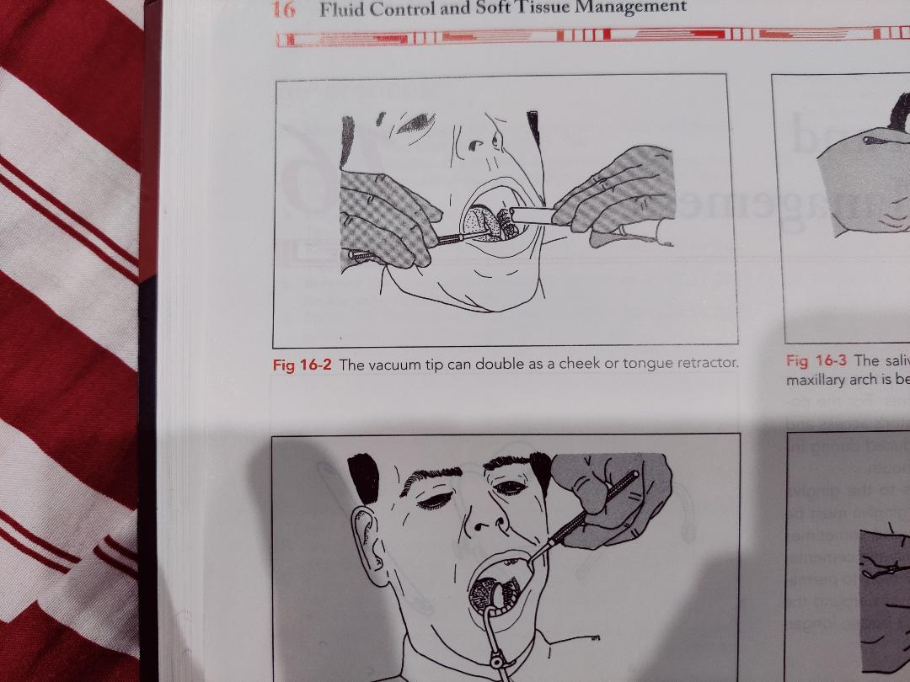
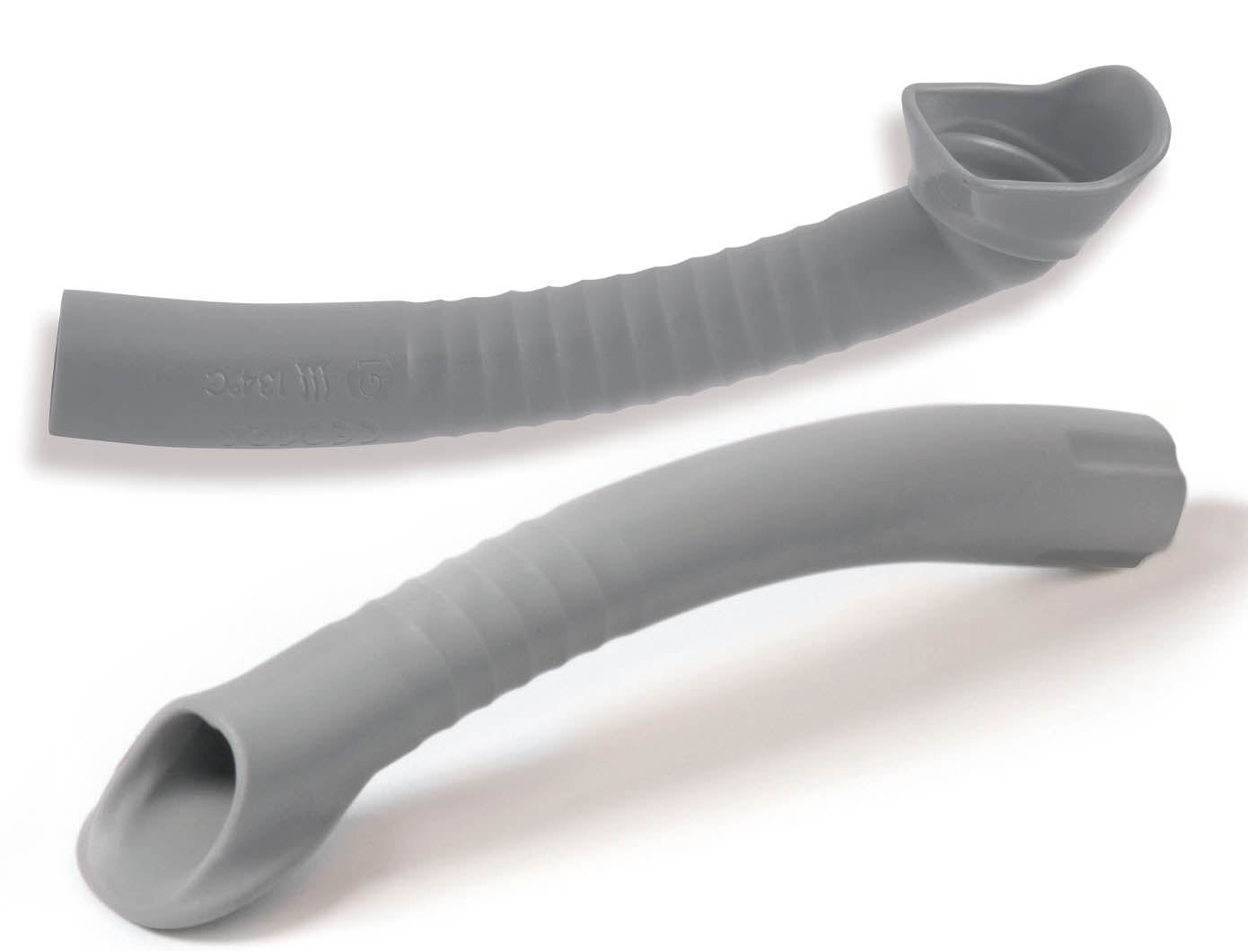
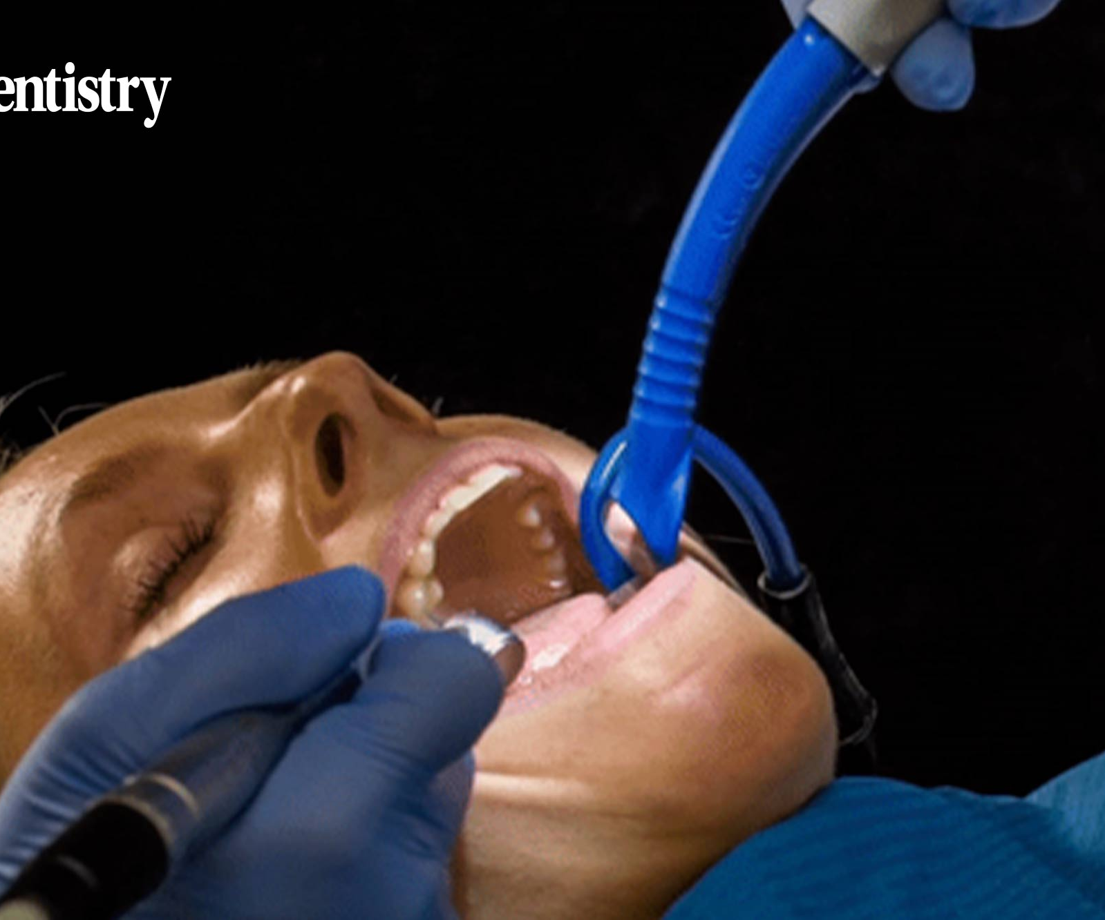
2. High – volume vacuum
Excellent retractor
During preparation phase with the assistant
Not practical during impression or cementation phases

Slide 6
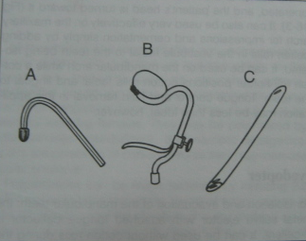
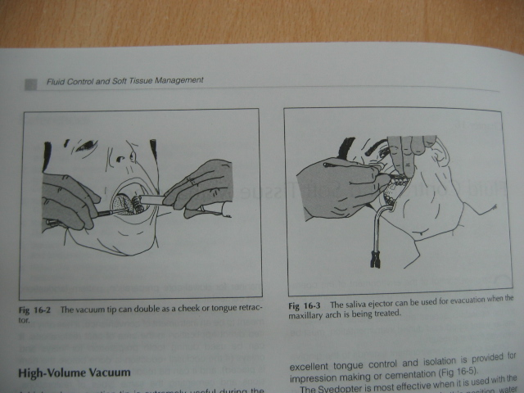
Saliva ejector
Svedopter
Vacuum tip
Vacuum tip Saliva ejector

Slide 7
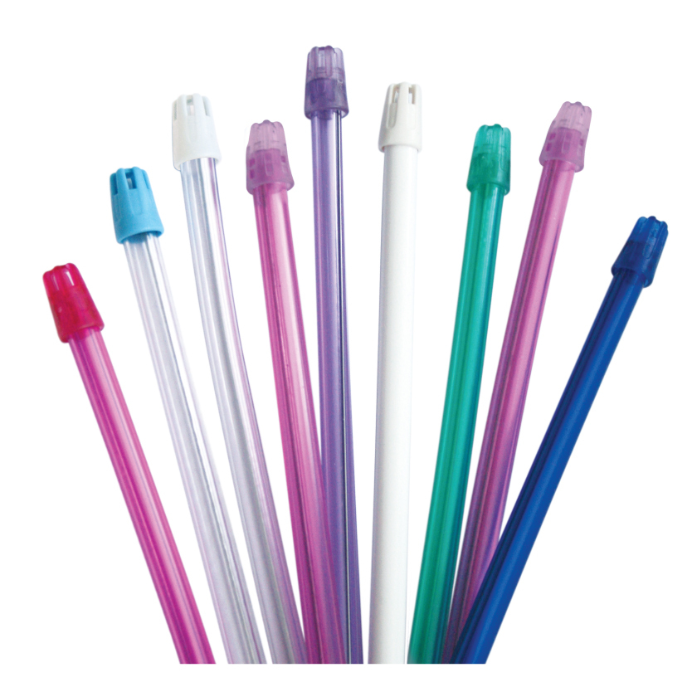
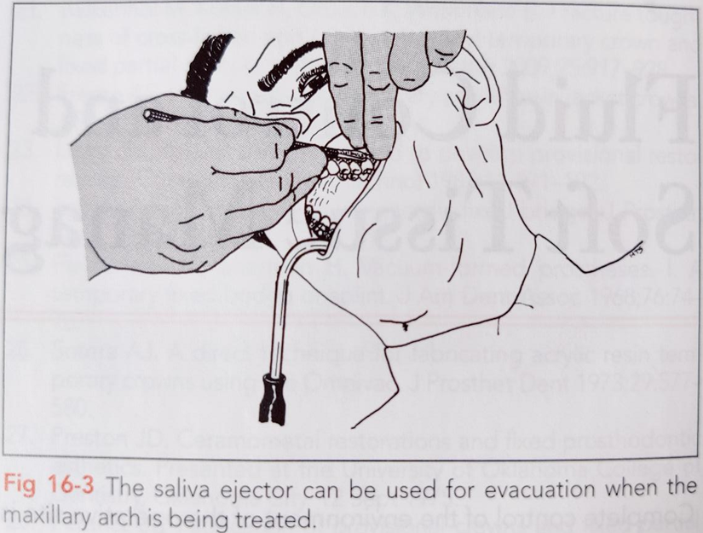
3. Saliva ejector :
Most useful as an adjunct to high- volume evacuation
Used for maxillary arch
Placed in the corner of the mouth opposite quadrant being treated
Can be used for mandibular arch along with cotton rolls

Slide 8
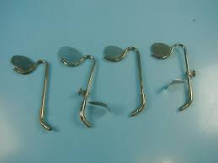
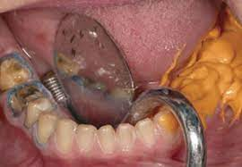
4. Svedopter :
metal saliva ejector with attached tongue deflector
For isolation & evacuation of mandibular teeth
Effective when the patient is sitting upright
Excellent for lone operator
Care must be taken to avoid tissue bruising
Mandibular tori – avoid

Slide 9
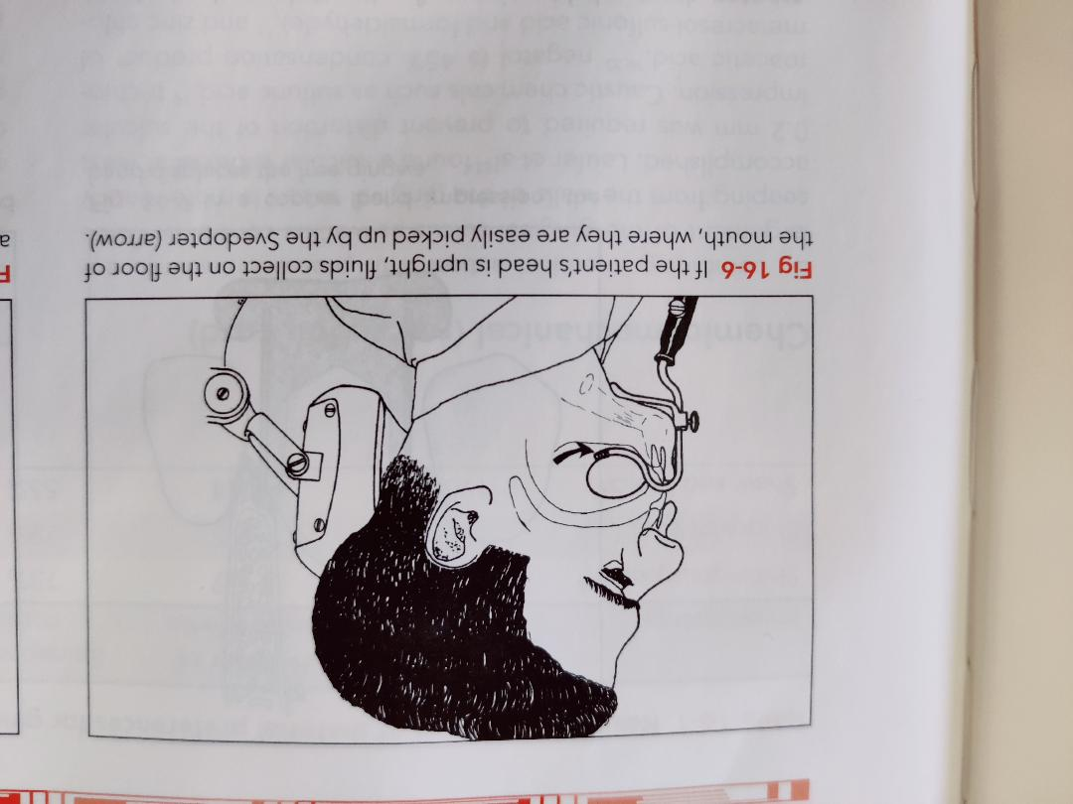
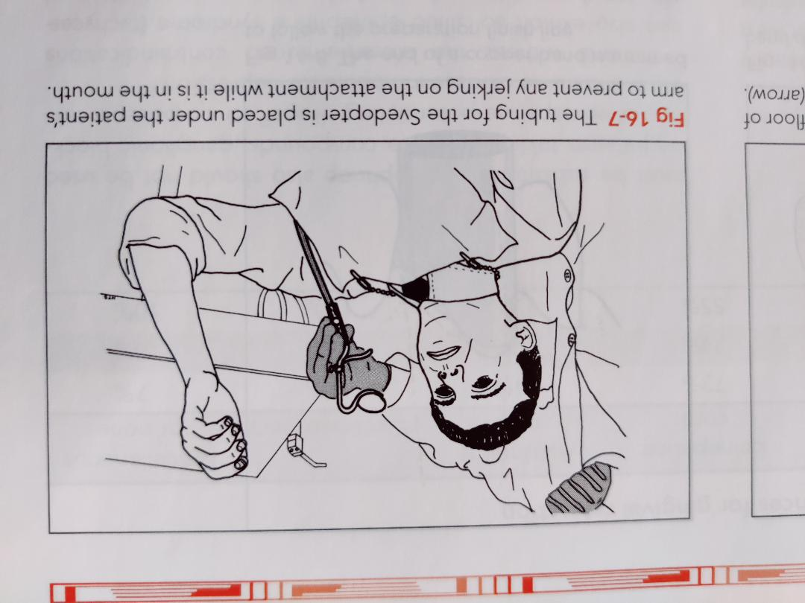

Slide 10
5. Antisialagogues
i) 50mg Methantheline bromide (Banthine) and 15mg propantheline bromide (Pro-Banthine)
gastrointestinal anticholinergics
act on the smooth muscles of the gastrointestinal, urinary, and biliary tracts, dry mouth as a side effect
Effects- drowsiness, blurred vision & unpleasant, bitter aftertaste
ii) 0.2mg clonidine hydrochloride
antihypertensive agent
side effect- besides a dry mouth, drowsiness

Slide 11
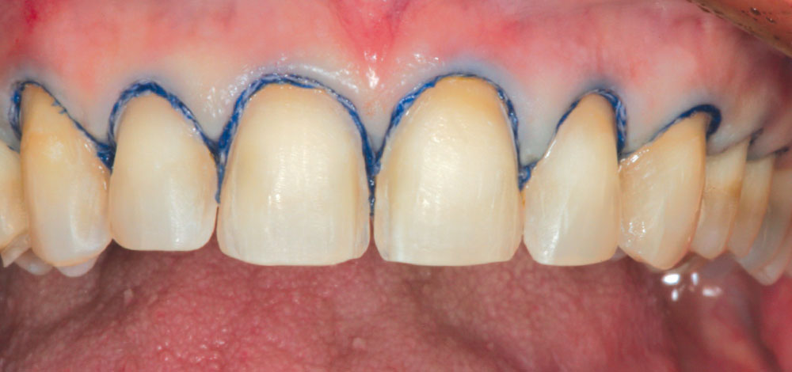
Gingival Retraction
Dr. KAMAL SHIGLI

Slide 12
LAQ
What do you understand by the term tissue dilatation, and what are the different methods to obtain it?
SAQ
Write a note on soft tissue management in fixed prosthodontics.

Slide 13
CONTENTS
DEFINITION
AIM
CLASSIFICATION OF GINGIVAL RETRACTION METHODS
Mechanical methods
Chemico-mechanical method
Surgical methods
    a. Rotary gingival curettage
    b. Electrosurgical methods
Lasers
RECENT ADVANCES IN GINGIVAL RETRACTION MATERIAL

Slide 14
Definition
Gingival Retraction/displacement is deflection of the marginal gingiva away from a tooth. (GPT-9)
Gingival retraction is a process of exposing margins when making impression of prepared teeth.

Slide 15
AIM:
Reversibly displaces gingival tissue in labial direction
Allows bulk of impression material to be introduced into the widened sulcus
Capture the marginal detail.

Slide 16
Critical Sulcular Width : 0.2 mm
Impression with width < 0.2mm:
  ↑ Incidence of voids in the marginal area
  ↑ Tearing of impression material
  ↓ Marginal accuracy
Optimal position of gingival margin:
        0.5 mm from healthy free gingiva .
        3 to 4 mm from crest of alveolar bone.
        Must follow the natural scalloped form.

Slide 17
Classification
    1. Mechanical methods
    2. Chemico-mechanical method
    3. Surgical methods
    a. Rotary gingival curettage
    b. Electrosurgical methods
    4. Lasers

Slide 18
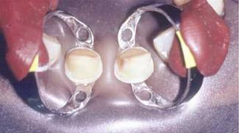
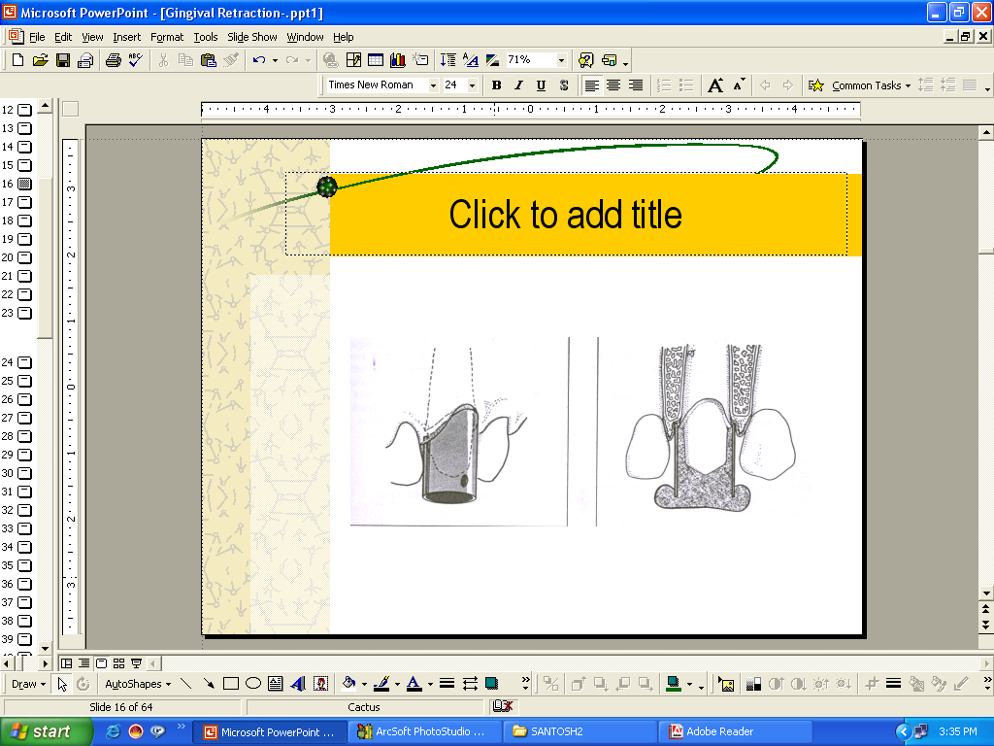
Mechanical methods

Slide 19
Mechanical Method……
First to be developed
Physical displacement of gingival tissue
Used alone or in conjunction with other methods Methods:
Rubber dam
Copper rings
Aluminium shell

Slide 20
A. Rubber dam
    Heavy & extra heavy rubber dams are used
    Produced retraction by compression
    Advantages
    Control of seepage & hemorrhage
    Ease of application
    Disadvantages
    Full arch models cannot be made
    Severe cervical extension preparations

Slide 21
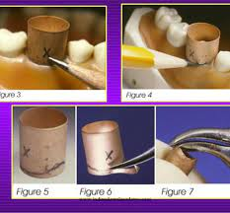
B. Copper band impressions
Means of carrying the impression material & a mechanism for gingival retraction.
Technique
  Selection of copper band.
  One surface of band may be perforated.
  Cervical end of the band may be trimmed in accordance with the finish line.
  It is filled with modeling compound, then seated carefully in place along the path of insertion of the tooth preparation.

Slide 22
ADVANTAGES
Copper bands are especially useful for situations in which several teeth have been prepared. The likelihood of capturing all of the finish lines in one impression decreases as the number of prepared teeth increases.
The use of a copper band could negate the necessity of remaking an entire full-arch impression just to capture one or two preparations.

Slide 23
Chemico-mechanical method
Gingival retraction using chemically impregnated retraction cord is a mechanico-chemical method of displacement:
    Mechanical aspect
    Chemical aspect

Slide 24
Chemicomechanical (RETRACTION CORD)
By combining chemical action with pressure packing, enlargement of the gingival sulcus as well as control of fluids seeping from the walls of the gingival sulcus is accomplished.

Slide 25
criteria for a gingival retraction material
(1) effectiveness in gingival displacement & hemostasis,
(2) absence of irreversible damage to the gingiva, &
(3) minimal untoward systemic effects.

Slide 26
Chemicomechanical (RETRACTION CORD)
cord impregnated with 8% racemic epinephrine was the most commonly used means of producing gingival retraction.
Epinephrine produces hemostasis, & it causes local vasoconstriction, which in turn results in transitory gingival shrinkage.
Epinephrine causes an elevation of blood pressure & increased heart rate.

Slide 27
Most commonly used vasoconstrictor is epinephrine.
It is contraindicated in some of the conditions such as:
Patient who are hypersensitive to epinephrine.
Patient having some CVS disorder.
Patient on pacemaker.
Hyperthyroidism
Systemic manifestation of gingival procedures:
maximum dose(MD) of epinephrine for
Healthy patient HP: 0.2 mg
Cardiac patient CP :0.04 mg
Epinephrine impregnated cord contain 0.2 to 1 mg of racemic epinephrine per inch of cord depending on diameter.

Slide 28
Donovan & associates reported that only 3% of the dentists they surveyed recorded the patient’s pulse, & fewer than 10% recorded blood pressures routinely. Given this, it is likely that few patients would receive even a rudimentary cardiovascular evaluation. Therefore, the routine use of epinephrine in dentistry, even on healthy patients, has been questioned.

Slide 29
Chemicals used :
Aluminum chloride [AlCl₃ ],
Alum (aluminum potassium sulfate), [Al K(SO₄)₂ ],
Aluminum sulfate [Al₂ (SO₄)₃ ], &
Ferric sulfate [Fe₂ (SO₄)₃]
Nasal and ophthalmic decongestants-
      Oxymetazoline hydrochloride 0.05%
      Tetrahydrozoline hydrochloride 0.05%
      Phenylephrine hydrochloride 0.25%

Slide 30
Chemicals used :
  0.1% Epinephrine for 10 min
  100% Alum solution (potassium aluminium sulfate) for 10 min
  5% and 25% aluminium chloride solution for 10 min
  13.3% ferric sulfate solution
  8% and 40% zinc chloride solution for 3 min
  20% and 100% tannic acid solution for 10 min
  Merocel
  Ferric subsulphate (Monsel’s solution) for 3 min
  Neosynephrine

Slide 31
  45% Negatol solution (45% condensation product of meta cresol sulfonic acid and formaldehyde)
  Caustic acid –sulfonic acid ,trichloracetic acid.
  Nasal and ophthalmic decongestants-
      Oxymetazoline hydrochloride 0.05%
      Tetrahydrozoline hydrochloride 0.05%
      Phenylephrine hydrochloride 0.25%
  Combinations of chemicals
      Zinc chloride with 8% epinephrine

Slide 32
Mechanism of action
Vasoconstrictors –
They act by:
Transitory gingival shrinkage.
Transient ischemia.
Controlling seepage of gingival fluid.
Vasoconstrictors physiologically restrict the blood supply to the area by decreasing
Size of the blood capillaries.
Tissue fluid seepage.
Consequently size of the free gingiva.
Ex: epinephrine & norepinephrine.

Slide 33
Biologic fluid coagulants-
Coagulate blood & tissue fluids locally,
Creating surface layer that is efficient sealant against blood and crevicular fluid seepage.
Very safe agent as they induce no systemic effects.
Ex: 100% alum,
15-25% aluminium-chloride,
10% aluminium potassium sulphate &
15-25% tannic acid.

Slide 34
Surface layer tissue coagulants –
Coagulate surface layer & free gingival epithelium as well as seeped fluids
They create temporarily impermeable film for underlying fluids.
  Effects of excessive amount/ time:
  Ulceration, local necrosis, & change in the dimension & location of the free gingiva
  Ex: 8% zinc chloride & silver nitrate.

Slide 35
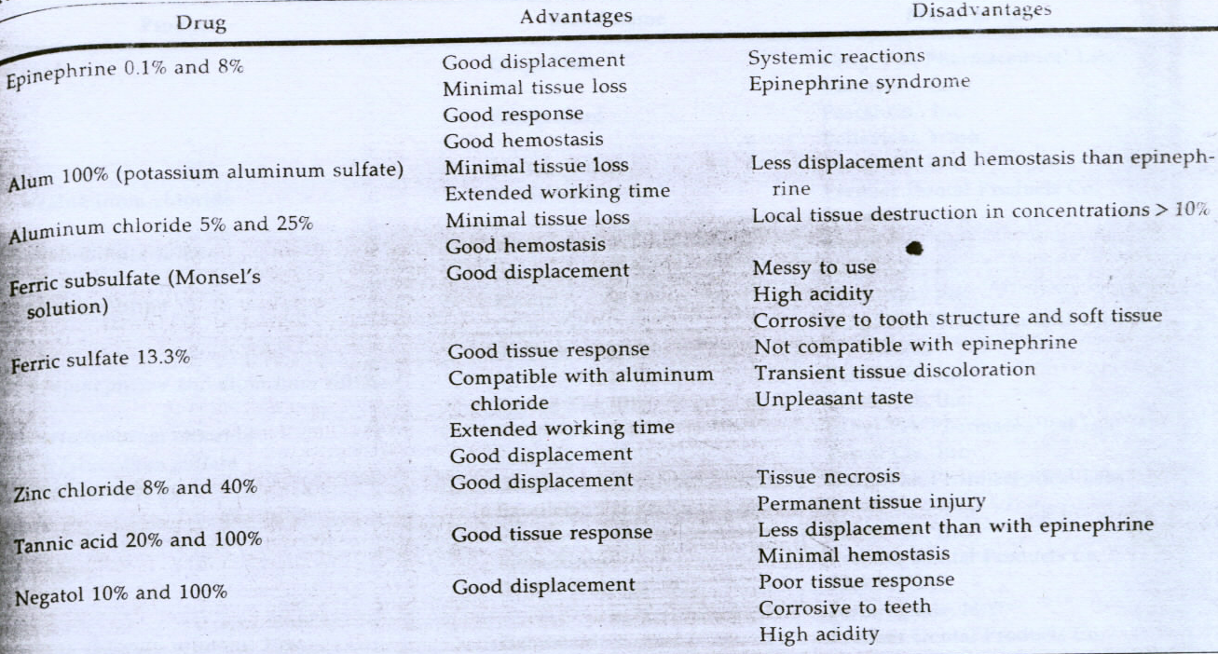
Advantages & disadvantages of
CHEMICO-MECHANICAL method

Slide 36
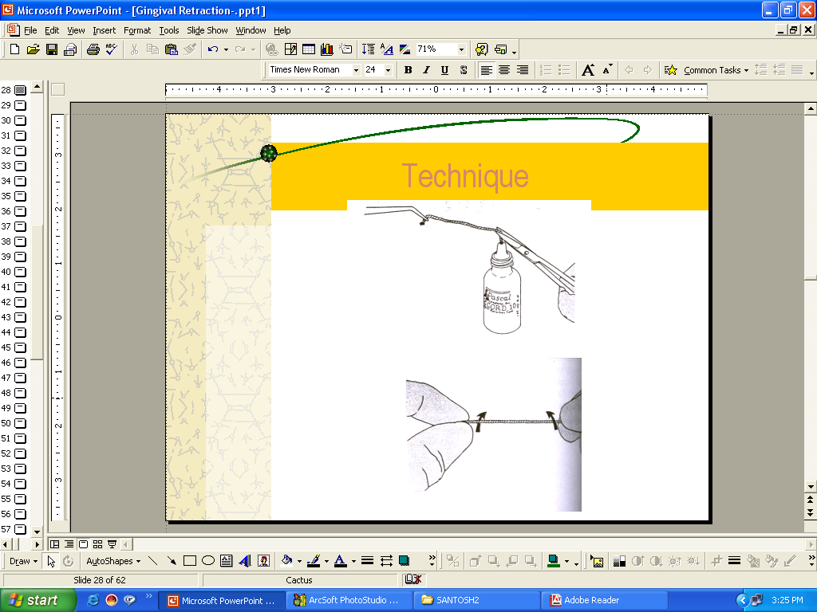
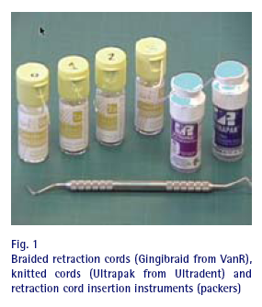
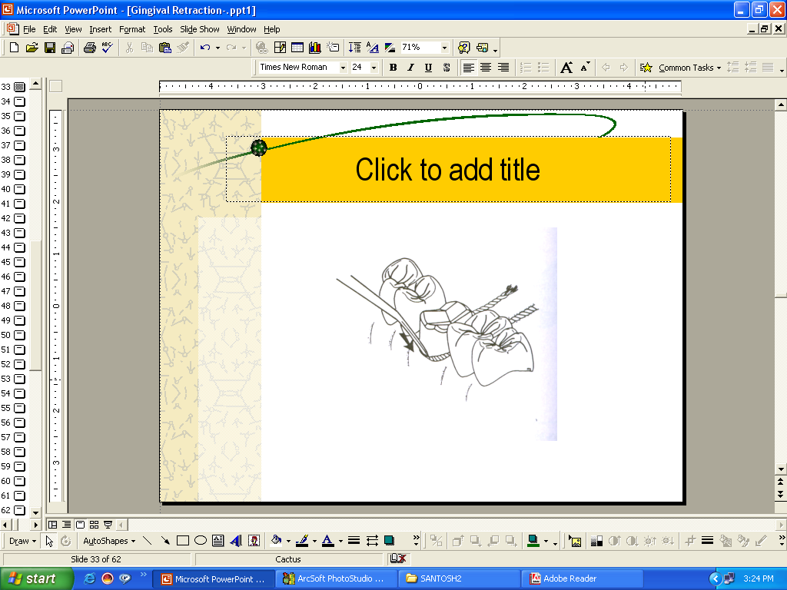
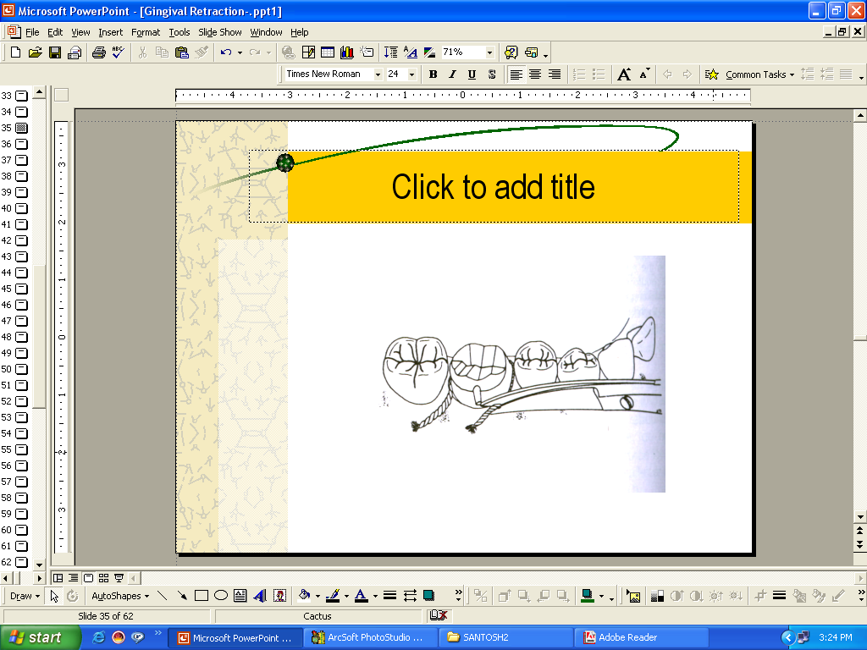
GINGIVAL RETRACTION CORD

Slide 37
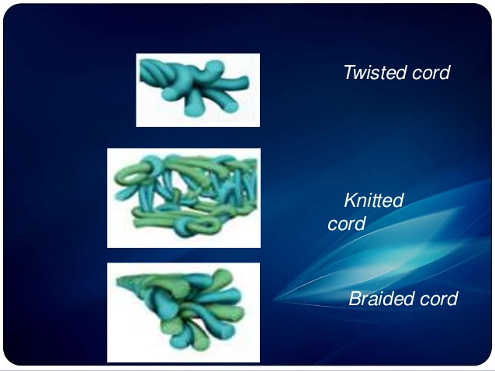
Classification of retraction cords
[6] a.- f.
a. Depending on the configuration
Twisted
        Knitted
        Braided
        Plain
b. Depending on surface finish
Waxed
Unwaxed

Slide 38
c. Depending on the chemical treatment
Plain
Impregnated
d. Depending on number of strands
Single
Double-string

Slide 39
e. Depending on the thickness (color coded)
Black 000
Yellow 00
Purple 0
Blue 1
Green 2
Red 3
f. Depending on surface texture
Wet
Dry

Slide 40
Techniques of gingival retraction:
  Single cord technique.
  Double cord technique.

Slide 41
SINGLE CORD TECHNIQUE

Slide 42
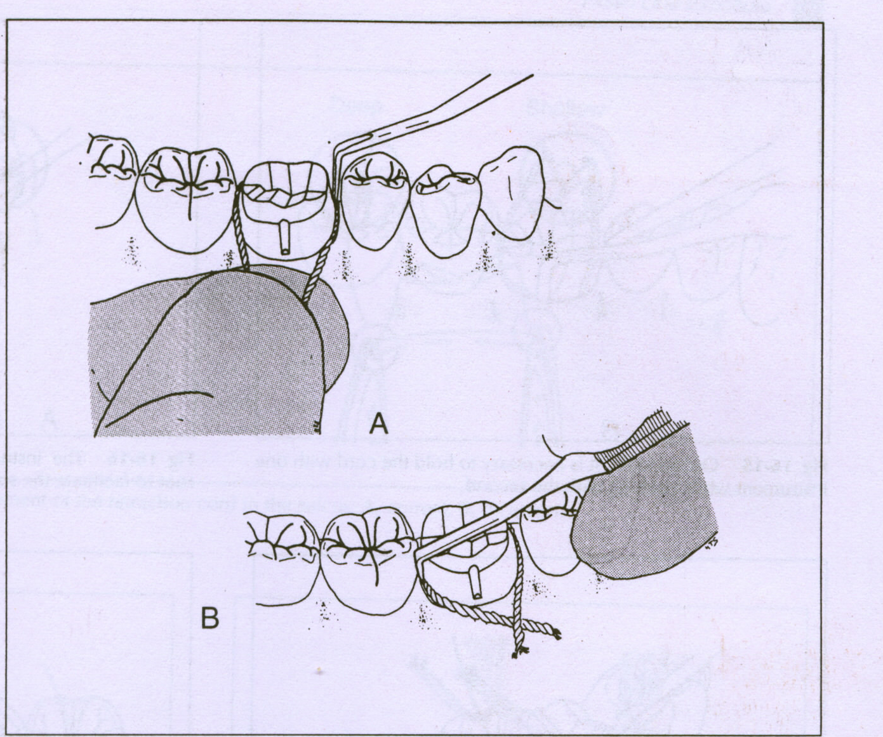
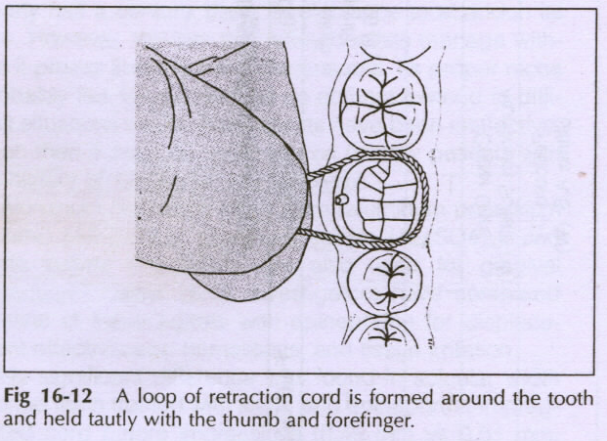

Slide 43
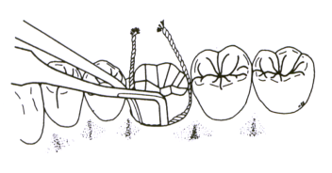
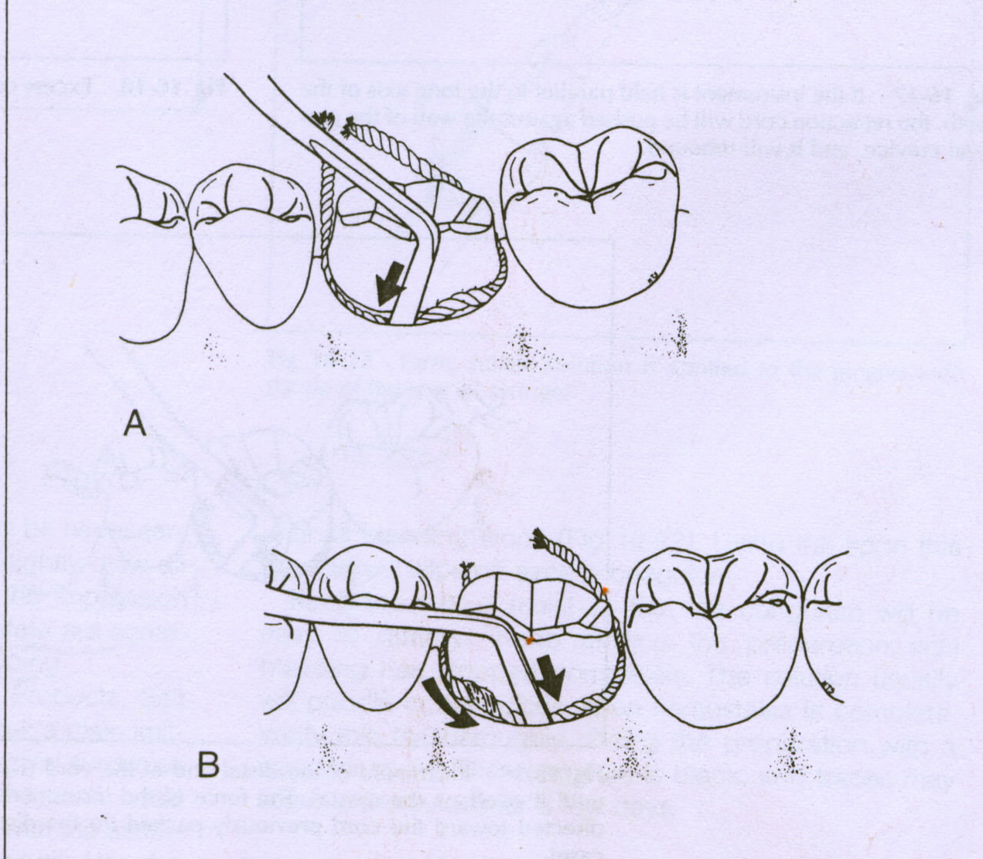

Slide 44
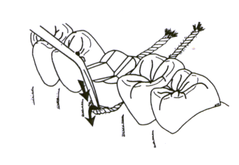
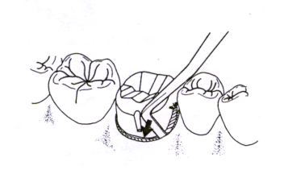

Slide 45
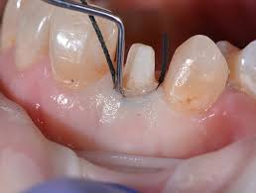
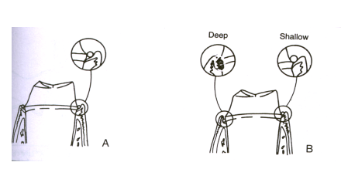

Slide 46
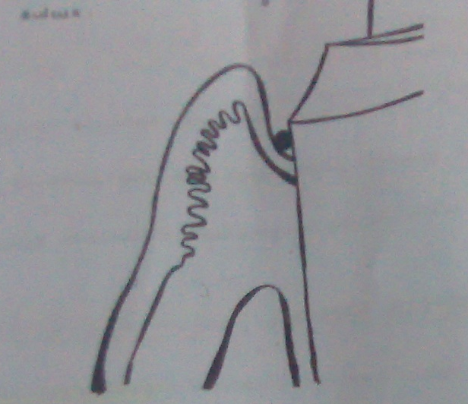
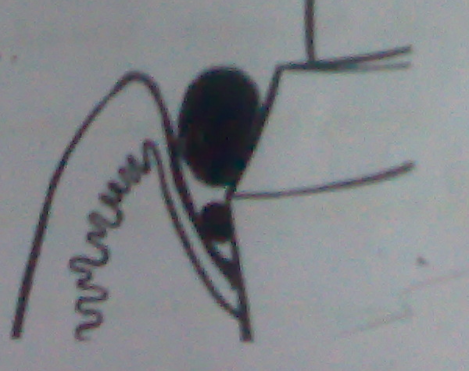
Double cord technique:
Indication:
  When making impression of multiple prepared teeth & when making impression when tissue health is compromised.
  Procedure:
  Small diameter cord is placed in sulcus. This cord
  is left in the sulcus during impression making.
  Second cord is soaked hemostatic agent of choice is placed in the sulcus above small diameter cord.
  After waiting 8-10 minutes, the larger cord is removed.

Slide 47
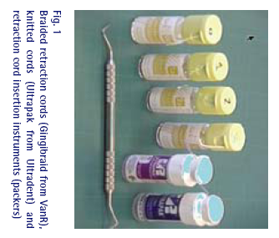
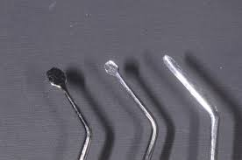
CORD PACKERS
They have a thin tip & are made of stainless steel
Unique shoulder curve at both the end to the axis of the shaft
allow better adaptability
easy to use
provide balance
Firmness during packing
Finely etched edges give better cord traction without pulling
The “stark cord packer” has a non-stick GTX coating
–prevents sticking to cord .
The studies states that gingival retraction should be accomplished under a pressure of between 0.1 & 1N/mm² to avoid tearing of the epithelial attachment.

Slide 48
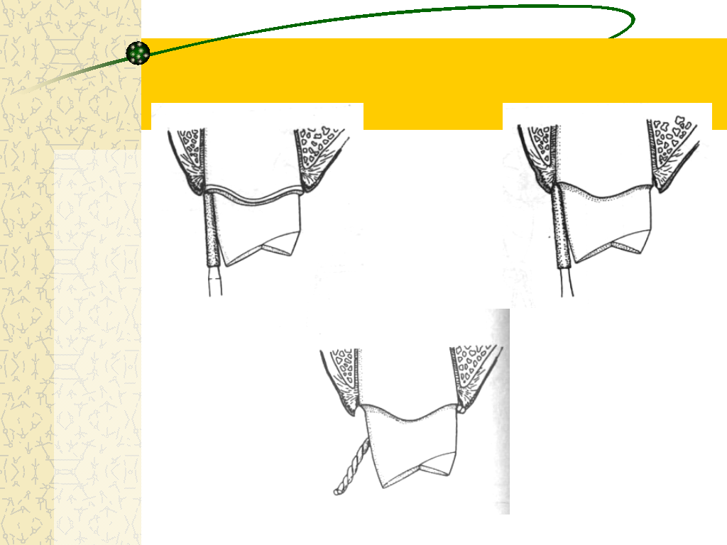
ROTARY GINGIVAL CURETTAGE

Slide 49

Rotary gingival curettage
“Gingetage”
Troughing technique
Purpose is limited removal of epithelial tissue while a chamfer finish line is being created.
The removal of epithelium from the sulcus by rotary curettage is accomplished with little detectable trauma to soft tissue, although there is a lessened tactile sense for the dentist.

Slide 50
Criteria for rotary curettage
1.Must be done on healthy & inflammation-free tissue.
2.Absence of bleeding on probing.
3.Sulcus depth less than 3.0 mm.
4.Presence of adequate keratinized gingiva.

Slide 51
Technique
Shoulder finish line preparation at gingival crest using flat end tapered diamond.
Then a torpedo-shaped diamond simultaneously forms a chamfer finish line apically,½-2/3 ^{rd} the depth of the sulcus, converting the finish line into a chamfer & removing the epithelial lining of the sulcus.
Place retraction cord in the “troughed” sulcus for hemostasis.
Remove the cord after 4-8 minutes & make impression.
This technique is well suited for use with reversible hydrocolloid.
Disadvantages
Technique sensitive
Can potentially damage periodontium

Slide 52
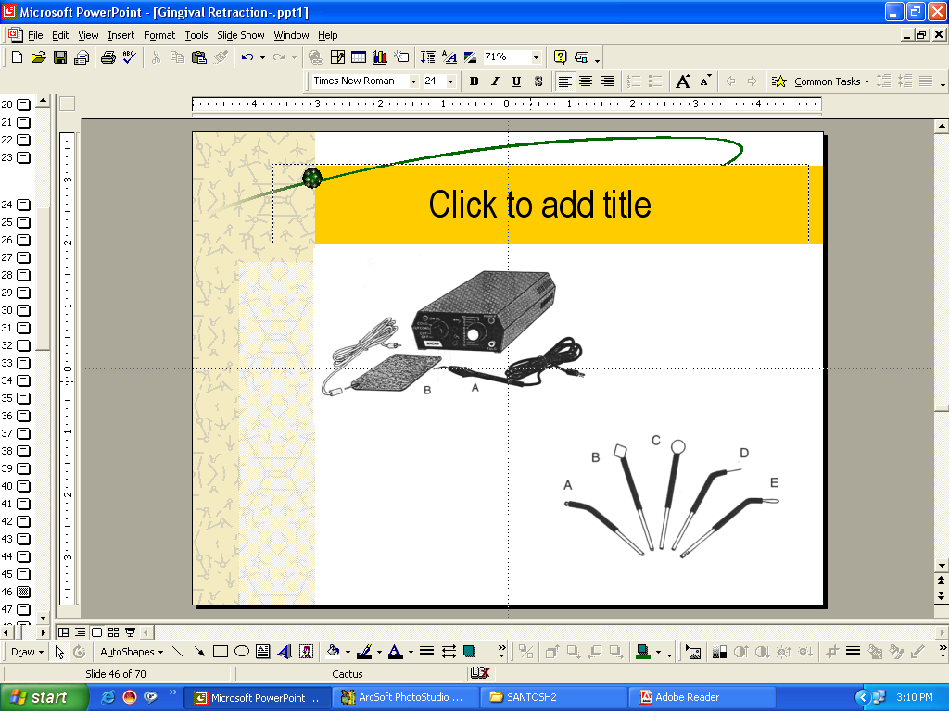
ELECTROSURGERY

Slide 53
Electrosurgery
  History
  Schillinburg stated that the use of heat as surgical tool was known to Egyptians about 3000BC.
  Experiments of d’Arsonvol (1891) demonstrated that electricity at high frequency will pass through a body without producing a shock (pain or muscle spasm), producing instead an increase in the internal temperature of the tissue.
  This discovery was used as the basis for eventual development of electrosurgery.

Slide 54
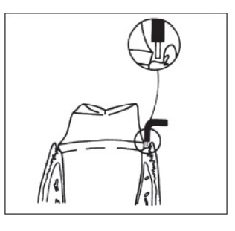
Electrosurgery
There are situations in which it may not be feasible to manage the gingiva with retraction cord alone.
It may have been necessary to place the finish line of the preparation so near the epithelial attachment that it is impossible to retract the gingiva sufficiently to get an adequate impression.
In these cases, it may be necessary to use some means other than cord impregnated with chemicals to gain access & stop minor bleeding.

Slide 55
Electrosurgery
Recommended for enlargement of the gingival sulcus & control of hemorrhage to facilitate impression making.
It cannot stop bleeding once it starts. If hemorrhage occurs, it first must be controlled with pressure &/or chemicals, & then the vessels can be sealed with a coagulating ball electrode.

Slide 56
Electrosurgery
It is used for the removal of irritated tissue that has proliferated over preparation finish lines, & it is commonly used for that purpose.
There has been concern expressed about the use of electrosurgery on inflamed tissue based on an exaggerated response to an electrosurgical procedure. Proximity to bone & lateral heat production may have been responsible for the response because bone is very sensitive to heat.

Slide 57
Electrosurgery
An electrosurgery unit is a high-frequency oscillator or radio transmitter that uses either a vacuum tube or a transistor to deliver a high-frequency electrical current of at least 1.0 MHz (one million cycles per second).
It generates heat in a way that is similar to a microwave oven heating food / a diathermy machine producing heat in muscle tissue for physical therapy.
Electrosurgery has been called surgical diathermy.

Slide 58
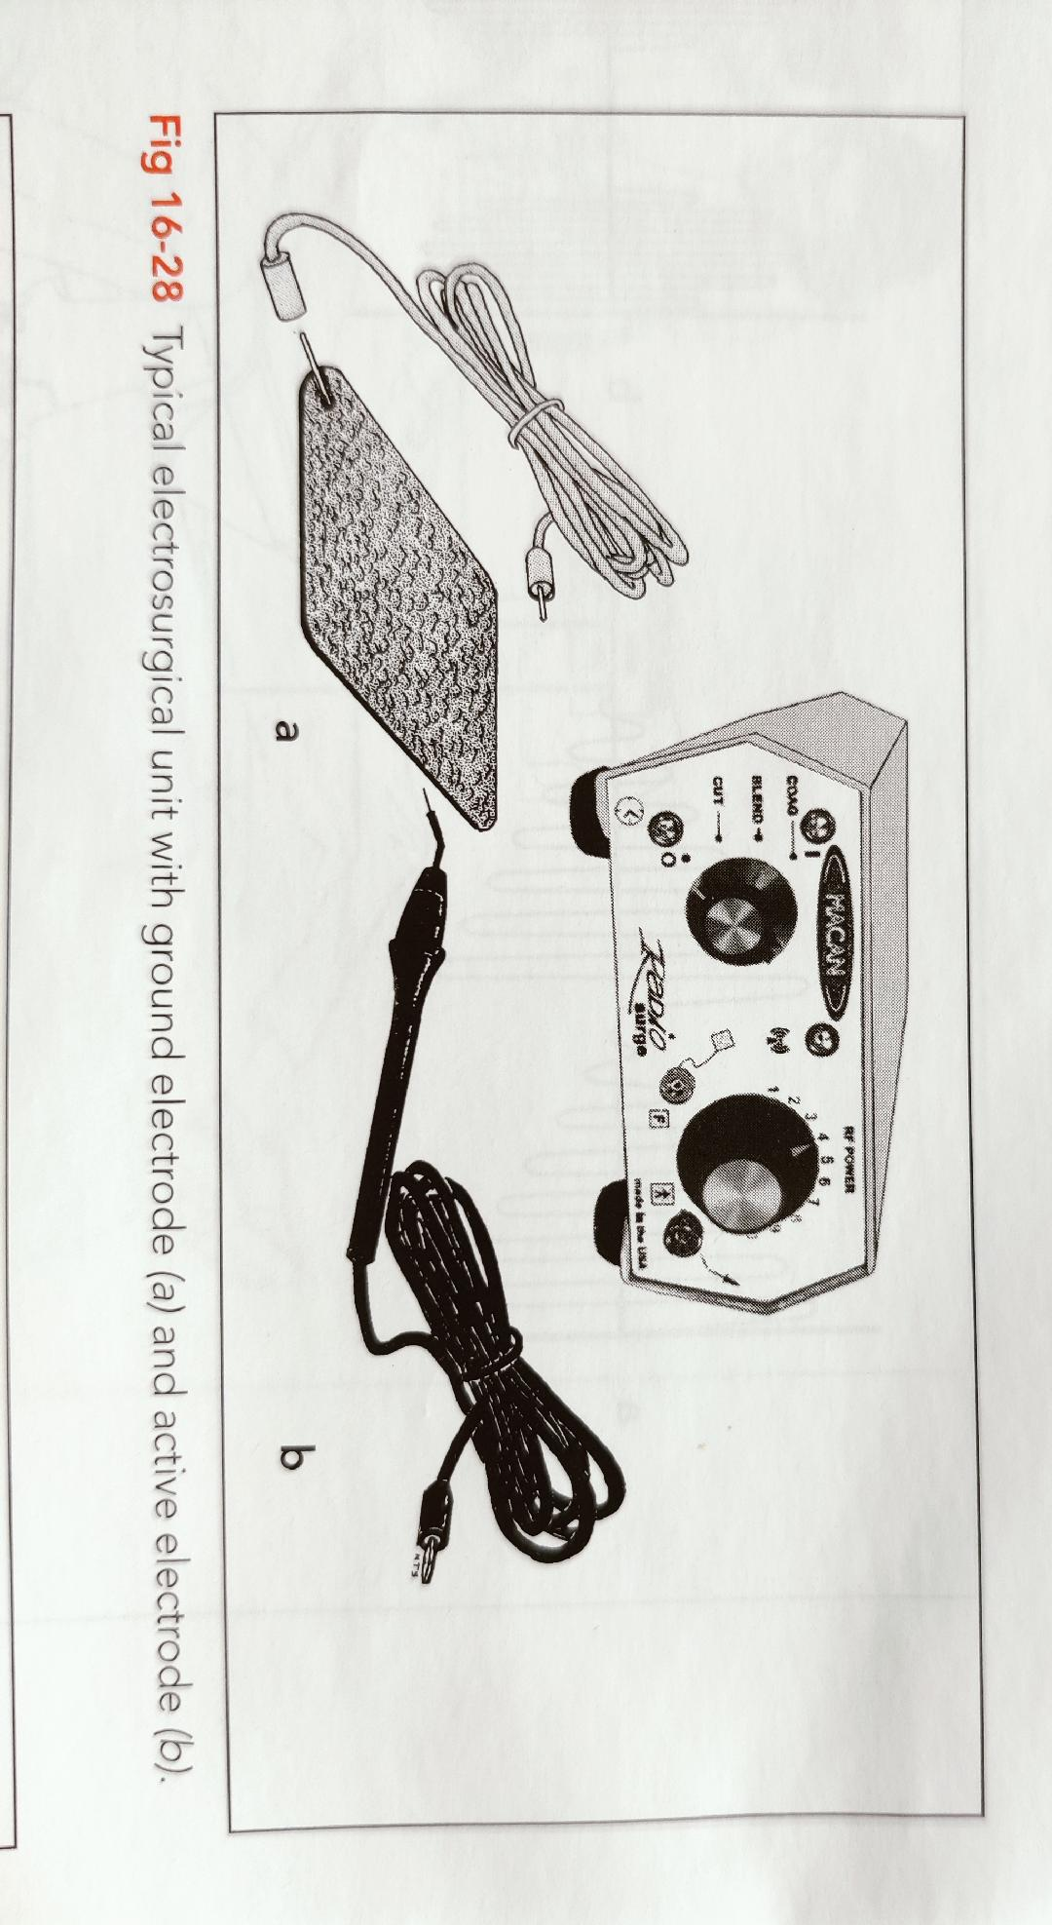
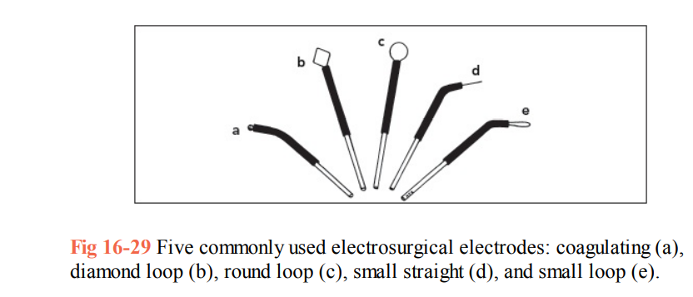

Slide 59
Mechanism of action
Controlled tissue destruction.
Current flows through a small cutting electrode.
Producing high current density & rapid temperature rise
Cells directly adjacent to the electrode are destroyed due to this temperature increase.
The current concentrates at points & sharp bends. Cutting electrodes are designed to take advantage of this property so they will have maximum effectiveness.

Slide 60
Mechanism of action
The circuit is completed by contact between the patient & a ground electrode that will not generate heat in the tissue because its large surface area produces a low current density, even though the same amount of current passes through it.
The cutting electrode remains cold; this differs from electrocautery, in which a hot electrode is applied to the tissue.

Slide 61
Key Differences Between Electrosurgery & Electrocautery
Electrosurgery passes electrical current through tissue to accomplish a desired result. The electricity used is a form of alternating current similar to that used to generate radio waves. The current passes through the patients tissue as opposed to producing an electric shock effect.
Electrocautery uses electrical current to heat a metal wire that is then applied to the target tissue in order to burn or coagulate the specific area of tissue. It is not used to pass the current through tissue, but rather is applied directly onto the targeted area of treatment. Using this technique, heat is passed through a resistant metal wire which is used as an electrode. This hot electrode is then placed directly onto the treatment area destroying that specific tissue.

Slide 62
Key Differences Between Electrosurgery & Electrocautery
Another rather obvious difference between the two is that electrocautery devices are usually small, battery operated, devices which use physical heat to destroy the targeted tissues or cause a specific & desired effect.
The electrosurgery devices are more sophisticated radio-wave generators that pass modified electrical current through the target tissues to achieve the desired surgical result.
https://www.boviemedical.com/2016/09/05/3-key-differences-between-electrosurgery-electrocautery/

Slide 63
Types of current
1.Fully Rectified current (modulated)
  continuous flow of current
  good cutting characteristics
  enlargement of gingival sulcus
2.Fully Rectified current (filtered)
  continuous current wave
  excellent cutting characteristics
  less injury than modulated current

Slide 64
3.Partially rectified current (damped)
    Considerable tissue destruction.
    Slow healing.
    Used for spot coagulation.
4.Unrectified current (damped)
    Recurring peaks of current that rapidly diminish.
    Causes intense dehydration & necrosis.
    Slow & painful healing.
    Not used in dental surgery.

Slide 65
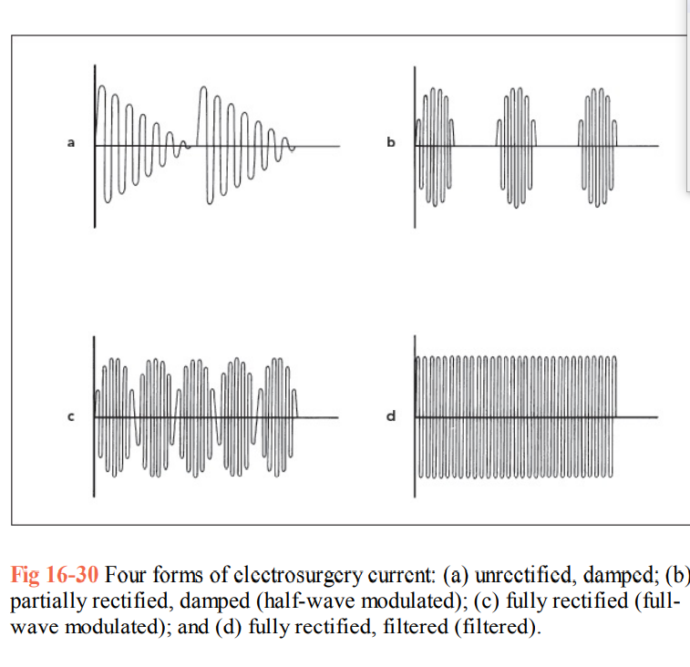

Slide 66
Tissue considerations
Keep electrode in motion.
Appropriate current setting.
Larger the electrode, greater the current required.
5-10 seconds between applications.
Patient should be properly grounded.
Tissue must be moist.
Electrode must remain free of tissue fragments.
Electrode must not touch any metallic restorations.

Slide 67
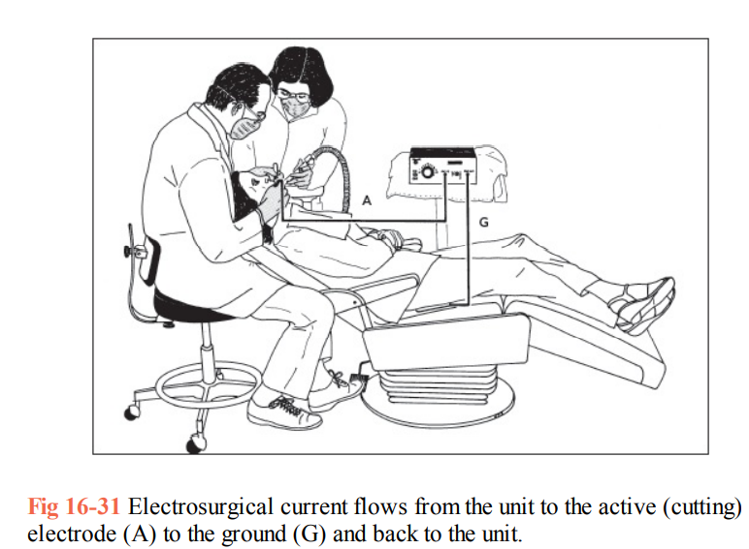

Slide 68
The safe use of electrosurgery dictates that current flow be facilitated along the proper circuit from the generator to the active electrode, the patient, & back to the generator.
Because patient burns have been attributed to faulty grounding in many cases, the proper grounding of a patient is considered to be the single most important safety factor when electrosurgery is used.

Slide 69
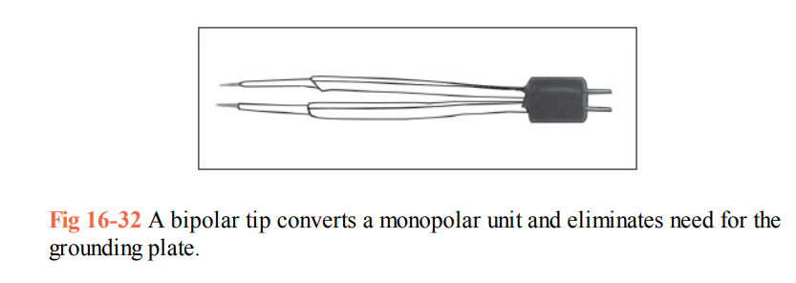
There are “bipolar” units that eliminate the need for a grounding plate. These units have dual tips, one of which serves as the active electrode & the other as the passive electrode.
This may be an advantage as it helps to avoid current passing through adjacent bone, implants, or restorations.

Slide 70
Advantages
Clear operating area without or no bleeding.
Healing by primary intension.
Lack of pressure to incise tissue.
Less tissue loss after healing

Slide 71
Disadvantages
Unpleasant odour.
Slight loss of crestal bone (Kamansky F.W. et al)
Burn mark on the root surface.
Not suitable for thin gingiva.
Contraindications
Patients with cardiac pace maker.
Patients with delayed wound healing.

Slide 72
Technique
Anesthesia
A drop of aromatic smelling oil.
Complete seating of electrodes in handpiece.
Light pressure & quick strokes.
Power selector dial, as recommended.

Slide 73
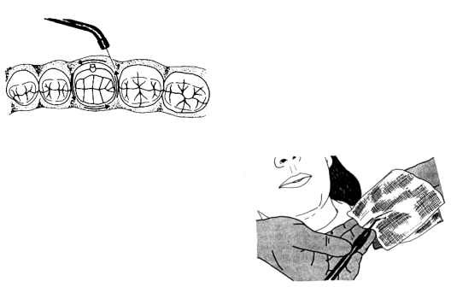

Slide 74
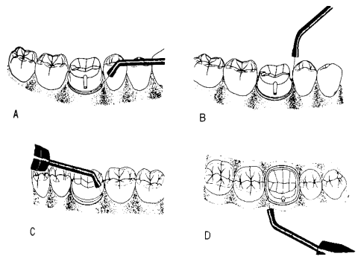

Slide 75
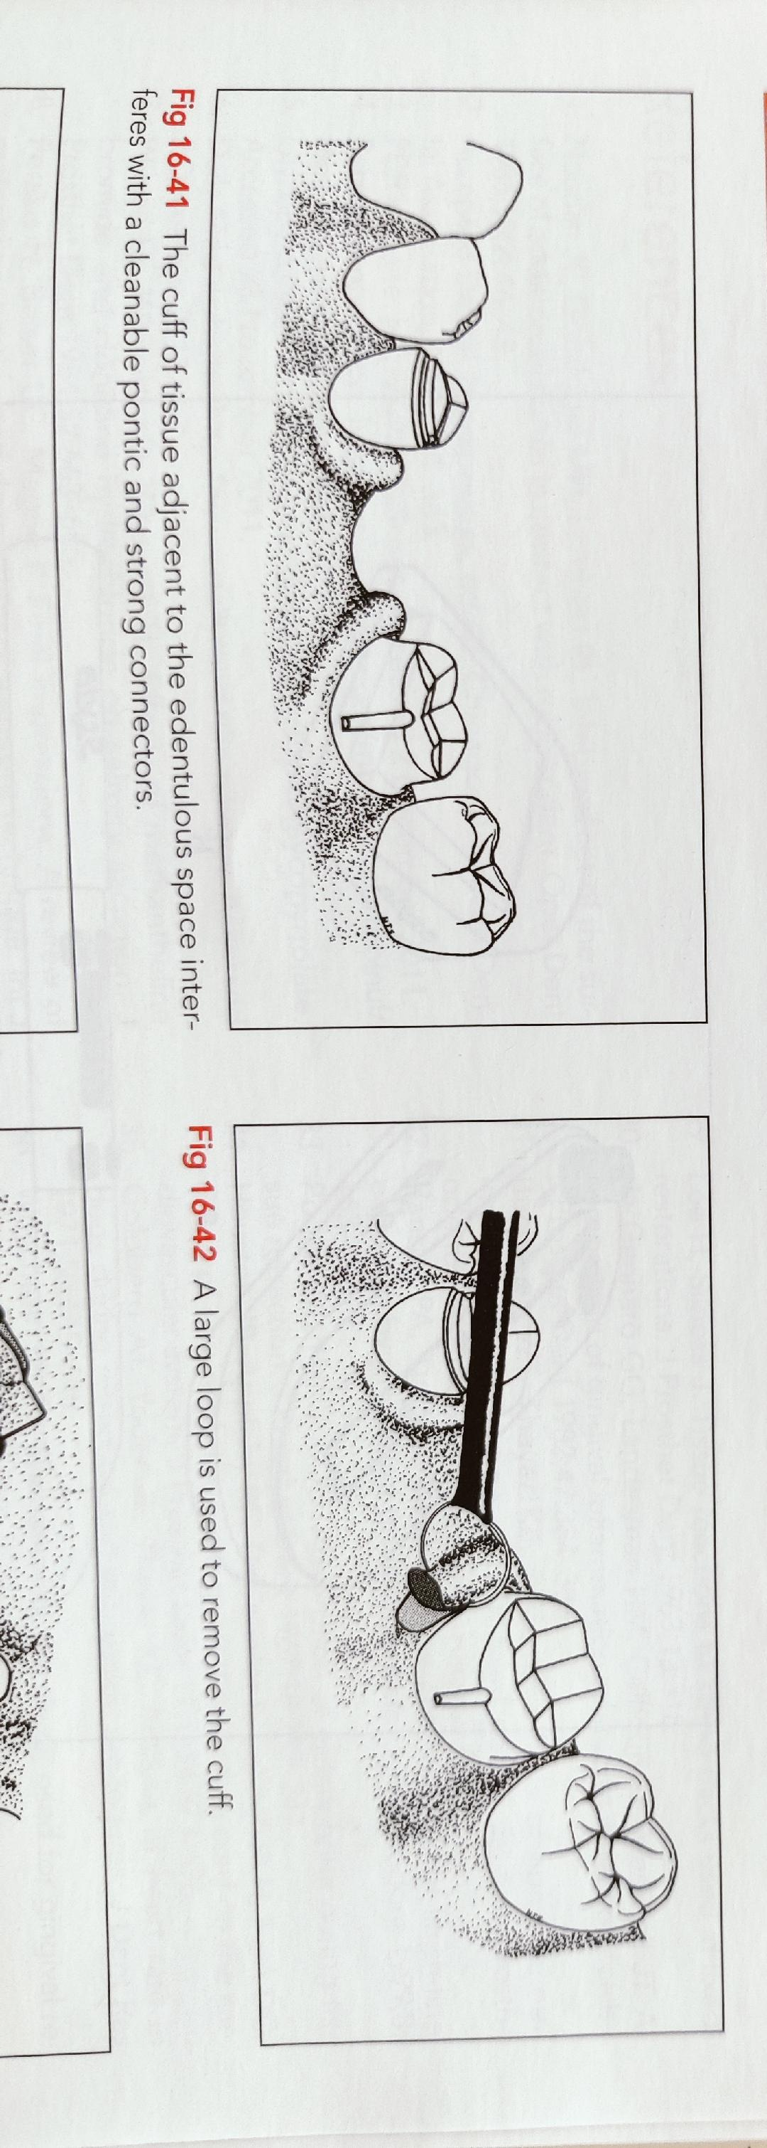

Slide 76
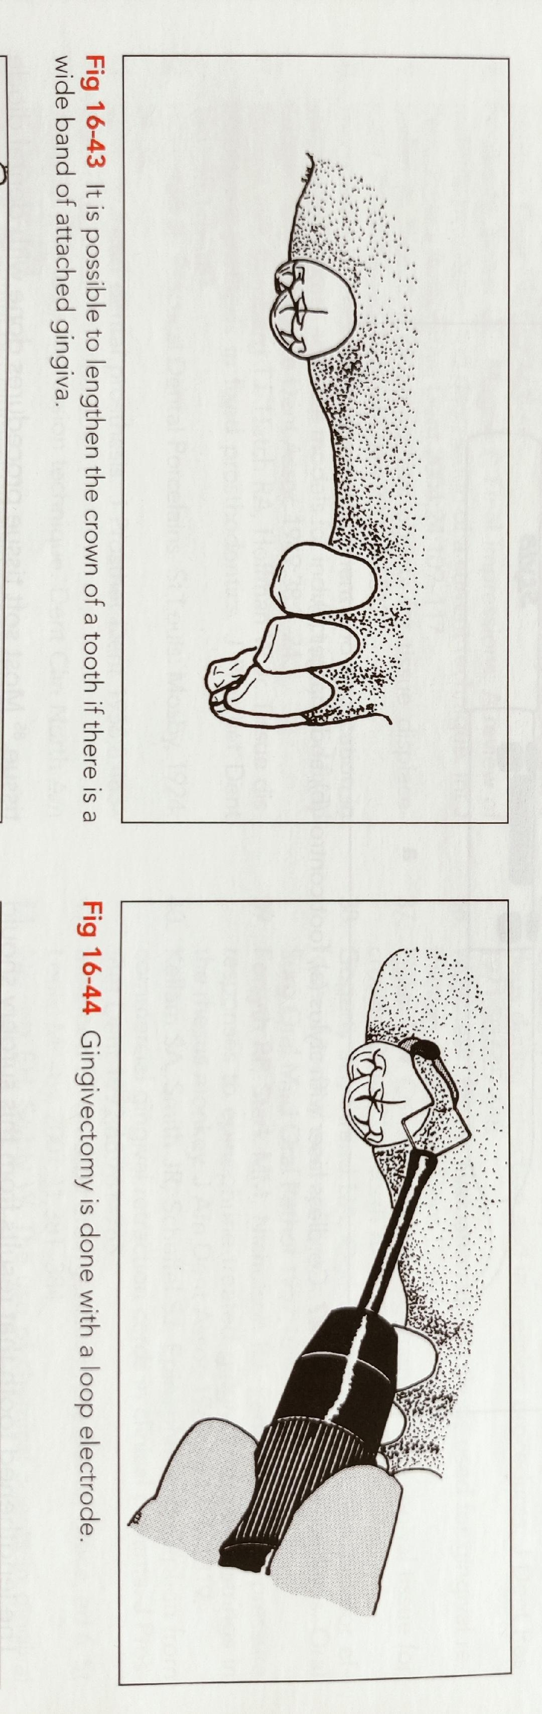

Slide 77
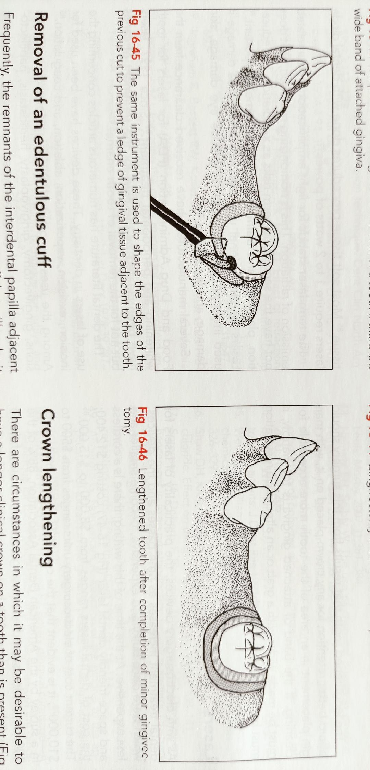

Slide 78
Lasers
Light amplification by stimulated emission of radiation
Lasers helps in exposure of subgingival finish lines, controls the hemorrhage
Removes just enough epithelial attachment & periodontal ligament to facilitate the placement of retraction cord.
Laser tips 400-600 micron in diameter.
A feather light stroke should be used.
The laser handpiece should be kept moving.
Along with the attached gingiva, approximately 1mm of epithelial attachment should be removed & coagulated to achieve hemostasis & to expose the crown margins.
Ex: argon laser ,CO₂ lasers, neodymium lasers

Slide 79
Advantages
Minimum pain, inconvenience discomfort
Less fear anxiety, stress
Minimum or no anaesthesia
No drill sounds
Less chair time
Reduced post operative complications
Minimum or no bleeding

Slide 80
Recent Advances
Expasyl retraction paste
Excellent retraction. Physically displaces tissue for superb marginal access.
Safe. Minimal pressure required. No danger of rupturing epithelial attachment.
Significant time savings. Places quickly.
Comfortable. Much less time & force needed than with packing cord.
Hemostatic. Controls bleeding & crevicular seepage.
Won’t dry out. New foil pouch for the capsules
Composition: aluminium chloride (15%), kaolin, excipients

Slide 81
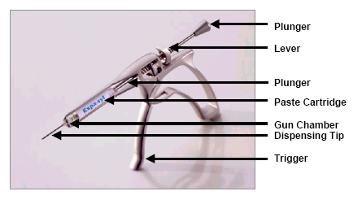
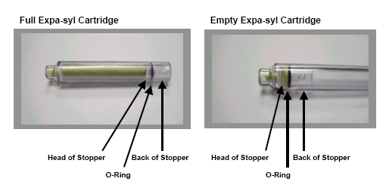

Slide 82
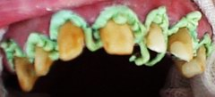



Slide 83

Magic foam

Slide 84


Marco Ferrari et al in 1996 they found merocel a synthetic material that is specifically chemically extracted by a biocompatible polymer (hydroxylate polyvinyl acetate)
MEROCEL RETRACTION STRIPS

Slide 85



Slide 86


Matrix impression system
Gus J. Livaditis (1998) in this system a matrix of polyether occlusal registration elastomeric material is made over the tooth preparation.

Slide 87




Slide 88





Slide 89



Slide 90
CONCLUSION
No clinical study has demonstrated the superiority of one technique over another, so the choice of which procedure to use depends on the presenting clinical situation & operator preference.
Sometimes a combination of methods may be needed, & some things may work for one clinician & not for another. The effort put into the appropriate retraction of gingival tissues pays off in terms of longevity of restorations, better margins & aesthetics.

