Slide 1
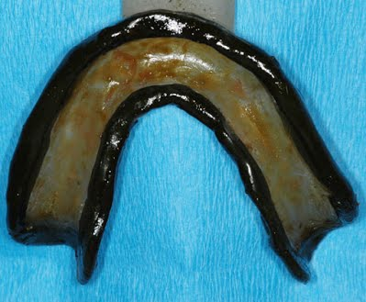
MANDIBULAR BORDER MOLDING

Slide 2
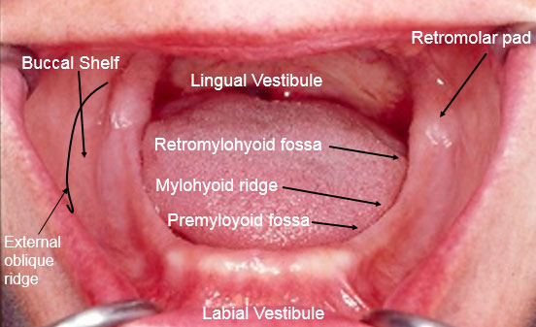
Anatomical landmarks

Slide 3
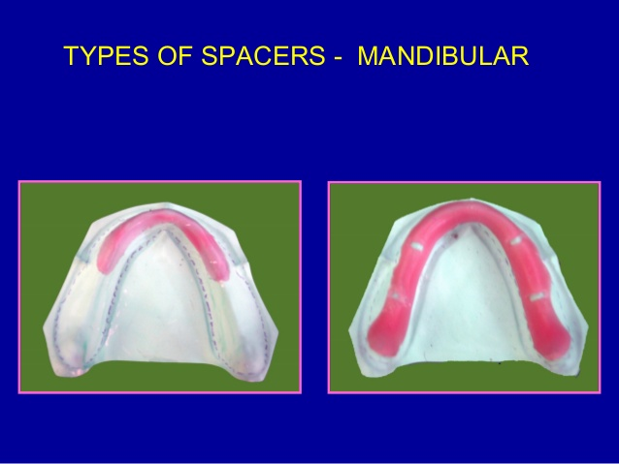
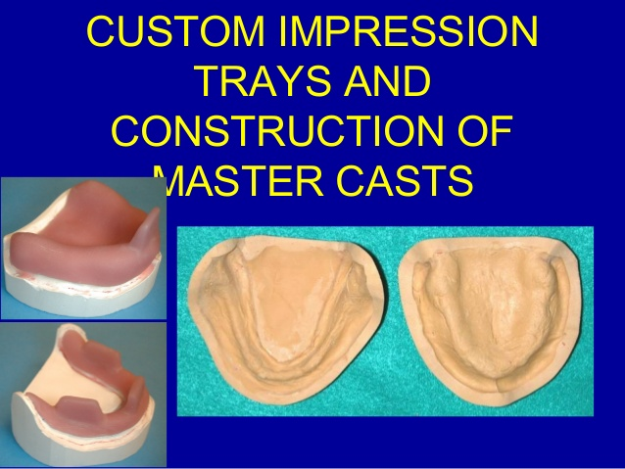
CUSTOM TRAY
CUSTOM TRAY SHOULD BE 2 TO 3 MM SHORT OF VESTIBULE

Slide 4
SEQUENCE OF BORDER MOLDING
LABIAL FLANGE
BUCCAL FLANGE
DISTOBUCCAL AREA AND MASETRIC NOTCHES
LINGUAL FLANGE
A] ANTERIORLINGUAL FLANGE
B]MIDDLELINGUAL FLANGE
C]DISTO LINGUAL FLANGE

Slide 5
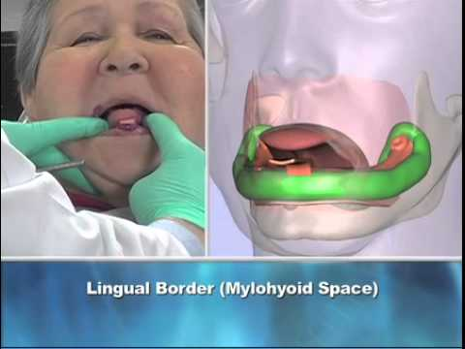
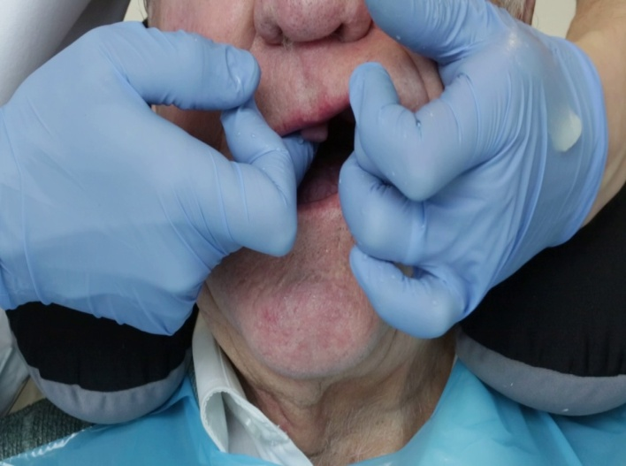
TWO TYPES OF MOVEMENTS
ACTIVE MOVEMENTS
PASSIVE MOVEMENTS

Slide 6
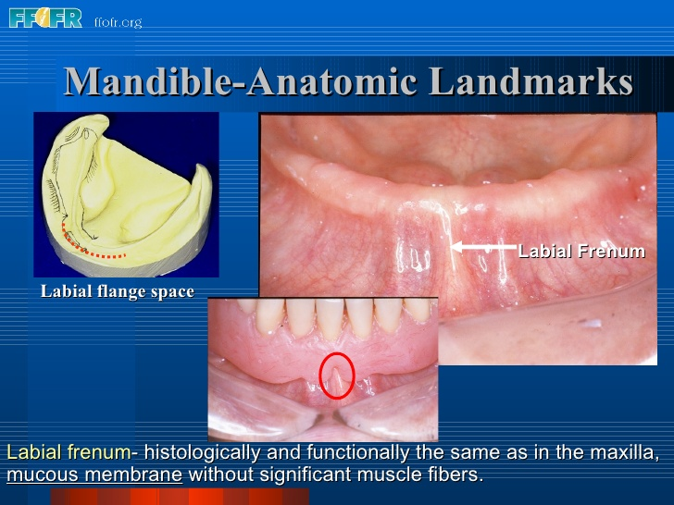
LABIAL FLANGE
PASSIVE MOVEMENTS – LIP IS LIFTED OUTWORDS N INWORDS

Slide 7
BUCCAL FLANGE
ACTIVE MOVENTS –
PATIENT IS ASKED TO PUCKER AND SMILE
PASSIVE MOVEMENTS –
LIFT LIP OUTWARDS UPWARDS INWARDS

Slide 8
LINGUAL FLANGE
ANTERIOR LINGUAL FLANGE
MIDDLE LINGUAL FLANGE
DISTOLINGUAL FLANGE

Slide 9
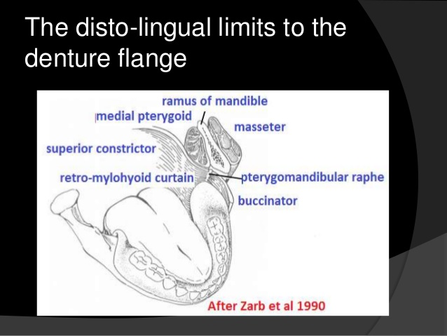

Slide 10
RETROMYLOHYOID CURTAIN
Medial pterygoid and superior contrictor muscle is present in this space
PATIENT IS TOLD TO
PROTRUDE THE TONGUE OUT
ACTIVATES SUPERIOR CONSTRICTOR
PATIENT IS TOLD TO
CLOSE UNDER PRESSURE
CONTRACTION OF MEDIAL PETERYGOID MUSCLE ACTIVATES SUPERIOR CONSTRICTOR AND RECORDS POSTERIOR LATERALASPECT OF RETROMYLOHYOID CURTAIN

Slide 11
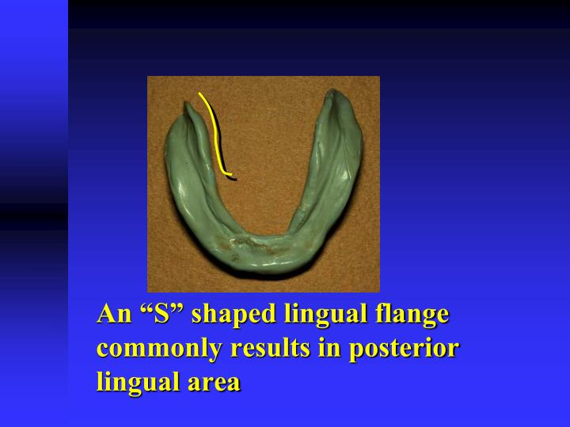
RETROMOLAR PAD
Muscle involved –
Posterior superior fibers of temporalis
Buccinator
Petrygomandibular Raphe
Medially by superior constrictor of pharynx
ACTION OF ALL THE MUSCLES LEADS TO S SHAPED FLANGE AND PREVENTS OVER EXTENSION OF THE DENTURE BASE AND EVEN EXTRA PRESSURE DURING IMPRESSION

