Slide 1


Slide 2
Occlusion in complete dentures

Slide 3
contents
Introduction
Definitions
Difference between natural and artificial teeth
Review of literature
Theories of occlusion
Ideal requirements of complete denture occlusion
Occlusal scheme requisites to fulfill the requirements
Sears axioms of complete denture occlusion
Guidelines for schemes in occlusion

Slide 4
General concepts of complete denture occlusion
Characteristic requirements of balanced occlusion
Importance of balanced occlusion
Principles of balanced occlusion
Concepts proposed to obtain balanced occlusion
Factors influencing balanced occlusion
Impact of selected variables on occlusal form of restoration
Conclusion
Bibliography

Slide 5
Introduction
One of the chief aims of preventive and restorative dentistry is to maintain an occlusion that will function in harmony with the other components of the masticatory system thereby preserving their health and provide optimum masticatory function.

Slide 6
Occlusion is an anatomic and physiologic complex present when the opposing teeth are in contact .
It consists of positional relations, the stresses directed to the supporting structures, their resistance to stresses & the form and arrangement of the teeth.

Slide 7
Occlusal harmony in complete dentures necessary for:
1. dentures to be comfortable.
2. function efficiently .
3. preserve supporting structures.

Slide 8
what is occlusion ?

Slide 9
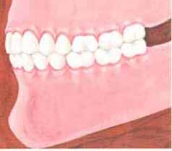
definitions
An act of closure or state of being closed
Occlusion : ( GPT 8)
“The static relationship between the incising or masticating surfaces of maxillary and mandibular teeth or tooth analogues.”
Dorland’s dictionary :
Occlusion is the contact of the teeth of both the jaws when closed or during those excursive movements of the mandible essential to the function of mastication.

Slide 10
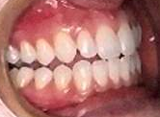
Articulation :
Occlusion deals with static relationship of the opposing teeth while articulation deals with the dynamic relationship.
Important :
1. Stability
2. Retention

Slide 11
what is the need to study occlusion?

Slide 12
occlusion needed : a. comfort b. Function c. esthetics
Teeth contact - resultS in force - may vary in magnitude and direction - must always be resisted by supporting tissues.
Teeth - natural or artificial - not immobile - so occlusion can never be considered a purely static relationship .
Artificial occlusion - more apparent movement – since teeth move as a group on a common base - structures are constantly changing.

Slide 13
Differences between natural and artificial teeth

Slide 14
Natural teeth | Artificial teeth
Function independently and each individual tooth disperses the occlusal load. | Function as a group and the occlusal loads are not individually managed.
Malocclusion can be non-problematic for a long time. | Malocclusion is problematic.
Non-vertical forces are well tolerated. | Non-vertical forces damage the supporting tissues.

Slide 15
Incising does not affect the posterior teeth. | Incising will lift the posterior part of the denture.
The second molar is the favored area for heavy mastication. | Heavy mastication over the second molar can tilt or shift the denture base.
Bilateral balance is not necessary and is usually considered a hindrance | Bilateral balance is mandatory to produce stability of the denture.
Proprioceptive impulses give feedback to avoid occlusal prematurities. This helps the patient to have a habitual occlusion away from centric relation. | There is no feedback and the denture rests in centric relation. Any prematurities in this position can shift the base.

Slide 16
Review of literature

Slide 17
History :
The first description –Edward Angle – 1809
Bonwill in 1858 described the equilateral triangle theory
He coined word –articulation
Spee in 1890 introduced the concept of curve of Spee

Slide 18
Alfred Gysi in 1914 designed first porcelain anatomical teeth and described lingualized occlusion
Monson in 1918 put forth spherical theory of occlusion
R. E. Hall gave conical theory of occlusion
Balanced occlusion based on 3 theories

Slide 19
Hanau in 1926 formulated laws of balanced articulation (Hanau's quint)
Box Miller, Sorrin in 1950 pointed out importance of balanced occlusion
Sears 1952 – axioms for planning complete denture occlusion
Trapazzano in 1963 and Levin 1978 laid down triad and quad of articulation

Slide 20
DeVan 1954 suggested --- concept of neutrocentric occlusion
Organic occluison concept was put forward –Stuart, Stallard in 1961 and Thomas 1967
Schweitzer 1963 - theory of transographics
Payne 1941 and Pound 1973 --- described lingualized occlusion

Slide 21
Equilateral triangle – BONWILL
Conical theory - Hall
Spherical theory - Monson

Slide 22
Theories of occlusion

Slide 23
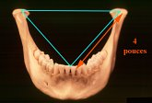
BONWILL’S EQUILATERAL
TRIANGLE THEORY
In 1858, Bonwill described
his triangular theory
Concept of bilateral balanced occlusion and developed an articulator that applied his 4 –inch triangular theory based on 3 points of occlusal balance

Slide 24
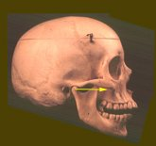
Bonwill’s theory
According to this theory :
“teeth move in relation to each other as guided by condylar controls and incisal points.”

Slide 25
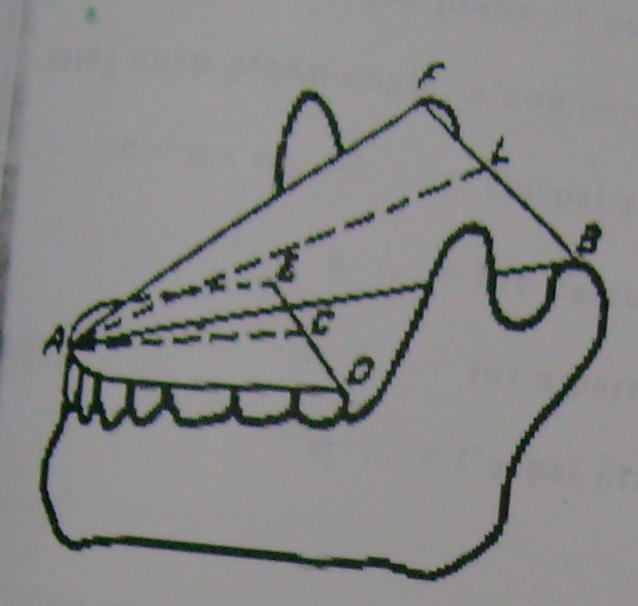
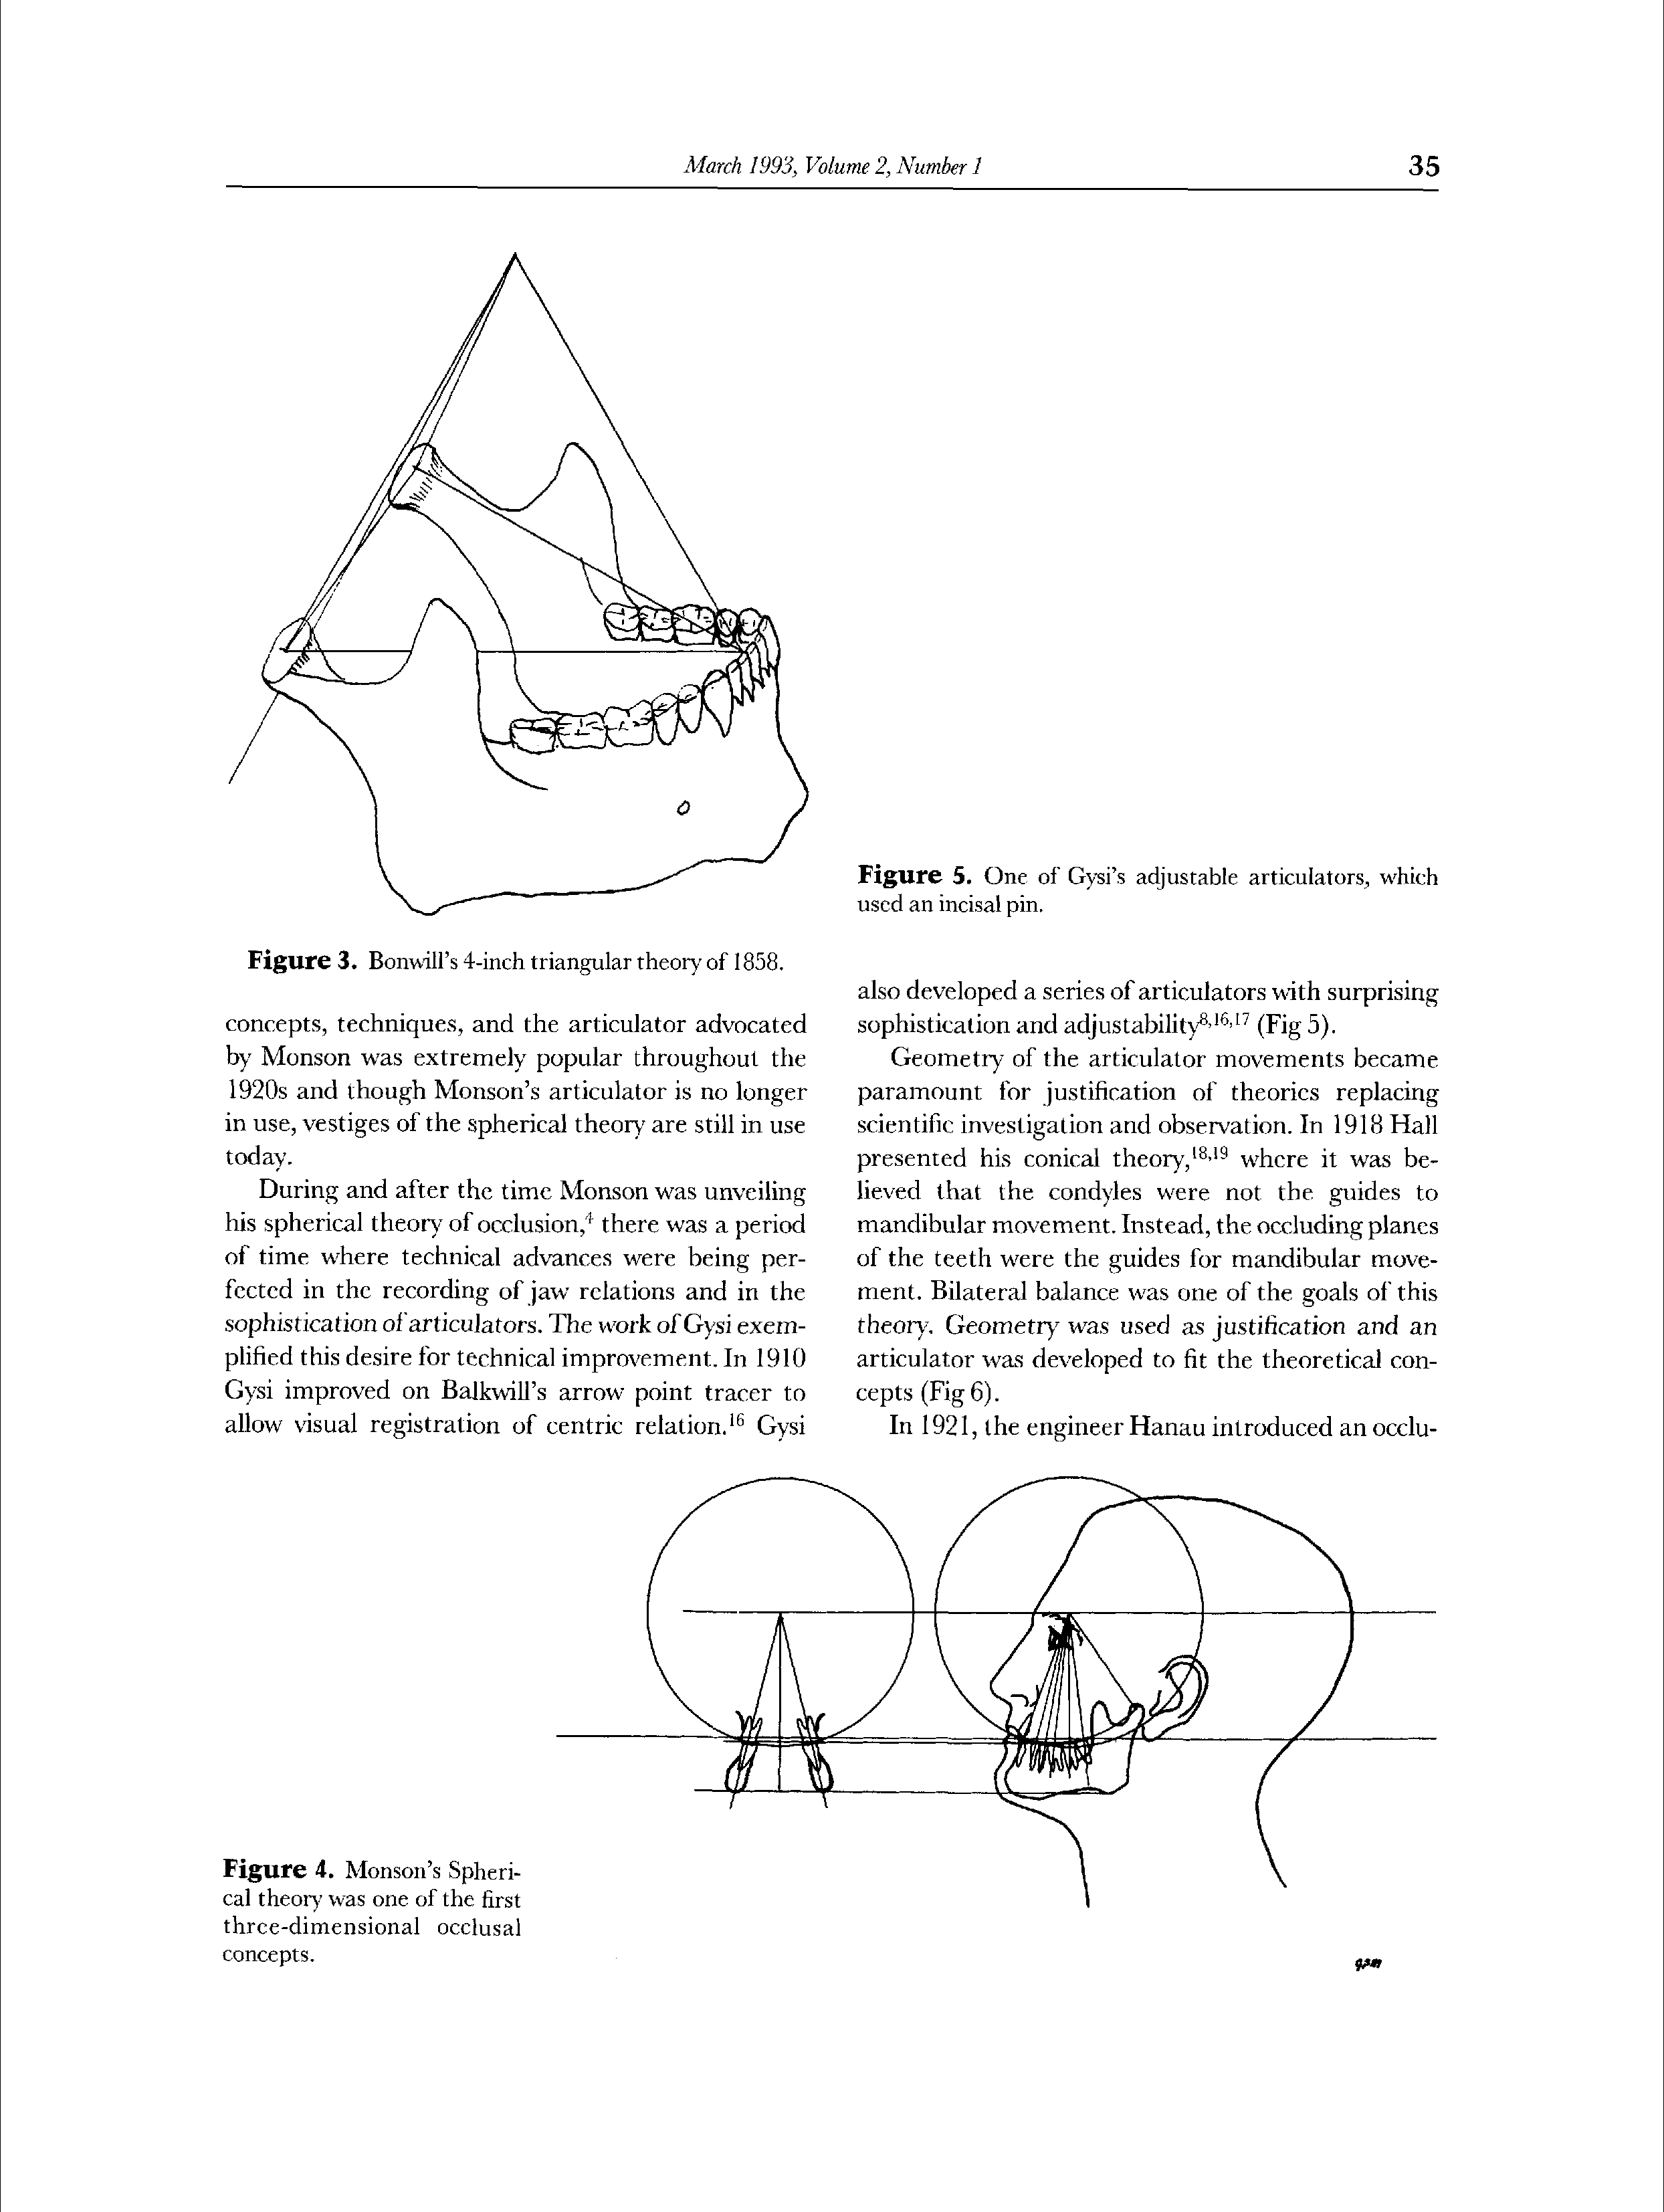
Bonwill analyzed mandible and described in terms of equilateral triangle with 10 cm side connecting both the condyles and mesioincisal angles of mandibular central incisors.
Notes:
Bonwill triangle: eponym for a 4 inch equilateral triangle bounded by lines connecting the contact points of the mandibular central incisor’s incisal edge (or the mid-line of the mandibular residual ridge) to each condyle (usually its mid point) and from one condyle to the other.

Slide 26
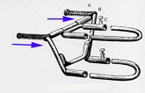
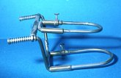
In an attempt to more faithfully reproduce mandibular function and anatomy, Bonwill developed an equilateral anatomical articulator with two independent condylar elements.

Slide 27
Limitations:
Non adjustable condylar guidances
Permits movement only in vertical plane

Slide 28
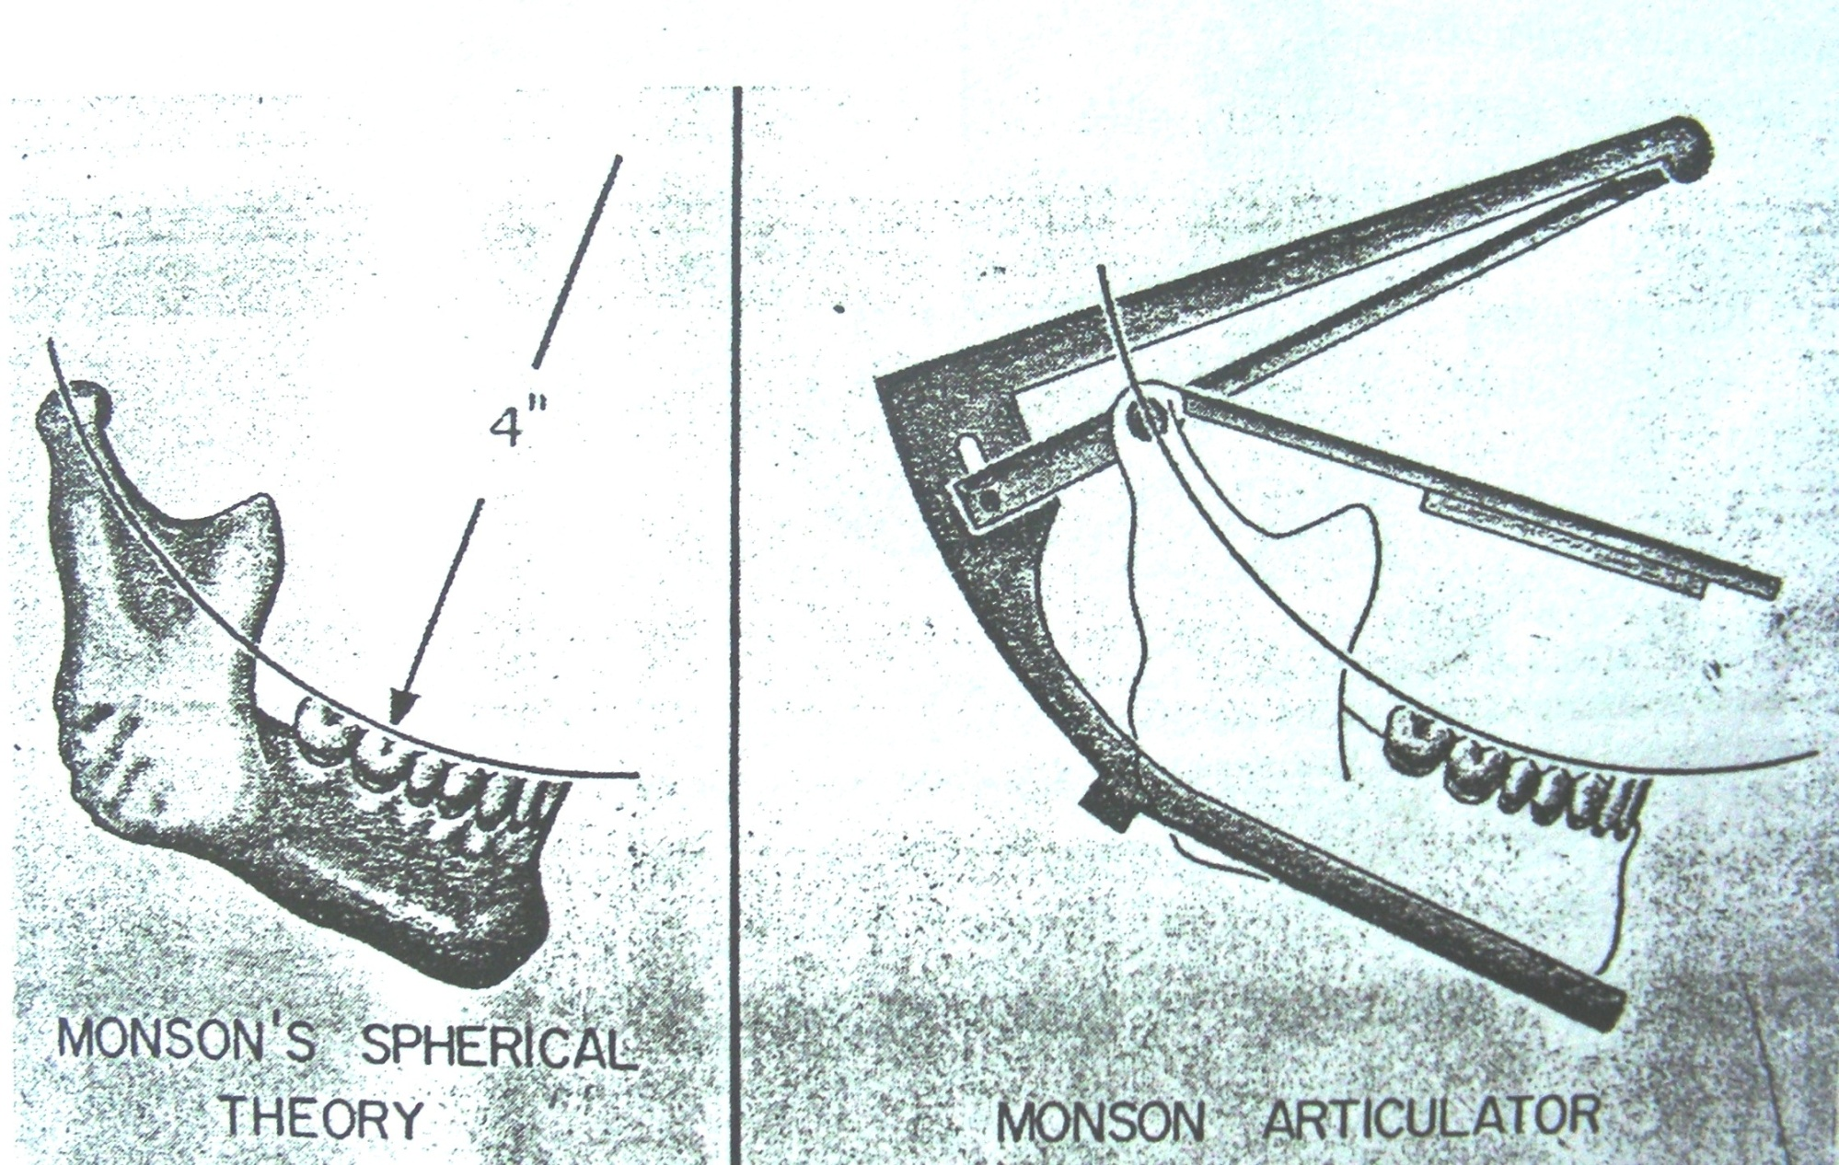
In 1866, Balkwill discovered that during lateral jaw movement, the translating condyle moved medially
In 1890, Von Spee observed : occlusal plane of the teeth followed a curve in the sagittal plane. “curve of Spee”

Slide 29
In 1899 Snow, devised a method for transferring
articulated casts to the articulator with a face bow
In 1901 Christensen, observed the opening of the
posterior teeth in mandibular protrusion
In 1908 Bennett, described the immediate side shift (Bennett movement).
Gysi's instrument was one of the first to allow for the Balkwill-Bennett movements.

Slide 30
Monson formulated a three-dimensional occlusal philosophy by combining the concepts of :
  Bonwill's 4-inch triangle
  Von Spee's compensating curve
  Observances of Balkwill and Christensen on condylar movement
This occlusal model was named the Spherical Theory.

Slide 31
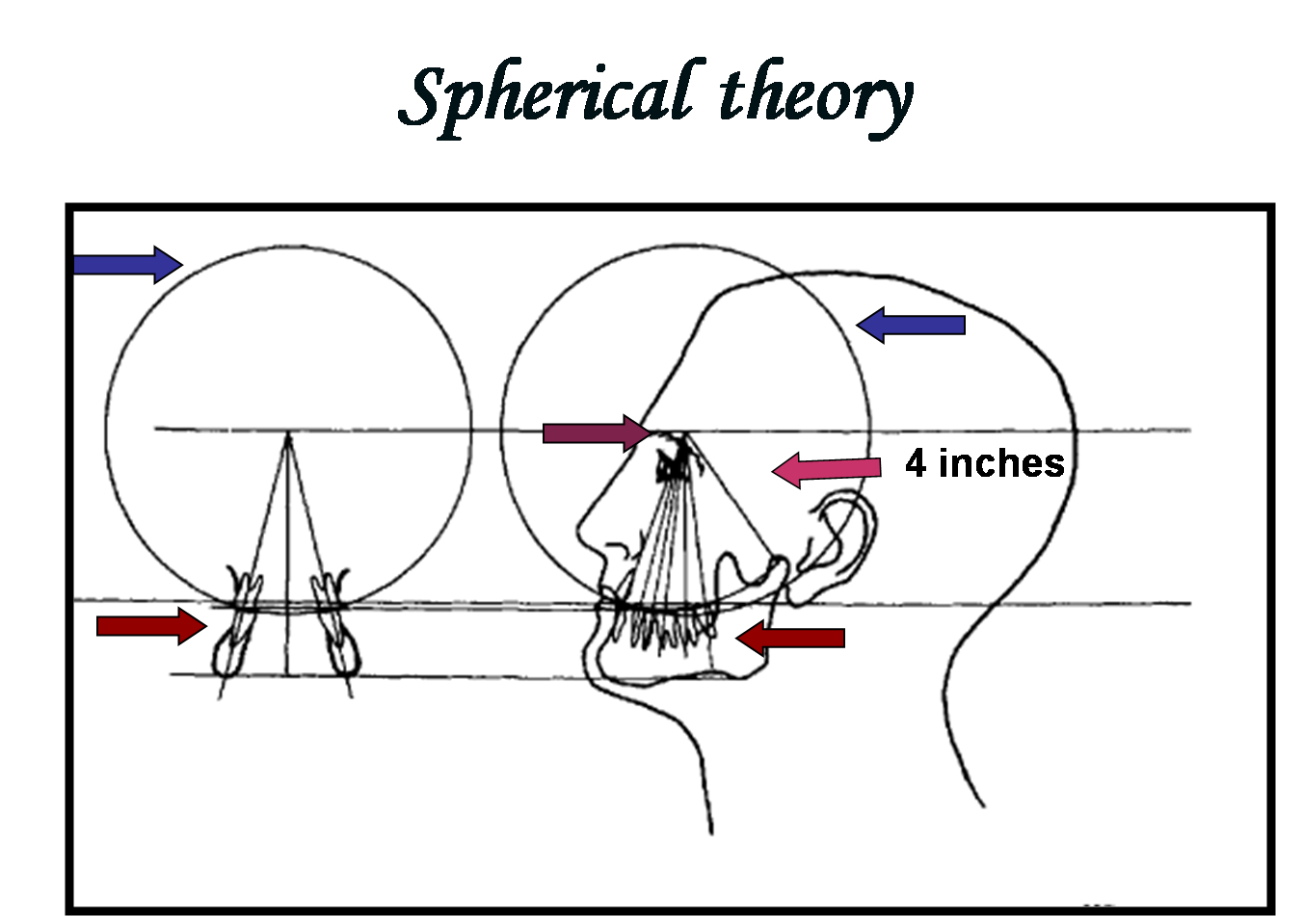

Slide 32
Spherical theory ….1916
G.S.Monson
It proposed that :
Lower teeth move over the surfaces of upper teeth as over the surfaces of a sphere with diameter of 8 inches (20 cm).
Centre of the sphere - glabella
Surfaces of the sphere pass through the glenoid fossae or are concentric with articulating eminences.

Slide 33
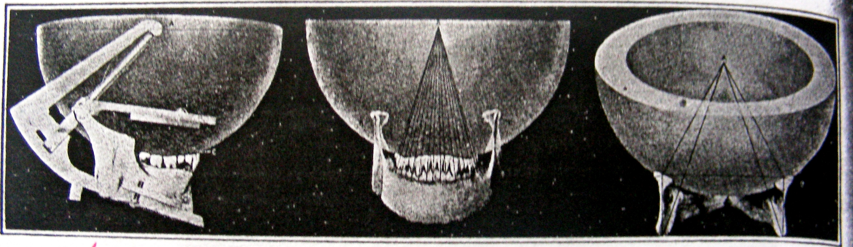

Slide 34
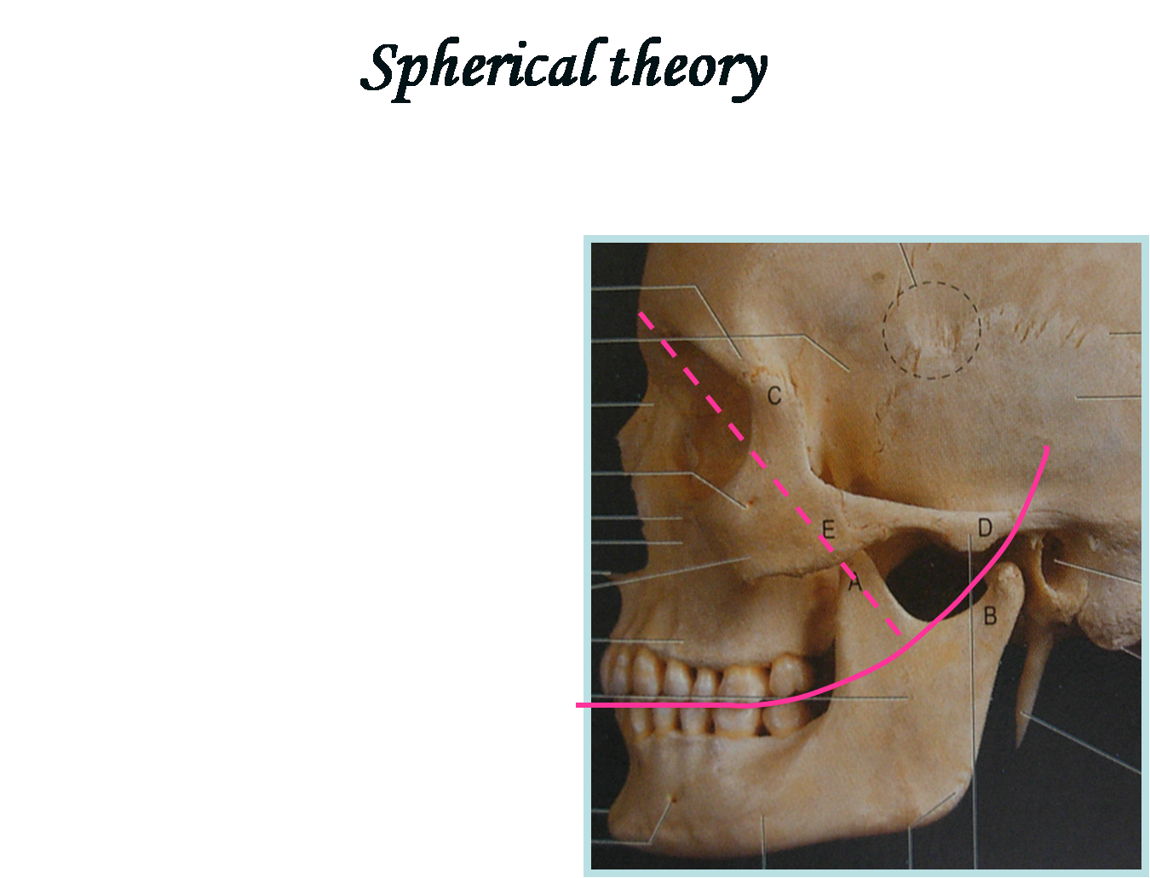
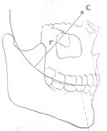

Slide 35
Monson disregarded that translation of the mandible during excursions as proposed by Bonwill.
He adapted the 10 cm equilateral triangle that
formed the basis of Bonwill‘s theory and added to it the occlusal curvature, fixed central axis of rotation concept of Spee
His conclusion produced the 10 cm radius sphere
Bilateral balance was the natural consequence of such an approach to occlusion

Slide 36
MONSON’S ARTICULATOR

Slide 37
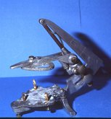
In 1916, MONSON introduced the so called spherical articulator based on spherical theory
Monson instrument is an arbitrary articulator
He copied the HALL central axis principle of lateral movement and embodied an improvement of registering downward movement

Slide 38
Curve of Monson: Ideal curve of occlusion elements, and each cusp and incisal edge touches or confirms to a segment of the surface of a sphere 8 inches in a diameter with its centre in the region of the glabella.
But this Monson’s theory was questioned by few people
They said that this occlusion must be developed in curved form, the arc of plane having its convex face downward and concave face upward.

Slide 39
Those very curvatures create displacing elements, and for balancing dentures in function such form is illusory because :
The relationship between the maxillary and mandibular dentures is merely when it is in the range of this plane and predetermined in one vertical dimension position as stopping places for the masticatory functional stroke.
Hence occlusion cannot balance against the forces which have acted previous to the contact of the teeth.

Slide 40

Conical theory…1914
R .E.HALL
It was believed that the condyles were not the guides to mandibular movement
Instead, the occluding planes of the teeth were the guides for mandibular movement
It proposed that :
lower teeth move over the surfaces of upper teeth as over the surface of a cone with a generating angle of 45 degrees and with the central axis of cone tipped at 45 degrees to occlusal plane

Slide 41
Hall advocated reproducing condylar movements in articulators.
He described the mandible as having the ability to move in “four distinct directions: forward, lateral (to either side) and backward.”
He also believed previous inventors had forgotten- the fourth movement – backward movement.

Slide 42
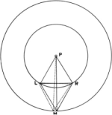
Hall envisioned that if 2 equilateral triangles (constructed on Bonwill’s principles were placed back to back, they would share a common base that represented the condylar axis .
The vertex of the anterior triangle would be located at the incisor point and the posterior vertex would be located in the region of the external occipital protuberance.

Slide 43
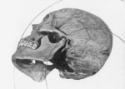
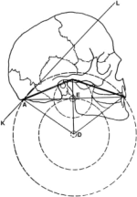
Hall also believed that the mandible opened and closed on arcs concentric to a point at the external occipital protuberance.

Slide 44
Hall automatic articulator
the maxillary teeth set to conform to the inner surface of an 8-inch cone, the length having been determined by the 2 Bonwill 4 inch equilateral triangles placed back to back
Teeth with 45⁰ cusp inclination necessary

Slide 45
Anti-monson theory
Proposed by Avery brothers in 1930
Reverse curve would stabilize the lower complete denture
Which advocated a reverse occlusal curve of Wilson-lateral compensating curve
The theory was based on the observation that the occlusion of dentures and natural dentitions tend to wear in a reverse curve fashion

Slide 46
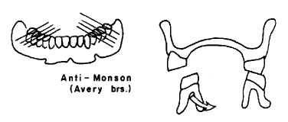
It does not allow for bilateral balance in eccentric jaw movements.
This form of occlusion was referred as reverse pitch occlusion, in which the occlusal surfaces of the posterior teeth are inclined obliquely upward, from their buccal to their lingual borders.

Slide 47
Pleasure’s theory
Pleasure, in 1937, introduced “pleasure curve” which advocates the antimonson reverse curve except for the second molars.
when viewed in the frontal plane, conforms to a curve that is convex from the superior view, except for the last molars which reverse that pattern
Second molars are tipped up to allow for bilateral balance of three points in ( incisal and both second molars) in eccentric movements
The pleasure curve retained the alleged benefits of the antimonson curve while allowing for bilateral balance in eccentric movements.

Slide 48
IDEAL REQUIREMENTS OF
COMPLETE DENTURE OCCLUSION
Stability in both centric and eccentric relations.
Tripod contact during all eccentric movements.
Unlocking the cusps mesiodistally.
Reduction of cuspal height to control the horizontal forces.
Functional lever balance should be obtained.

Slide 49
Cutting, penetrating and shearing efficiency of the occlusal surface should be equivalent to that of natural dentition.
Incisal clearance during posterior functions like chewing.
Minimal area of contact to reduce pressure while crushing food (Lingualized occlusion).
Sharp ridges, cusps and sluiceways to increase masticating efficiency.

Slide 50
Occlusal scheme requisites.
These requirements can be easily applied if occlusion is divided into 3 distinct units:
Incising units
Working units
Balancing units.

Slide 51
Each occlusal scheme has three characteristics:
Incising unit working unit Balancing side
(4 incisors) (canine &post (canine &post
teeth on teeth on non
working side) working side)

Slide 52
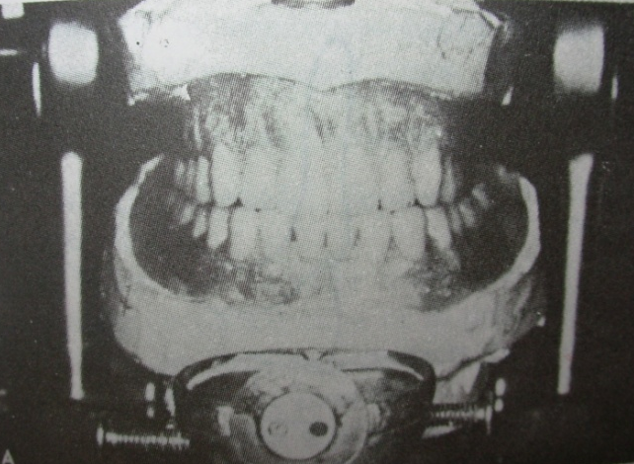
incising units
Sharp units for improved incising efficiency.
The units should contact during protrusion not during mastication.
Shallow incisal guidance.
Increased horizontal overlap to avoid interference during settling.

Slide 53
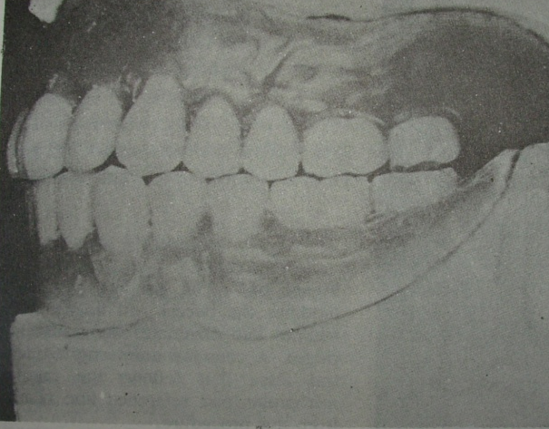
working units
Cusps for good cutting and grinding efficiency.
Smaller buccolingual width to decrease the occlusal load transferred to the tissues.
Group function at the end of the chewing cycle in eccentric positions.

Slide 54
The occlusal load should be directed to the anteroposterior centre of the denture.
The plane of occlusion should be parallel to the mean foundation plane of the ridge.

Slide 55
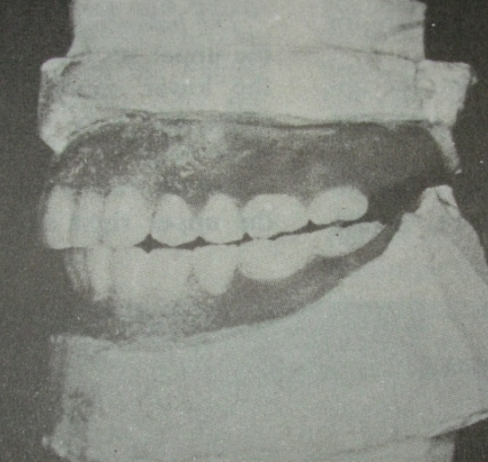
balancing units
The second molars should be in contact during protrusive action (protrusive balance )
They should have contact along with the working side at the end of the chewing cycle .
Smooth gliding contacts should be available for uninterred lateral and protrusive movements.

Slide 56

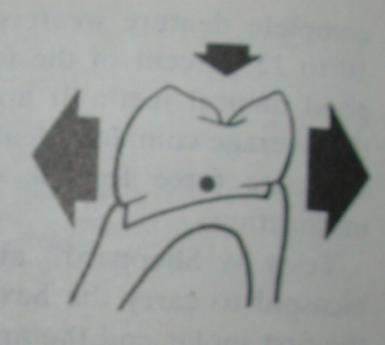
Sears axioms of complete denture occlusion :
To help plan a complete denture occlusion Sears 1952 proposed following factors:
1. smaller the occlusal surface
lesser the occlusal load transmitted
2. vertical force on a tilted occlusion
nonvertical force on the denture

Slide 57
Vertical forces acting on a tilted tissue support produces non vertical forces on the denture .
Vertical force on the denture base lying over the resilient tissues will produce lever forces on the denture .
Vertical forces acting outside the ridge crest will produce tipping of the denture.

Slide 58
Schemes of occlusion
Scheme of occlusion - the form or design and arrangement of the occlusal and incisal units of a dentition or of the teeth on a denture .( Mosby’s dental dictionary )

Slide 59
Guidelines for scheme of occluison
1.Cusped teeth are recommended in those patients who exhibit obvious excursive movements & who have sufficient ridge form ,to bear lateral displacing forces.
Balanced articulation is possible in cusped teeth .
2 If the ridge is poor or patient denture control is deemed to be poor then ,nonanatomically shape teeth are used.
3. Nonanatomically teeth are considered to eliminate displacing forces arising from deflective cuspal contacts when no food is in the mouth ,also reduces lateral stresses.

Slide 60
4.. Combination of cuspless and anatomical teeth have been used for many years.
5. More recently ,modification of cusped teeth are used in “ lingualized occlusion “.
6. In this connection the buccal cusp of maxillary teeth are grinded out of contact ,and the palatal cusps are placed in the central fossae of the mandibular teeth ,thus directing the occlusal forces lingual to the ridge.

Slide 61
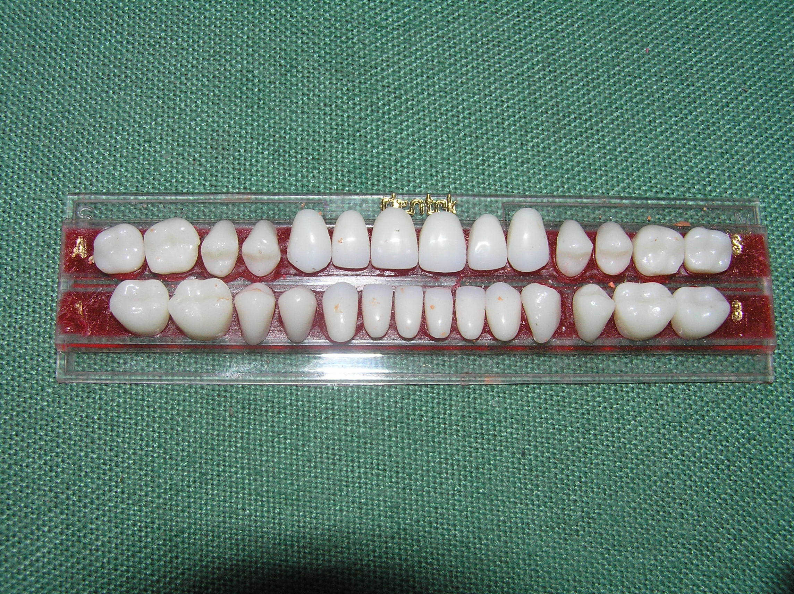
Anatomic teeth
Artificial teeth that have prominent cusps on the masticating surface and that are designed to articulate with the teeth of the opposing natural or prosthetic dentition . (GPT-8)
Anatomic teeth → cuspal inclinations
Tend to replicate natural tooth

Slide 62
advantages of anatomic teeth
They are more efficient in the cutting of food. Thereby reducing the forces directed on the ridge.
The cuspal inclinations facilitate the development of bilateral balance in the various eccentric occlusion.
They look like natural teeth and are therefore esthetically acceptable.
4. Cusp teeth provide a resistance to denture rotation.

Slide 63
disadvantages of anatomic
TEETH
It is mandatory to use an adjustable articulator.
Eccentric records must be made for articulator adjustment.
3 .Mesiodistal interlocking will not permit settling of the base without horizontal forces developing.
4. Harmonious balanced occlusion is lost when settling occurs.
5. The presence of cusps generate more horizontal force during function.

Slide 64
Non anatomic teeth
Non-anatomic tooth is one that is essentially flat and has no cusp heights to interdigitate with an opposing tooth.
The occlusal surface is composed of varying designs of flat planes and sulci to enhance its comminuting effect on food.

Slide 65
Advantages of nonanatomic
TEETH
Cuspless teeth eliminate the possibility of defective occlusal contacts when there is no food in the mouth…
2. Less laboratory time and effort .
3. When the neuromuscular controls are uncoordinated,
balanced occlusion can not be achieved, then cuspless teeth are useful .
4 . Horizontal forces directed on the tissues are reduced .

Slide 66
disadvantages of non-anatomic
TEETH
These are esthetically inferior than cusp teeth.
Reduces the mechanical efficiency to masticate or penetrate the food.
They probably require the application of force in a nearly horizontal direction of jaw movement to shear food and this results in lateral forces against residual ridges.

Slide 67
SPHERICAL SCHEME OF OCCLUSION:
Spherical scheme of occlusion with cusped teeth characterized by a buccal and lingual cusp lift for lateral excursions to contact positions. The radius for the spherical scheme is above the occlusal plane as shown by the curved dotted line.(as shown in the figure) The length of the radius is determined by the steepness of the cusp angle and the inclination of the teeth. When the radius is four inches, the teeth conform to the Monson curve.

Slide 68
(b) FLAT SCHEME OF OCCLUSION :
The flat occlusal scheme as developed by the use of nonanatomic teeth, showing the direction of the resultant force. The inclination of the non-anatomic teeth occlusal surfaces can modify this scheme.
(c) REVERSE SCHEME OF OCCLUSION:
The reverse occlusal scheme(pleasure curve or antimonson curve) in which the radius for the curvature is below the occlusal plane as represented by the curved broken line. The direction of the resultant force is represented by the straight broken line, which is inside the ridge crest. The scheme is designed to give lever balance to the lower denture during masticatory function. “Pleasure” described this occlusal scheme and used it for posterior teeth.

Slide 69
(d) PLEASURE CURVE :
The "Pleasure curve," as later described by Dr. Max Pleasure (U.S. dentist), in which a reverse is set in the bicuspid area for lever balance.
A flat scheme of occlusion is set in the first molar area, and a spherical scheme set in the second molar area by raising the buccal incline to provide for balancing contact in lateral position. The distal end of the second molar can also be elevated to produce a compensating curve for protrusive balance.

Slide 70
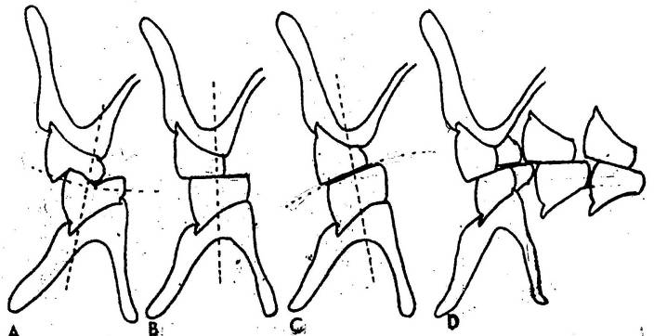
Spherical scheme of occlusion
Flat occlusal scheme.
The reverse occlusal scheme.
The pleasure curve

Slide 71
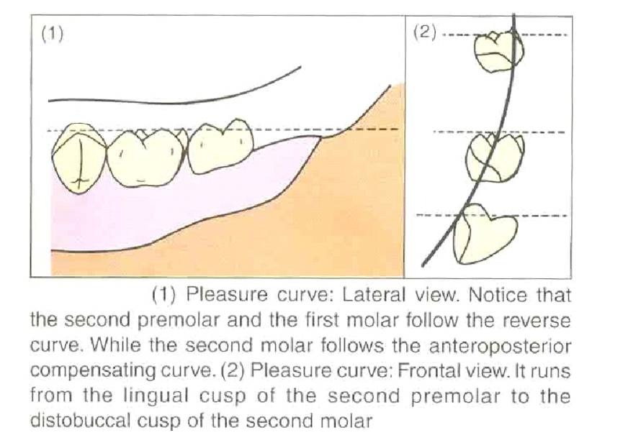

Slide 72
General concepts of complete denture occlusion
In planning of occlusion in complete dentures, various different concepts are used.
They fall into 2 categories:
Balanced occlusion
Non balanced occlusion.

Slide 73

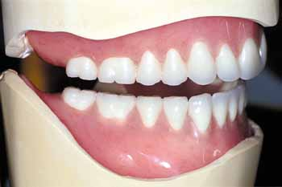
Balanced occlusion should have tripod contact even in eccentric relation.
Teeth Selection
Anatomic teeth Non anatomic teeth
Balanced Occlusion Monoplane Occlusion

Slide 74
Five basic occlusal schemes in use today acc to Gregory Parr and Gerald Loft :
Anatomic; Balanced occlusion
Semi anatomic; Balanced occlusion
Non anatomic ; Balanced occlusion
Lingualized occlusion ; balanced or non balanced
Neutrocentric occlusion

Slide 75
Concepts of occlusion

Slide 76
DIFFERENT CONCEPTS OF OCCLUSION
Lingualized occlusion
Monoplane occlusion .
Linear occlusion .
Neutrocentric occlusion.
spherical occlusion.
organic occlusion .
physiologically generated occlusion.
Balanced occlusion

Slide 77
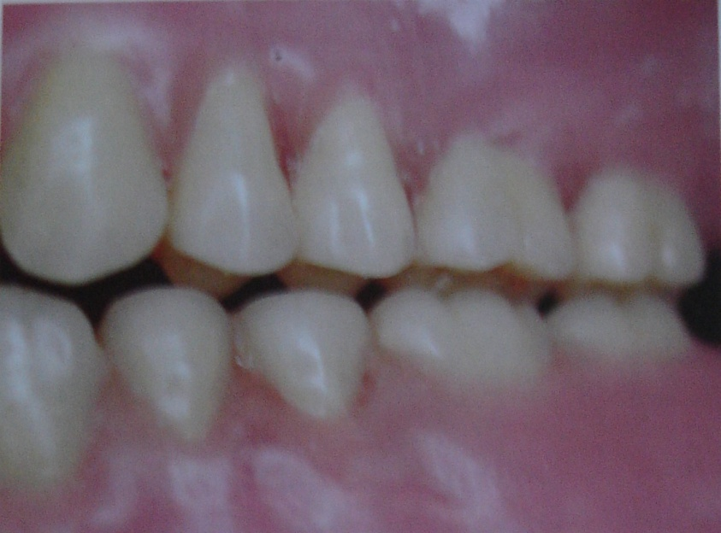
lingualized occlusion
this concept was introduced by ALFRED GYSI (1927 )
S.H. PAYNE ( 1941 ) familiarized it “ cup to fossa occlusion”
POUND and MURREL also advocated this concept.
the umbrella term “ lingualized occlusion’ encompasses a number of different occlusal schemes :bilaterally balanced ,non-balanced ,linear functional –rational ,or functional .

Slide 78
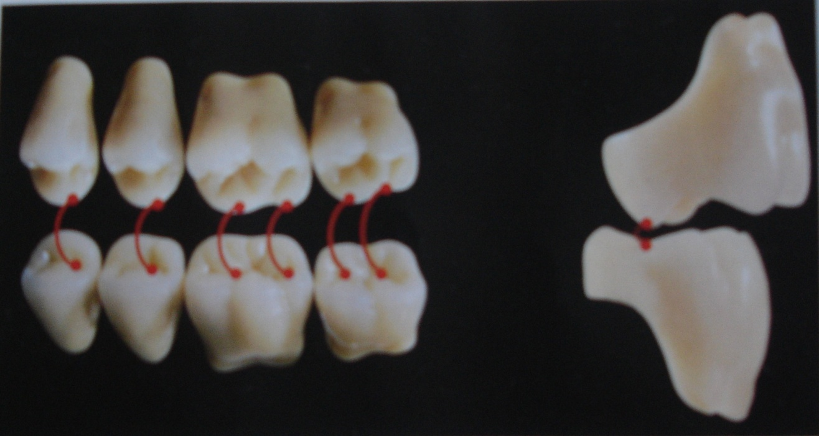
“This form of denture occlusion articulates the maxillary lingual cusps with the mandibular occlusal surfaces in centric working and nonworking mandibular positions.”(GPT 8)
It is an attempt to maintain the esthetic and food penetration advantages of the anatomic form while maintaining the mechanical freedom of the nonanatomic room.

Slide 79
Principles
Anatomic posterior (30 or 33 degree) teeth are used for maxillary denture : Tooth forms with prominent lingual cusps are helpful.
Non-anatomic or semi-anatomic teeth are used for mandibular denture : Shallow or flat cusp form is used : Narrow occlusal table is preferred in severe residual ridge resorption.

Slide 80
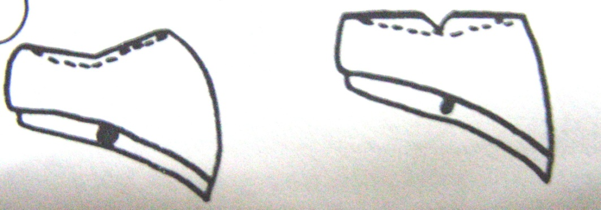
Principles
Selective grinding of mandibular posterior teeth is always necessary : It smoothens the central fossae, lowering marginal ridges & forms slight buccal & lingual inclines creating a slight concavity in the occlusal surface.
Porcelain or plastic teeth can be used, but plastic teeth should not be used to oppose porcelain teeth.
Shallow cusp form
0º cusp Form

Slide 81
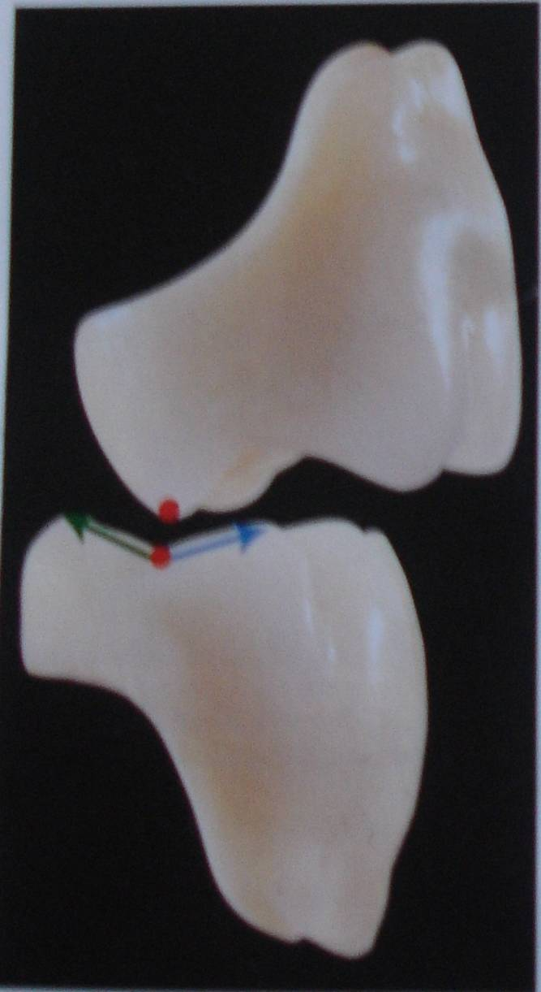
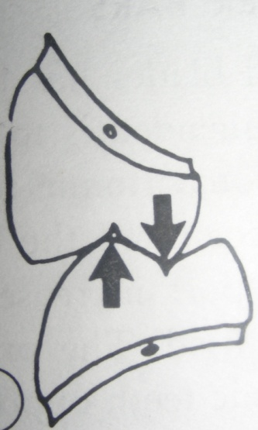
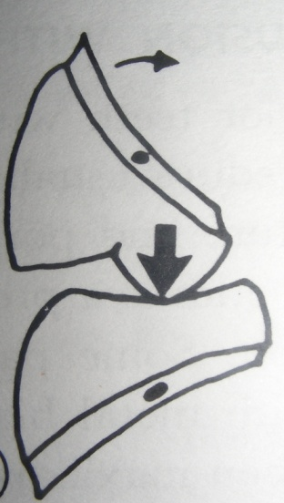
Principles
Maxillary lingual cusps should contact mandibular teeth in centric occlusion.
Mandibular buccal cusps should not contact maxillary teeth in centric occlusion (as is customary with usual anatomic tooth placement).
Anatomic arrangement
Lingualized arrangement

Slide 82
Principles
Slight buccal rotation of maxillary posterior teeth allows for slight clearance of buccal cusps in working position & to reduce need for extensive grinding.

Slide 83
Principles
Posterior teeth are arranged & adjusted to establish bilateral balanced occlusion in lateral mandibular excursions for a range of 2-3 mm around centric relation.
Selective grinding of maxillary buccal cusps may be needed to create small clearance between maxillary & mandibular buccal cusps on working side when excursive movements are initiated.

Slide 84
Principles
Maxillary lingual cusps remain in contact on the working side, reducing lateral movement of mandibular denture by placing occlusal forces more lingual to & towards the centre of mandibular teeth.
On balancing side, maxillary lingual cusps contact mandibular buccal cusps (as in anatomic occlusal arrangements).

Slide 85
Principles
Balancing & working contacts should occur only on maxillary lingual cusps
C.O.
Balancing Side
Working Side

Slide 86
Principles
Protrusive balancing contacts should occur only between maxillary lingual cusps & mandibular teeth.
Reduction of antero-posterior interferences on mandibular teeth may be necessary to provide a range of balanced occlusion in protrusive position.

Slide 87
Bilateral balanced
Lingualized occlusion
Protrusion - Sagittal View
Protrusion - Frontal View
C.O.
C.O.

Slide 88
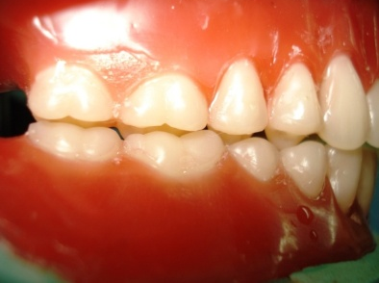
advantages:
Advantages of both anatomic and nonanatomic teeth .
Cusp form increases esthetics
Good chewing ability
Bilateral balance.
Vertical forces are centralized on mandibular teeth &it provides an area of closure ,allowing easier accommodation to unpredictable basal sear changes.
. indications:
In patients with severe ridge resorption .
class II jaw relationship .
Highly displaceable supporting tissues .
When complete denture opposes an RPD

Slide 89
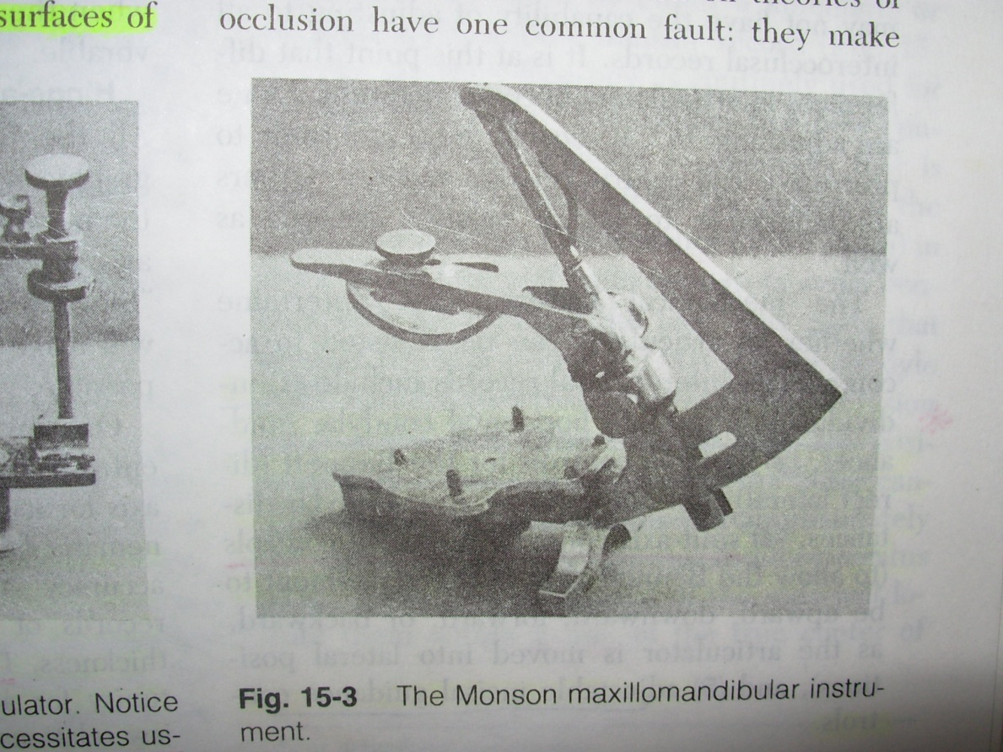
Spherical concept of occlusion(monson):
According to this CONCEPT ,the anteroposterior and mesiodistal inclines of the artificial teeth should be arranged in harmony with a spherical surface .

Slide 90
Physiologically generated occlusion
Mehrringer J E ( 1973 )developed this occlusion to harmonize complete denture occlusion neuromuscular system and Rt and Lt TMJ.
It is mainly indicated for patients having adequate foundation with stable record bases . And good neuromuscular control & can give functional movements consistently .

Slide 91
Advantages : comfortable to patient.
Limitation: time consuming
no scientific evidence.

Slide 92
Organic concept of occlusion
Organic occlusion was originally developed for natural dentition .it was then applied for complete denture occlusion.
In organic occlusion - three phases of mutually interdependent protection are present .
1. The posterior teeth should protect the anterior teeth in the centric occlusal position .
2. the maxillary incisors should have vertical overlap sufficient to provide separation of the posterior teeth when the incisors are in end to end contact .

Slide 93
3 . in lateral mandibular position outside the masticatory cyclic
movements ,the cuspids should prevent contact of all other teeth.
for this,
The shapes of the teeth are altered to have cusps suitable for the patient.
The ridge and groove directions of the posterior teeth are determined as a result of the movements of the condyle .
The cusp height ,fossa depth of posterior teeth and the proper concavity of the lingual surfaces of the maxillary ant teeth are determined as a result of mandibular movements.

Slide 94
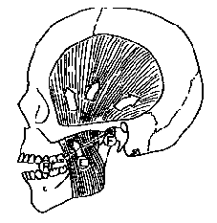
An articulator capable of receiving and reproducing pantograms in 3 planes is recommended to develop the organic concept of occlusion.
This type of occlusion is more applicable in natural dentition and fixed partial denture ,than in complete dentures.

Slide 95
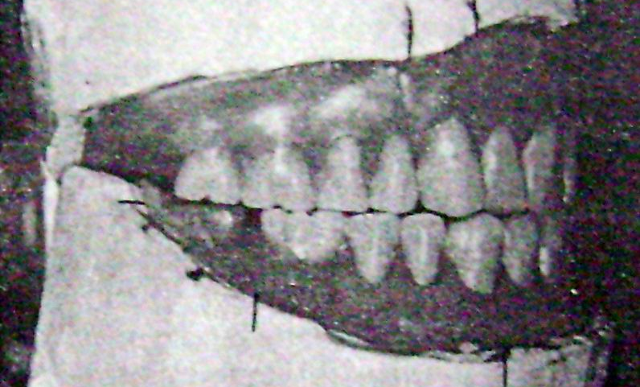
Neutrocentric concept of occlusion
The plane of occlusion should be flat and parallel to the residual alveolar ridge .
This concept is similar to the monoplane occlusion used to set nonanatomic teeth .
The term neutrocentric denotes an occlusion that eliminates the anteroposterior and buccolingual inclines in order to direct the forces to the posterior teeth .
There are five elements in this occlusal scheme: Position, Proportion, Pitch, Form , Number

Slide 96
It mainly uses the concept of arranging teeth on a plane (flat ) parallel with bony support .
It is independent of horizontal condylar guidance and has no compensating curves.
It eliminated anteroposterior and mediolateral inclination of teeth .which directs force of occlusion on posterior teeth .there are no balancing contacts. The total number of teeth used is decreased with use of posterior protrusive balancing ramp, and the buccolingual width of teeth also reduced.
The main disadvantage :poor stability in eccentric contacts.
also results in chopping masticatory
movements.

Slide 97
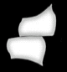
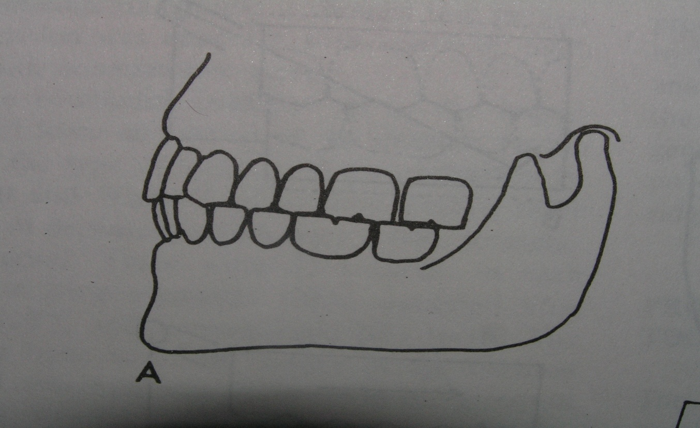
Monoplane occlusion
Definition : an occlusal arrangement wherein the posterior teeth have masticatory surfaces that lack any cuspal height .(GPT8)

Slide 98
ADVANTAGES :
More adaptable to class II and III malocclusion.
Used more easily when variations in the width of upper and lower jaws indicate a cross bite set up .
0 degree provide sense of freedom in mandibular movements.
O teeth - occlude in more than one position .CR is not that critical .
It is simple ,less time consuming.
They accommodate better ,to inevitable negative changes in ridge height that occurs with ageing .

Slide 99
Linear occlusion
“the occlusal arrangement of artificial teeth ,as viewed in the horizontal plane ,where in the masticatory surfaces of the mandibular posterior artificial teeth have a straight ,long narrow occlusal form resembling that of a line ,usually articulating with opposing monoplane teeth.” GPT 7 - - FRUSH (1966)

Slide 100
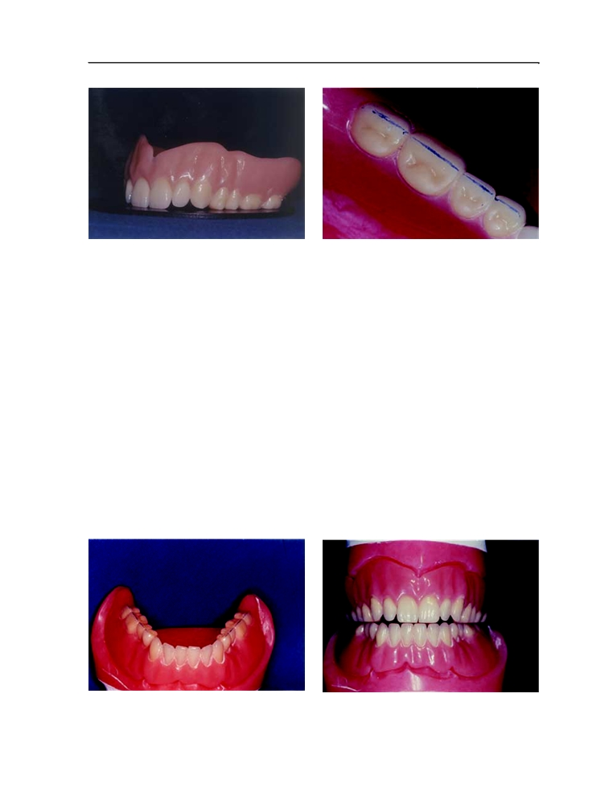
Linear occlusion
This concept advocates a straight line of points or knife edge contacts on artificial teeth in one arch occluding with flat non-anatomic teeth in the opposing arch, thereby reducing unfavorable occlusal forces.

Slide 101
balanced occlusion
“ Bilateral simultaneous ,anterior and posterior occlusal contact of teeth in centric and eccentric positions developed to lessen or limit tipping or rotating of the denture bases in relation to the supporting structures . ”(GPT)
“Balanced occlusion in complete dentures can be defined as stable simultaneous contact of the opposing upper and lower tooth in centric relation position and a continuous smooth bilateral gliding from this position to any eccentric position within normal range of mandibular function .”(WINKLER)

Slide 102
Characteristic requirements of balanced occlusion
All the teeth of the working side (central incisor to second molar) should glide evenly against the opposing teeth.
No single tooth should produce any interference or disocclusion of the other teeth.
There should be contacts in the balancing side, but they should not interfere with the smooth gliding movements of the working side.
There should be simultaneous contact during protrusion

Slide 103
Importance of balanced occlusion
Balanced occlusion is one of the most important factors that affect denture stability
Absence of occlusal balance will result in leverage of the denture during mandibular movement.
Sheppard stated that, “Enter bolus, Exit balance”. According to this statement, the balancing contact is absent when food enters the oral cavity. This makes us think that balanced occlusion has no function during mastication; hence, it is not essential in a complete denture. But this is not true.

Slide 104
Brewer reported the importance of balanced occlusion. He stated that on an average, a normal individual makes masticatory tooth contact only for 10 minutes in one full day compared to 4 hours of total tooth contact during other functions.
So, for these 4 hours of tooth contact, balanced occlusion is important to maintain the stability of the denture. Hence, balanced occlusion is more critical during parafunctional movements.

Slide 105
General considerations for balanced occlusion
Ideal occlusion can be achieved on wide & large ridges .
Teeth arranged on lingual side of ridges will provide better occlusal support and balance than on buccal side .
There should be bilateral & simultaneous contact of teeth during centric & eccentric movements of mandible
The complete denture designed that forces of occlusion are centered anteroposteriorly in the denture.

Slide 106
advantages of bilateral balanced occlusion
Esthetic
Bilateral simultaneous contact help to seat the denture in a stable position during mastication, swallowing and maintain retention and stability of the denture and the health of the oral tissues.

Slide 107
Denture bases are stable even during bruxing activity
Due to cross-arch balance, as the bolus is chewed on one side,
the balancing cusps will come close or will contact on the other.
Anatomic teeth used in balanced occlusion penetrate bolus better , requiring less chewing force and therefore decreasing the vertical force on the ridges
,

Slide 108
The ability of the cusped teeth to be arranged in harmony with the temporomandibular joint and muscles of mastication during speech, swallowing and chewing supposedly will improve the occlusion which is mechanically and physiologically balanced and therefore more acceptable to the oral environment.

Slide 109
The interdigitation of the denture teeth is believed to resist rotation movement of the denture thus encouraging a more vertical chewing pattern and greater denture stability

Slide 110
Disadvantages of balanced occlusion
precise reproducible records are needed.
A semi adjustable or fully adjustable articulator is required.

Slide 111
It is argued that this occlusion which functions against the inclines generates greater lateral force against the residual ridges. These lateral forces are more destructive then the vertical forces and that they might speed resorption of the residual ridges.
Anatomic occlusion is challenged on the grounds that in addition to being more technically challenging and more time consuming the results are short lived

Slide 112
The denture remains in good occlusal position until slight resorption occurs at which time the denture will be more difficult to adjust .
While balanced occlusion can be used for cross bite situations and for class II and class III relationships. The limitations placed on the tooth positions by the tight interdigitation of the cusps makes the use of this occlusal scheme difficult.

Slide 113
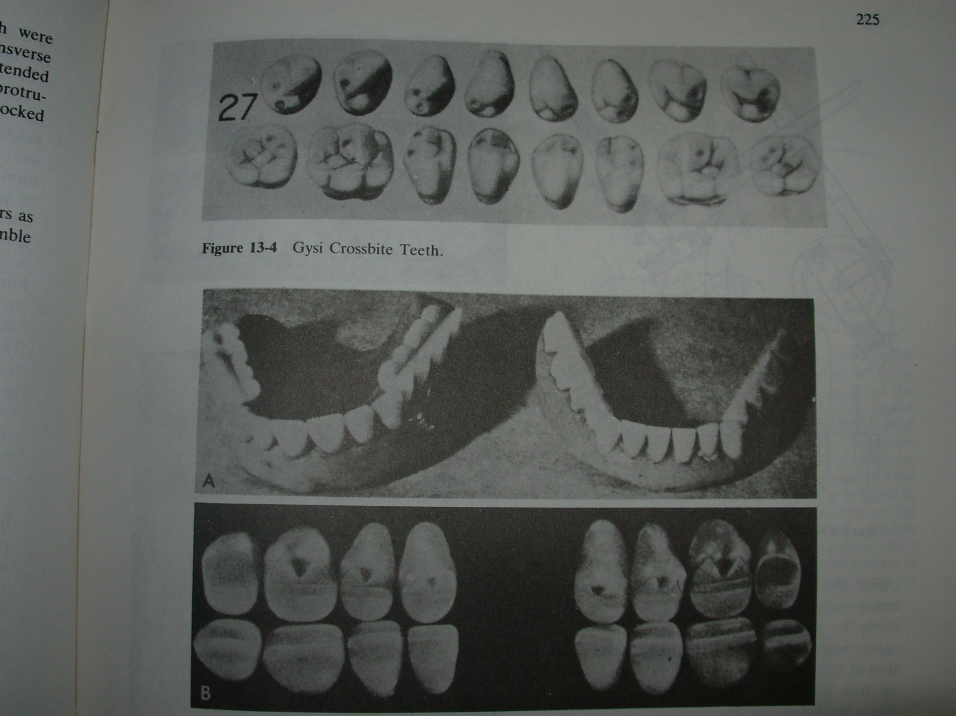
Concepts proposed to attain balanced occlusion
Gysi’s Concept: He proposed the first concept towards balanced occlusion in 1914. He suggested that arranging 33⁰ anatomic teeth could be used under various movements of the articulator to enhance the stability of the denture

Slide 114
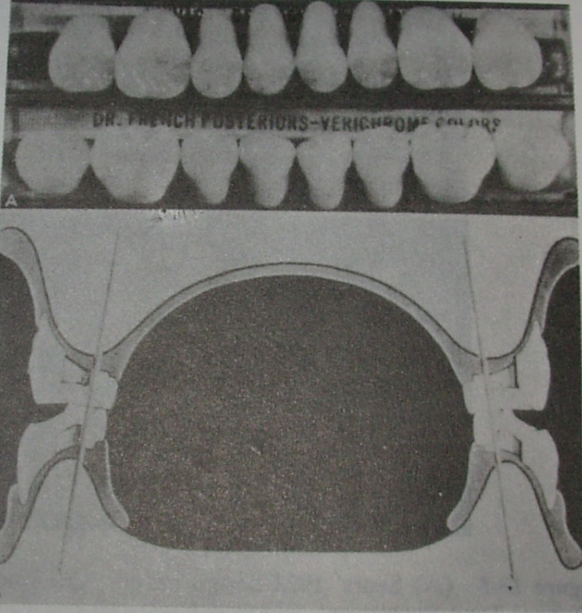
French’s concept (1954): He proposed lowering the lower occlusal plane to increase the stability of the dentures along with balanced occlusion. He arranged upper first premolars with 5⁰ inclination, upper second premolars with 10⁰ inclination and upper molars with 15⁰ inclination.

Slide 115
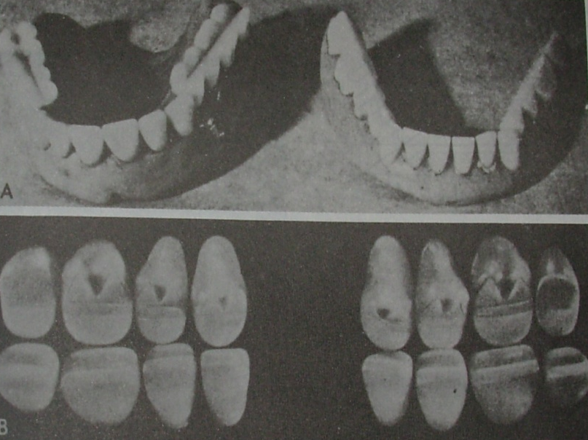
Sears’s concept: He proposed balanced occlusion for non-anatomical teeth using posterior balancing ramps or an occlusal plane which curves anteroposteriorly and laterally.

Slide 116

Pleasure’s concept: Pleasure introduced a pleasure curve or the posterior reverse lateral curve to align and arrange the posterior teeth in order to increase the stability of the denture

Slide 117
Frush’s Concept:
He advised arranging teeth in a one-dimensional contact relationship, which should be reshaped during try-in to obtain balanced occlusion.

Slide 118
Hanau’s Quint: Rudolph L. Hanau proposed nine factors that govern the articulation of artificial teeth. They are:
Horizontal condylar inclination
Compensating curve
Protrusive incisal guidance
Plane of orientation
Buccolingual inclination of tooth axis
Sagittal condylar pathway
Sagittal incisal guidance
Tooth alignment
Relative cusp height

Slide 120
These nine factors are called the laws of balanced articulation. Hanau later condensed these nine factors and formulated five factors, which are commonly known as Hanau’s quint:
Condylar guidance
Incisal guidance
Compensating curves
Relative cusp height
Plane of orientation of the occlusal plane

Slide 121
trapozzano’s concept of occlusion
He reviewed and simplified Hanau’s quint and proposed his Triad of Occlusion.
According to him, only three factors are necessary to produce balanced occlusion.
He dismissed the need for determining the plane of occlusion to produce balanced occlusion.
He said that the plane of occlusion could be shifted to favour weak ridges, hence, its location is not constant and is variable within the interarch distance.

Slide 122
He also dismissed the need for setting compensating curves, because, he suggested that when we arrange cusped teeth in principle these curves are produced automatically.
He considered the compensating curve as a passive factor, which is a resultant of setting cusped teeth.
Though his triad was simpler than the Hanau’s quint, it eliminated the important compensating curves and plane of orientation

Slide 123
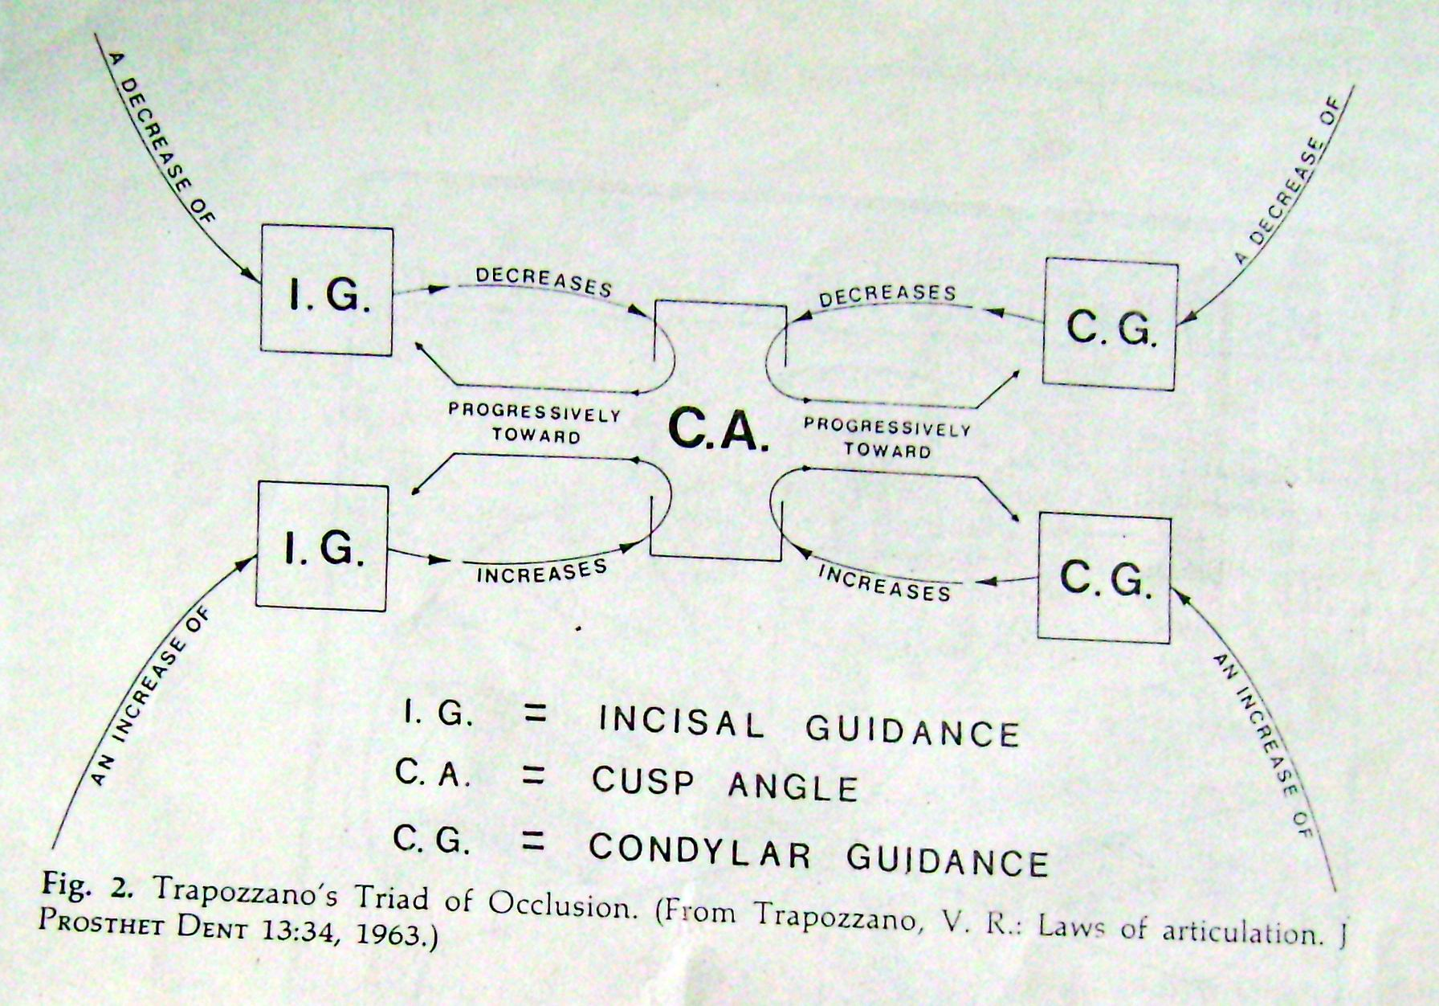

Slide 124
Boucher’s concept
Boucher confronted Trapozzano’s concept and proposed the following three factors for balanced occlusion. :
Orientation of the occlusal plane, the incisal guidance and the condylar guidance.
The angulation of the cusp is more important than the height of the cusp.
The compensating curve enables one to increase the height of the cusp without changing the form of the teeth.

Slide 125
Lott’s concept:
Lott clarified Hanau’s laws of occlusion by relating them to the posterior separation that is a resultant of the guiding factors.
The greater the angle of the condylar path, the greater is the posterior separation during protrusion.
The greater the angle of the overbite, the greater is the separation in the anterior and posterior regions irrespective of the angle of the condylar path.

Slide 126
Levin’s concept
Bernard Levin believed that it was not necessary to consider the plane of occlusion because it was not very useful practically.
Levin also states that the plane of occlusion can be slightly altered by 1-2 mm in order to improve the stability of a denture.

Slide 127
He named the other four factors of occlusion as the Quad:
The condylar guidance is fixed and is recorded from the patient.
The balancing condylar guidance will include the Bennett movement of the working condyle. This may or may not affect the lateral balance.

Slide 128
The incisal guidance is usually obtained from patient’s aesthetic and phonetic requirements. However, it can be modified for special requirements. E.g., the incisal guidance is decreased for flat ridges.
The compensating curve is the most important factor in obtaining occlusal balance. Monoplane or low cusp teeth must employ the use of compensating curve.
Cusp teeth have the inclines necessary for balanced occlusion but nearly always are used with a compensating curve.

Slide 129
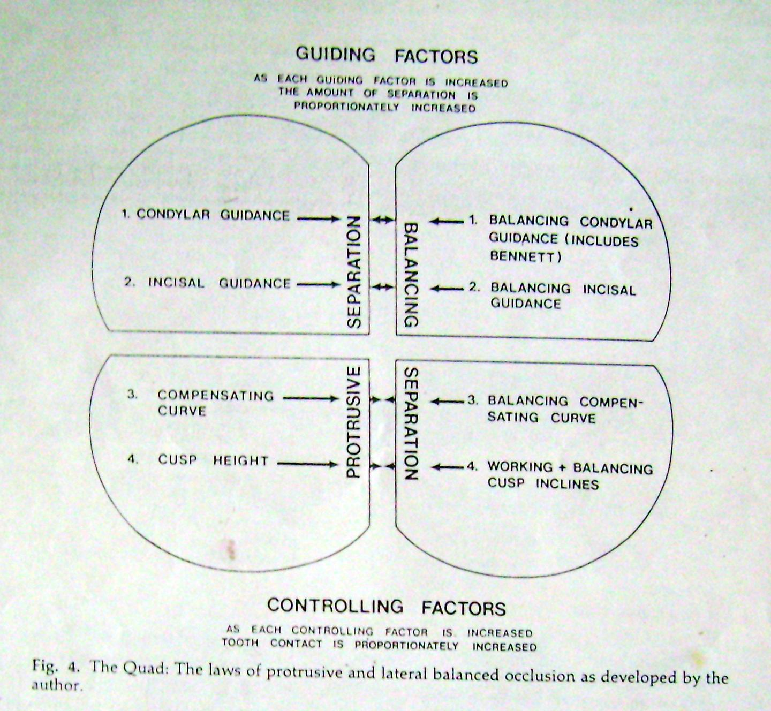

Slide 130
Unilateral balanced occlusion
Bilateral balanced occlusion
Protrusive balanced occlusion
Lateral balanced occlusion

Slide 131
Factors influencing balanced occlusion
Inclination of the condylar path or condylar guidance
Incisal guidance
Orientation of the plane of occlusion or occlusal plane
Cuspal angulation
Compensating curves.

Slide 132
There should be a balance within these five factors.
The incisal and condylar guidances produce a similar effect on balanced occlusion (they increase posterior tooth separation).
Similarly, the other three factors have a common effect on balanced occlusion (they decrease the posterior tooth separation).
The effect of the incisal and condylar guidances should be counteracted by the other three factors to obtain balanced occlusion.

Slide 133
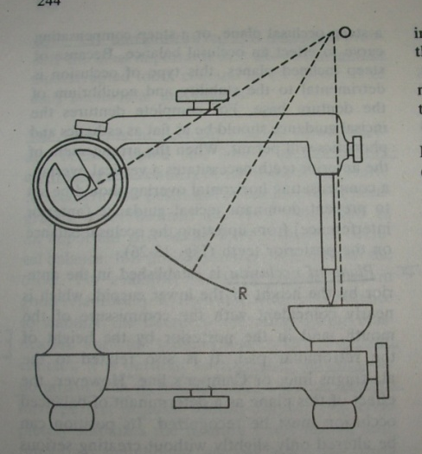
Incisal guidance:
This is defined as, “The influence of the contacting surface of the mandibular and maxillary anterior teeth on mandibular movements”.
It is determined by the dentist and customized for the patient during anterior try-in.
It should be set depending upon the desired overjet and overbite planned for the patient. If the overjet is increased, the inclination of the incisal guidance is decreased. If the overbite is increased, then the incisal inclination increases.

Slide 134
The incisal guidance has more influence on the posterior teeth than the condylar guidance.
During protrusive movements, the incisal edge of the mandibular anterior teeth move in a downward and forward path corresponding to the palatal surface of the upper incisors. This is known as the protrusive incisal path or incisal guidance. The angle formed by this protrusive path to the horizontal plane is called as the protrusive incisal path inclination or the incisal guide angle.

Slide 135
This influences the shape of the posterior teeth. If the incisal guidance is steep, compensatory curve is needed to produce balanced occlusion.
In a complete denture, the incisal guide angle should be as flat (more acute) as possible.
The incisal guidance cannot be altered beyond limits.
The location and angulation of the incisors are governed by various factors like aesthetics, function and phonetics, etc.

Slide 136
Condylar guidance
Condylar guidance is a mandibular guidance generated by the condyles traversing the contours of the glenoid fossa.
The condylar guidance and incisal guidance → end controlling factors.
It acts as a posterior control factors.

Slide 137
It is the one factor which the edentulous patient presents and can in no way be modified by the operator.
The condylar path is determined on the patient by a protrusive record and set on the instrument.

Slide 138
The degree of condylar inclination registered results from:
The shape of the bony contour of the TMJ.
Action of muscles attaching the mandible.
Limitations of movements effected by the attaching ligaments

Slide 139
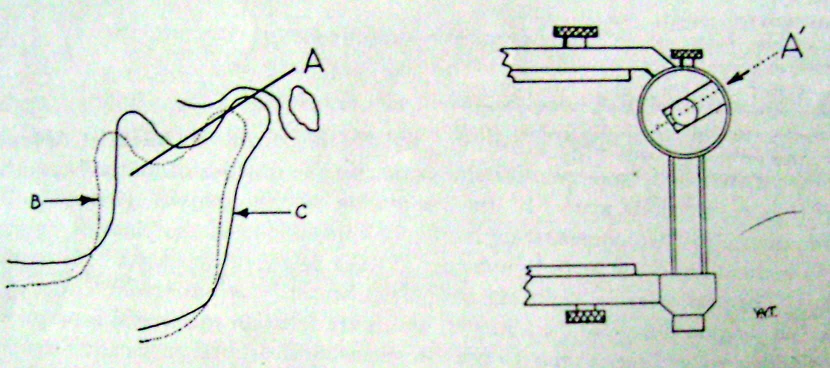
Among all the factors condylar inclination is most important in securing balanced articulation and form one of the end-controlling factor

Slide 140
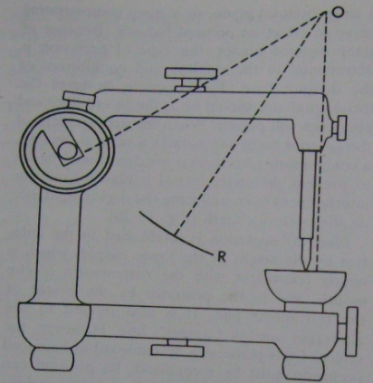
Plane of occlusion
It is defined as, “An imaginary surface which is related anatomically to the cranium and which theoretically touches the incisal edges of the incisors and the tips of the occluding surface of the posterior teeth.”
It is not a plane in the true sense of the word but represents the mean curvature of the surface.

Slide 141
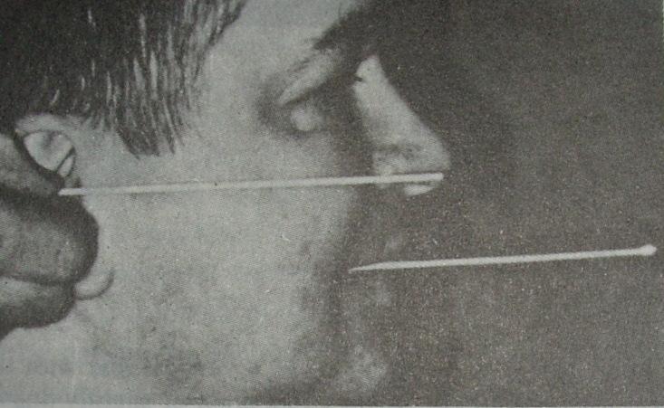
It is established anteriorly by the height of the lower canine, which nearly coincides with the commissure of the mouth and posteriorly by the height of the retromolar pad.
It is usually parallel to the ala-tragus line or Camper’s line.
It can be slightly altered and its role is not as important as other factors. Tilting the plane of
occlusion beyond 10⁰ is not
advisable

Slide 142
Compensating curve
it is defined as :”the antero-posterior and lateral curvatures in the alignment of occluding surfaces and incisal edges of artificial teeth which are used to develop balanced occlusion.”
It is determined by the inclination of the posterior teeth and their vertical relationship to the occlusal plane.
The posterior teeth should be arranged such that their occlusal surfaces form a curve. This curve should be in harmony with the movements of the mandible guided posteriorly by the condylar path.
There are two types of compensating curves namely:
Anteroposterior curves
Lateral curves

Slide 143
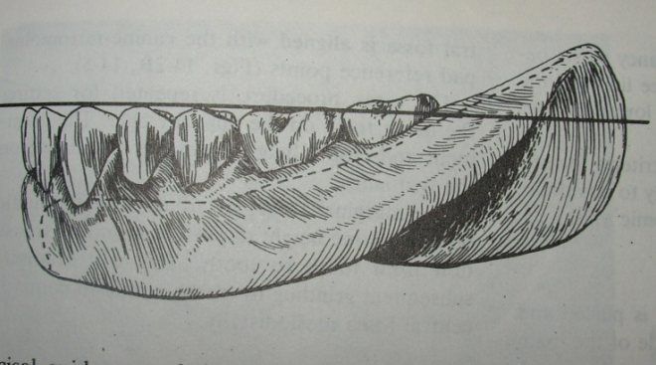
A steep condylar path requires a steep compensatory curve. If a shallow compensating curve is given for the same situation, there will be loss of balancing molar contacts during protrusion.
Curve of Spee, Wilson’s curve and Monson’s curve are associated only with natural dentition.
In complete dentures compensating curves
similar to these curves should be
incorporated to produce balanced
occlusion.

Slide 144
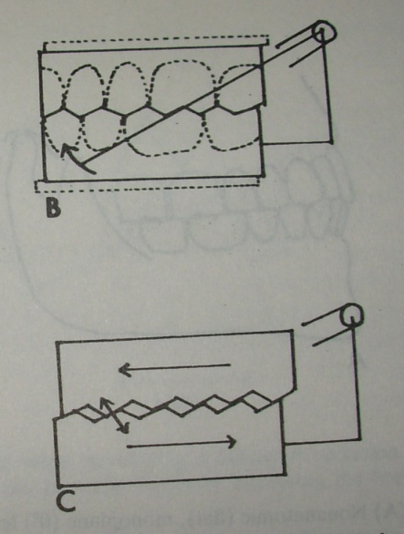

Cusp height and inclination
Cusp angle:“The angle made by the average slope of a cusp with the cusp plane measured mesiodistally or buccolingually”.
The cusps on the teeth or the inclination of the cuspless teeth are important factors that modify the effect of plane of occlusion and the compensating curves. The mesiodistal cusps lock the occlusion, such that repositioning of teeth does not occur due to settling of the base

Slide 145
In order to prevent the locking of occlusion, the mesiodistal cusps are reduced during occlusal reshaping.
In cases with a shallow overbite, the cuspal angle should be reduced to balance the incisal guidance. Teeth with steep cusps will produce occlusal interference in these cases.
In cases with a deep bite (steep incisal guidance), the jaw separation is more during protrusion. Teeth with high cuspal inclines are required in these cases to produce posterior contact during protrusion.

Slide 146

Inclination of the cusps:
It refers to the angle between
the total occlusal surface of
the tooth and the inclination
of the cusp in relation to
that surface.
For e.g. 10⁰ tooth indicates that the mesial slopes of the cusp make 10⁰ angle with a plane touching the tips of all the cusps of teeth. In other words the plane of reference (the horizontal plane) would be at right angles to the vertical axis of the tooth.

Slide 147
Swenson’s Formula:-
Swenson’s formula is an empirical formula and clarifies the relationship between the sagittal cusp inclination of the incisal guidance.
Cusp inclination = Incisal inclination + Fraction of distance from incisal guidance. (Condyle inclination - Incisal inclination)

Slide 148
Gysi’s formula for the second molar:
Gysi's formula for the angulation of second molar is –
Angulation of M2 = Condyle guide inclination + Incisal
guide inclination
2
That is EM2 = B + V
2
B – Condyle guide inclination
V – Incisal guide inclination

Slide 149
CONCLUSION
Neutrocentric concept | Lingualized concept | Monoplane concept | Lineal concept
Resorbed ridge cases, poor neuromuscular control. | Class I, class II, class III, cross bite, etc. | Poor ridge form, poor neuromuscular control | Where stability of the denture base is prime consideration
Different Clinical situations

Slide 150
single complete dentures | Combination syndrome
Direct forces vertically .post balanced occ Post teeth shd not extend beyond 1st molar | linear occlusion concept
Different Clinical situations

Slide 151
CONCLUSION
The search for the ideal occlusal scheme, one which provides stability, comfort, function & esthetics is still underway.
It requires the Dentist to establish a philosophy of occlusion, select an occlusal concept to be used with the philosophy & choose an occlusal scheme to satisfy the concept & fulfill the philosophy.

Slide 152
Bibliography
Boucher’s Prosthodontic Treatment for Edentulous Patient”, 12th edition, Zarb-Bolender.
Boucher’s Prosthodontic Treatment for Edentulous Patient”, 10th edition, Zarb-Bolender, Hickey, Carlsson.
Essentials of Complete Denture Prosthodontics, 2nd Edition, Sheldon-Winkler.
Complete Denture Prosthodontics – Swenson.
Text Book of Complete Dentures, 5th edition, Rahn, Charles Heartwell.
Complete Denture Prosthodontics – Sharry.
Journal of Prosthetic Dentistry 1972; 27:246
Journal of Prosthetic Dentistry 1978; 39 : 484.
Journal of Prosthetic Dentistry 1977; 38:601.
Journal of Prosthetic Dentistry 1972; 25:94-100.
Journal of Prosthetic Dentistry 2001; 85(1):15-19.
Journal of Prosthetic Dentistry 1971; 25(2):121-138.
Journal of Prosthetic Dentistry 1971; 26(5):448-455.
Journal of Prosthetic Dentistry 1981; 57 : 704-707.
British Dental Journal 1997; 128:1140.
Journal of Prosthetic Dentistry 2000; 84(4):390-393.

