Slide 1
BALANCED OCCLUSION
DEPARTMENT OF PROSTHODONTICS,
GDC, NAGPUR

Slide 2
SPECIAL LEARNING OBJECTIVES
The learner should be able to
Define balanced occlusion
Rationale of balanced occlusion
Prerequisites of balanced occlusion
Factors affecting balanced occlusion
Advantages of balanced occlusion

Slide 3
INTRODUCTION
  Functions served by teeth – Mastication
  Esthetics
  Phonetics
  Desirable qualities in denture – Adequate retention
  Stability
  Harmony in occlusion
  Preservation of the foundation
  Comfort

Slide 4
DEFINITION
To occlude = to shut off or to close tightly
Occlusion:
is defined as the static relationship between the incising or masticating surfaces of the maxillary and mandibular teeth.
Balanced Occlusion
The bilateral, simultaneous, anterior and posterior occlusal contact of teeth in centric and eccentric position.

Slide 5
These requirements can be easily applied if occlusion is divided into 3 distinct units. Occlusion can be divided into three distinct units
        Incising units.
        Working units.
        Balancing units.

Slide 6
COMPARISION BETWEEN NATURAL DENTITION AND ARTIFICIAL PROSTHESIS
Natural dentition | Artificial prosthesis
1. Each tooth individually is supported by periodontal tissue in the bony socket. | 1. All the teeth are supported by a common denture base that rests upon mucosa
2.Each tooth can move independently and can migrate slowly to favorable occluding positions. | 2. All the teeth move as a unit with the denture base.

Slide 7
Natural dentition | Artificial prosthesis
3. Incising with the anterior teeth does not affect the posterior teeth. | 3. Incising from anterior teeth can potentially cause tipping of the denture from the posterior.
4.Balancing side contact rarely found, if present considered as balancing side interference. | 4. Balancing side contact (bilateral balancing) necessary for base stability.
5. Due to proprioceptive mechanism a person can avoid premature contacts and interferences. | 5. Due to lack of proprioceptive mechanism any premature contacts and cuspal interference will dislodge the denture.
6. Malocclusion of natural teeth does not evoke any immediate response. | 6. Not applicable.

Slide 8
REQUIREMENTS OF COMPLETE DENTURE OCCLUSION
Stability of occlusion
Balanced bilateral contacts
Buccolingual cusp height reduction - Control of horizontal force
Cutting, penetrating and shearing efficiency of occlusal surfaces
Anterior incisal clearance

Slide 9
These requirements can be most easily applied
if the occlusion is divided into three distinct
units:
Incising,
Working, and
Balancing.
It is possible to establish requirements
for these units that will favor function stability
and phonetics.

Slide 10
Requirements for Incising Units:
These units should be sharp in order to cut efficiently.
They should not contact during mastication.
They should have as flat an incisal guidance as possible considering esthetics and phonetics

Slide 11
They should have horizontal overlap to allow for base setting without interference.
They should contact only during protrusive incising function.
Requirements for Working Occlusal Units:
They should be efficient in cutting and grinding.
They should have decreased buccal-lingual width to minimize the work force directed to the denture foundation.

Slide 12
They should function as a group with simultaneous harmonious contact at the end of the chewing cycle and during eccentric excursions.
They should be over the ridge crest in the masticating area for lever balance.
They should have a surface to receive and transmit the force of occlusion essentially vertically.

Slide 13
They should center the work load near the anteroposterior center of the denture.
They should present a plane of occlusion as parallel as possible to the mean foundation plane.

Slide 14
Requirements for Balancing Occlusal Units:
They should contact on the second molars when the incising units contact in function.
They should contact at the end of the chewing cycle when the working units contact.
They should have smooth gliding contacts for lateral and protrusive excursions.

Slide 15
FACTORS INFLUENCING BALANCED
OCCLUSION
The five basic factors that determine the balance of an occlusion are
Inclination of condylar guidance
Incisal guidance
Orientation of occlusal plane
Inclination of cusp angle
Prominence of compensating curves

Slide 16
CONDYLAR GUIDANCE
The angle formed between horizontal plane and a line formed by joining two positions of condyles – (centric relation and protrusive relation position)
It is anatomical factor . Angulation depends upon the curvature of condylar path and head of condyle and the condition of joint ligaments and muscles
Operator has no control – posterior end controlling factor

Slide 17
CONDYLAR GUIDANCE
“ The condylar path should be determined on the patient and set on the instrument so that the patients TMJ is in harmony with the occlusion as programmed on the articulator”. This will help in creating balance in occlusion during antero-posterior movements. The value is transferred on articulator by using plaster wafer made at protrusive relation recorded by gothic arch method

Slide 18
INCISAL GUIDANCE
This is defined as “The influence of the contacting surfaces of the mandibular and maxillary anterior teeth on mandibular movements”-GPT.

Slide 19
INCISAL GUIDANCE
Arrangement of anterior teeth is done by following general and specific principles of teeth arrangement keeping in mind the desired vertical overlap (overbite) and horizontal overlap (overjet) of maxillary anteriors with mandibular.
By joining tips of maxillary and mandibular central incisor at centric relation position a line making angle with horizontal plane is referred as incisal guidance

Slide 20
The incisal guidance should be always less than horizontal condylar guidance. Thus minimum vertical overlap to be provided
The incisal guide table is adjusted in anterio posterior direction as per the incisal guidance
The incisal pin has to be in contact during centric relation position as well as protrusive relation position.
After approval of anterior try-in, this factor is not changeable – anterior end controlling factor

Slide 21
ORIENTATION OF THE OCCLUSAL PLANE
It is the average plane established by incisal and occlusal surfaces of teeth. –GPT
A plane formed after joining contact point of maxillary central incisors with distobuccal cusp tips of maxillary second molars of both sides.

Slide 22
Occlusal plane = parallel with interpupilllary
line in anterior segment
= parallel with ala tragus line
in posterior segment
However operator may modify the plane as per functional , stability and esthetic requirement
Hence it is factor in the hands of operator while creating balance in occlusion
It is incorporated during jaw relation

Slide 23
INCLINATION OF CUSP
The angle between the total occlusal surface of the tooth and the inclination of the cusp in relation to that surface.
Selection of posterior tooth form in relation to the cusp angle should match the requirement of condylar and incisal guidances
Necessary modification of cusp angle/cusp height can be done by grinding the cusp or changing the angulation of the tooth – effective cusp angle

Slide 24
Usually anatomic teeth are used for balanced occlusion
However by changing the individual tooth angulations of non anatomic teeth (Zero degree) compensating curve is generated for balance
This factor is in total control of operator to develop balance in occlusion

Slide 25
COMPENSATING CURVE
It is defined as “The anteroposterior and lateral curvatures in the alignment of the occluding surfaces and incisal edges of artificial teeth which are used to develop balanced occlusion”.-GPT
Determined by the inclination of the posterior teeth and their vertical relationship to occlusal plane so that occlusal surface results in a curve that is in harmony with the movement of the mandible as guided by the condylar path.

Slide 26
Anterio posterior curve – Formed after joining tips of canine and buccal cusps of posteriors, gradually rising upwards posteriorly
Mediolateral curve –
(A) Curve of Wilson (Monsoon) in maxillary first molar region formed after joining tips of buccal and palatal cusps. The convexity is facing downwards
(b) Antimonsoon curve in the region of max. first premolar formed after joining tips of buccal and palatal cusps. The convexity is facing upwards
Combination of both mediolateral curves – Pleasure curve

Slide 27
By peculiar fashion of posterior teeth arrangement by giving buccolingual and mesiodistal inclination to the teeth, these curves are generated in anterioposterior and mediolateral direction
The compensating curves should match the requirement of condylar and incisal guidances already set on articulator
The plane of occlusion is now replaced by compensating curve
This factor is in total control of operator to develop balance in occlusion

Slide 28
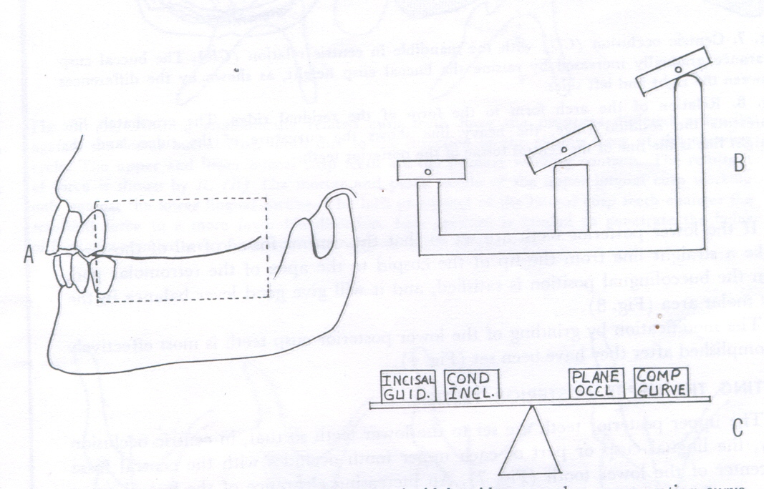
cusps
The five factors of balanced occlusion related to one another on a balance beam

Slide 29
NO CONTROL OF OPERATOR
TOTAL CONTROL OF OPERATOR
OP
IG
CC
CG
CA
BALANCED IN OCCLUSION

Slide 30
Steps involved in balancing
-The teeth have to be inclined to develop a balanced occlusion.
-The upper and lower incisal units meet only when the mandibular teeth are protruded and protrusive balancing unit functions only when upper and lower units contact.
-To develop a balanced occlusion one needs an adjustable articulator which should:
-Receive a face-bow transfer.
-Adjust to individual inter condylar guidance.
-Have an adjustable incisal guide table.

Slide 31
-To adjust the articulator requires:
  A centric relation record.
  Eccentric protrusive record.
  Right and left lateral records
-If the articulator will not receive the lateral records (Hanau type) then lateral condylar guidance is calculated as: L = H/8 + 12

Slide 32
Advantages of Bilateral Occlusal Balance:
Esthetic
Bilateral simultaneous contact help to seat the denture in a stable position during mastication, swallowing and maintain retention and stability of the denture and the health of the oral tissues.

Slide 33
Due to cross-arch balance, as the bolus is chewed on one side, the balancing cusps will come close or will contact on the other.
Denture bases are stable even during bruxing activity
Anatomic teeth used in balanced occlusion penetrate bolus better requiring less chewing force and therefore decreasing the vertical force on the ridges

Slide 34
The ability of the cusped teeth to arranged in harmony with the temporomandibular joint and muscles of mastication during speech swallowing and chewing supposedly will improve the occlusion which is mechanically and physiologically balanced and therefore more acceptable to the oral environment

Slide 35
The interdigitation of the denture teeth is believed to resist rotation movement of the denture thus encouraging a more vertical chewing pattern and greater denture stability

Slide 36
Disadvantages of Balanced Occlusion
Precise exact reproducible records are required to generate this occlusion on a semi or fully adjustable articulator there by requiring a more careful and time consuming technique.
A semi adjustable or fully adjustable articulator is required.

Slide 37
It is argued that this occlusion which functions against the inclines generates greater lateral force against the residual ridges. these lateral forces are more destructive then the vertical forces and that they might speed resorption of the residual ridges
Anatomic occlusion is challenged on the grounds that in addition to being more technically challenging and more time consuming the results are short lived,

Slide 38
Cont. The denture remains in good occlusal position until slight resorption occurs at which time the denture will be more difficult to adjust and keep in adjustment than one with an occlusion of simpler nature.
While balanced occlusion can be used for crossbite situations and for class II and class III relationships. The limitations placed on the tooth positions by the tight interdigitation of the cusps makes the use of this occlusal scheme difficult.

Slide 39
Occlusal balance achieved is totally mechanical and exists only on the articulator. Its is a well known that most articulators used in removable prosthodontics do not reproduce the exact movements of the mandible and therefore will not produce the same areas of occlusal contact as they exist in the mouth. The resulting occlusion is not a duplication of nature but an approximation.

Slide 40
The antirotational element of the anotomic occlusion may be effiective in the young healthy edentulous patients with good ridges and healthy oral mucosa, it is not at all effective in the patients with poor ridges and friable unhealthy oral mucosa

Slide 41
Thank you…..

